Slide 1
Chapter 10: Stem Cells, Cell Division and Cancer
Biology Trending, 4e
Eli Minkoff and Jennifer Hood-DeGrenier

Slide 2
Multicellular organisms are organized groups of cells and tissues that develop from undifferentiated stem cells
Cooperation and homeostasis
Cellular differentiation and tissue formation

Slide 3
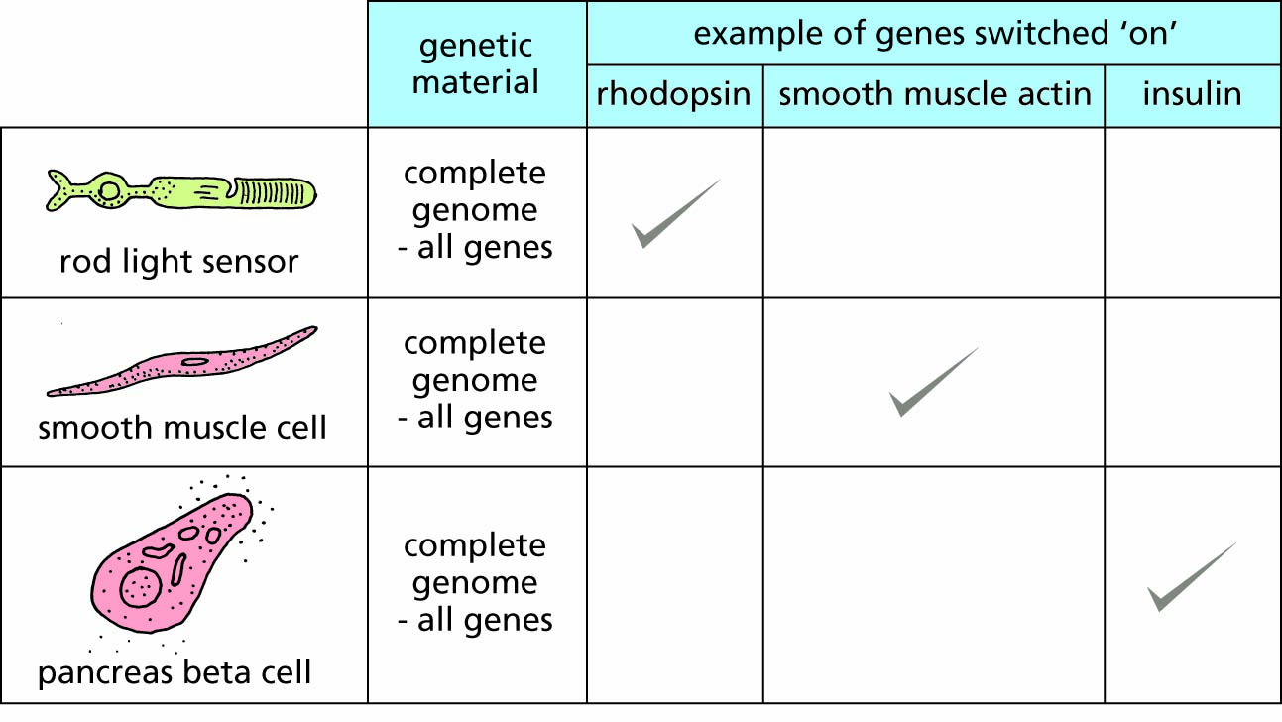
Figure 10.1 Virtually all somatic cells contain the complete genome, but different genes are expressed by the cells of different tissues.

Slide 4
Signalling between cells is the basis of cooperation and specialization
Cells receive signals from the outside that are transmitted across the cell membrane to cause internal changes
Regulating gene expression and protein function

Slide 5
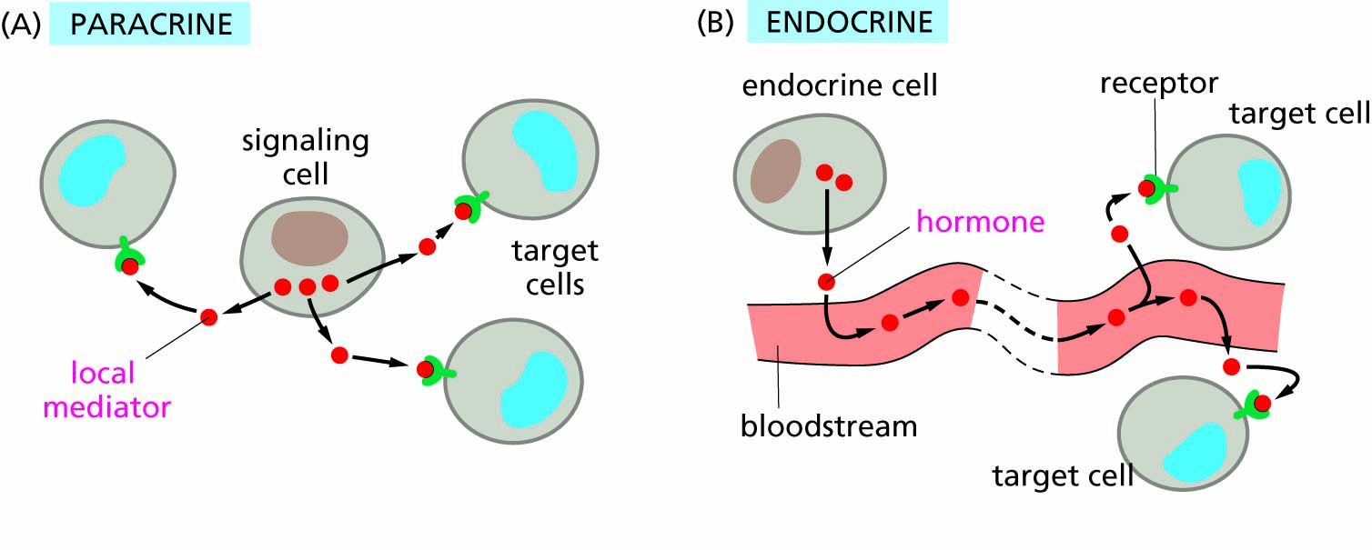
Figure 10.2 Signals can travel short or long distances to reach target cells. A, paracrine signals are released by one cell and affect neighboring cells. B, endocrine signals enter the bloodstream and travel throughout the body to reach distant target cells.

Slide 6
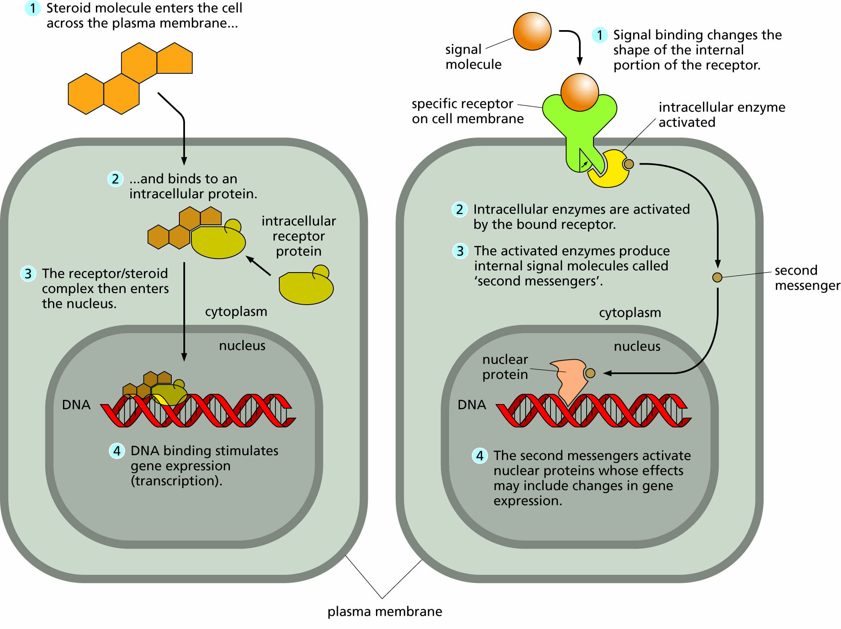
Figure 10.3 Signal reception and signal transduction A, Steroid hormones cross the cell membrane to bind internal receptors that regulated gene transcription. B, Other signals bind cell-surface receptors to activate a signal transduction cascade inside the cell. 1) Signal binding changes the shape of the internal portion of the receptor. 2) Internal signaling proteins are activated by the bound receptor. 3) Some internal signaling proteins are enzymes that produce internal signals called second messengers. 4) Second messengers activate proteins that cause the final outcome of a signal, such as changes in gene expression.
For an animated version of this figure, go to https://biologytrending.Routledge.com.

Slide 7
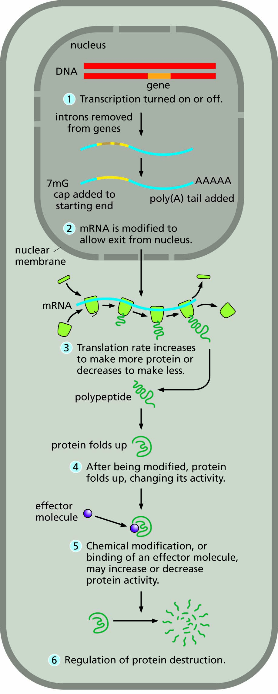
Figure 10.6 Regulation of gene expression can occur at many steps in eukaryotic cells.

Slide 8
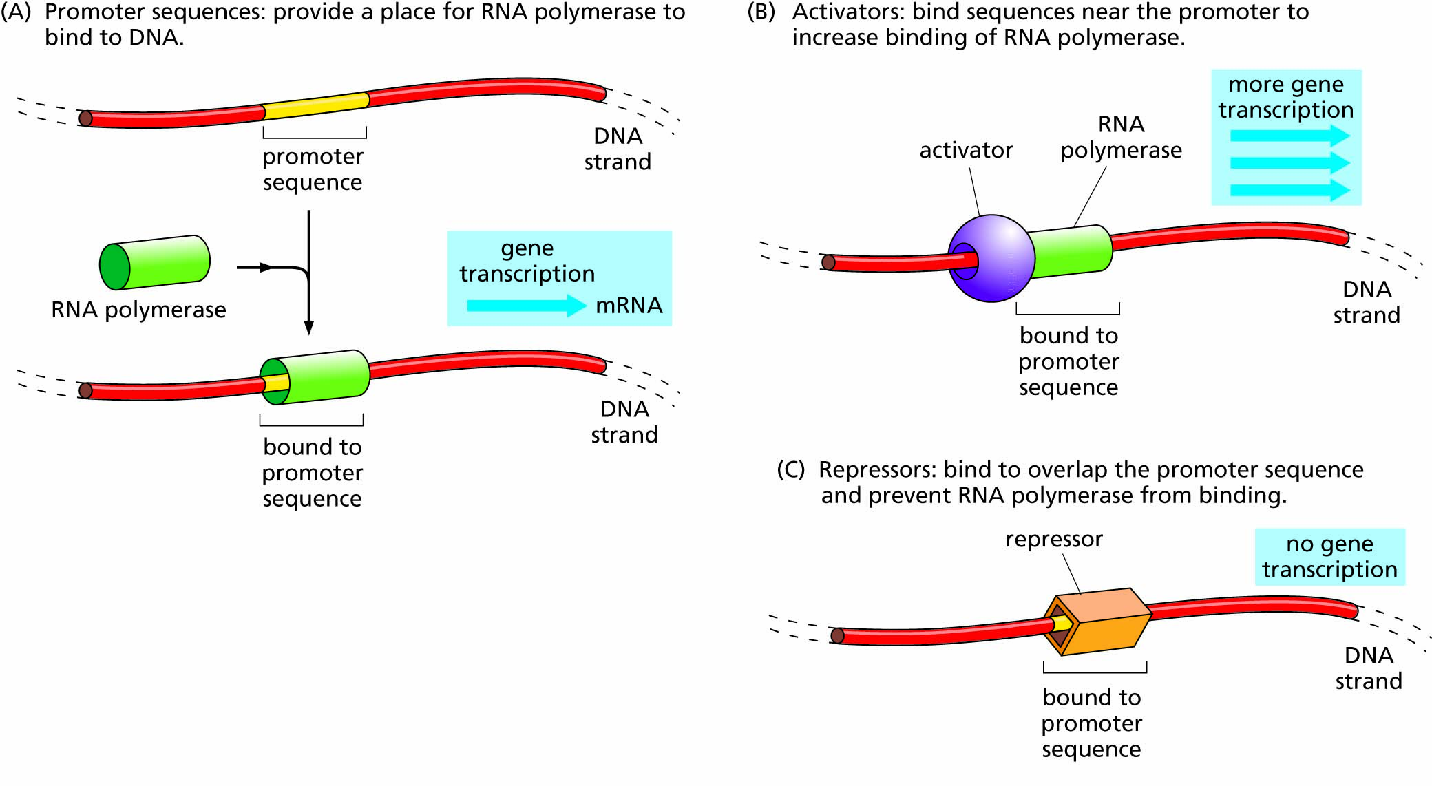
Figure 10.4 Regulation of transcription. A, RNA polymerase binds to genes at promoter sequences to begin transcription. B, When activator proteins bind to DNA, they help RNA polymerase bind to the promoter and increase the number of RNA transcripts produced. C, When repressor proteins bind to DNA, they block RNA polymerase and prevent transcription.

Slide 9
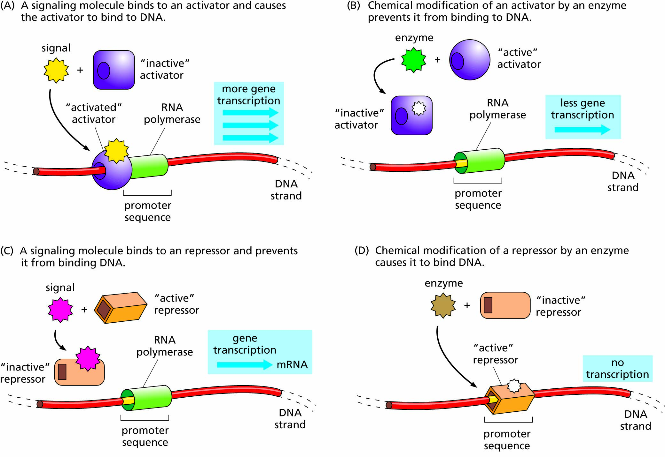
Figure 10.5 The activity of transcriptional activators and repressors is also regulated. A, A signaling molecule binds to an activator and causes the activator to bind DNA. B, Chemical modification of an activator causes it to bind DNA. C, A signaling molecule binds to a repressor and prevents it from binding DNA. D, Chemical modification of a repressor prevents it from binding DNA.

Slide 10
Cell division is closely regulated in normal cells
The cell cycle
Regulation of cell division
Limits to cell division
Programmed cell death

Slide 11
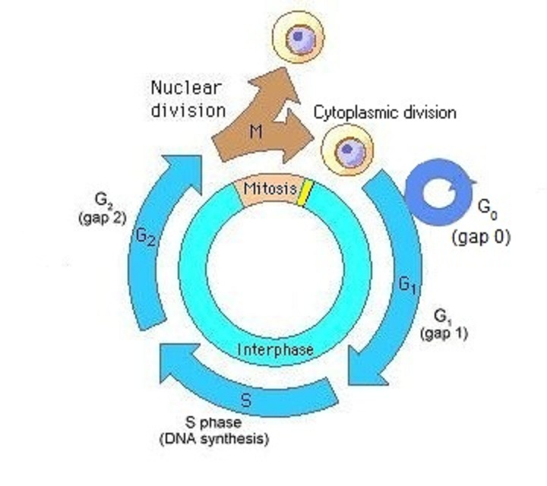
Overview of the CELL CYCLE

Slide 12
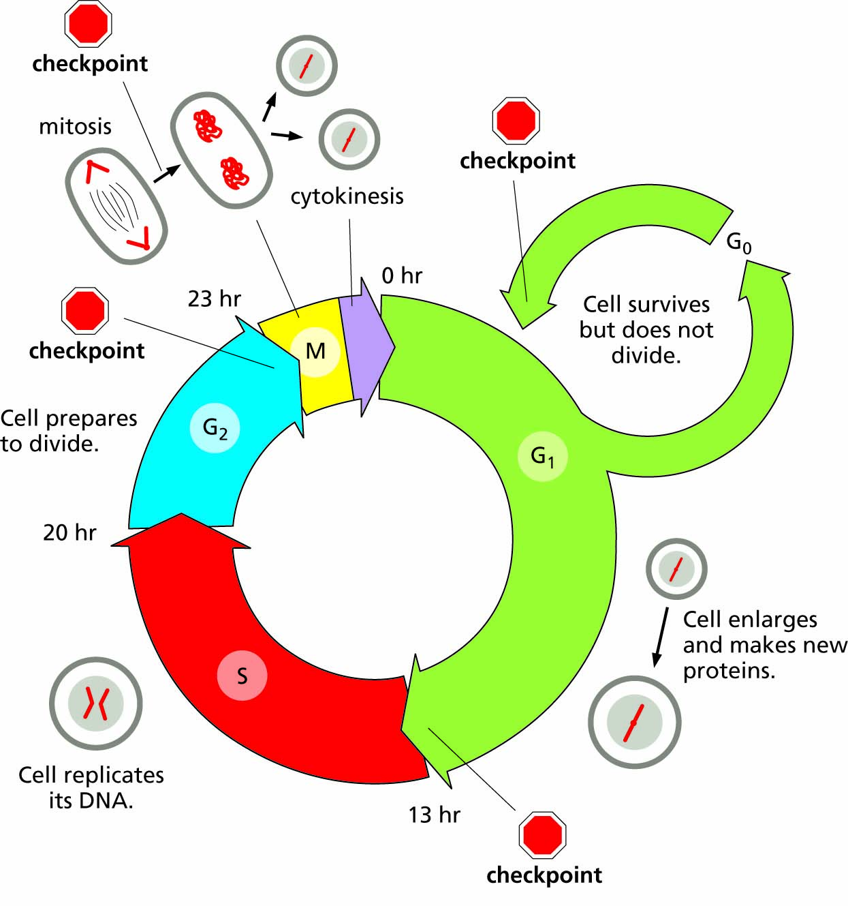
Figure 10.7 The cell cycle. Hours shown are the approximate lengths of time for each phase in a cell with a 24-hour cell cycle, typical of many eukaryotic cells.

Slide 13
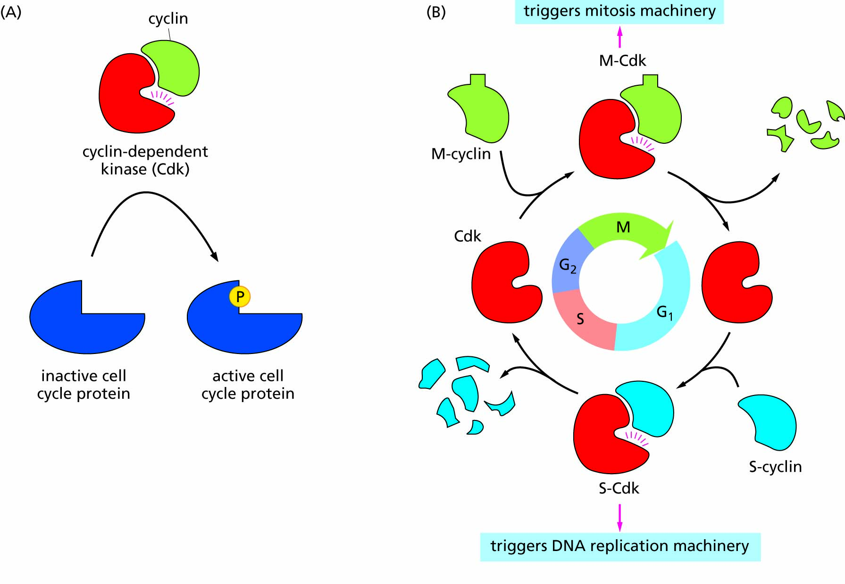
Figure 10.8 Cyclin dependent kinases (CDKs) drive cell cycle progression. A) CDKs are activated by binding to cyclins; phosphorylation of target proteins triggers cell cycle transitions. B) Different cyclins accumulate and are destroyed at different times in the cell cycle, causing activation of the appropriate CDKs at the right times to trigger cell cycle events.

Slide 14
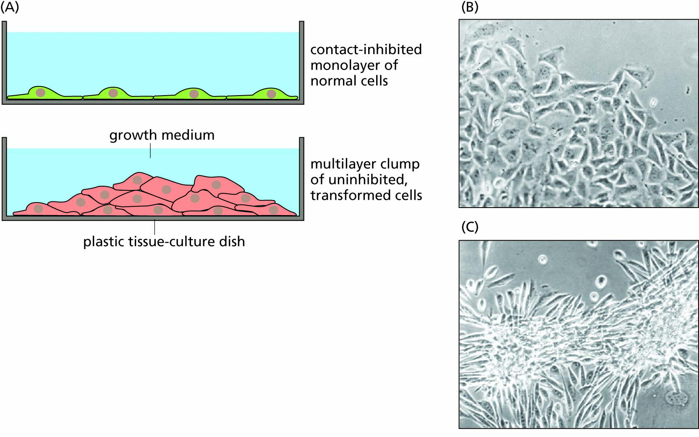
Figure 10.9 Contact inhibition and anchorage dependence. A, Normal cells in a culture dish stop dividing when they have formed a complete layer, a property called contact inhibition; cancer cells continue to grow and form a multilayer clump. B, Most normal cells need to be attached to a surface (culture dish or tissue) in order to divide, a property called anchorage dependence. C, Cancer cells lose their attachment (rounding up) but continue to divide in an anchorage independent manner.

Slide 15
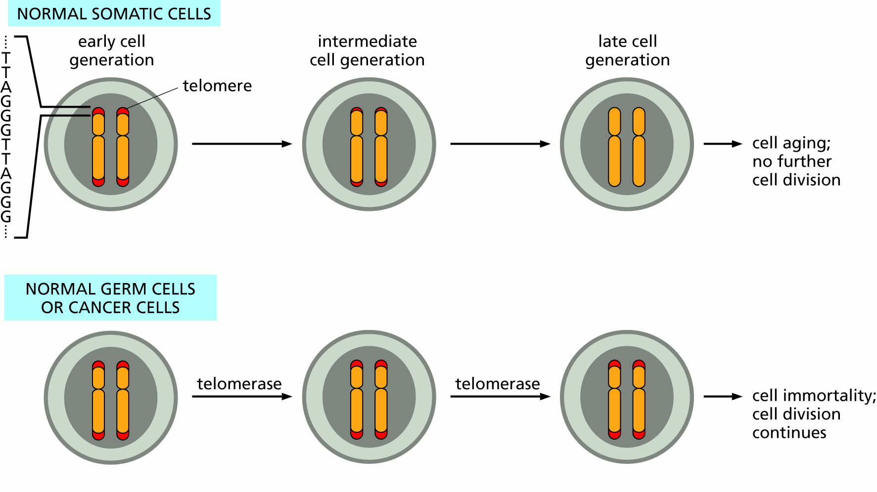
Figure 10.10 Telomeres are repeated DNA sequences (TTAGGG in humans) at the ends of eukaryotic chromosomes that shorten with each cell division. In normal somatic cells, telomere shortening with each round of cell division leads to cell aging and eventually lack of further division. In cancer cells, the enzyme telomerase is active and restores the telomeres, allowing the cells to continue dividing without limit.

Slide 16
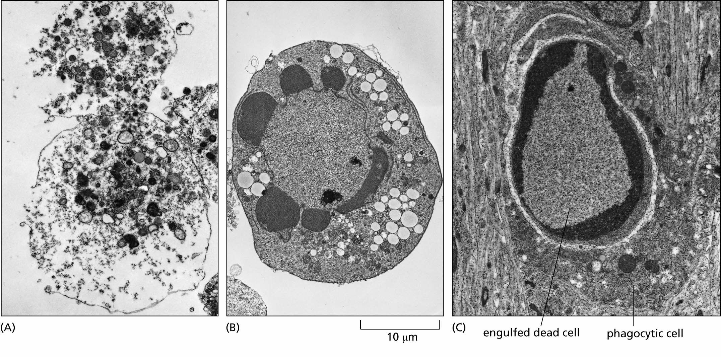
Figure 10.11 Types of cell death: apoptosis vs. necrosis. A, Cells that die by necrosis break open, spilling their contents into the tissue and causing inflammation. B, In apoptosis, the nucleus fragments and the cell shrinks inward without bursting. C, Immune cells called phagocytes engulf and digest apoptotic cells, clearing them from the tissue.

Slide 17
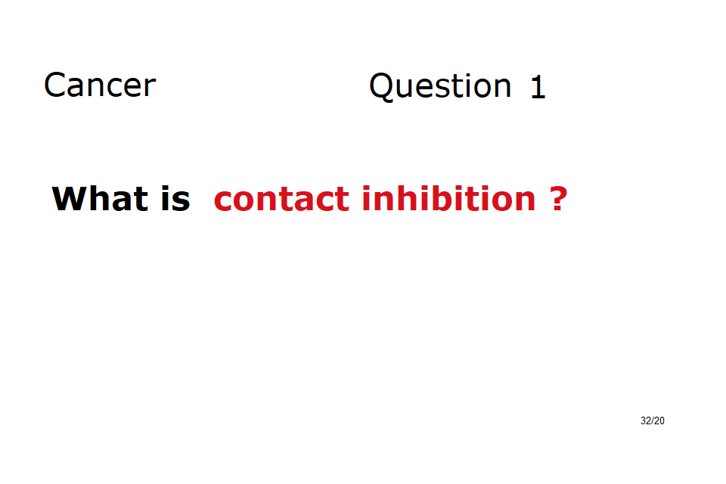

Slide 18
Stem cells can divide indefinitely and produce cells that undergo differentiation
Cellular differentiation and tissue formation
Spatial distribution of signaling molecules drives differentiation
Stem cells and their therapeutic uses
Ethical and scientific questions

Slide 19
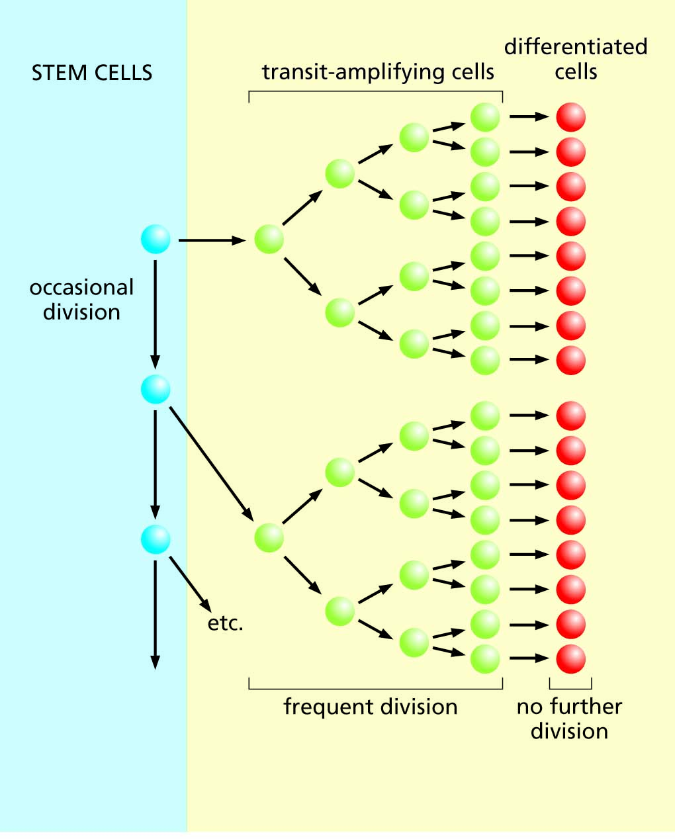
Figure 10.12 When a stem cell divides, one daughter cell remains as an undifferentiated stem cell and the other begins the process of differentiating into a specialized, non-dividing cell, passing through a stage of multiple cell divisions as a transit amplifying cell.

Slide 20
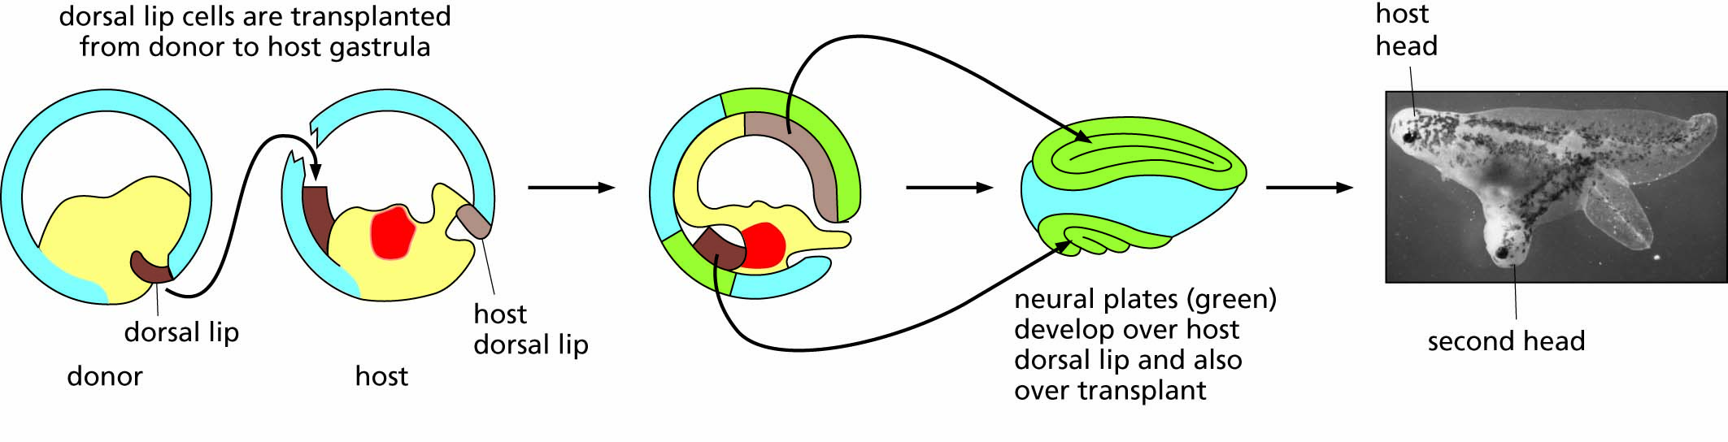
Figure 10.13 Experimentally induced differentiation. By manipulating cells from the gastrula stage of frog embryos, Hans Spemann and Hilde Mangold showed that an area called the 'dorsal lip' served as an 'organizer' to induce the formation of a nervous system. At the locations of both host and transplanted dorsal lip cells, neural plates developed and went on to form brains and other head structures. Subsequent experiments showed that the transplanted donor cells were not actually part of the induced neural plate. Rather, the dorsal lip secretes 'organizer' signals that cause the overlying host cells to differentiate. Spemann was awarded the Nobel Prize for these experiments in 1935.

Slide 21
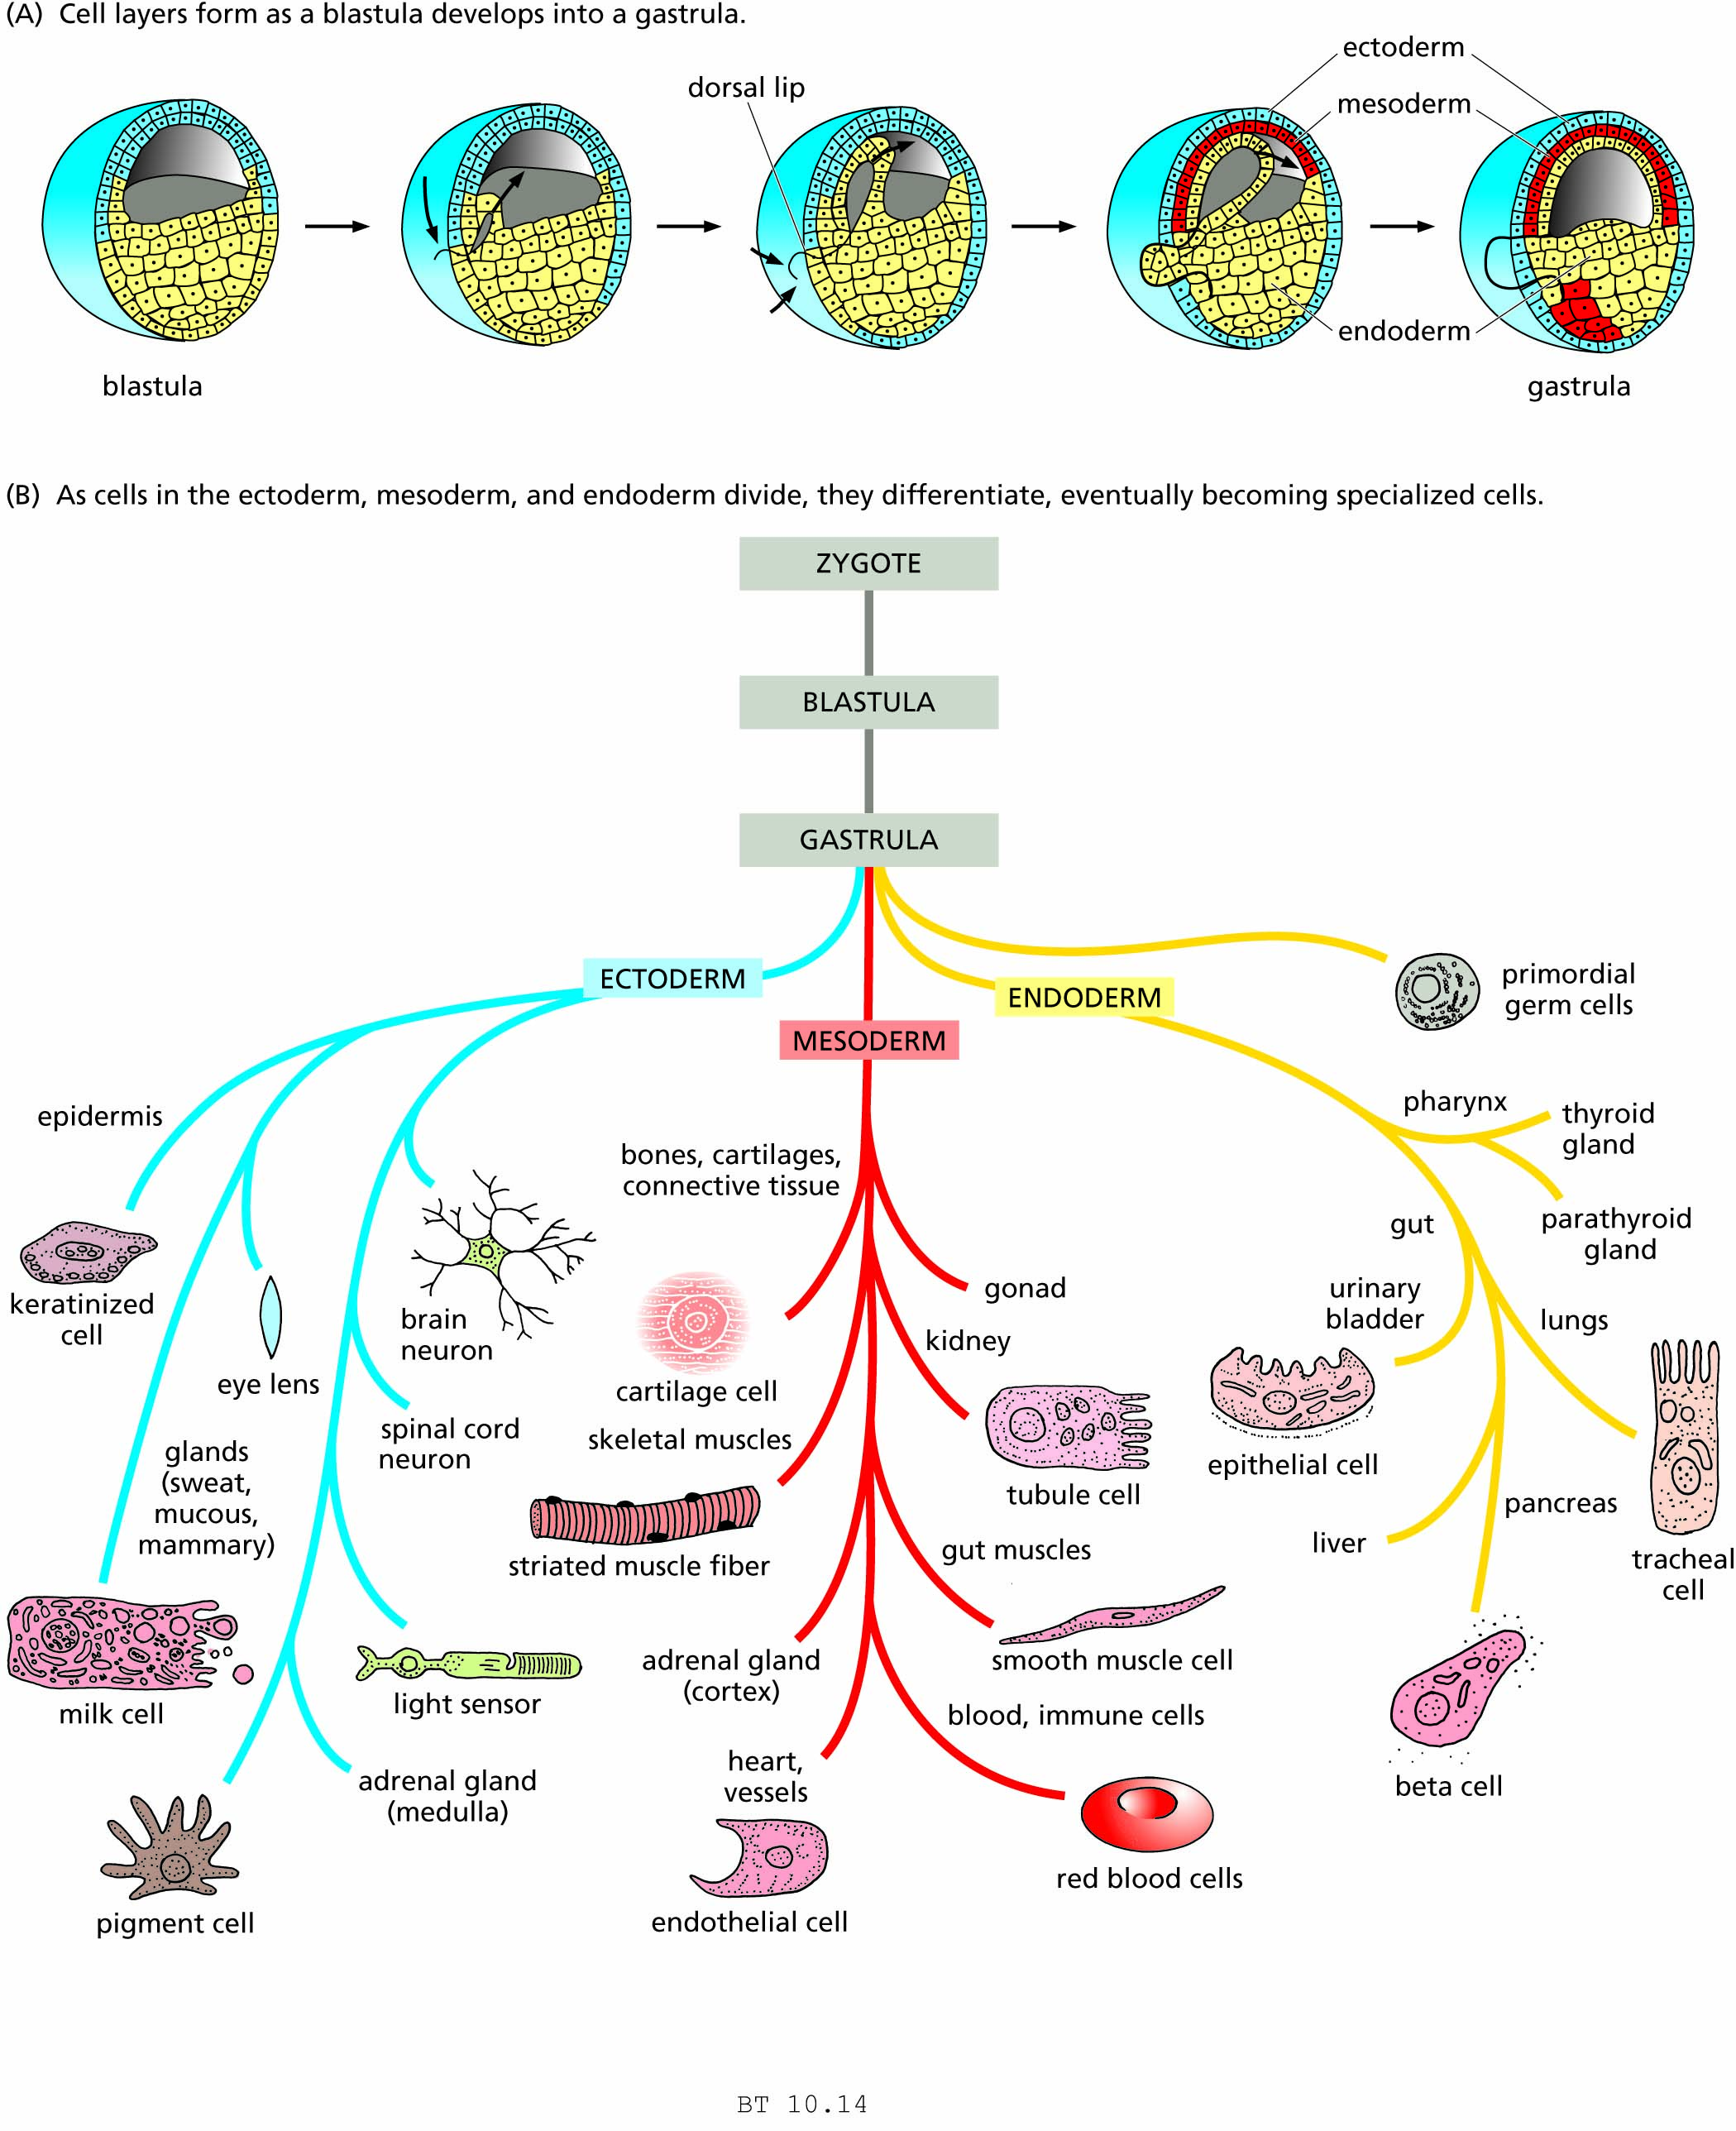
Figure 10.14 Differentiation of various cell types during embryonic development. A, Cell layers form as a blastula develops into a gastrula, as shown here in a frog embryo. B, As cells in the ectoderm, mesoderm, and endoderm divide, they differentiate, eventually becoming specialized cells.

Slide 22
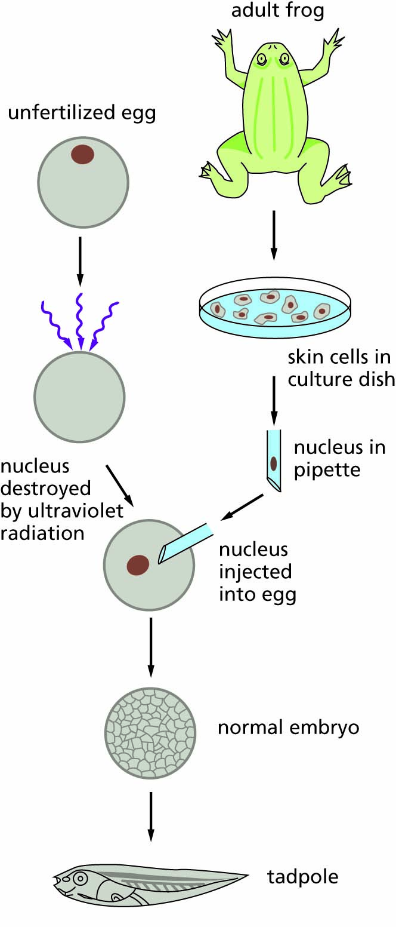
Figure 10.15 Gurdon’s experiment demonstrating that a differentiated cell contains all the genes needed for the development of a complete organism. The nucleus of a frog egg was destroyed by ultraviolet irradiation and was replaced by the nucleus from the fully differentiated skin cell of another frog. The egg with its transplanted nucleus was allowed to grow and it developed into a normal tadpole.

Slide 23
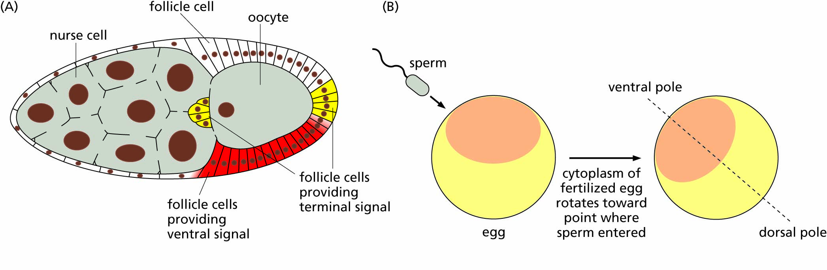
Figure 10.16 Establishing asymmetry (polarity) in a developing embryo. A) Some eggs, such as those of fruit flies, have asymmetry even before fertilization. B) In other organisms, including frogs, symmetry is established based on the position where the sperm enters upon fertilization.

Slide 24
Cancer results when cell division is uncontrolled
Properties of cancer cells
The genetic basis of cancer
Accumulation of many mutations
Progression to cancer

Slide 25
Characteristics of normal cells and transformed (cancer) cells.
CELLULAR BEHAVIOR | NORMAL | TRANSFORMED
Limit to the number of cell divisions | Finite | Immortal
Differentiation | Present | Inhibited
Transport of nutrients across cell membrane | Slower | Faster
Nutrient requirement | Higher | Lower
Contact inhibition | Present | None
Requirement for attachment | Present | None
Adhesiveness | High | Low
Secretion of protein-degrading enzymes | Low | High
Genetic material | Stable | Unstable

Slide 26
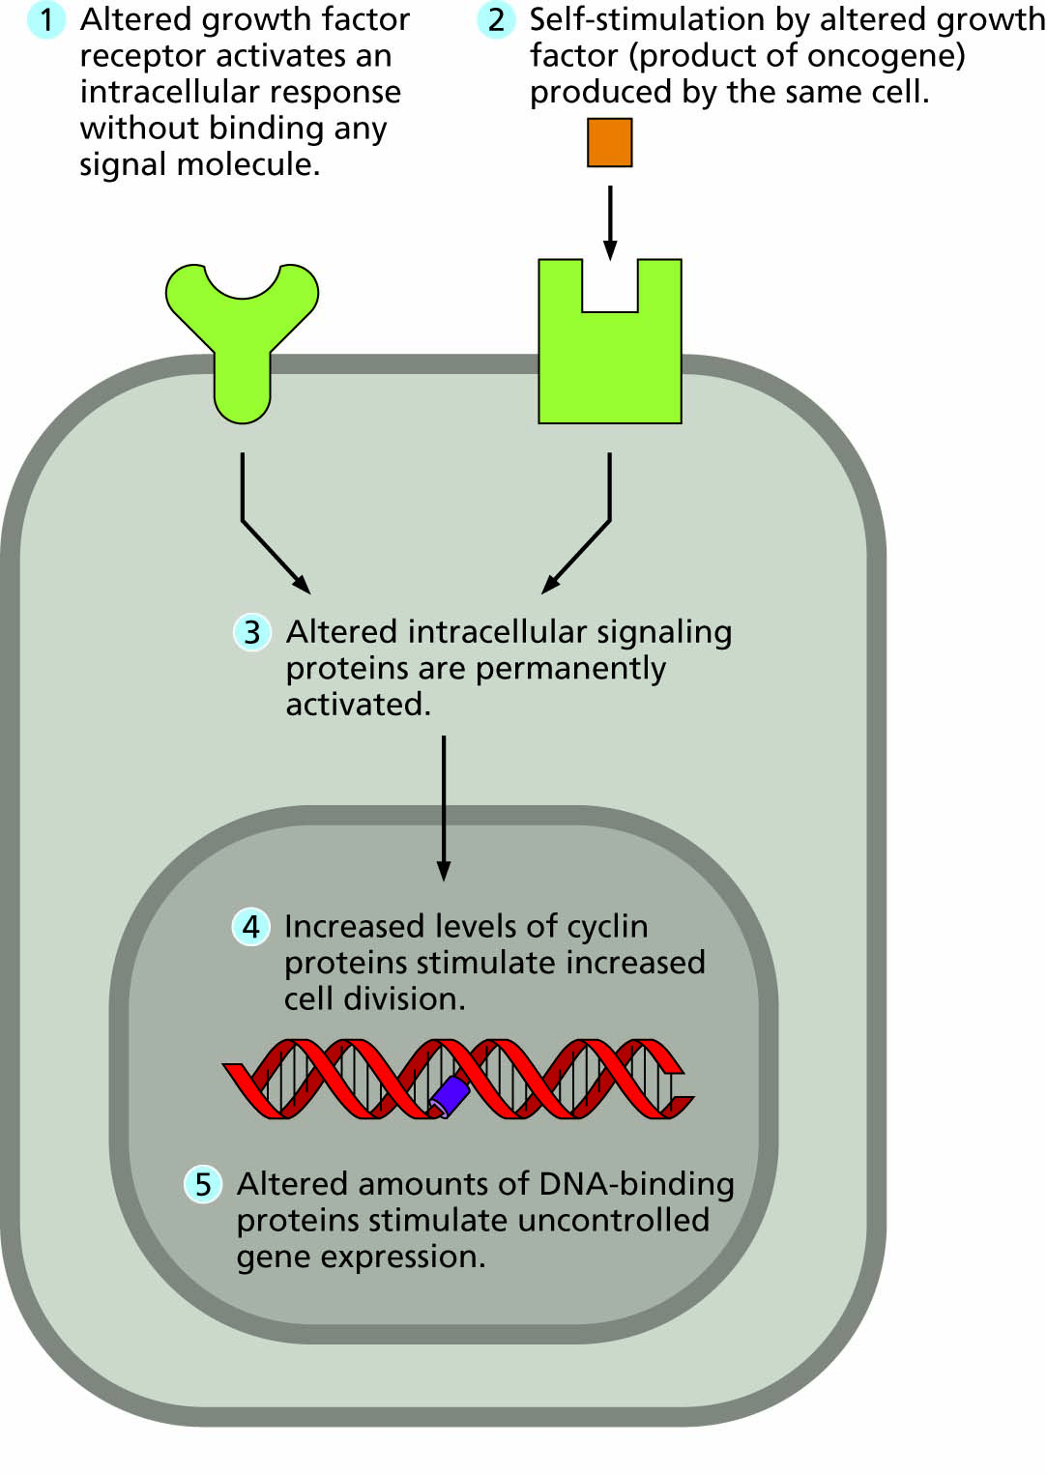
Figure 10.17 Five different ways in which the mutated protein products of oncogenes can cause continuous signaling of cell division in transformed cells.

Slide 27
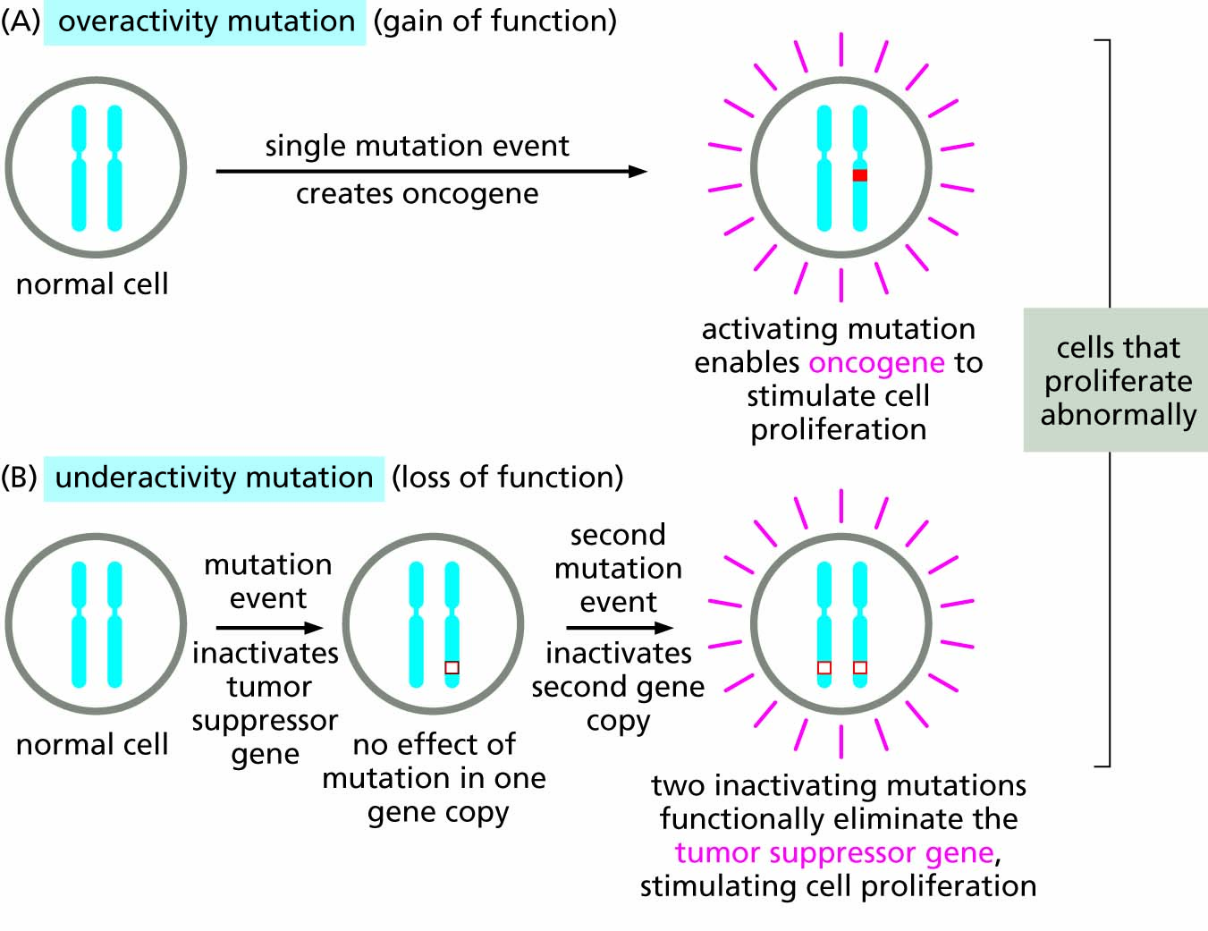
Figure 10.18 Only one oncogene mutation but two tumor suppressor mutations are required to promote cancer. Thus, oncogenes show dominant genetic behavior, while tumor suppressor mutations show recessive genetic behavior.

Slide 28
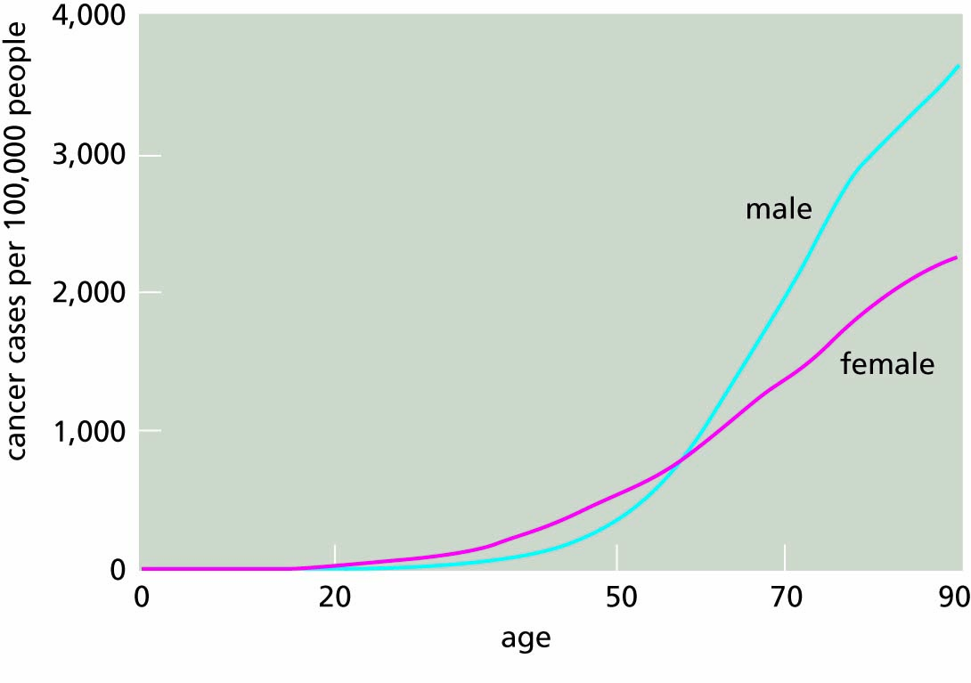
Figure 10.19 The risks for cancer increase strongly with age.

Slide 29
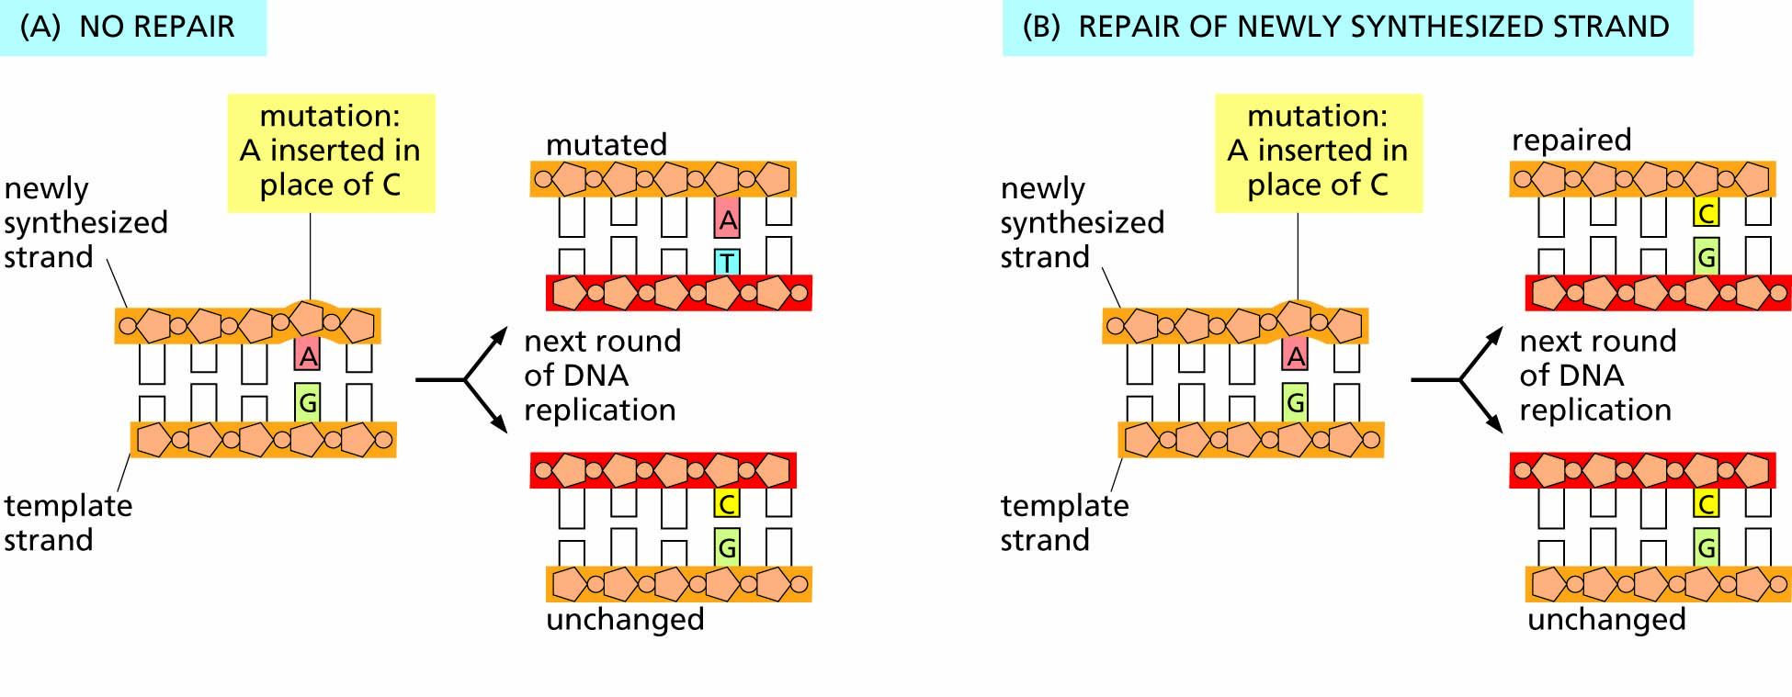
Figure 10.20 DNA mismatch mutations and their repair. (A) If a mismatch occurs during replication, it can lead to a permanent mutation if not corrected on the new strand. (B) A mismatch repair protein (spell-checking protein) checks for mismatched bases on the new strand as synthesis proceeds. If a mismatch is detected by the shape of improperly bonded nucleotides between the strands, part of the new strand is trimmed back before synthesis can restart and allow the correct base to be inserted.

Slide 30
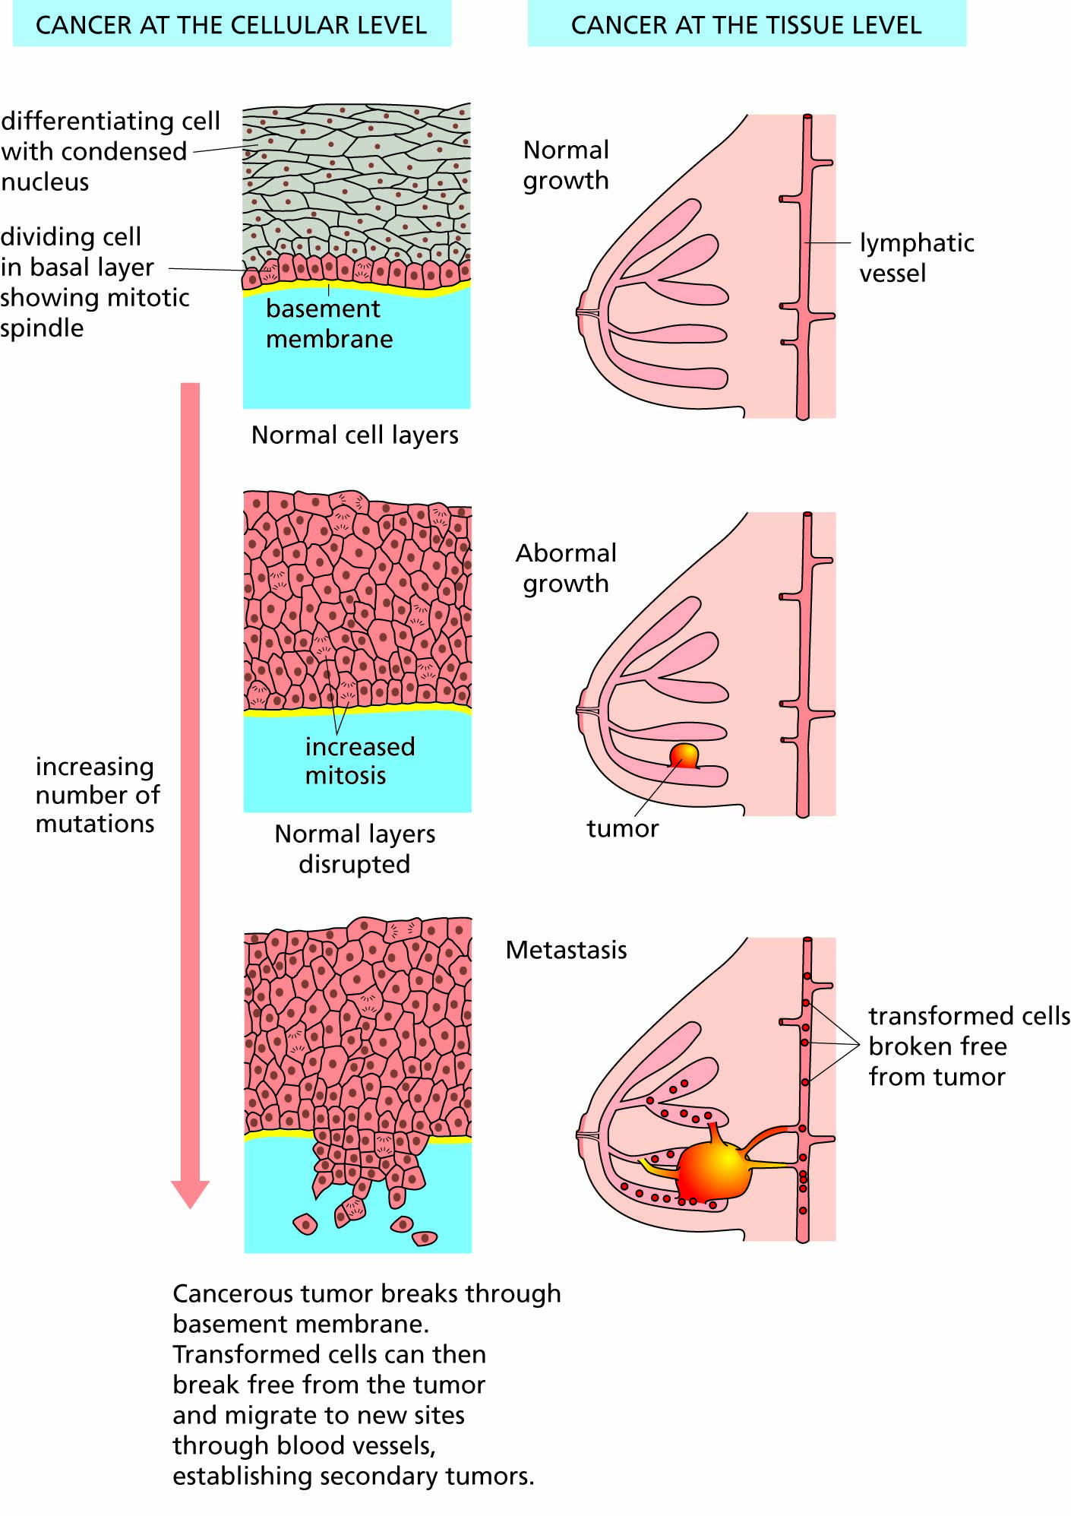
Figure 10.21 The growth of a tumor in the human breast.

Slide 31
Cancers have complex causes and multiple risk factors
Inherited predispositions for cancers
Increasing age
Viruses
Physical and chemical carcinogens
Dietary factors
Internal resistance to cancer
Social, economic and racial factors

Slide 32
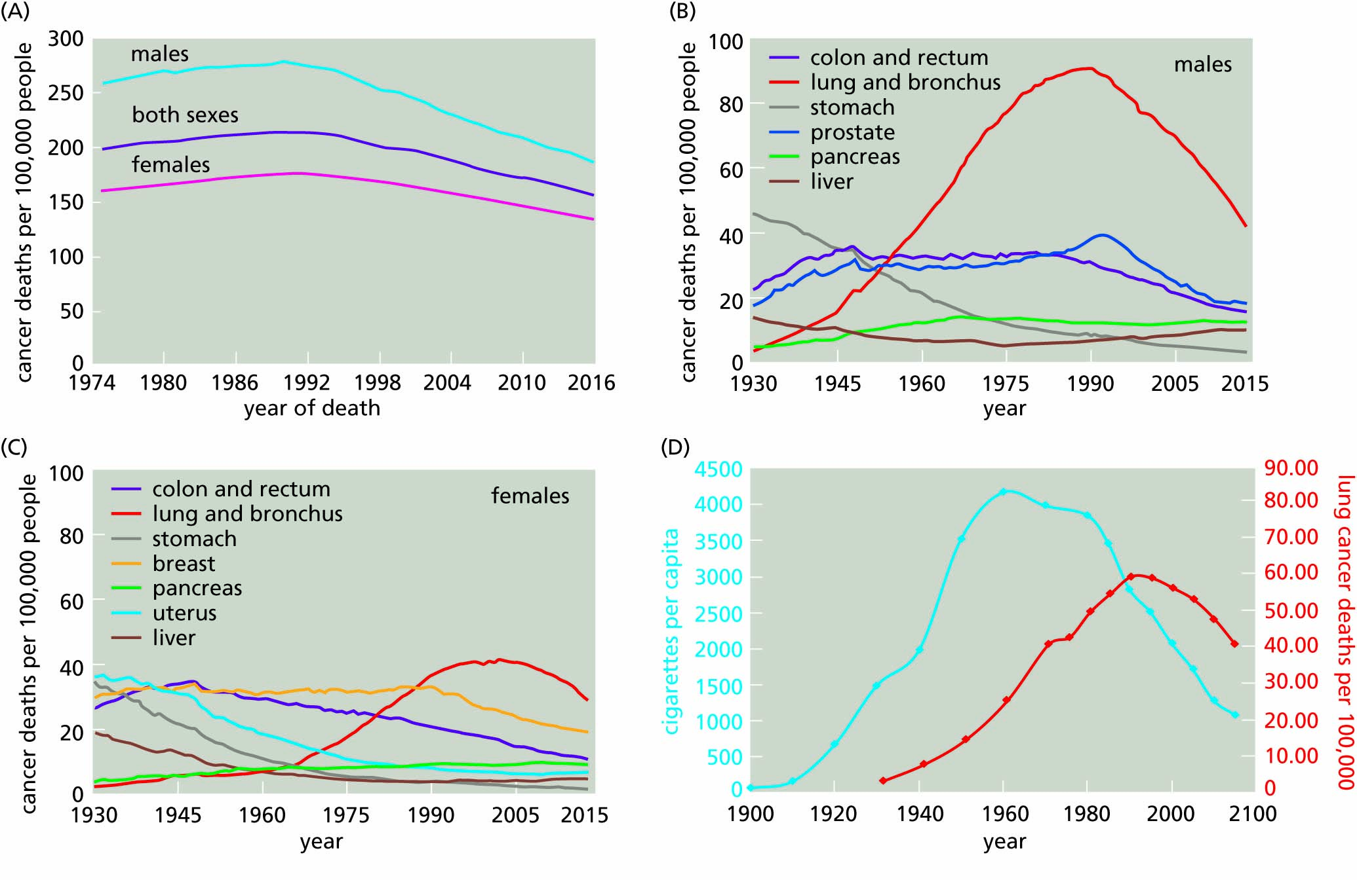
Figure 10.22 Deaths from cancers in the United States. (A) Death rates from all cancers combined (B) Death rates for different cancer sites in males (C) Death rates for different cancer sites in females. (D) Lung cancer death rate and cigarette consumption. (A, from National Center for Health Statistics data as analyzed by NCI; B,C from American Cancer Society, Cancer Facts & Figures, 2020; D, redrawn from several sources)

Slide 33
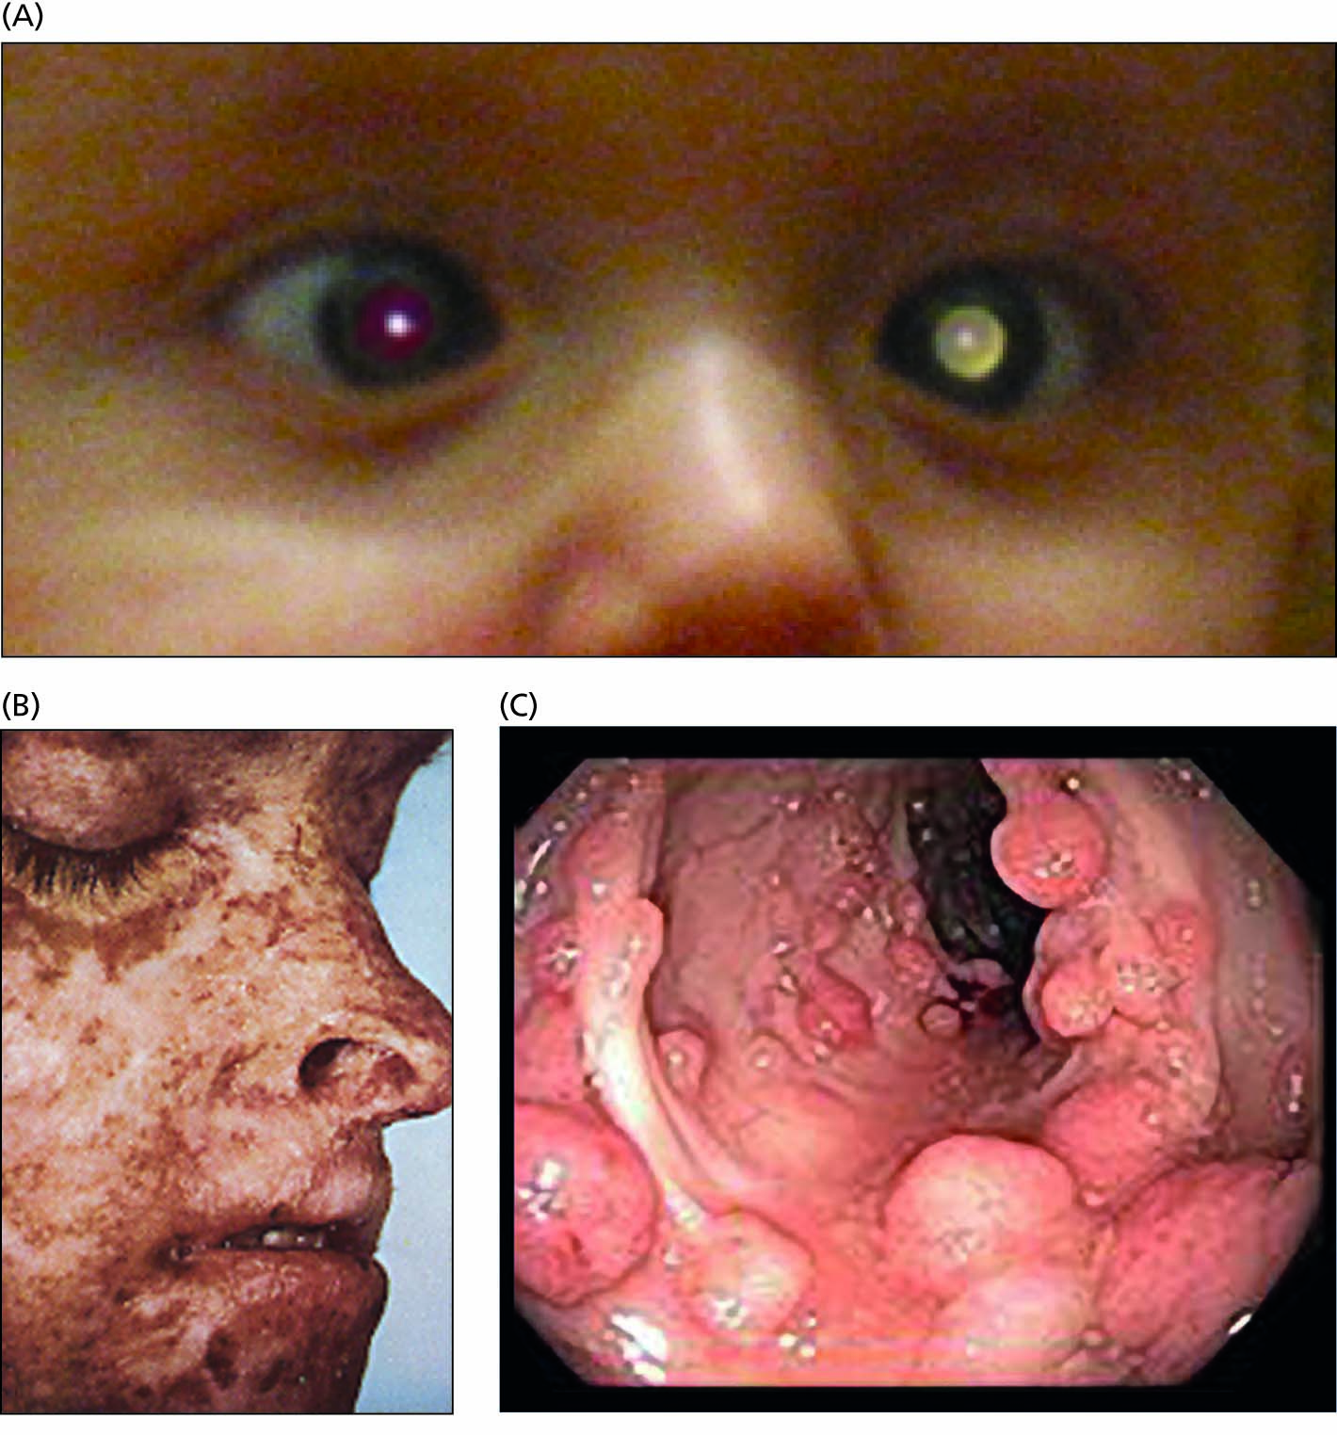
Figure 10.23 Familial cancers. (A) Retinoblastoma (B) Xeroderma pigmentosum (C) Familial adenomatous polyposis (precursor to colon cancer)

Slide 34
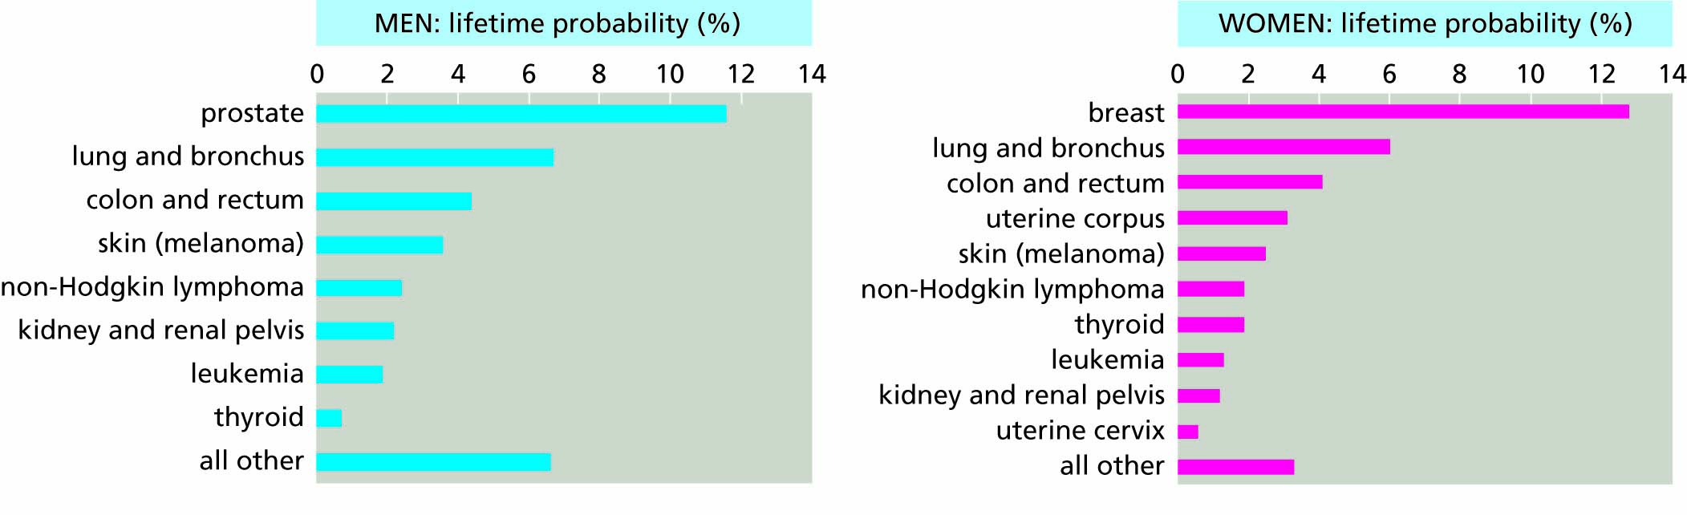
Figure 10.24 Lifetime probabilities of acquiring malignant cancers (U.S., 2014-2016), based on data from National Cancer Institute, 2019.

Slide 35
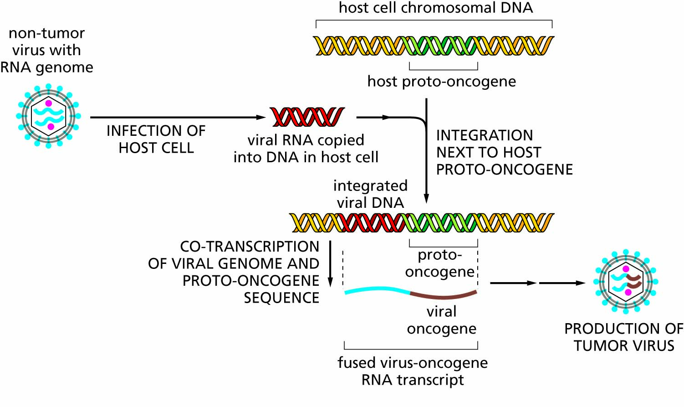
Figure 10.25 Tumor viruses carry oncogenes.

Slide 36
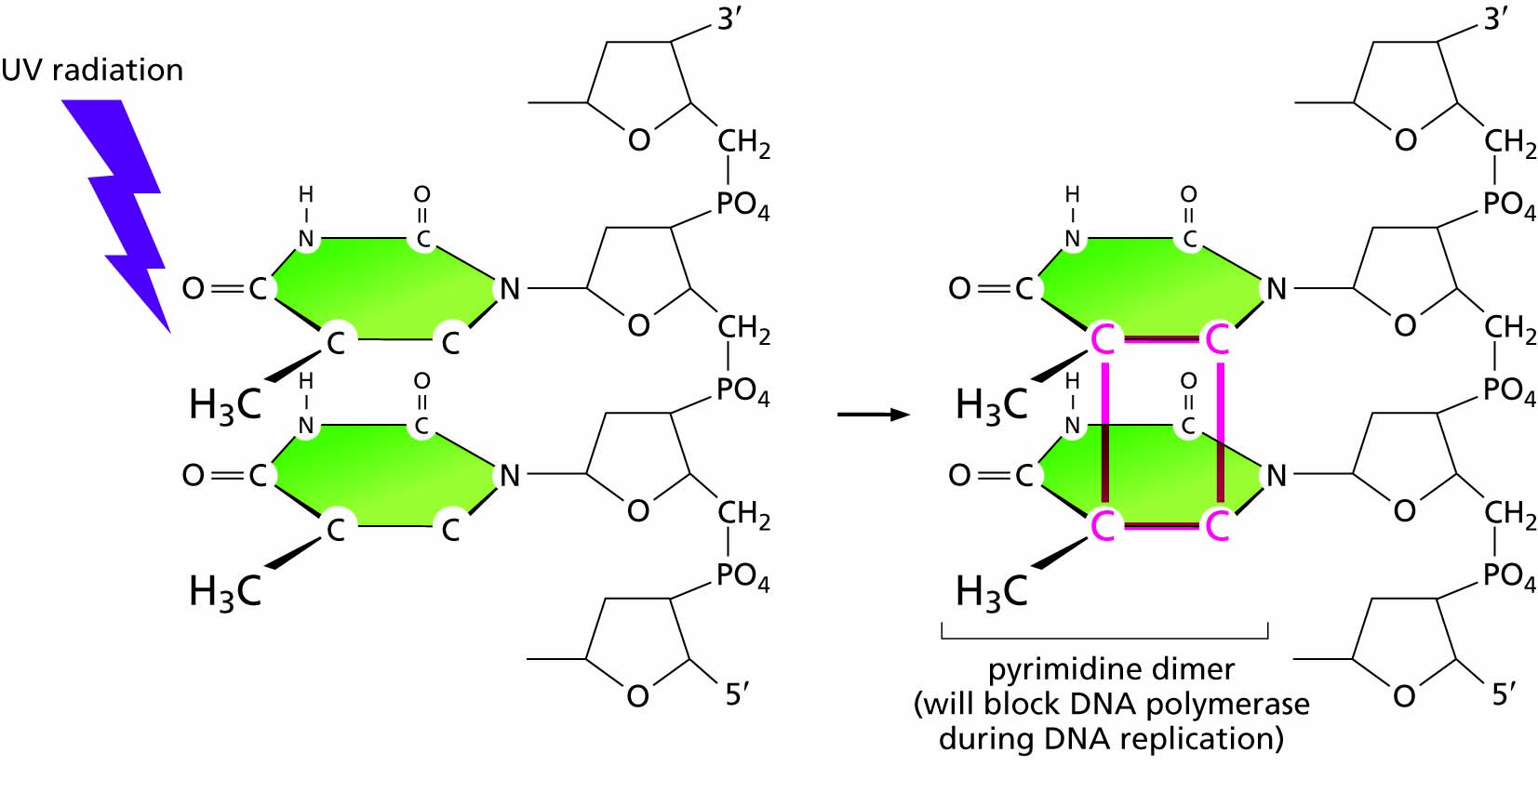
Figure 10.26 UV irradiation induces abnormal bonds between neighboring nucleotides.

Slide 37
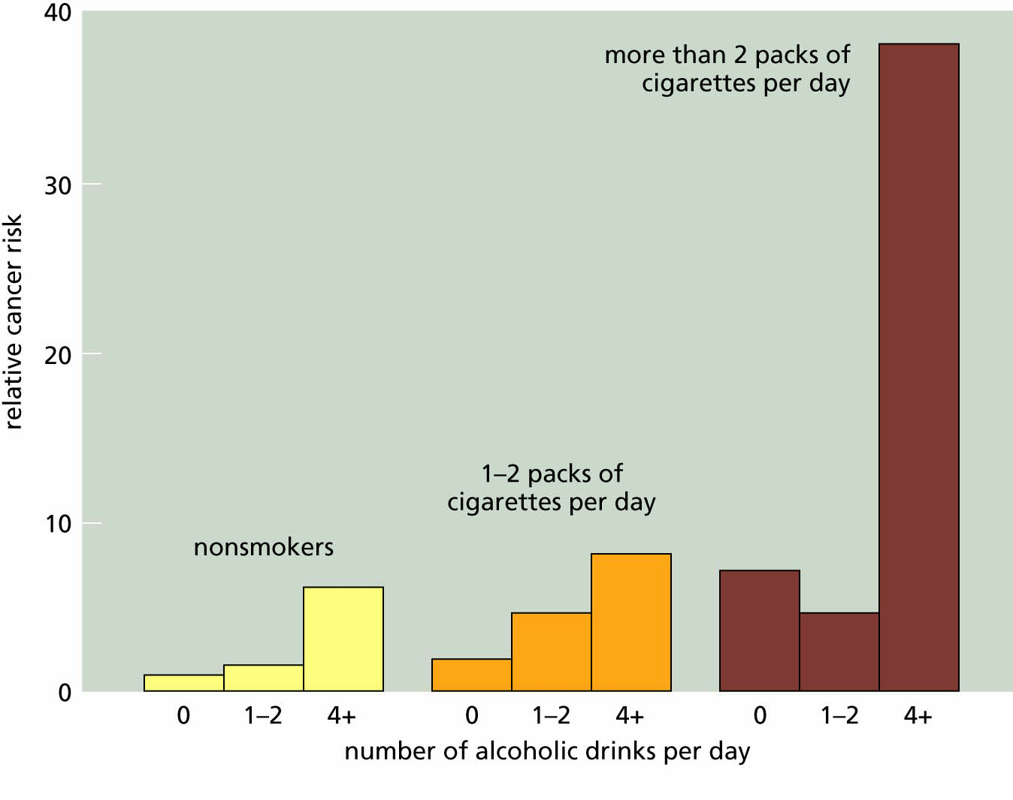
Figure 10.27 Synergism between alcohol and cigarettes in producing cancers of the mouth and throat.

Slide 38
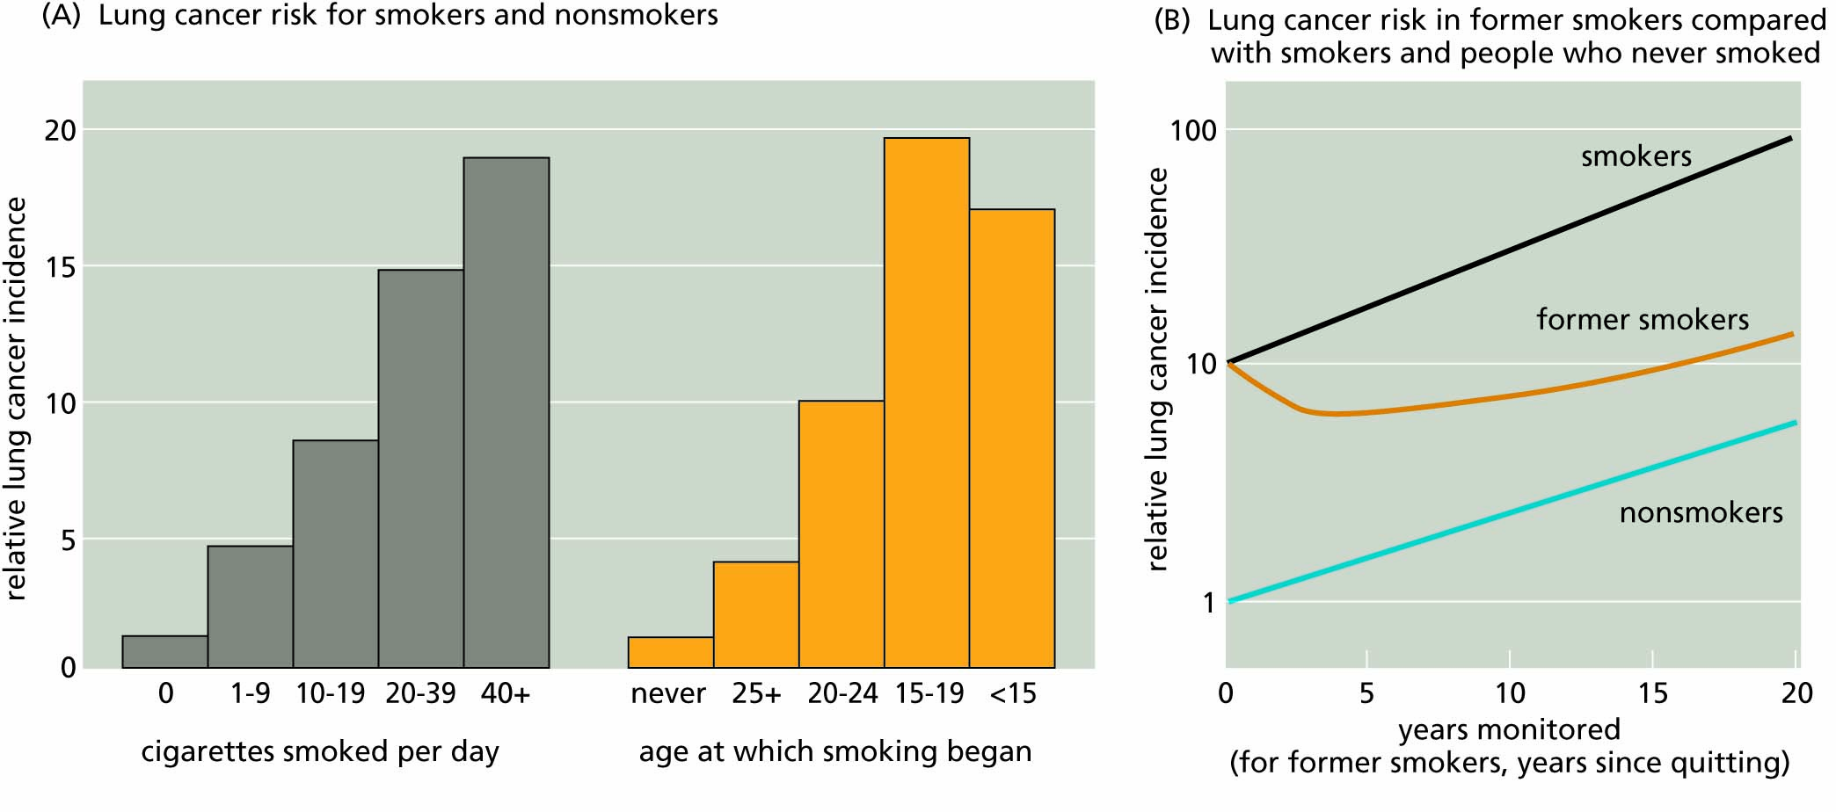
Figure 10.28 The effects of smoking on the incidence of cancer.

Slide 39
We can treat many cancers and lower our risks for many more
Traditional cancer therapies: Surgery, radiation and chemotherapy
Targeted cancer drugs
Immunotherapies
The cost of cancer treatment
Cancer detection and predisposition
Cancer management
Cancer prevention

Slide 40
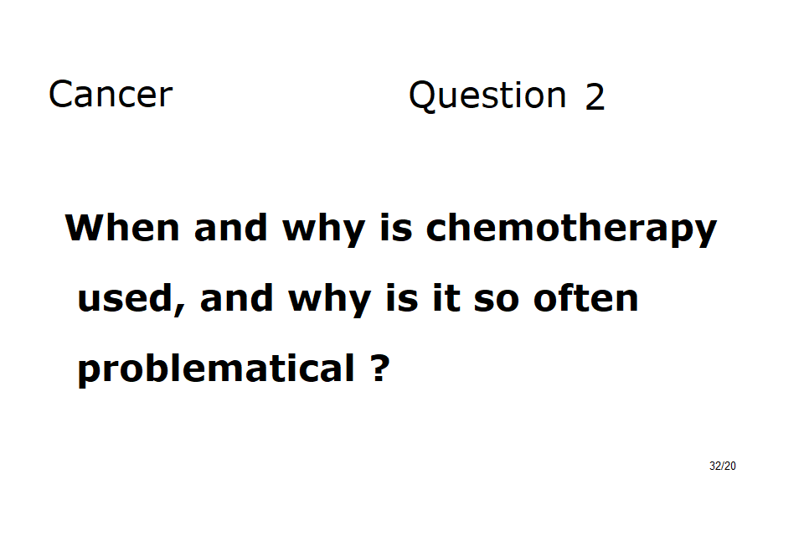

Slide 41
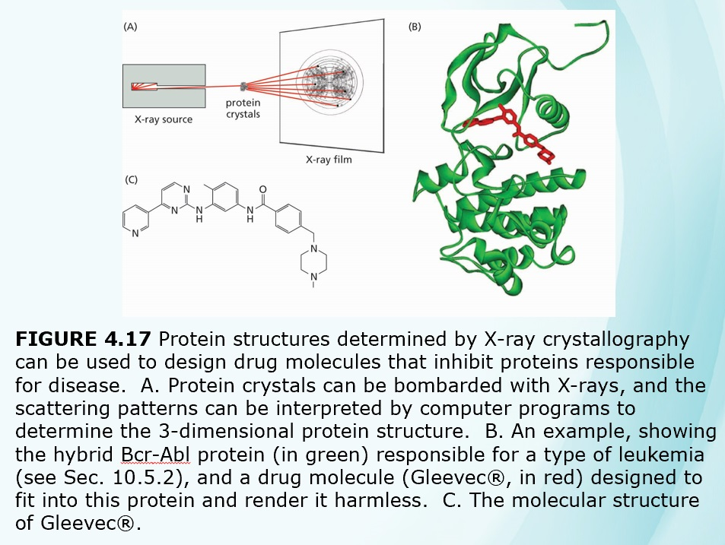
Gleevec, a TARGETED cancer drug

