Slide 1
Chapter 19: Climate Change and Other Threats to the Biosphere
Biology Trending, 4e
Eli Minkoff and Jennifer Hood-DeGrenier

Slide 2
The biosphere: land, water, atmosphere and life
The development of the atmosphere, and of life
1. Primary atmosphere (H2 rich, Oparin)
2. Secondary atmosphere (CO2 rich,
heterotrophic life)
3. Modern atmosphere (O2 rich, resulting
from photosynthesis)
The water cycle

Slide 3
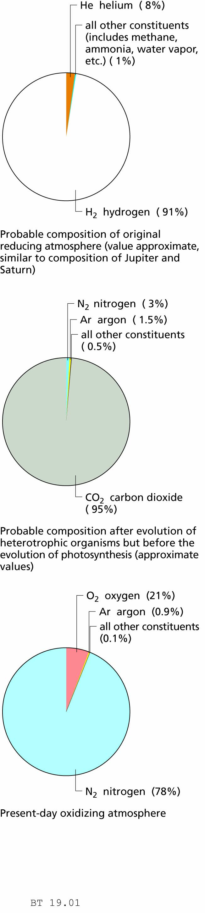
Figure 19.1 Chemical composition of the atmosphere.
Primary
atmosphere
Secondary
atmosphere
Modern
atmosphere

Slide 4
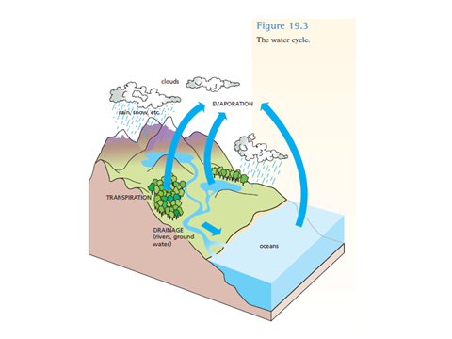
WATER CYCLE

Slide 5
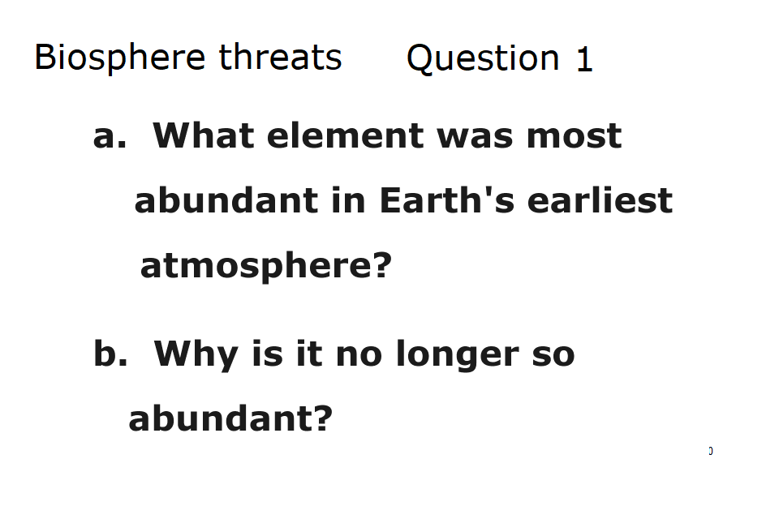

Slide 6
Pollution threatens much of life on Earth
Sources and indicators of pollution
Toxic effects
Pollution prevention

Slide 7
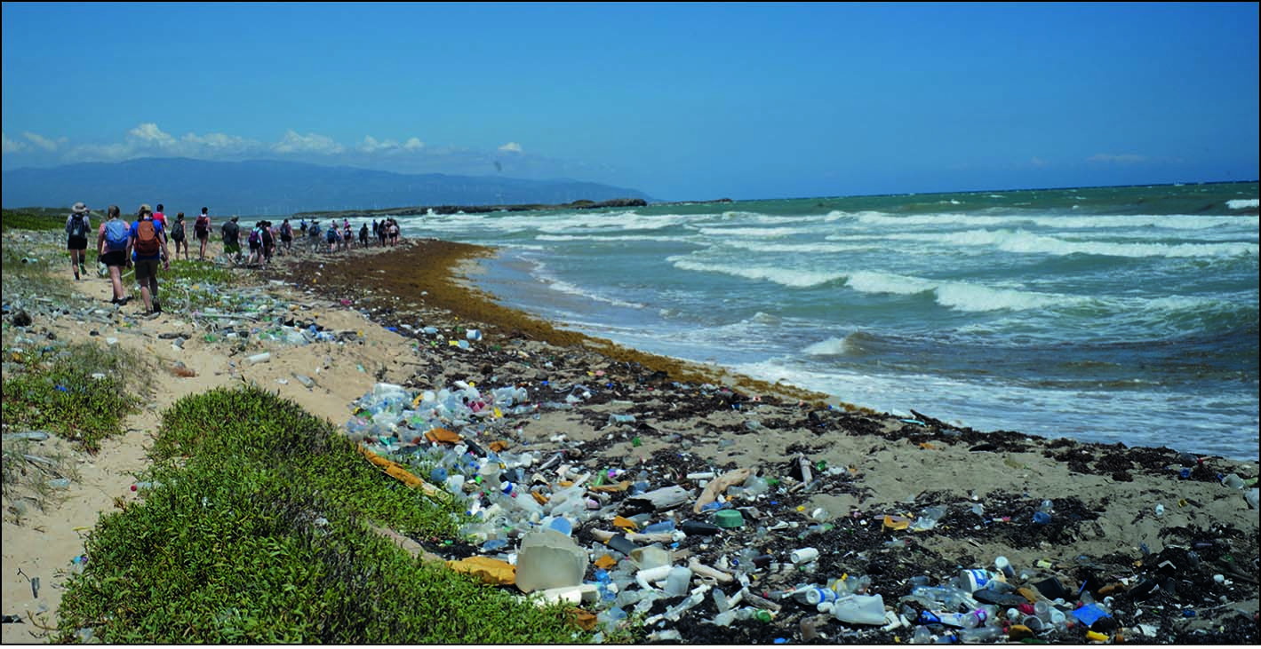
Figure 19.3 Pollution (mostly plastic) on a tropical beach in the Caribbean.

Slide 8
Human activities are affecting the biosphere
Aquatic pollution and its biological effects
Bioremediation
Air pollution
Acid rain
Atmospheric ozone
CO₂ and climate change, including global warming

Slide 9
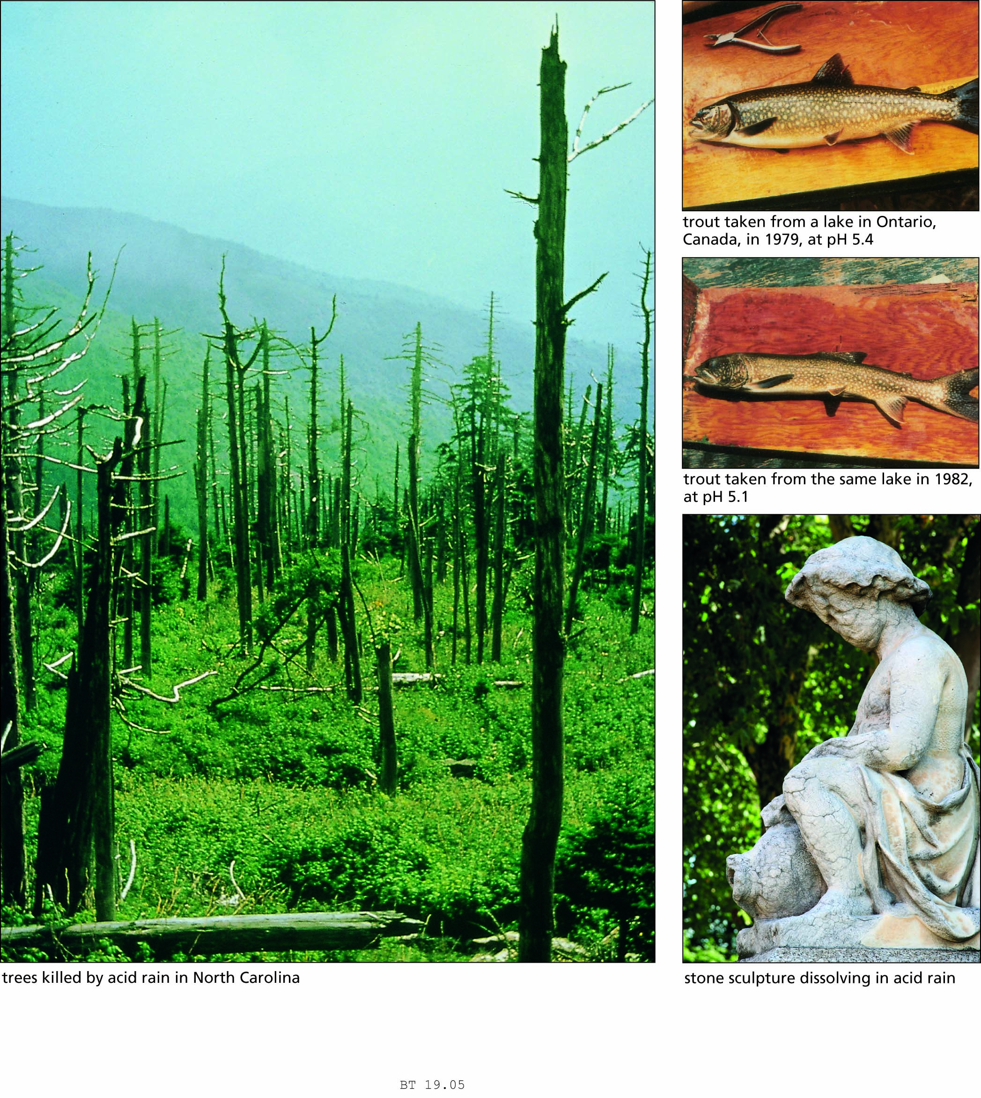
Figure 19.5 Some of the effects of acid rain.

Slide 10
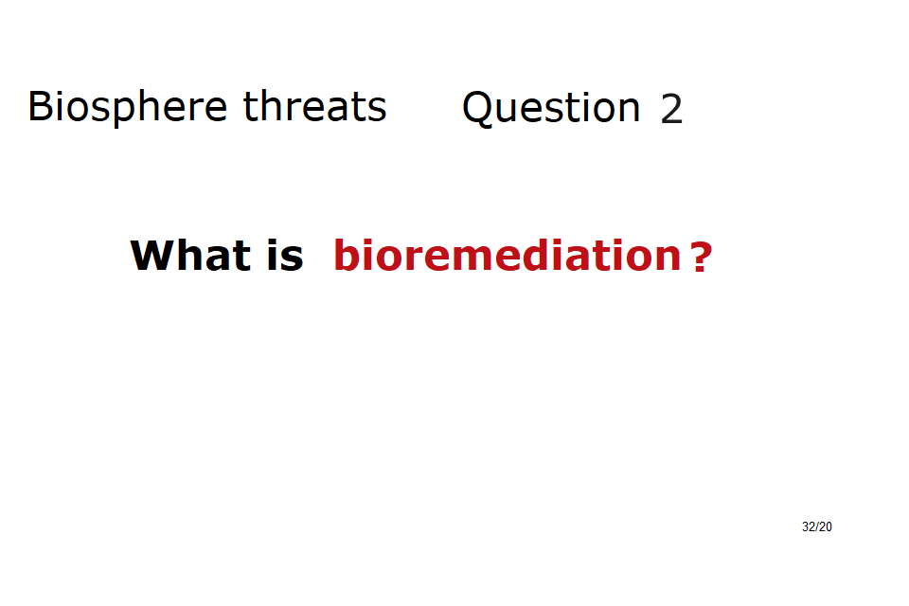

Slide 11
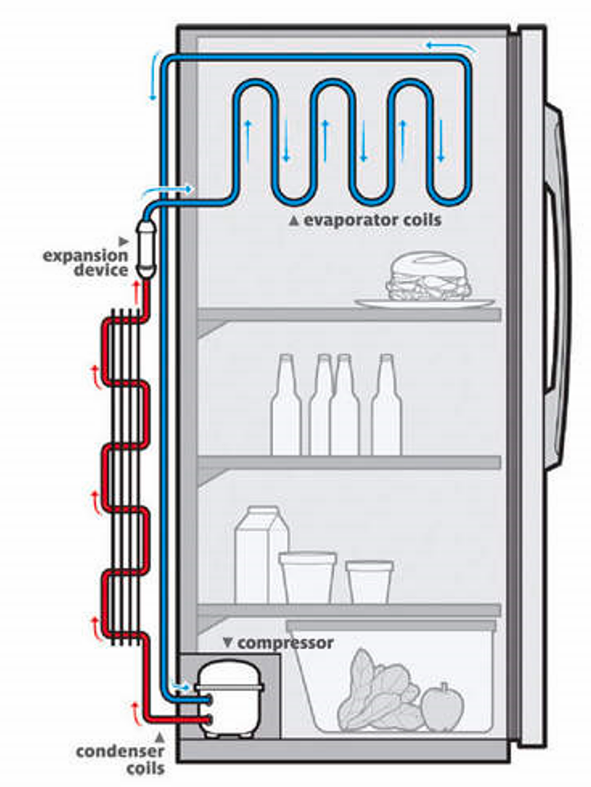

Slide 12
Chlorofluorocarbons (CFCs):
Freons (Dupont Corp., 1930s)
Use in spray cans: hair sprays, etc.
Rowell & Molina (1974) study
Johnson Wax advertising, etc.
Antarctica: high-altitude studies (Halley Bay)
“ozone hole” over Antarctica
(see next 2 slides)
Montreal Protocol (1987)

Slide 13
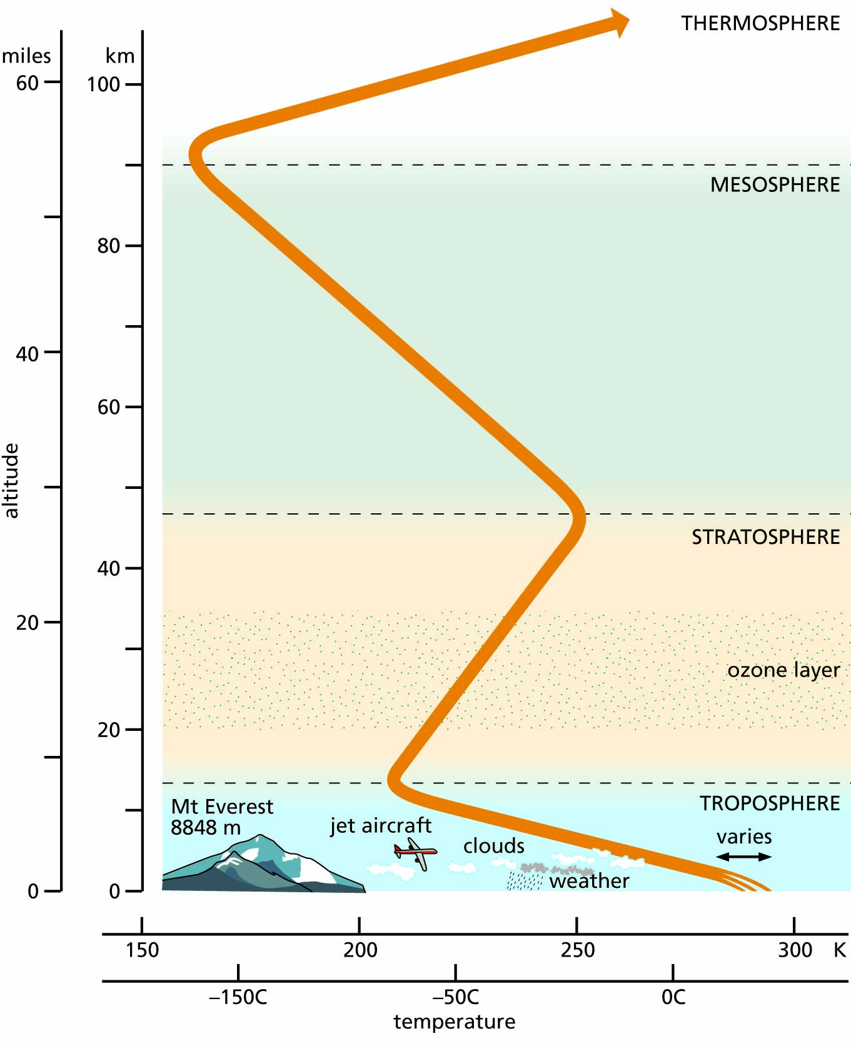
Figure 19.6 Structure of the Earth's atmosphere.

Slide 14
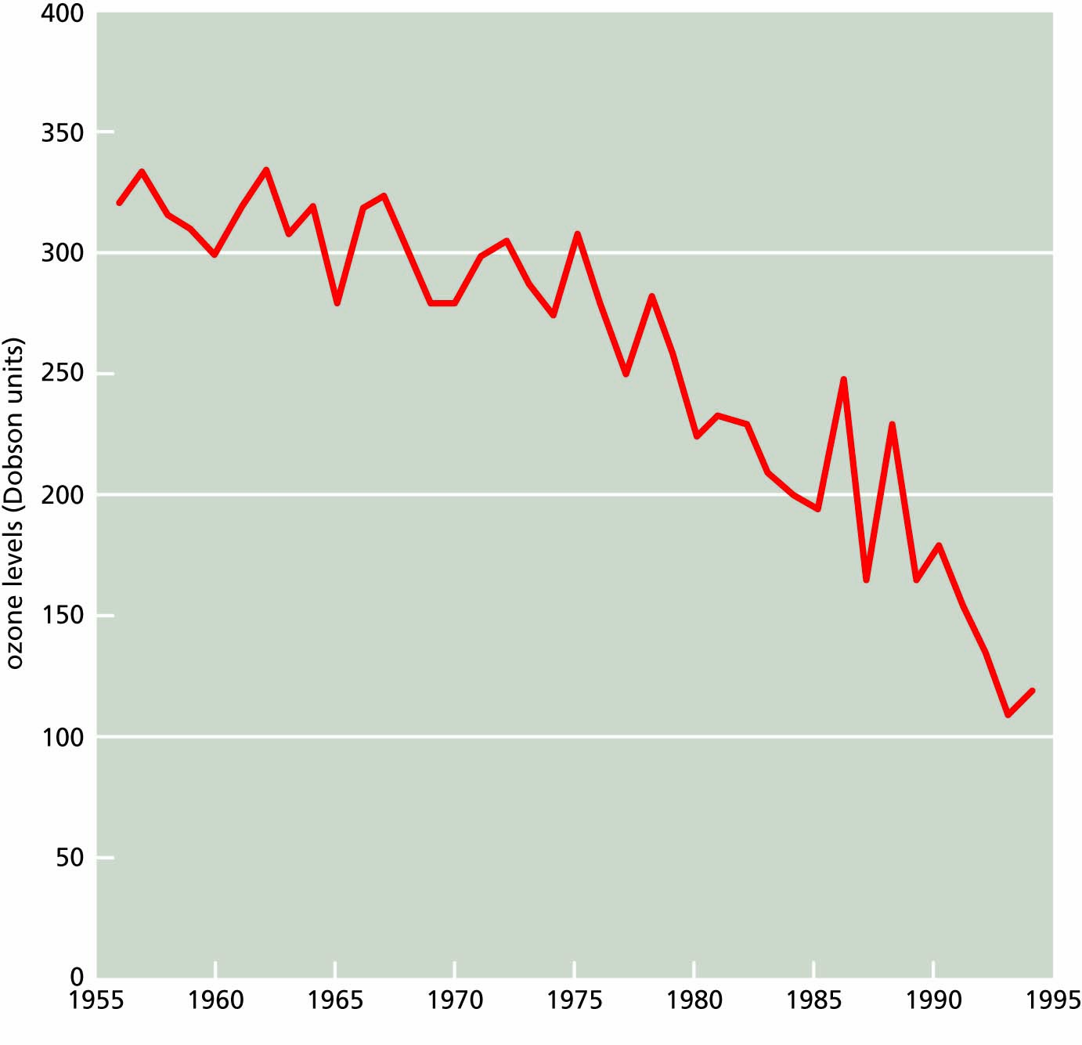
Figure 19.7 Changes in the levels of atmospheric ozone, as measured at Halley Bay, Antarctica, in October of each year.

Slide 15
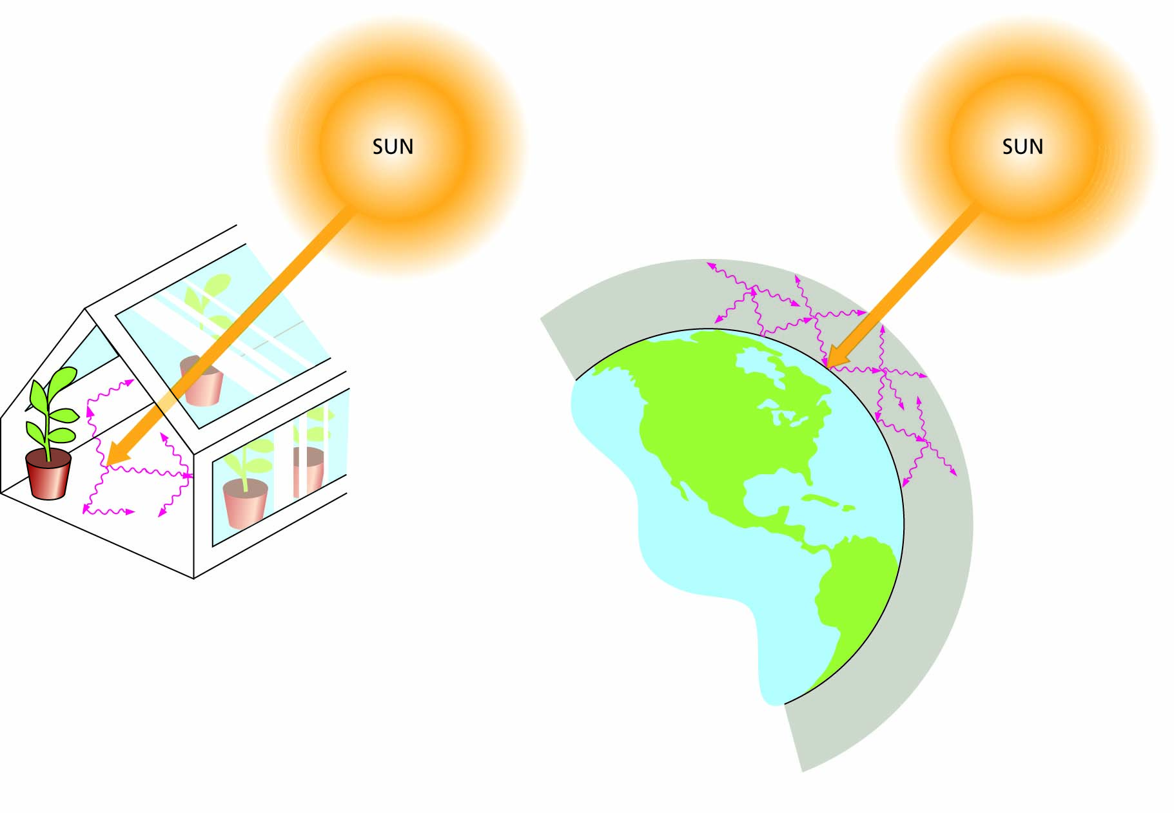
Figure 19.8 How a greenhouse captures heat. Sunlight penetrates the atmosphere or the walls of a greenhouse. When the sunlight strikes opaque objects, much of the energy is converted into infrared (heat) radiation, which becomes trapped inside the greenhouse or inside the atmosphere. Not to scale.

Slide 16
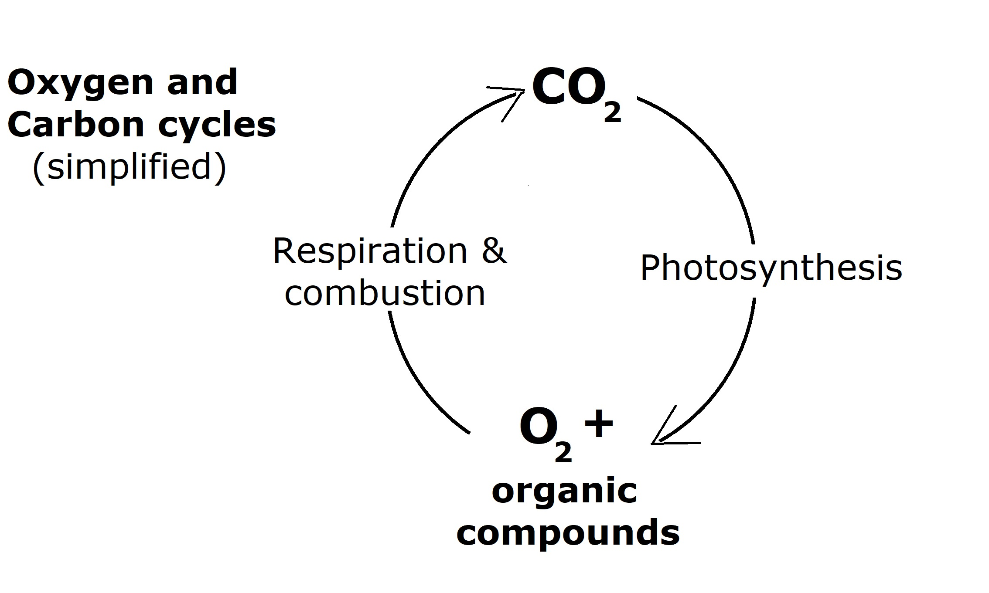

Slide 17
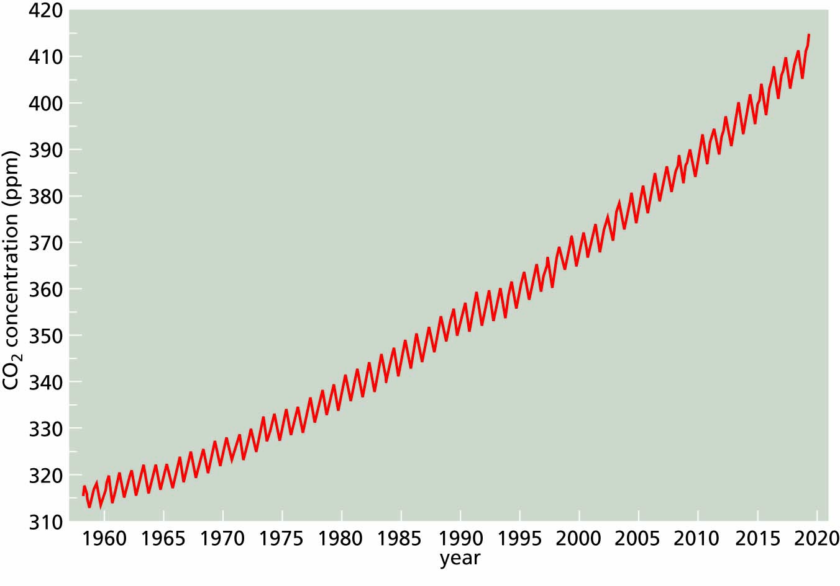
Figure 19.9 Annual fluctuations and persistent long-term increases in CO₂ concentrations, as measured at the Mauna Loa Observatory in Hawaii.

Slide 18
Coral reef bleaching
As ocean temperatures rise and CO2 levels increase,
the symbiotic algae that live within coral reefs (and give them their distinctive colors) are dying.
Here is a link to an article about this:
https://apnews.com/article/coral-reef-bleaching-climate-change-fdbeddf7ae3ccc9d7cf85d1c3267e581

Slide 19
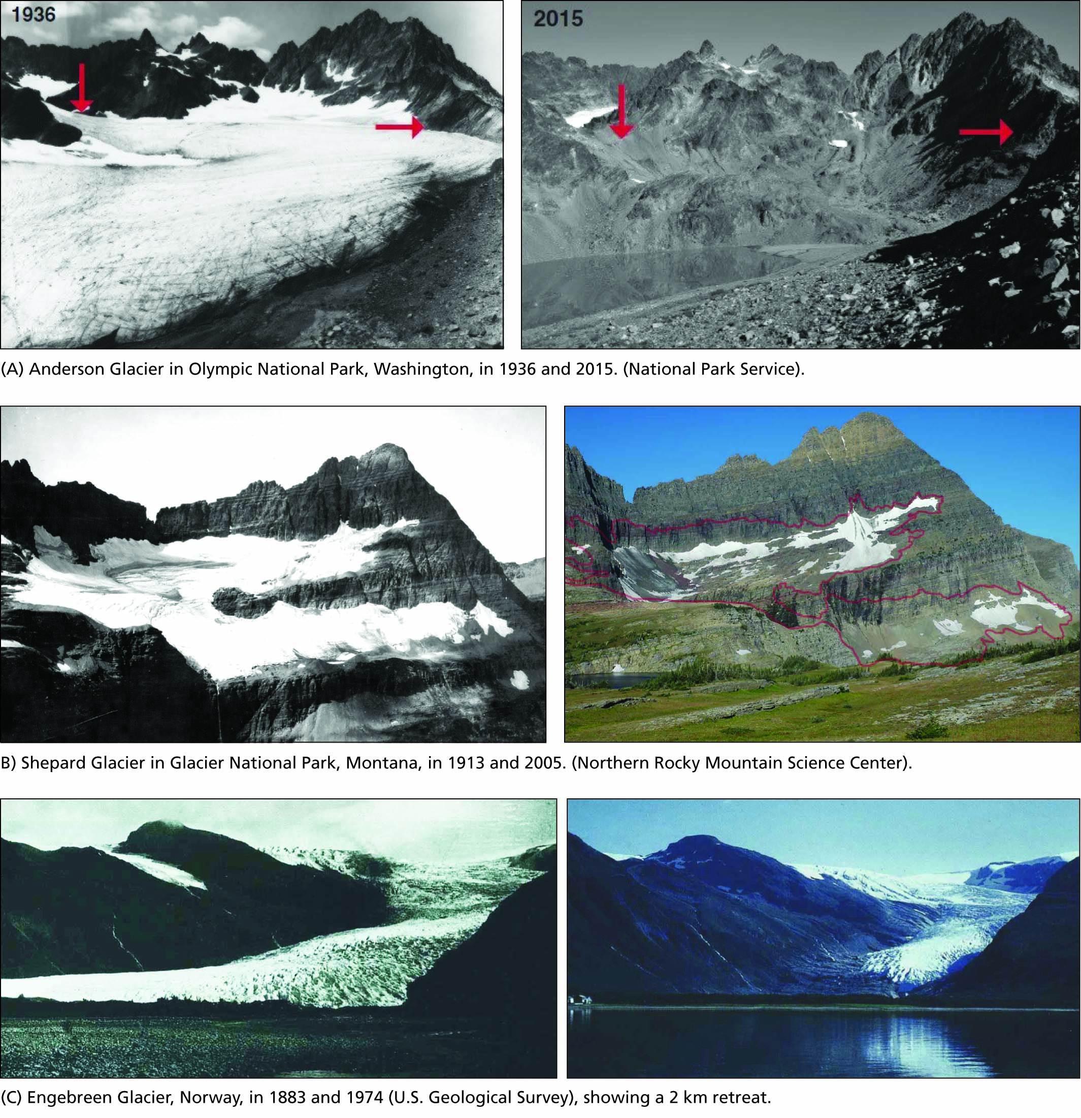
Figure 19.10 Melting of glaciers has been documented on every continent.

Slide 20
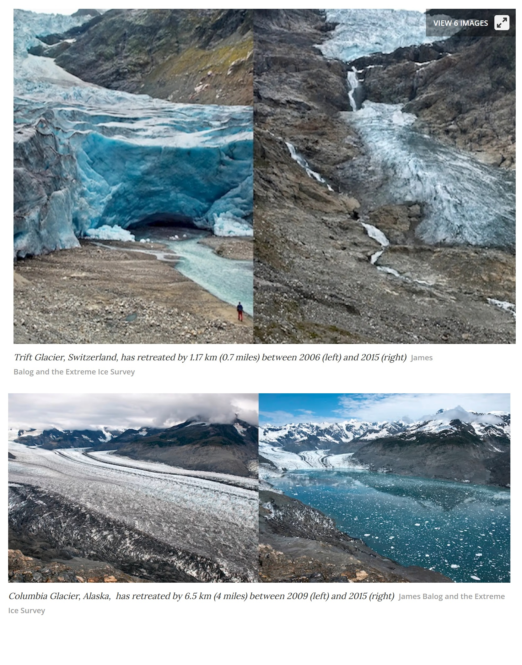

Slide 21
