Slide 1
Chapter 18: Biodiversity and Threatened Habitats
Biology Trending, 4e
Eli Minkoff and Jennifer Hood-DeGrenier

Slide 2
Biodiversity results from ecological and evolutionary processes
Factors influencing the distribution of biodiversity
Interdependence of humans and biodiversity

Slide 3
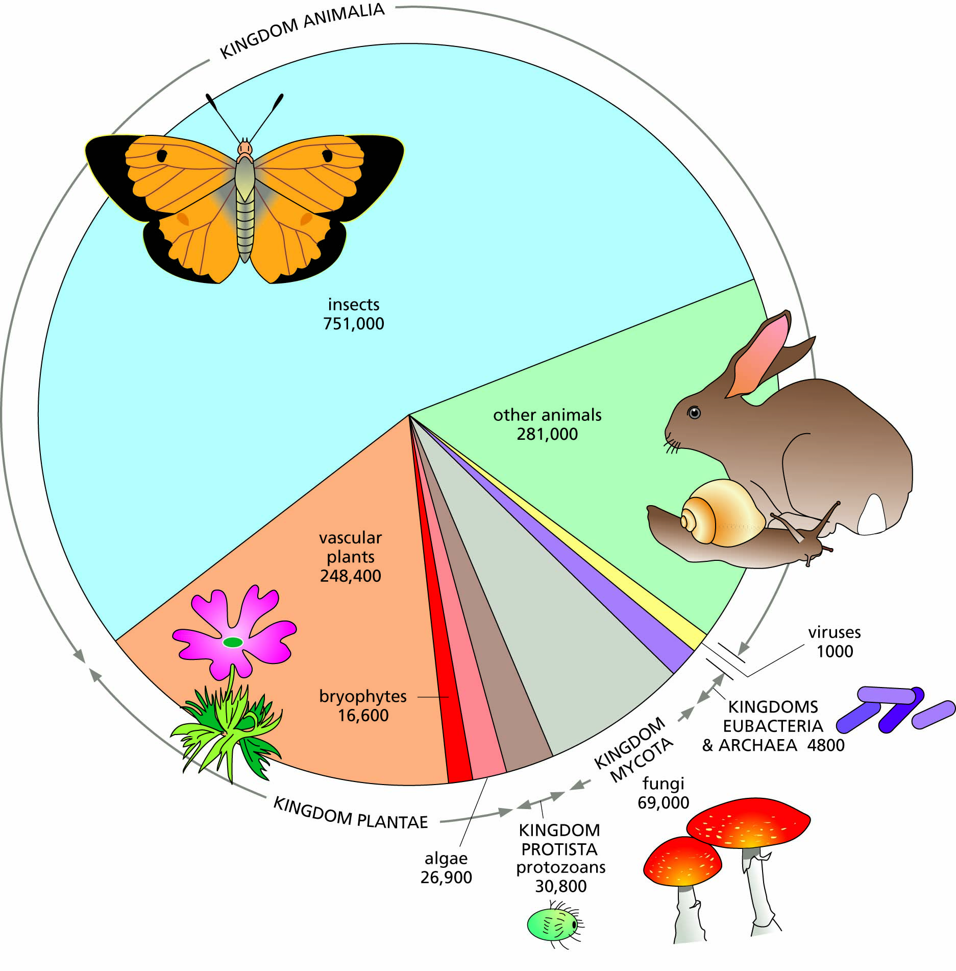
Figure 18.1 Numbers of species currently known in the major groups of organisms.

Slide 4

Figure 18.2 Coral reef diversity in the Red Sea, Egypt.

Slide 5
Extinction reduces biodiversity
Types of extinction
Analyzing patterns of extinction
Species threatened with extinction today

Slide 6
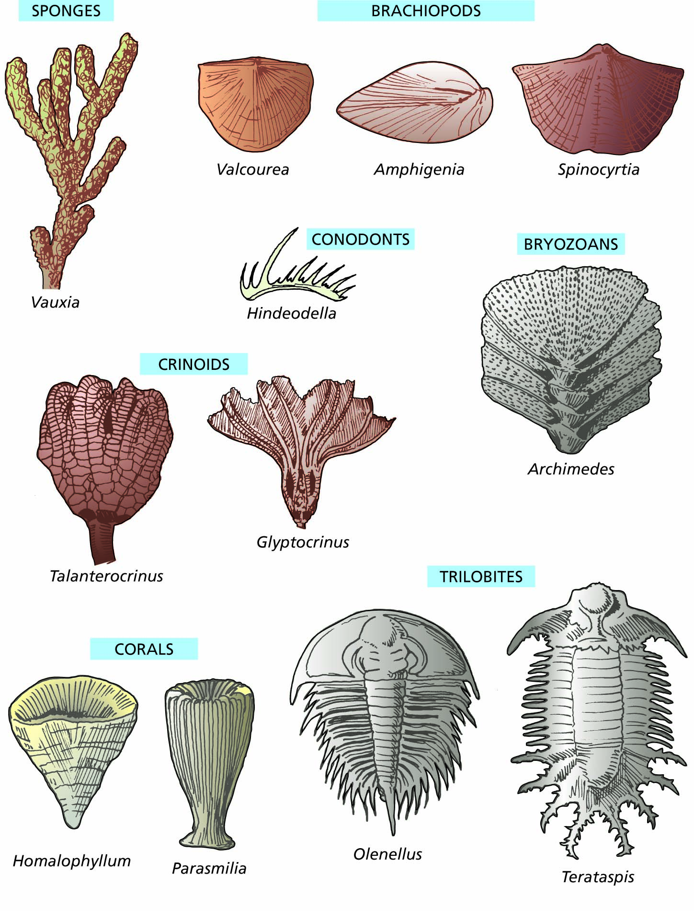
Figure 18.3 Extinct species of the Paleozoic era. The fossils shown here represent groups that were abundant during Paleozoic times. All these groups suffered considerable extinction at the end of the Permian period. The trilobites (belonging to the phylum Arthropoda) and conodonts (jaw structures belonging to the phylum Chordata) are truly extinct groups with no living descendants. The other groups have some living species, but the species alive today are not the same as the Paleozoic species.

Slide 7
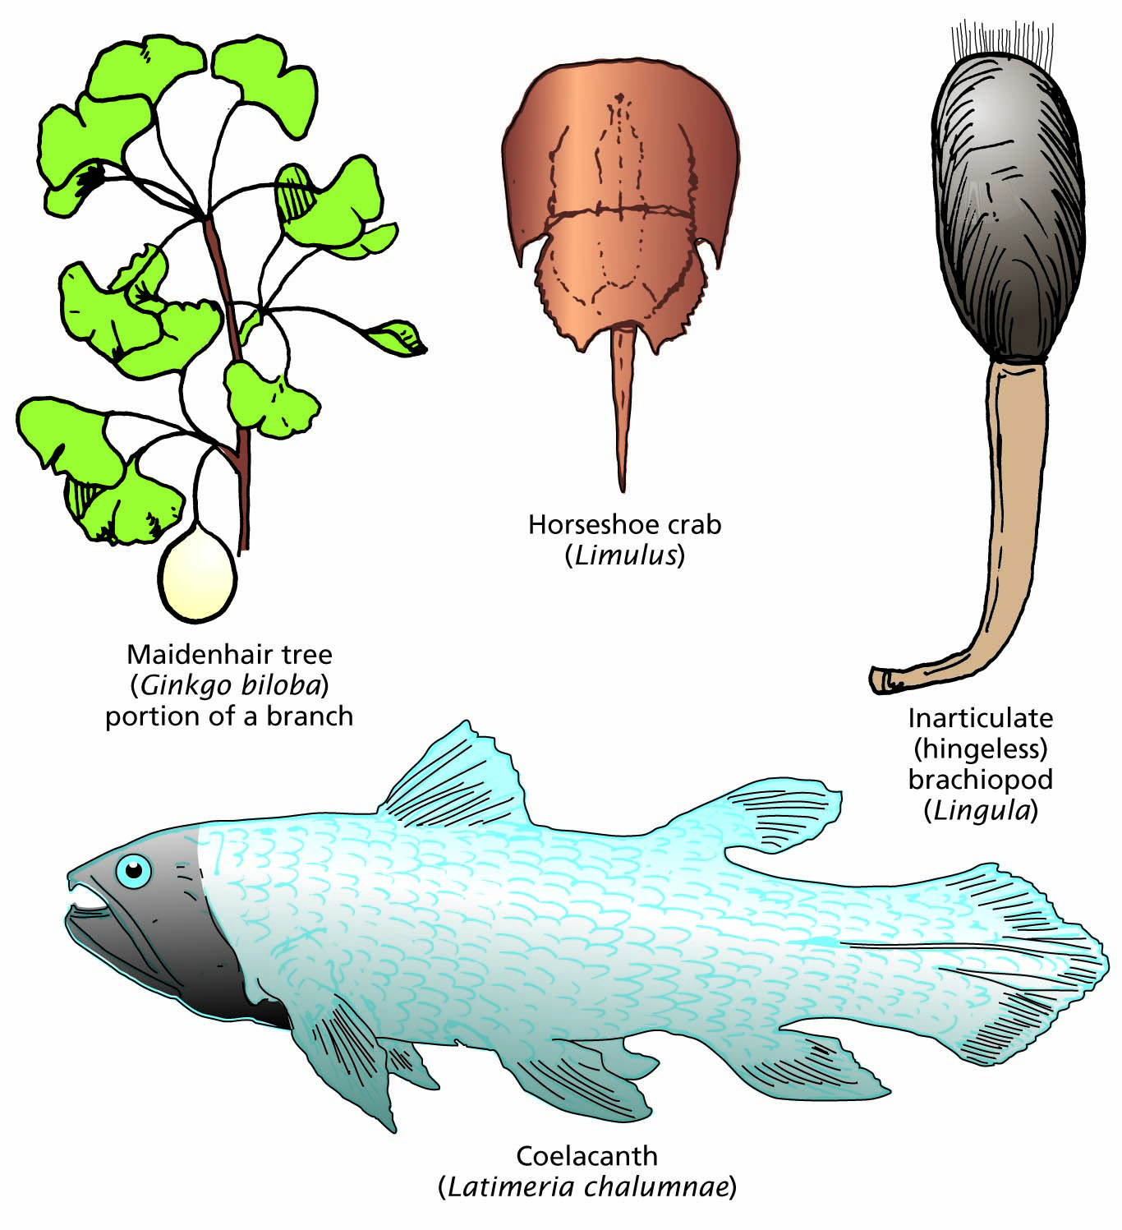
Figure 18.4 Living fossils that have avoided extinction over long periods of time.

Slide 8
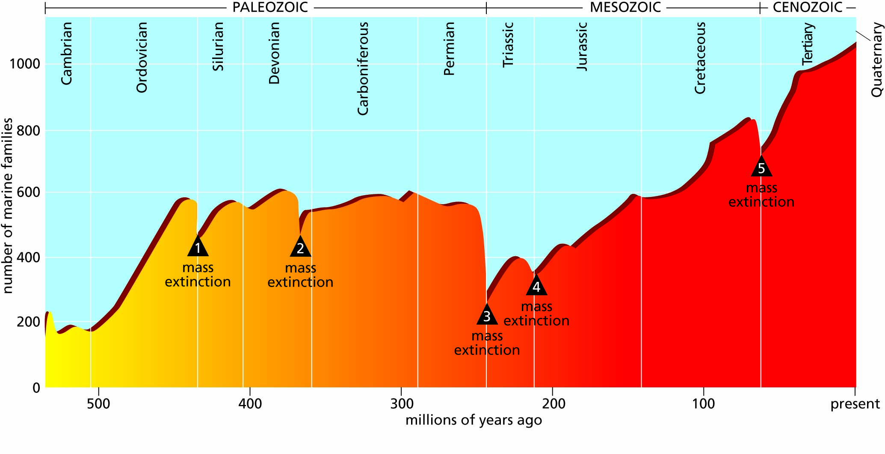
Figure 18.5 Changes through time in the number of families of marine organisms. Mass extinctions are indicated by numbered triangles.

Slide 9
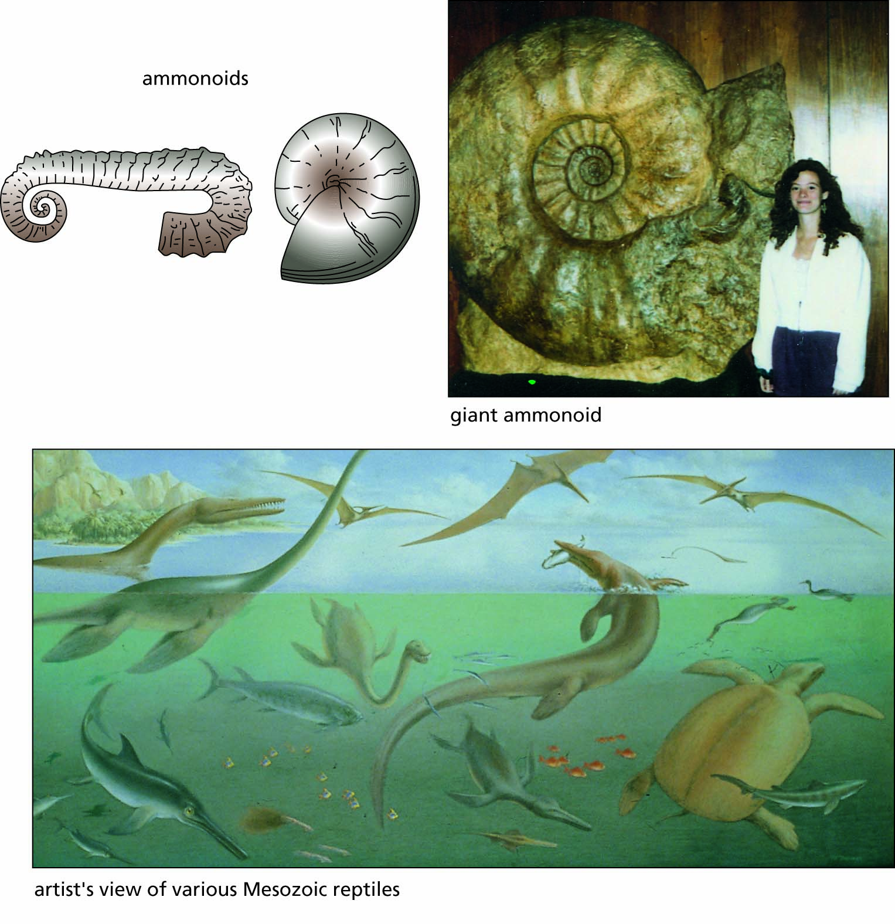
Figure 18.6 Extinct species belonging to groups that died out completely at the end of the Cretaceous period.

Slide 10
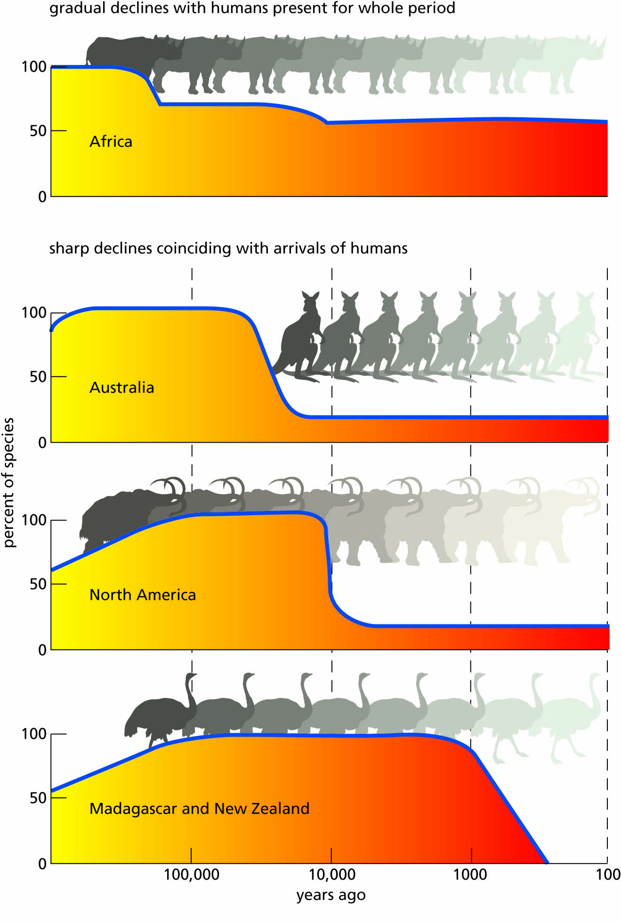
Figure 18.7 The extinction of many large mammals and flightless birds followed soon after human arrival in many parts of the world. In Africa, however, extinctions took place more gradually because humans had been present for a much longer period.

Slide 11
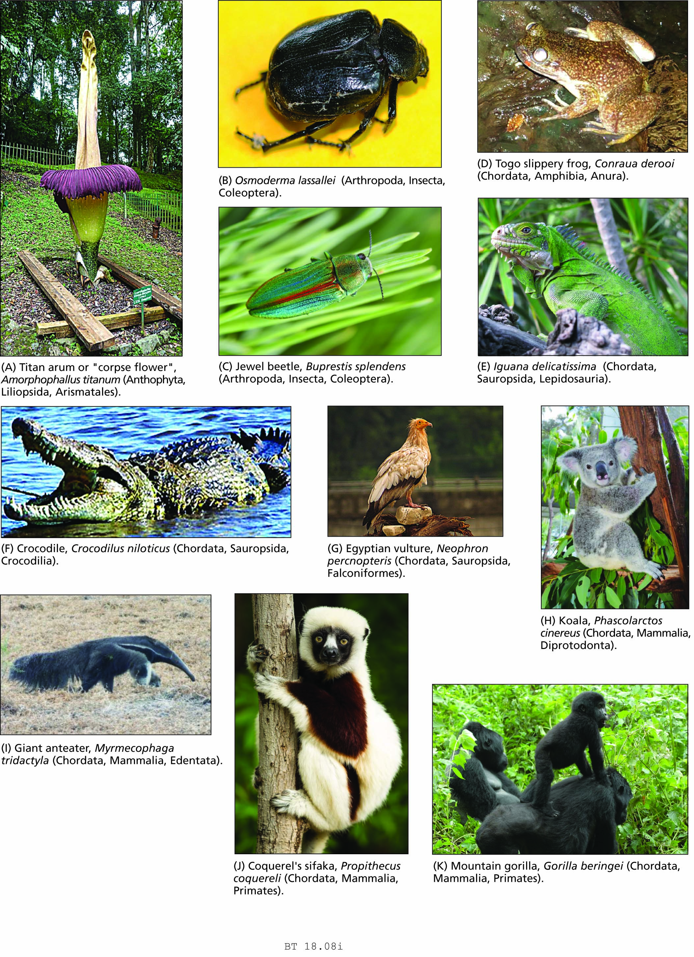
Figure 18.8 Selected species currently threatened with extinction.

Slide 12
Figure 18.8 Selected species currently threatened with extinction.

Slide 13
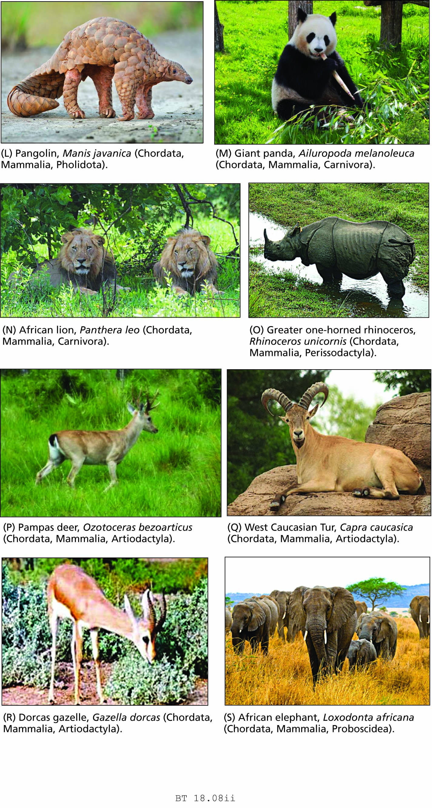
Figure 18.8 Selected species currently threatened with extinction.

Slide 14
Figure 18.8 Selected species currently threatened with extinction.

Slide 15
Question 1:
What is PSEUDOEXTINCTION?

Slide 16
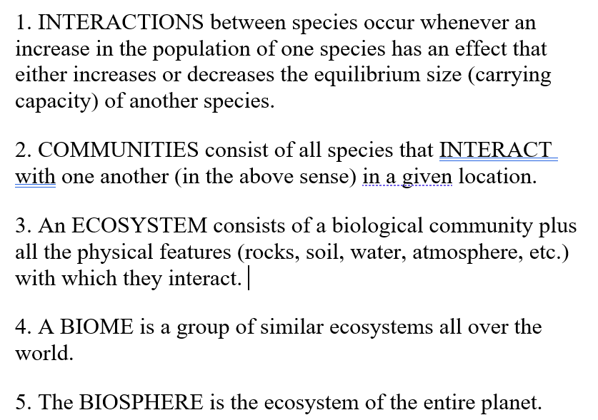
Some basic definitions:

Slide 17
Some entire habitats are threatened
The tropical rainforest biome
Desertification
Valuing habitat

Slide 18
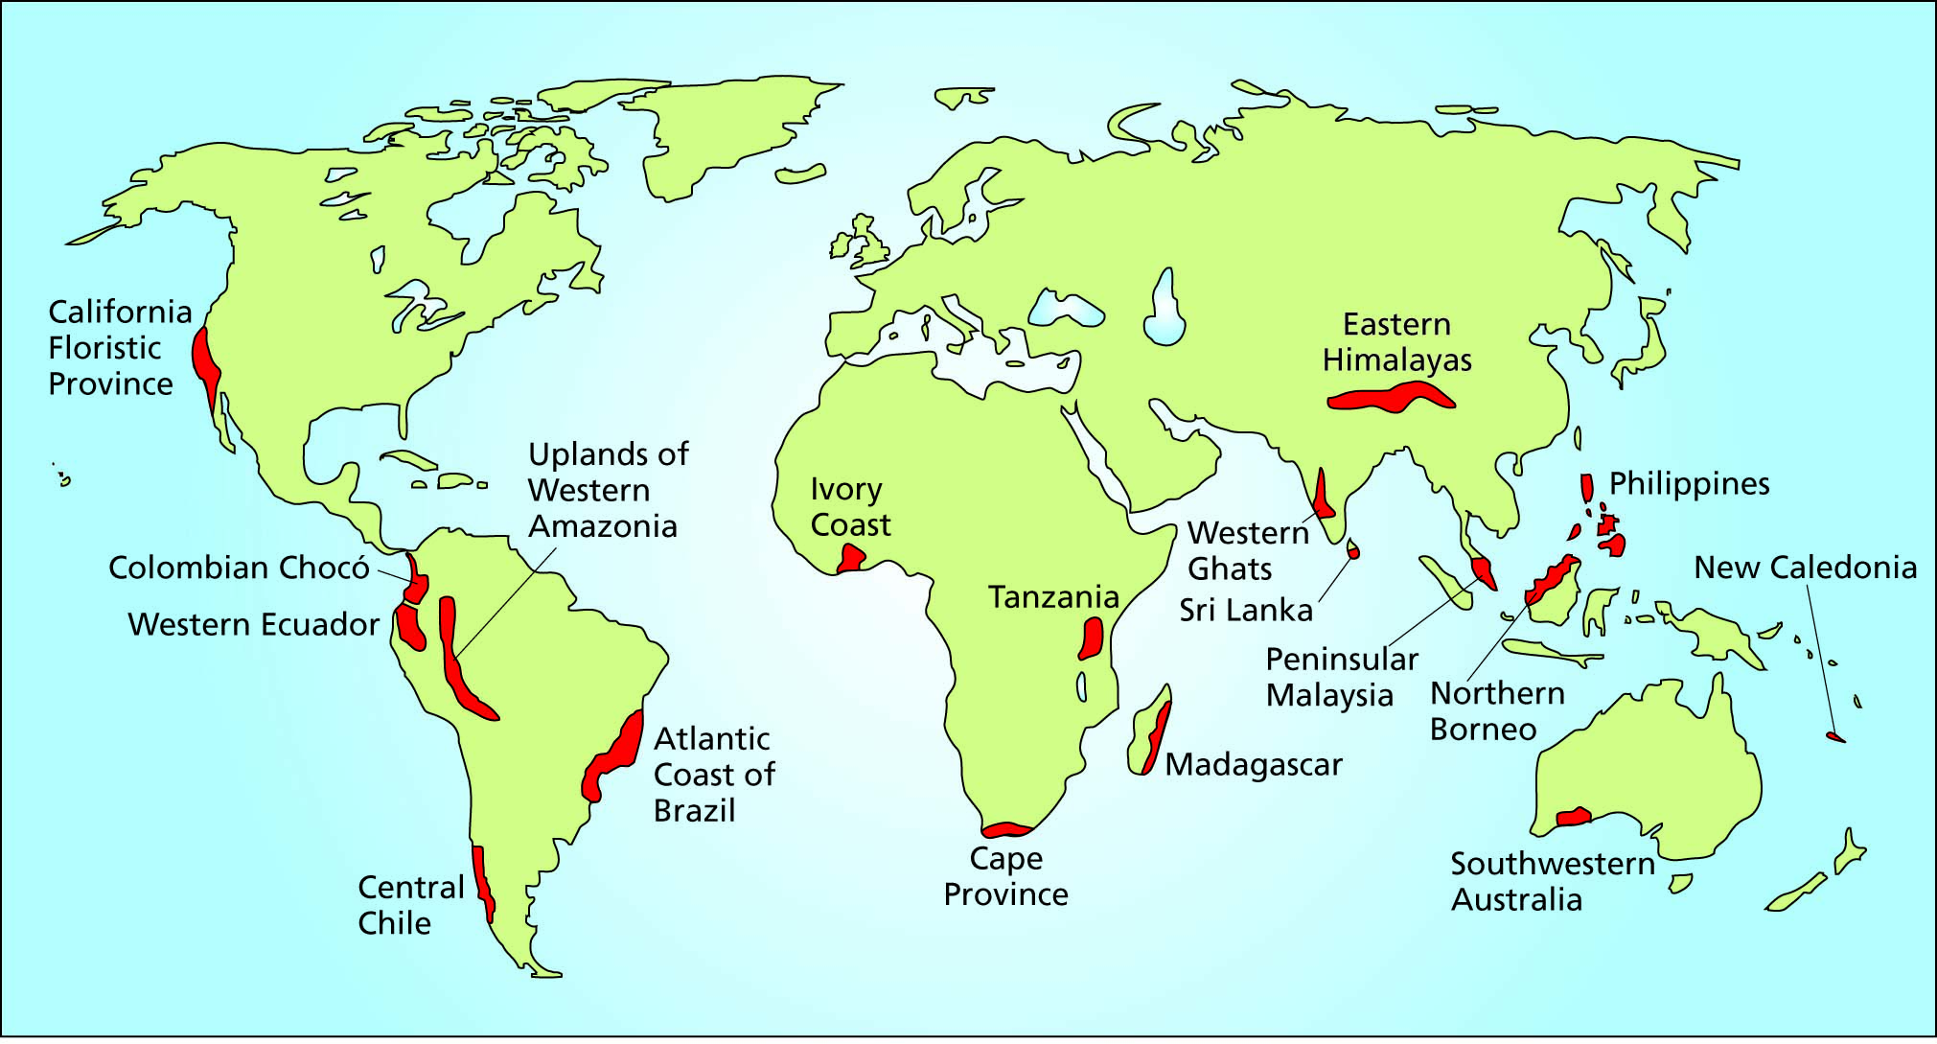
Figure 18.9 ‘Hot spots’: habitats containing many species found nowhere else and threatened with extinction from human activity.

Slide 19
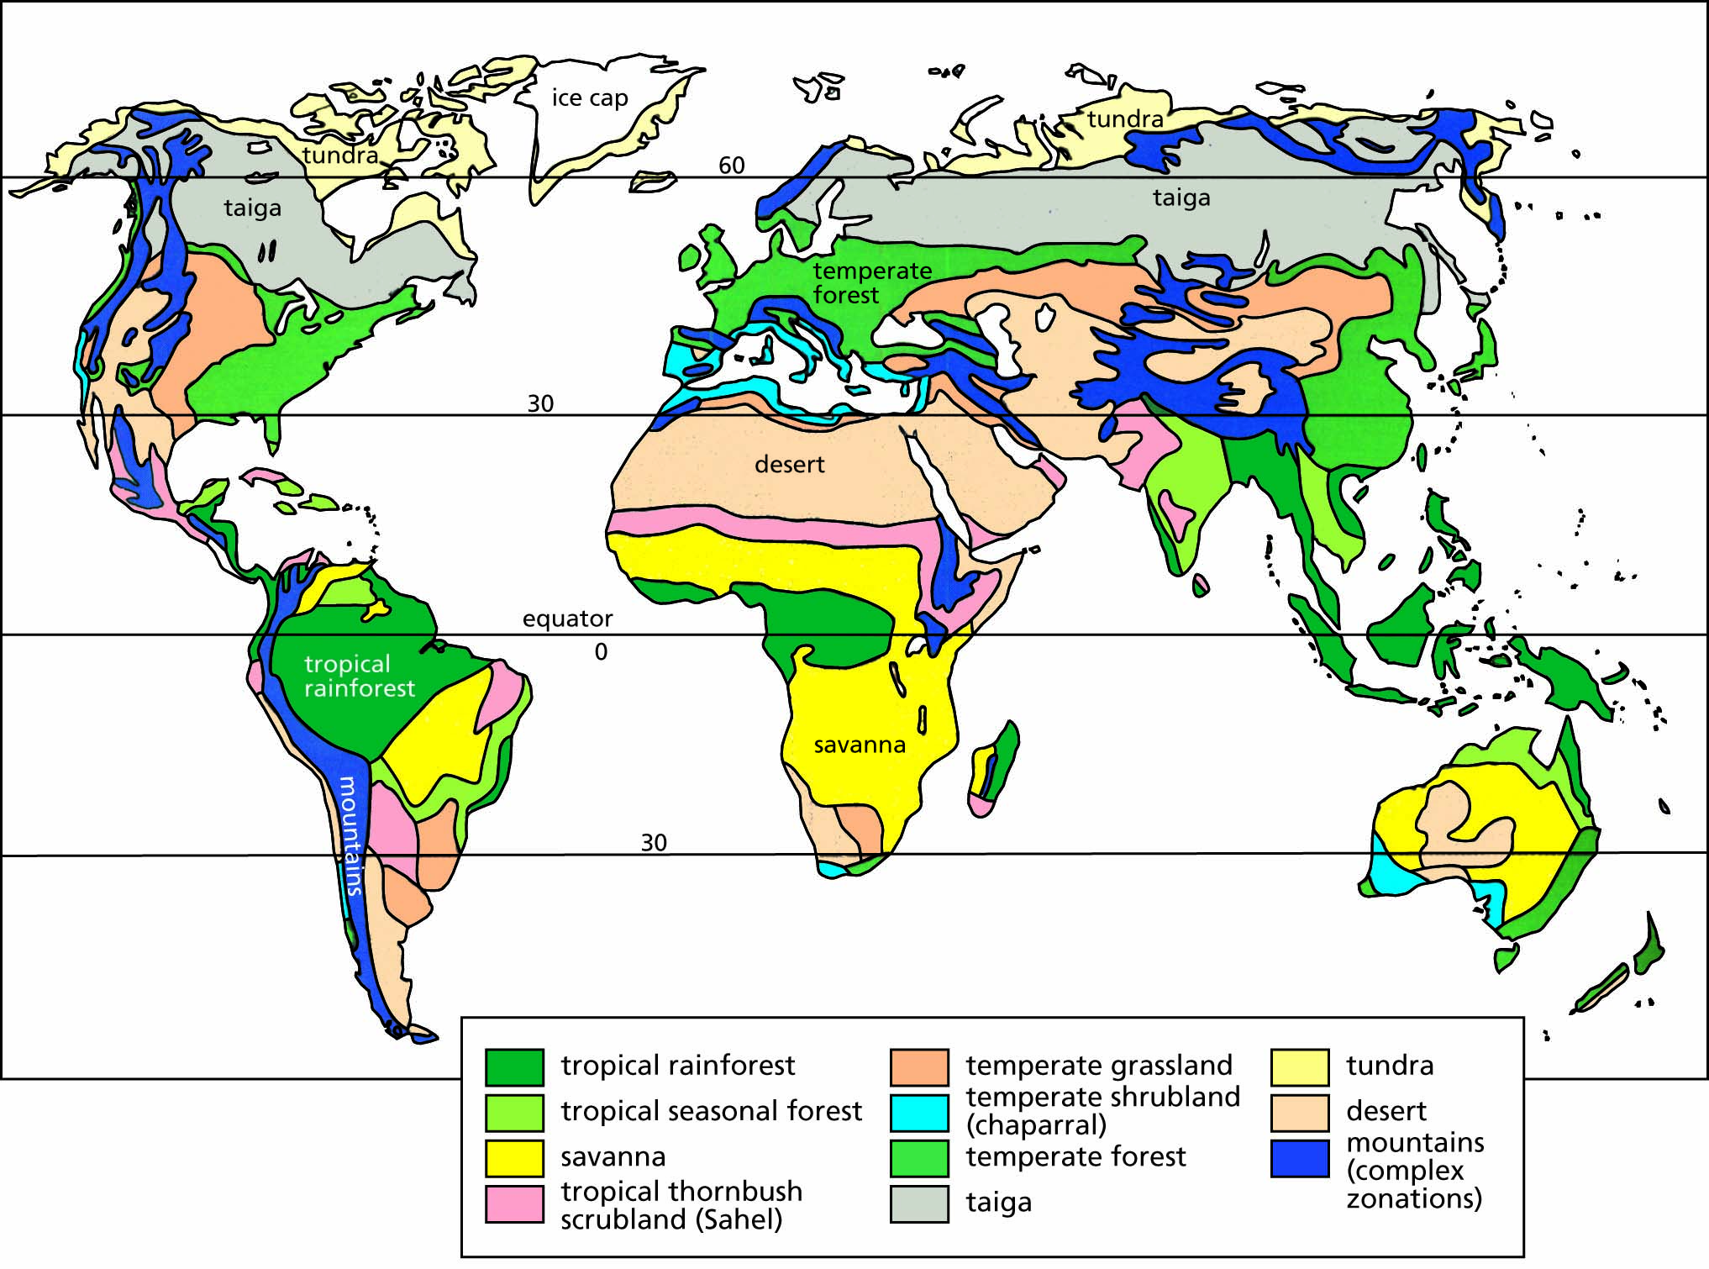
Box 18.1 Terrestrial biomes of the world.

Slide 20
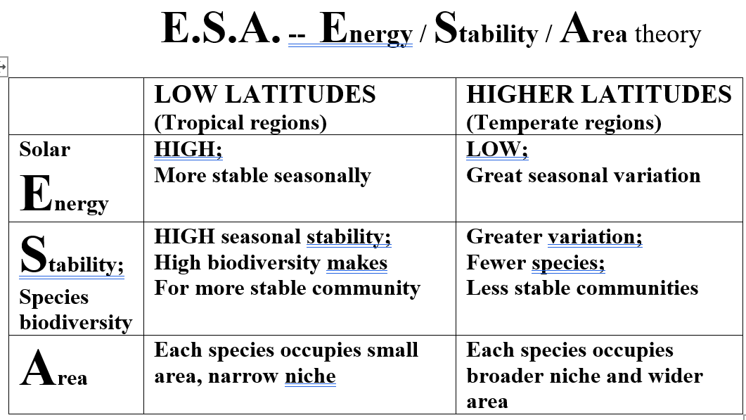

Slide 21
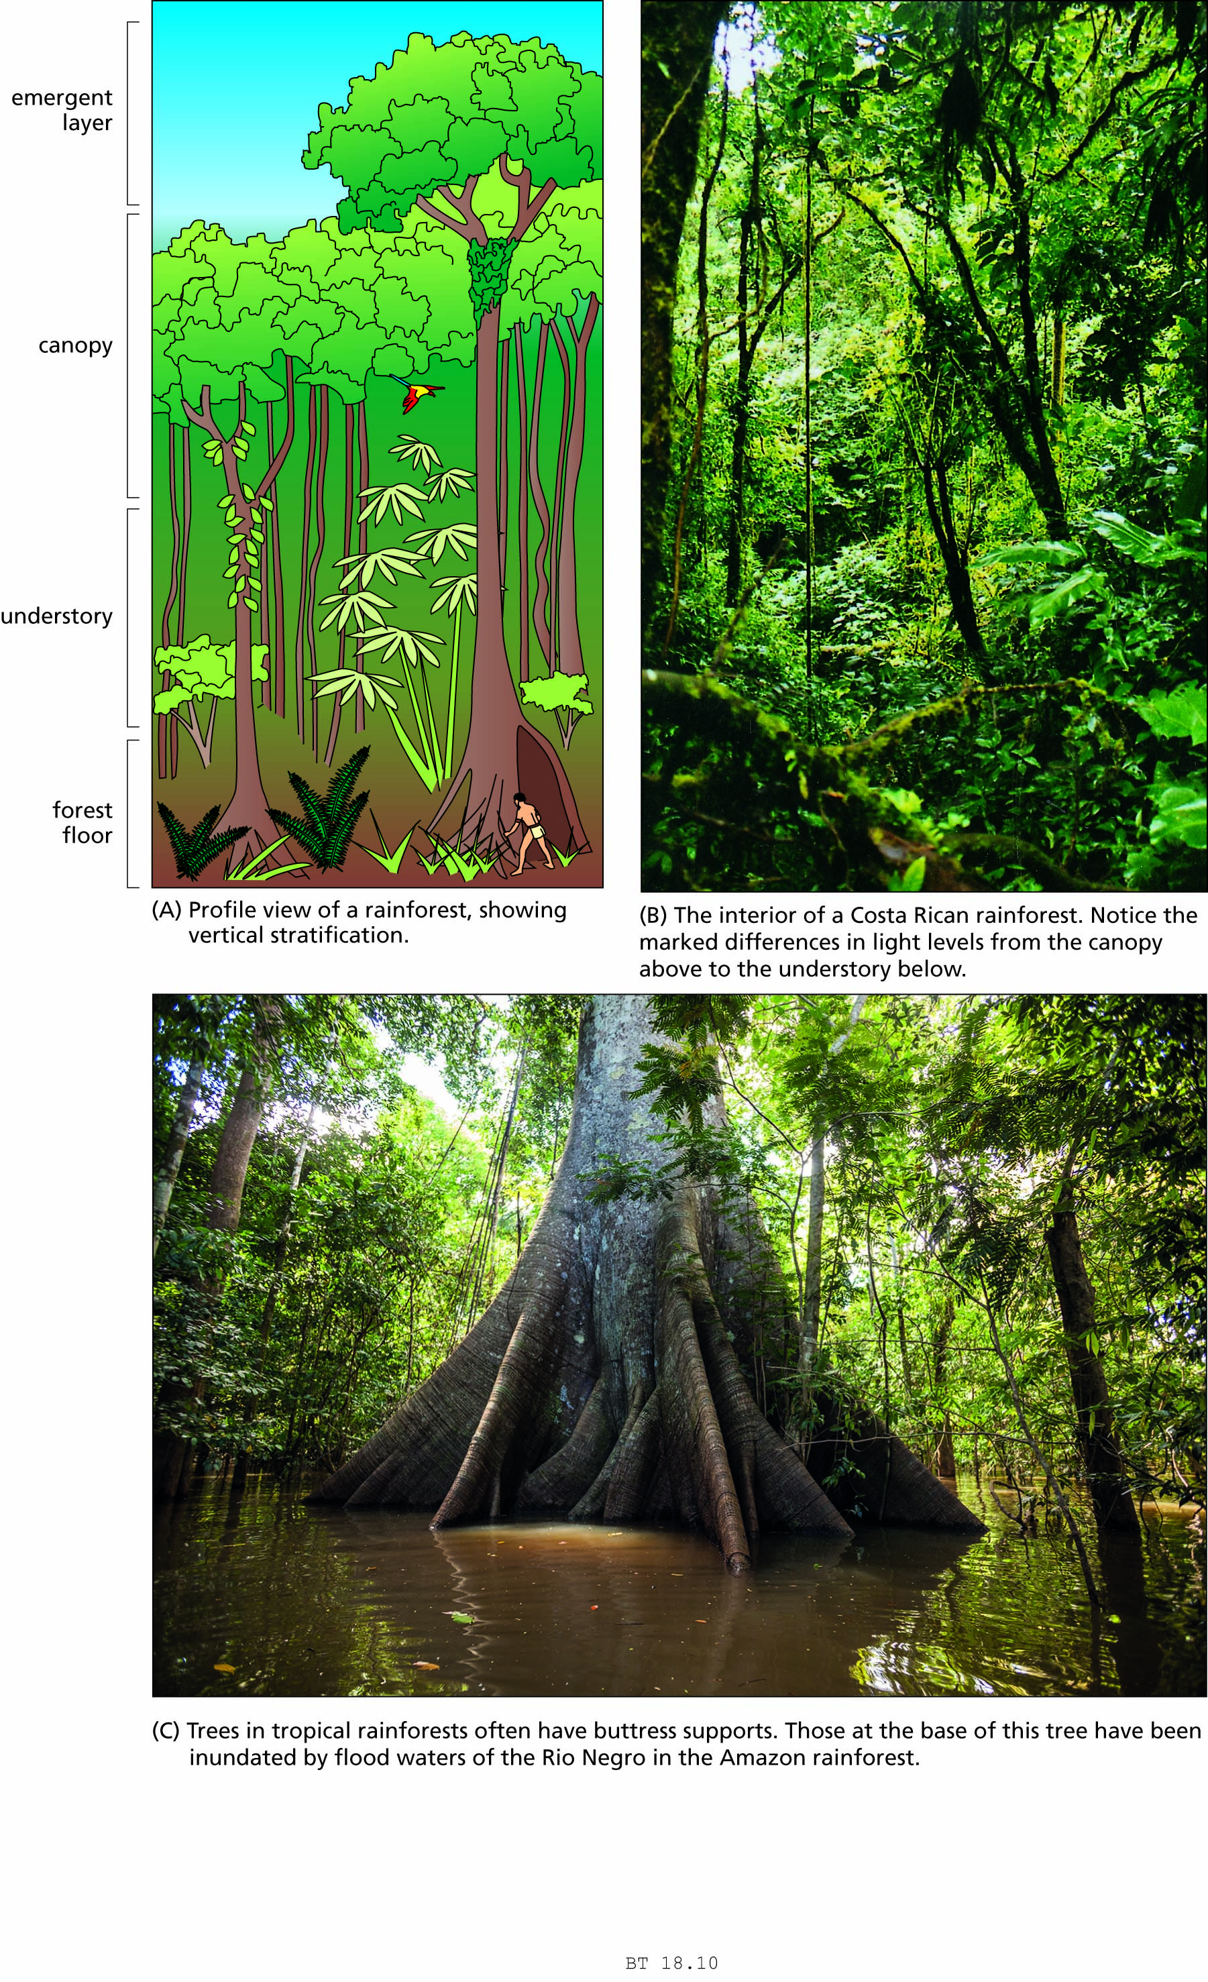
Figure 18.10 Rainforests.

Slide 22
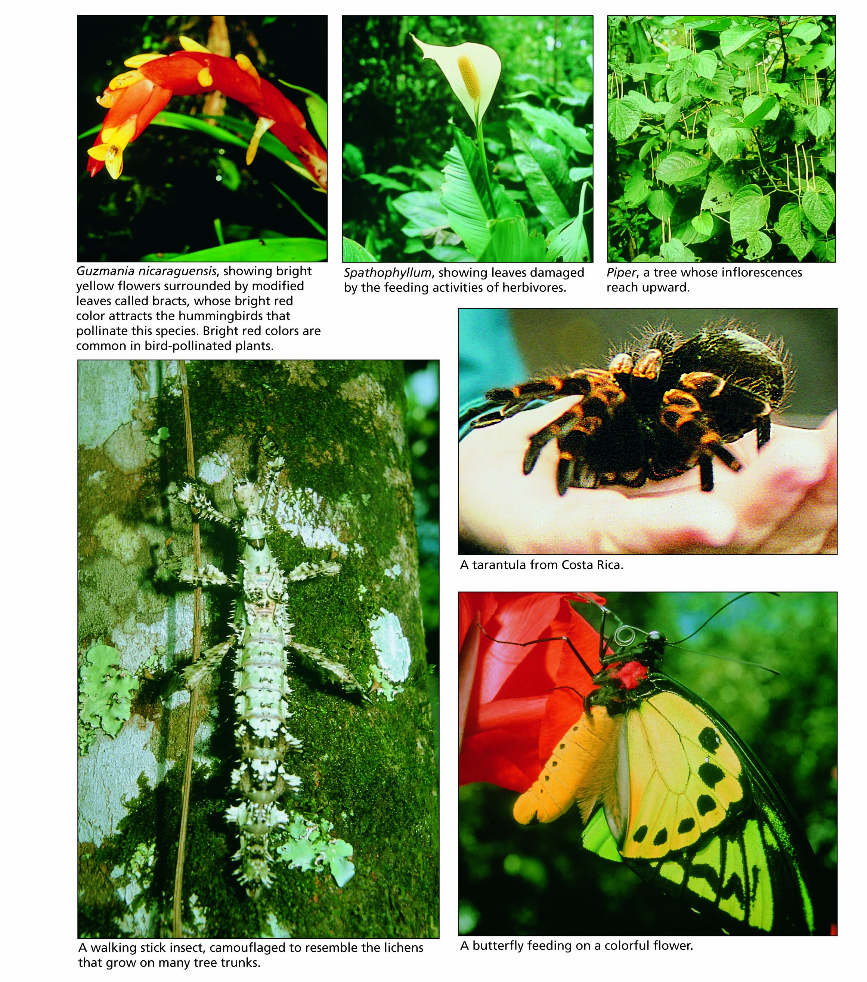
Figure 18.11 Some of the biodiversity of tropical rainforests.

Slide 23
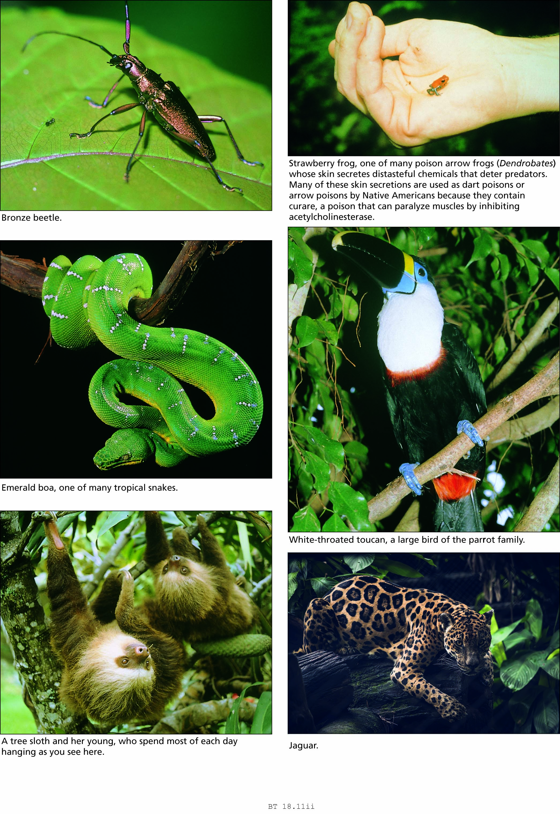
Figure 18.11 Some of the biodiversity of tropical rainforests.

Slide 24
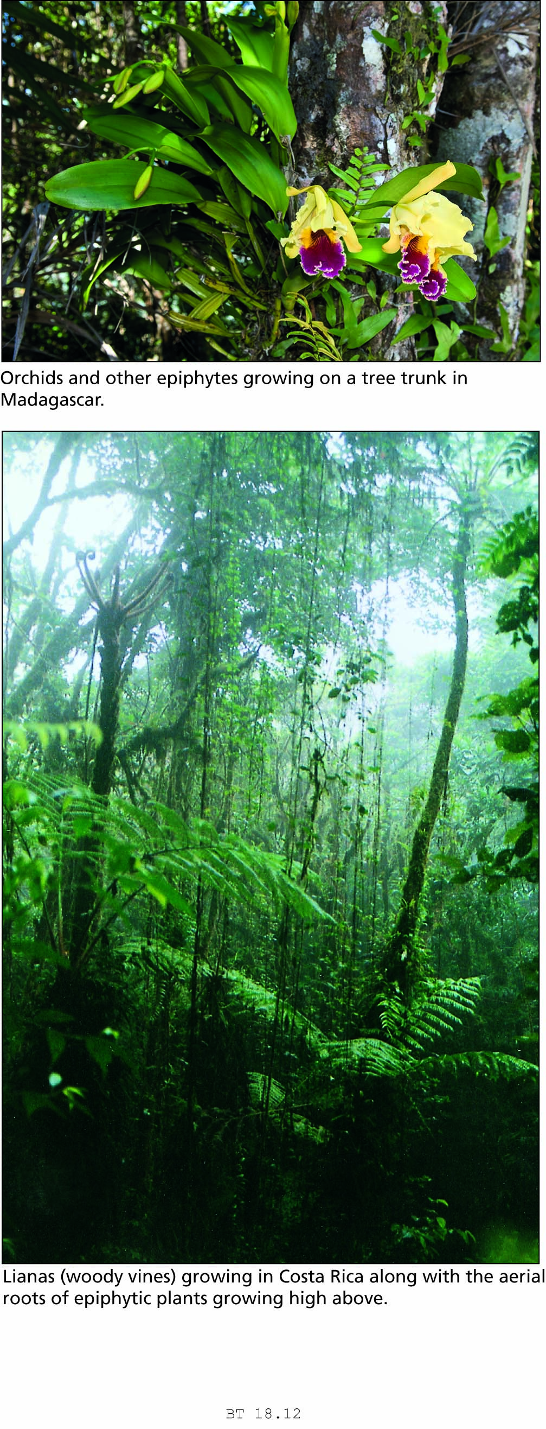
Figure 18.12 Life on rainforest tree trunks.

Slide 25
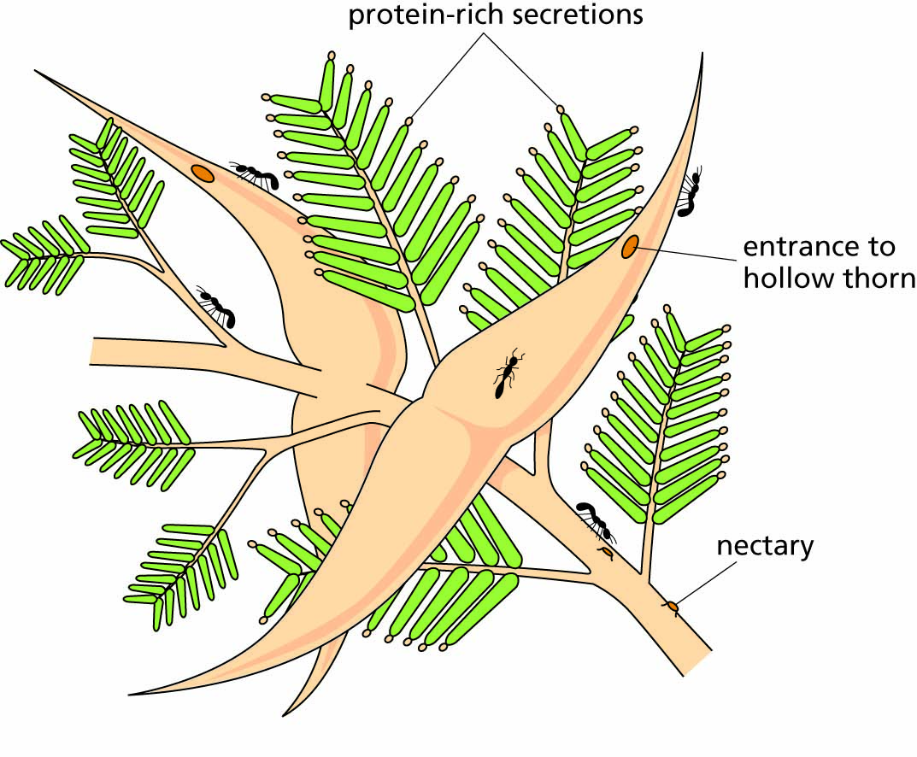
Figure 18.13 Mutualism between the bull’s horn acacia (Acacia cornigera) and ants of the genus Pseudomyrmex.

Slide 26
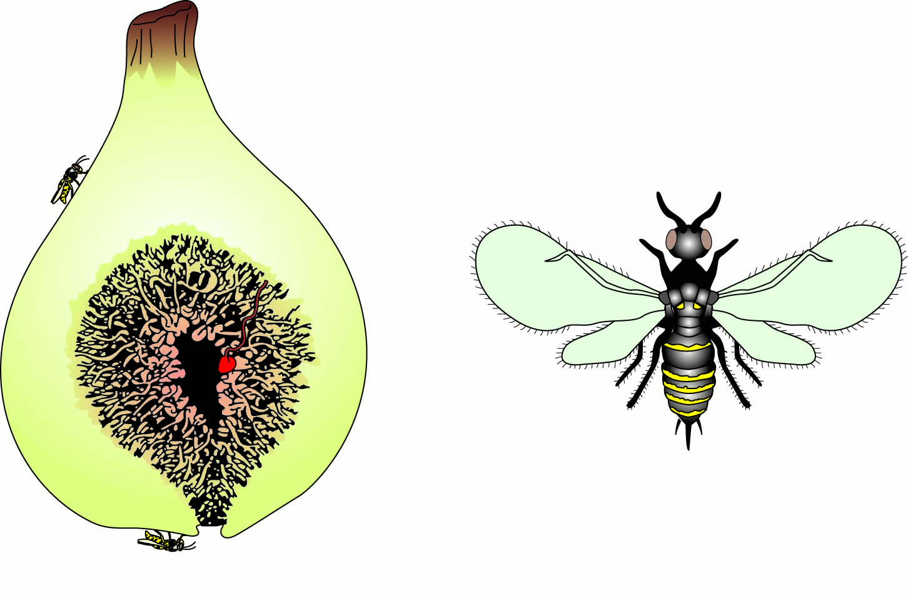
Figure 18.14 Cutaway view of a fig (Ficus), showing a female fig wasp (Blastophaga) ready to enter. An enlarged view of the female wasp is shown; the male has a similar body but is wingless. One of the many flowers inside the fig is shown in red.

Slide 27
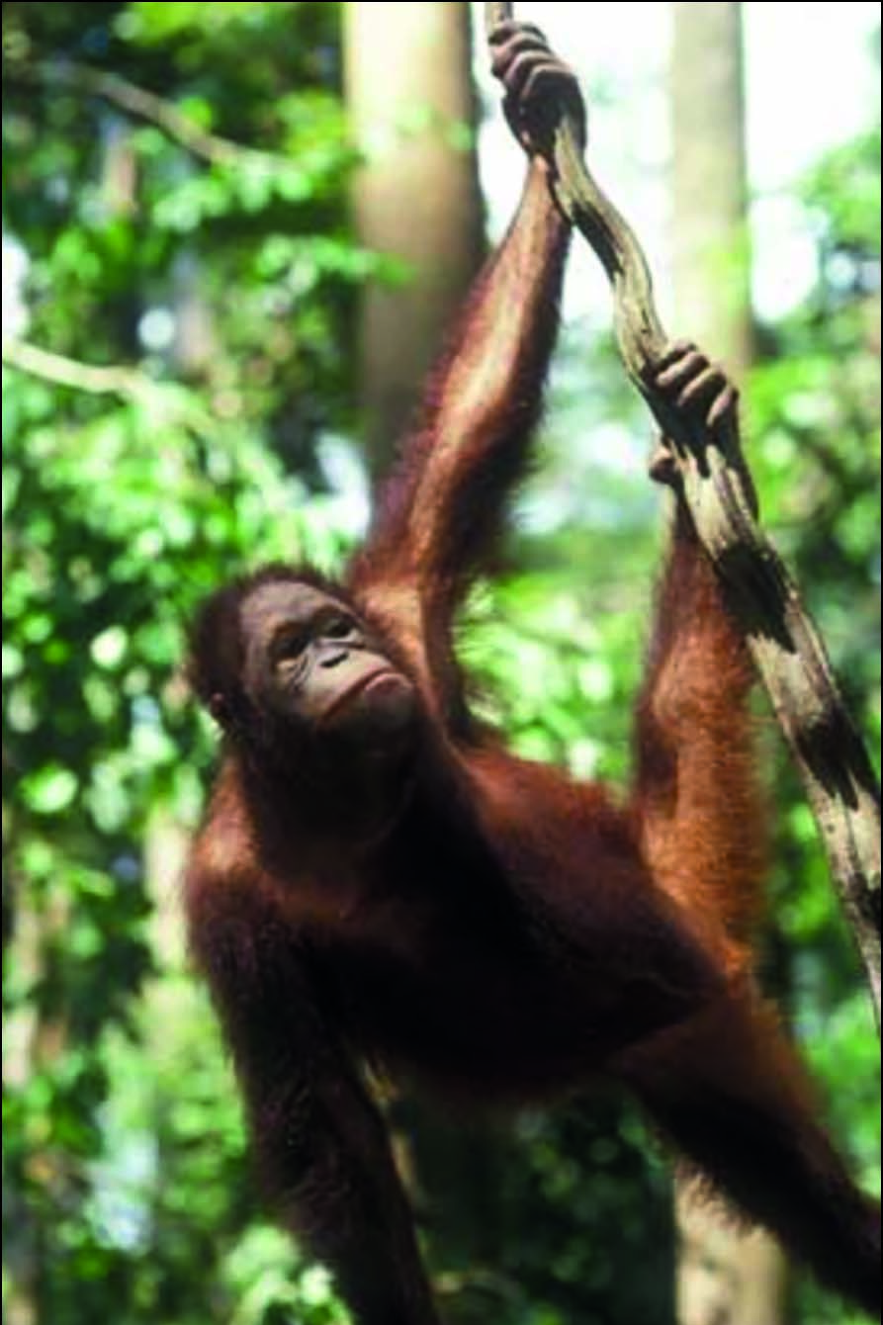
Figure 18.15 The orangutan, Pongo pygmaeus, showing quadrumanual clambering.

Slide 28
Question 2:
Why is there more
BIODIVERSITY in the
TROPICS?

Slide 29
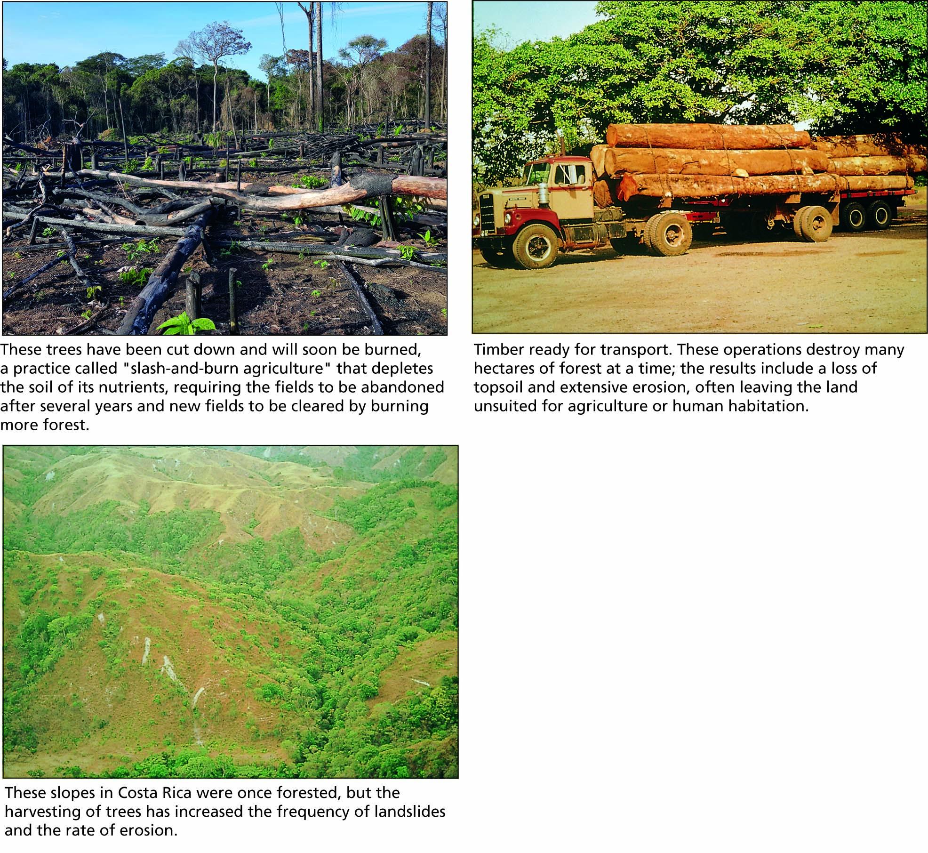
Figure 18.16 Tropical deforestation.

Slide 30
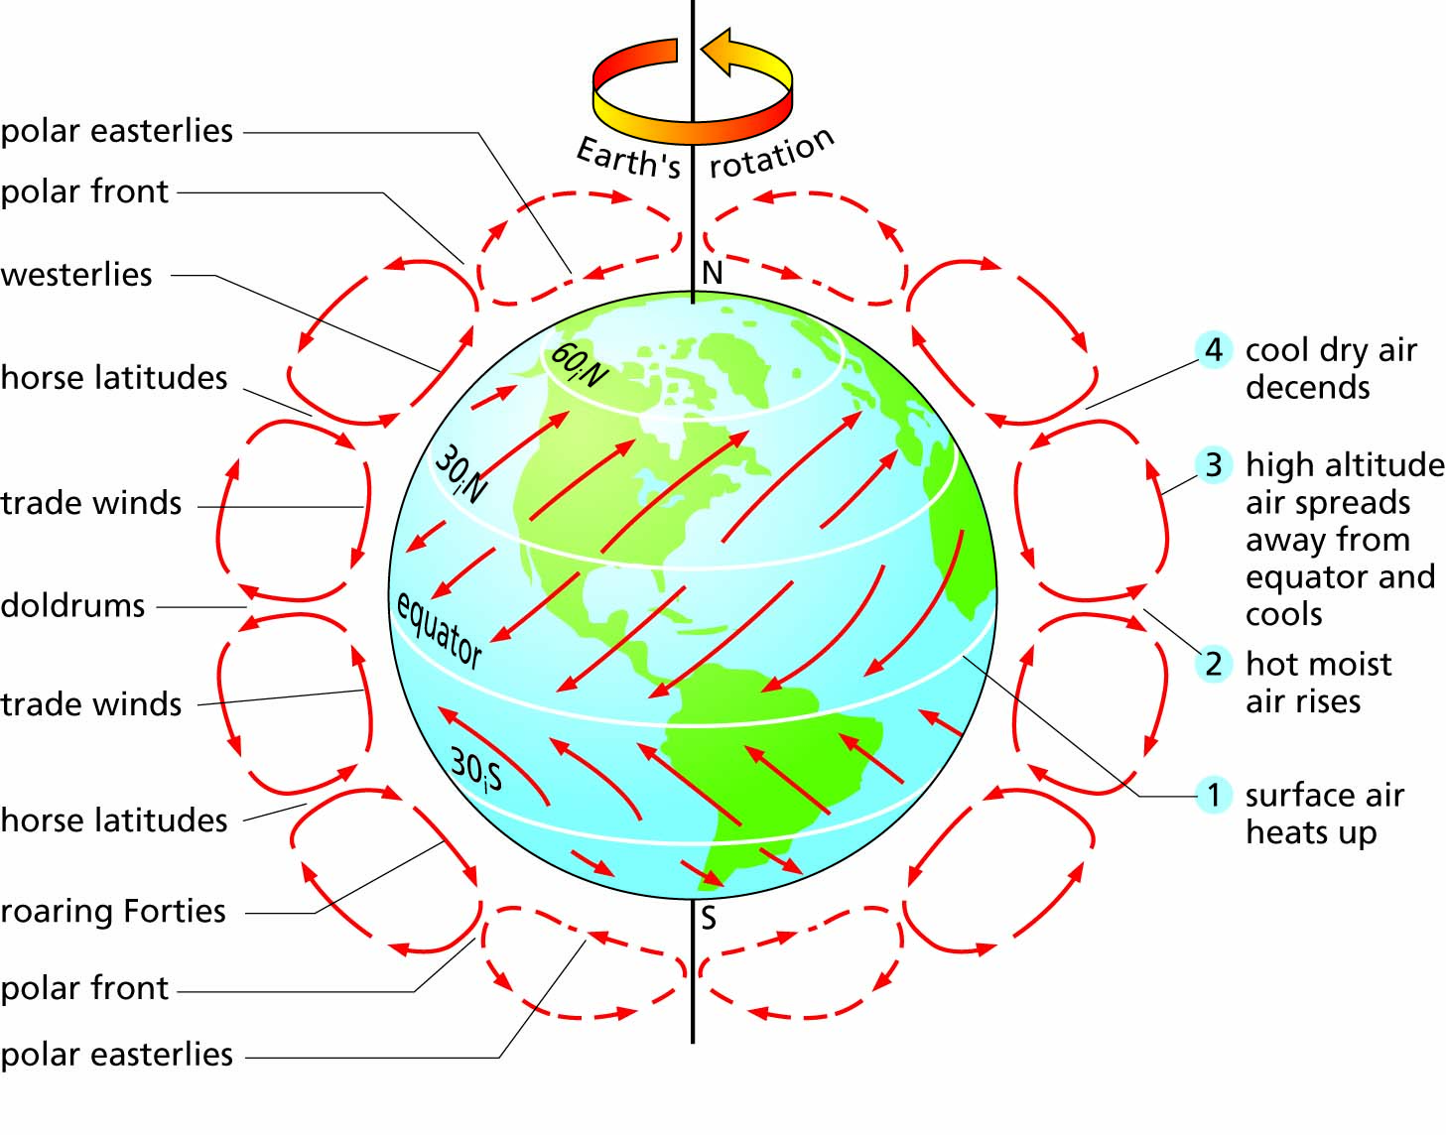
Figure 18.17 Global patterns of prevailing winds. Notice that winds blow away in both directions from latitudes 30° S and 30° N, carrying moisture away from these latitudes and creating desert regions.

Slide 31
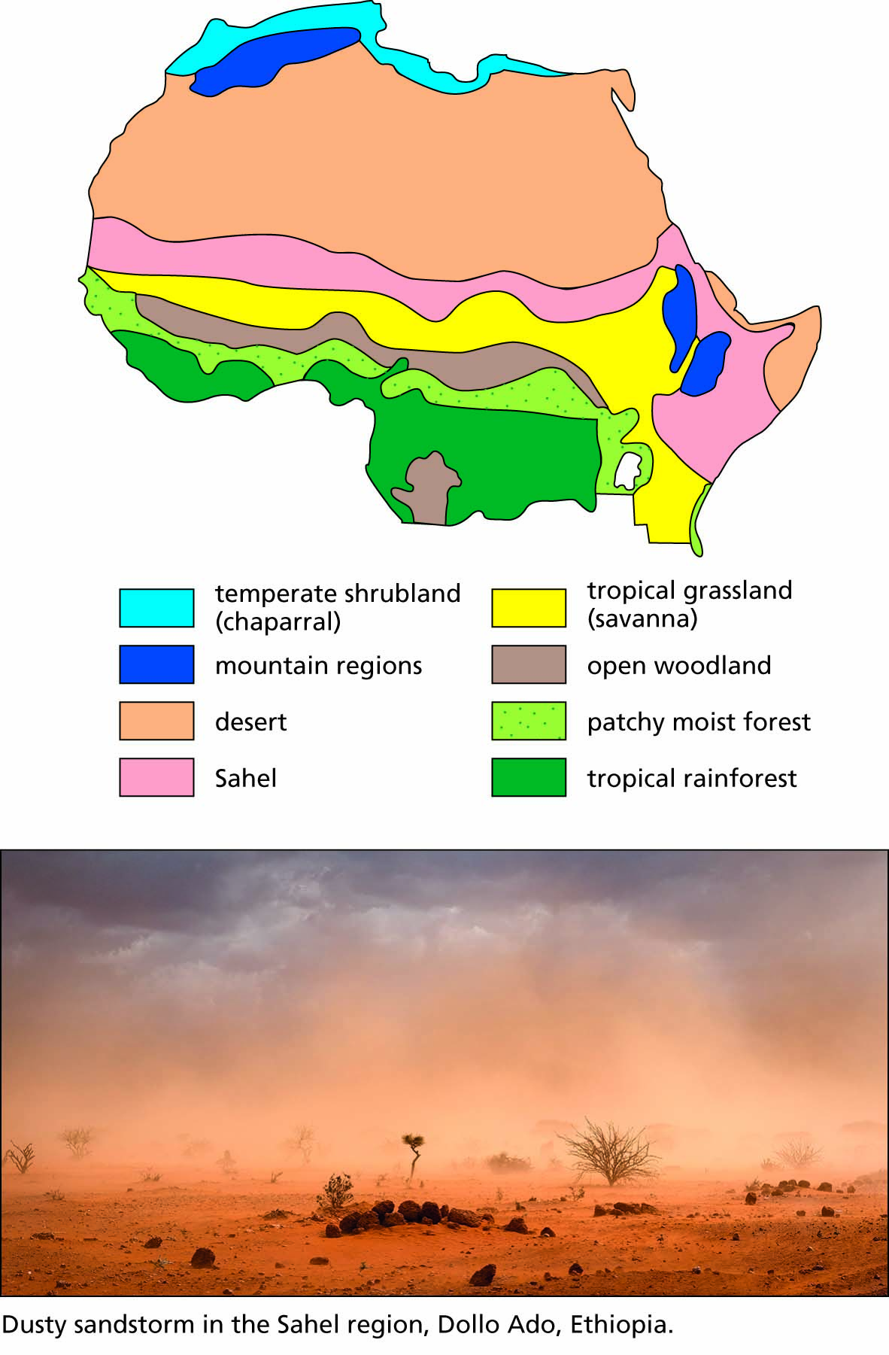
Figure 18.18 A. Vegetation zones in Africa north of the Equator. B. Dusty sandstorm in the Sahel region, Dollo Ado, Ethiopia.

