Slide 1
Chapter 15: HIV and AIDS
Biology Trending, 4e
Eli Minkoff and Jennifer Hood-DeGrenier

Slide 2
AIDS is an immune system deficiency
AIDS is caused by a virus called HIV
Discovery of the connection between HIV and AIDS
Establishing cause and effect
Viruses and HIV

Slide 3
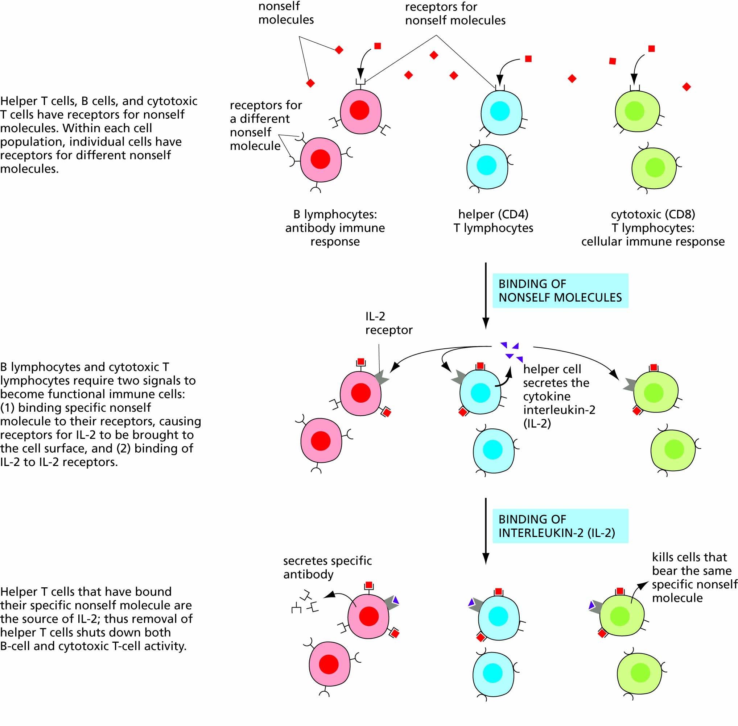
Figure 15.1 Interactions between lymphocytes and their cytokines.

Slide 4
Discovery of AIDS and HIV:
Epidemiology-- case clusters
Pneumocystis carinii pneumonia in San Francisco
Kaposi’s sarcoma in New York
Kaposi’s sarcoma in transplant patients
CD4 T-lymphocytes; Immune Deficiency (AIDS)
Hemophilia patients (filtered blood products)
Calls for more research--
Identifying the virus:
Bethesda MD (R.Gallo) vs Paris (L.Montagnier)
HIV: Human Immunodeficiency Virus

Slide 5
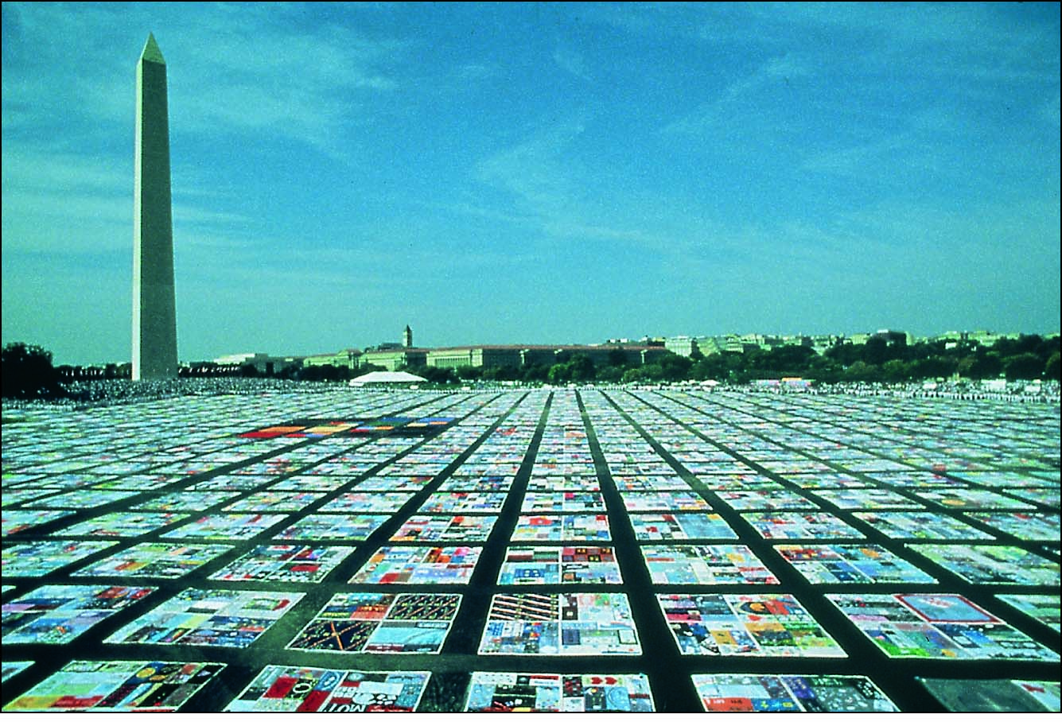
Figure 15.2 The AIDS quilt, commemorating those who have died of AIDS. In 1999 the quilt had grown to be 42,960 panels commemorating 83,279 names.

Slide 6
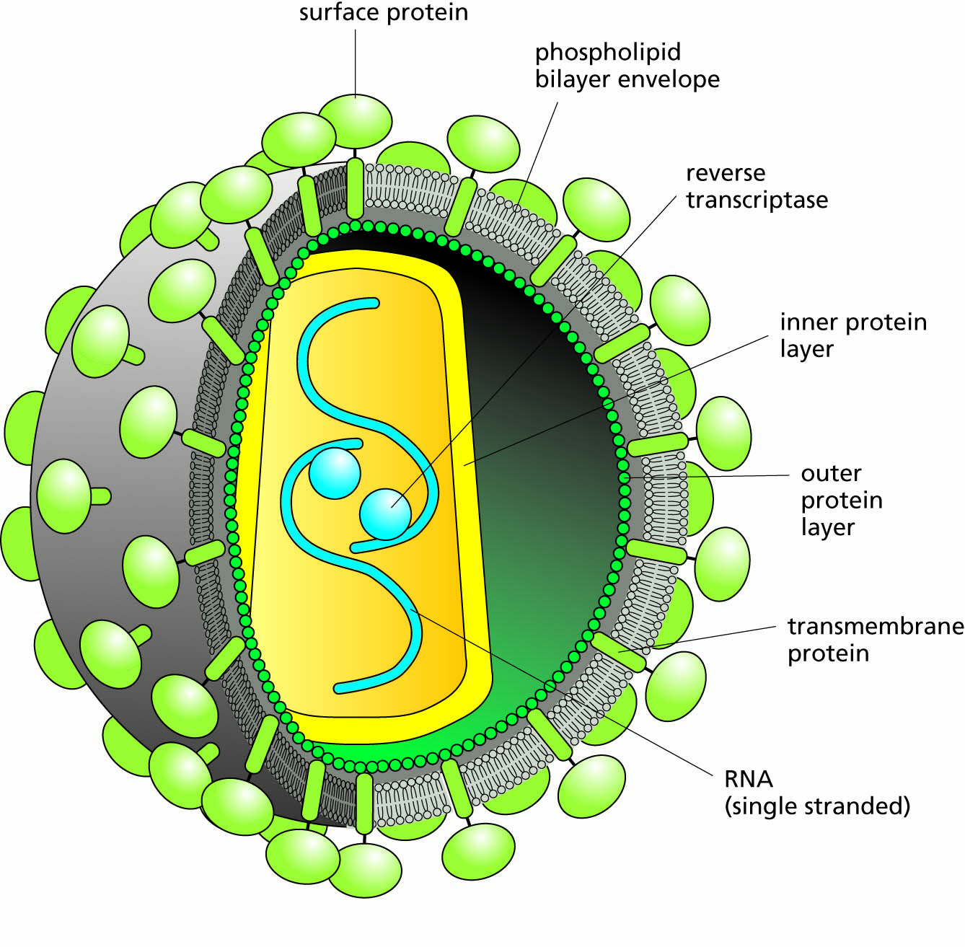
Figure 15.3 The structure of HIV.

Slide 7
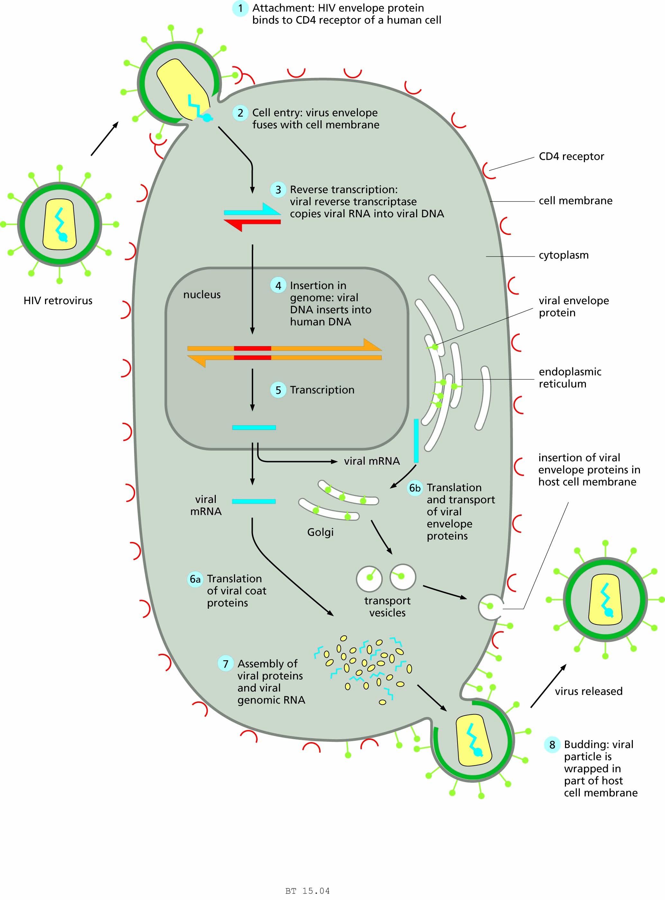
Figure 15.4 The retroviral life cycle.

Slide 8
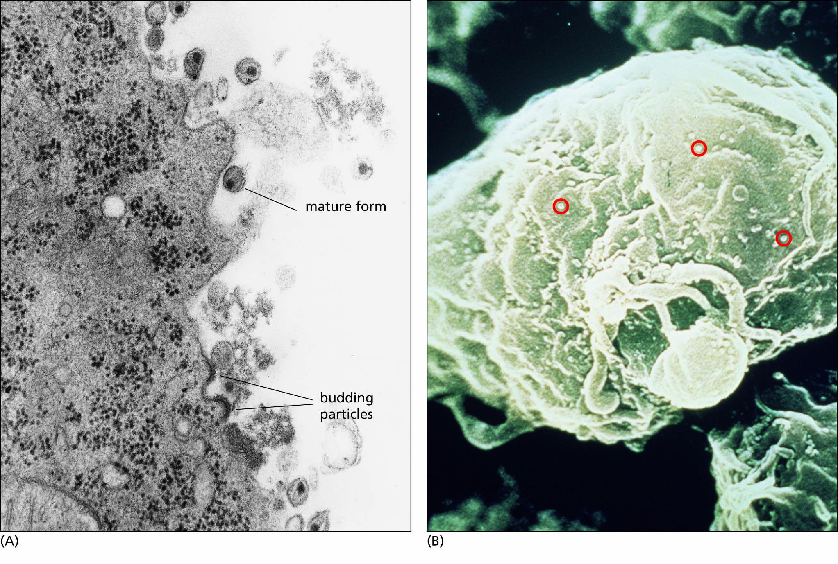
Figure 15.5 HIV budding from a helper T cell. (A) Budding and mature HIV. The mature viruses are free of the cell; the viral protein can be seen inside the viral envelope (a piece of the cell membrane that the viruses have taken with them as they budded out). (B) Many HIV particles bud from the same cell.

Slide 9
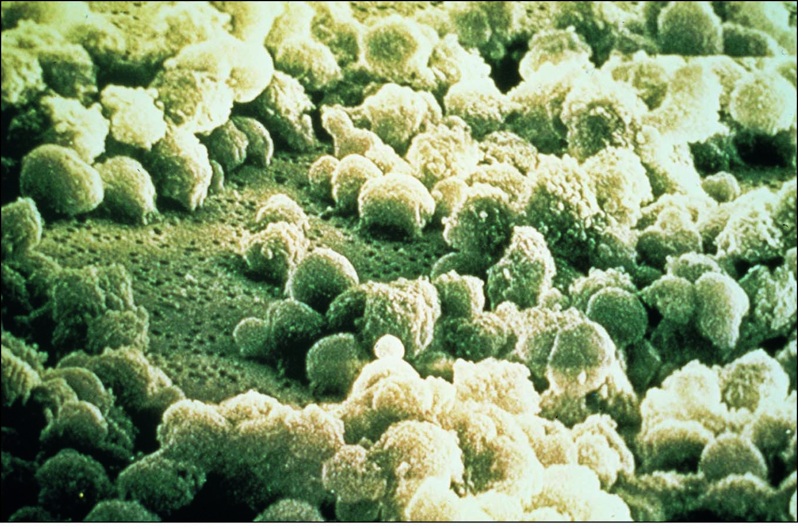
Figure 15.6 Many HIV particles emerging from a helper T cell. The dark circles are holes in the cell membrane left when the viruses bud out. These holes eventually kill the cell.

Slide 10
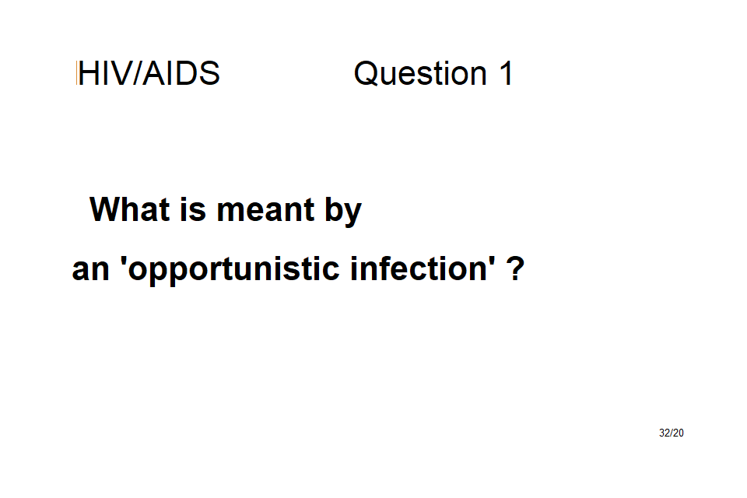

Slide 11
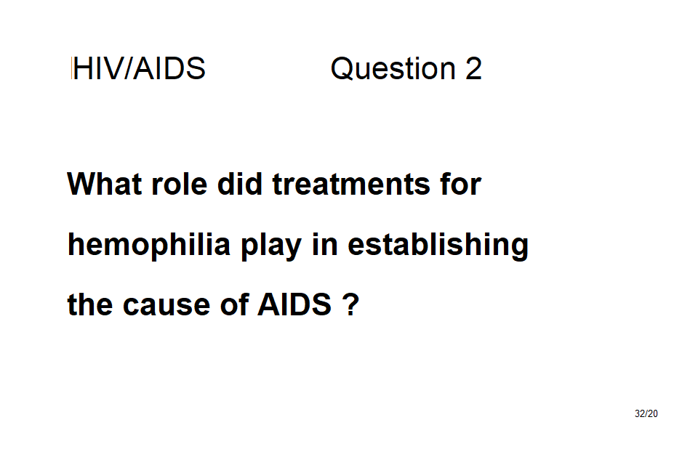

Slide 12
HIV infection progresses in certain patterns, often leading to AIDS
Events in infected helper T cells
Progression from HIV infection to AIDS
Tests for HIV infection
A vaccine against AIDS?
Drug therapy for people with AIDS

Slide 13
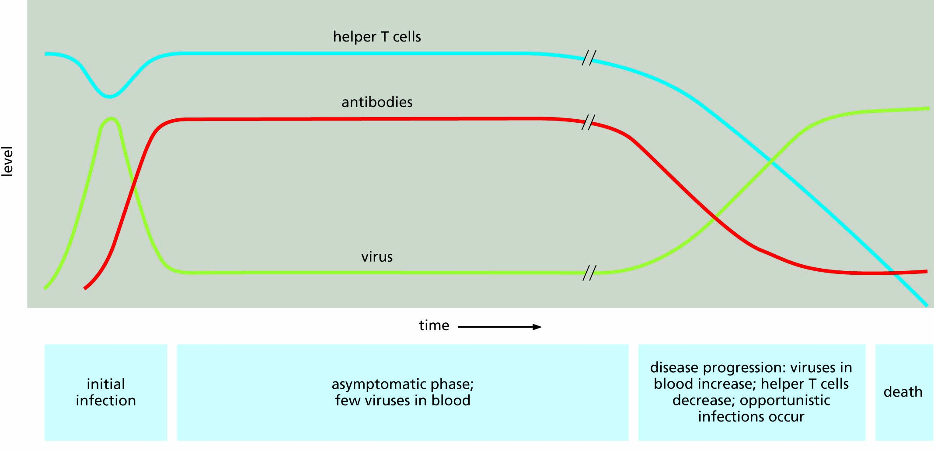
Figure 15.7 The course of HIV infection.

Slide 14
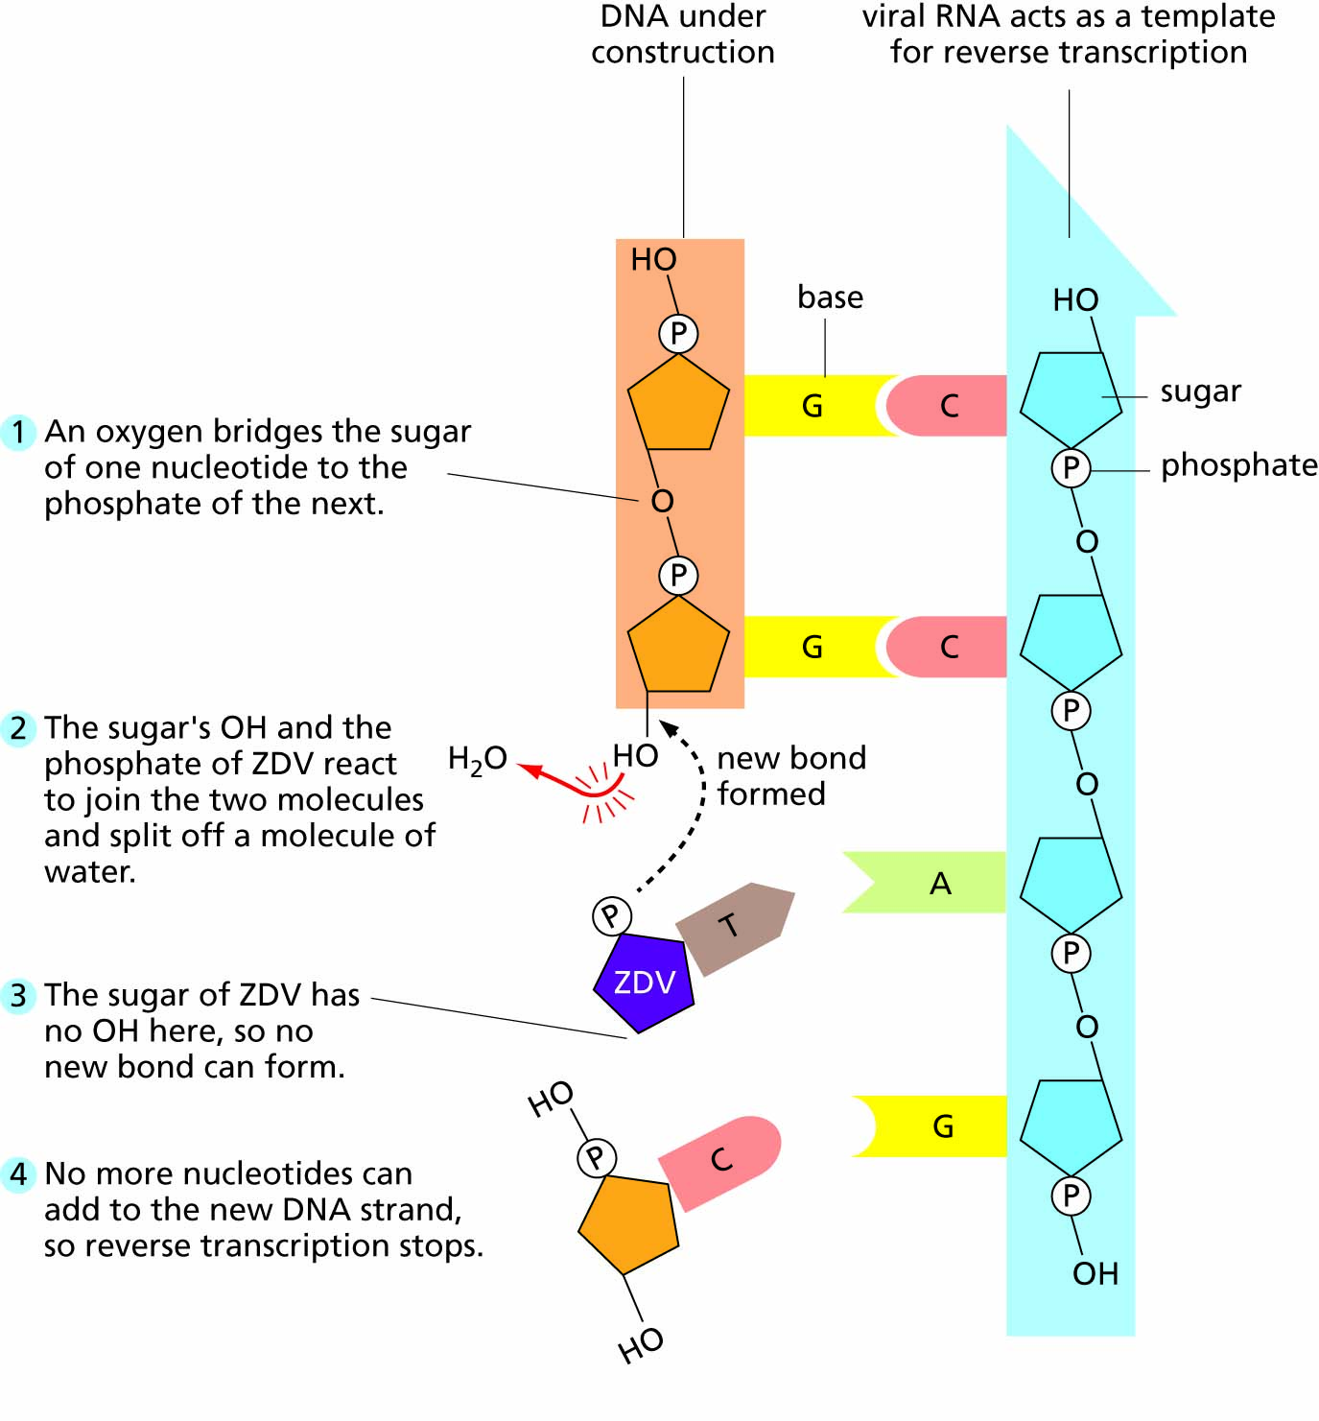
Figure 15.8 How the drug zidovudine (ZDV) interrupts the replication of the HIV virus.

Slide 15
Knowledge of HIV transmission can help you avoid infection
Risk factors: behaviours that may lead to infection
Communicability
Susceptibility versus high risk
Public health and public policy
Worldwide patterns of infection

Slide 16
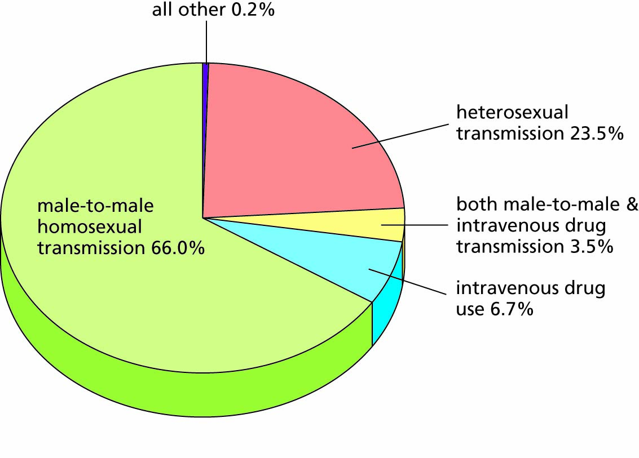
Figure 15.9 Routes of HIV transmission in the United States, based on statistics for the year 2018 from the Centers for Disease Control and Prevention (https://www.cdc.gov/hiv/risk/estimates/riskbehaviors.html).
The percentages indicate the proportion of cases transmitted by each route.

Slide 17
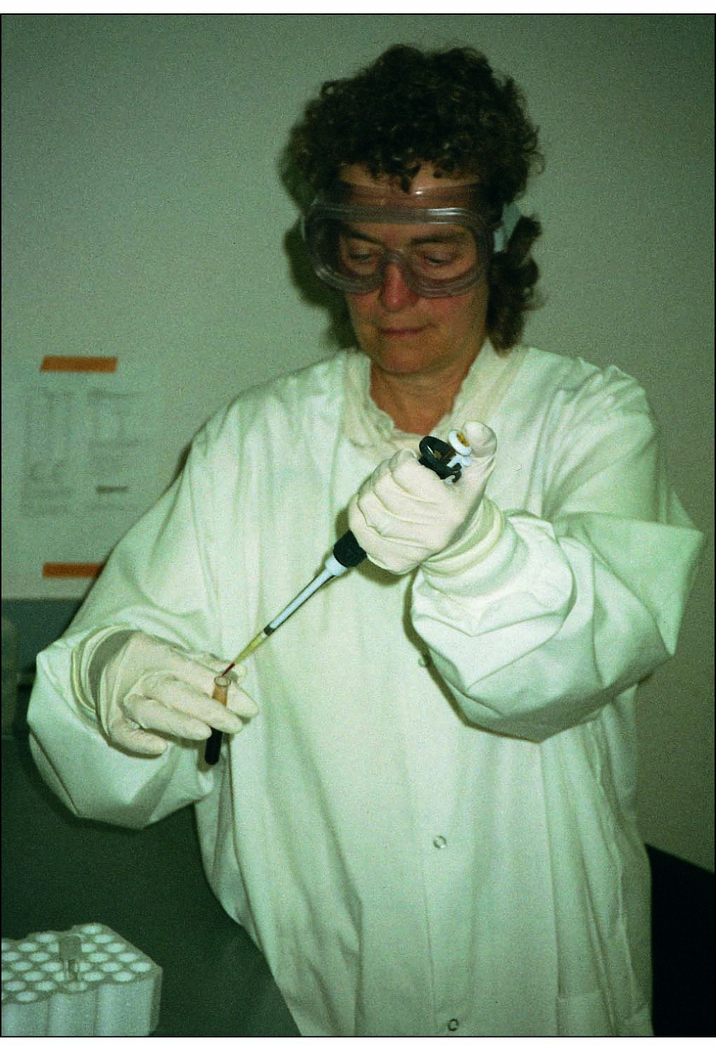
Figure 15.10 Health care workers, researchers, and others who handle human blood must follow the Universal Precautions for Blood-Borne Pathogens.

Slide 18
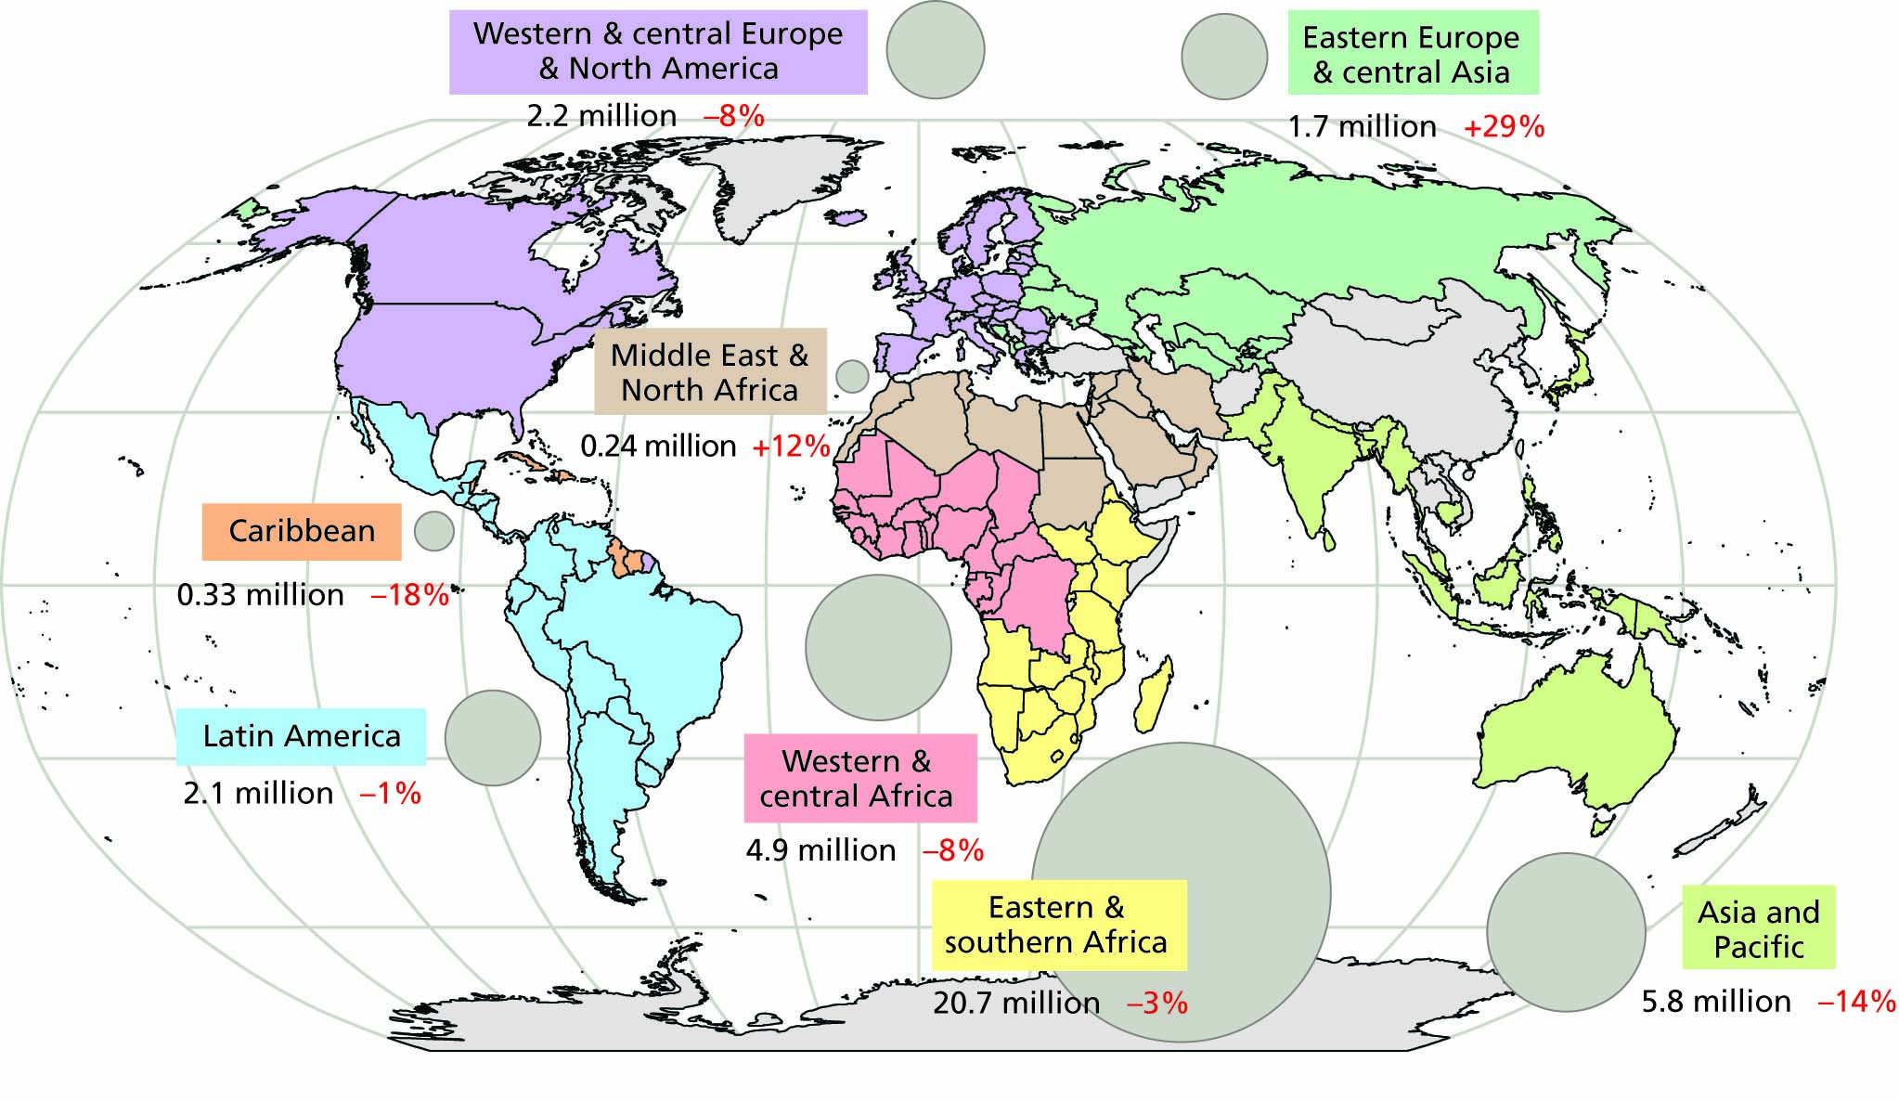
Figure 15.11 HIV/AIDS in the different regions of the world recognized by UNAIDS. Circles and numbers in black show prevalence, the number of people living with HIV/AIDS in 2019. Numbers in red show the trend (or change) in incidence (number of new cases per year) from 2000-2017.

