Slide 1
Chapter 14: Mind, Body and Immunity
Biology Trending, 4e
Eli Minkoff and Jennifer Hood-DeGrenier

Slide 2
The mind and the body interact
The immune system maintains health
Cells of the immune system and the lymphatic circulation
Innate immunity
Specific immunity
Immunological memory
Passive immunity
Harmful immune responses and immunosuppression

Slide 3
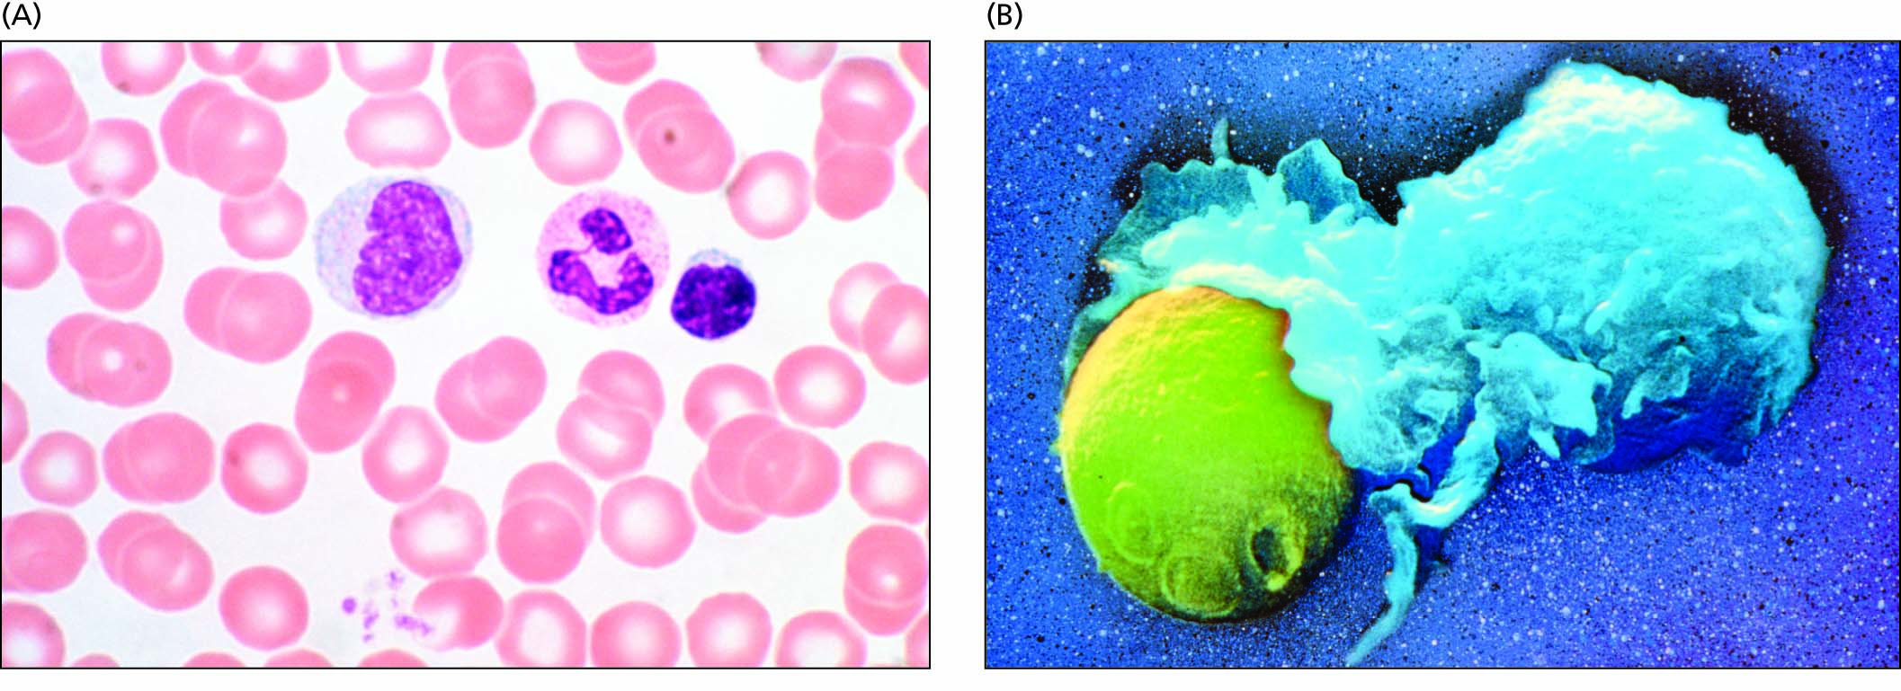
Figure 14.1 White blood cells that provide innate and specific immunity.
A. Three types of white blood cells (left to right: monocyte, neutrophil, lymphocyte), surrounded by smaller red blood cells (erythrocytes). Monocytes and neutrophils are phagocytic, functioning in innate immunity. Lymphocytes, which function in specific immunity, are of two types that cannot be distinguished by appearance alone: the B-lymphocytes secrete antibodies, while T-lymphotcytes kill virally infected cells and cancer cells.
B. Phagocytic leukocyte engulfing a yeast cell.

Slide 4
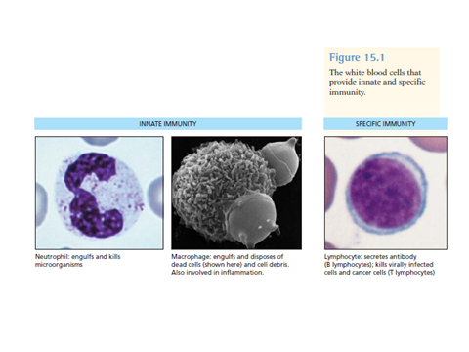

Slide 5
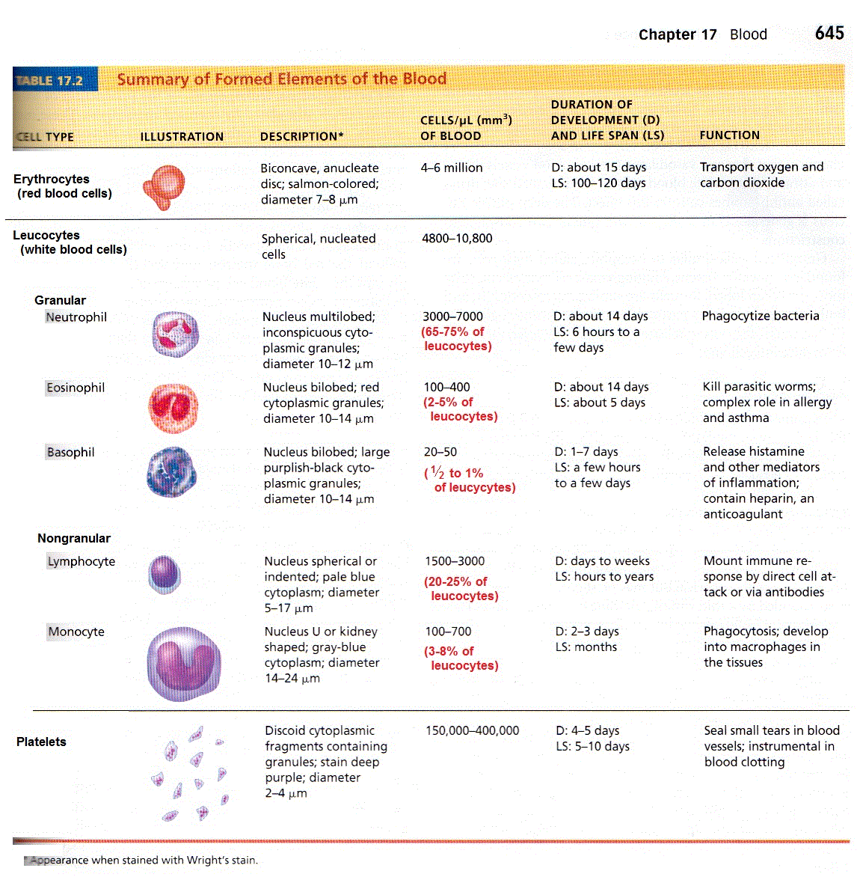

Slide 6
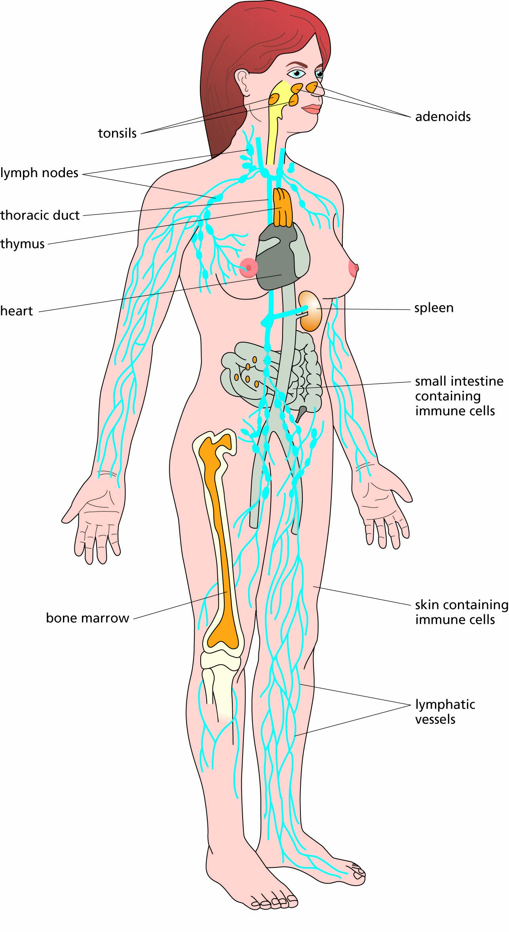
Figure 14.2 Macroscopically visible parts of the immune system. The parts of the lymphatic circulation are in blue, and the major lymphatic tissues (thymus, bone marrow, tonsils, etc.) are colored orange.

Slide 7
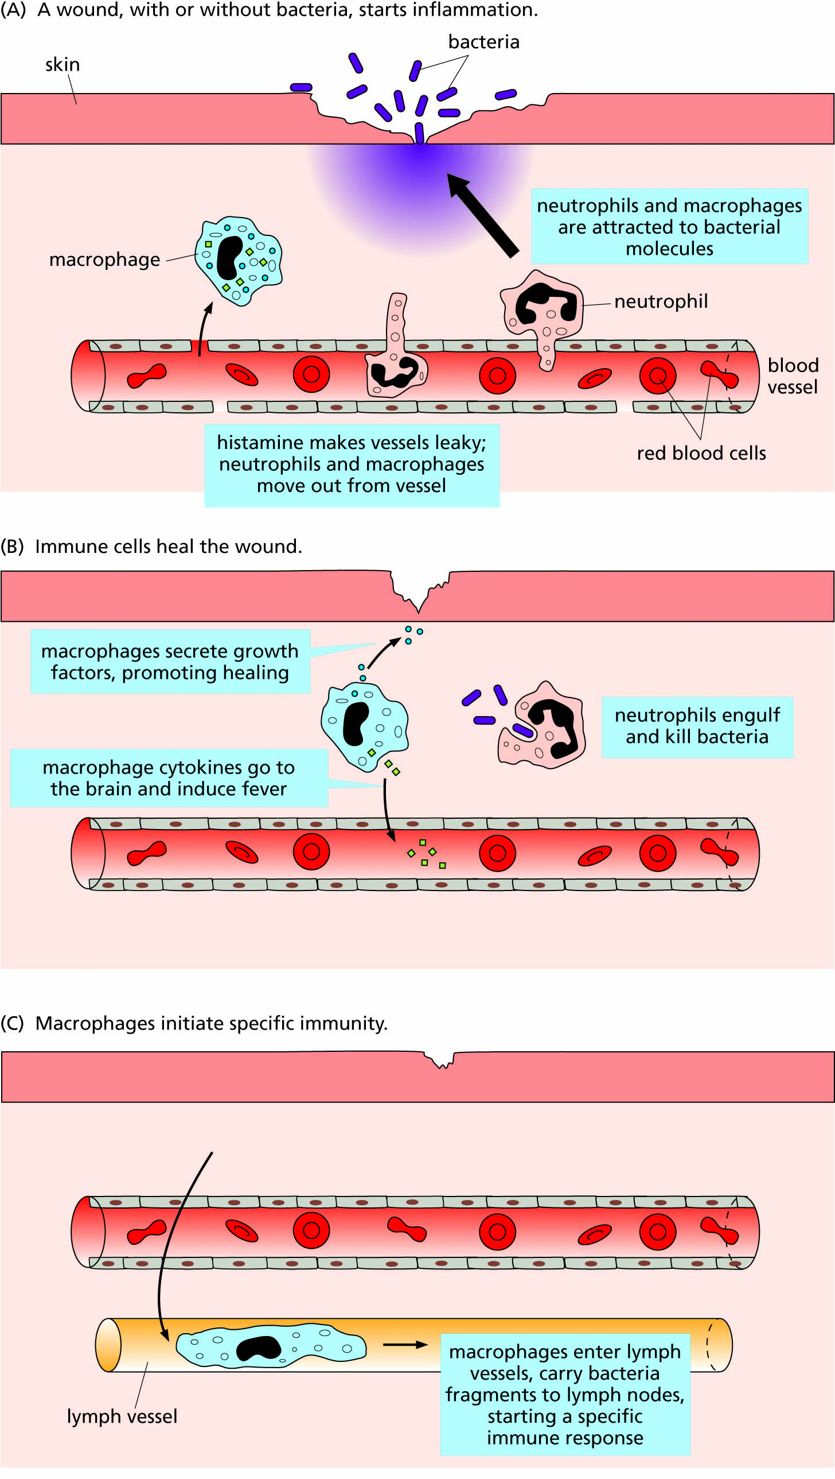
Figure 14.3 The stages of inflammation.

Slide 8
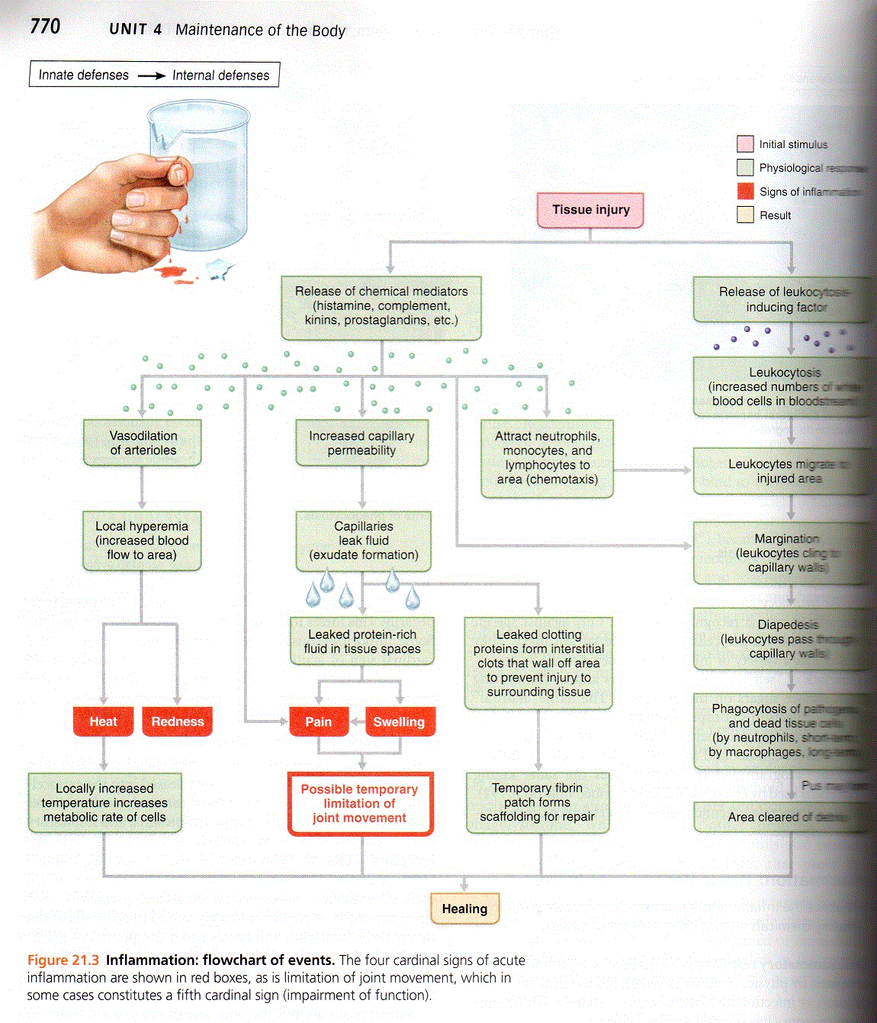

Slide 9
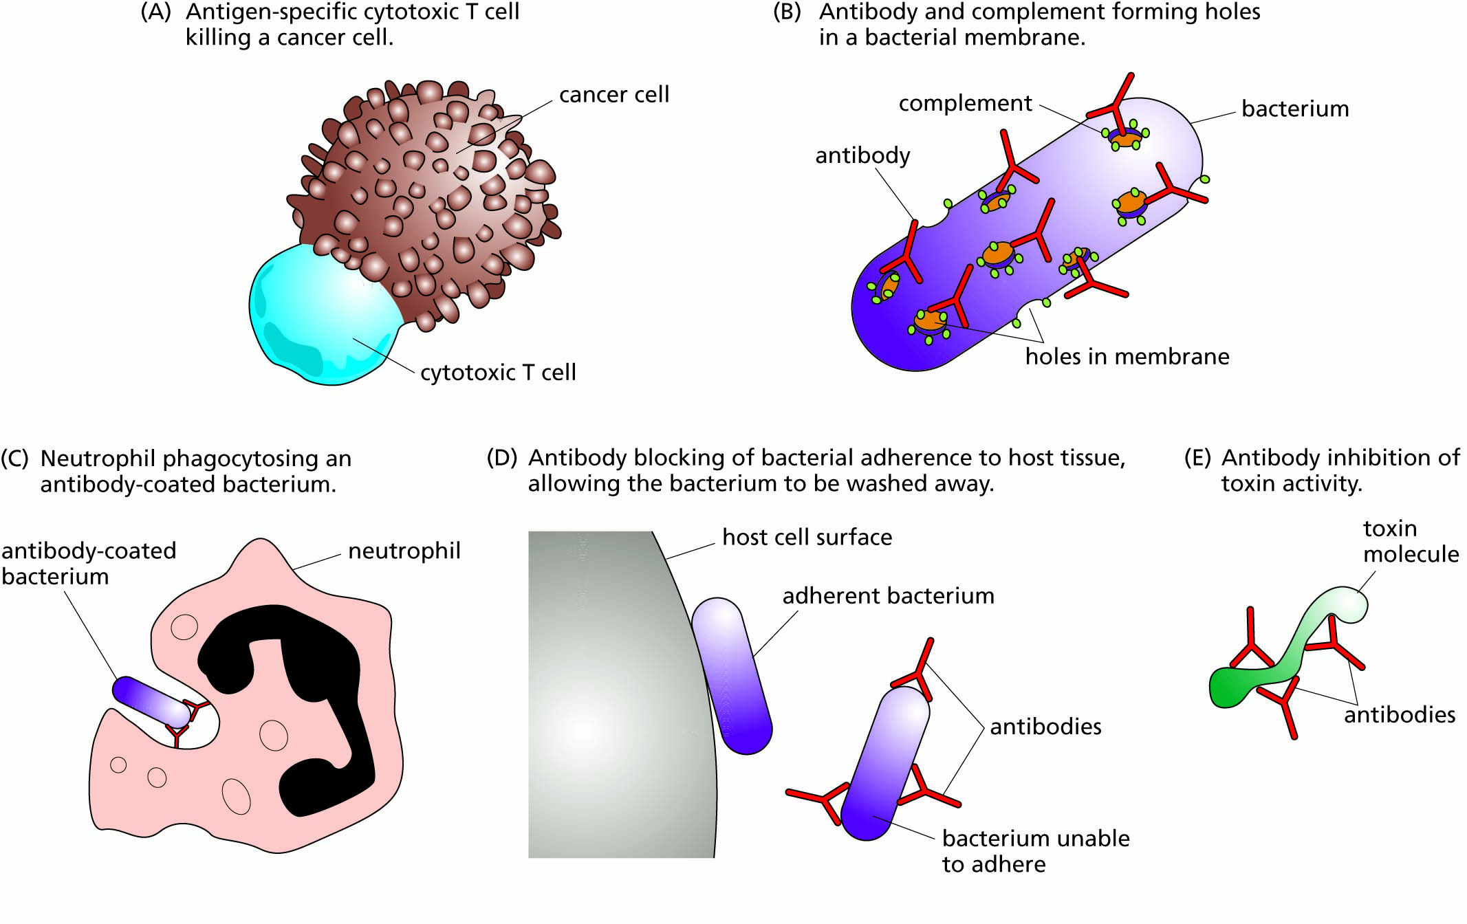
Figure 14.4. Ways in which the immune system can eliminate non-self antigens.

Slide 10
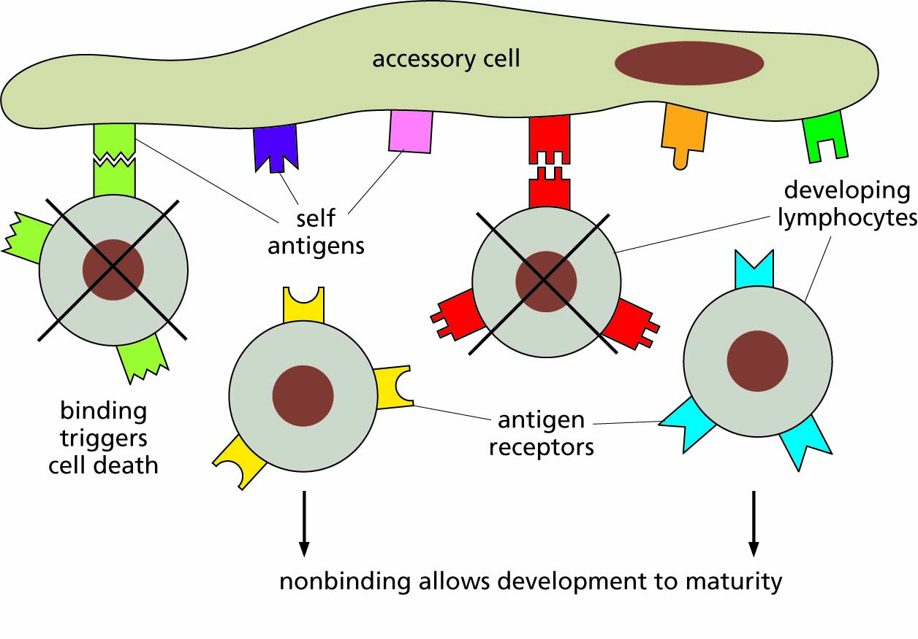
Figure 14.5. Immune selection. Developing B and T lymphocytes, each with a unique antigen receptor on its cell membrane, encounter characteristic 'self' antigens on accessory cells. Any developing lymphocyte whose antigen receptor binds to a self antigen on an accessory cell dies. Lymphocytes whose receptors do not bind develop to maturity and are available to bind to any foreign antigens that match their antigen receptors at a later time.

Slide 11
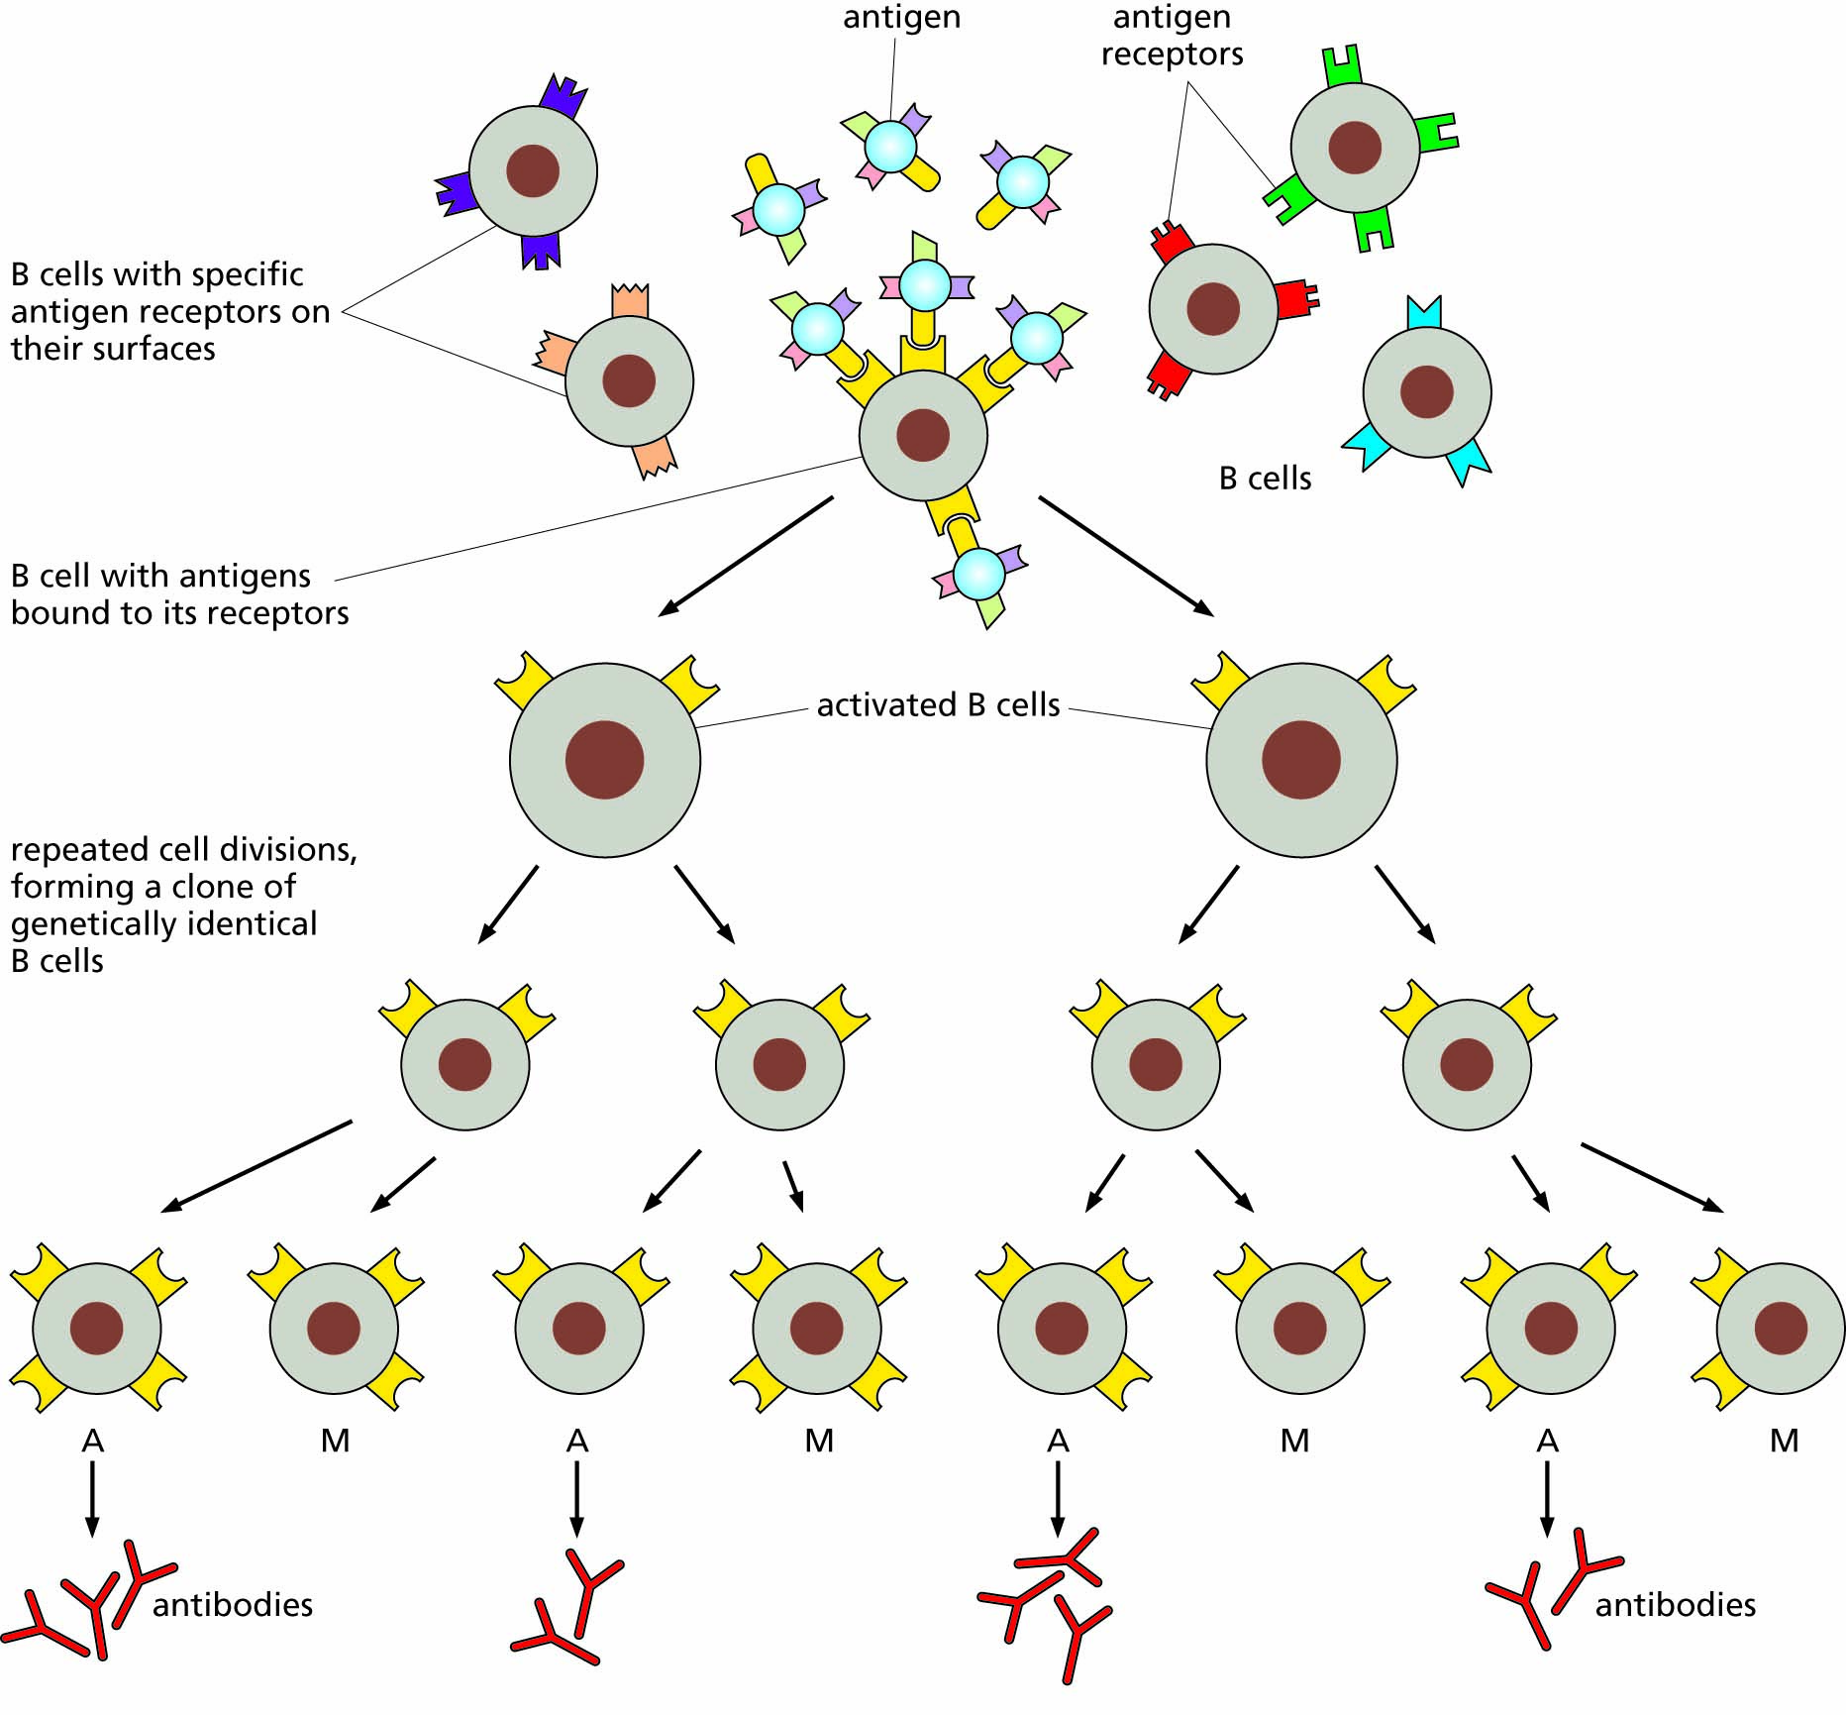
Figure 14.6. B cell activation. When a B cell binds to an antigen, it becomes activated and starts to divide repeatedly, forming a clone of genetically identical B cells. Some of these cells become antibody-secreting cells (A), while others become memory cells (M). Both types of B cell have receptors that bind to the same antigen that was originally encountered, and this is the basis of antigen-specific immunity.

Slide 12
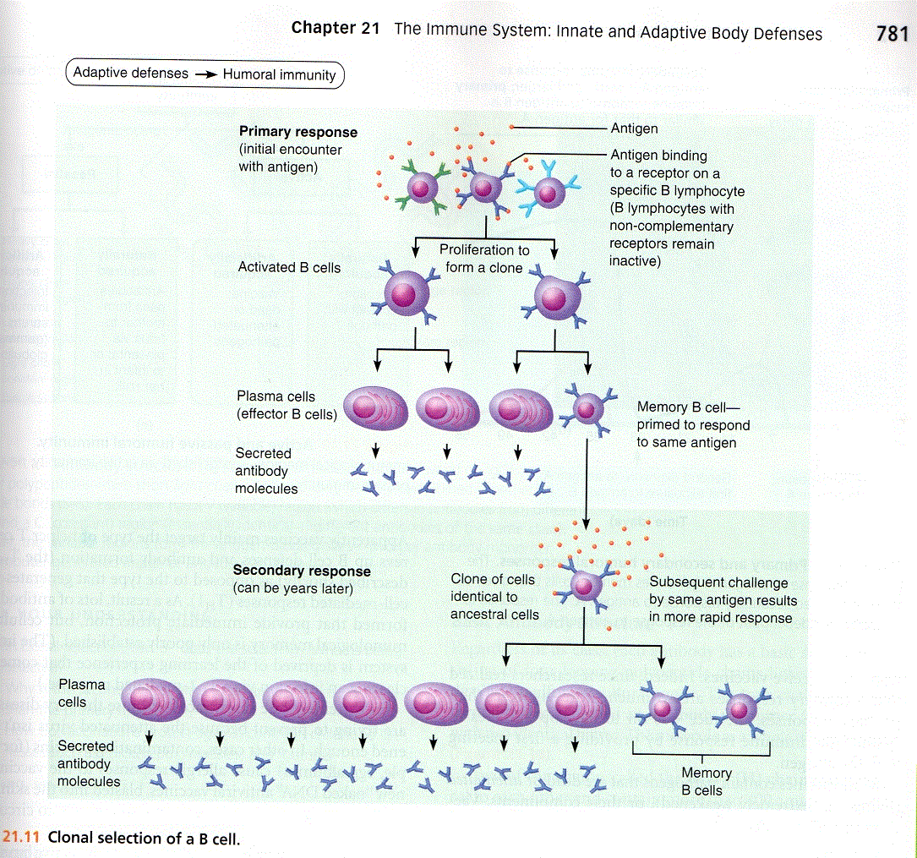

Slide 13
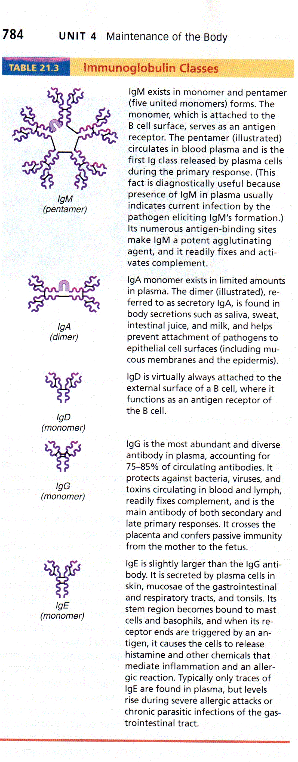

Slide 14
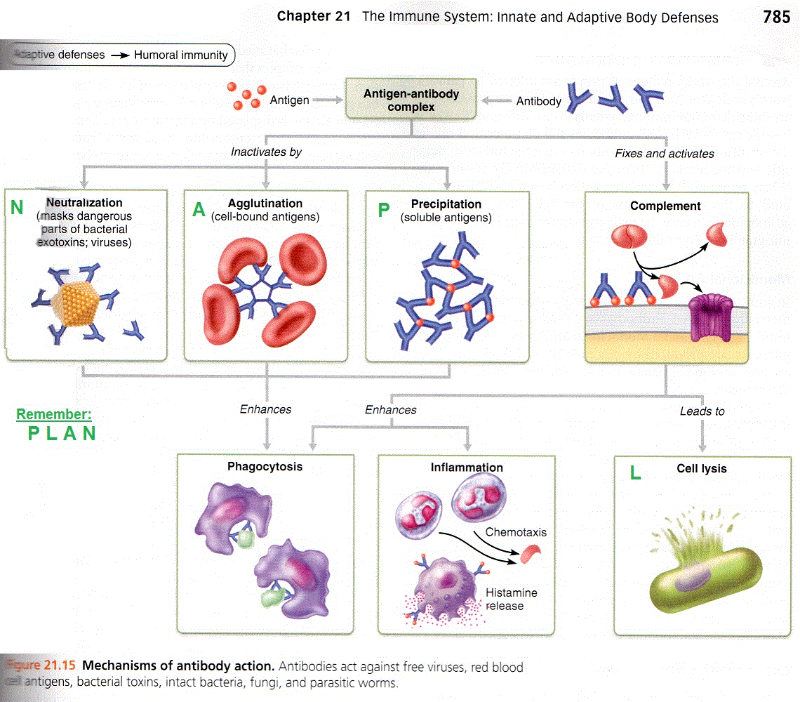

Slide 15
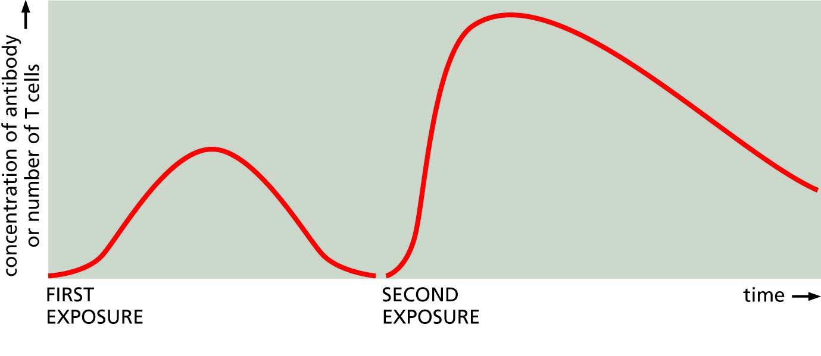
Figure 14.7 The activity of the immune system changes in response to a second exposure to an infectious microorganism.

Slide 16
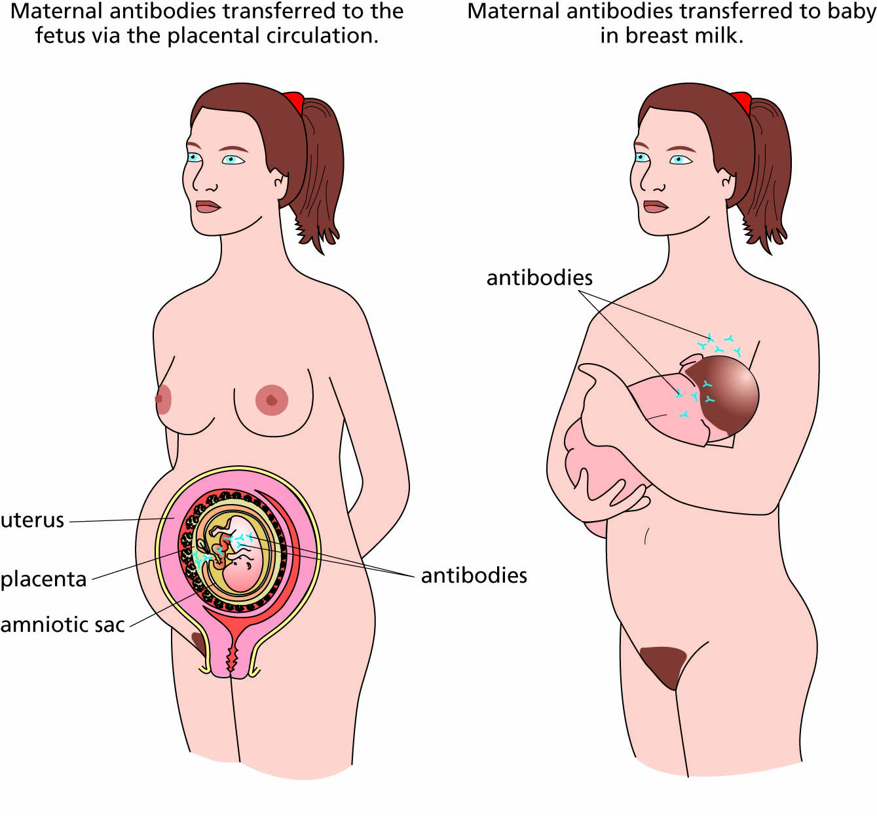
Figure 14.8. Passive immunity transferred from mother to child.

Slide 17
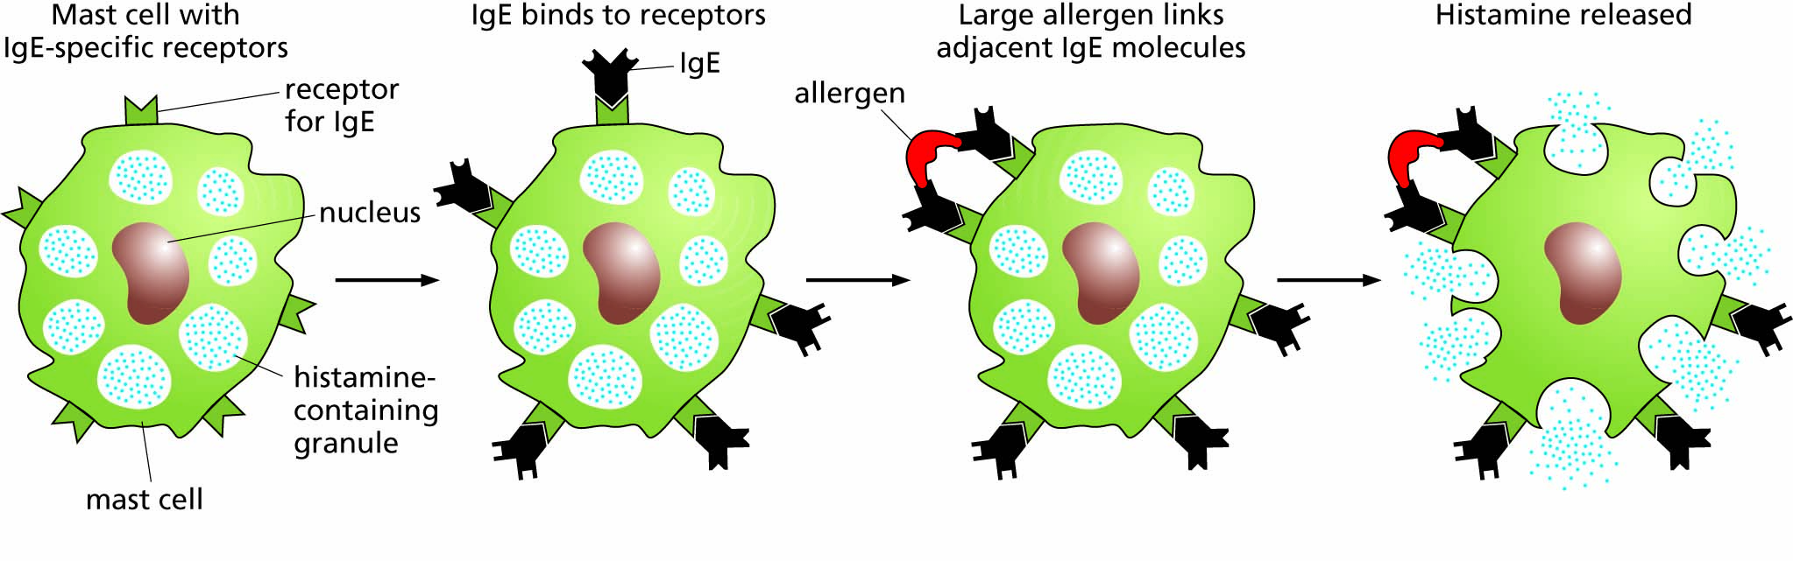
Figure 14.9 Allergic release of histamine.

Slide 18
The neuroendocrine system consists of neurons and endocrine glands
The autonomic nervous system
The stress and relaxation responses

Slide 19
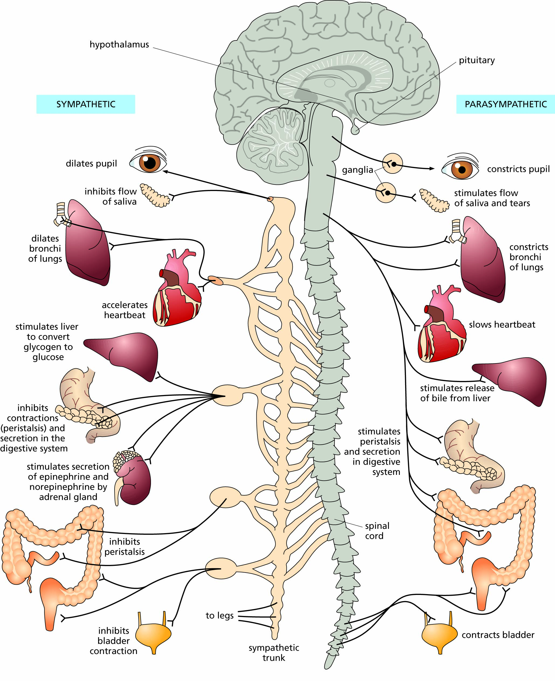
Figure 14.10 Functions of the sympathetic and parasympathetic nervous systems.

Slide 20
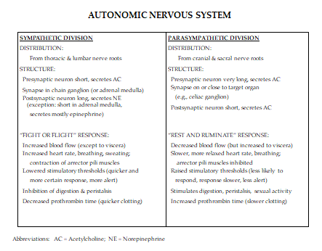

Slide 21
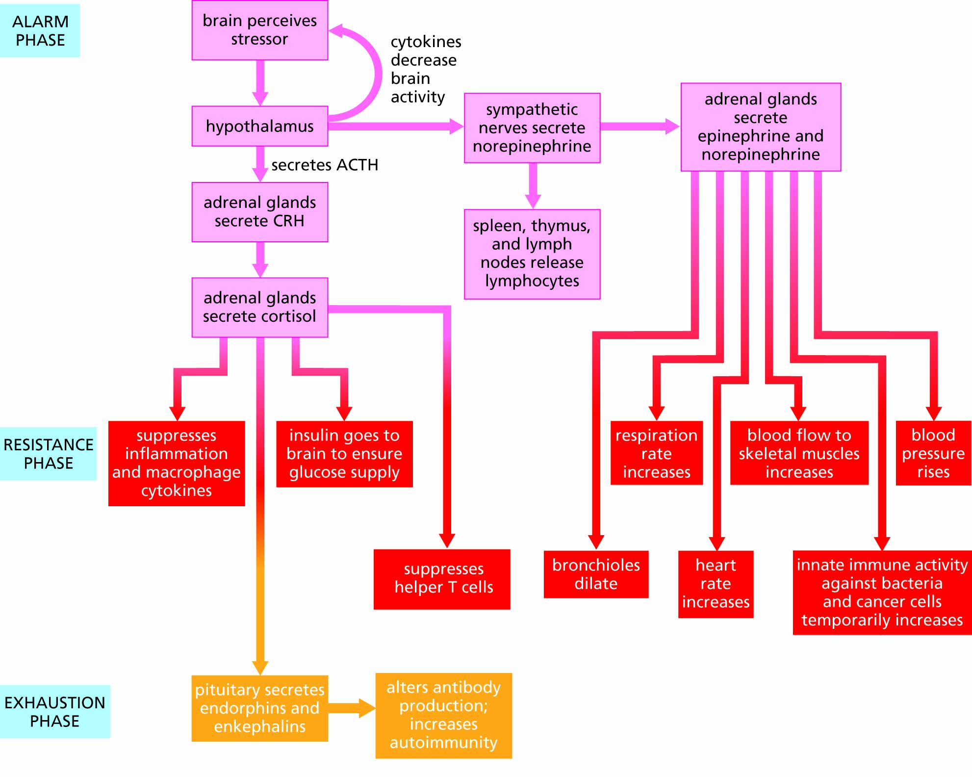
Figure 14.11 The phases of the stress response. Stressors induce a variety of physiological changes, including immunological changes, which are mediated by the sympathetic nervous system and adrenal hormones. CRH is corticotrophin releasing hormone.

Slide 22
The neuroendocrine system interacts with the immune system
Evidence for one interconnecting network
The placebo effect
Effects of stress on health
Conditioned learning in the immune system
Voluntary control of the immune system

Slide 23
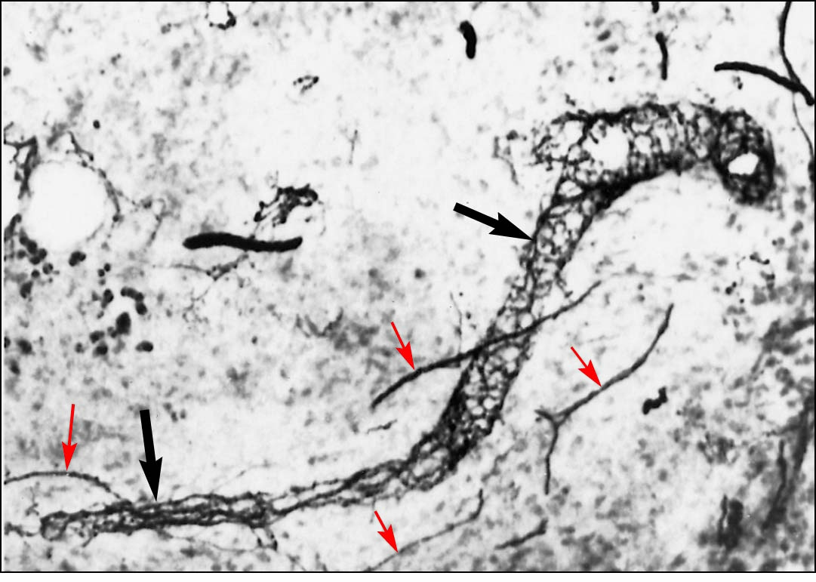
Figure 14.12 Immunohistochemical staining showing the presence of the neurotransmitter norepinephrine in the rat spleen. Large black arrows: blood vessels. Small red arrows: nerve fibers synthesizing norepinephrine.

Slide 24
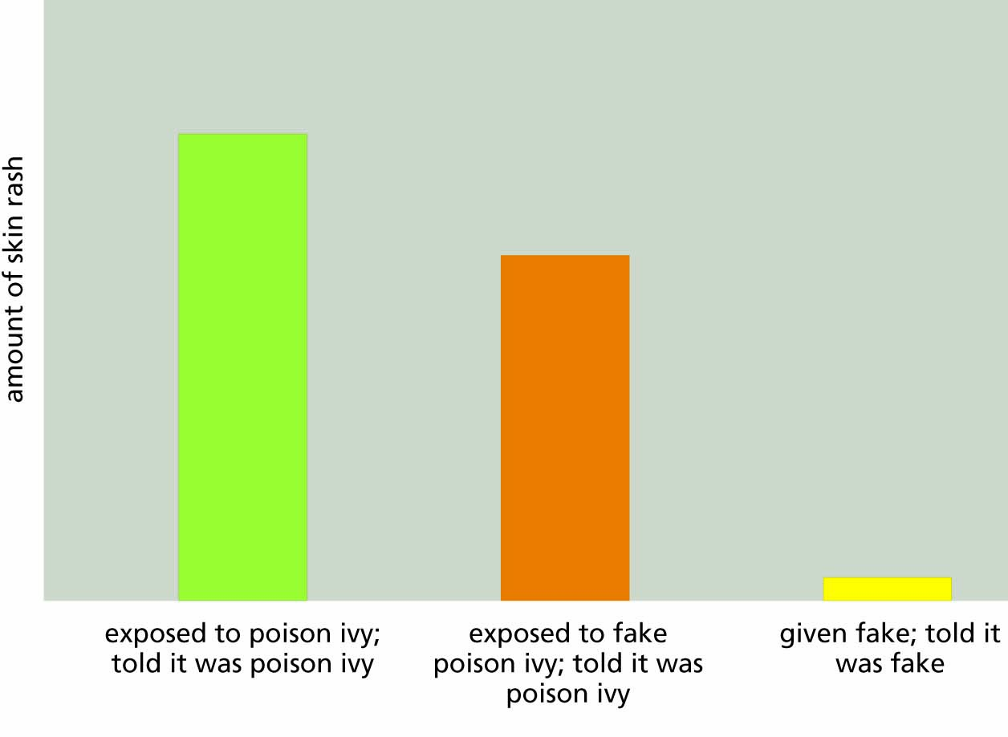
Figure 14.13 The placebo effect.

Slide 25
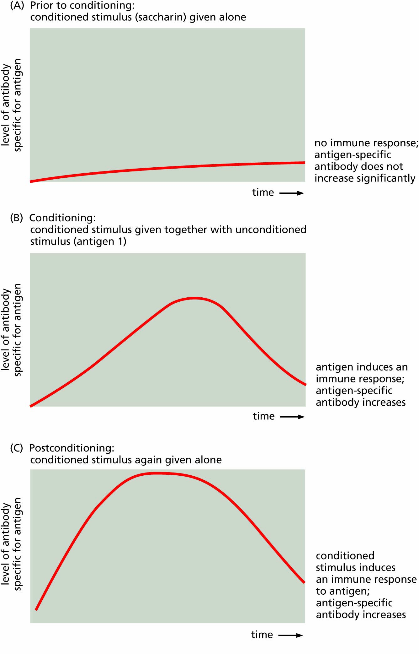
Figure 14.14 Classical conditioning of the immune response.

Slide 26
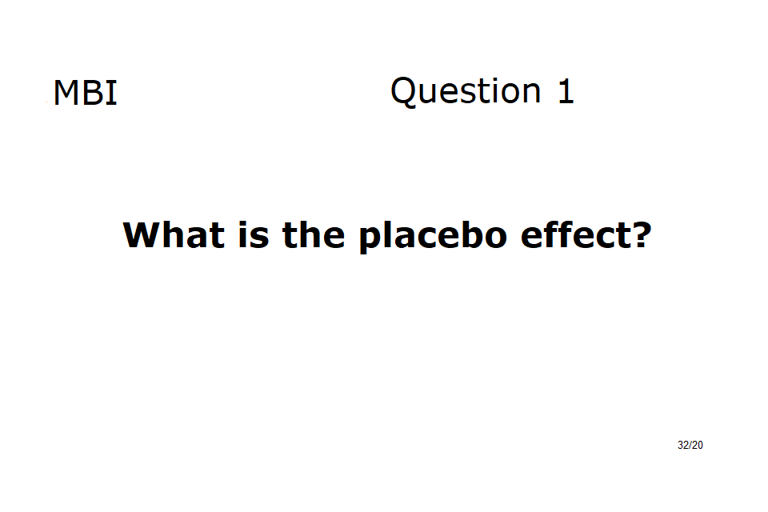

Slide 27
Voluntary control of the . immune system .
EXAMPLE:
Breast cancer survival rates

Slide 28
