Slide 1
Chapter 13: Drugs and Addiction
Biology Trending, 4e
Eli Minkoff and Jennifer Hood-DeGrenier

Slide 2
Drugs are chemicals that alter biological processes
Drugs and their activity; acute vs chronic effects
Routes of drug entry into the body
Distribution of drugs throughout the body
Elimination of drugs from the body
Drug receptors and drug action on cells
Side effects and drug interactions
Drug safety

Slide 3
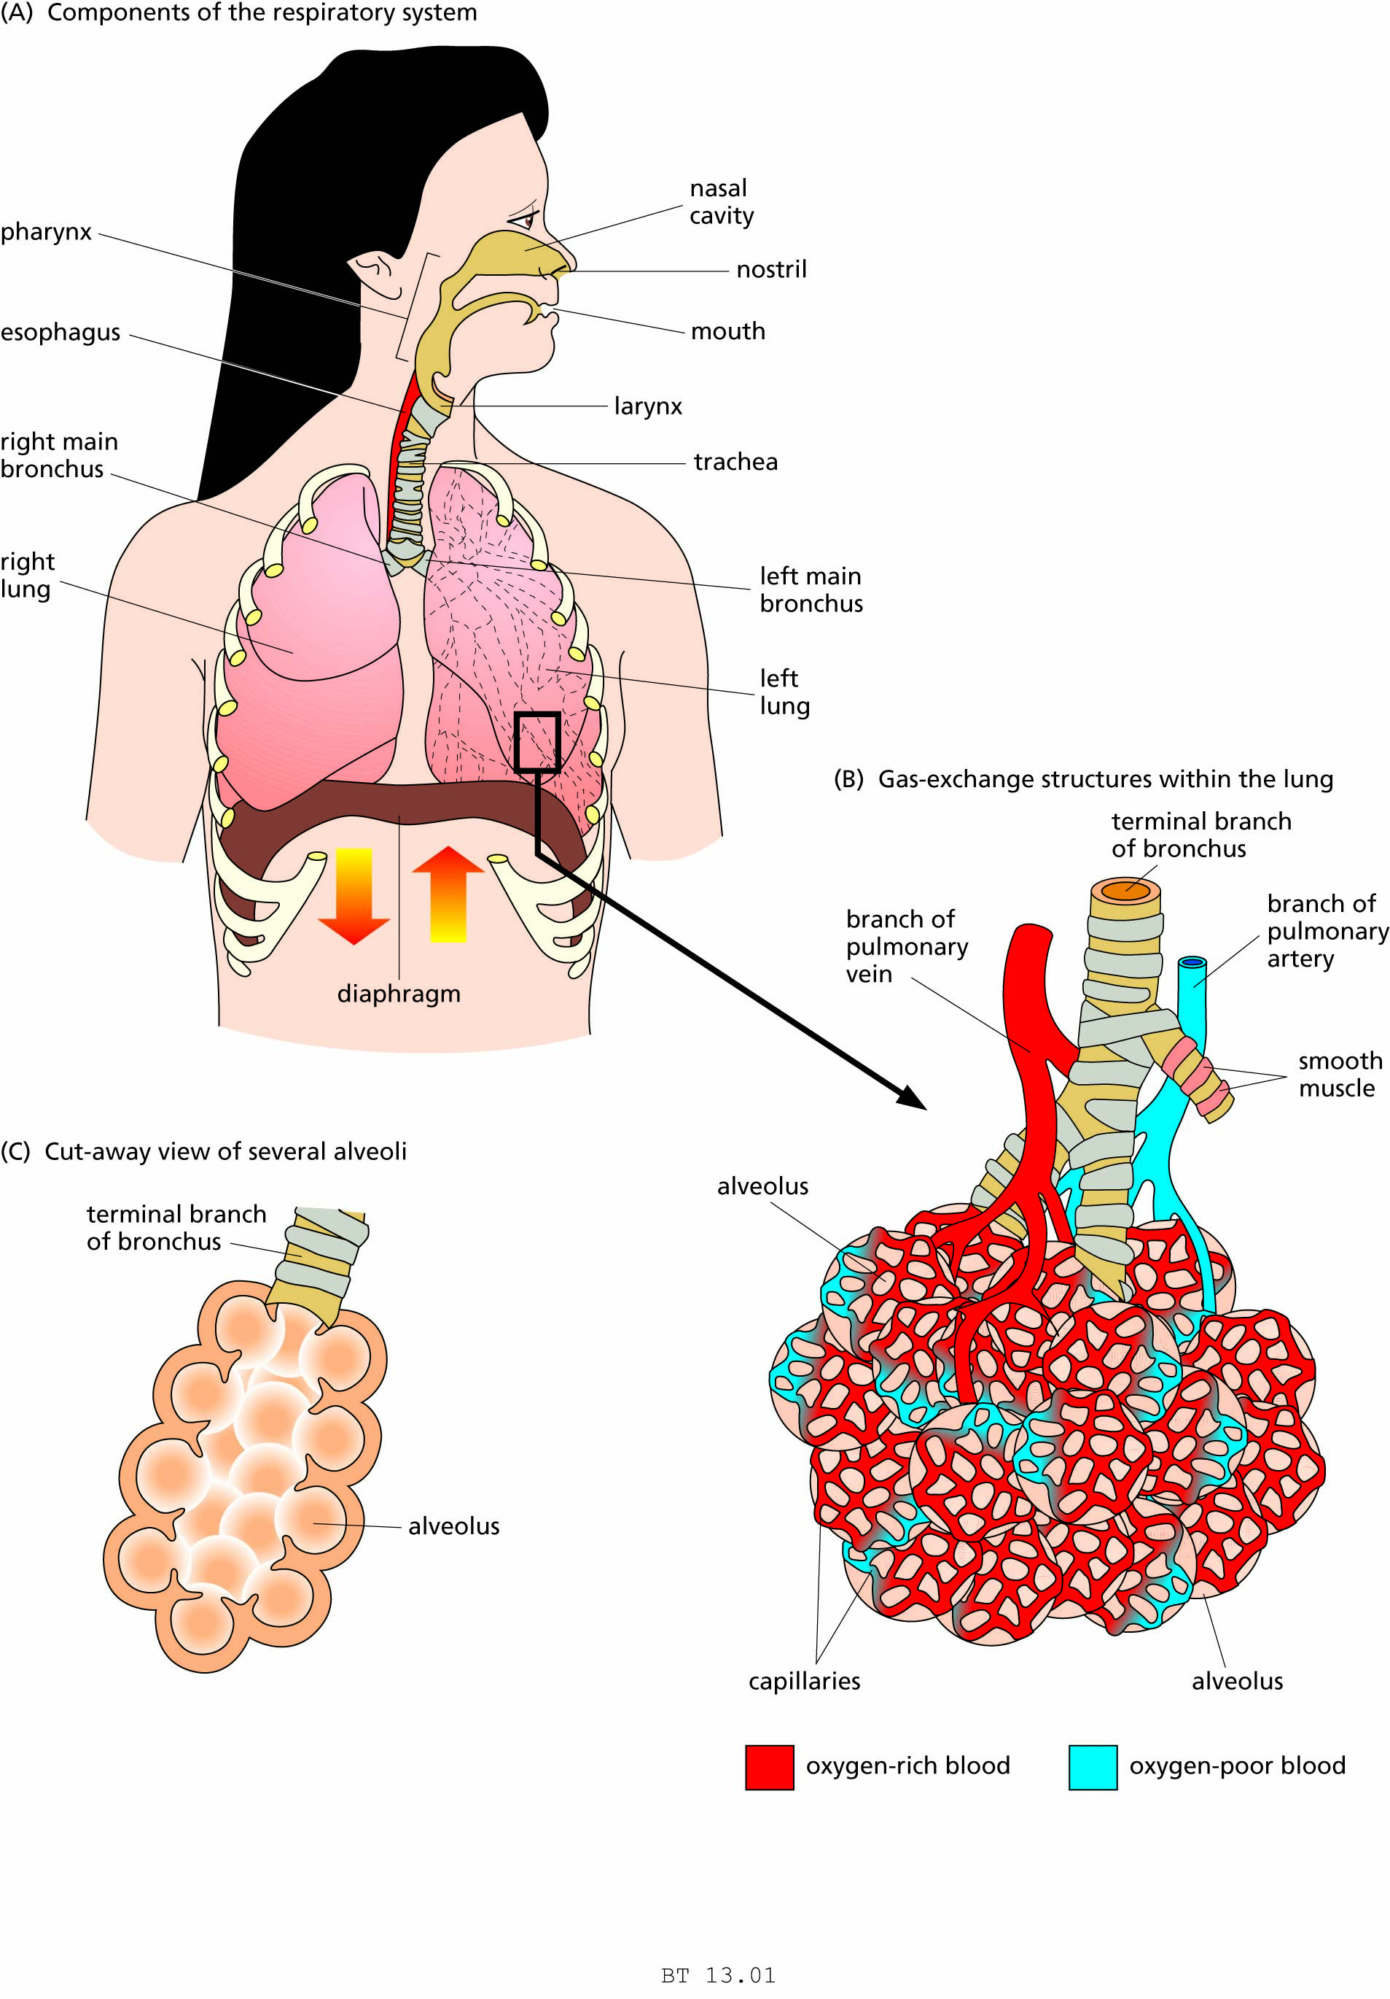
Figure 13.1 The human respiratory system.

Slide 4
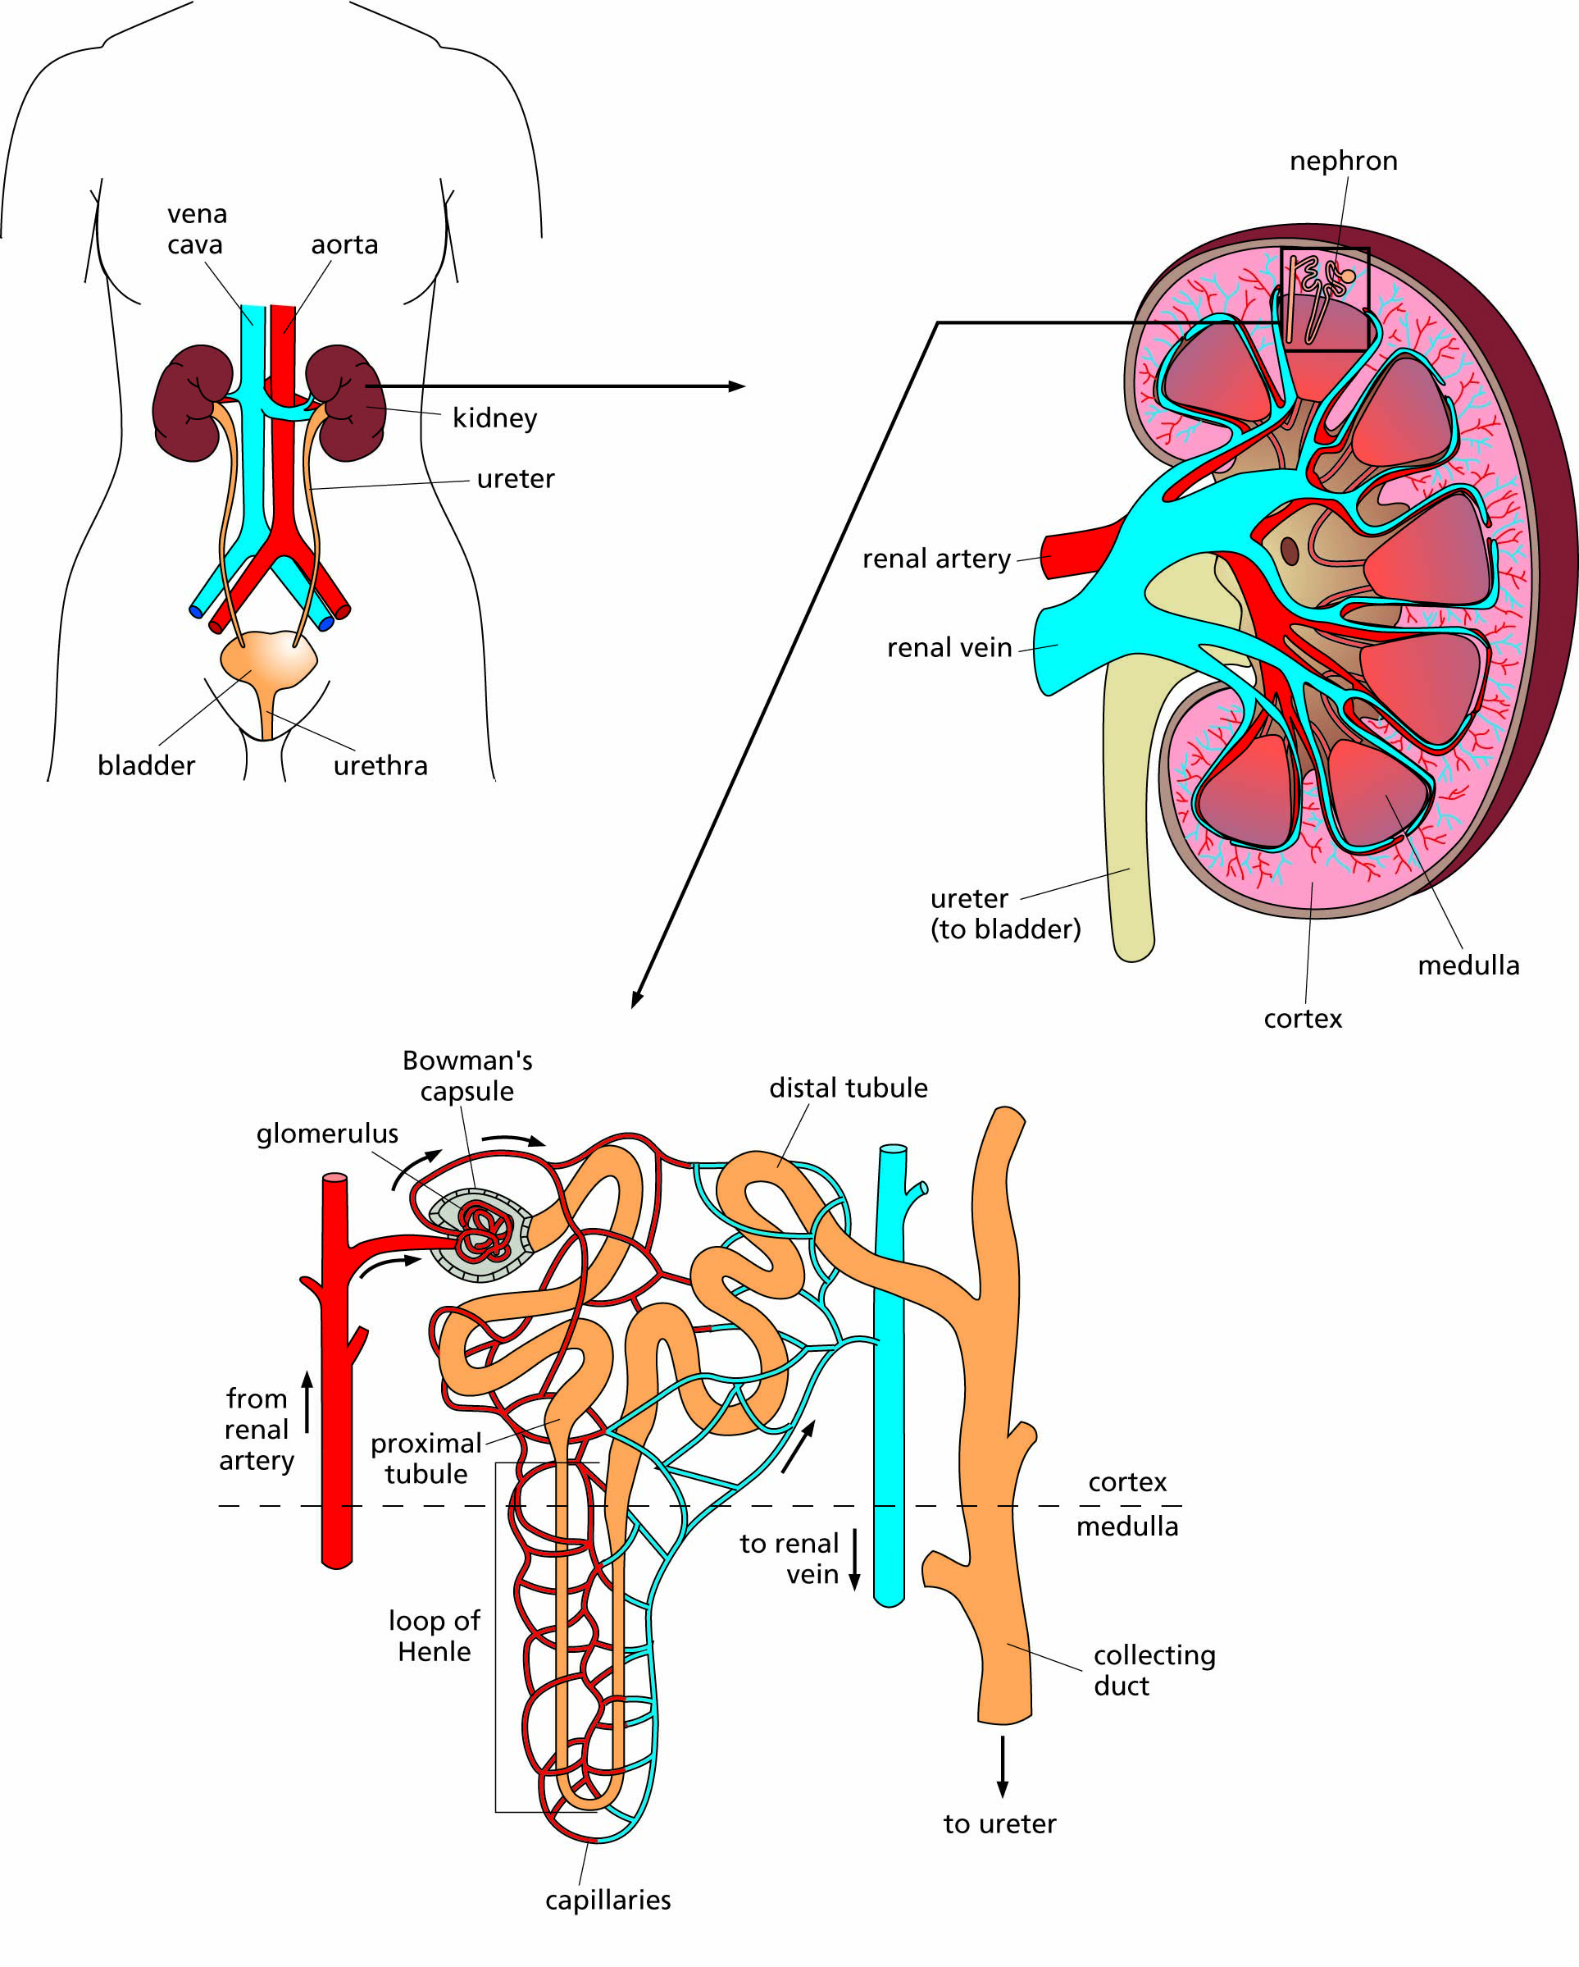
Figure 13.2 The major organs of the human excretory system, responsible for the production of urine.

Slide 5
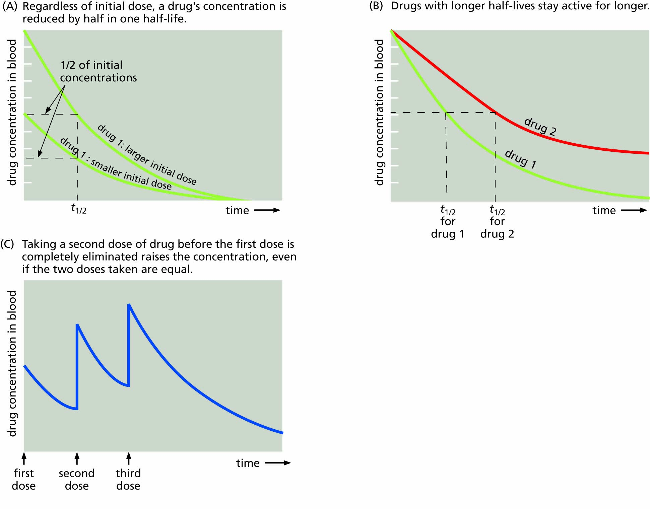
Figure 13.3 Half-lives of various drugs. The half-life of a drug (t_{1/2}) is the time required for its active concentration to be reduced by half.

Slide 6
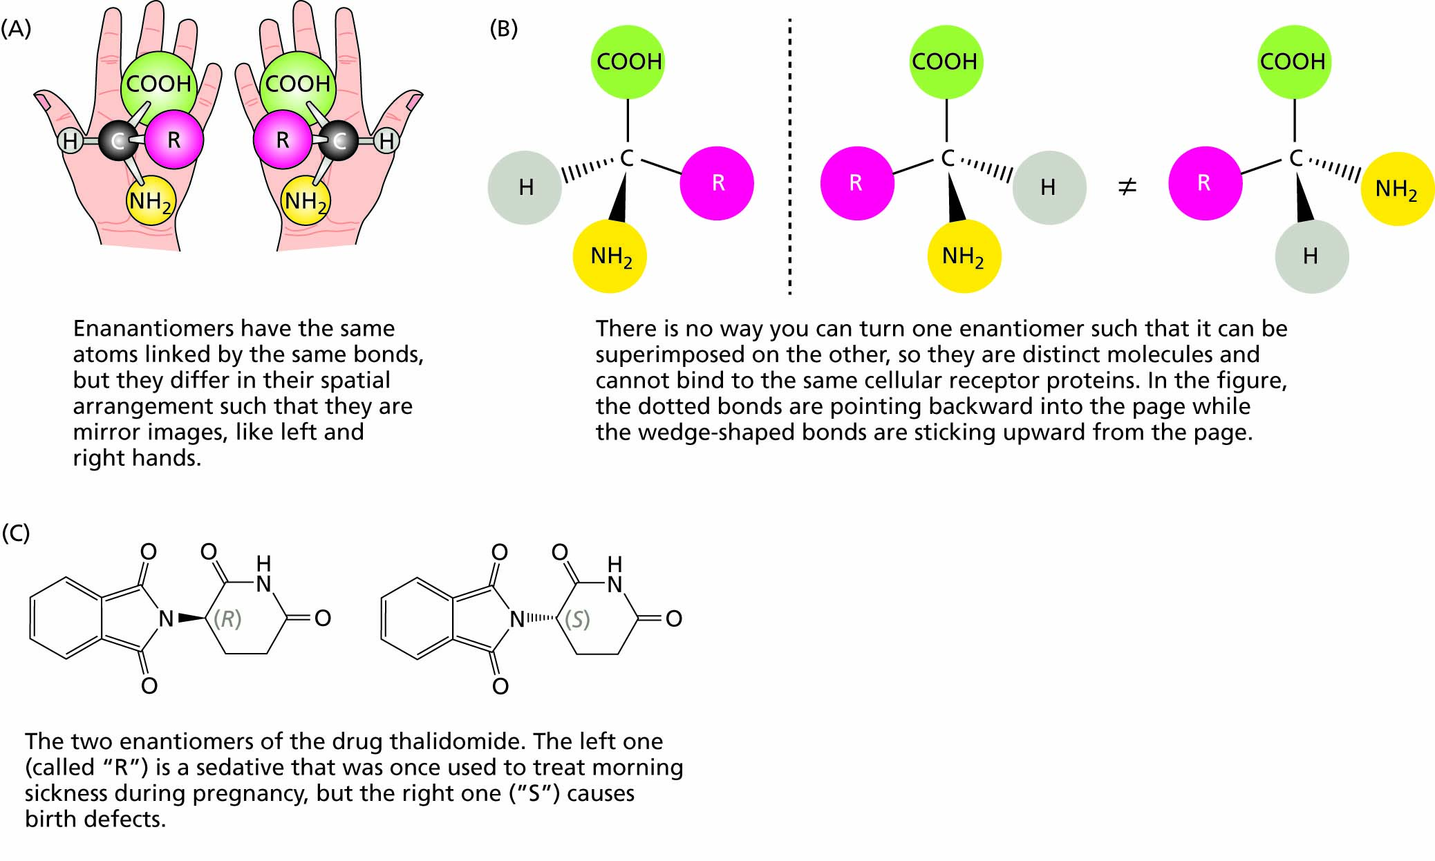
Figure 13.4 Enantiomers are mirror-image molecules that often have very different biological effects. [A, Enantiomers have the same atoms and the same bonds linking those atoms, but the parts of the molecules are arranged differently in space so that they are mirror images of each other. B, mirror-image molecules are not superimposable. C, One enantiomer of thalidomide (the “R” version) acts as a sedative, whereas the other version (“S”) causes birth defects.]

Slide 7
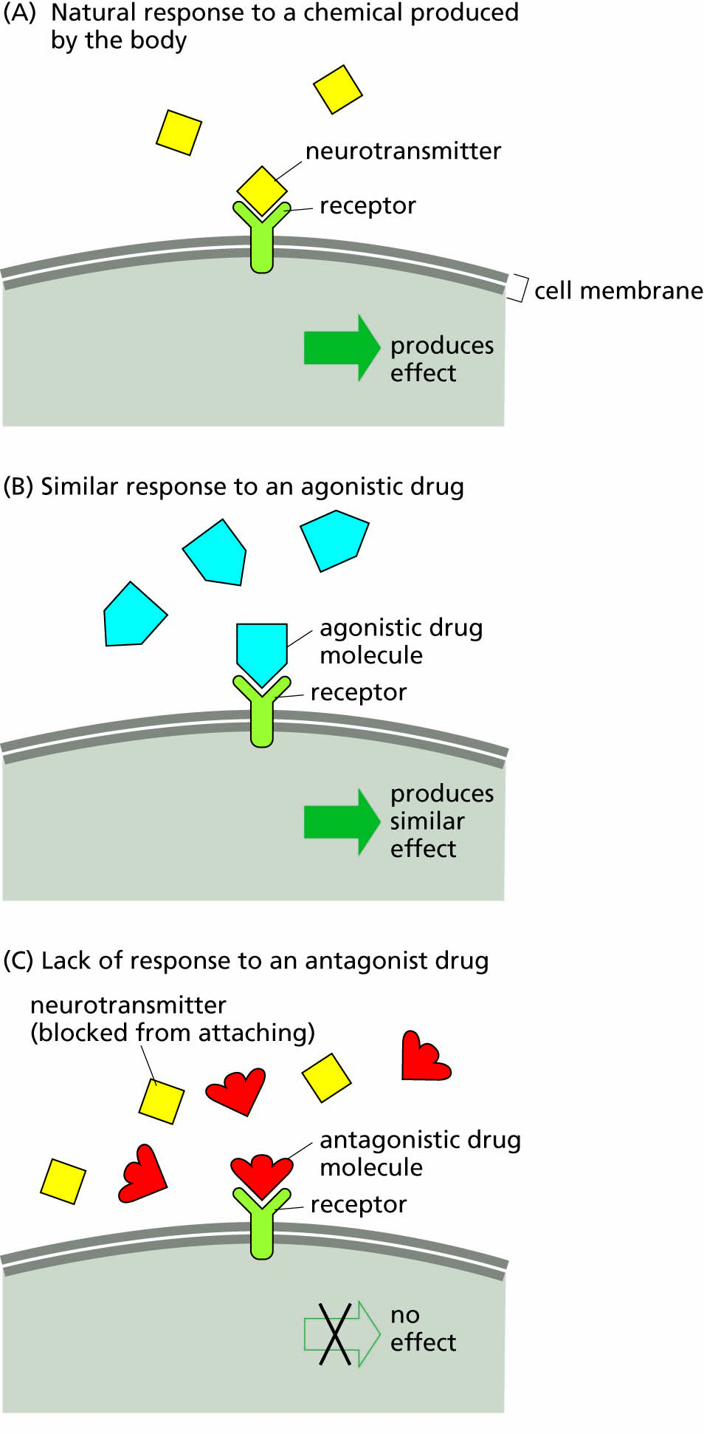
Figure 13.5 Drug agonists and antagonists.

Slide 8
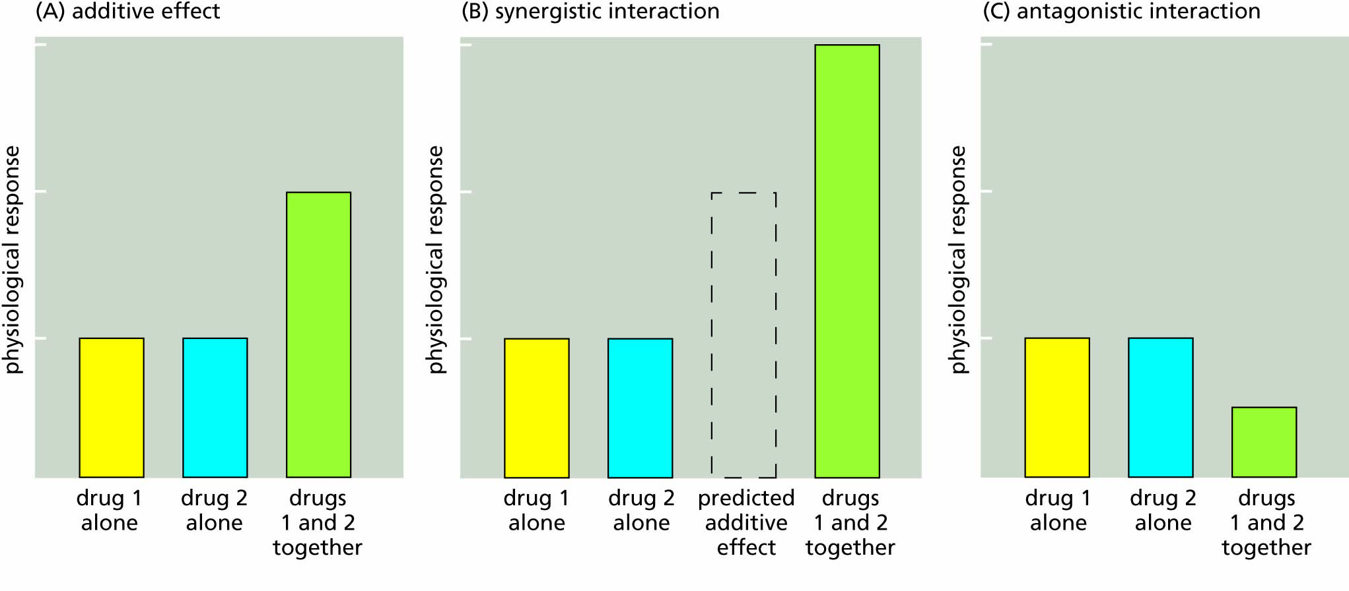
Figure 13.6 How drugs interact.

Slide 9
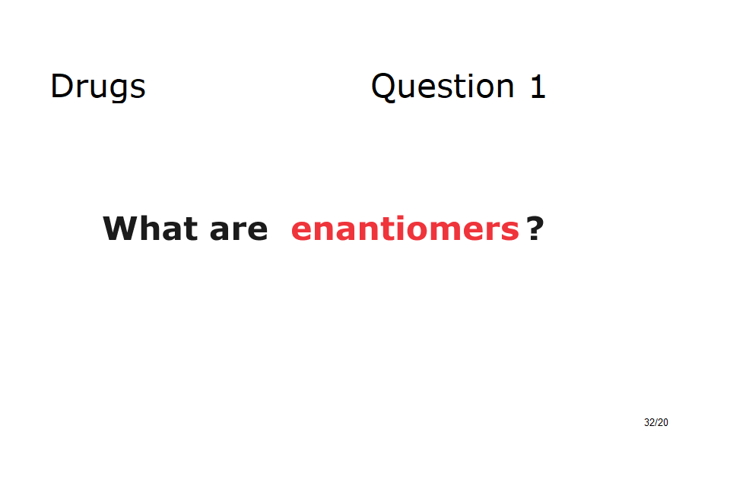

Slide 10
Psychoactive drugs affect the mind
Nicotine and nicotinic receptors
Amphetamines: agonists of norepinephrine
LSD: an agonist of serotonin
Caffeine: a general cellular stimulant
Alcohol: a CNS depressant

Slide 11
Most psychoactive drugs are addictive
Dependence and withdrawal
Brain reward centers and drug-seeking behaviors
Drug tolerance

Slide 12
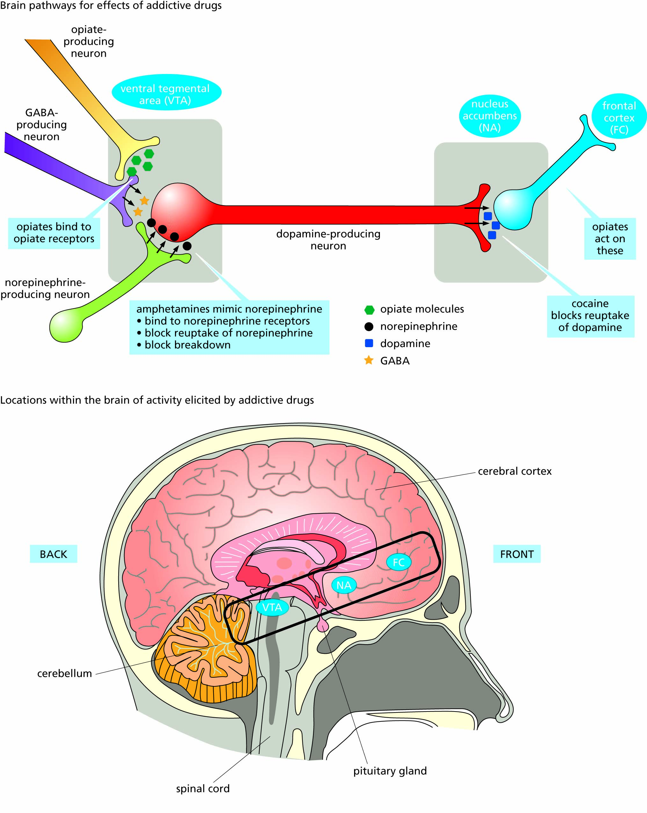
Figure 13.8 Positive reinforcement areas of the brain, and the locations of action of addictive drugs on synapses in the cells of these areas.

Slide 13
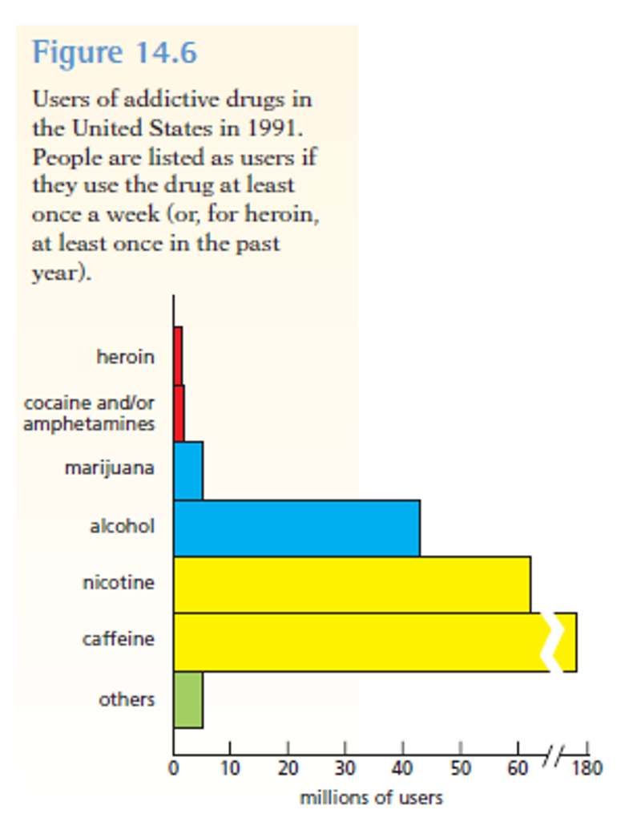

Slide 14
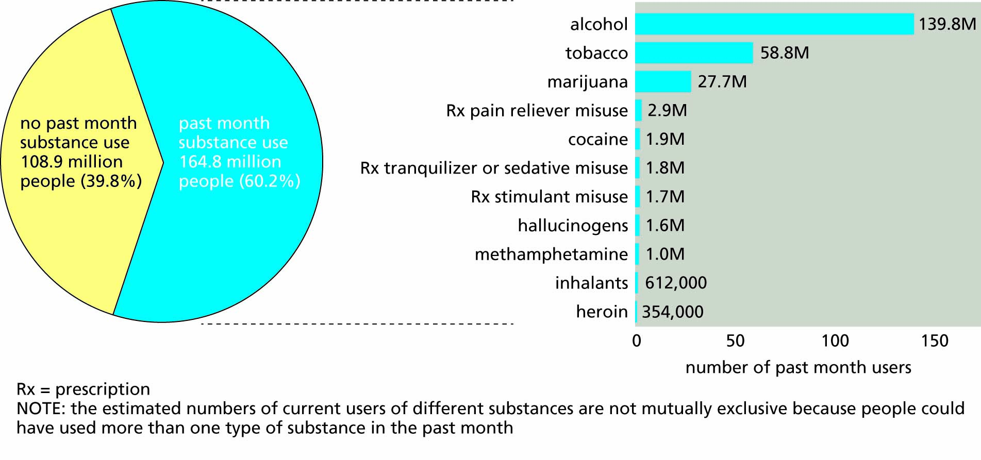
Figure 13.7 Users of addictive drugs in the United States in 2018. People are listed as users if they used the drug at least once in the past month. This figure does not include the most popular addictive drug, caffeine; a 2014 report estimated that 85% of Americans (approximately 271 million) used caffeine on a daily basis.

Slide 15
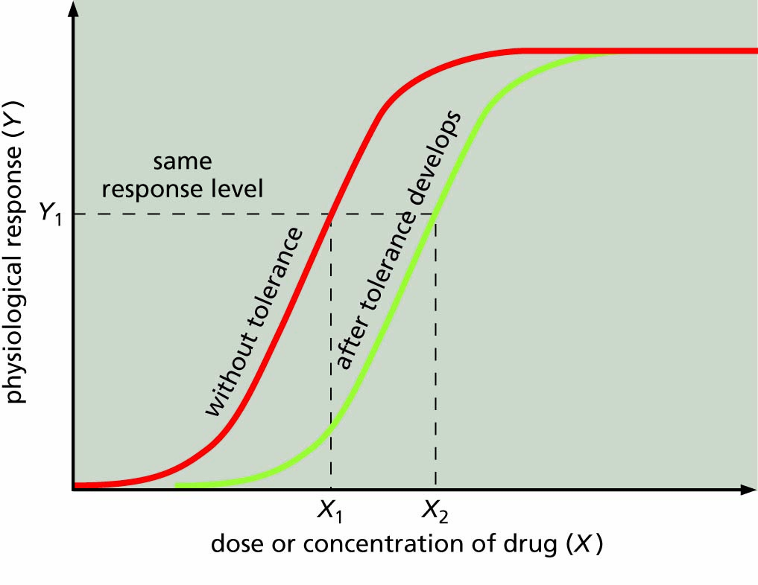
Figure 13.9 Effect of drug tolerance on the dose–response curve. A higher dose (X₂) is required to produce the same response after drug tolerance develops.

Slide 16
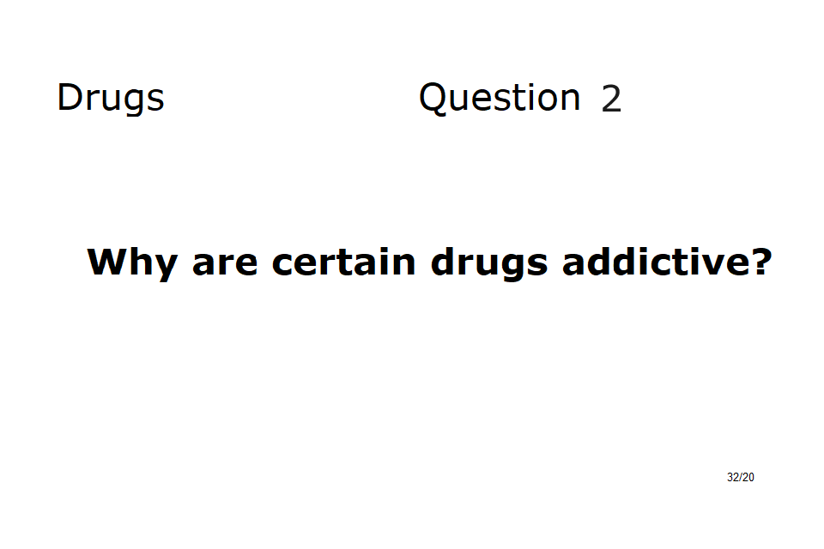

Slide 17
Drug abuse impairs health
Drug effects on the health of drug users
Drug effects on embryonic and fetal development
Drug abuse: public health and social attitudes

Slide 18
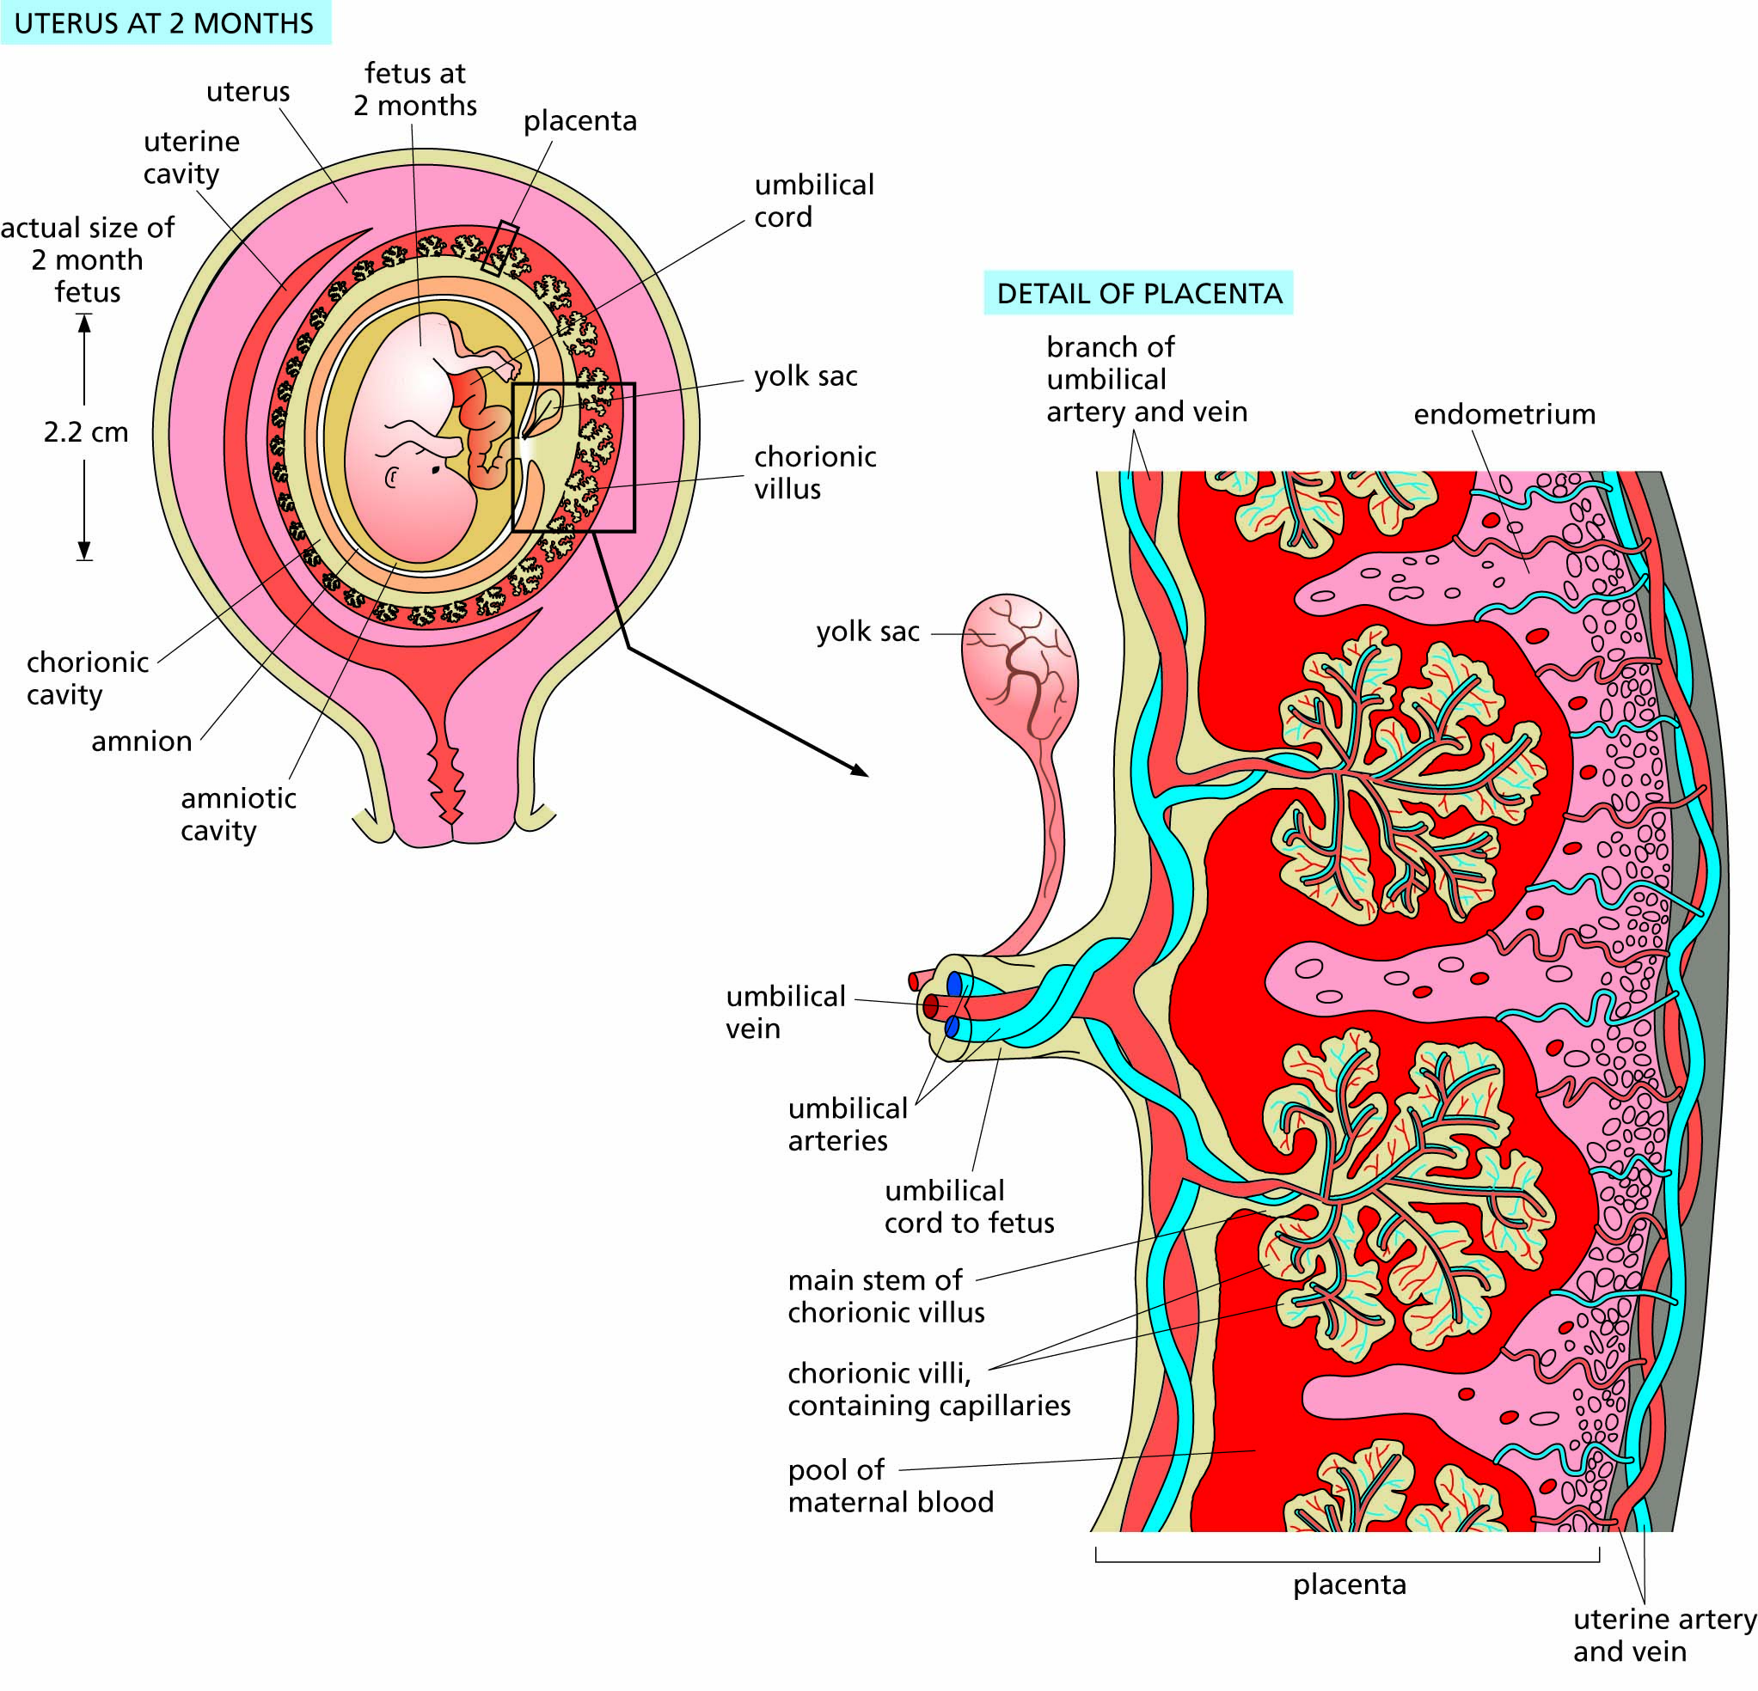
Figure 13.10 Maternal and fetal circulation in the placenta. Fetal blood flows through vessels in the umbilical cord to the chorionic villi, which are in close contact with maternal blood.

Slide 19
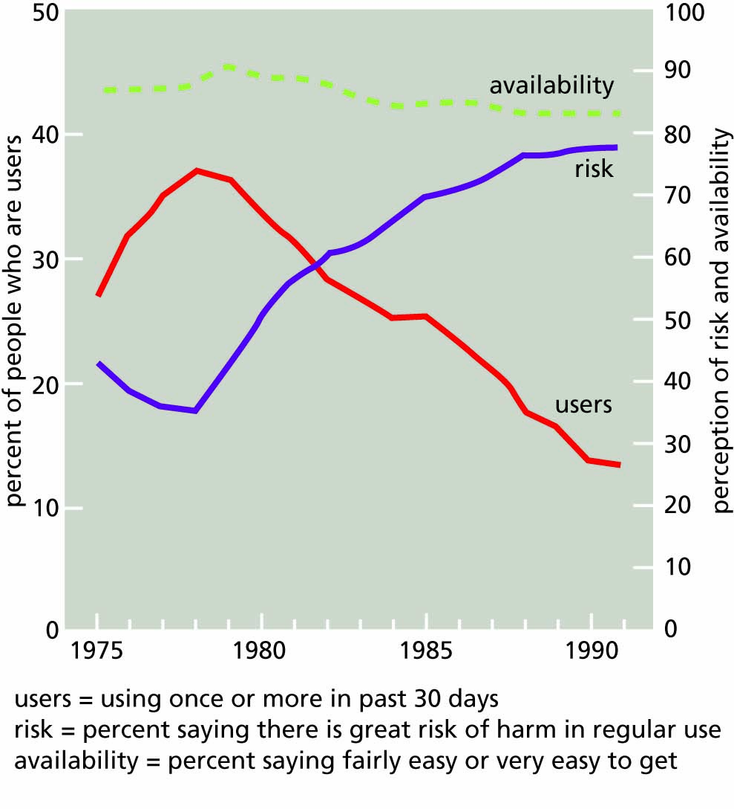
Figure 13.11 Influence of perception of risk on the use of marijuana. The availability of marijuana in the United States remained uniform over the years covered by this graph, but use decreased in inverse proportion to the perception of risk.

Slide 20
