Slide 1
Chapter 12: Aging and Alzheimer’s Disease
Biology Trending, 4e
Eli Minkoff and Jennifer Hood-DeGrenier

Slide 2
Aging is a natural process
Aging and its causes
Aging at the cellular and molecular levels
Changes in body function with aging
Aging and the immune system
Aging and cancers

Slide 3
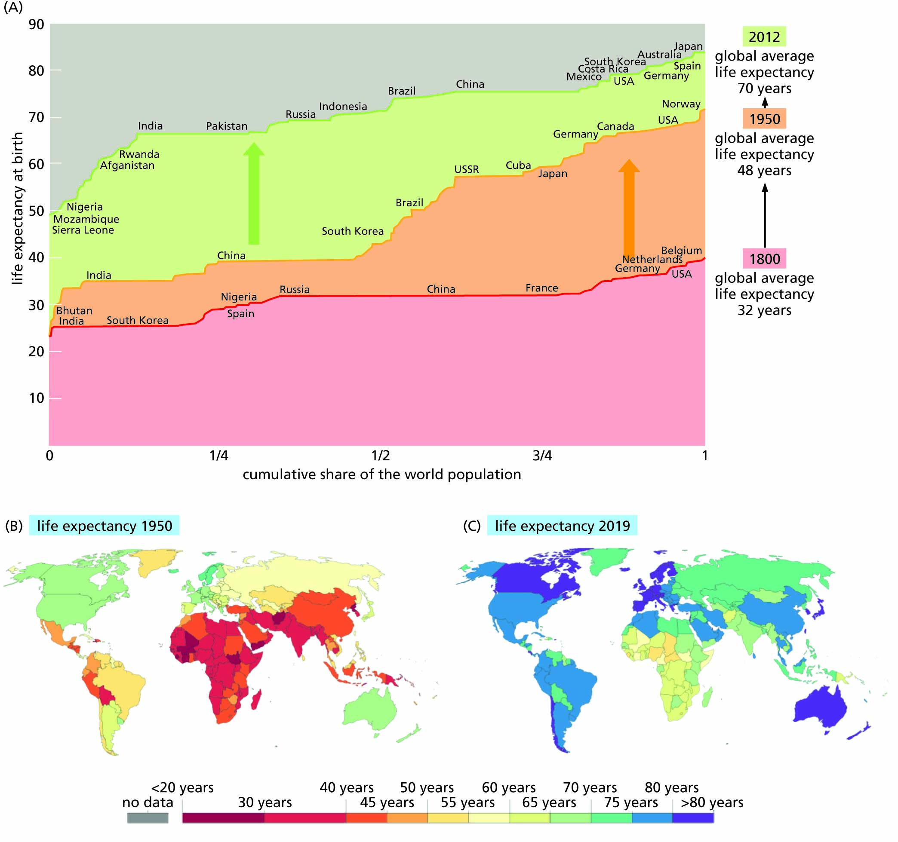
Figure 12.1 Life expectancy has improved over the last hundred years in nearly every country of the world, with occasional setbacks during wars and other crises.
A. Data for each country plotted for 1800, 1950, and 2012, showing that life expectancy in 1950 varied from around 24 to 73 years in different countries but increased by 2012 to a variation from 46 to 84 years.
B. Data by country for 1950. C. Data by country for 2019.

Slide 4
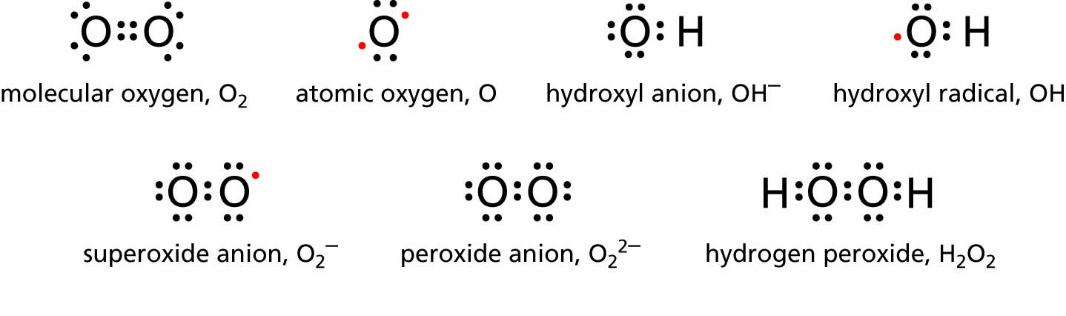
Figure 12.2 Some reactive oxygen species (ROS). Those that have unpaired electrons (shown in red) also qualify as "free radicals."

Slide 5
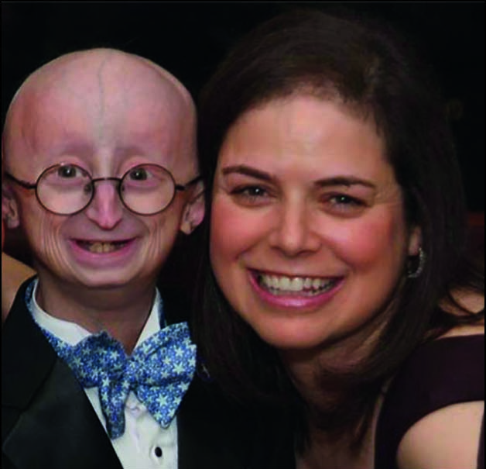
Figure 12.3 A child with Hutchinson-Gilford progeria syndrome, causing premature aging. Children with progeria usually die in their teens from cardiovascular disease more typical of the elderly. Sam Berns, shown here, lived to the age of 17. His mother, Leslie Gordon, also shown, is a medical researcher at Brown University and medical director of the Progeria Research Foundation.

Slide 6
Alzheimer’s disease
General description and course of the disease
Changes in the brain
Neuroimaging and diagnostic tests
Early onset Alzheimer’s
Genes and Alzheimer’s
Causes and risks for the disease
Drugs to treat Alzheimer’s
Living with Alzheimer’s disease

Slide 7
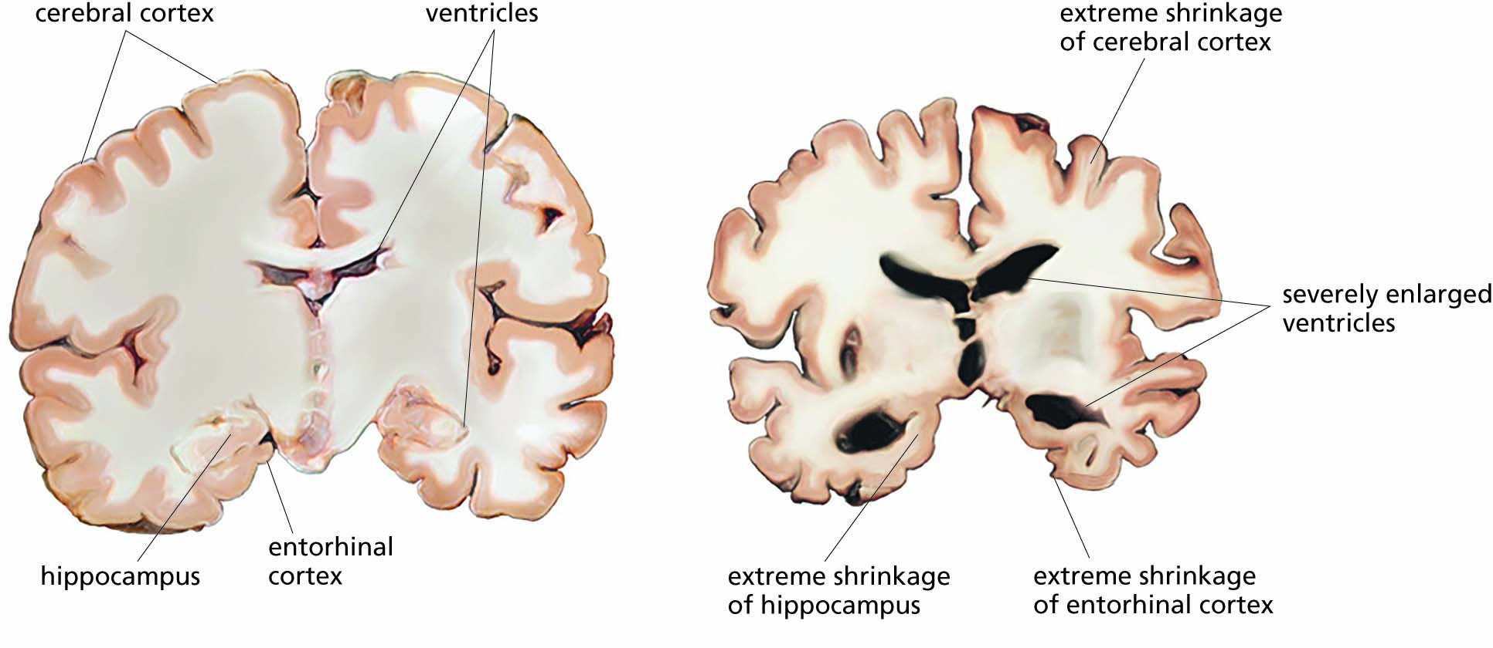
Figure 12.4 Changes in the brains of Alzheimer's patients. Transverse brain sections, showing a largely healthy brain (preclinical), and a brain with late-stage Alzheimer's disease.

Slide 8
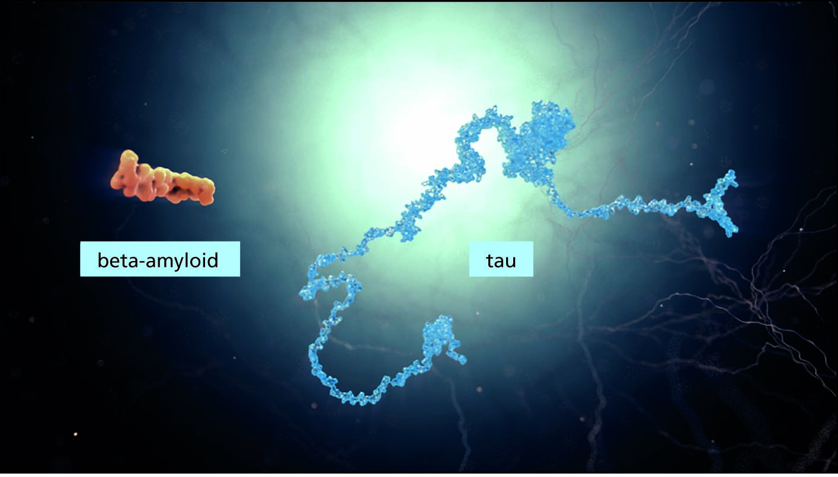
Figure 12.5 Amyloid-β and tau, two characteristic proteins that accumulate in the brains of Alzheimer's patients.

Slide 9
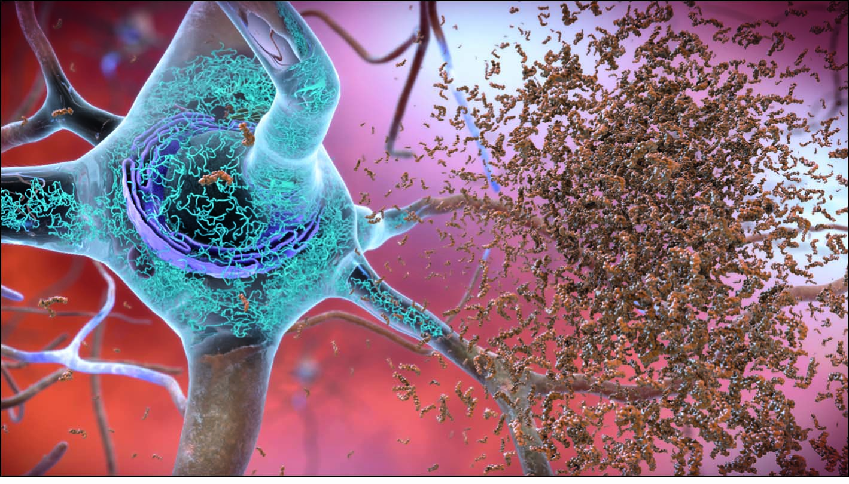
Figure 12.6 If amyloid-β proteins accumulate in the brain outside neurons, they clump together and form dense plaques, as shown here on the right. Notice that the neuron on the left also has an accumulation of tau protein (blue) that has formed tangled neurofibrils.

Slide 10
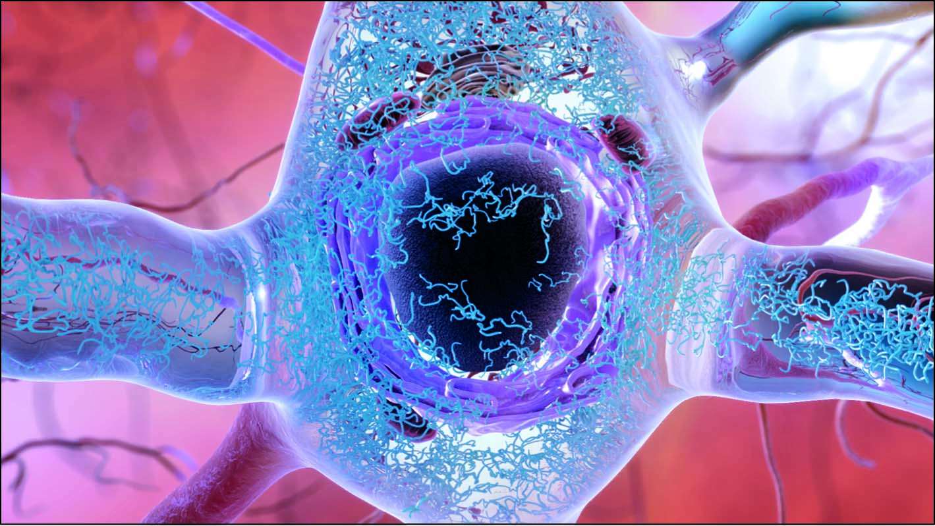
Figure 12.7 In the brains of Alzheimer's patients, tau protein accumulates inside neurons and causes neurofibrils to form the tangles shown here in blue.

Slide 11
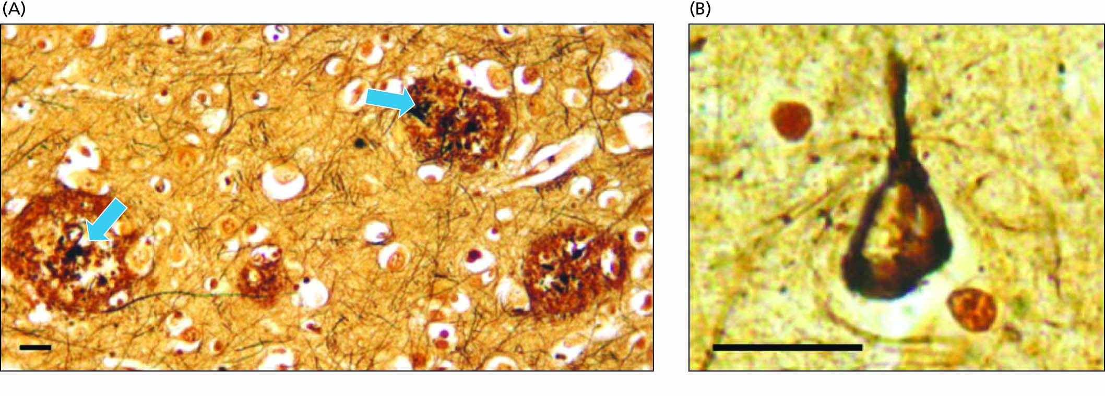
Figure 12.8 Sections of brain tissue in an Alzheimer's patient, showing dark-staining amyloid plaques (arrows, a) and dead nerve cell bodies (b).

Slide 12
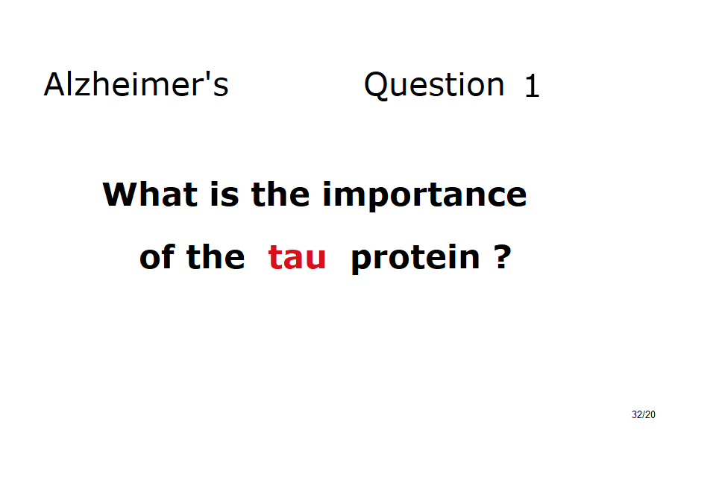


Slide 13
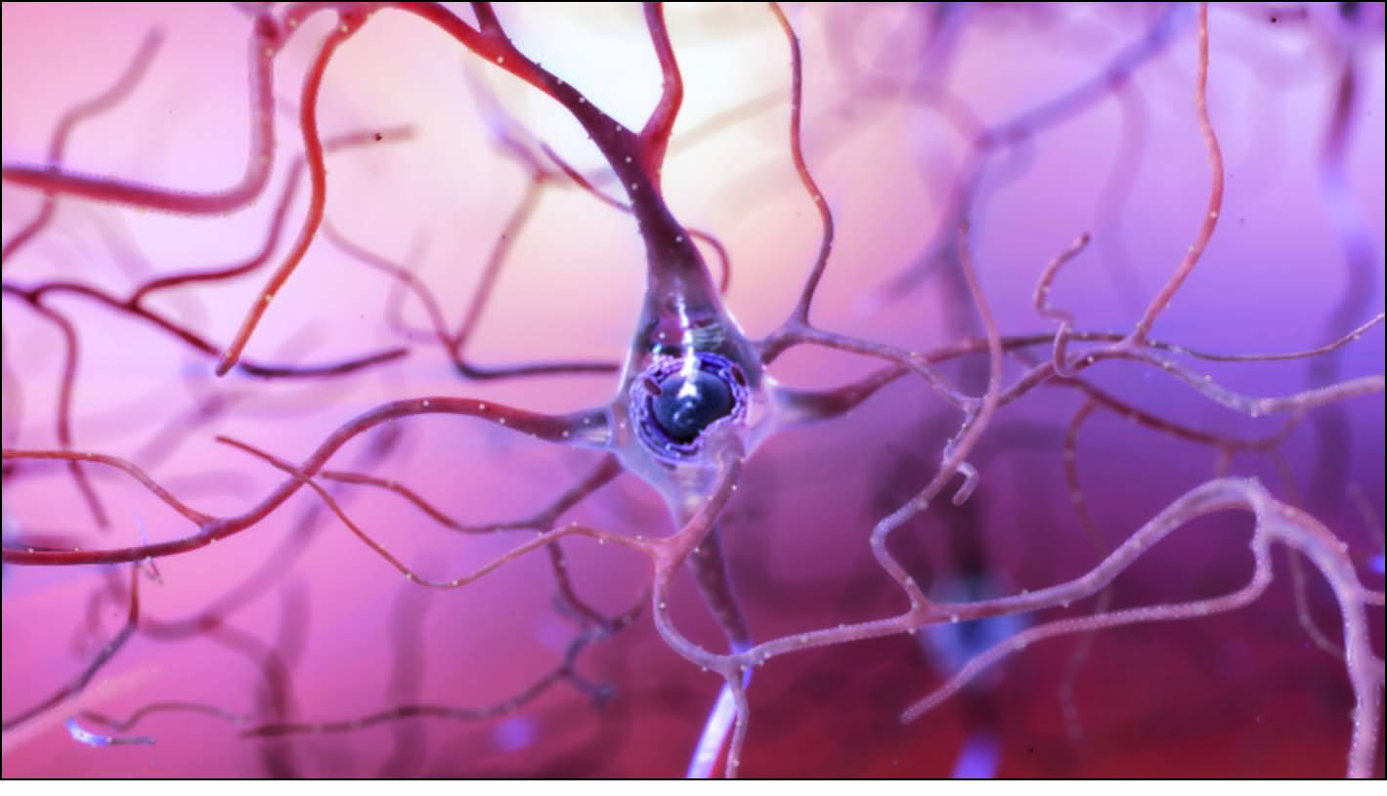
Figure 12.9 Appearance of a healthy neuron.

Slide 14
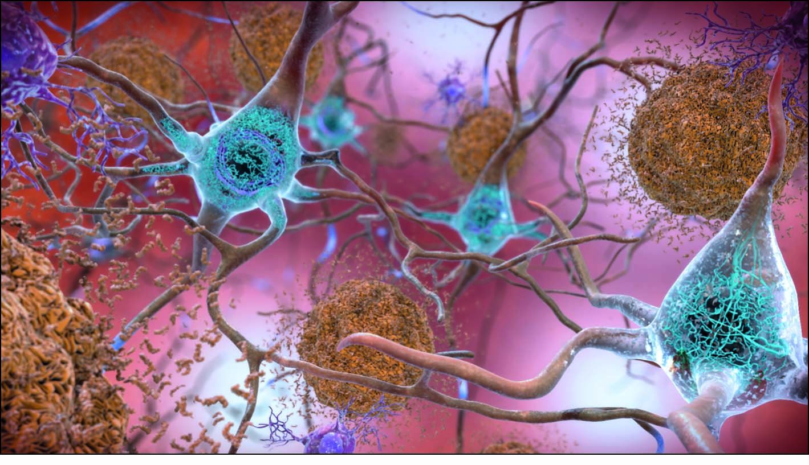
Figure 12.10 Amyloid-β plaques (light brown) and neurofibrillary tangles of tau protein (blue, inside the neurons) in the brain of an Alzheimer's patient.

Slide 15
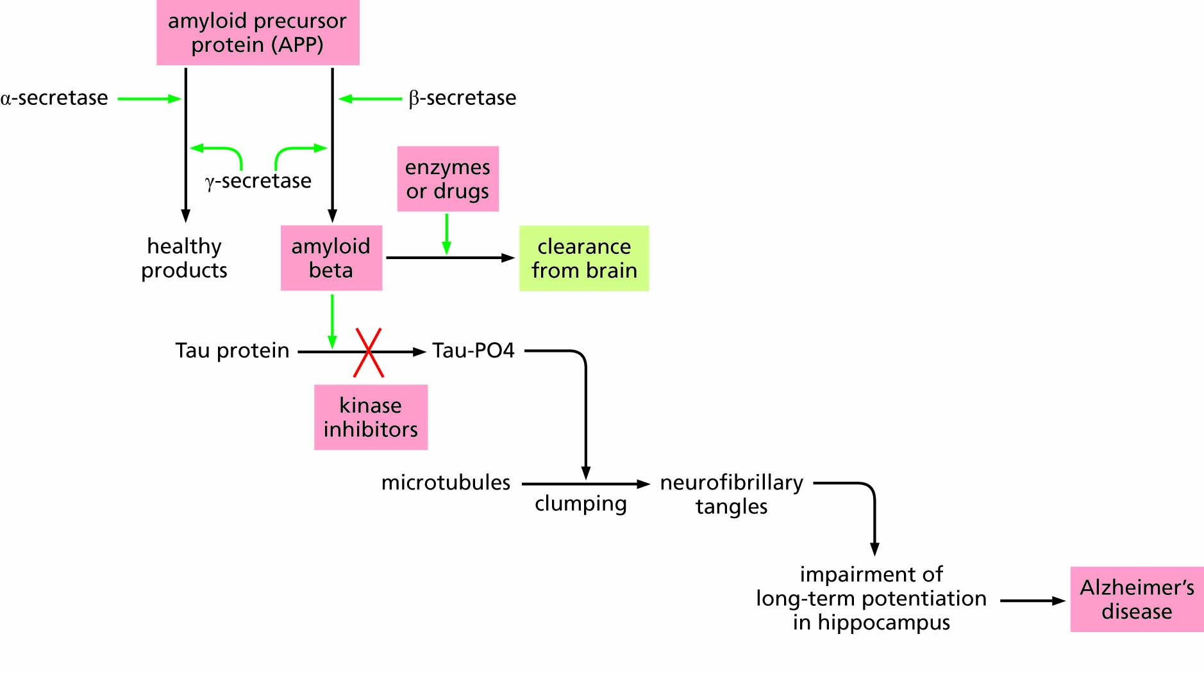
Figure 12.11 Hypothesized pathway for the control of Alzheimer's disease.

Slide 16
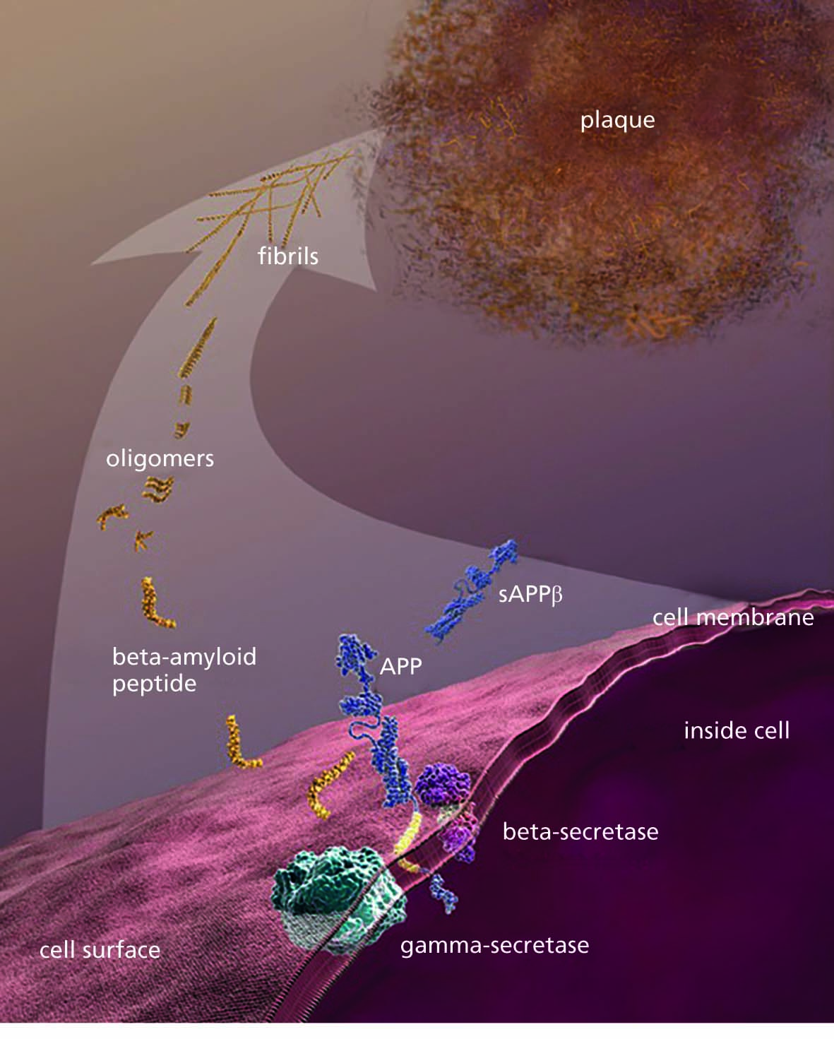
Figure 12.12 The process that leads to the formation of amyloid plaques.

Slide 17
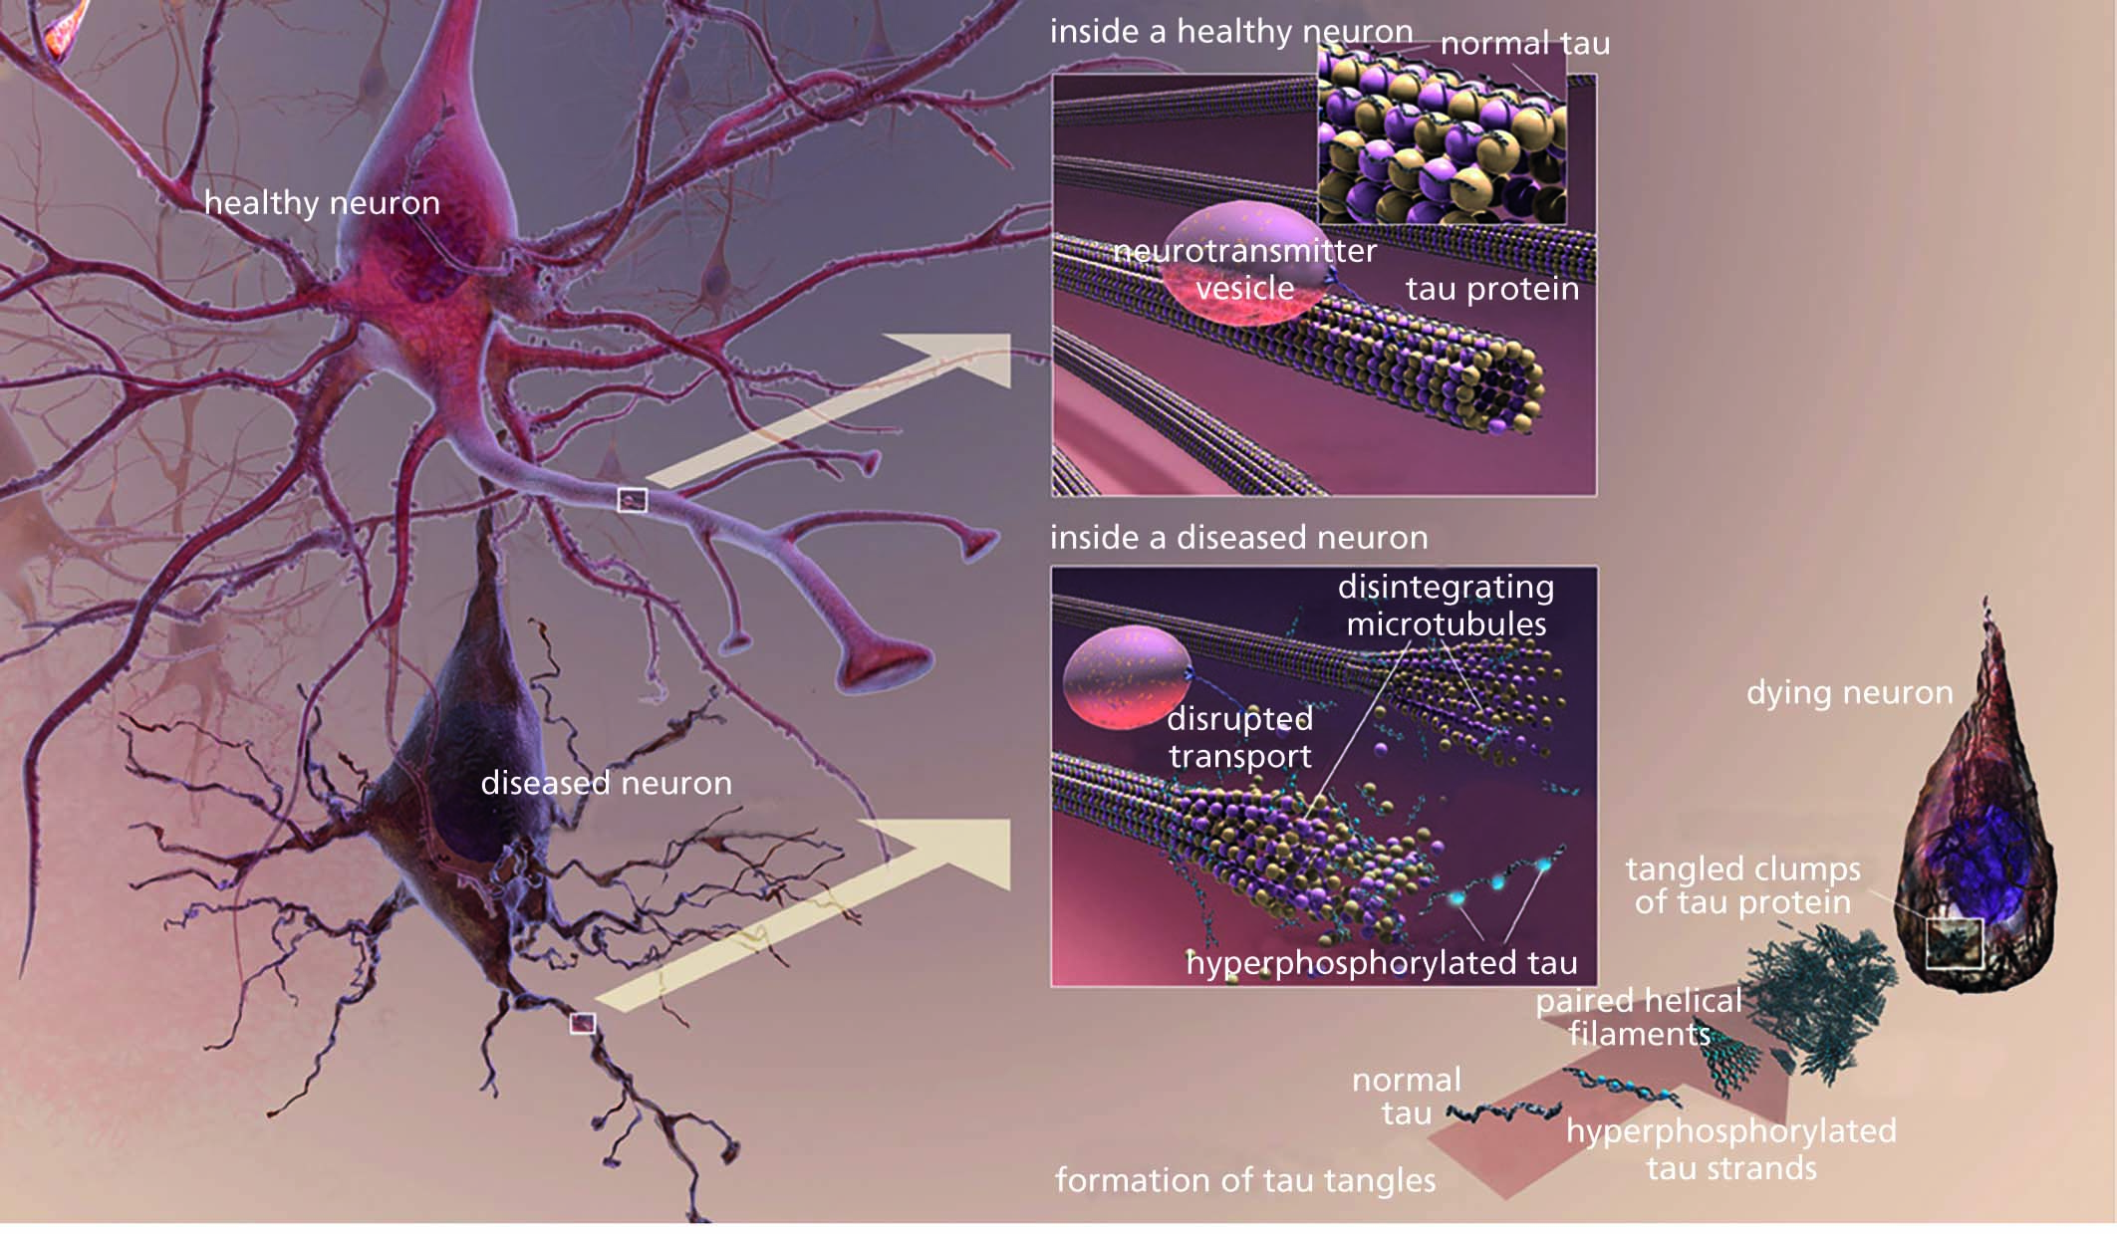
Figure 12.13 Comparison of a healthy neuron and a neuron affected by Alzheimer's disease, showing the disruption of microtubules and formation of neurofibrillary tangles (tau tangles).

Slide 18
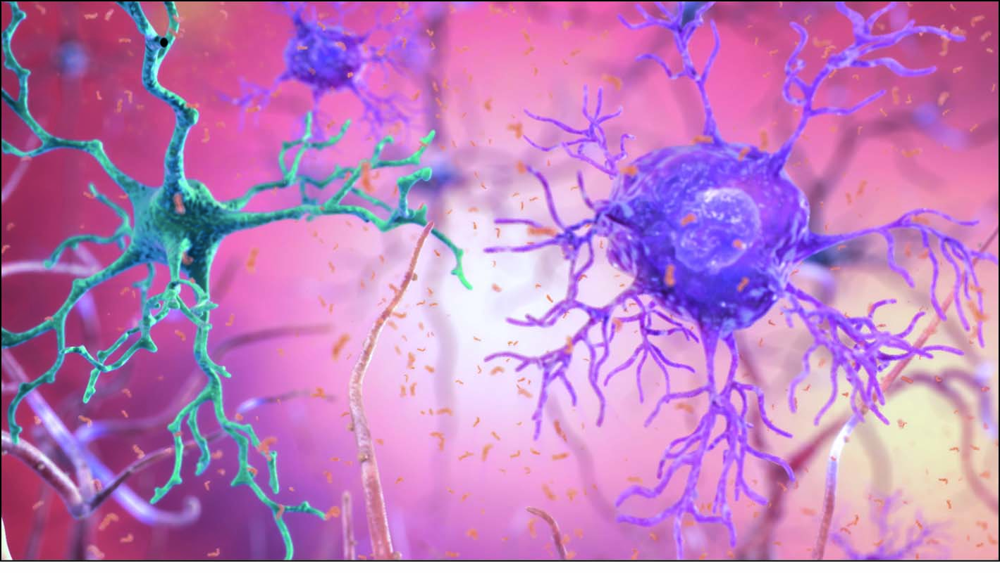
Figure 12.14 Astrocyte (right) and microglial cell (left), two types of glial cells in the brain.

Slide 19
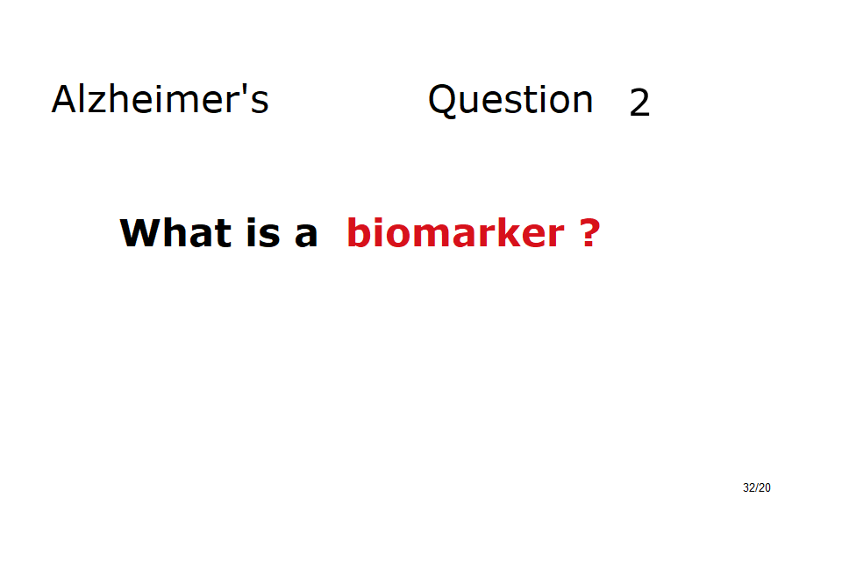

Slide 20
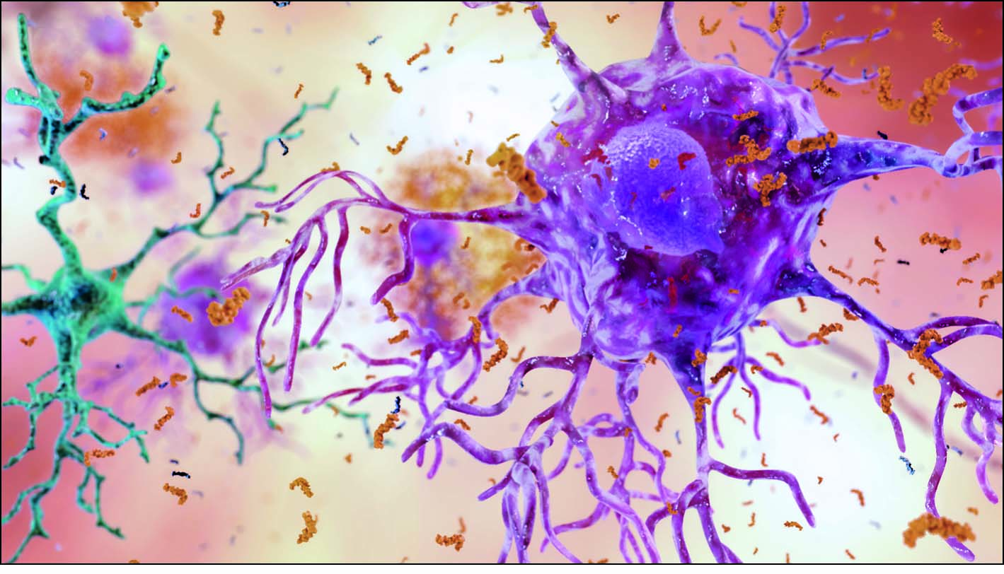
Figure 12.15 The microglial cell on the left functions as part of the immune system, patrolling the brain tissue and destroying damaged proteins. When Aβ (shown in light brown) accumulates in large amounts, it overwhelms the microglia, leaving the astrocytes, like the one on the right, to clear Aβ from the brain. Some drugs increase astrocyte activity in an attempt to rid the brain of accumulated Aβ.

Slide 21
Social consequences of an aging population:
Reduced need for social investment
in schools, etc.
Increased need for social investment in:
- eldercare (home, daycare, hospice, etc.)
- nursing & medical care for the elderly

