Slide 1
Chapter 9: Populations and Reproduction
Biology Trending, 4e
Eli Minkoff and Jennifer Hood-DeGrenier

Slide 2
Demography helps to predict future population size
Population growth
Malthus’ analysis of population growth
Growth within limits
Demographic transition

Slide 3
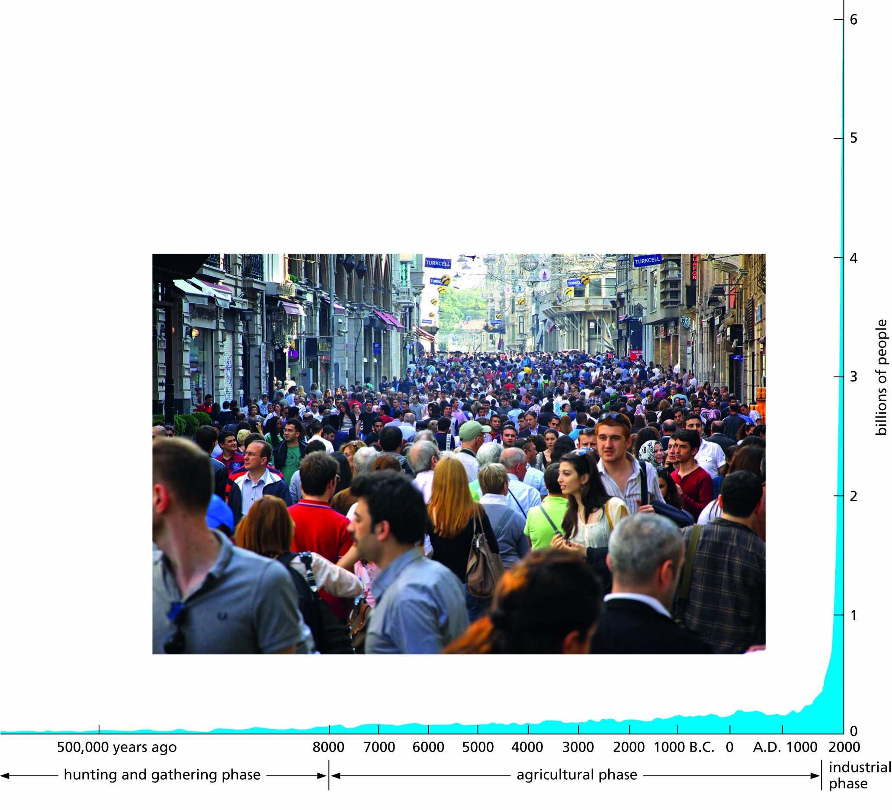
Figure 9.1 Graph showing the growth of the world’s human population. The inset shows a street scene in Istanbul, Turkey.

Slide 4
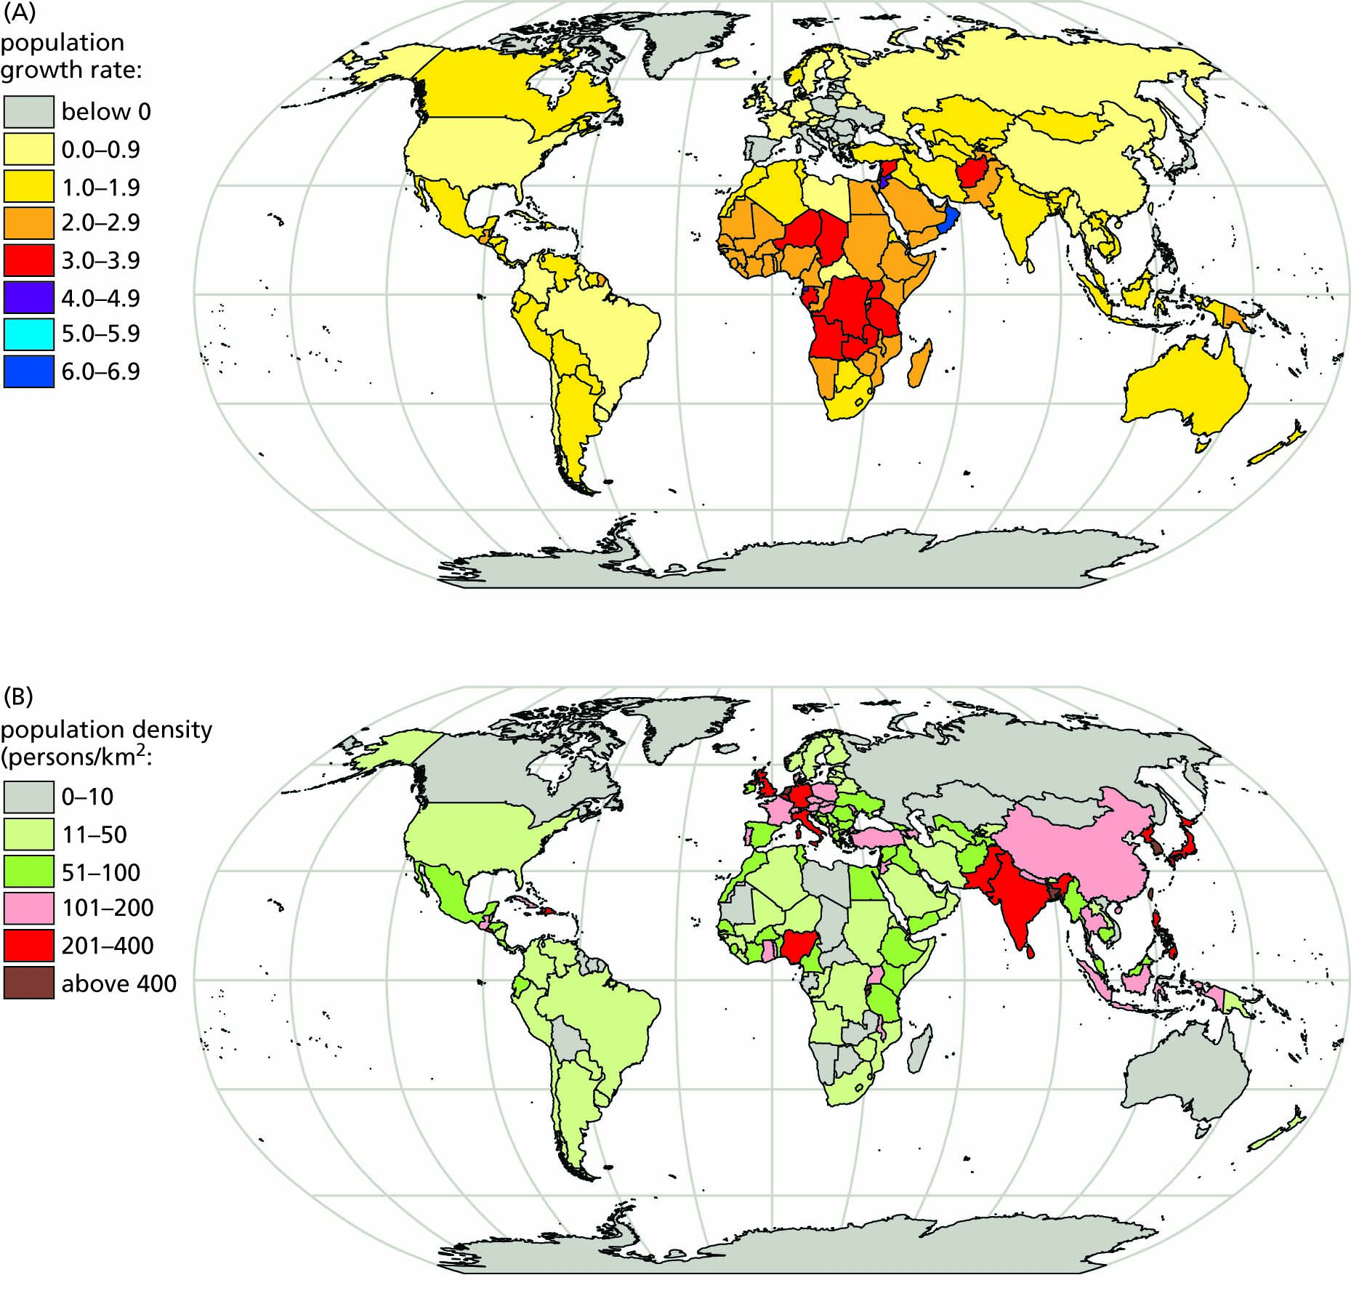
Figure 9.2 (A) Population growth rates (r) from 2010-2015 (U.N. estimates published 2018); negative growth rates for countries at war are usually temporary. (B) population densities around the world (from CIA World Fact Book 2018).

Slide 5
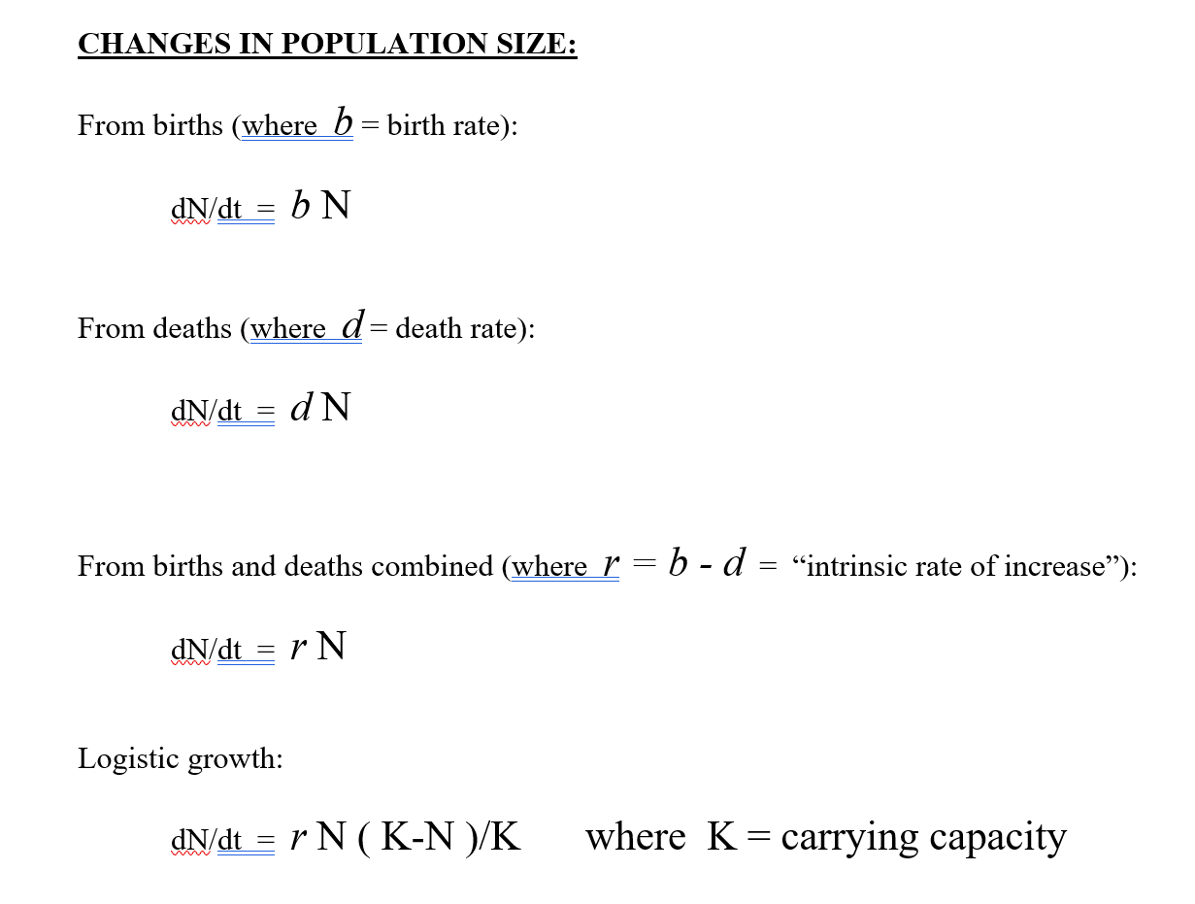

Slide 6
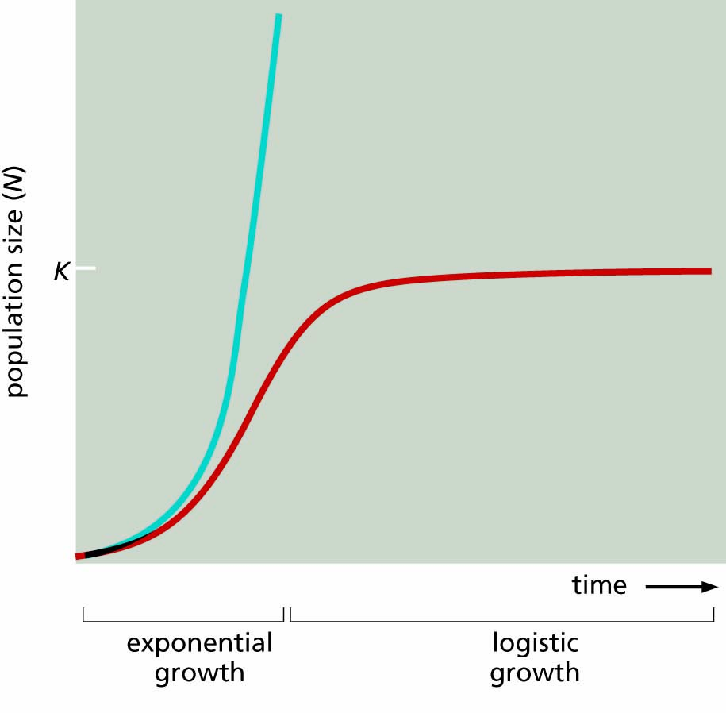
Figure 9.3 Exponential growth compared with logistic growth. The steeper (more vertical) the slope, the more rapid the rate of growth. Graphing exponential growth always gives a characteristic J-shaped curve (blue).

Slide 7
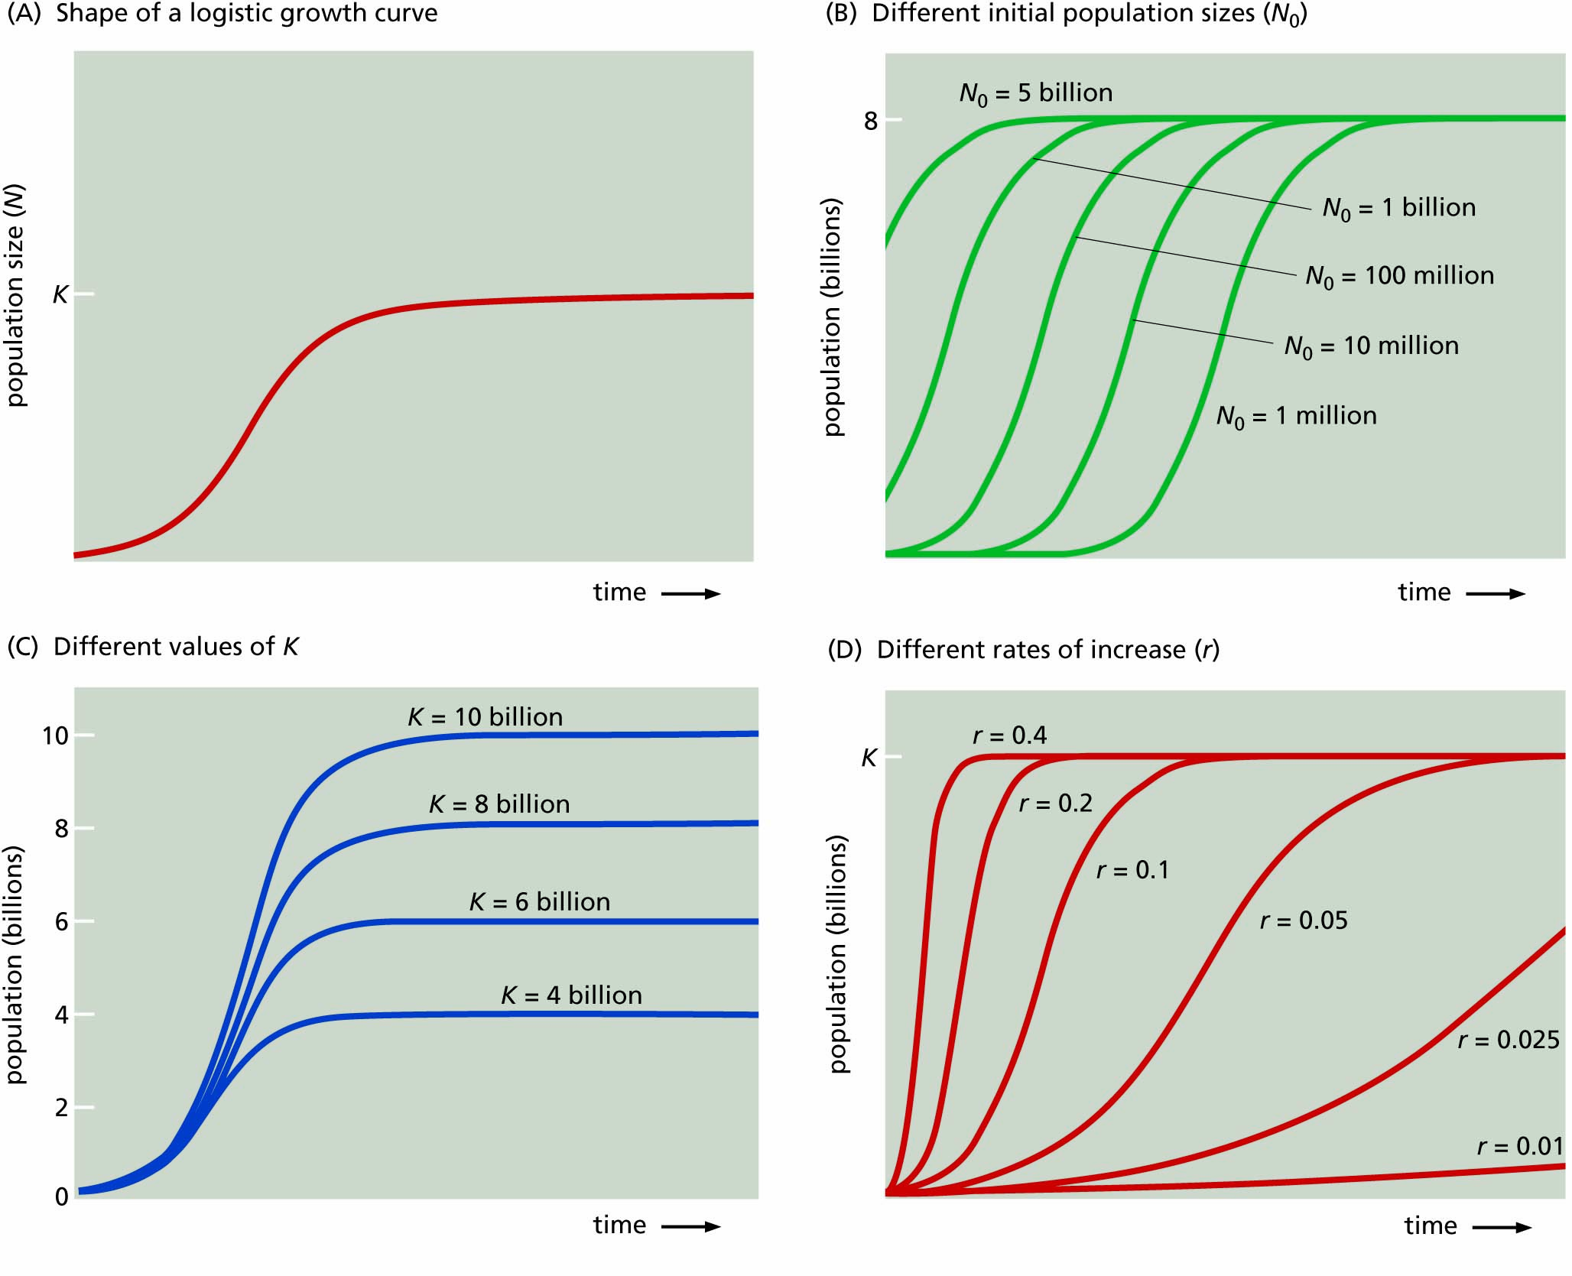
Figure 9.4 A variety of logistic growth curves.

Slide 8
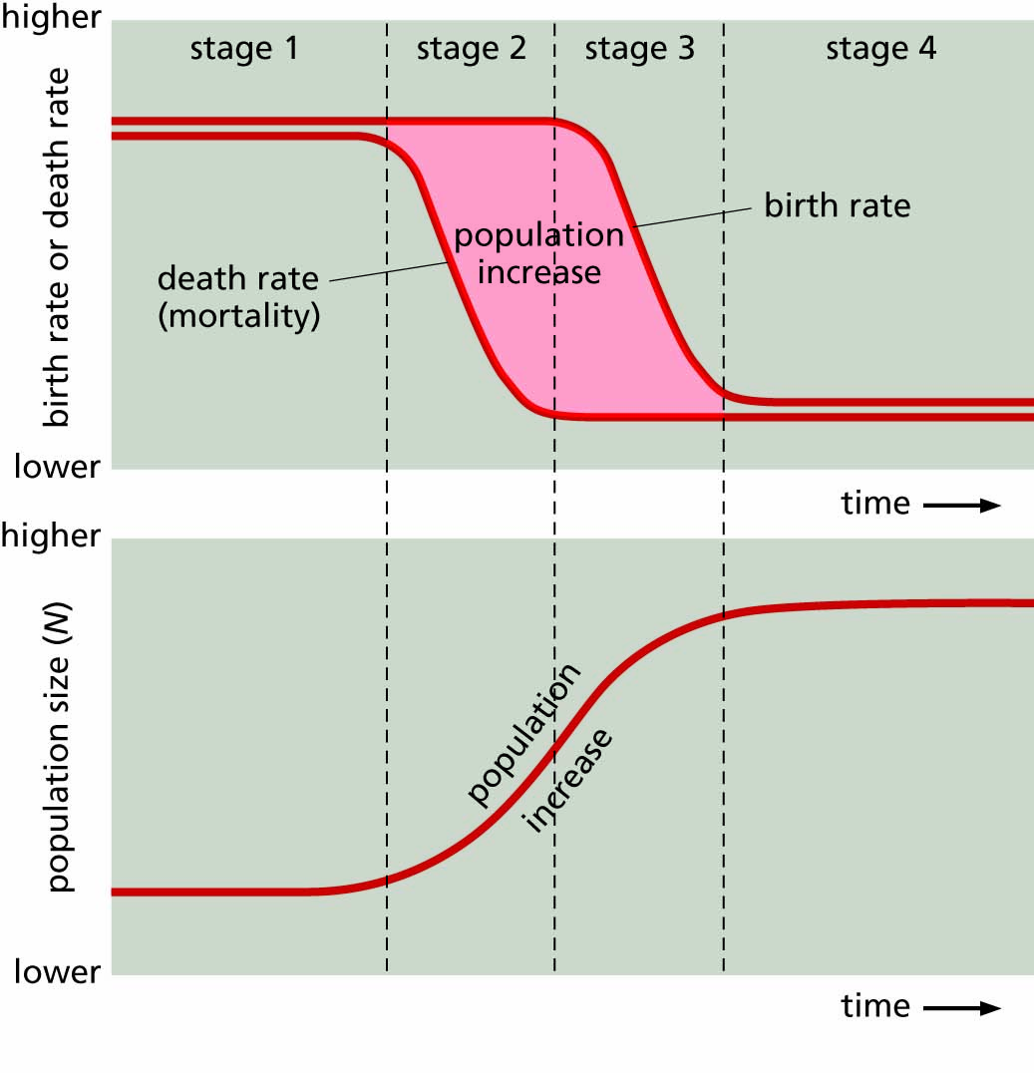
Figure 9.5 Idealized stages of a demographic transition. Some authorities recognize only three stages by combining the middle two.

Slide 9
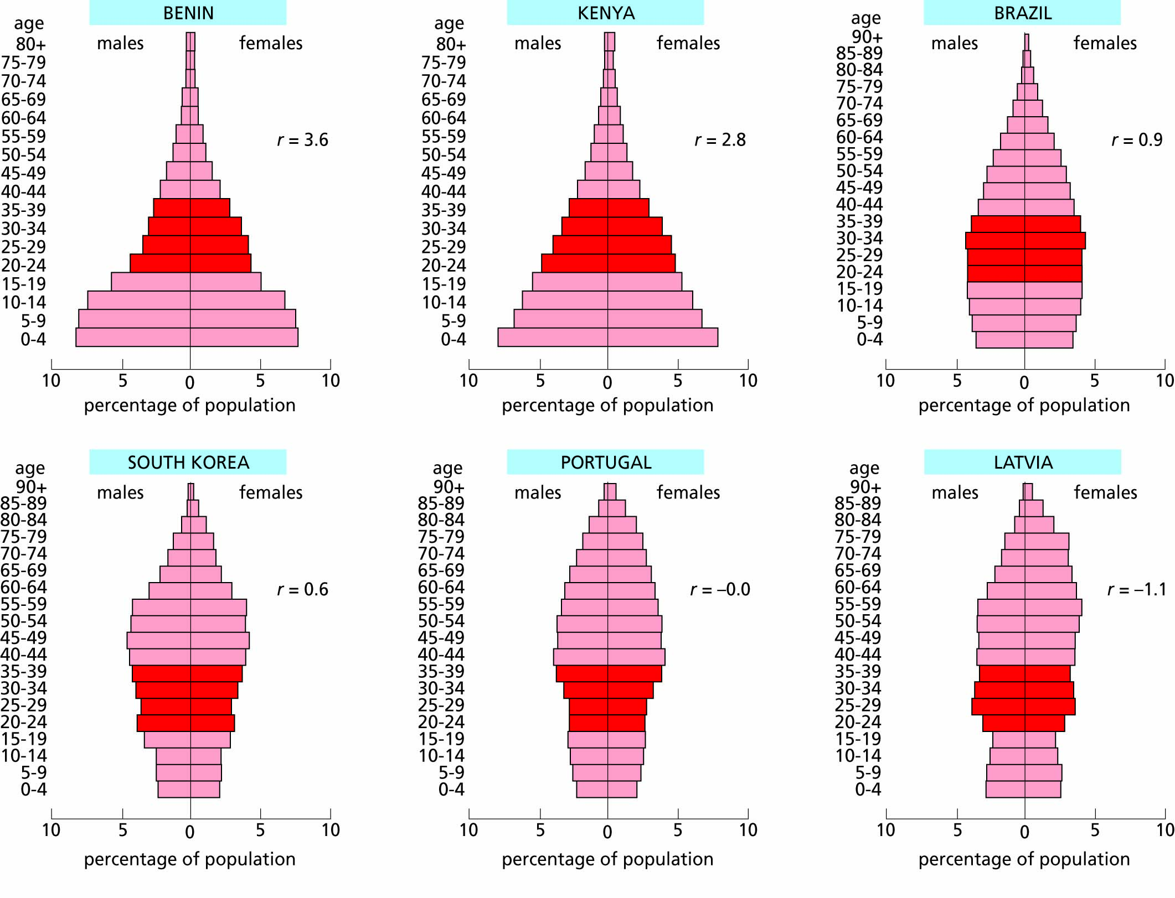
Figure 9.6 Age pyramids for two rapidly growing populations (high r), two populations with slower growth rates, one rather stable population (zero r), and a declining population (negative r), based on United Nations (2016) data. Age groups from 20 to 39 are darker to emphasize that most reproduction occurs in these age groups

Slide 10
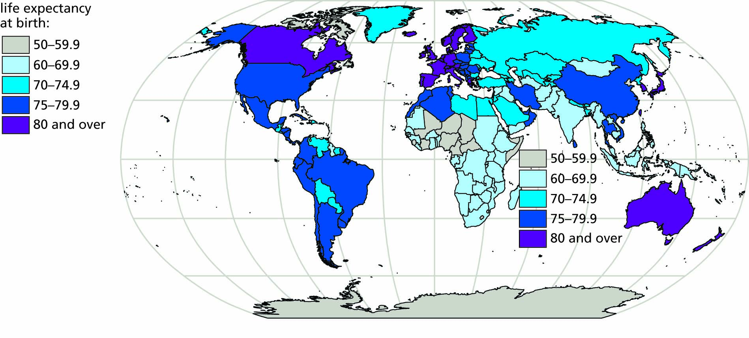
Figure 9.7 Human life expectancy at birth in various countries (2016), from United Nations WHO report (2018) and other sources.

Slide 11
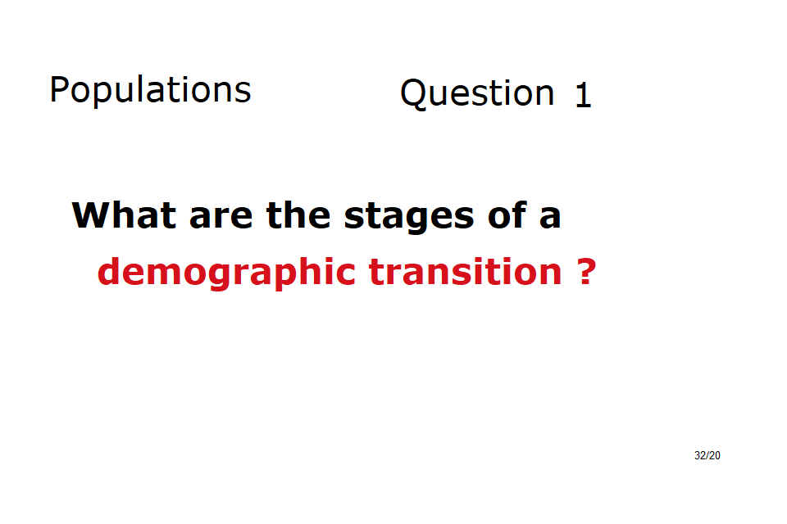

Slide 12
Human reproductive biology helps us to understand fertility and infertility
Reproductive anatomy and physiology
Impaired fertility
Assisted reproduction

Slide 13
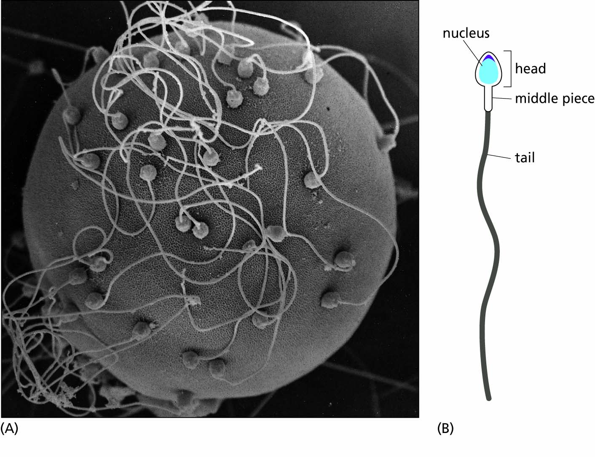
Figure 9.8 (A) An egg surrounded by sperm. (B) Schematic diagram of a human sperm.

Slide 14
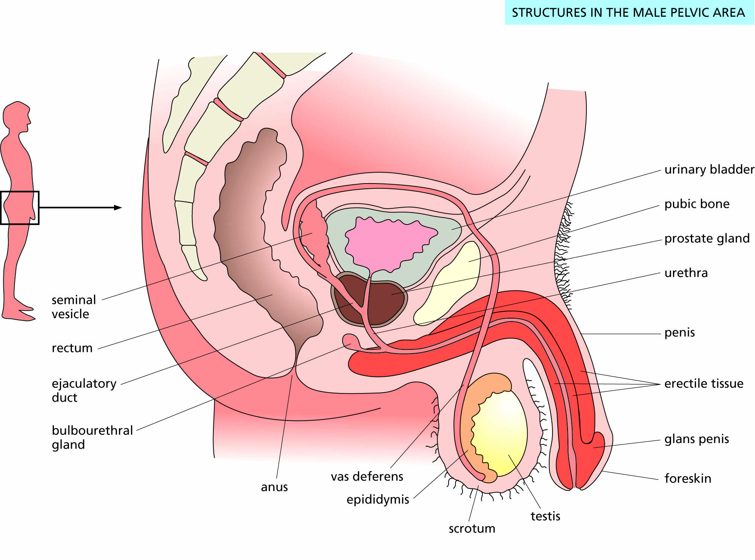
Figure 9.9 The human male reproductive system.

Slide 15
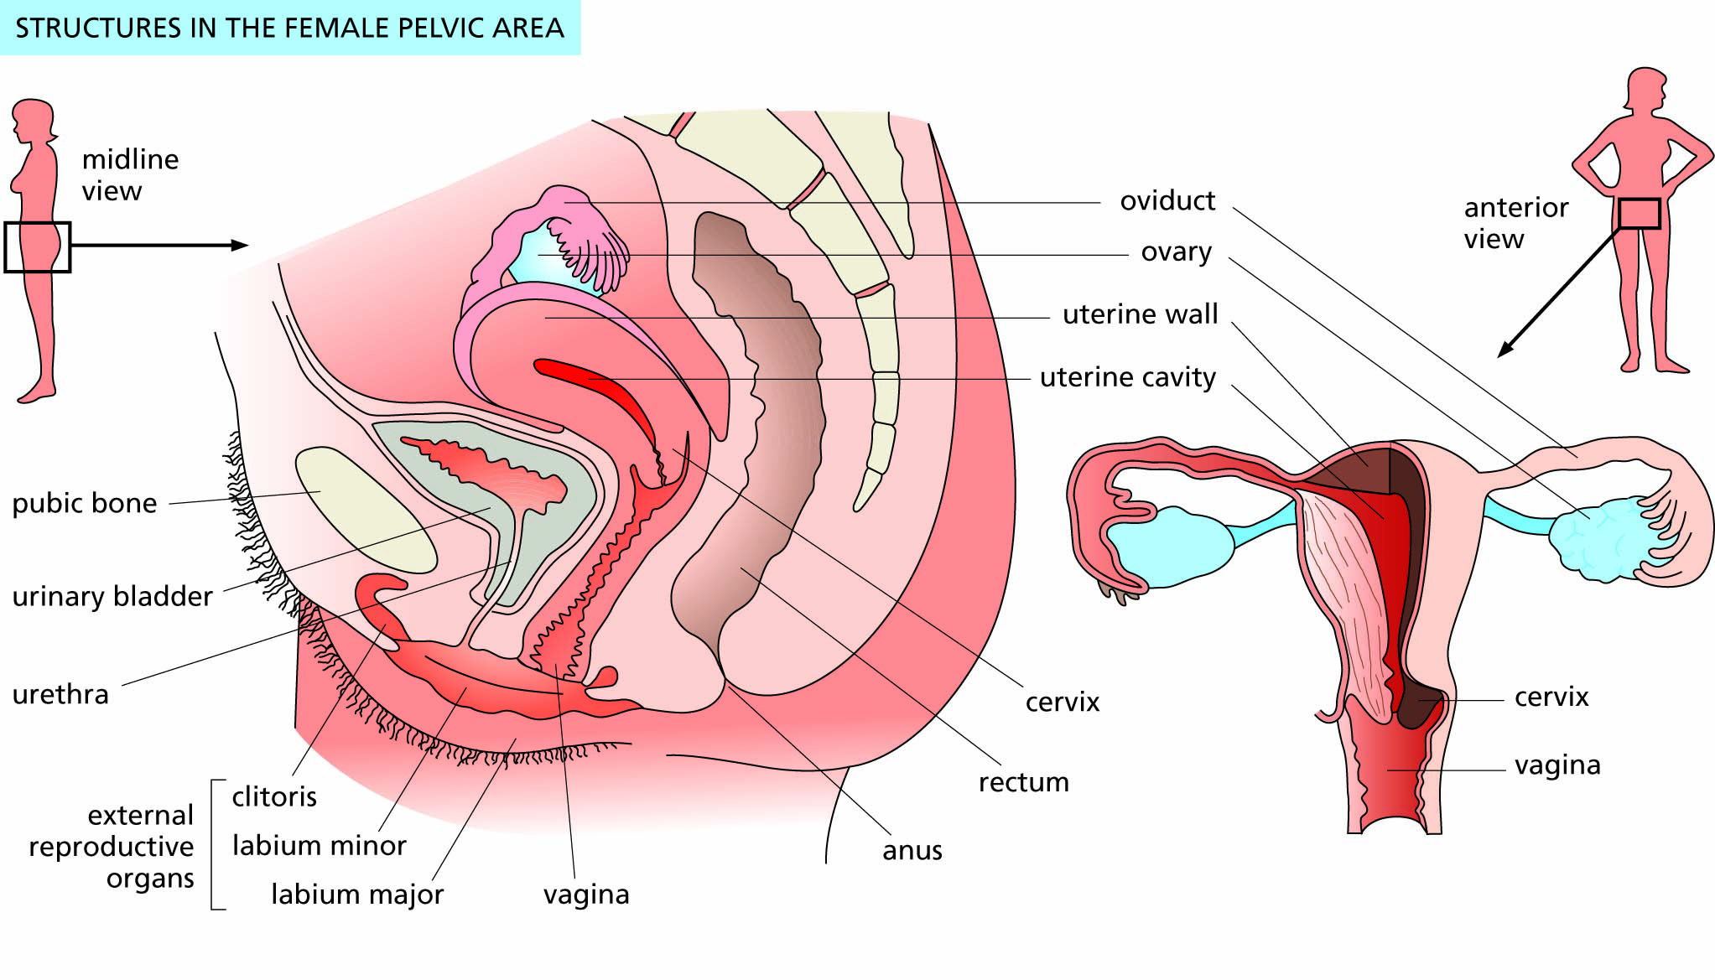
Figure 9.10 The human female reproductive system.

Slide 16
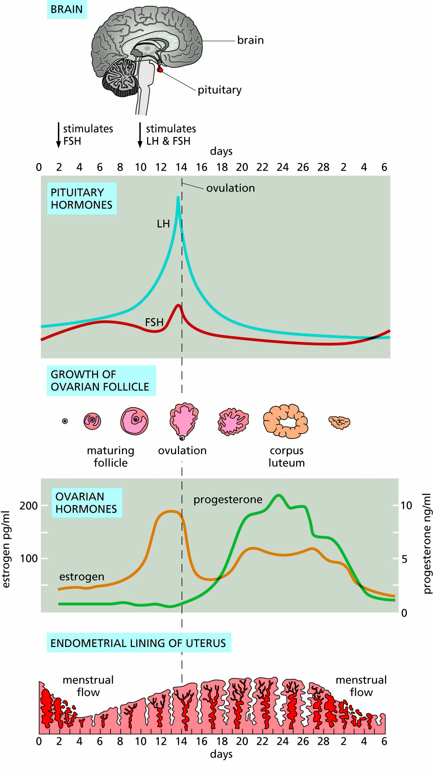
Figure 9.11 Reproductive cycles in the human female.

Slide 17
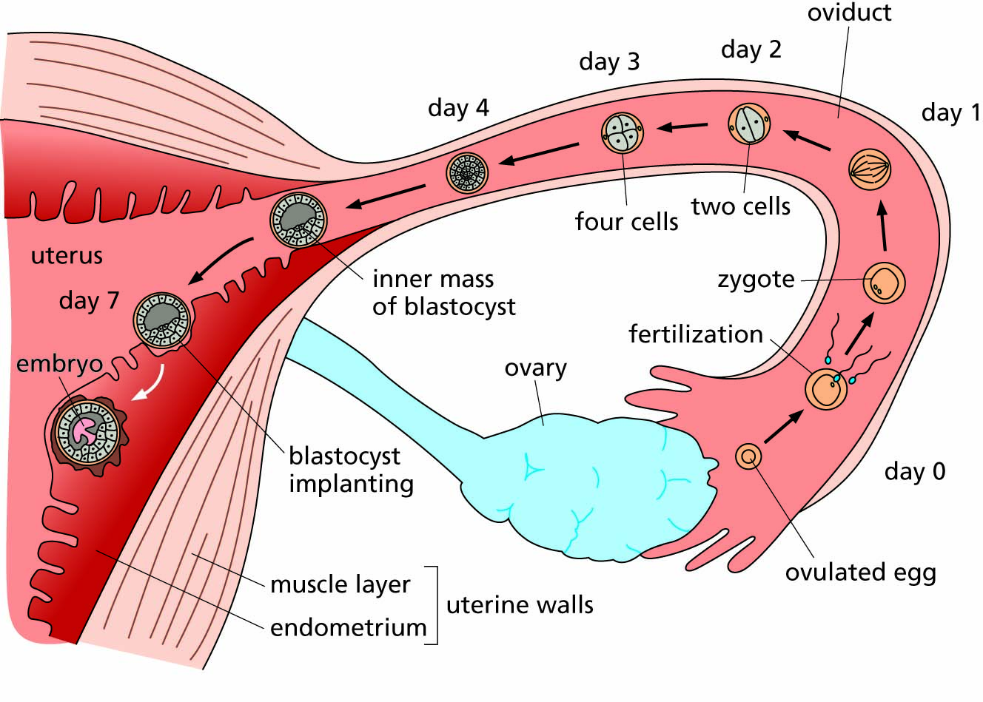
Figure 9.12 Fertilization in the oviduct and implantation in the uterus.

Slide 18
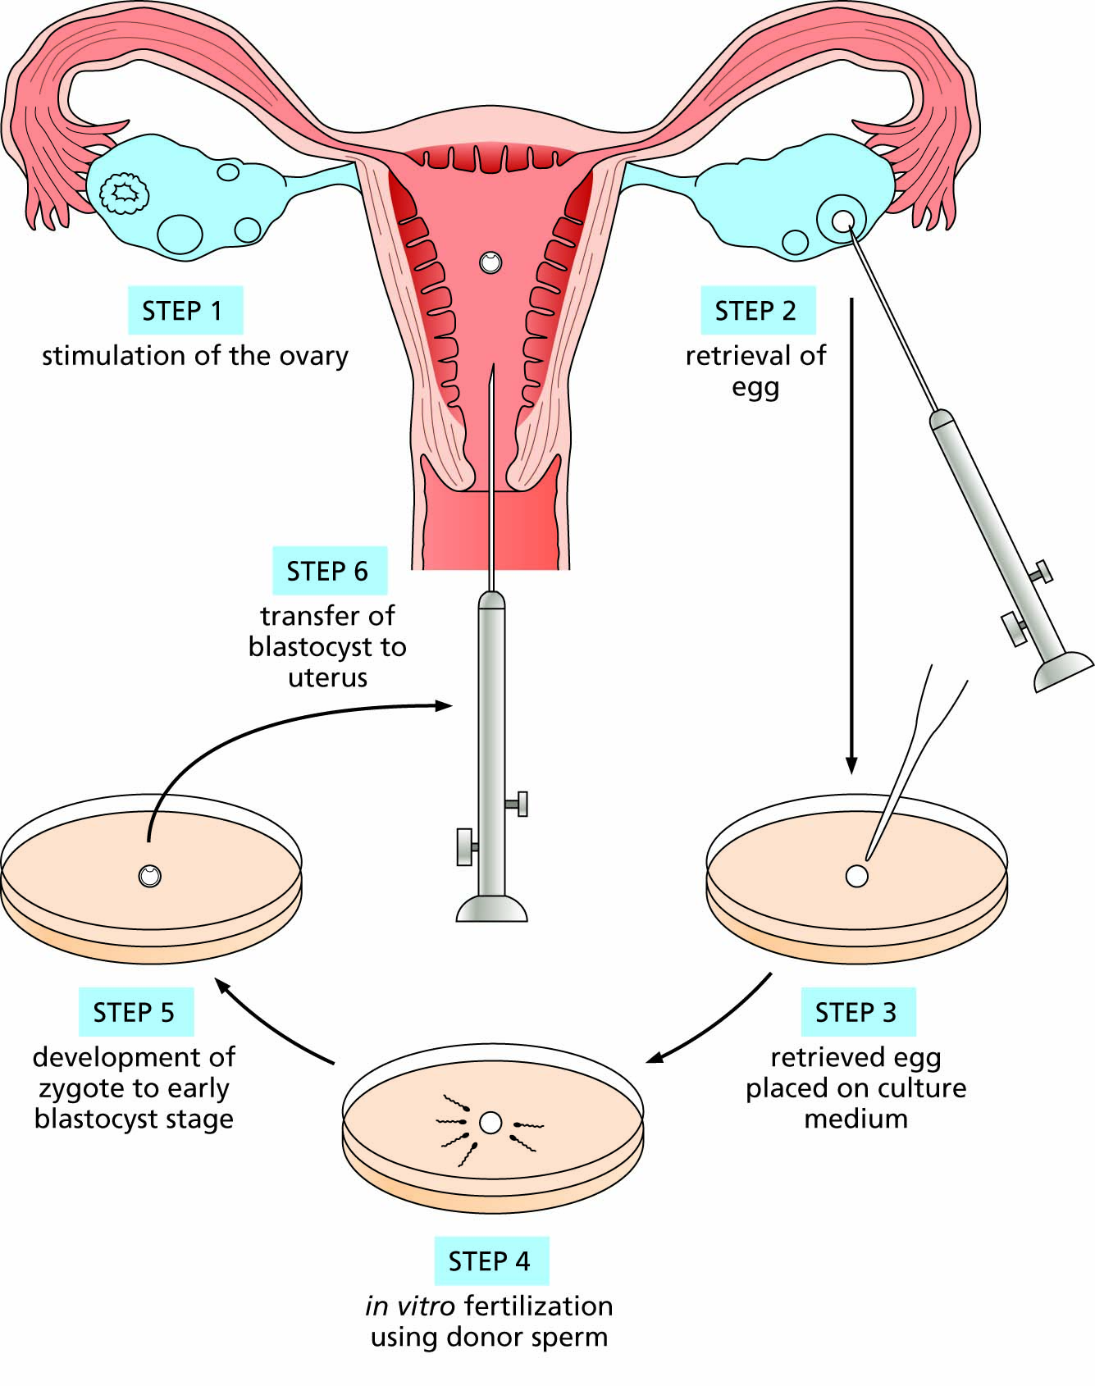
Figure 9.13 Outline of the procedure used for in vitro fertilization.

Slide 19
Can we diminish population growth and its impact?
Birth control acting before fertilization
Birth control acting after fertilization
Cultural and ethical opposition to birth control
Population control movements
The education of women
Controlling population impact

Slide 20
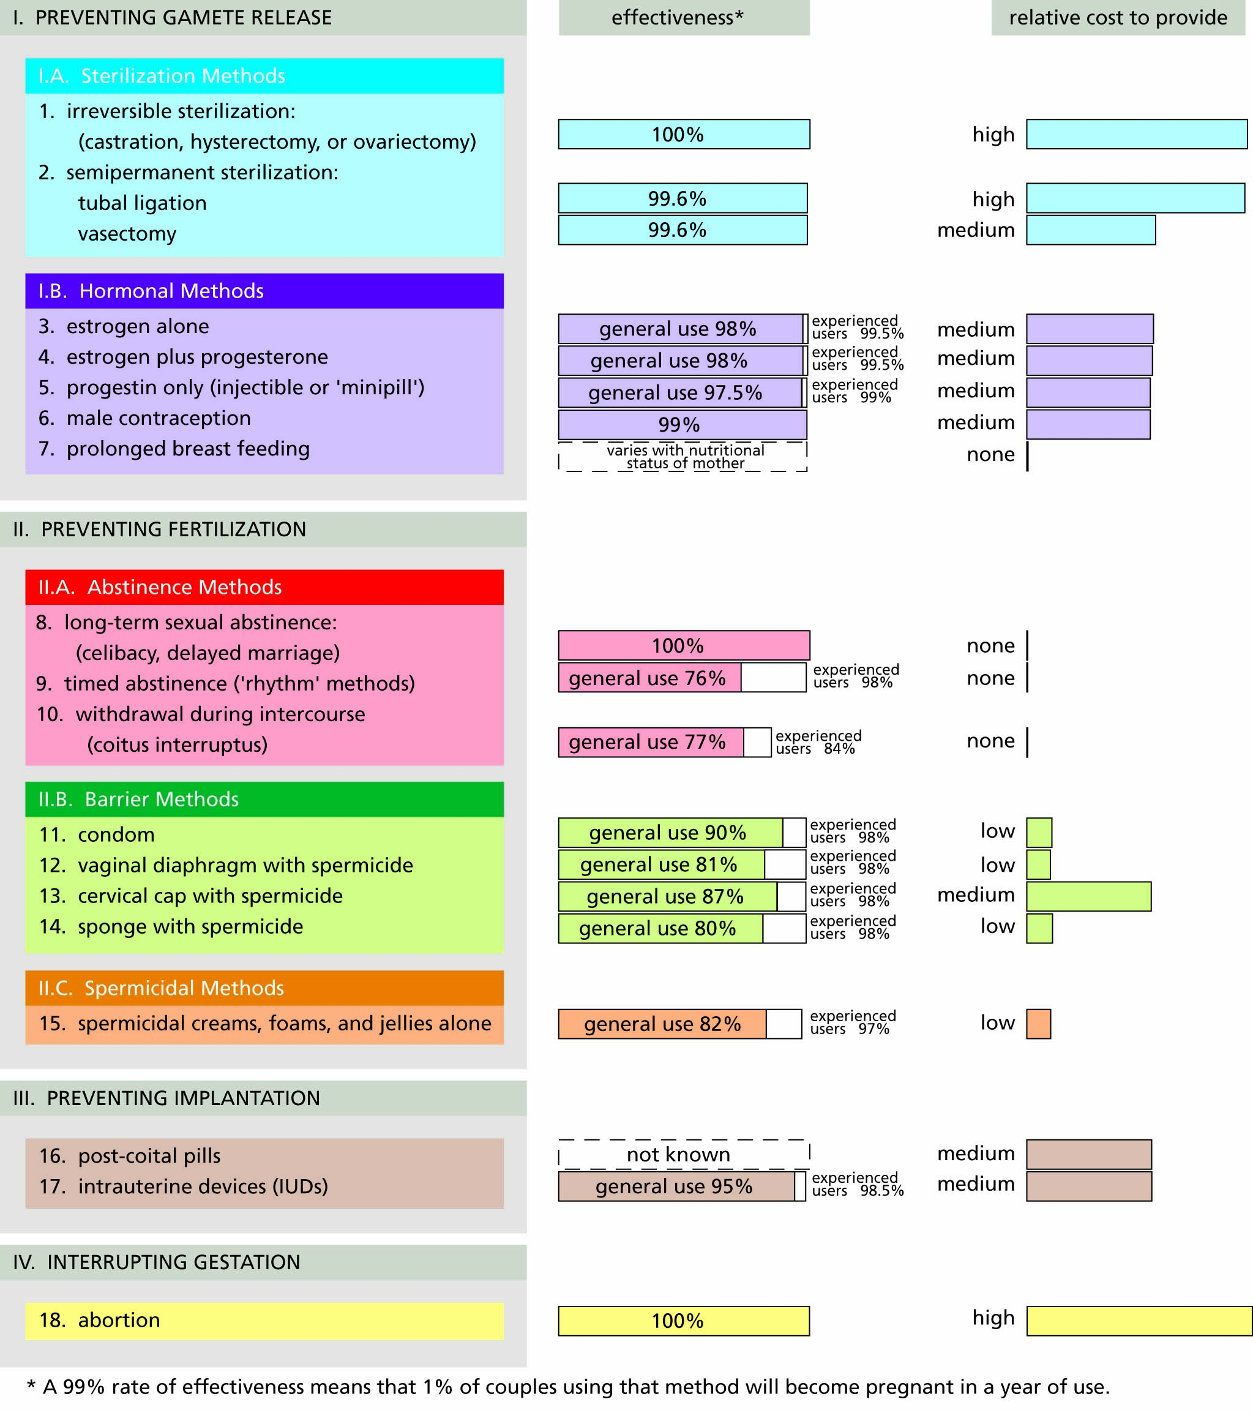
Figure 9.14 Methods of birth control.

Slide 21
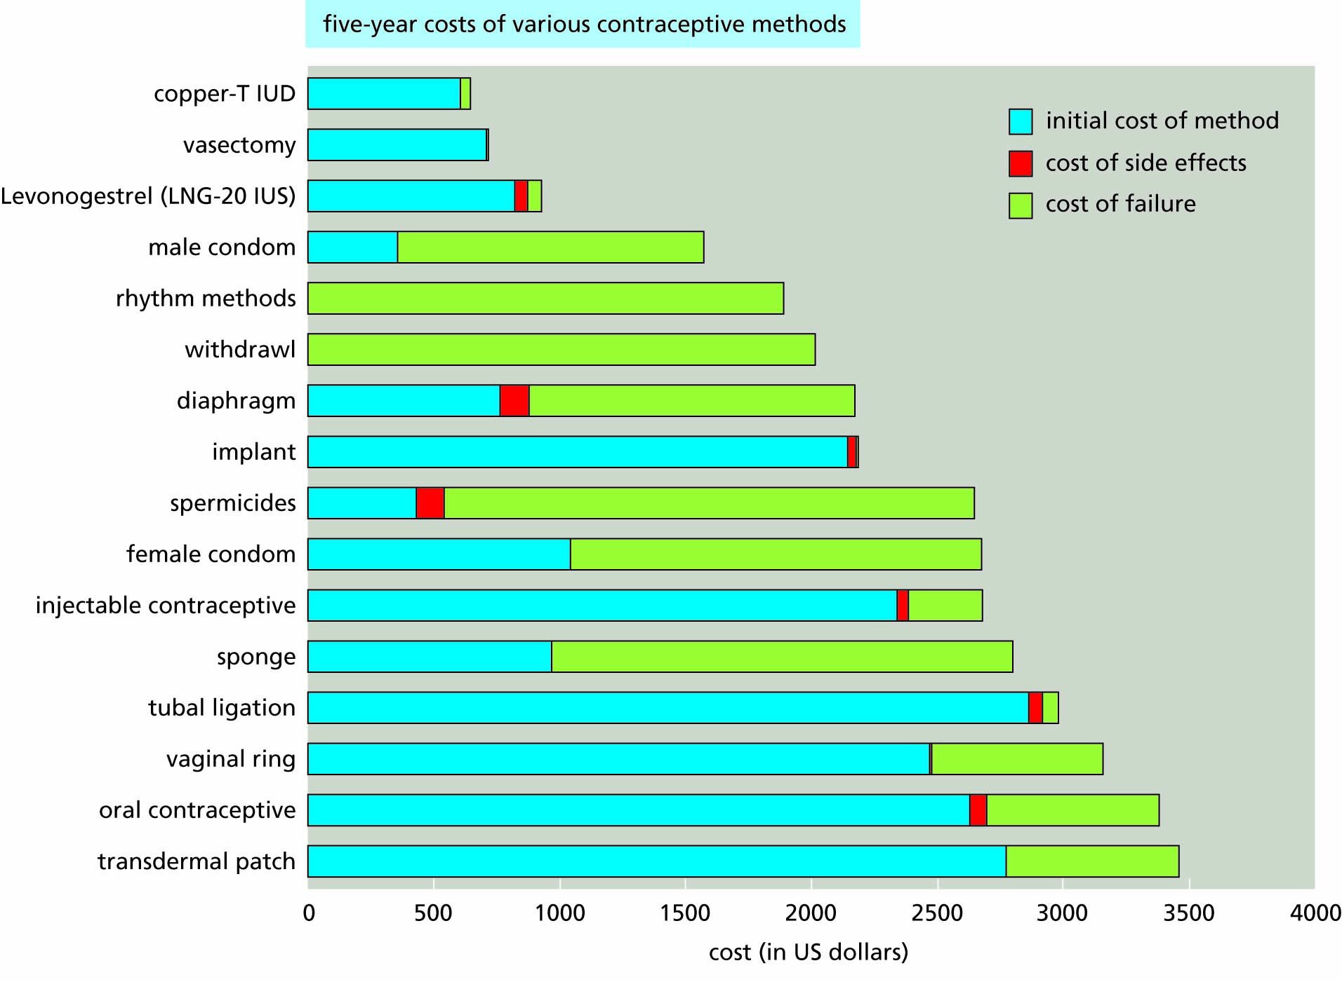
Figure 9.15 Relative costs (over five years of use) of various birth control methods under the type of medical insurance plans common in the United States. For many methods, the largest costs are those associated with unwanted pregnancies resulting from the method’s failure. (Based on data from Trussel et al., 2009.)

Slide 22

Figure 9.16 A poster promoting birth control in China. The poster reads, “Birth control benefits the nation and benefits the people”.

Slide 23
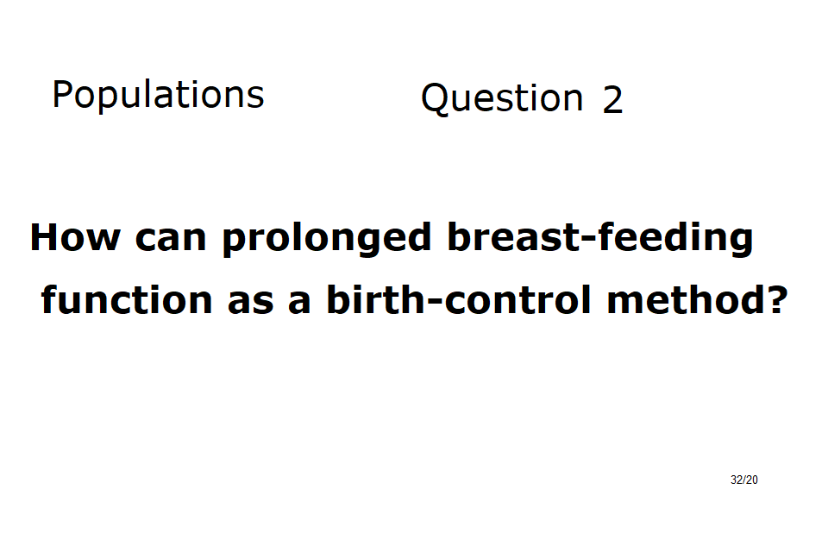

Slide 24
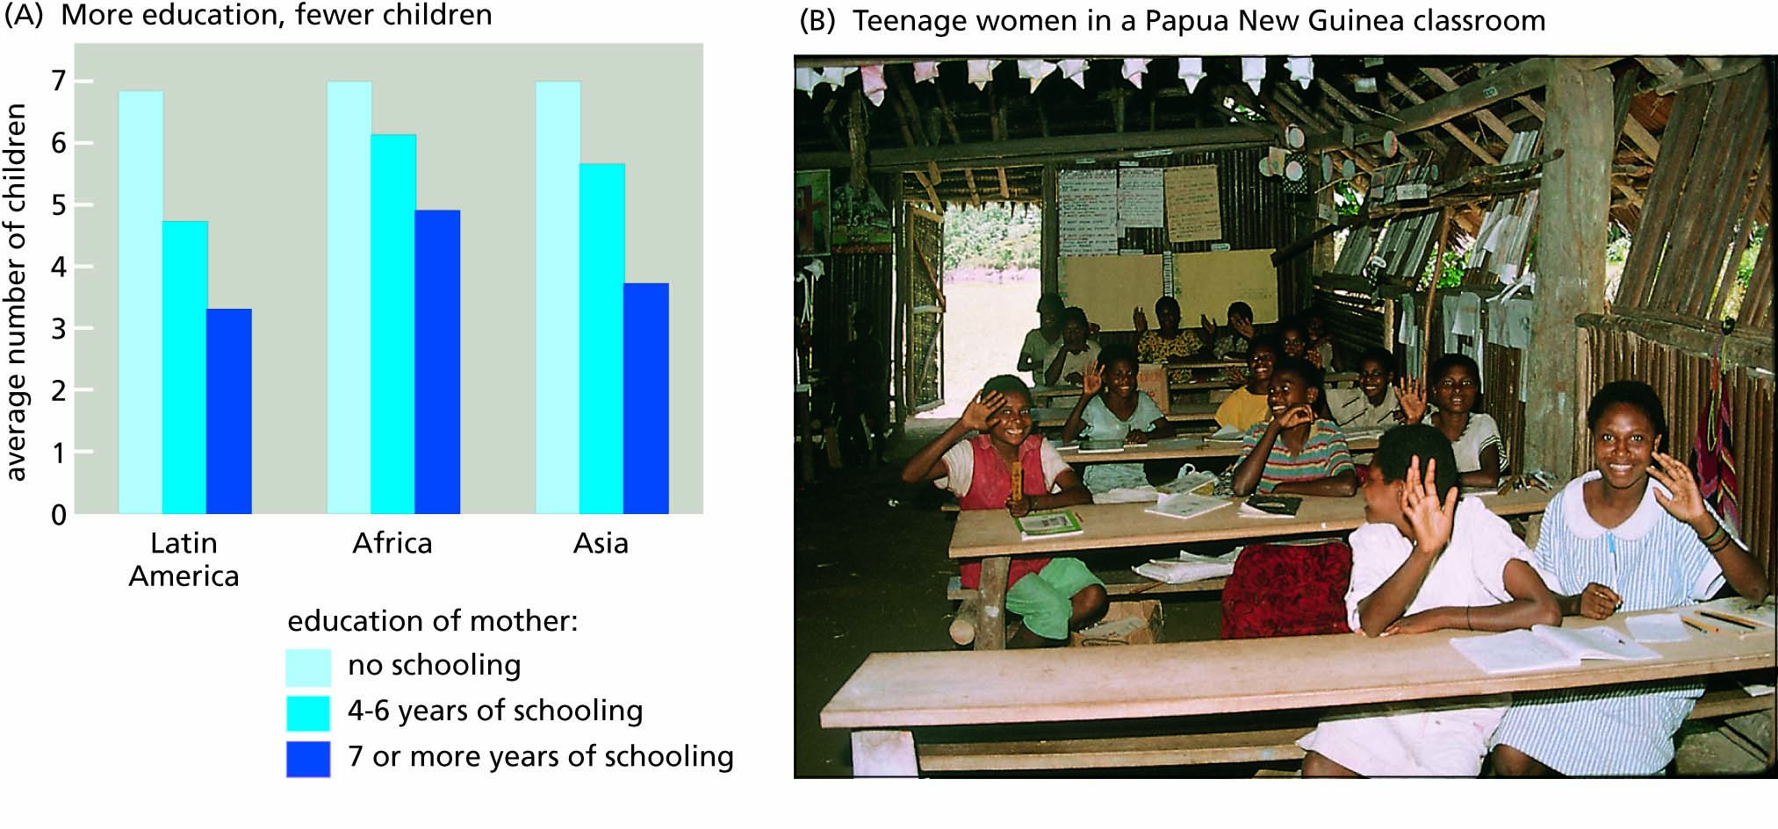
Figure 9.17 The education of women reduces the average number of children per family. Data for the graph are from the World Bank.

