Slide 1
Chapter 6: Classifying Nature’s Diversity
Biology Trending, 4e
Eli Minkoff and Jennifer Hood-DeGrenier

Slide 2
Why classification is important
“All those names”
Taxonomic theory

Slide 3
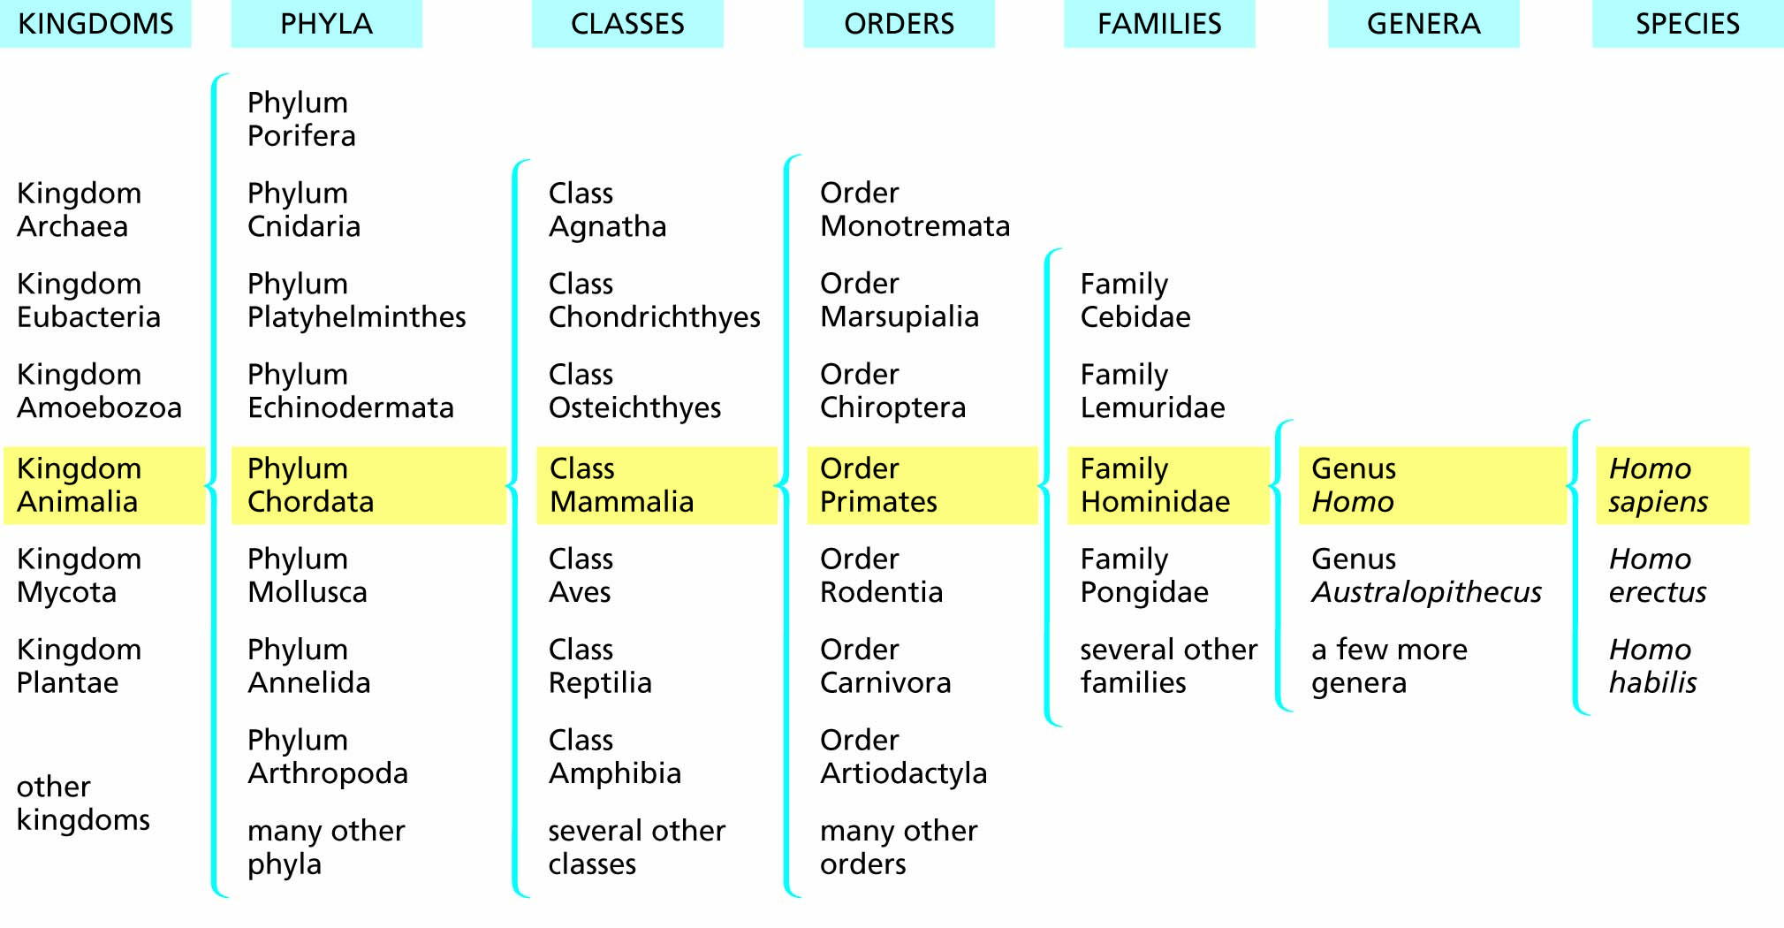
Figure 6.1 The place of the species Homo sapiens in the classification of organisms. Reading from right to left shows the increasingly more inclusive taxa to which our species belongs. Reading from left to right focuses on taxa of increasingly narrow scope.

Slide 4
Prokaryotic cells differ fundamentally from eukaryotic cells
Compartmentalization
Specialization
Prokaryotic cells
Eukaryotic cells

Slide 5
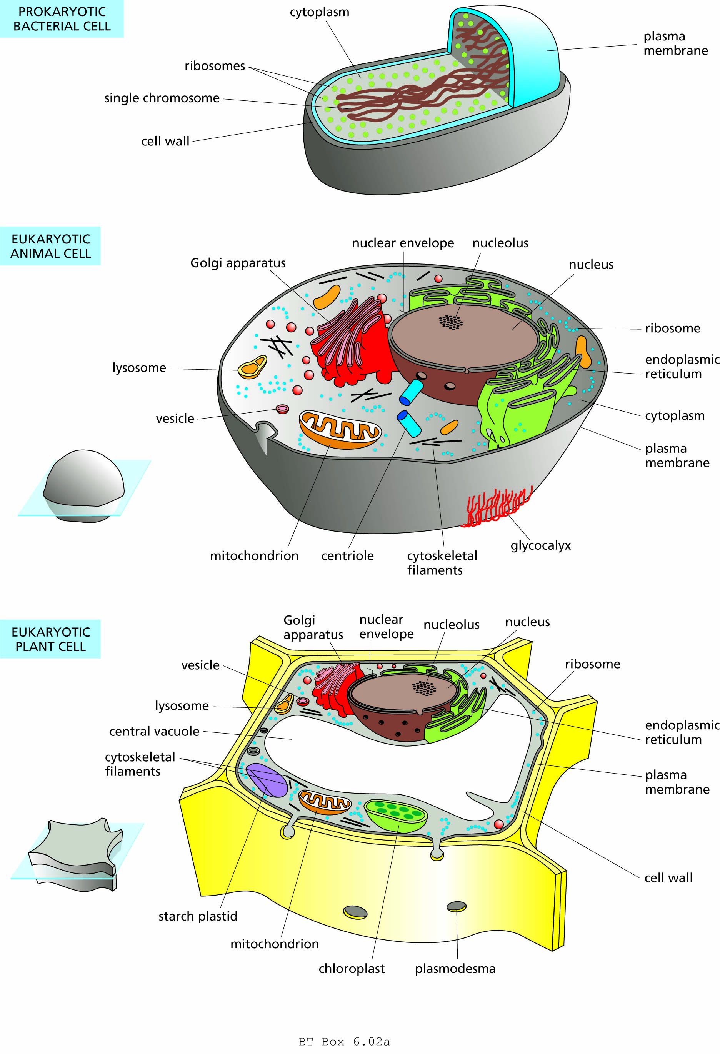
Structure of a prokaryotic cell.

Slide 6
Structure of a eukaryotic cell.

Slide 7
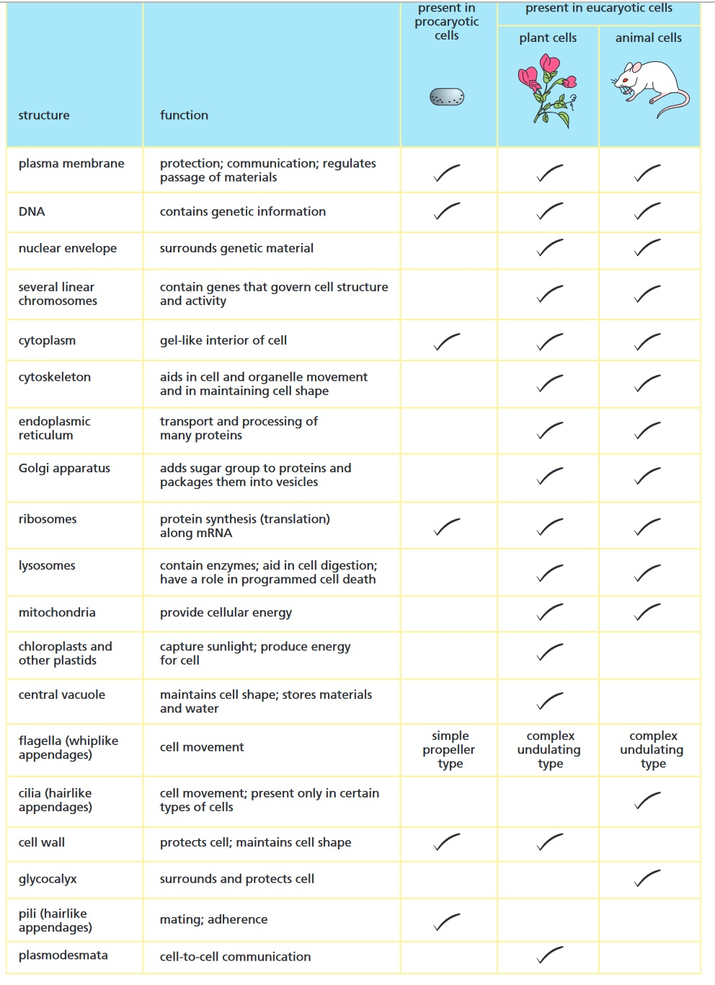

Slide 8
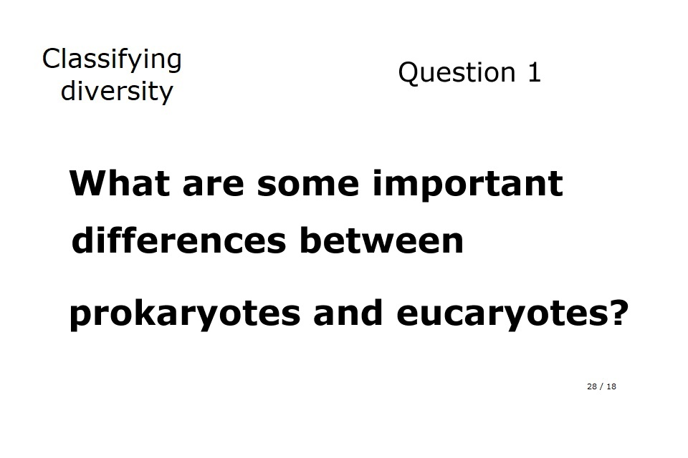

Slide 9
The two domains of prokaryotic organisms
Domain and kingdom archaea
Domain and kingdom eubacteria

Slide 10
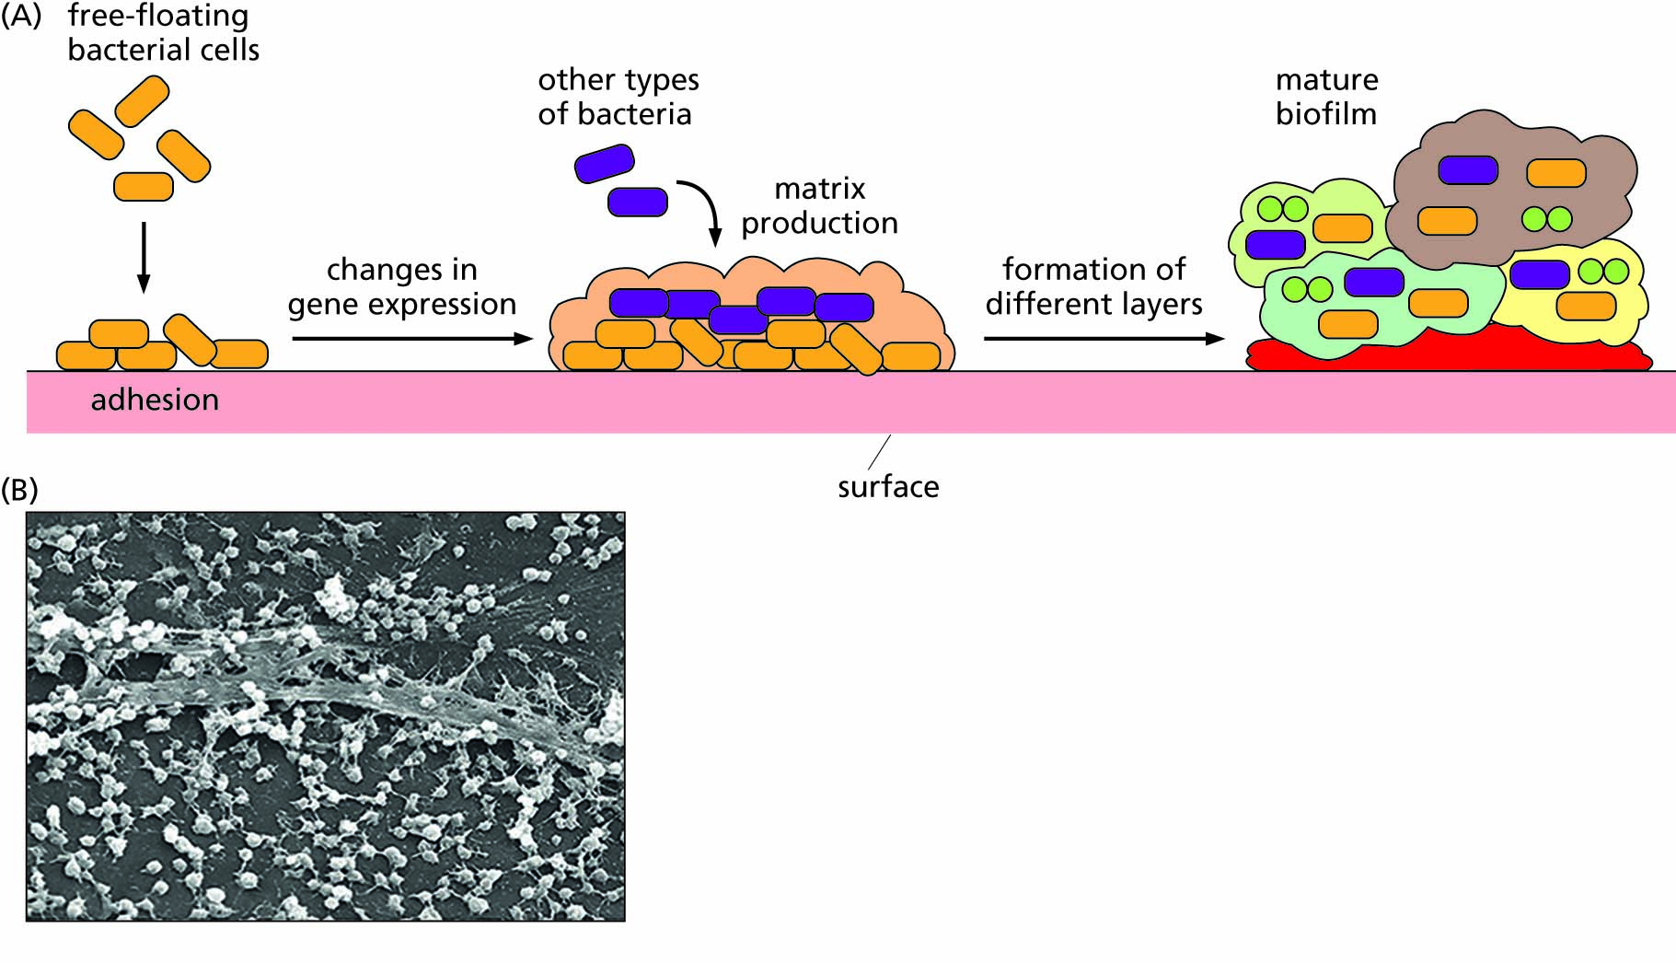
Figure 6.2 Bacteria can sometimes form aggregates where different cells have specialized features and functions. (A) Formation of a biofilm containing multiple bacterial species in distinct functional layers. (B) Scanning electron microscope image of a mature biofilm.

Slide 11
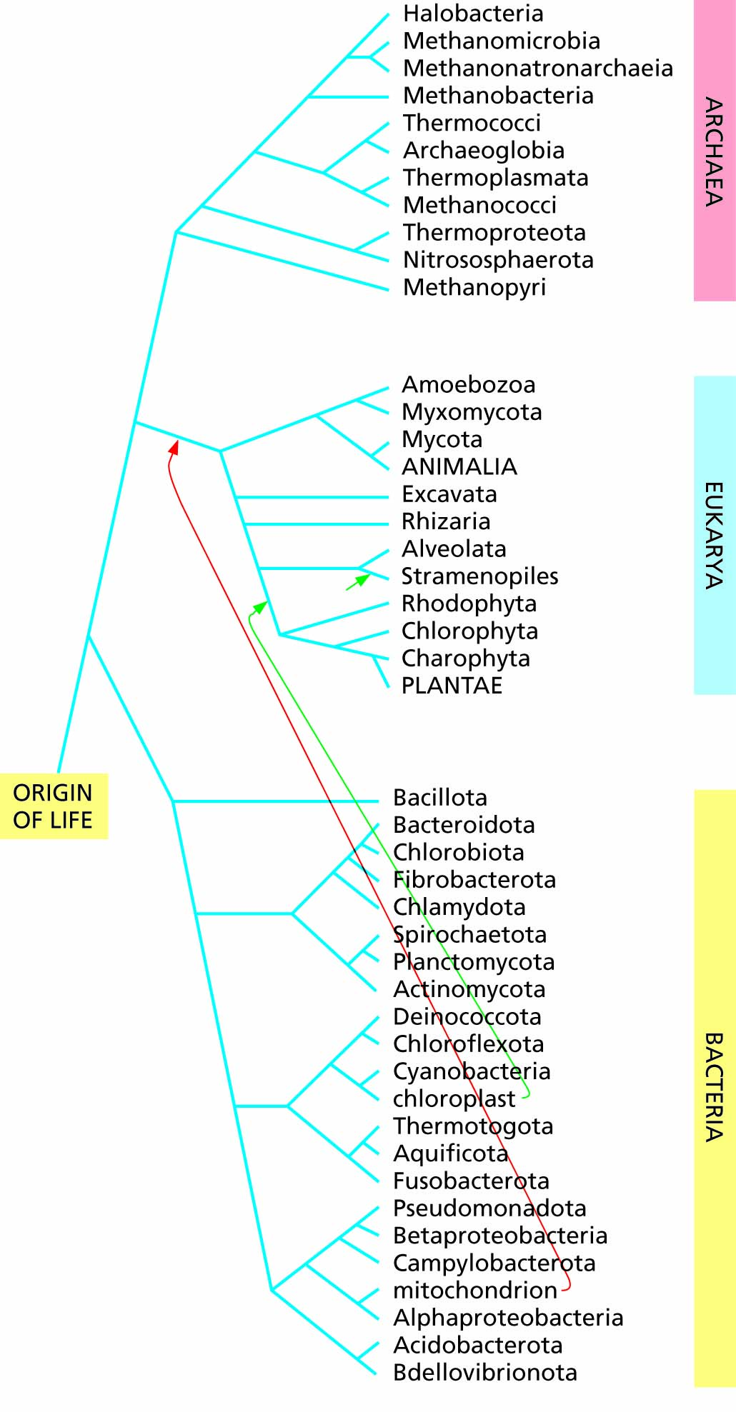
Figure 6.3 A family tree showing the arrangement of organisms into three domains, based on Ciccarelli et al. (2006), Yarza et al. (2008), and Parks et al. (2018), with names of bacterial phyla after Oren and Garrity (2021) wherever possible.

Slide 12
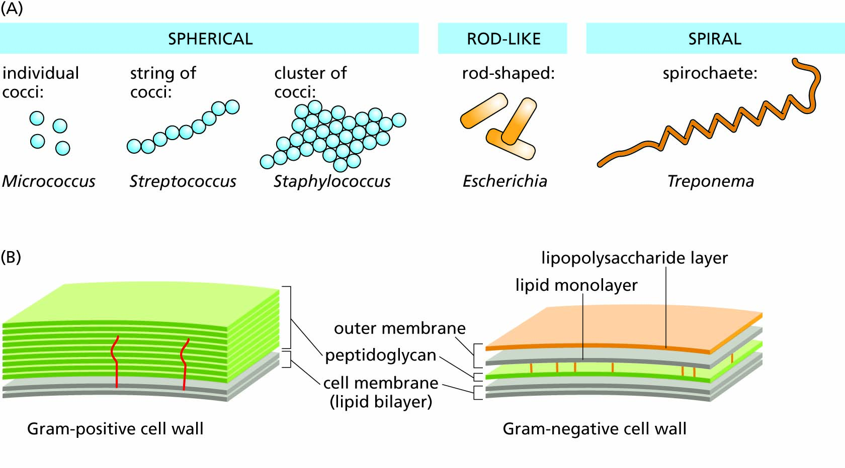
Figure 6.4 Bacterial diversity: (A) in shape; (B) in structure of cell walls.

Slide 13
Evolution and classification of the domain eukarya
Endosymbiosis and the evolution of eukaryotes
Classification of eukaryotic organisms is now based on nucleic acid sequences
The Animal Kingdom

Slide 14
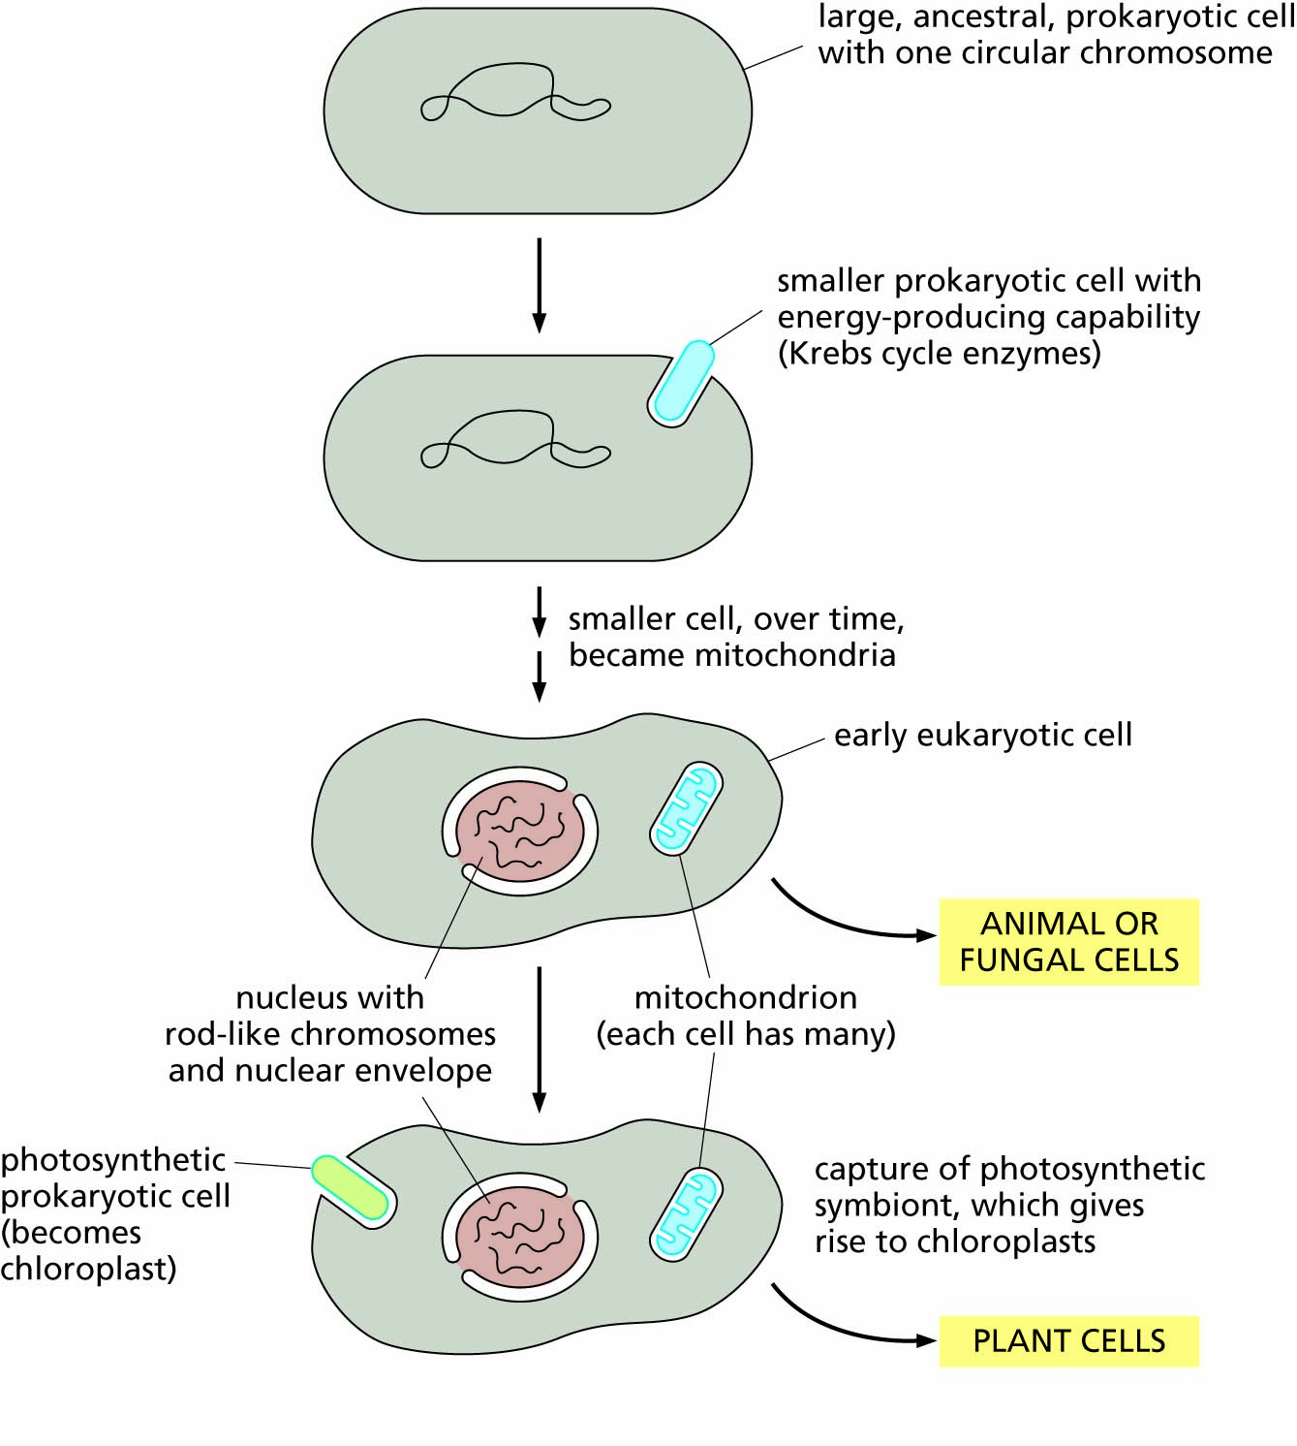
Figure 6.5 The origin of eukaryotic cells according to the widely accepted theory of endosymbiosis.

Slide 15
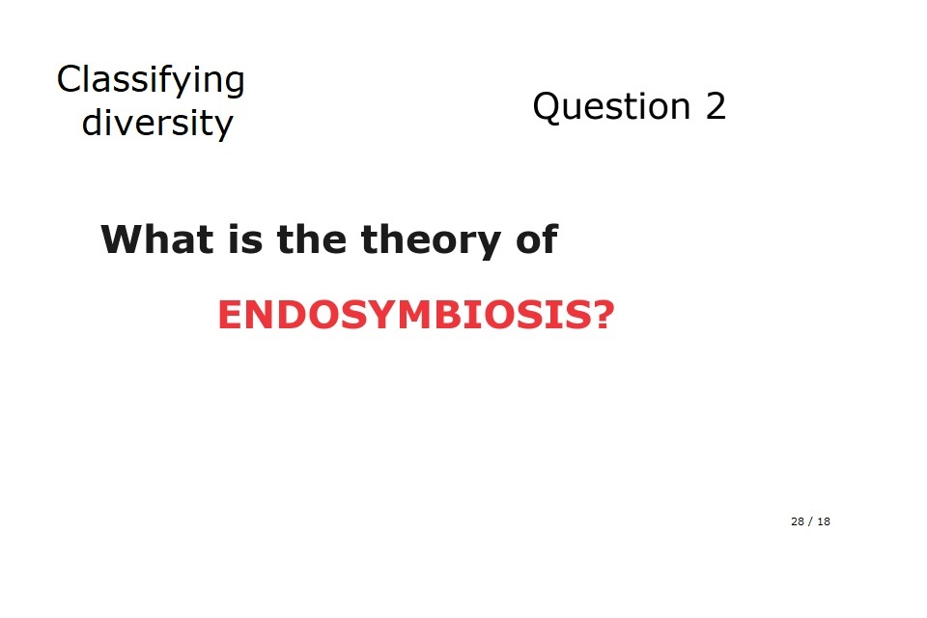

Slide 16
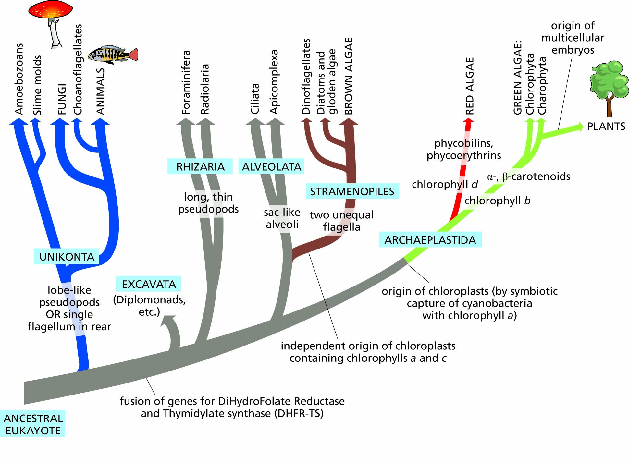
Figure 6.6 A family tree of Eukarya, as currently conceived.

Slide 17
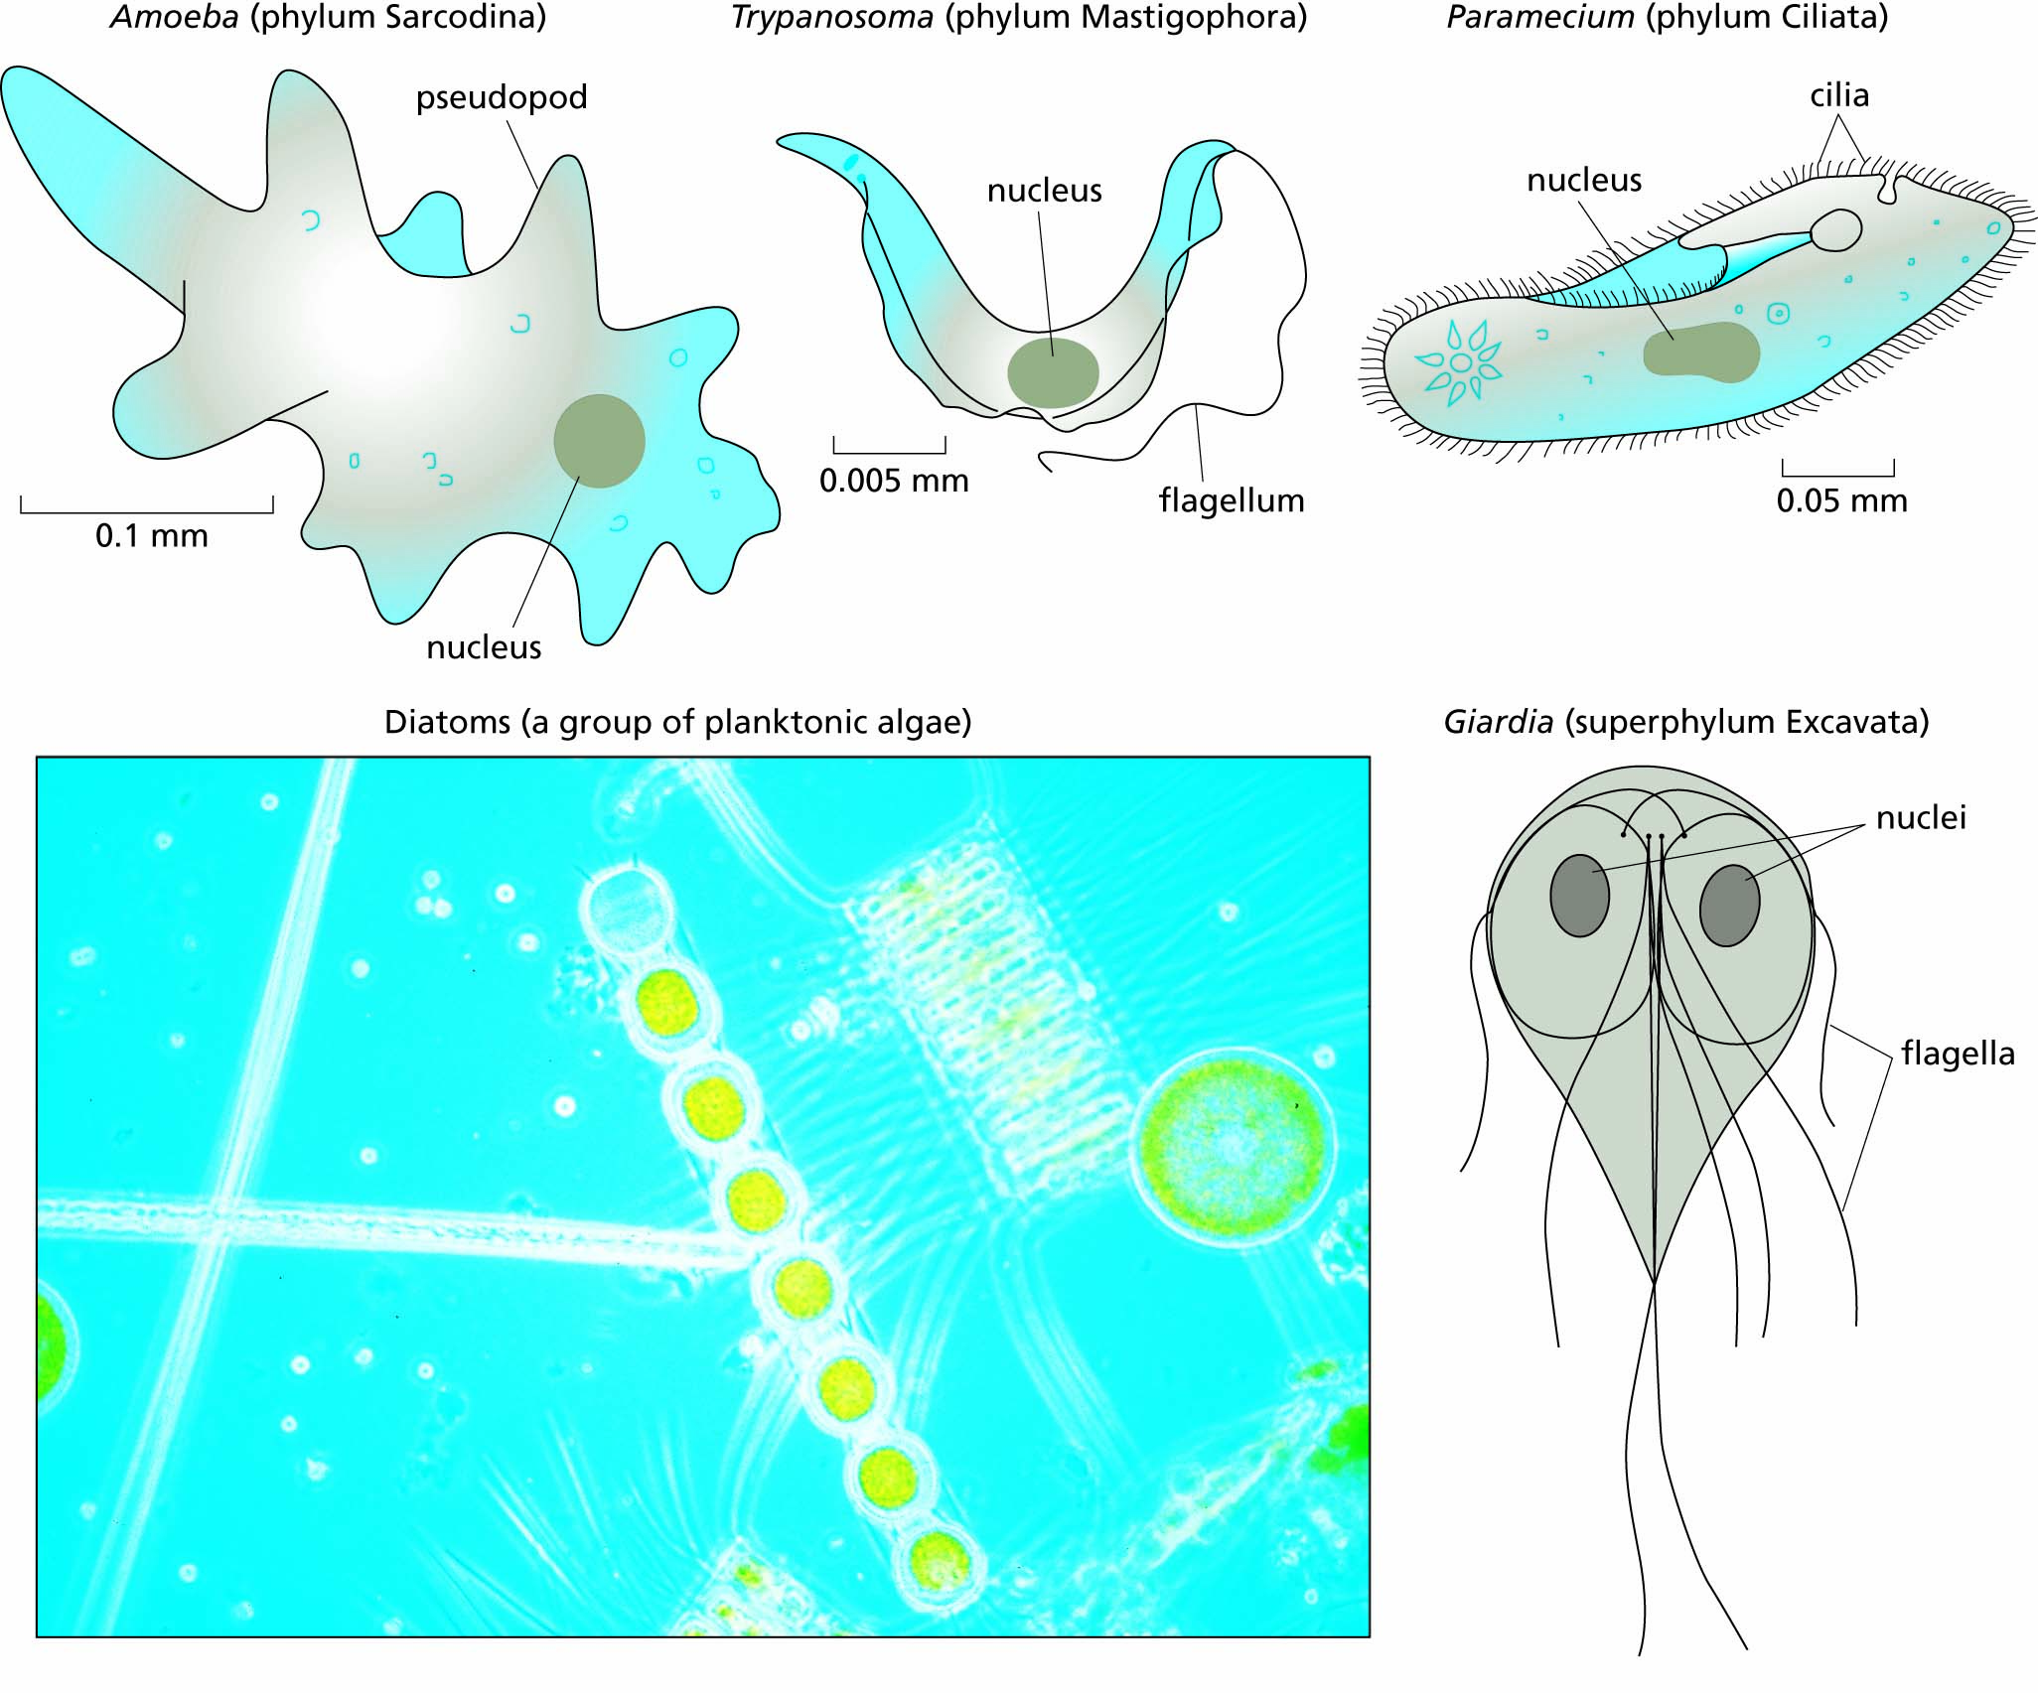
Figure 6.7 Representative single-celled eukaryotes.

Slide 18
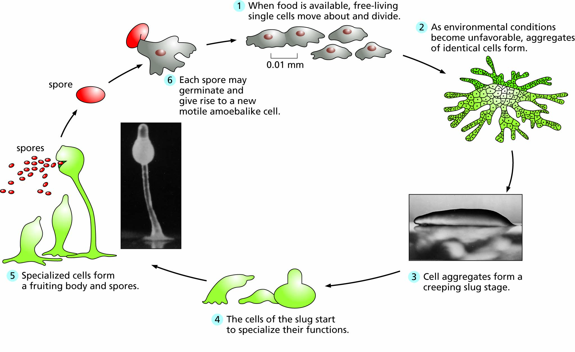
Figure 6.8 Life cycle of the slime mold Dictyostelium.

Slide 19
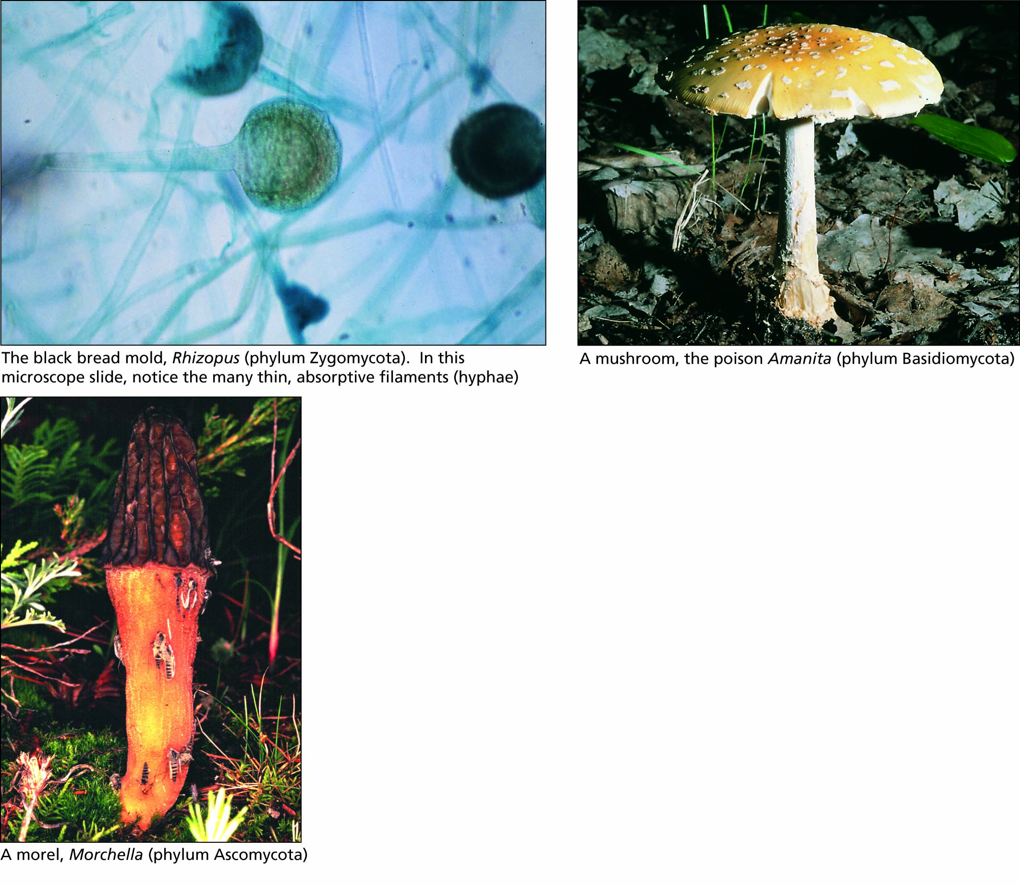
Figure 6.9 Some types of fungi (kingdom Mycota).

Slide 20
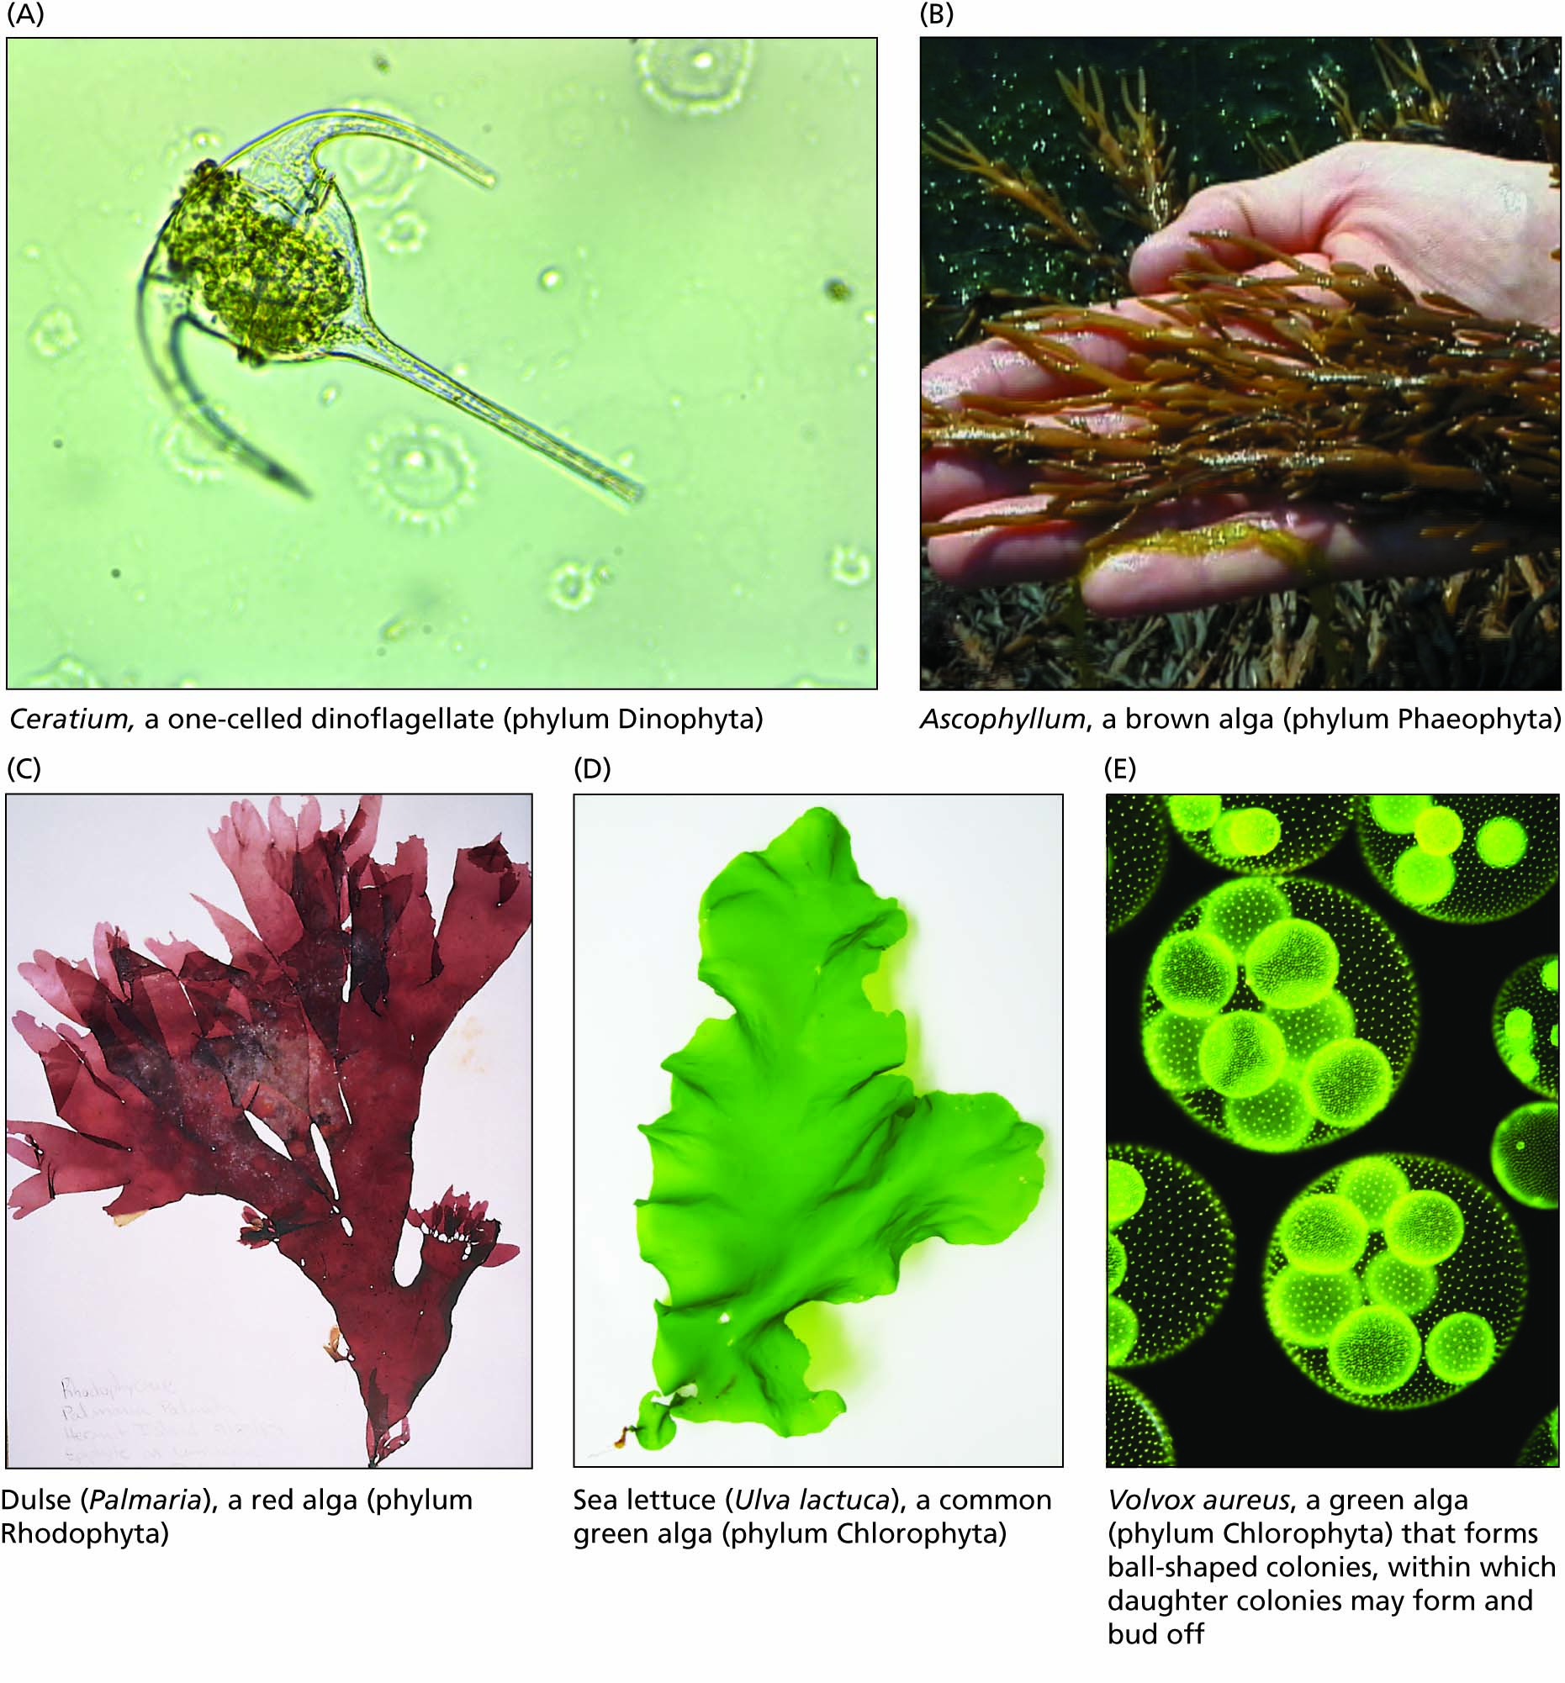
Figure 6.10 Various algae. Their different photosynthetic pigments are responsible for many different colors.

Slide 21
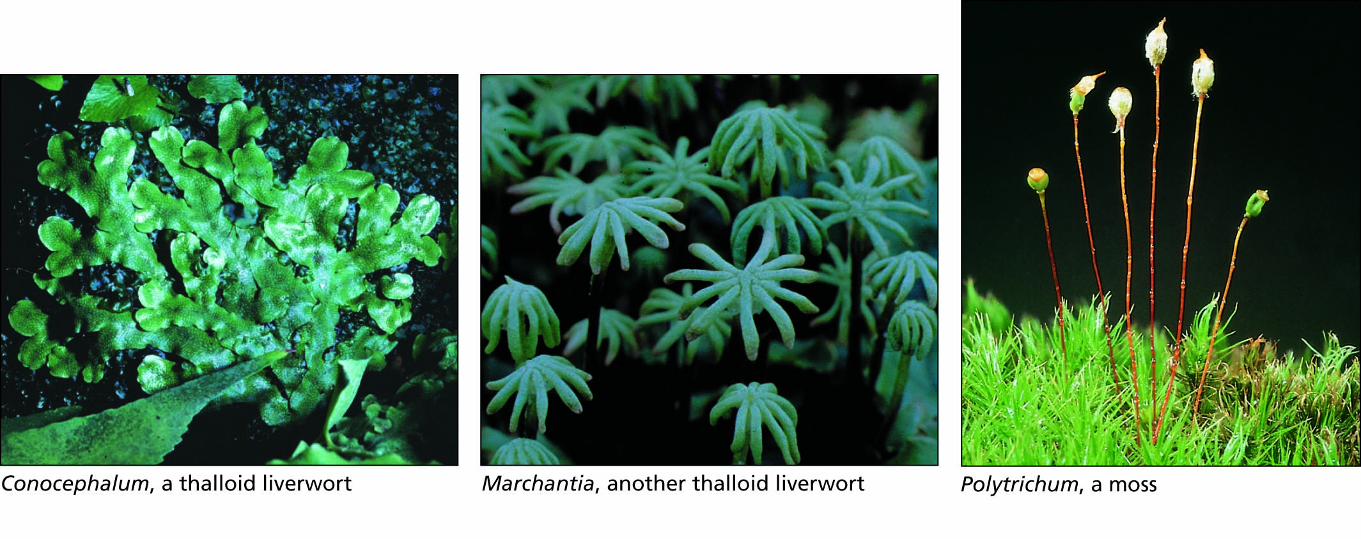
Figure 6.11 Representative bryophytes (phylum Bryophyta). These are land plants with protective cells surrounding the egg, but their lack of vascular tissues keeps them small.

Slide 22
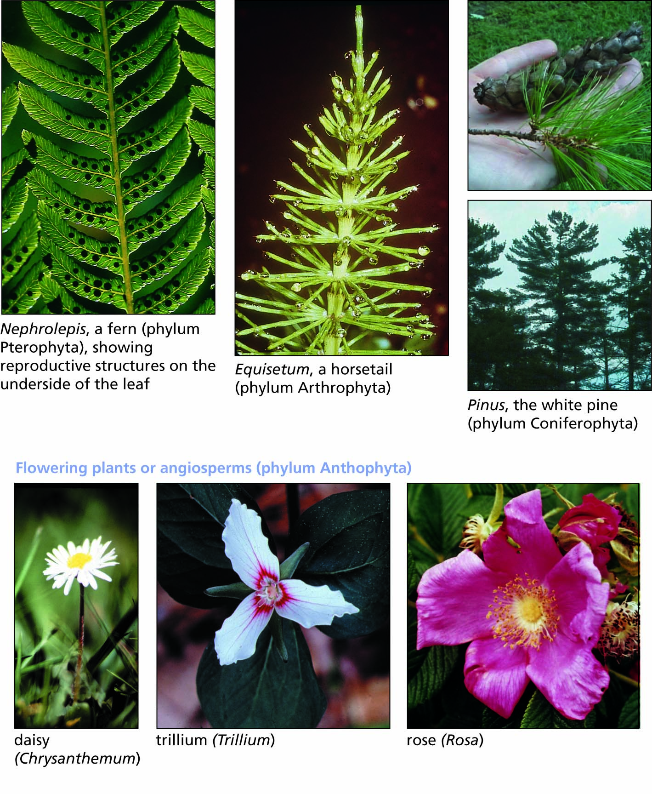
Figure 6.12 An assortment of vascular plants (Tracheophyta), belonging to several groups.

Slide 23
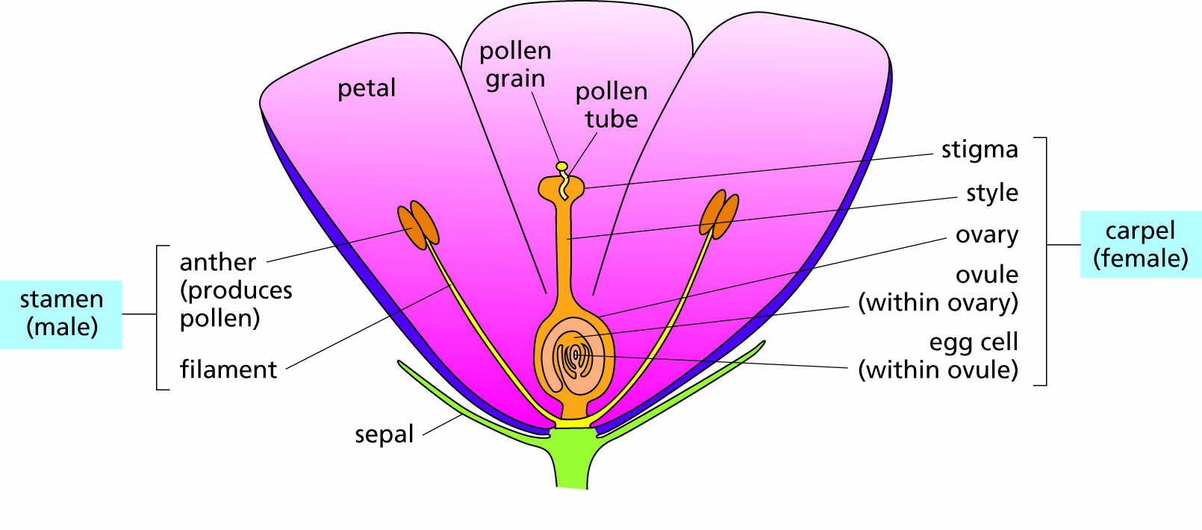
Figure 6.13 Diagram of a complete flower, containing both male and female parts together. After fertilization and ripening, the ovary becomes a fruit. Variations in the number and structure of the parts shown here are among the most useful characters in plant classification. Some plants have incomplete flowers in which there are separate male flowers with undeveloped female parts and female flowers with undeveloped male parts.

Slide 24
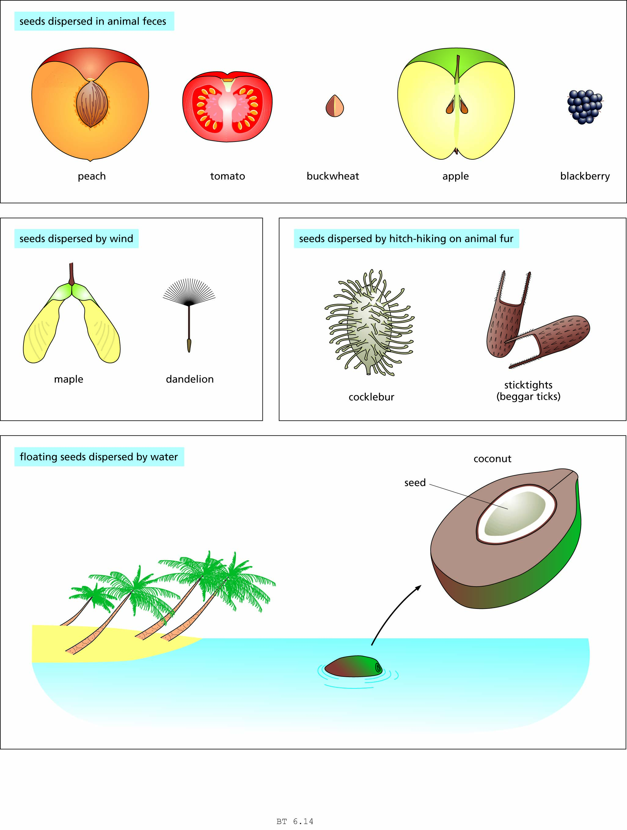
Figure 6.14 The dispersal of seeds in different kinds of fruits.

Slide 25
Domain Eukarya (continued)
The animal kingdom

Slide 26
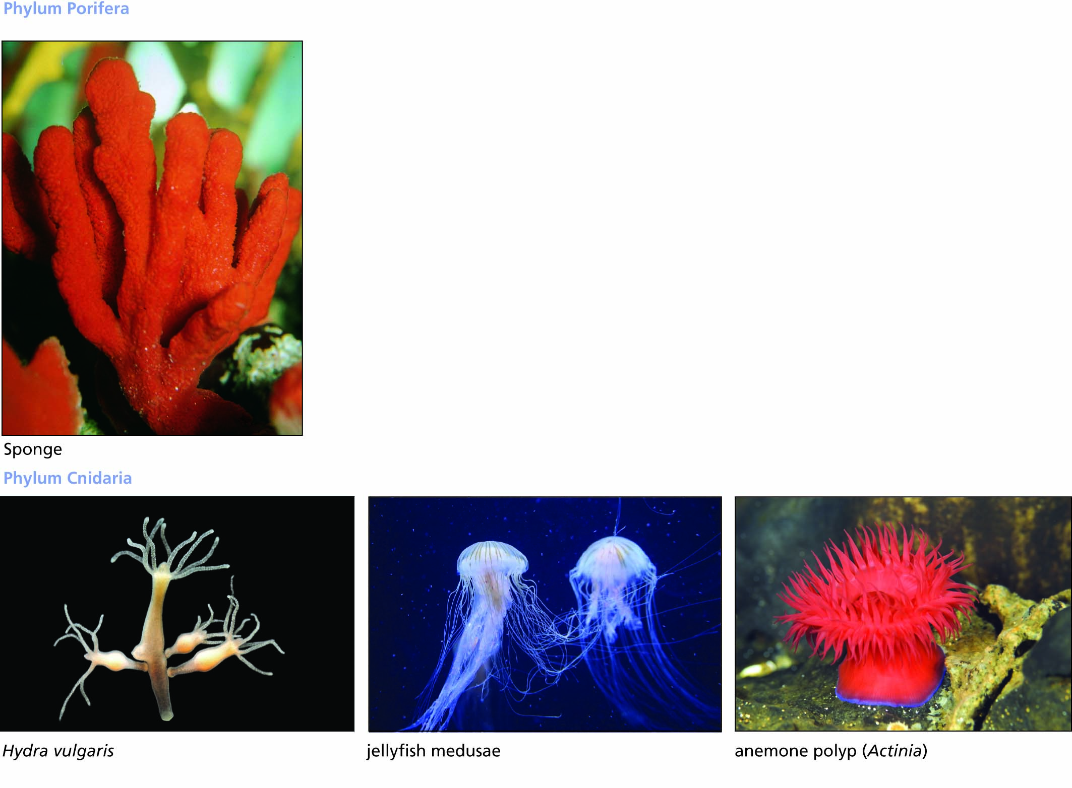
Figure 6.15 Sponges (animals not organized into tissue layers) and cnidarians (animals with radial symmetry and with two tissue layers, an outer ectoderm and an inner endoderm).

Slide 27
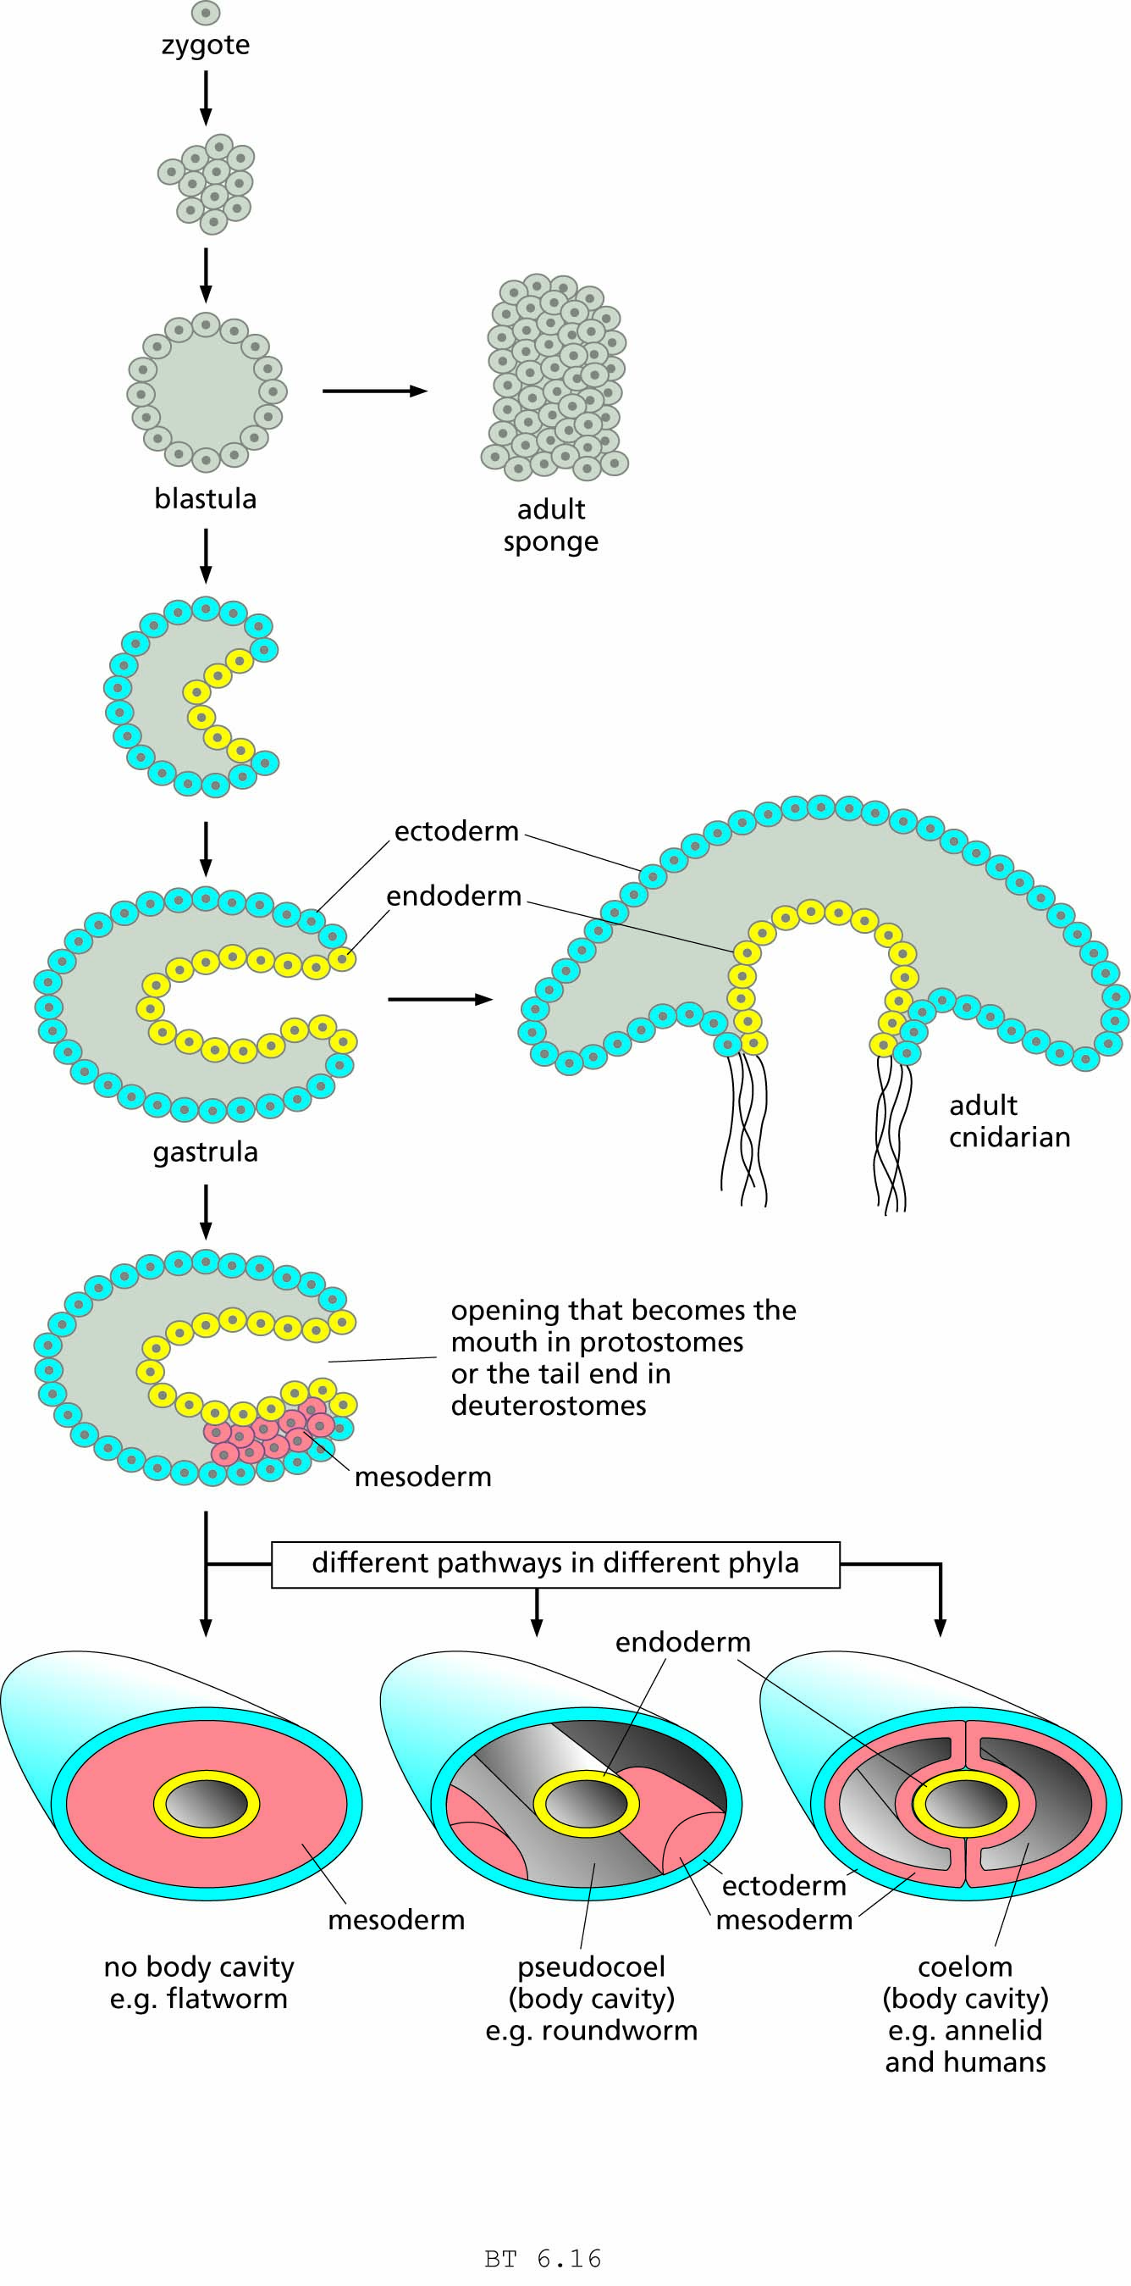
Figure 6.16 Early stages in the embryology of animals. Adult sponges develop directly from a modified blastula stage. All other animals go through both blastula and gastrula stages. Members of the phylum Cnidaria form adult stages that still resemble gastrulas, whereas most other animals develop a middle layer (mesoderm) that gives rise to additional internal organs.

Slide 28
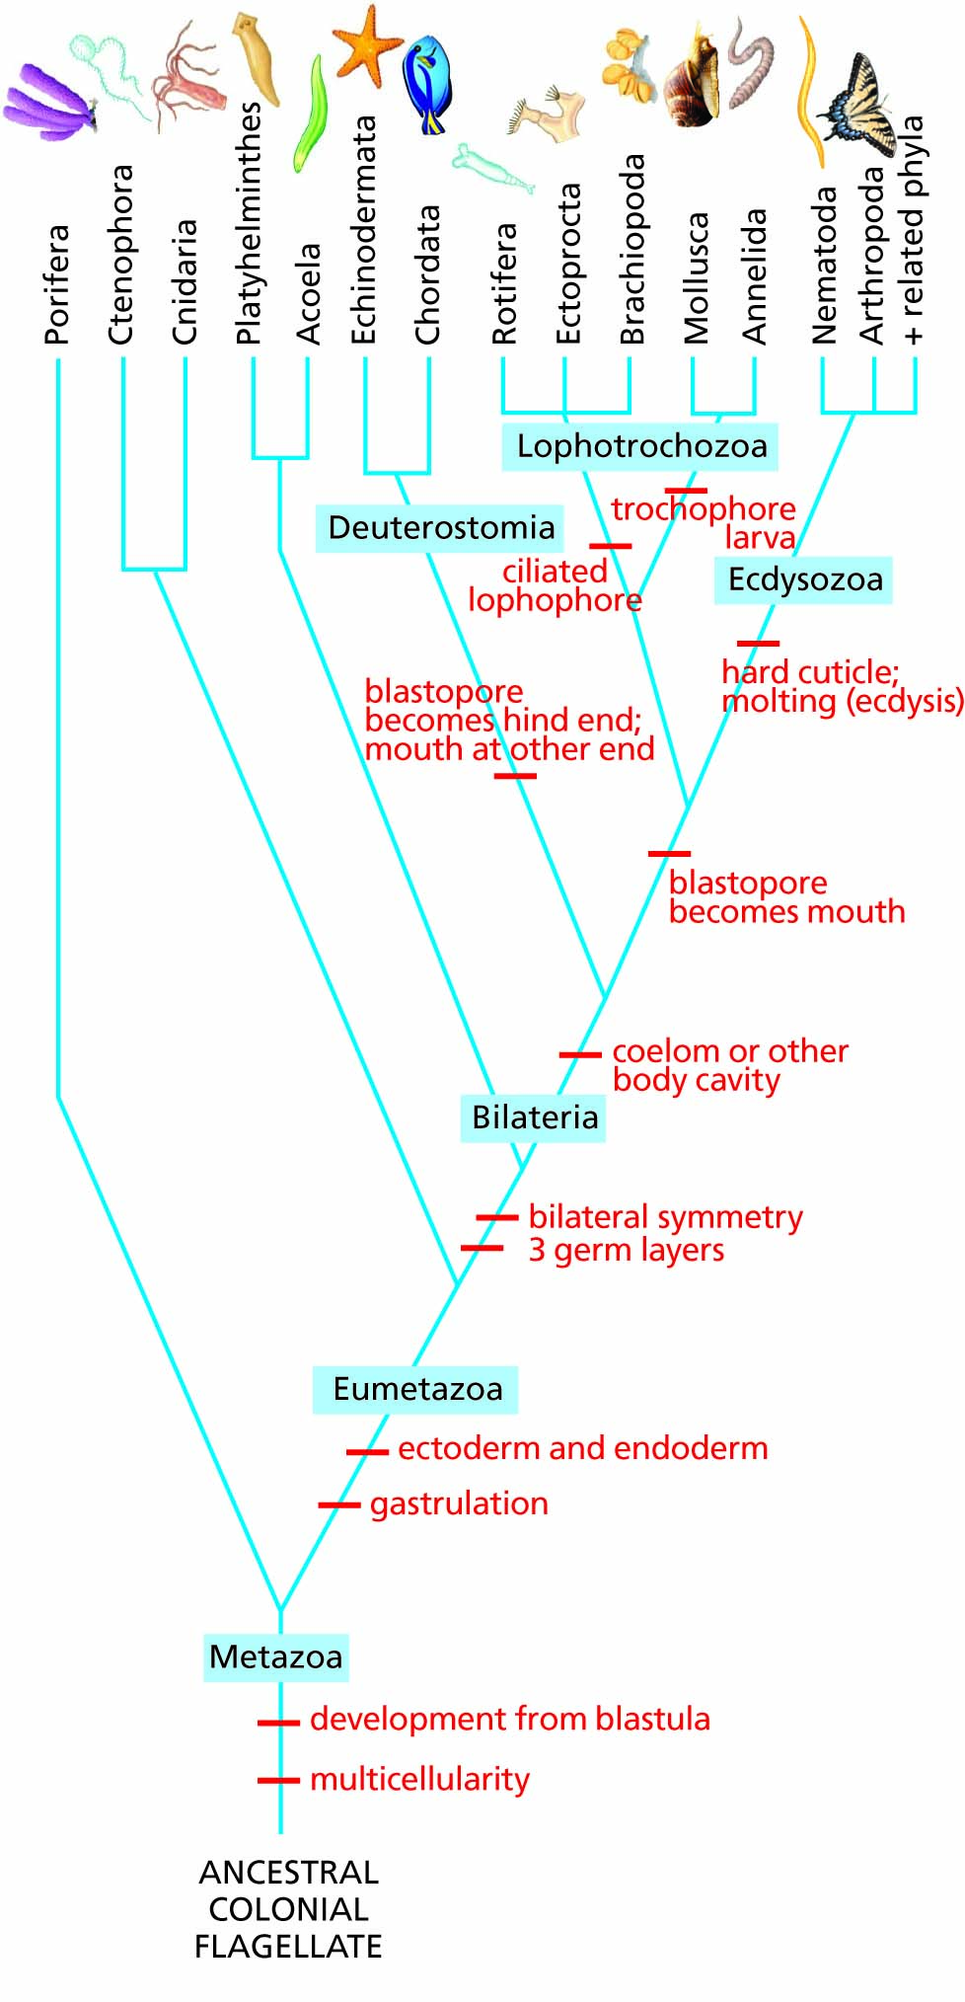
Figure 6.17 A family tree of the major animal phyla.

Slide 29
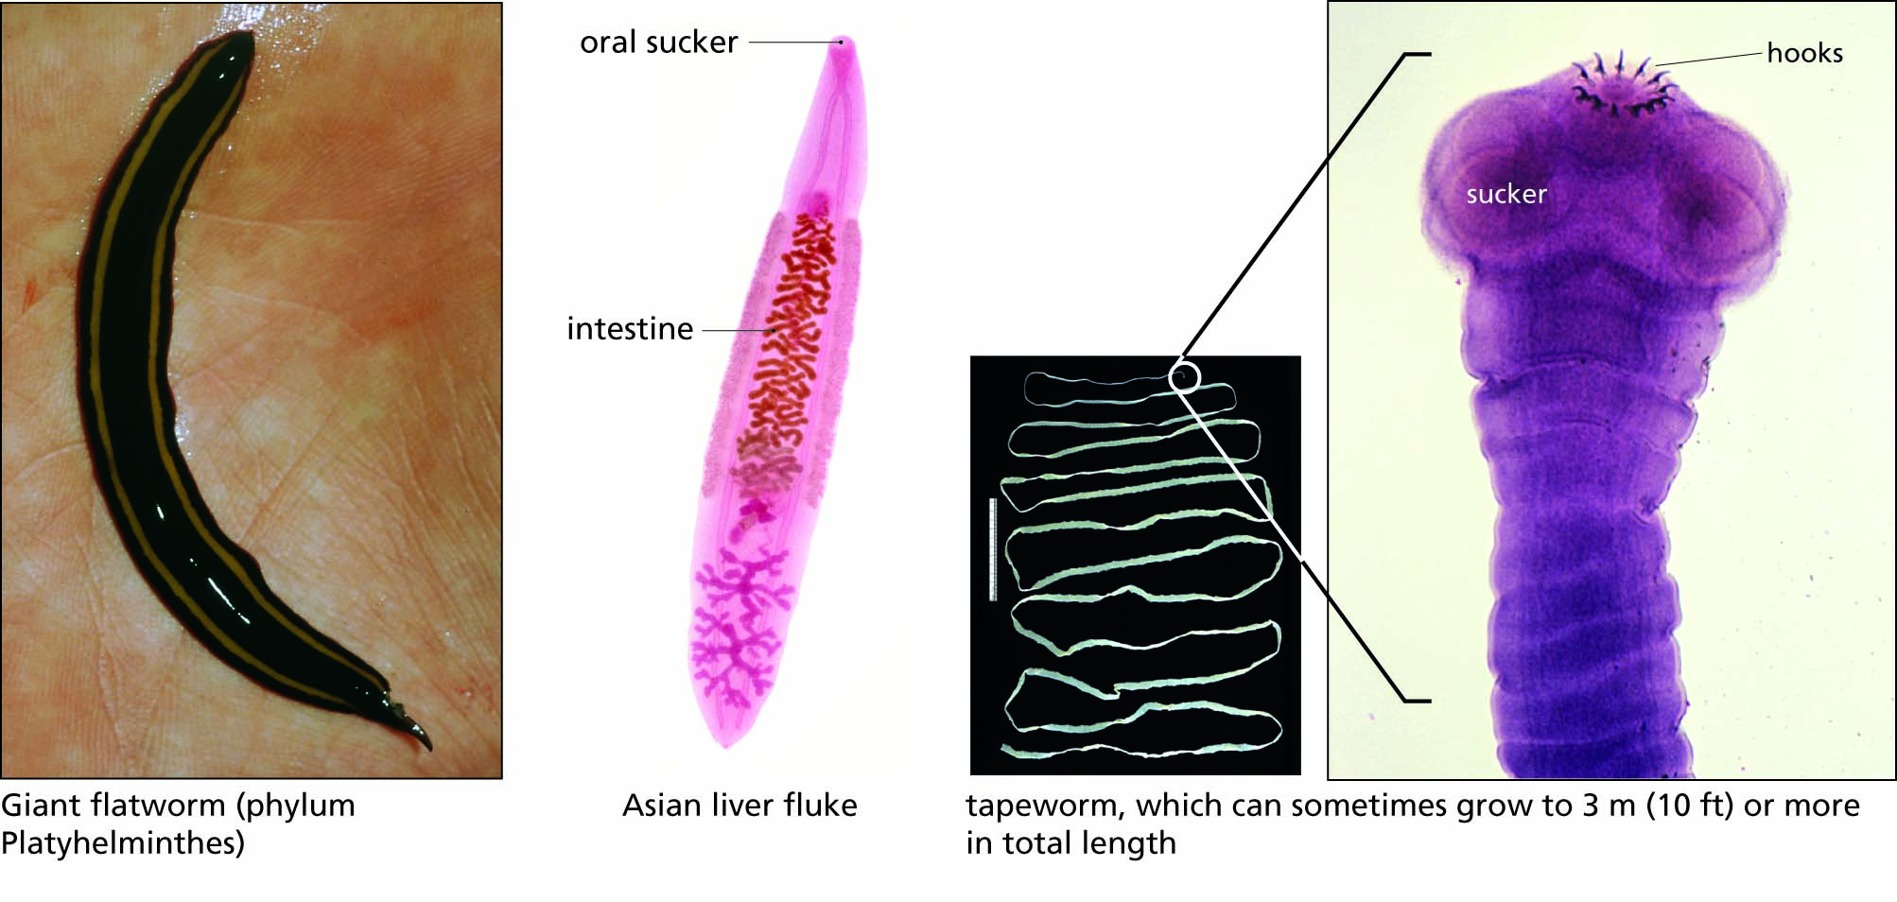
Figure 6.18 Flatworms (phylum Platyhelminthes).

Slide 30
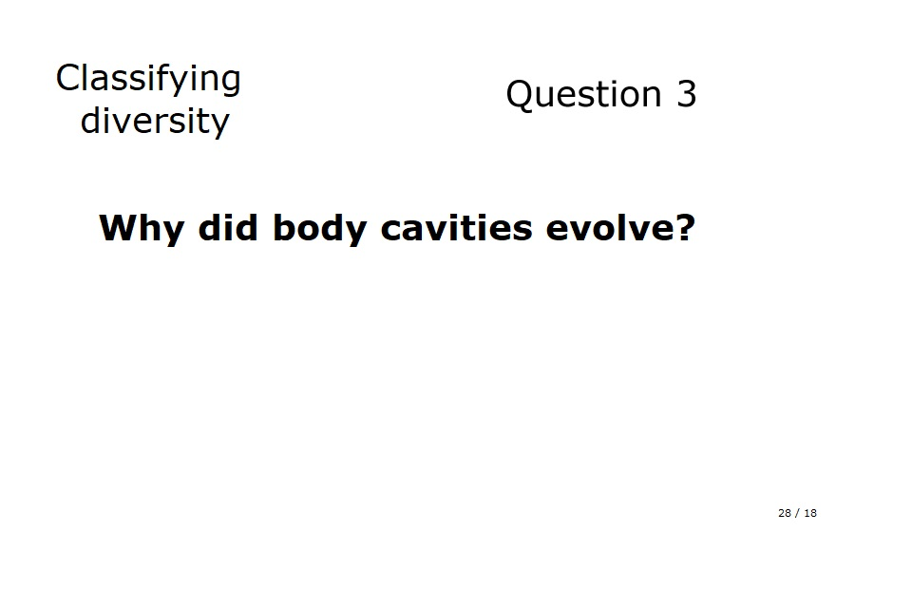
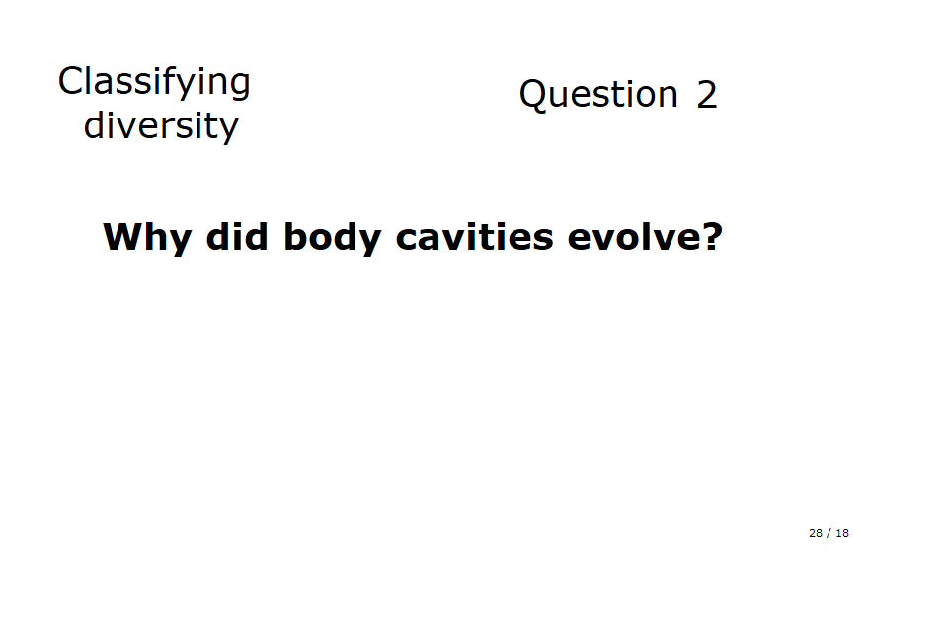

Slide 31
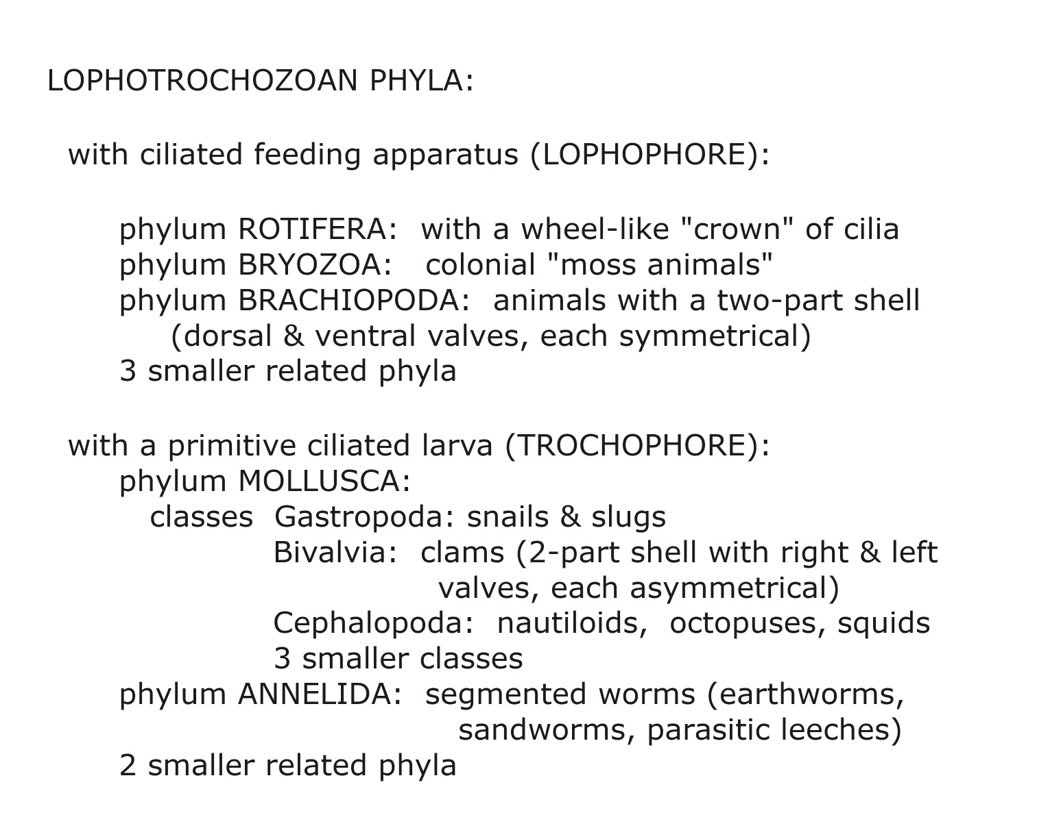

Slide 32
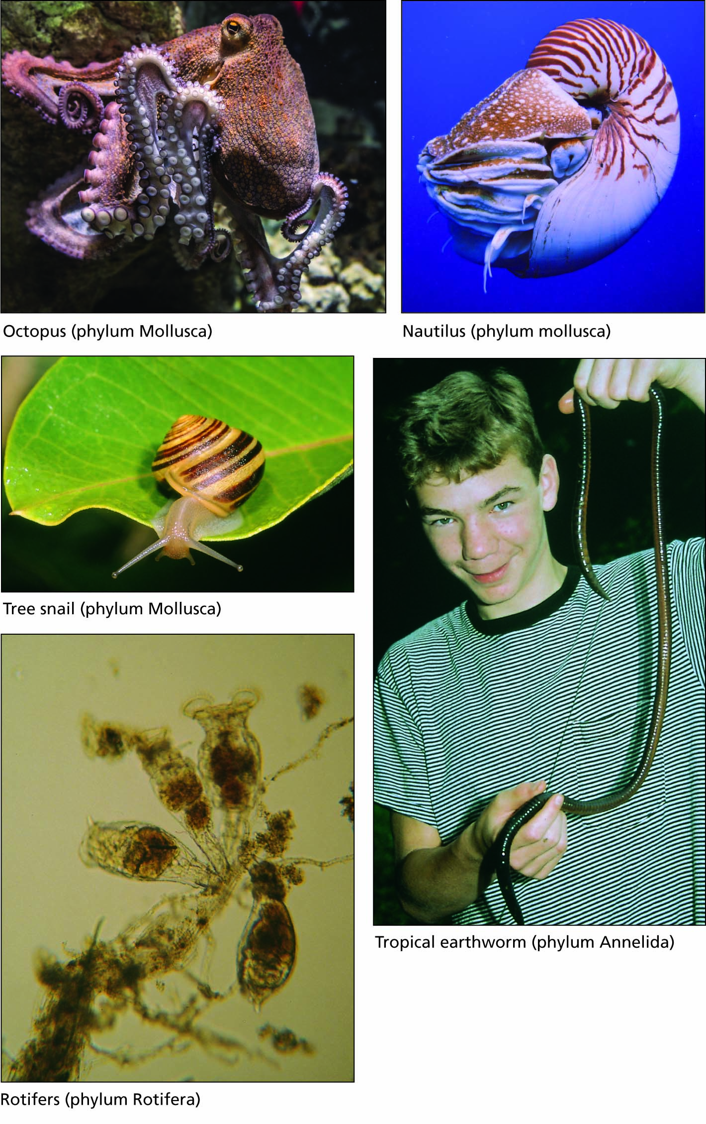
Figure 6.20 Representative invertebrate animals belonging to the lophotrochozoan phyla.

Slide 33
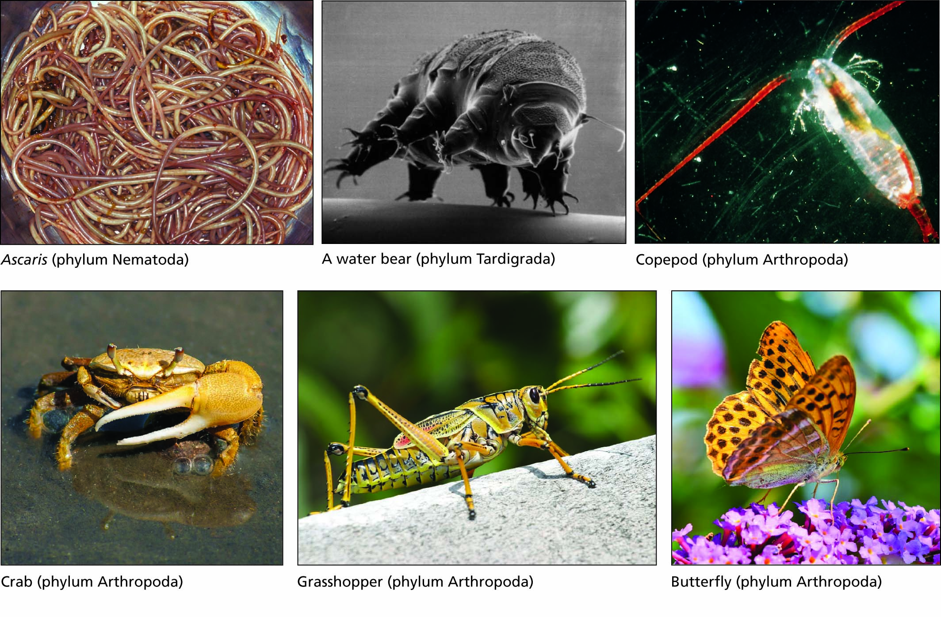
Figure 6.19 Representative invertebrate animals belonging to the Ecdysozoa.

Slide 34
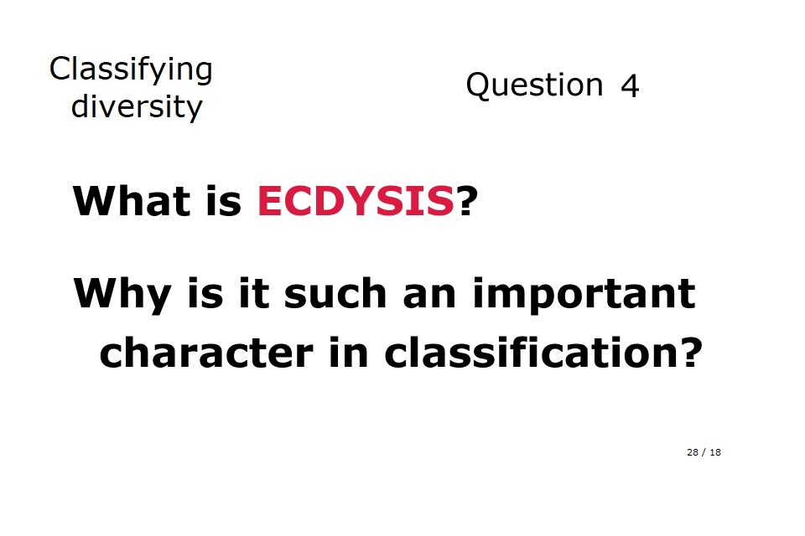

Slide 35
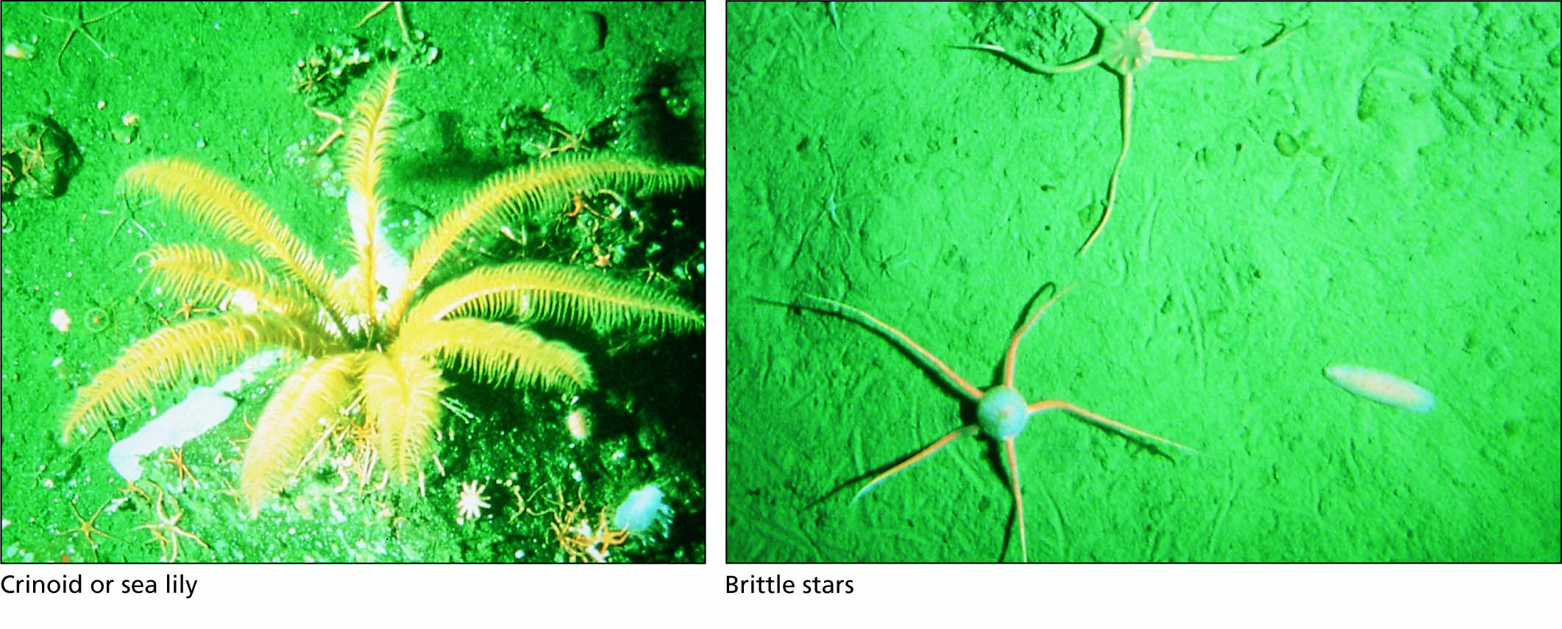
Figure 6.21 Echinoderms (deuterostomes of the phylum Echinodermata).

Slide 36
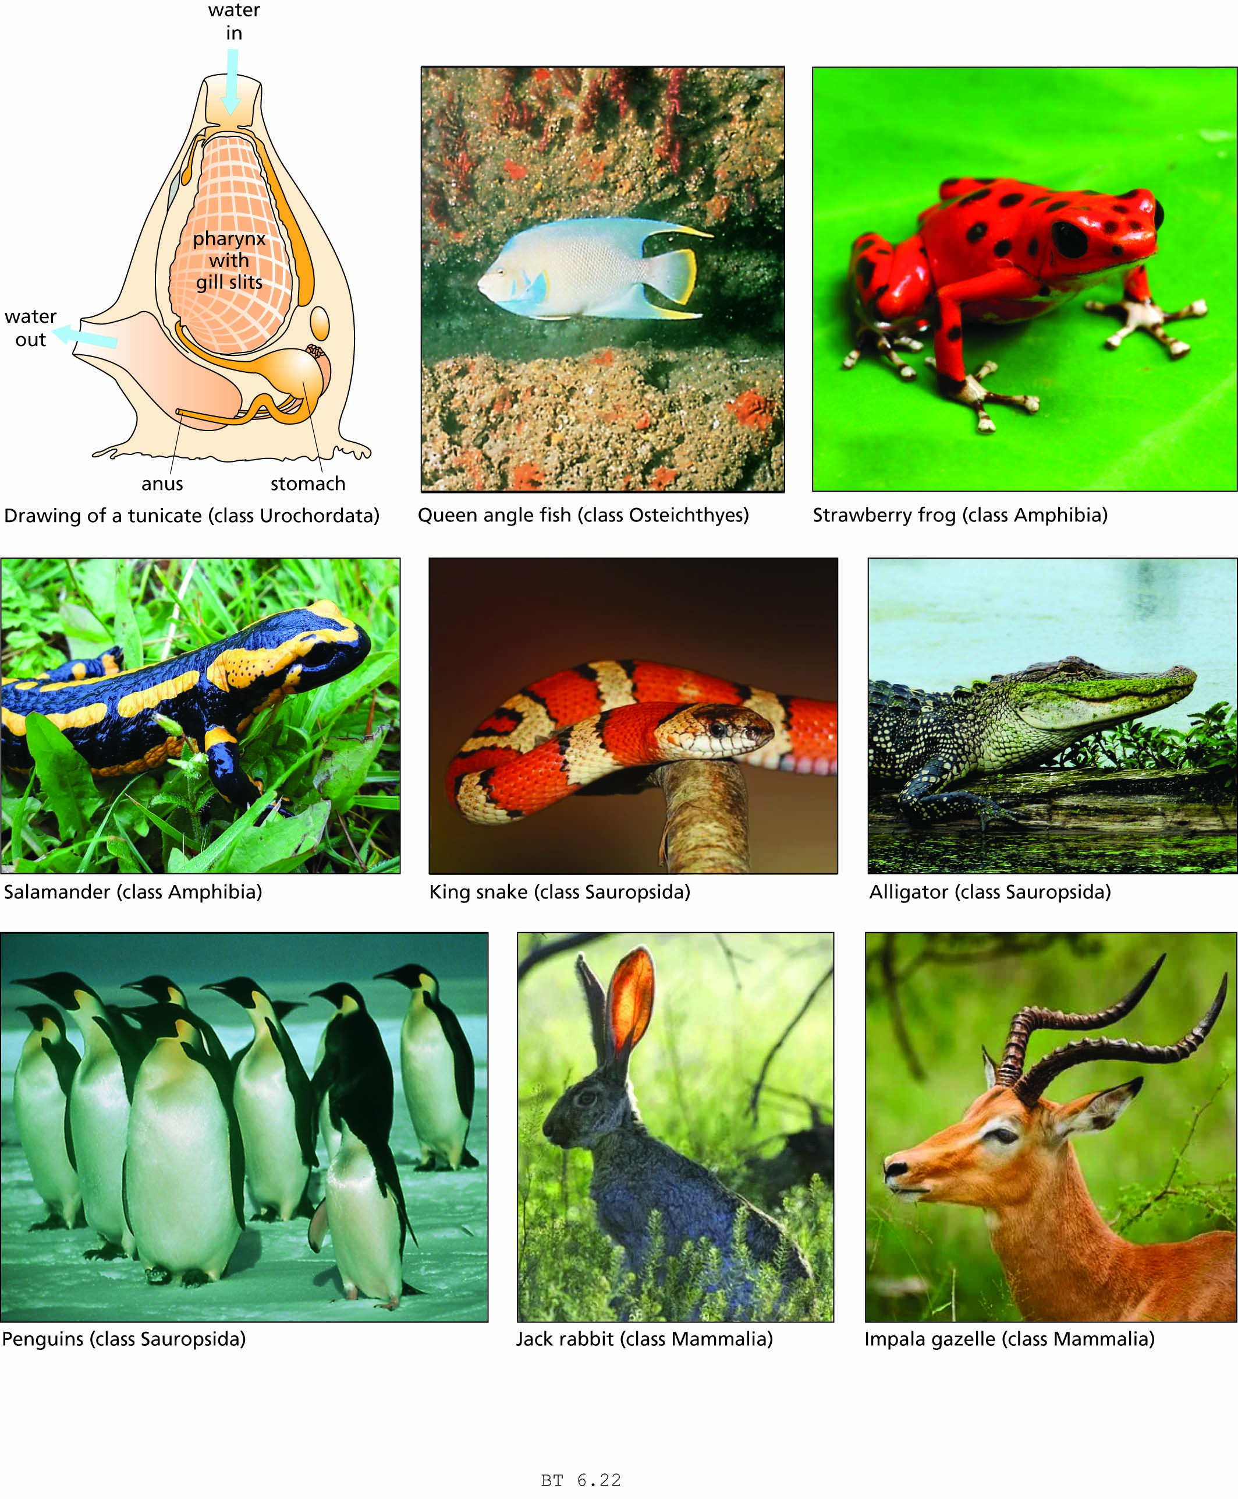
Figure 6.22 Representatives of the phylum Chordata, another deuterostome phylum. All of these animals have embryonic notochords and gill slits.

Slide 37
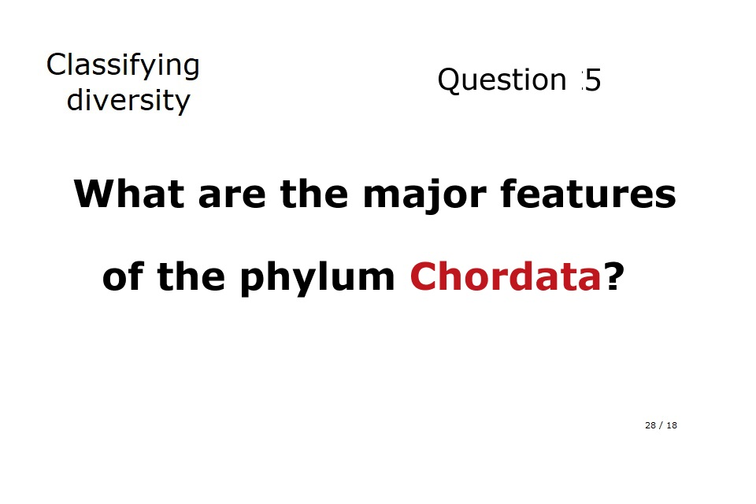

Slide 38
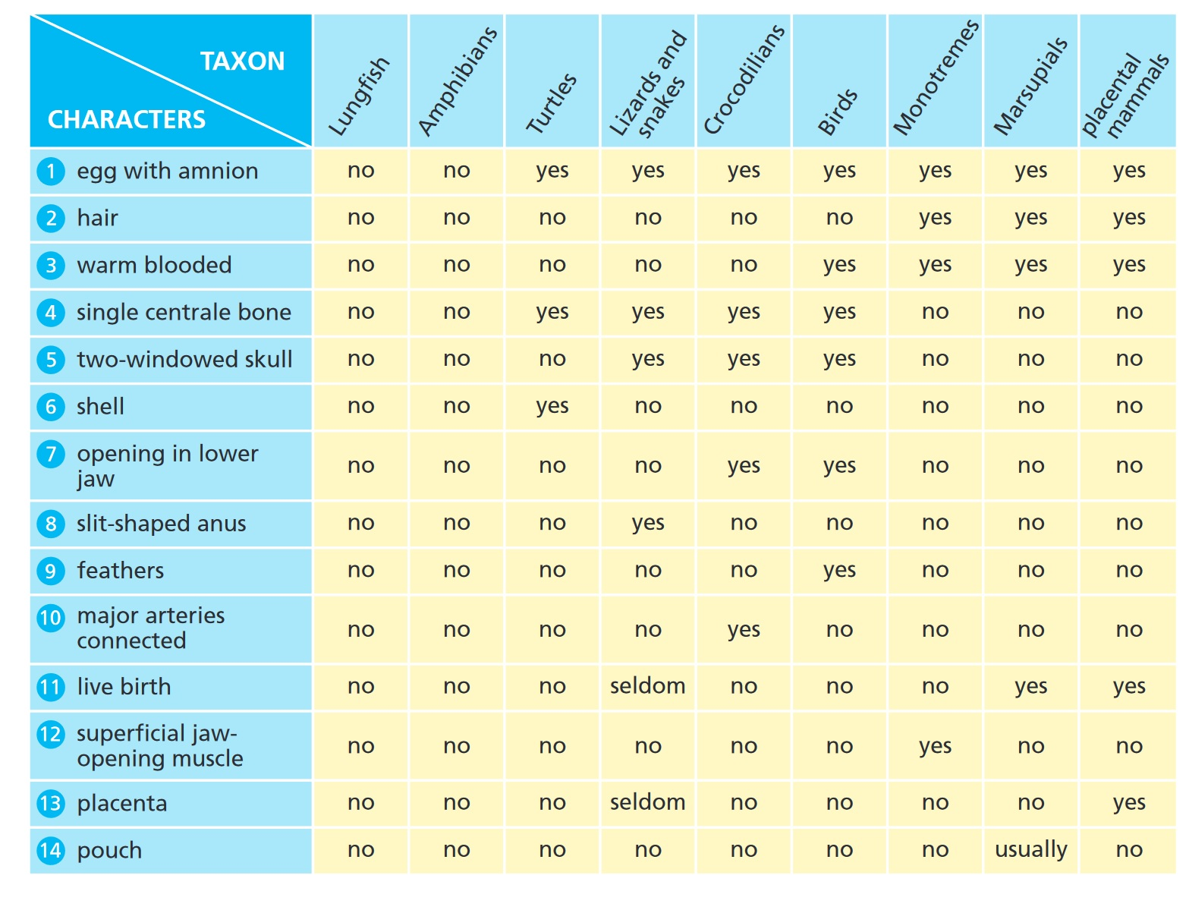

Slide 39
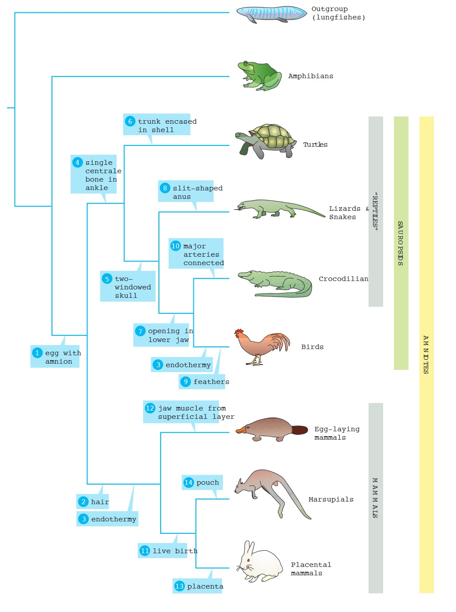

Slide 40
Humans are products of evolution
Our primate heritage
Early hominins
The genus Homo

Slide 41
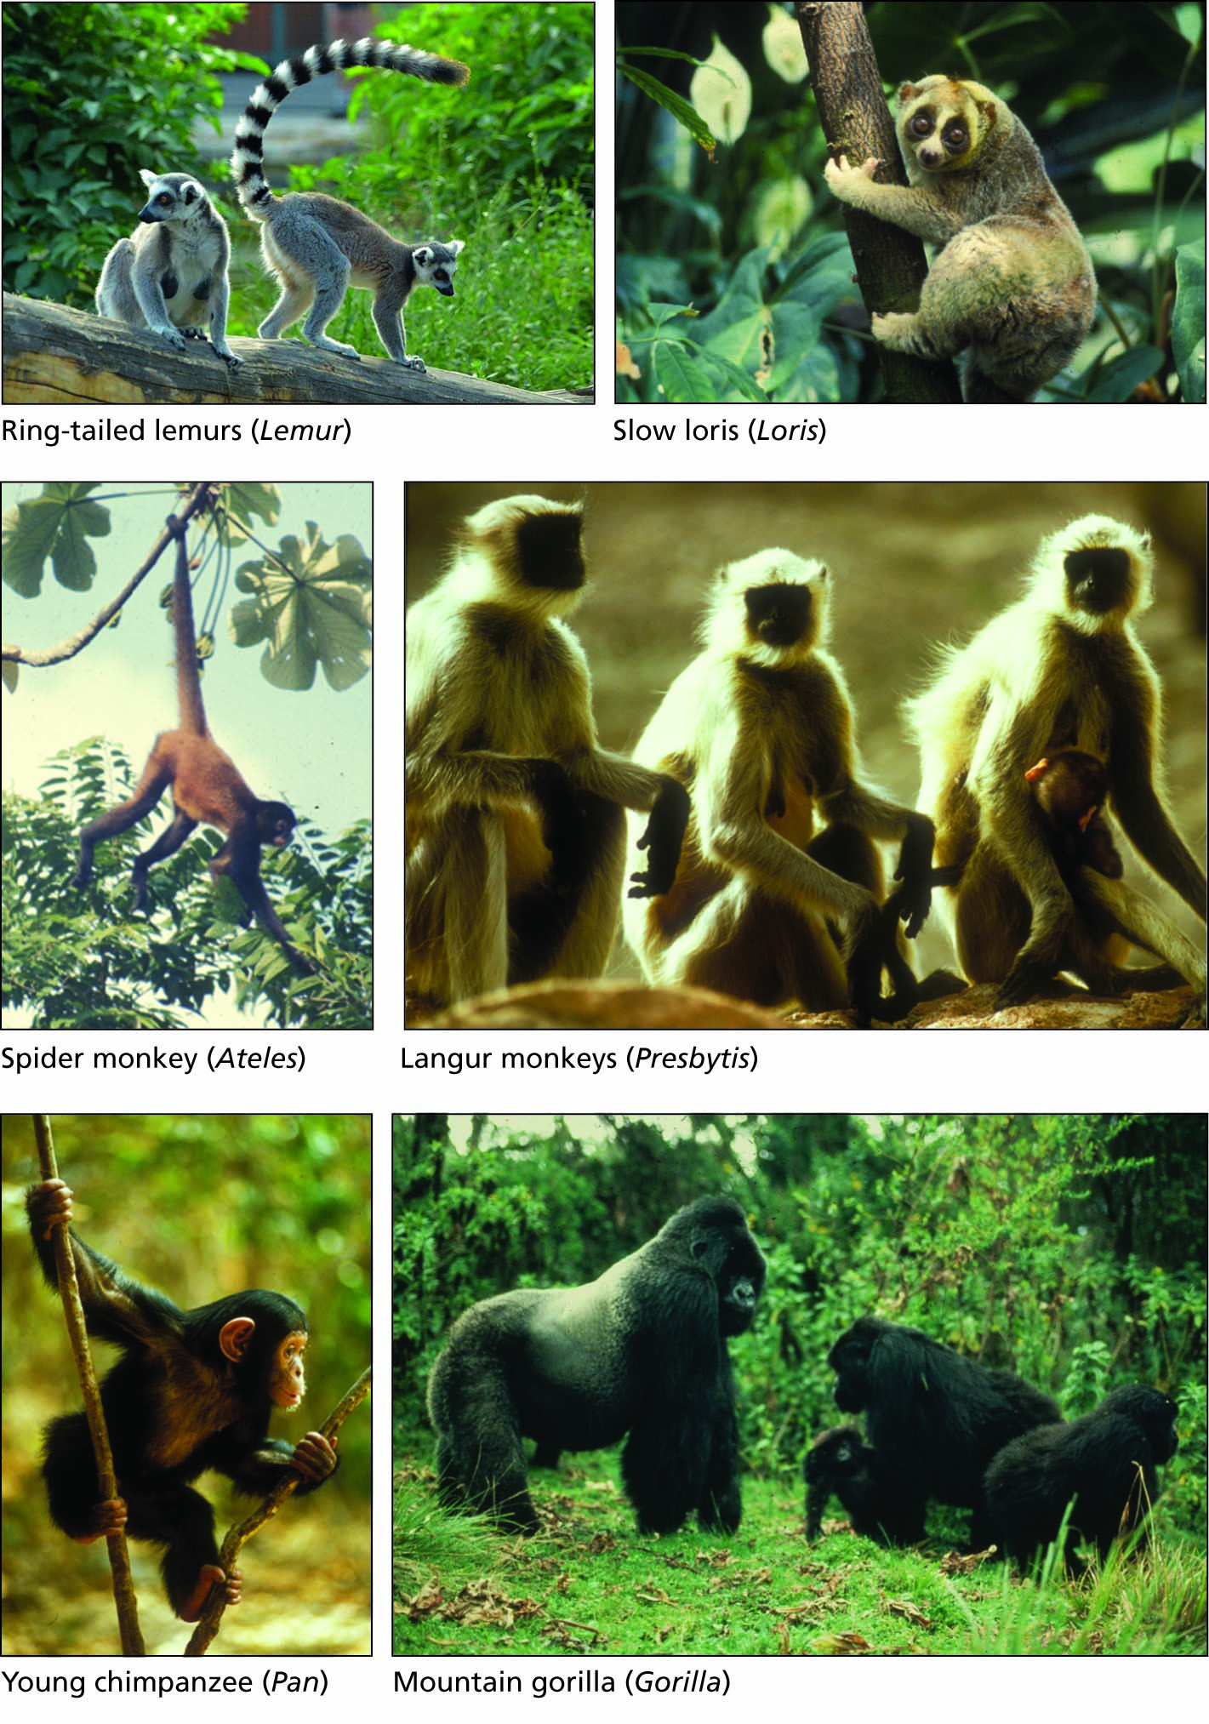
Figure 6.23 Representative primates (phylum Chordata, class Mammalia, order Primates).

Slide 42
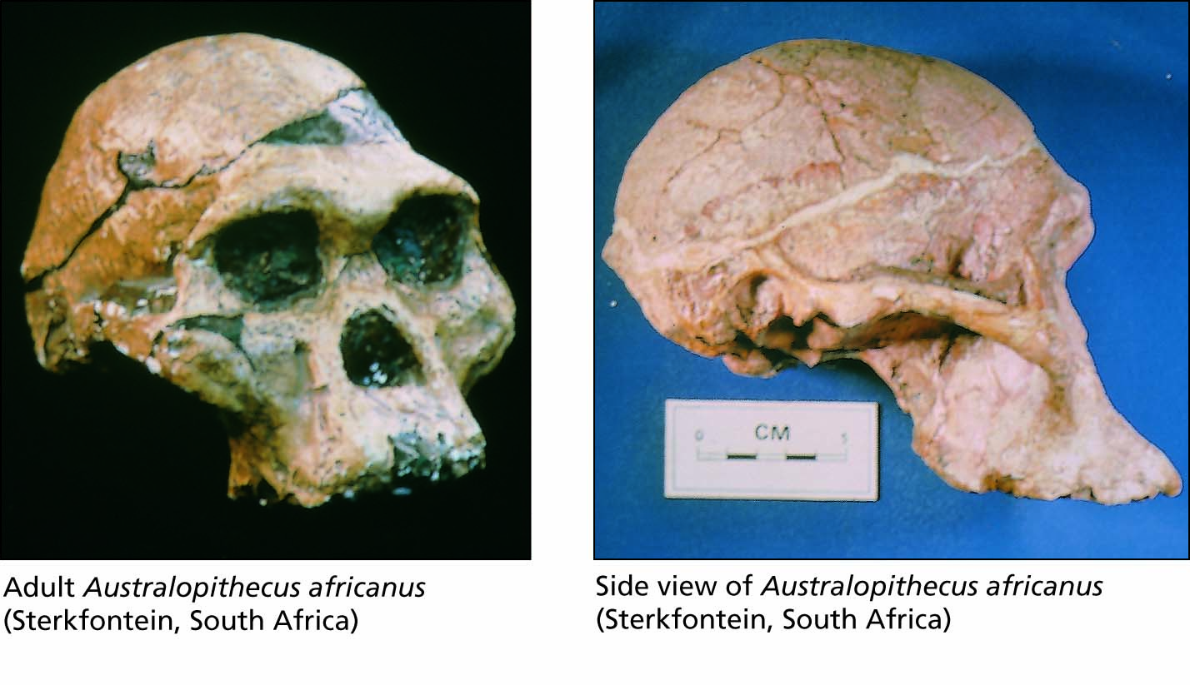
Figure 6.24 Fossils of the genus Australopithecus.

Slide 43
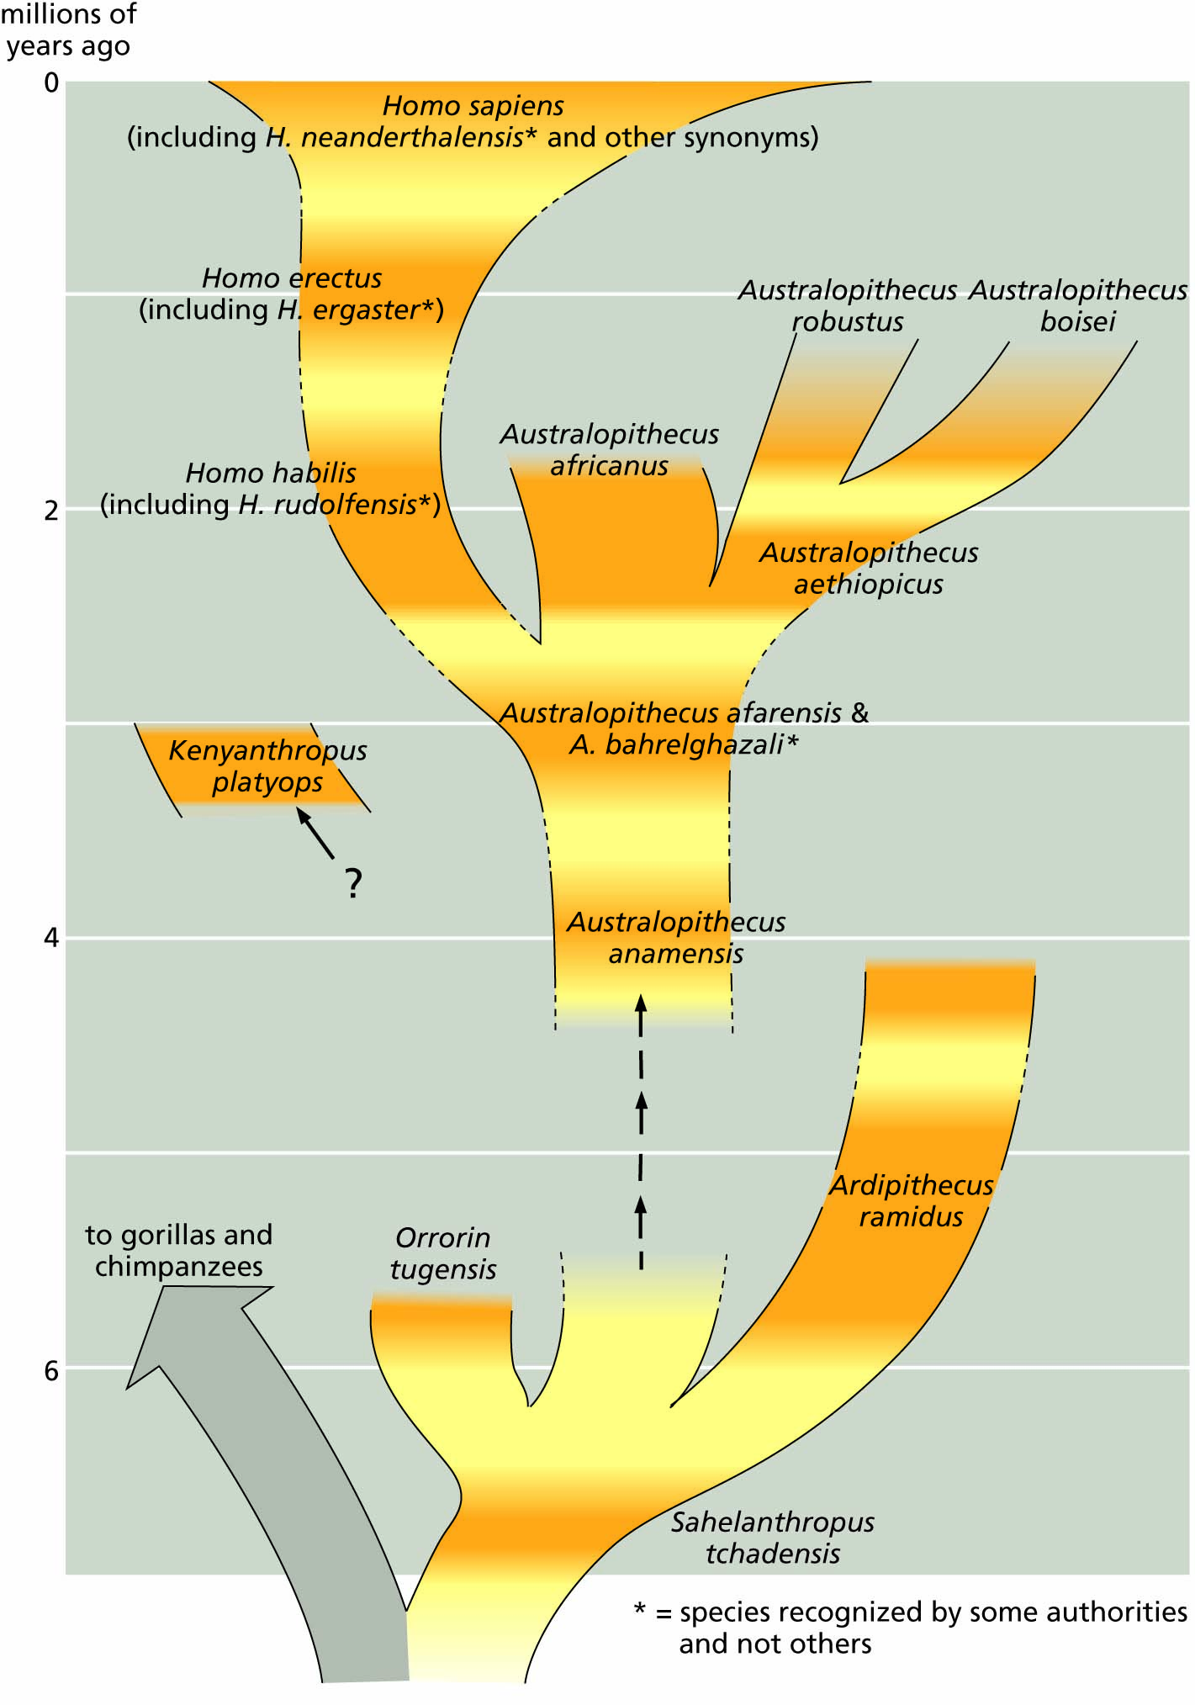
Figure 6.25 A family tree of the family Hominidae. Dark orange areas show the known time range of species represented by fossils. Some dates are approximate.

Slide 44
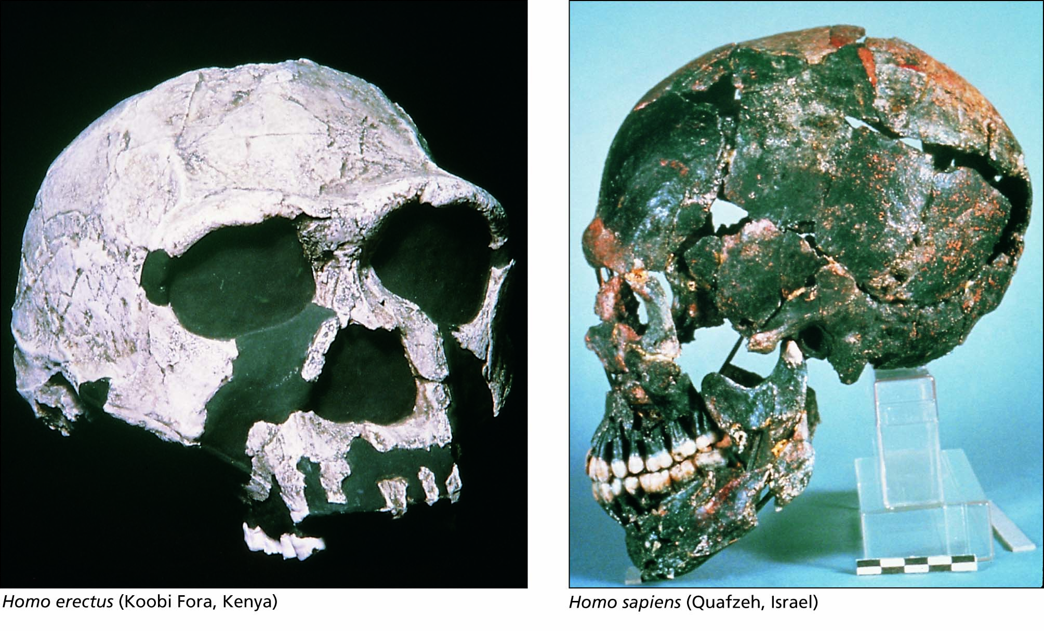
Figure 6.26 Fossils of the genus Homo.

