Slide 1
Chapter 3: Human Genetics and Gene Expression
Biology Trending, 4e
Eli Minkoff and Jennifer Hood-DeGrenier

Slide 2
Gene expression: Genetic information influences phenotypes through transcription and translation
Overview of gene expression
Transcription from DNA to RNA
Translation from RNA to protein
Mutations

Slide 3
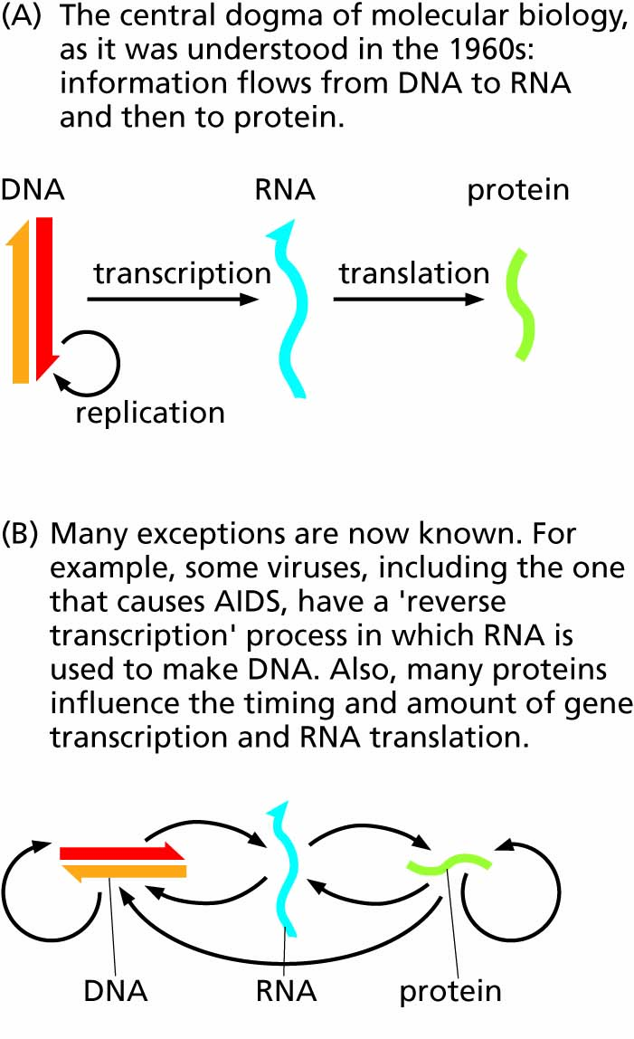
Figure 3.1 Changing concepts of the flow of genetic information.

Slide 4
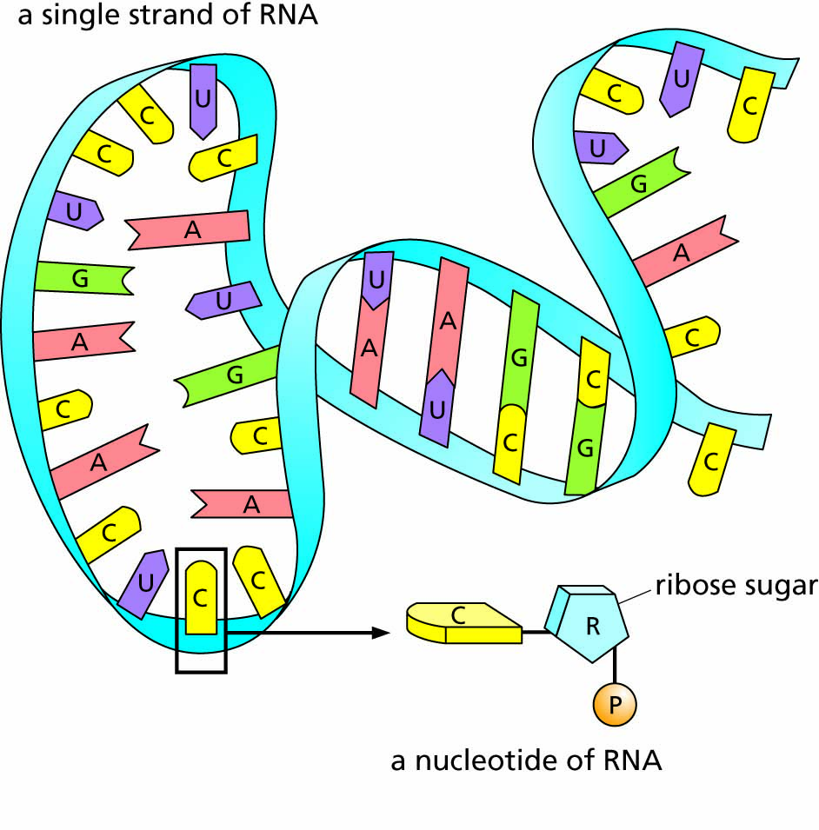
Figure 3.2 The structure of RNA. The molecule as a whole is usually single-stranded, but short portions of some RNA molecules can base-pair with other portions of the same molecule.

Slide 5
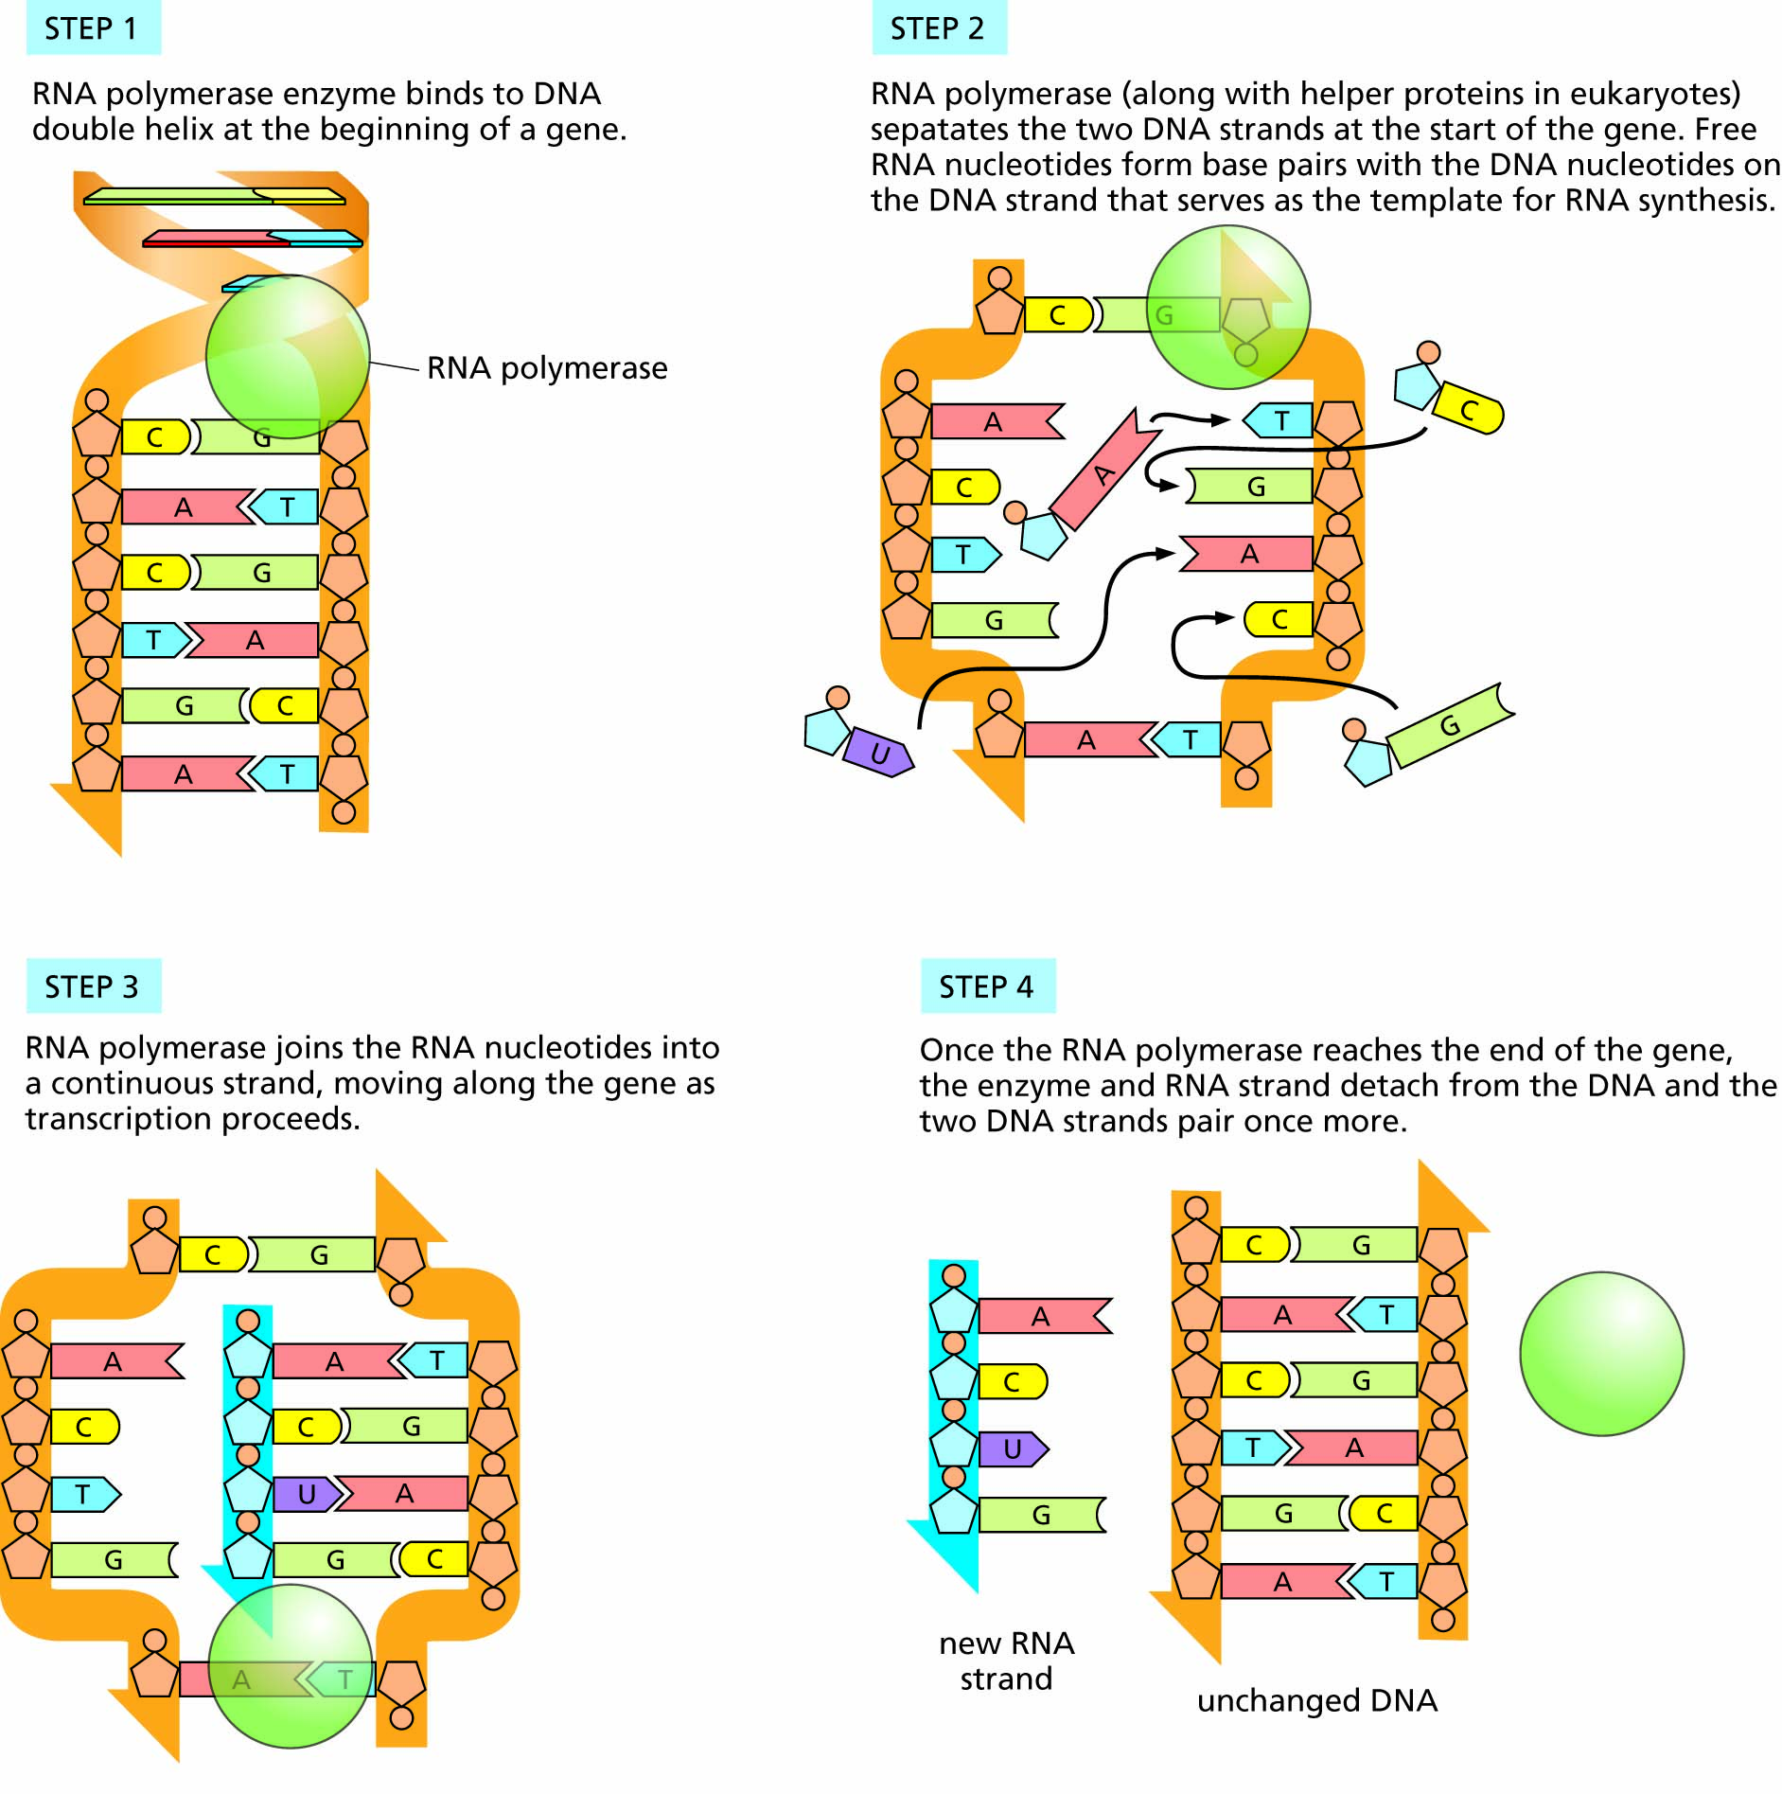
Figure 3.3 The transcription of DNA into RNA.

Slide 6
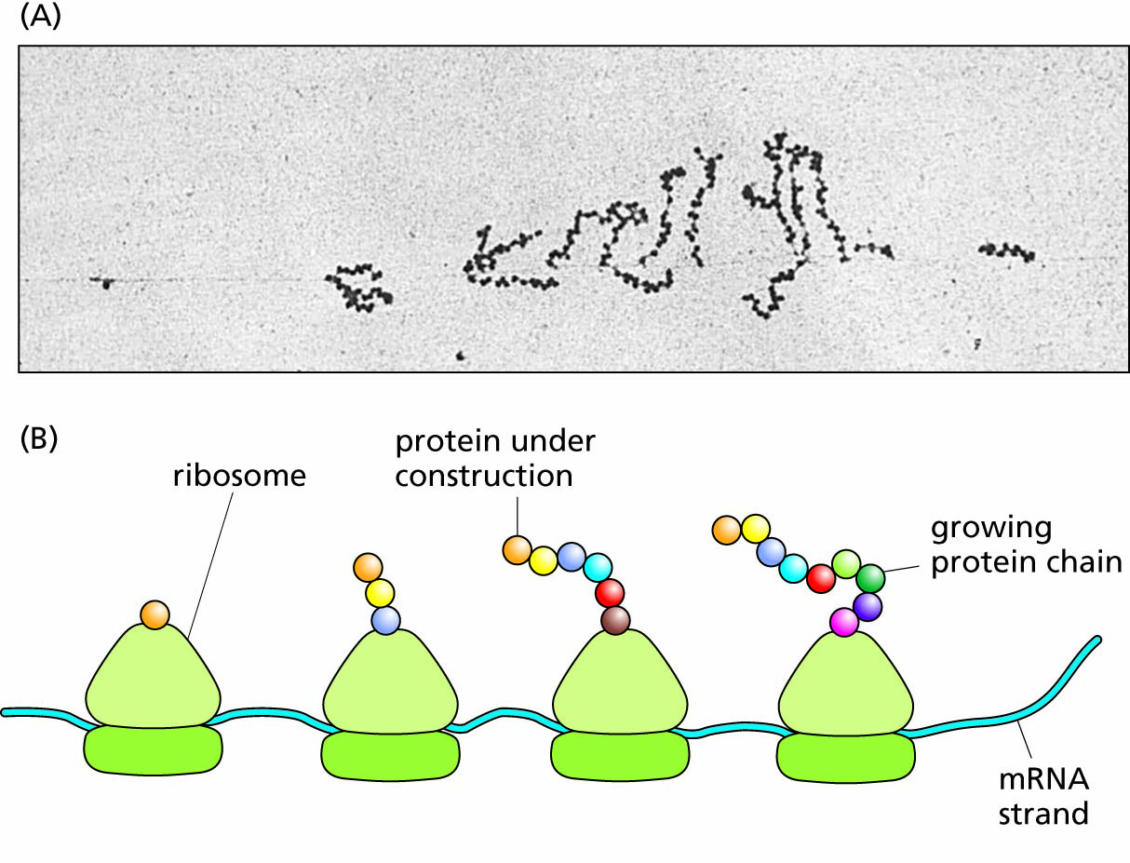
Figure 3.4 Translation of an mRNA into protein. The two subunits of a ribosome (shown in light and dark green) bind to the mRNA and move along it, interpreting the genetic code to link amino acids together into a protein chain. The protein chain elongates as the ribosome moves along, adding one amino acid at a time.
In the electron micrograph (A, above), notice that the mRNA strand appears as a very thin straight line. Both here and in the schematic diagram (B, below), notice that multiple ribosomes can be engaged in different stages of translation of the same mRNA at one time, leading to synthesis of multiple protein molecules.

Slide 7
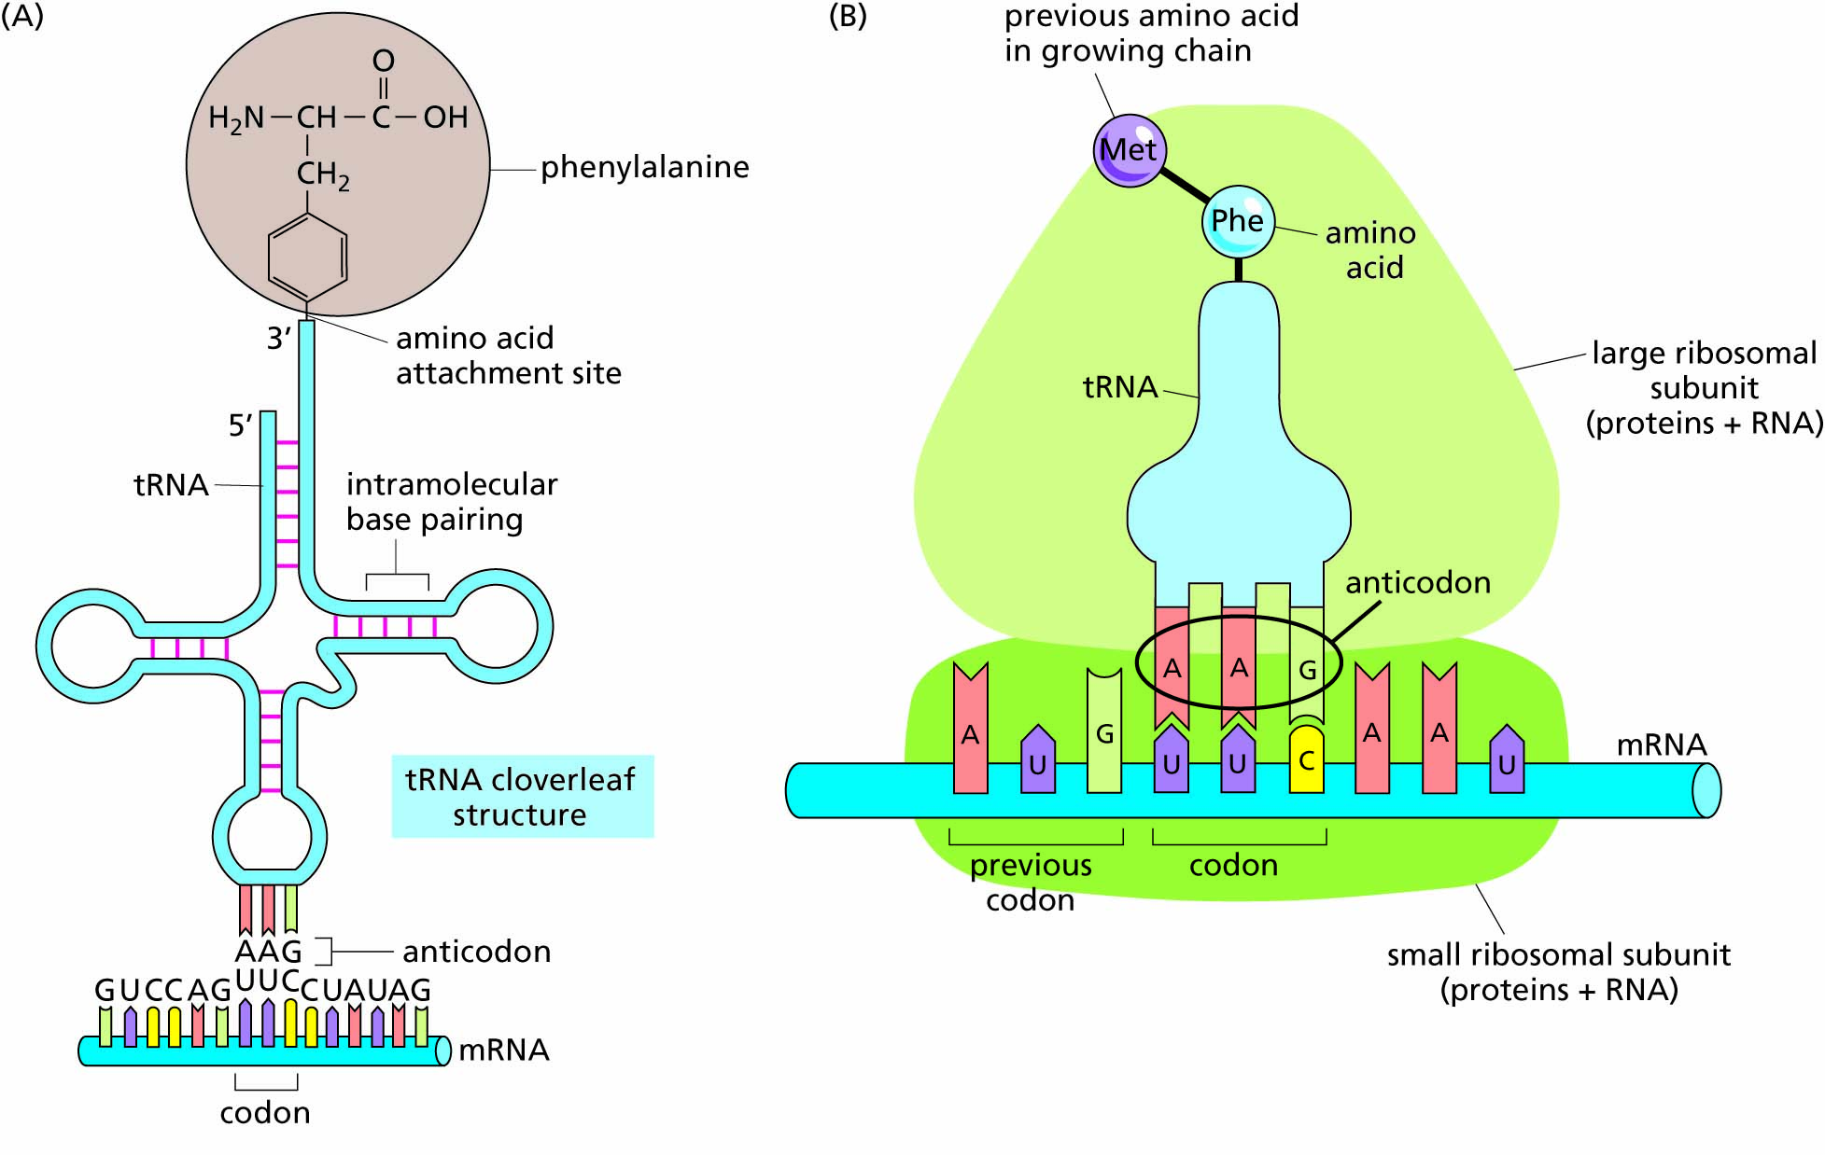
Figure 3.5 The structure of tRNA and its role in translation.
A, tRNA molecules make internal base-pairs to form a cloverleaf structure with the three-letter anticodon at the tip of the middle ‘leaf’ and a ‘stem’ that becomes attached to the amino acid corresponding to the mRNA codon that the anticodon recognizes. In the example shown here, the mRNA codon UUC matches the tRNA anticodon AAG, and this tRNA is attached to the amino acid phenylalanine (abbreviated Phe) that is specified by the UUC codon.
B, The ribosome (containing ribosomal proteins and rRNA) holds the tRNA in place on the mRNA. Here, the tRNA cloverleaf is shown in a more schematic structure for simplicity.

Slide 8
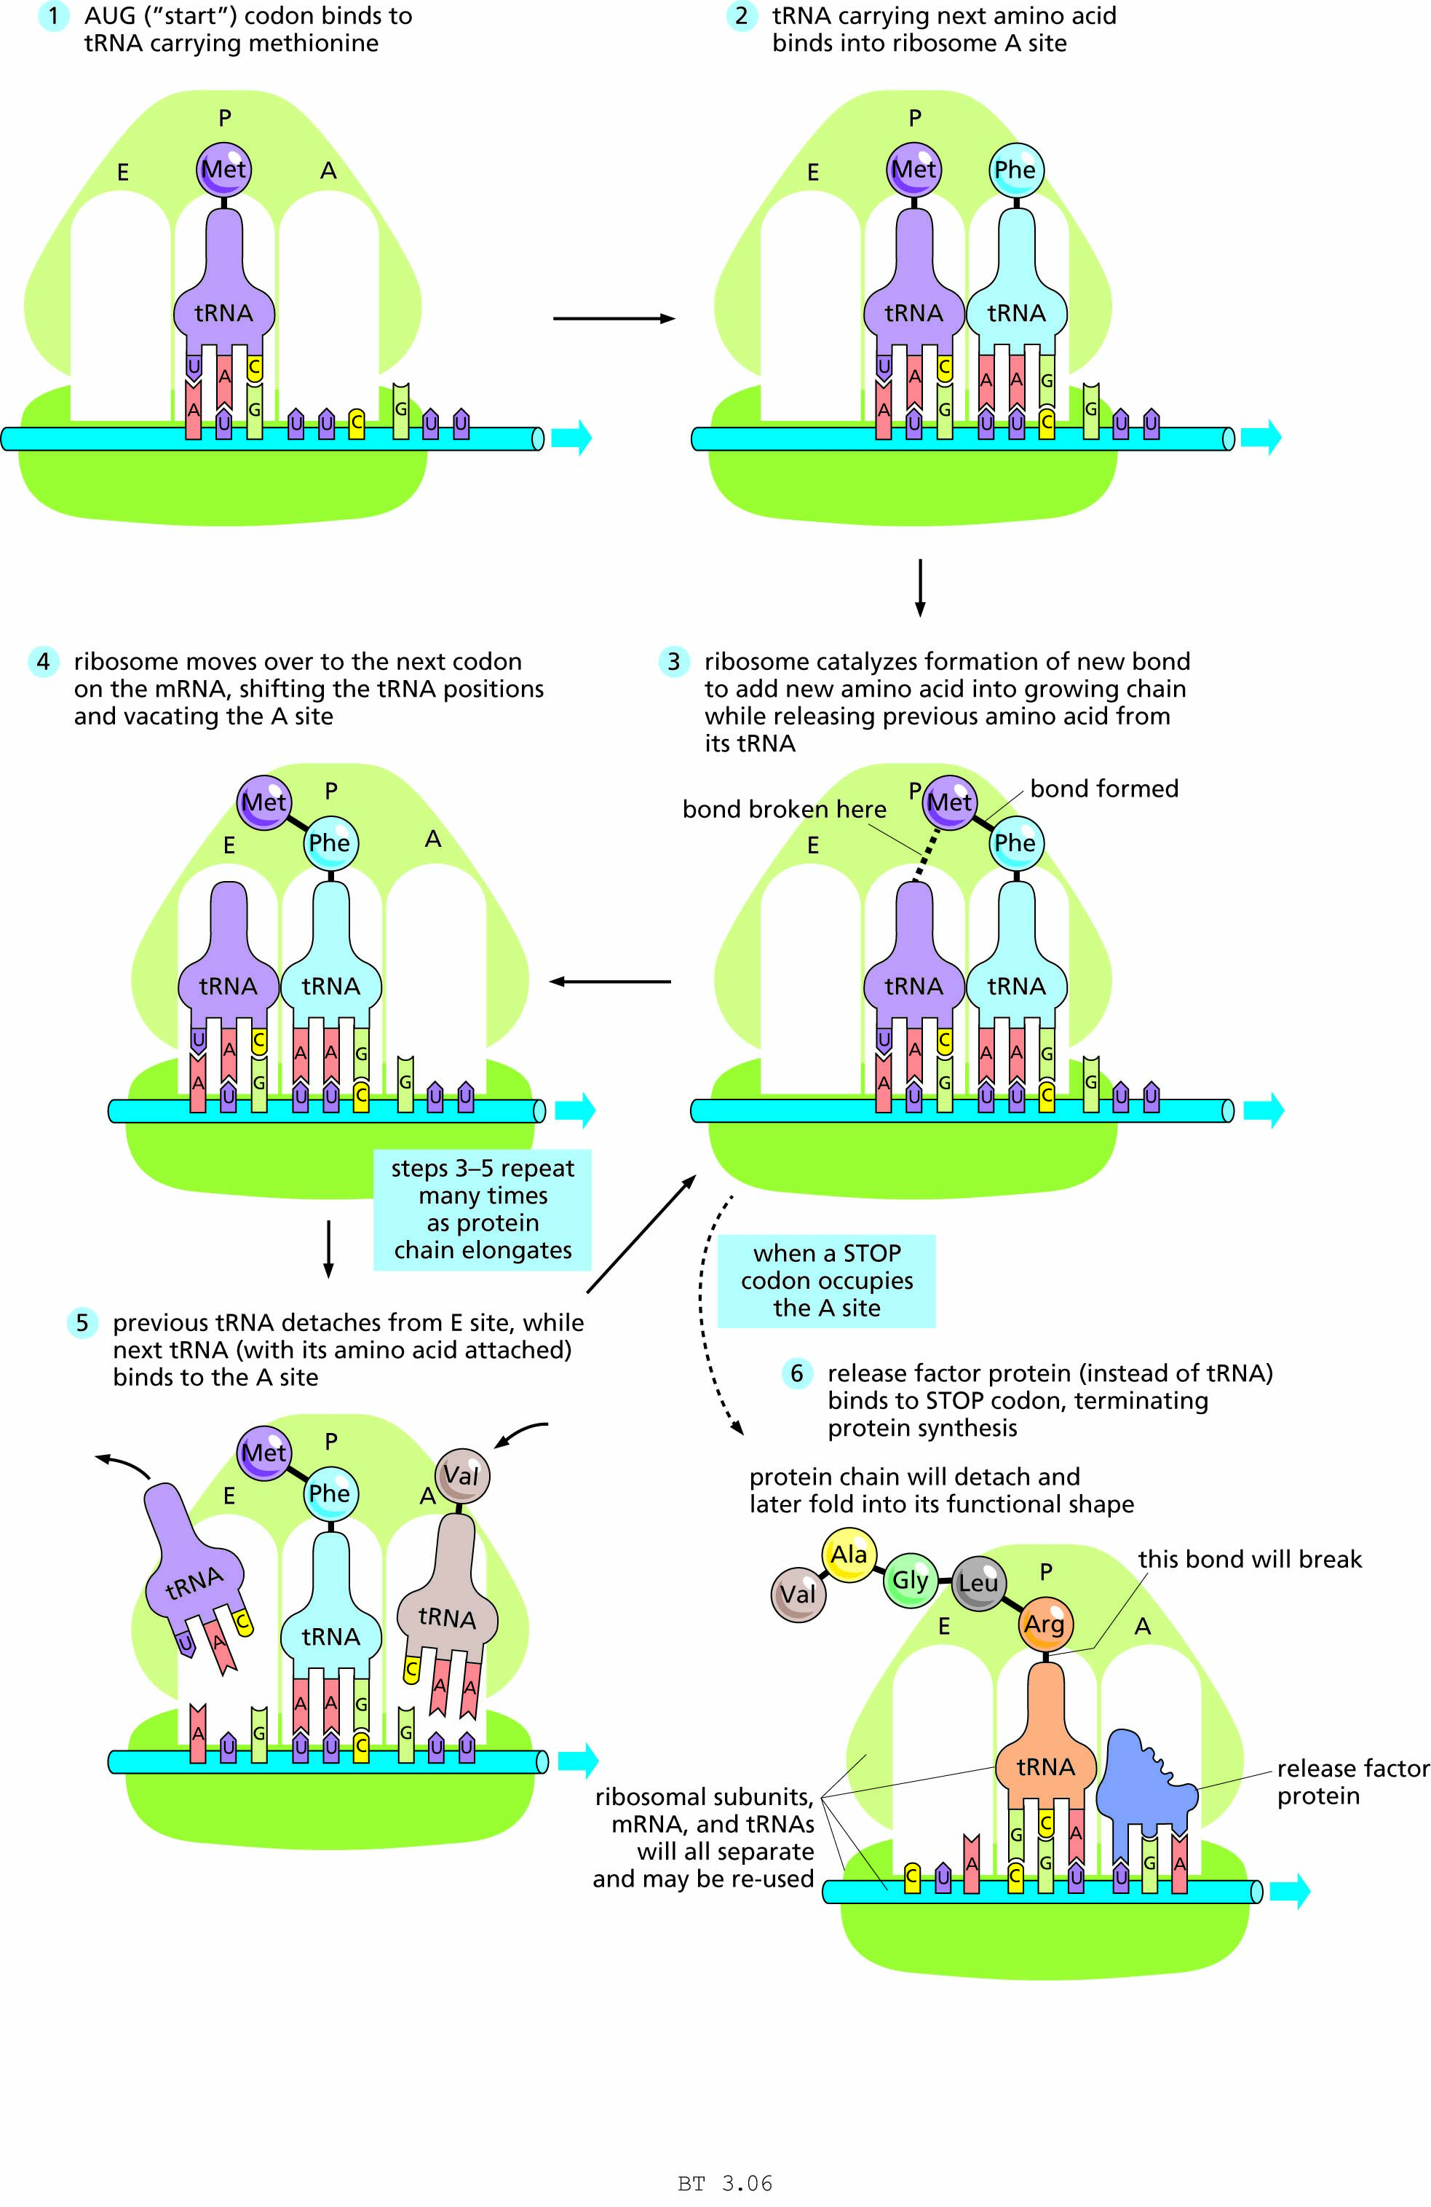
Figure 3.6 Steps in
translation.

Slide 9
Table 3.1

Slide 10
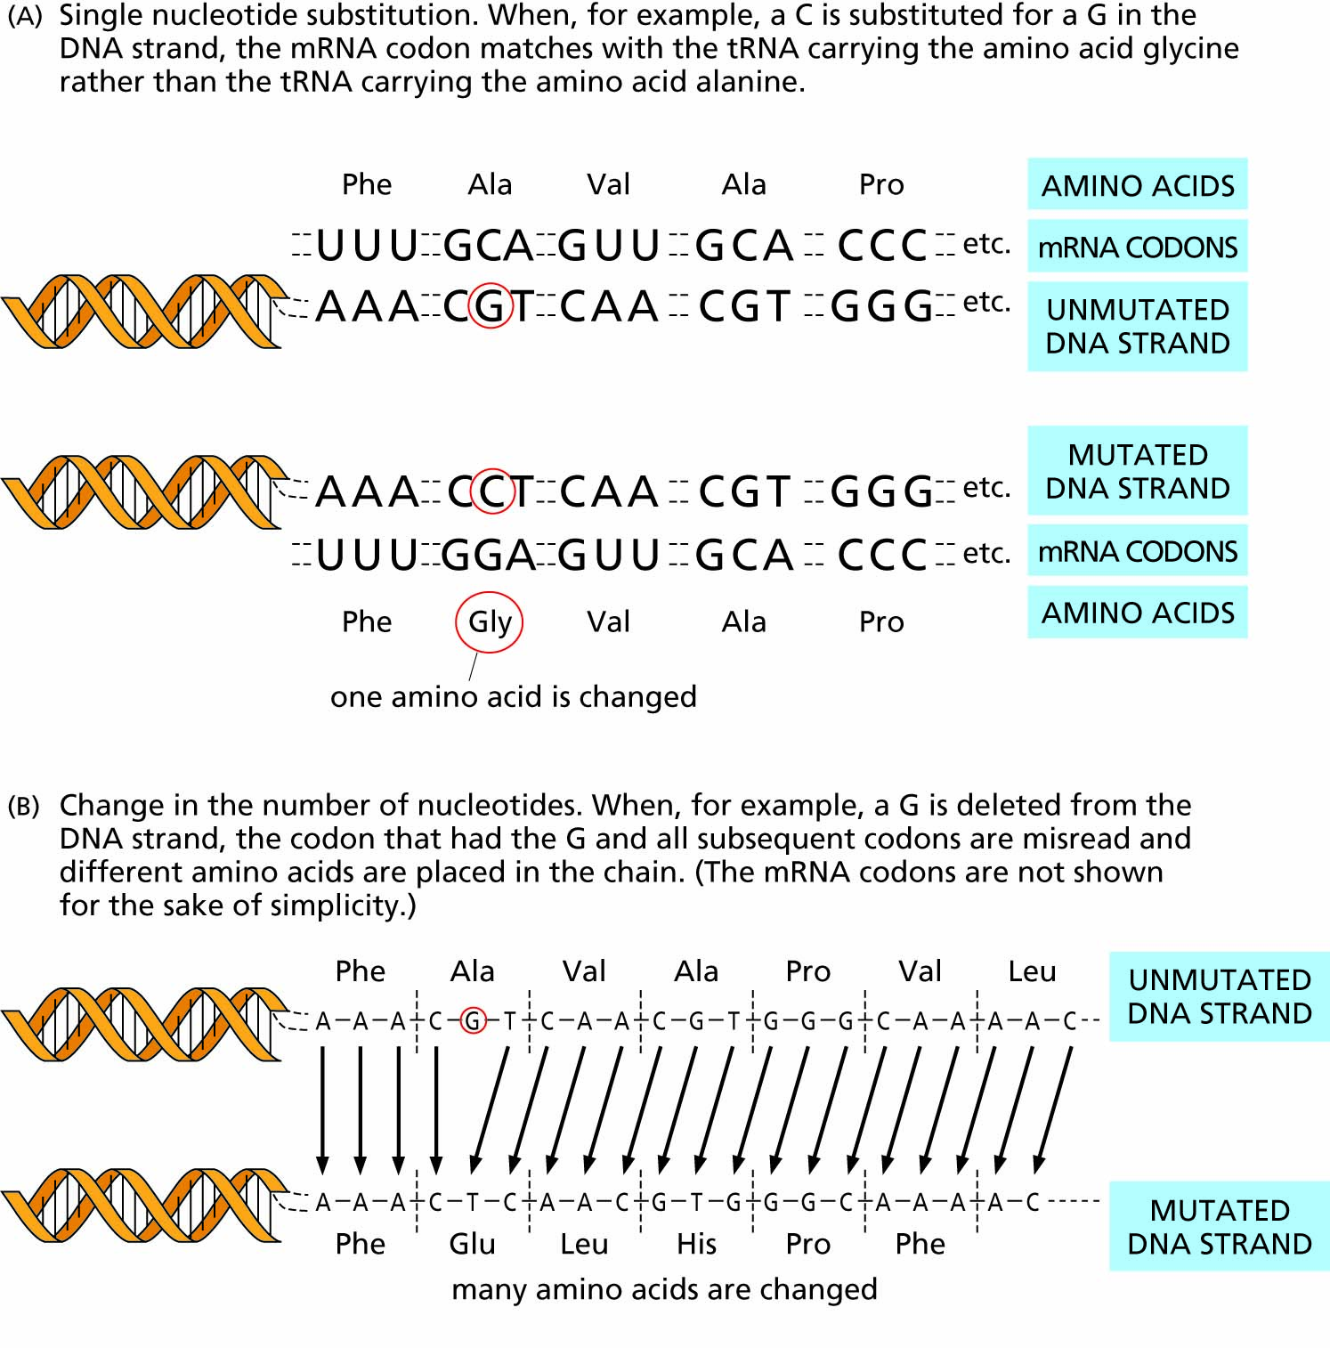
Figure 3.7 Examples of two types of mutations. (The DNA sequences shown are the template strands from which the mRNA codons are copied).

Slide 11
Genes carried on sex chromosomes determine sex and sex-linked traits
Sex determination
Sex-linked traits
Chromosomal variation
Social and ethical issues regarding sex determination

Slide 12
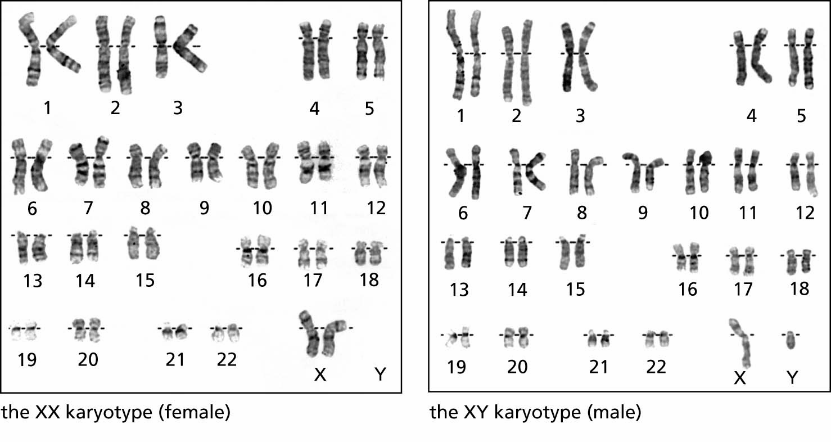
Figure 3.8 Human female and male karyotypes.

Slide 13
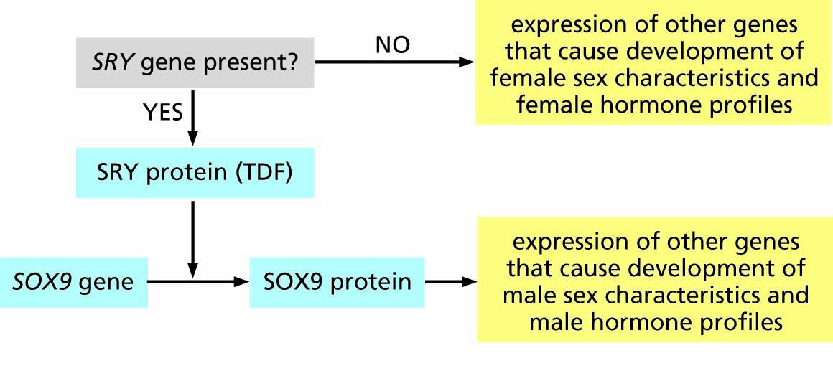
Figure 3.9 The relationship (simplified) between the SRY gene and sexual development in humans. The SRY protein is also known as Testis-Determining Factor (TDF).

Slide 14
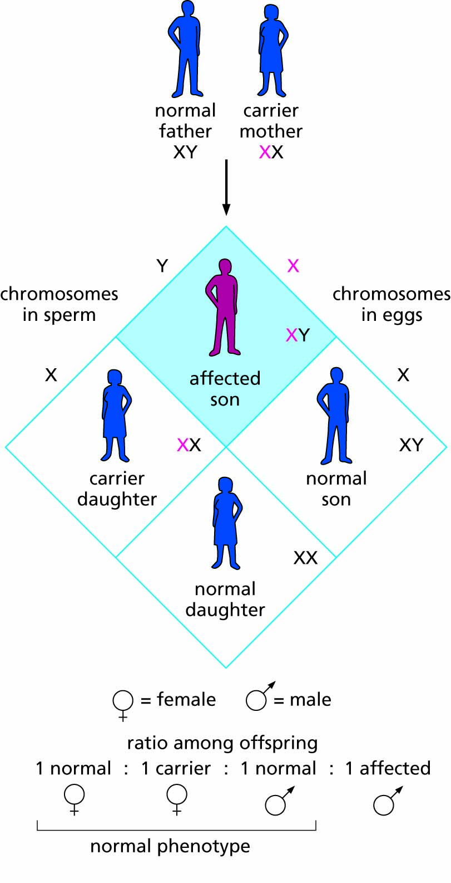
Figure 3.10 Inheritance of red–green colorblindness, a sex-linked recessive trait.

Slide 15
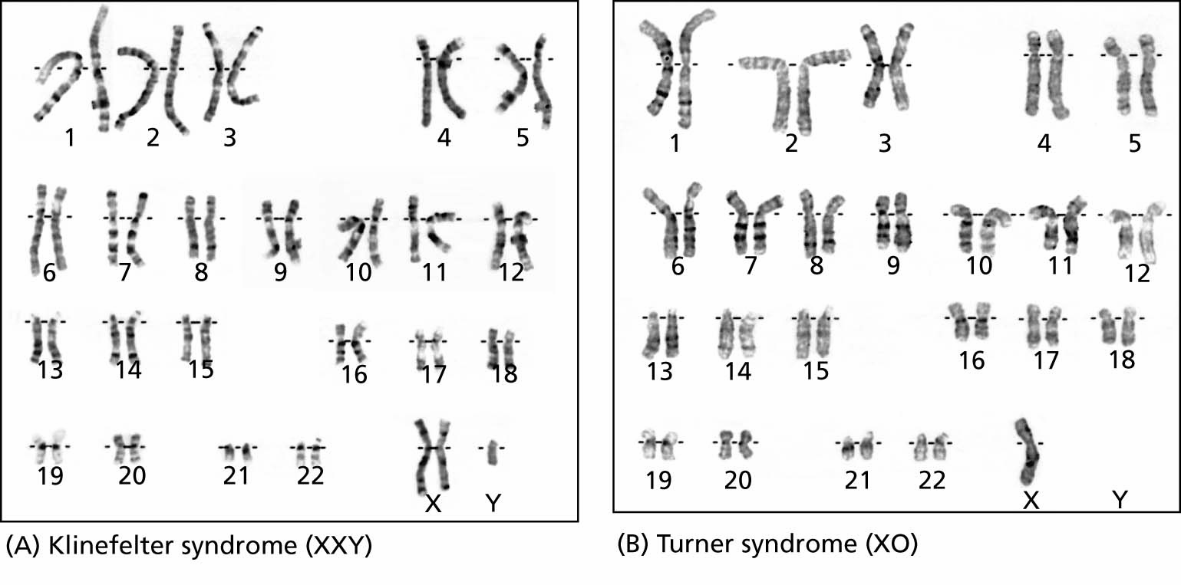
Figure 3.11 Two variations in human X and Y karyotypes.

Slide 16
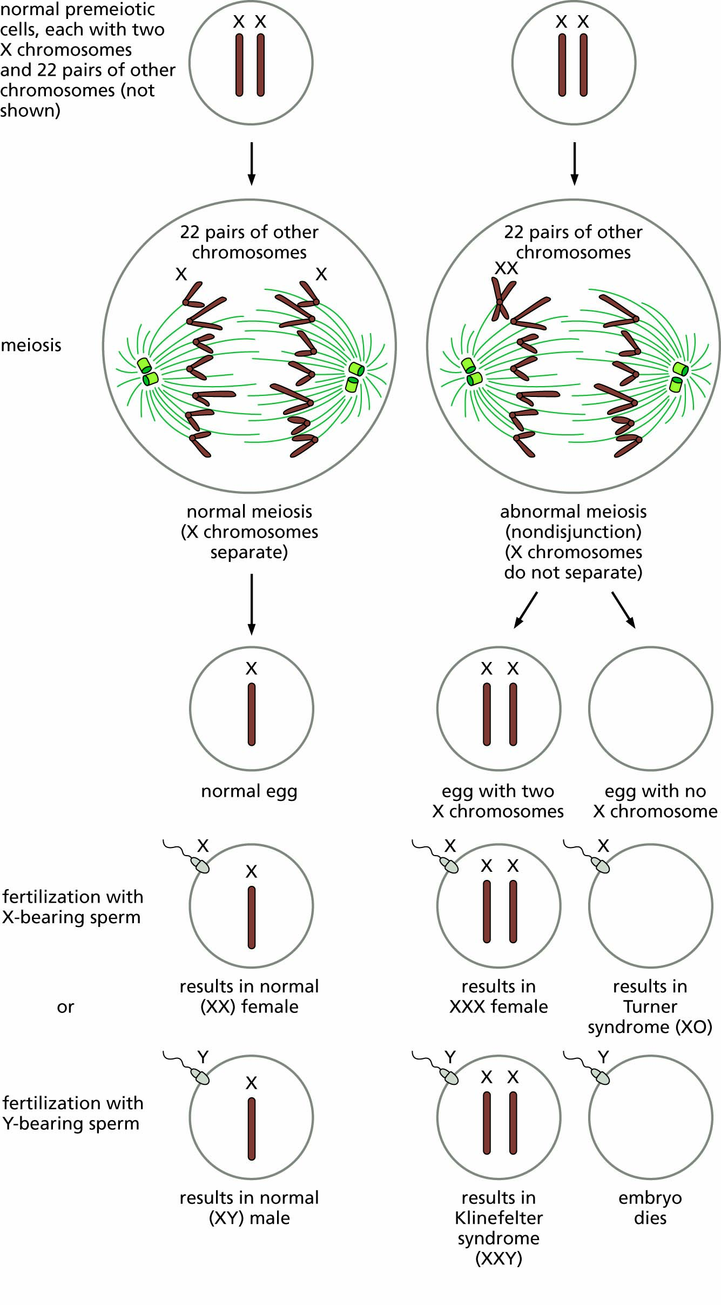
Figure 3.12 Abnormal meiosis during egg production, showing how certain chromosomal variations may arise.
(Nondisjunction can occur during either the first or second division of meiosis; in either case, the resulting chromosomal configurations are as shown here).

Slide 17
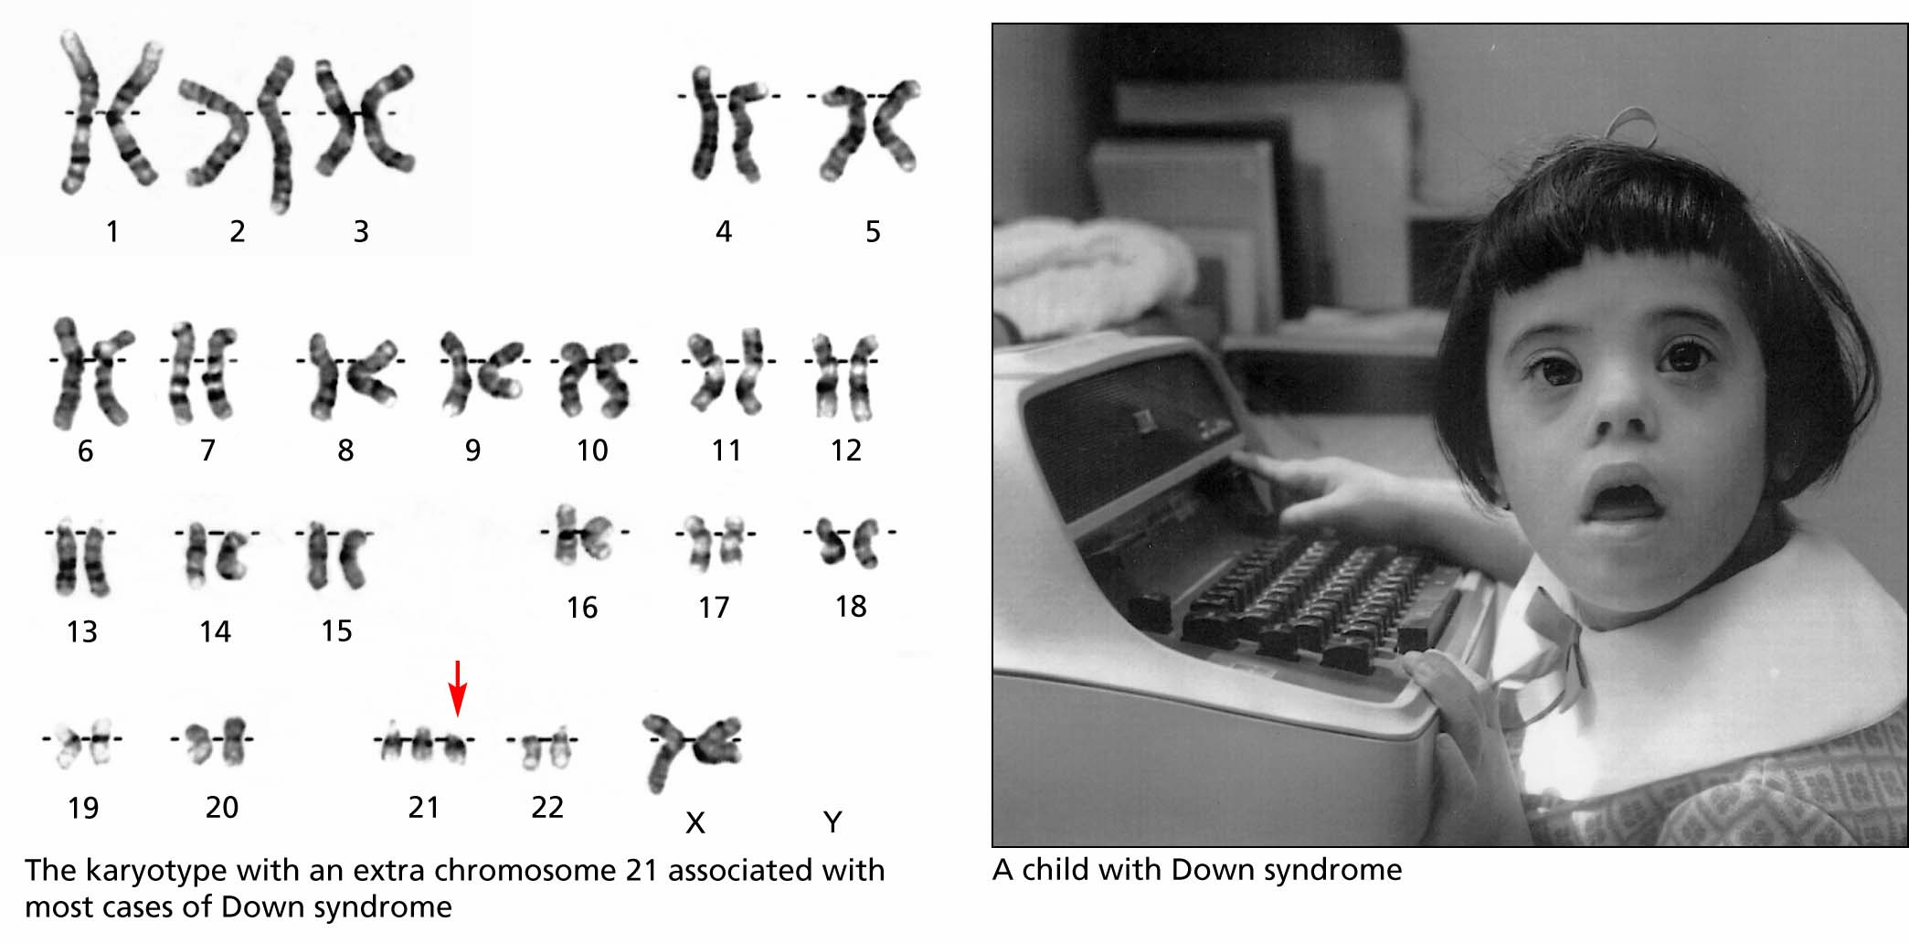
Figure 3.13 Down syndrome.

Slide 18
Some diseases and disease predispositions Are inherited
Inborn errors of metabolism
Identifying genetic causes for traits

Slide 19
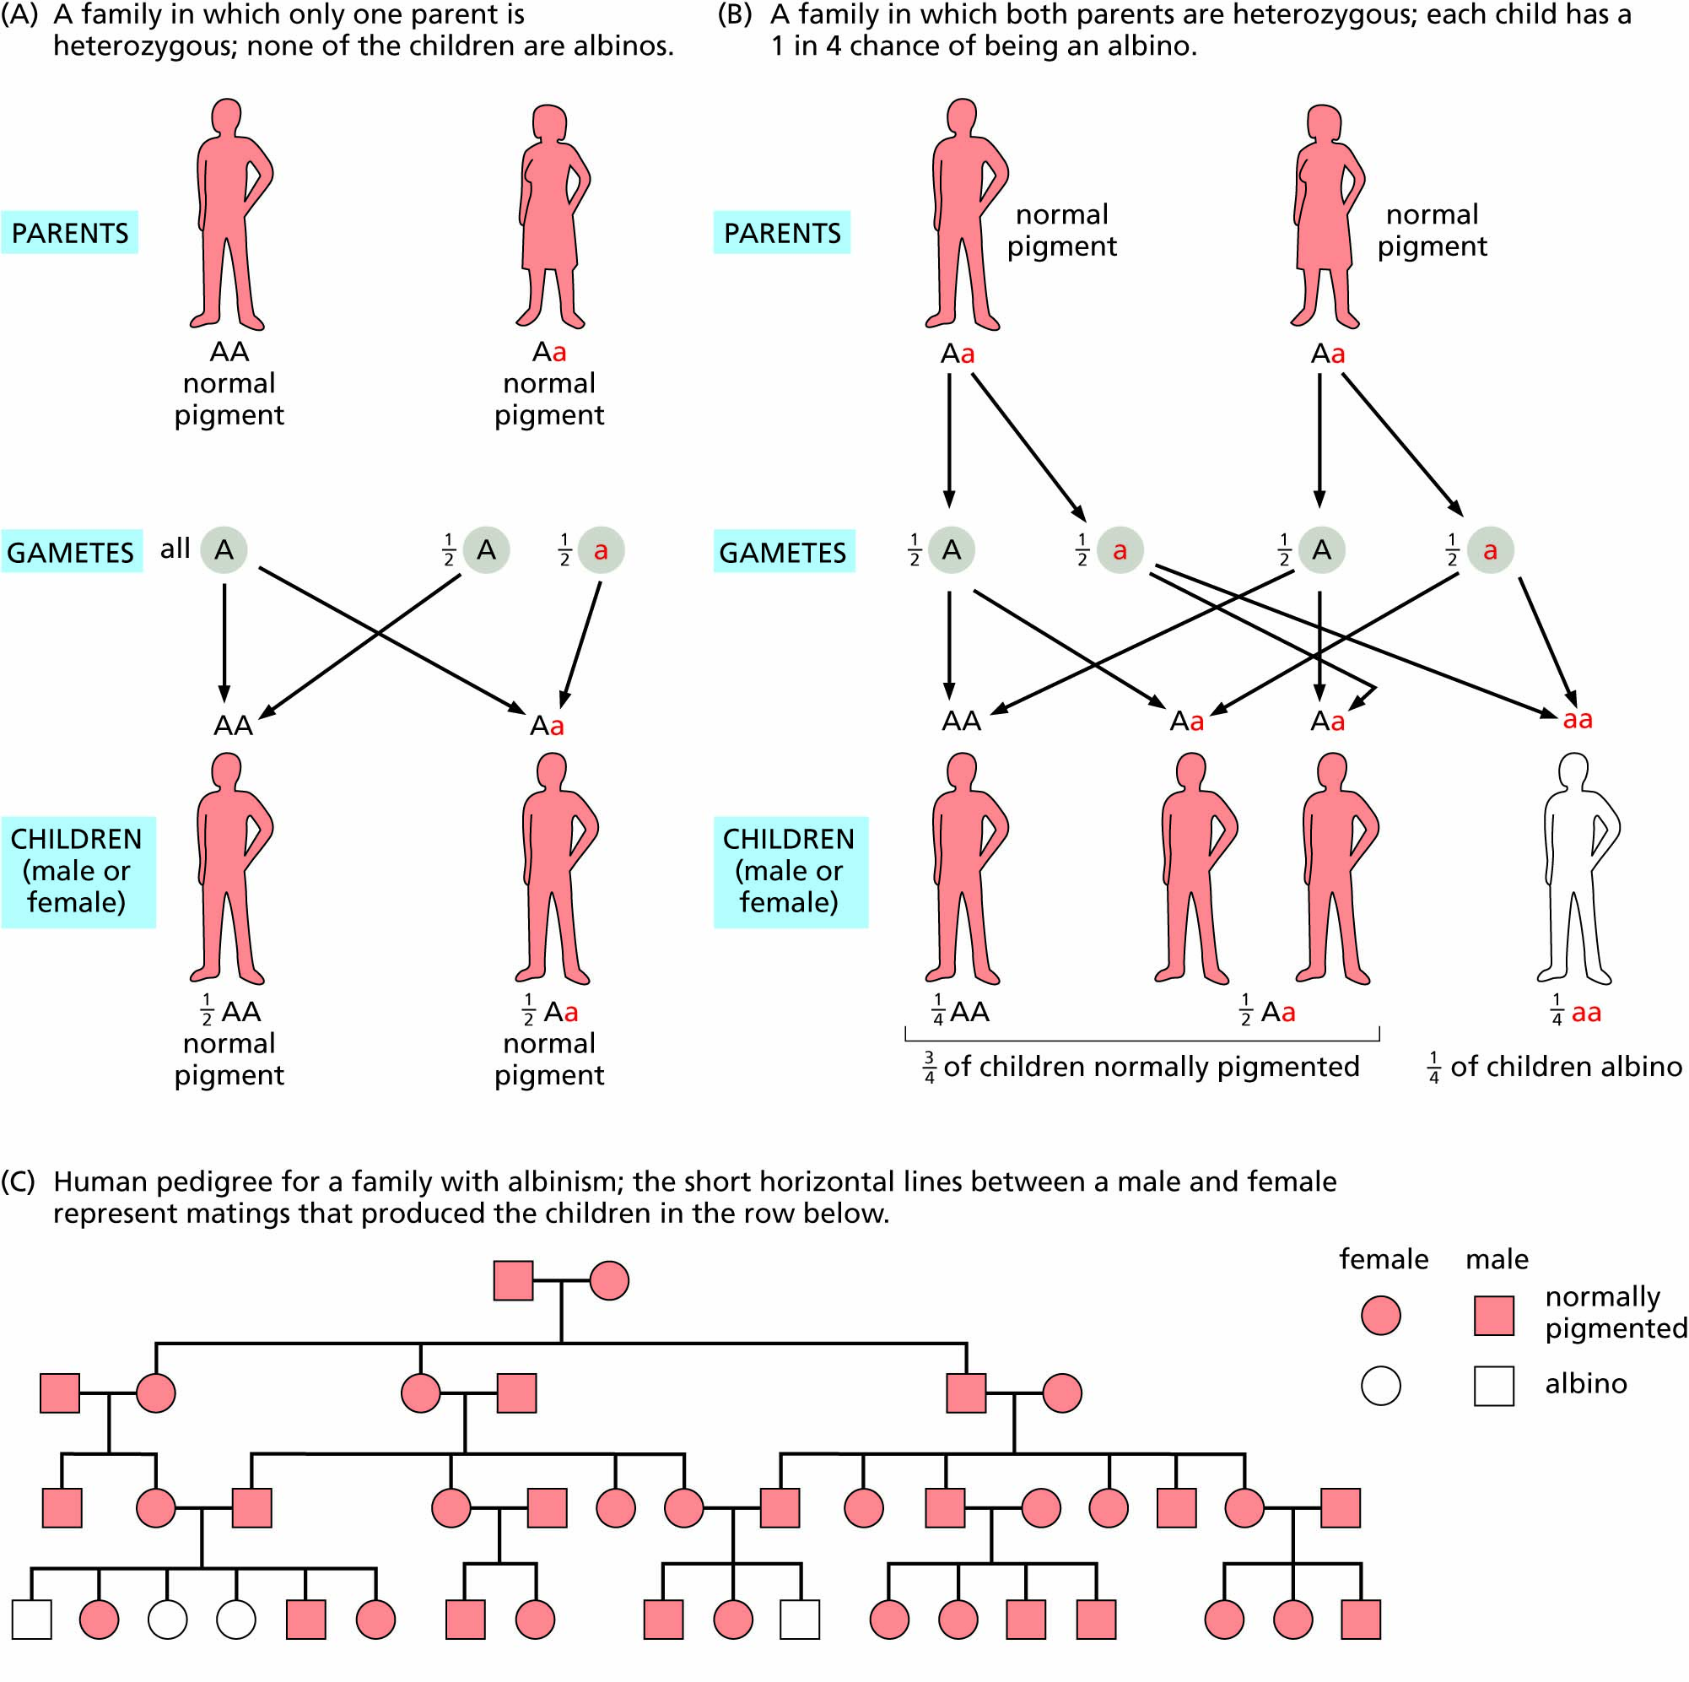
Figure 3.14 An example of simple Mendelian inheritance in humans.
Albinism, a recessive trait, arises in most cases from matings between heterozygotes, although it could also arise from matings between a heterozygous person and someone who is homozygous recessive.

Slide 20
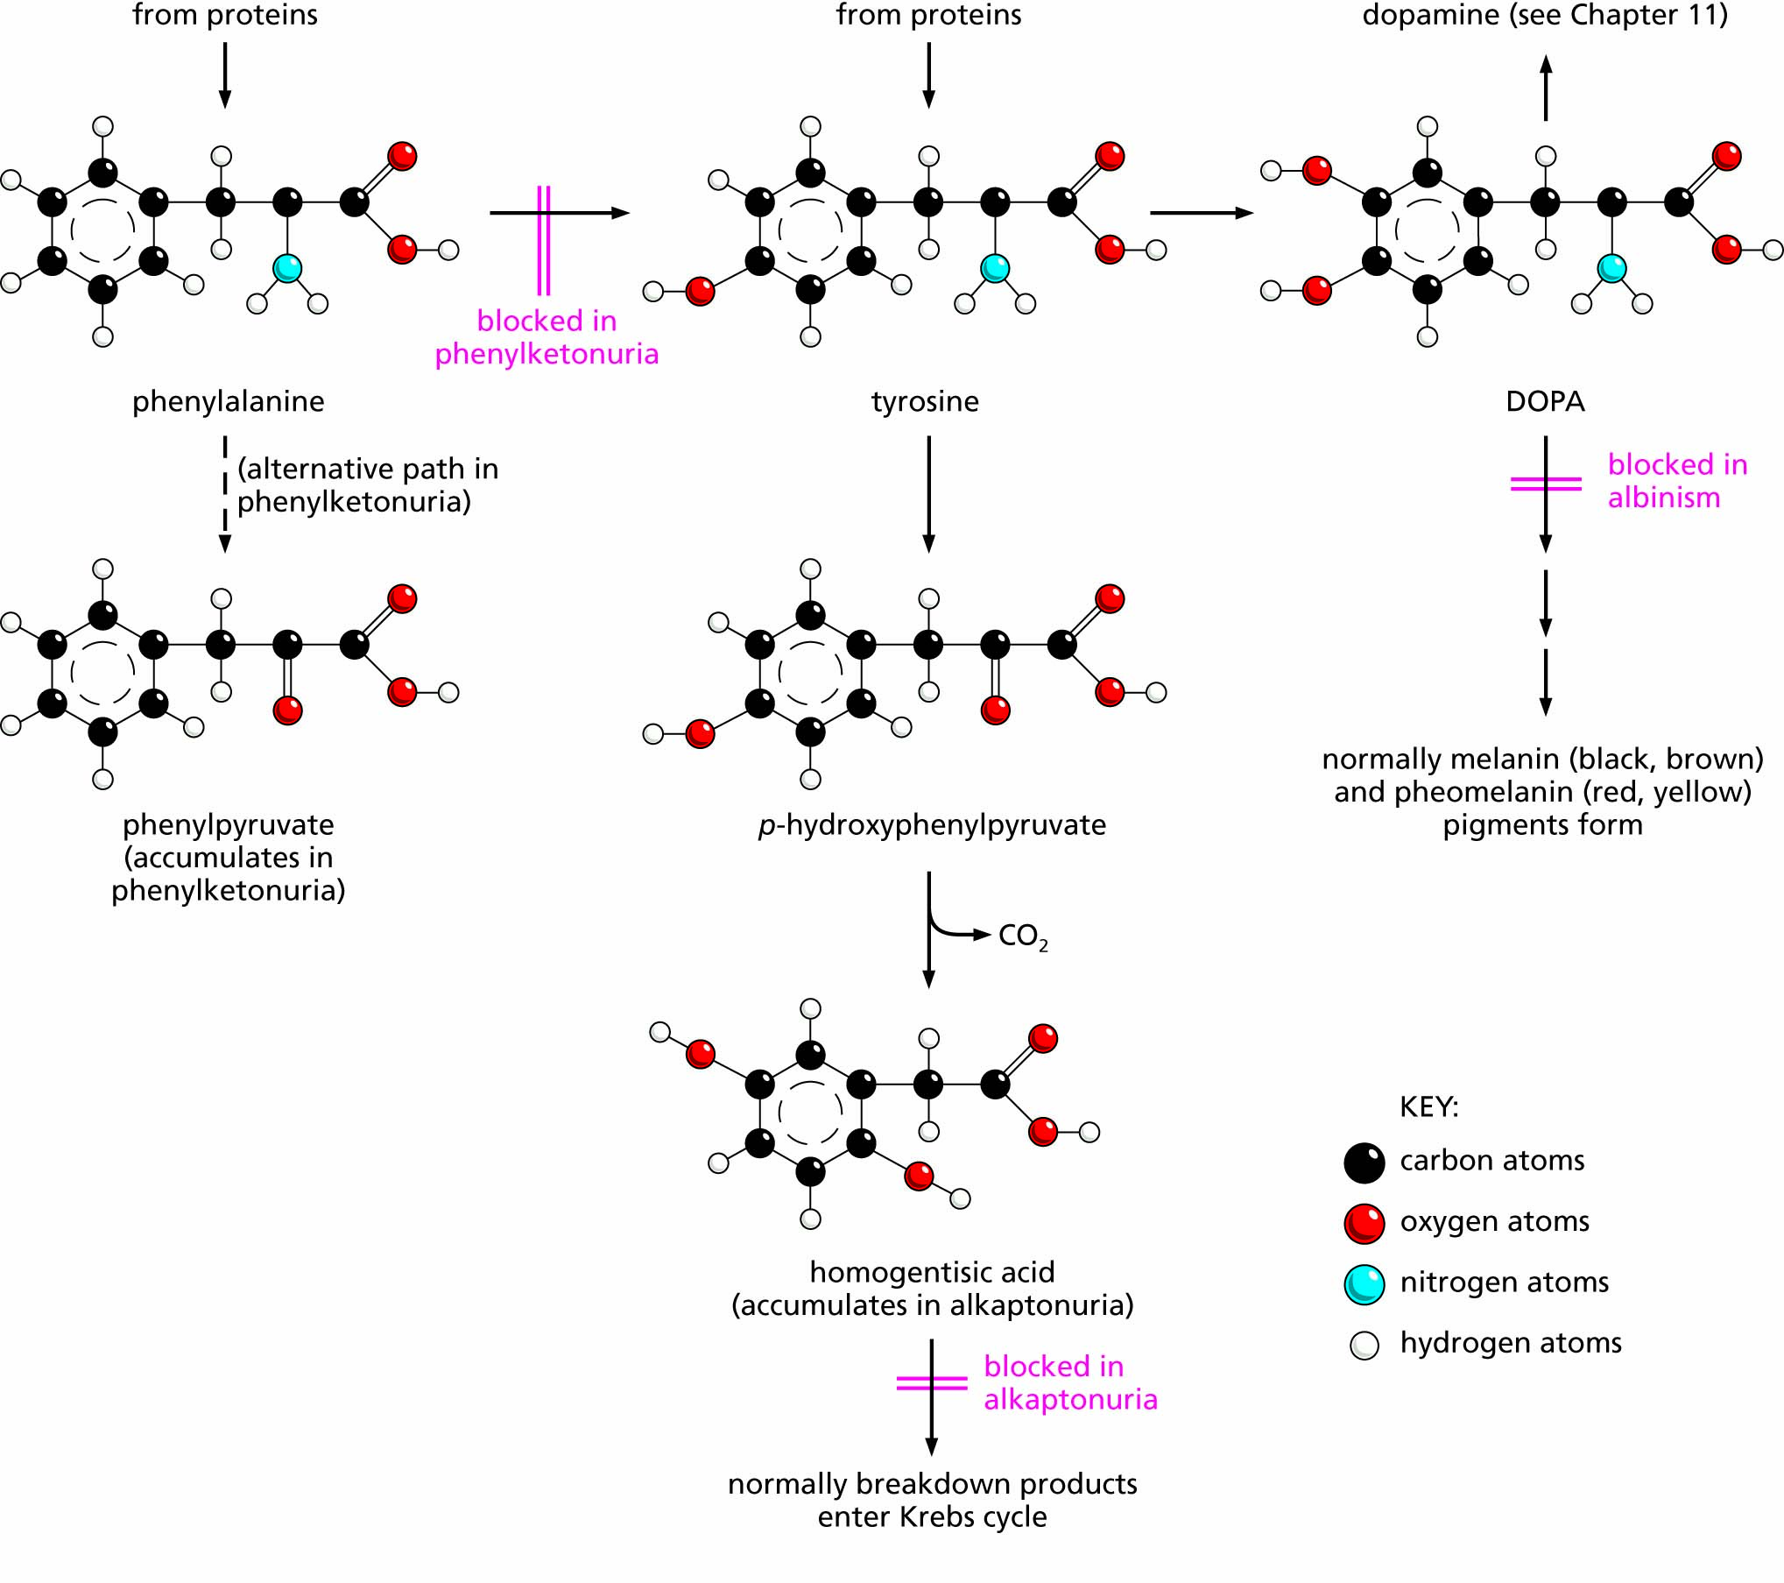
Figure 3.15 Biochemical pathways for three inborn errors of metabolism: phenylketonuria, alkaptonuria, and albinism.

Slide 21
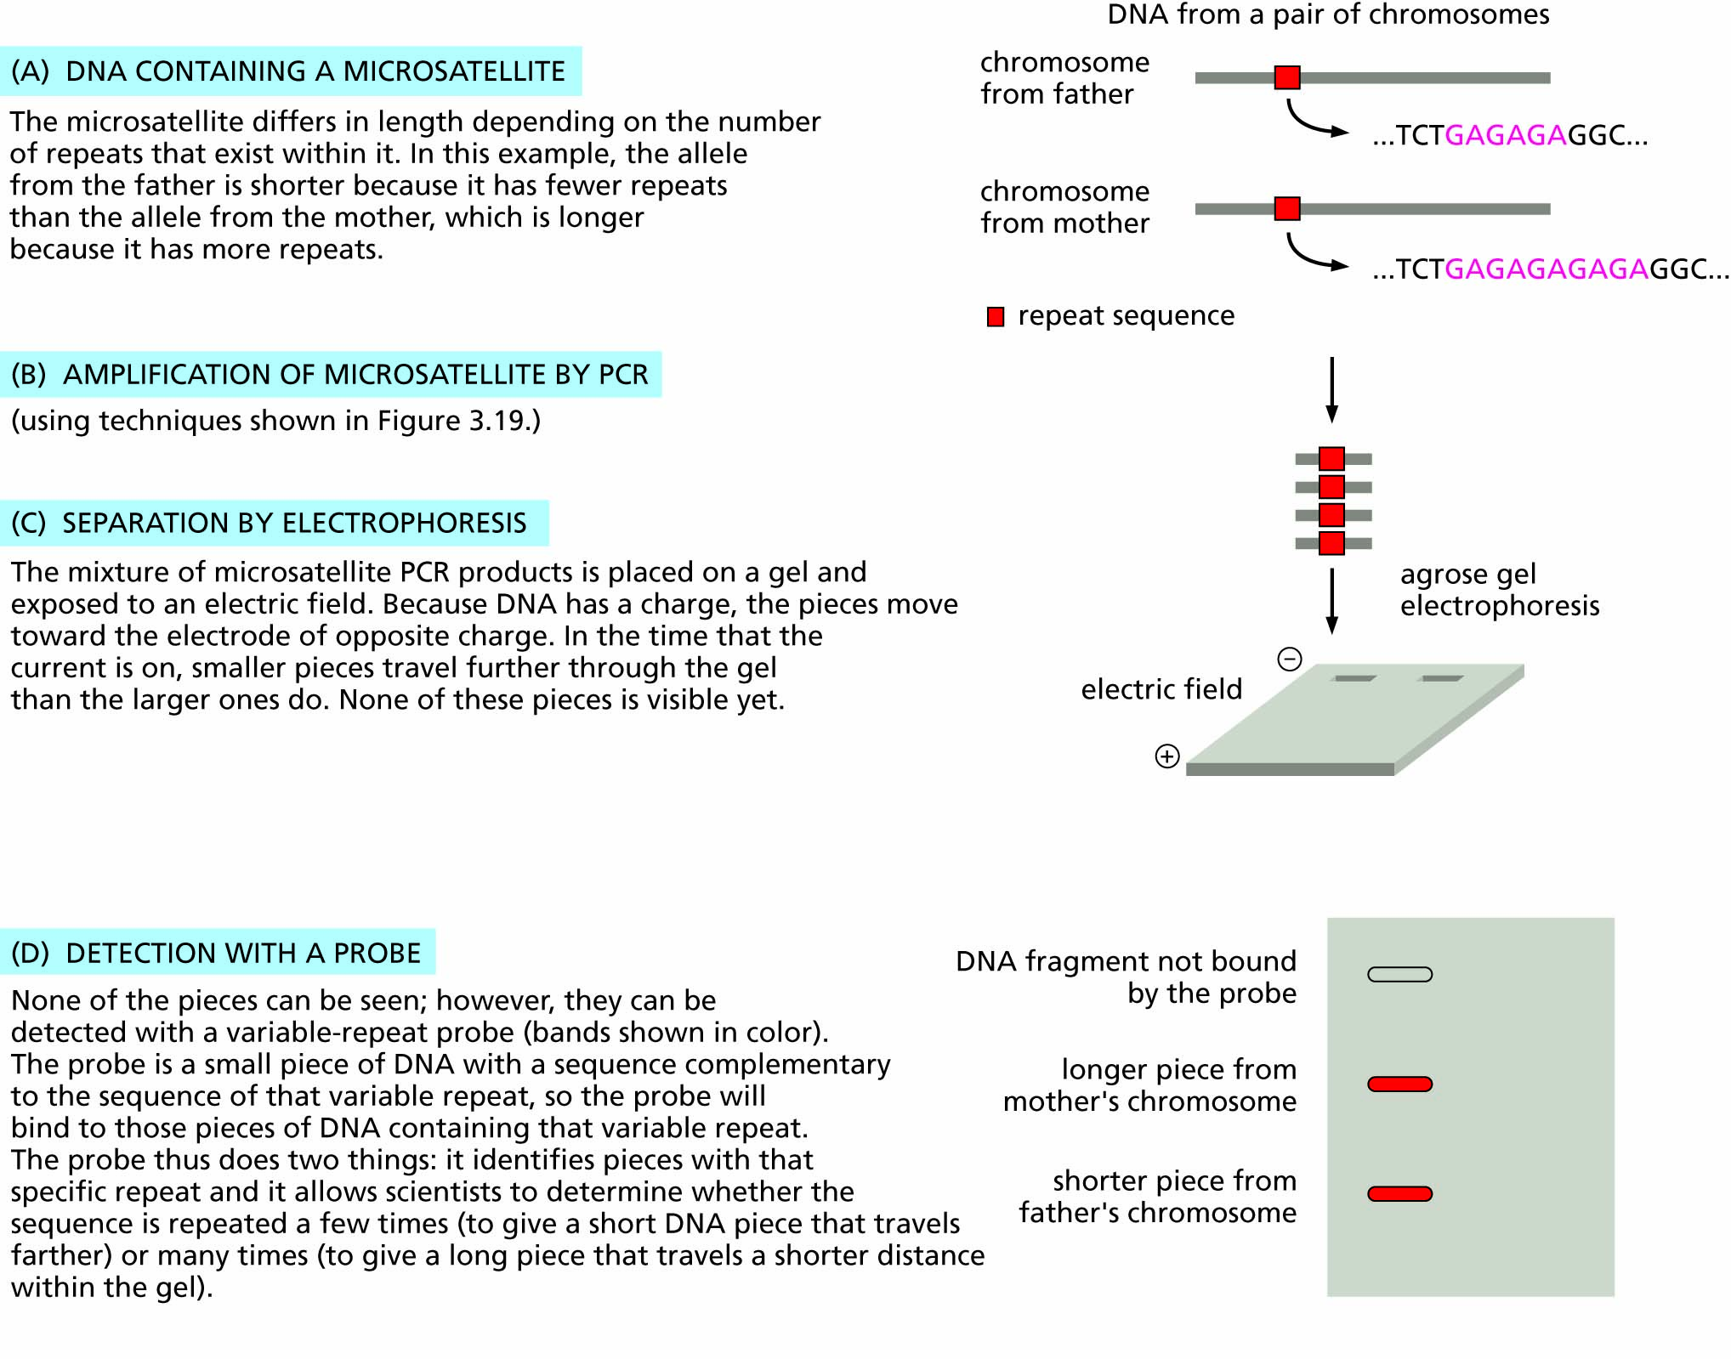
Figure 3.16 Microsatellite DNA marker alleles can be distinguished by the distance they travel during electrophoresis.

Slide 22
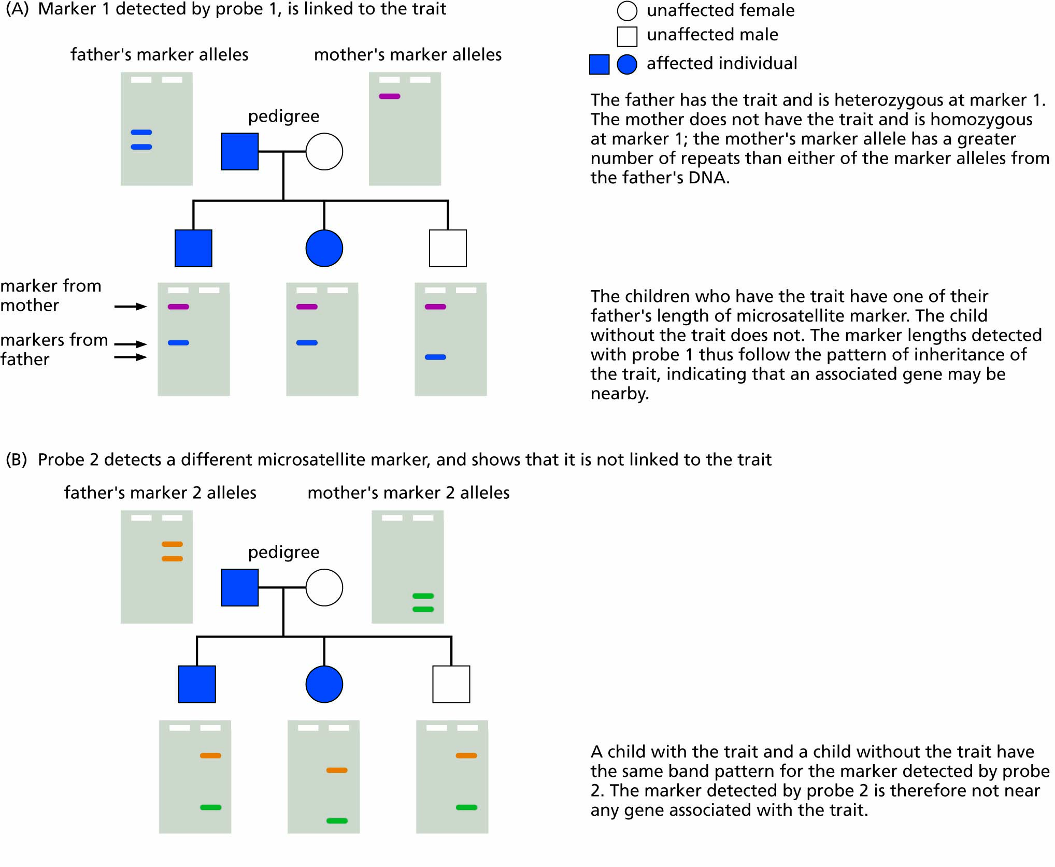
Figure 3.17 Using DNA markers to establish a linkage between a DNA region and an inherited phenotype.

Slide 23
Genetic information can be used or misused in various ways
Genetic testing and counselling
Altering individual genotypes
Altering the gene pool of populations
Changing the balance between genetic and environmental factors

Slide 24
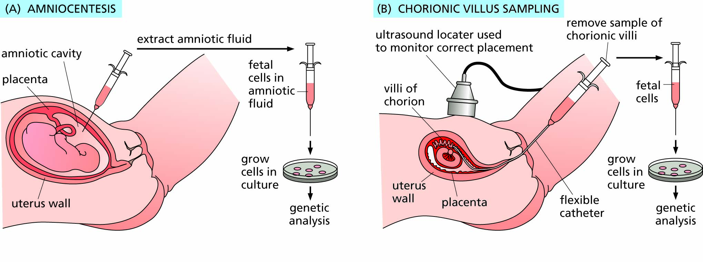
Figure 3.18 Techniques for prenatal detection of genetic conditions.

Slide 25
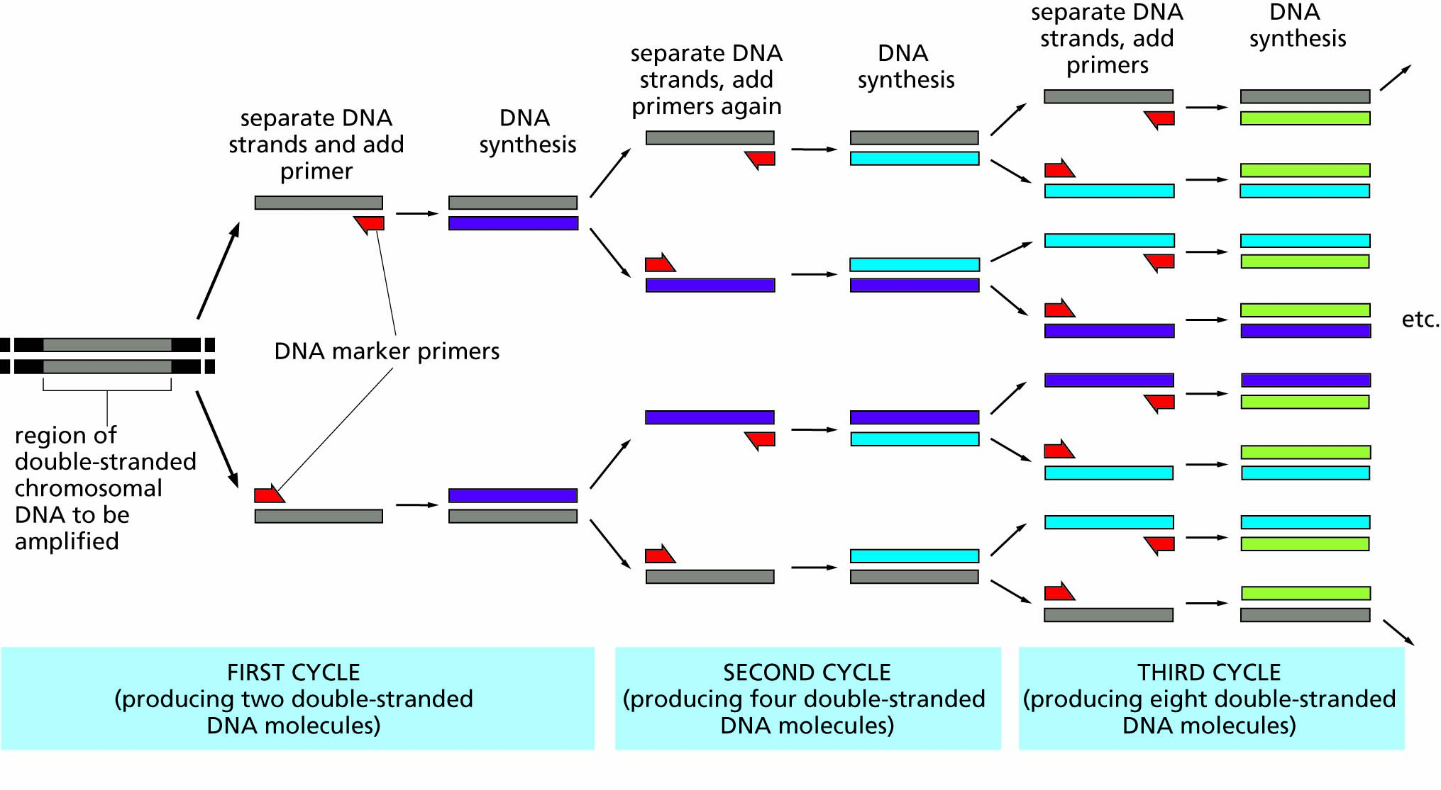
Figure 3.19 The polymerase chain reaction (PCR).

Slide 26
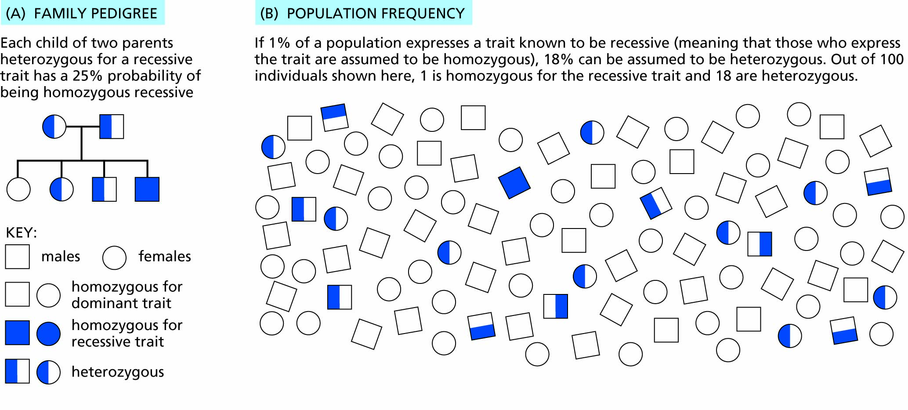
Figure 3.20 Two ways of assessing risk for a recessive trait with single-gene, simple Mendelian inheritance.

Slide 27
RECAP: Genetic information can be used or misused in various ways
Genetic testing and counselling
Altering individual genotypes
Altering the gene pool of populations
Changing the balance between genetic and environmental factors

