Slide 1
Chapter 2: Genes, Chromosomes, and DNA
Biology Trending, 4e
Eli Minkoff and Jennifer Hood-DeGrenier

Slide 2
Gregor Mendel (1822-1884)
Grew up on a farm in what was then part of Austrian Empire, now in the Czech Republic
Very smart, but family was very poor
Enrolled at Monastery of St. Thomas in Brno (Brünn) “in order to escape the limitations of his poverty”
Monastery wanted to train him as a teacher, so they paid for him to take classes at the University of Vienna
Greatly influenced by physicist Christian Doppler (author of Doppler effect), who insisted on reducing all science to numbers and formulas

Slide 3
Gregor Mendel (1822-1884)
Assigned to grow food for Monastery in adjacent garden
Grew many varieties of garden peas; kept careful records, counted everything
Began by establishing PURE LINES that bred true
Folklore predicted “blending” inheritance, but when Mendel crossed pure lines he discovered DOMINANT and RECESSIVE traits instead
PARTICULATE INHERITANCE: Hereditary traits are inherited as particles (now called GENES) that do not blend.
Different forms of the same gene are called ALLELES.

Slide 4
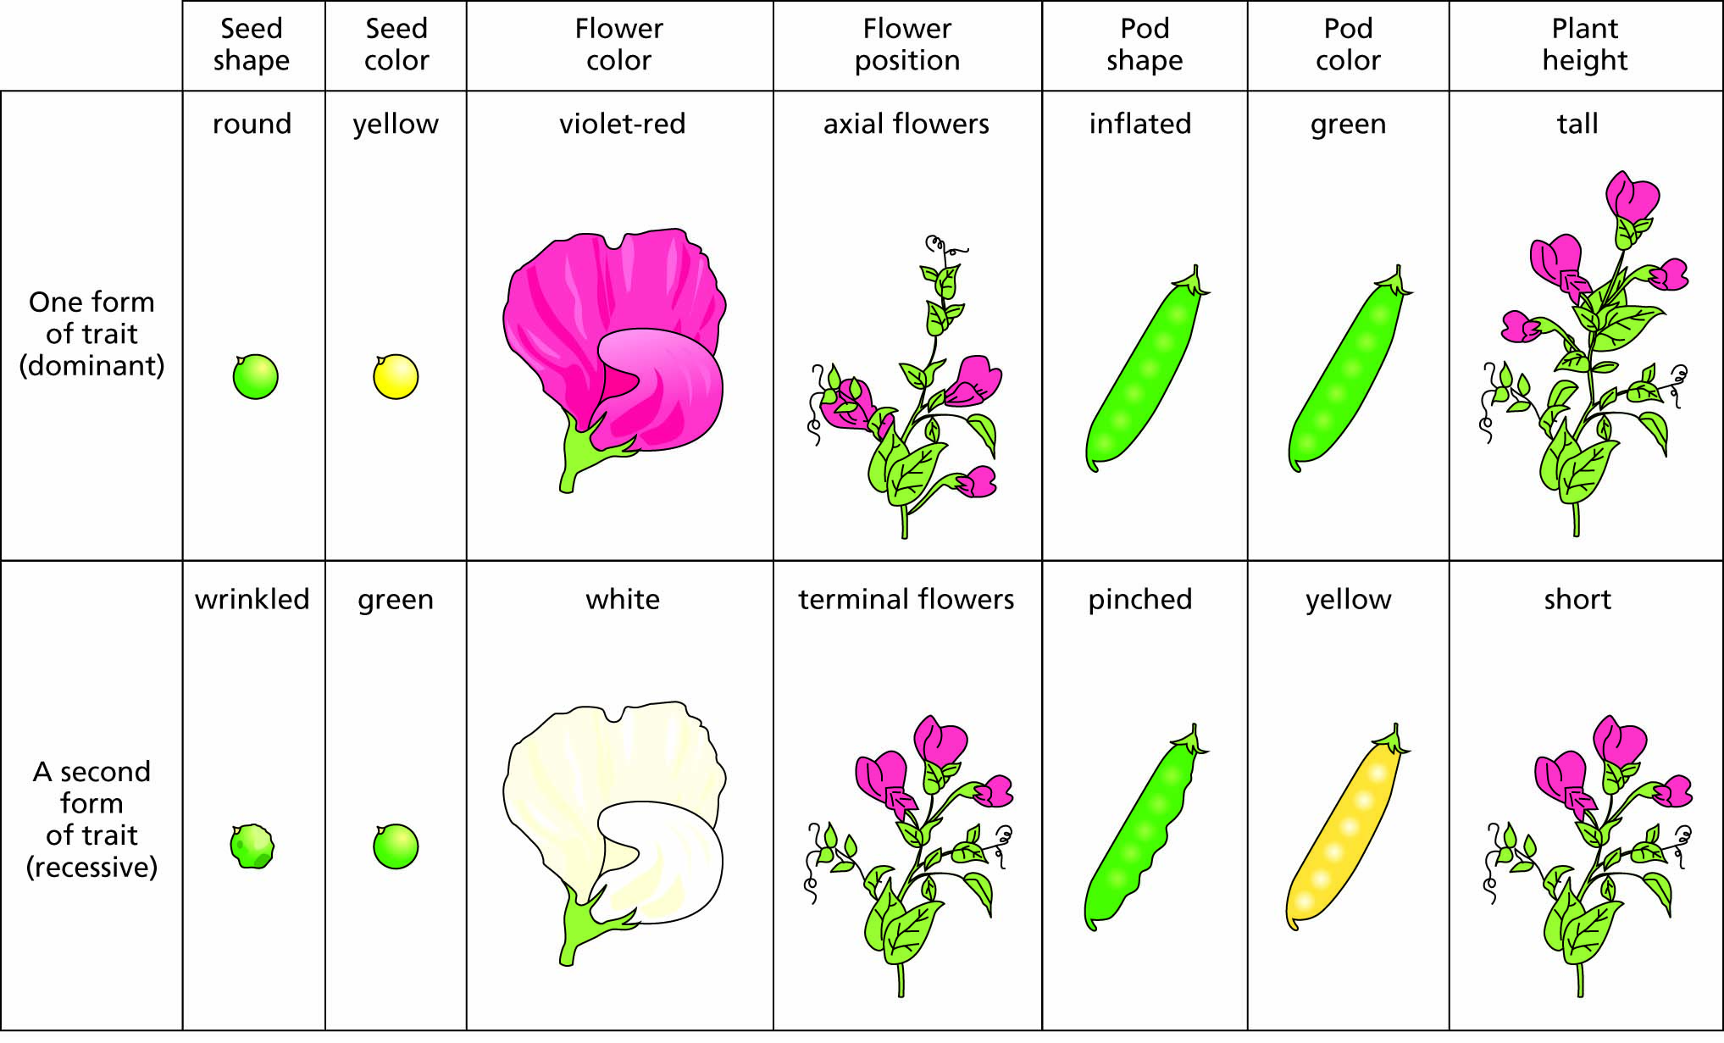
Figure 2.1 The seven traits studied by Mendel in peas.

Slide 5
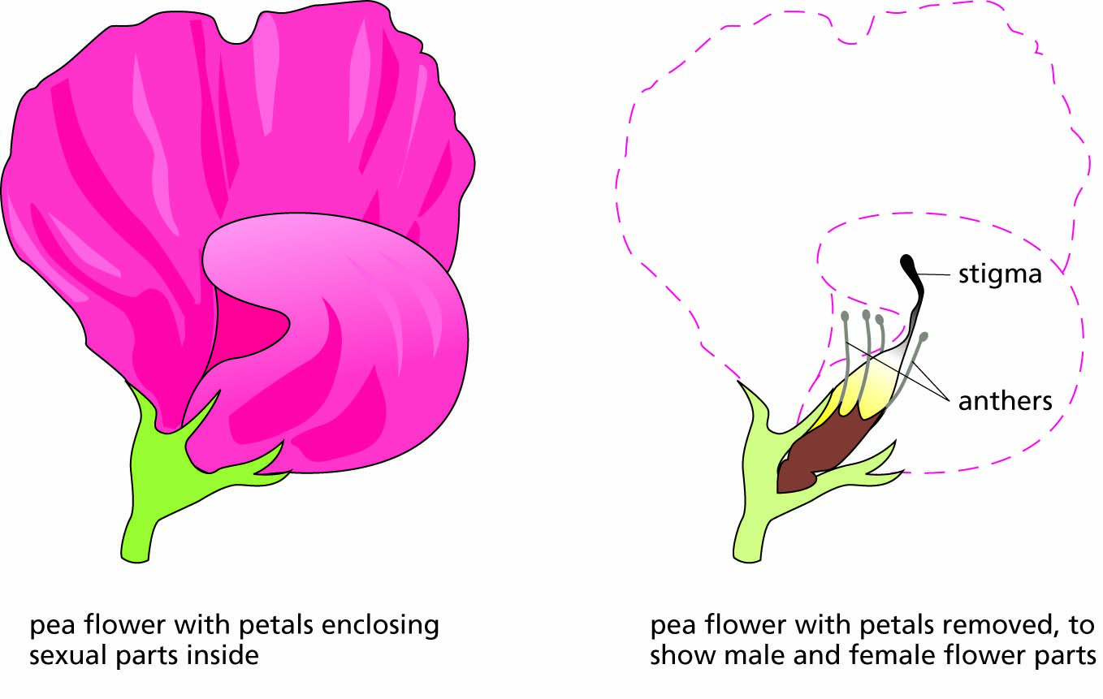
Figure 2.2 The structure of a pea flower. A more complete view of the sexual reproductive structures of flowering plants is shown in Figure 6.12.

Slide 6
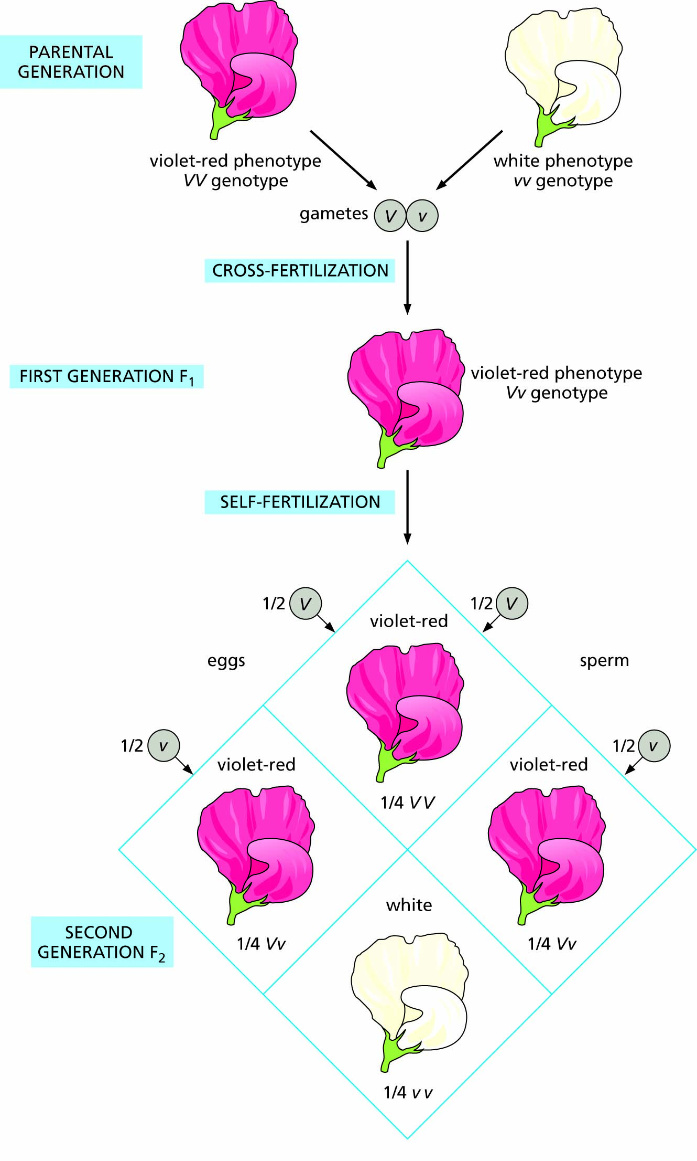
Figure 2.3 One of Mendel’s experiments with peas differing in a single trait.

Slide 7
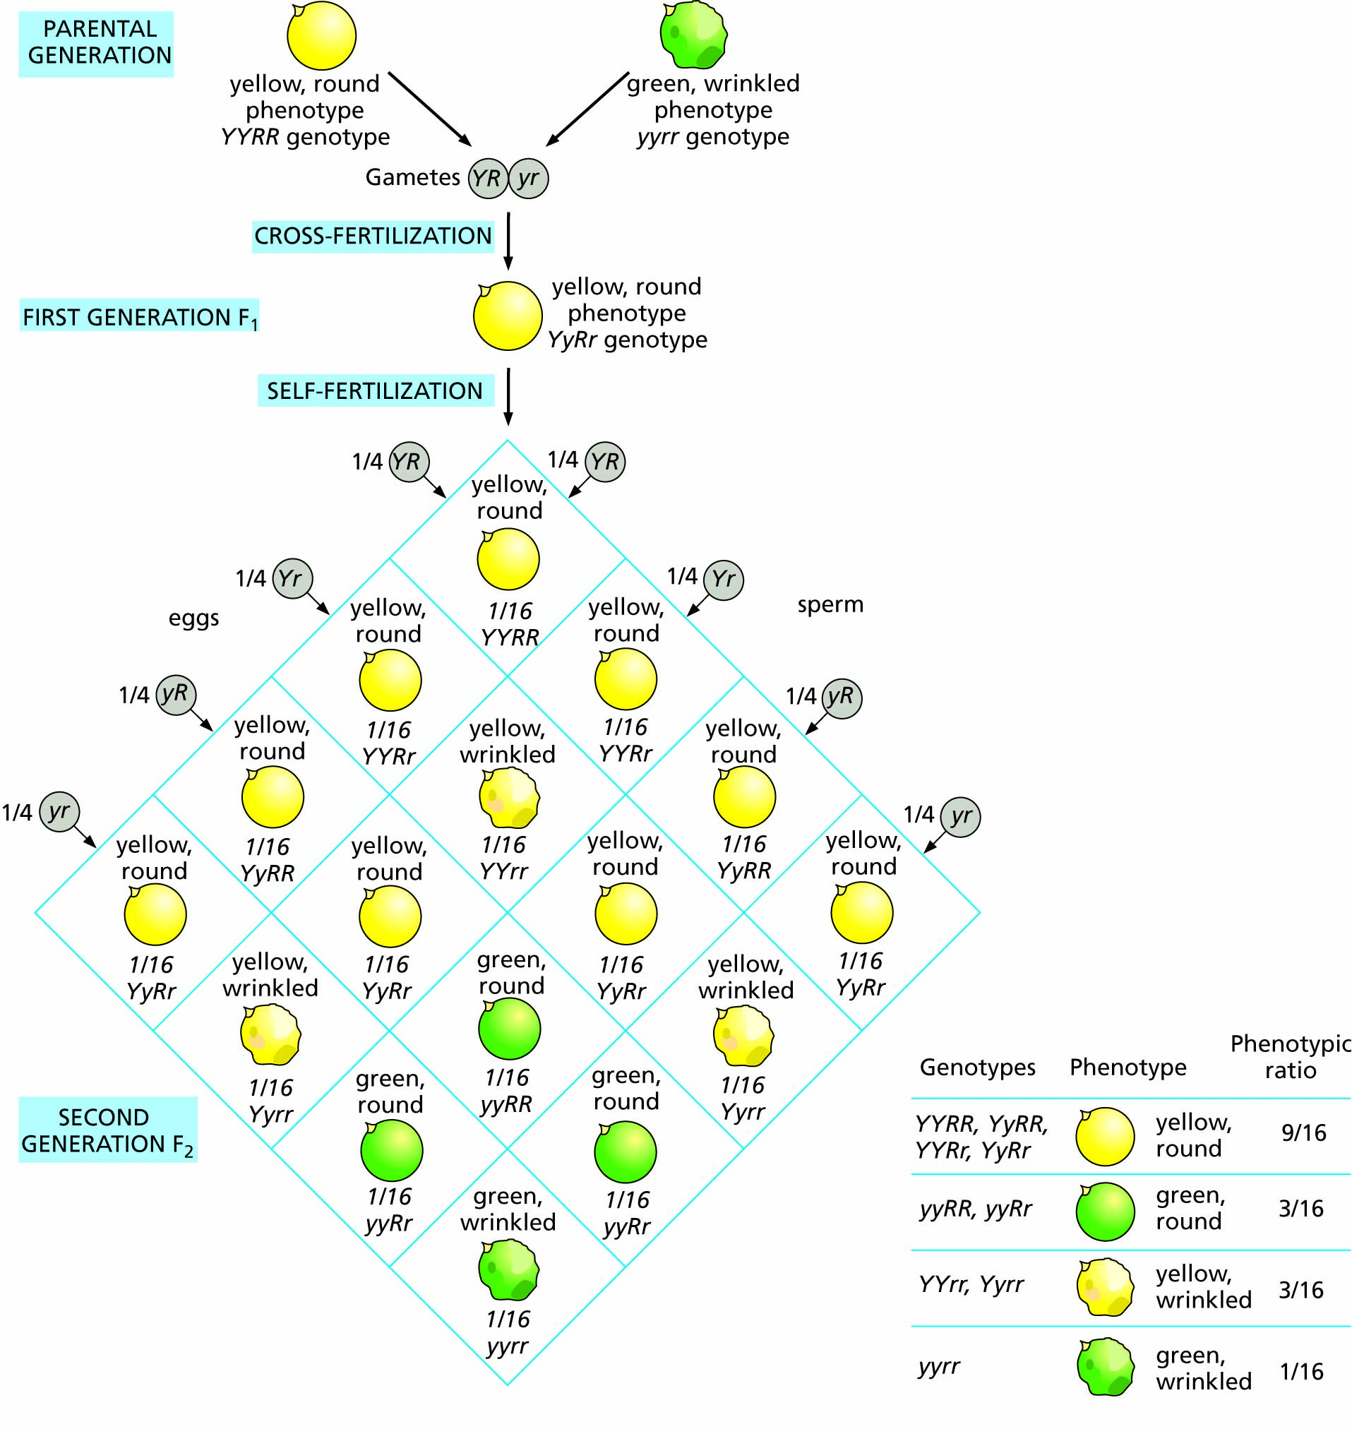
Figure 2.4 One of Mendel’s experiments with peas differing in two traits.

Slide 8
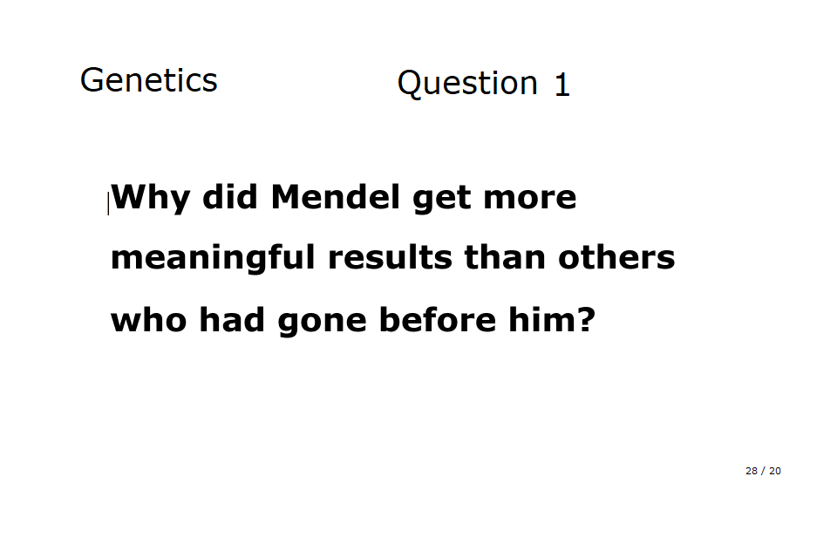

Slide 9
Where are the genes located?
Evidence shows that genes are located on CHROMOSOMES. When dividing cells are stained with certain dyes, chromosomes appear as colored bodies (Greek chroma = ‘color’, soma = ‘body’).
Walter Sutton first suggested this in 1902.
Sutton’s hypothesis was elaborated into the CHROMOSOMAL THEORY OF INHERITENCE, independently confirmed by two groups of researchers in 1931.

Slide 10
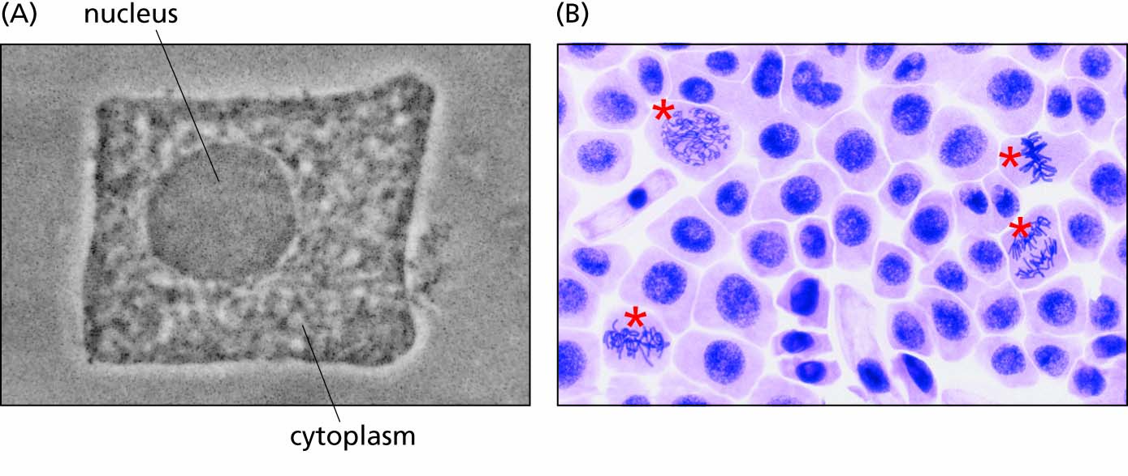
Figure 2.5 Structures of a nucleated cell.
(A) Individual chromosomes can only be seen in cells undergoing division. (B, cells marked with red asterisks). The images shown are for onion root tip cells.

Slide 11
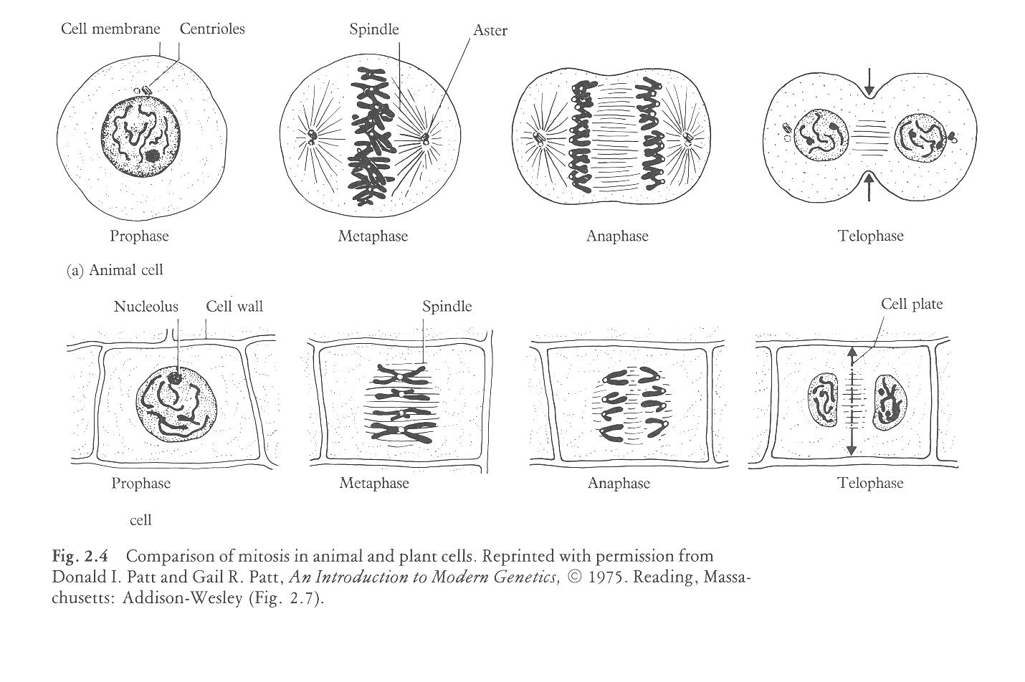

Slide 12
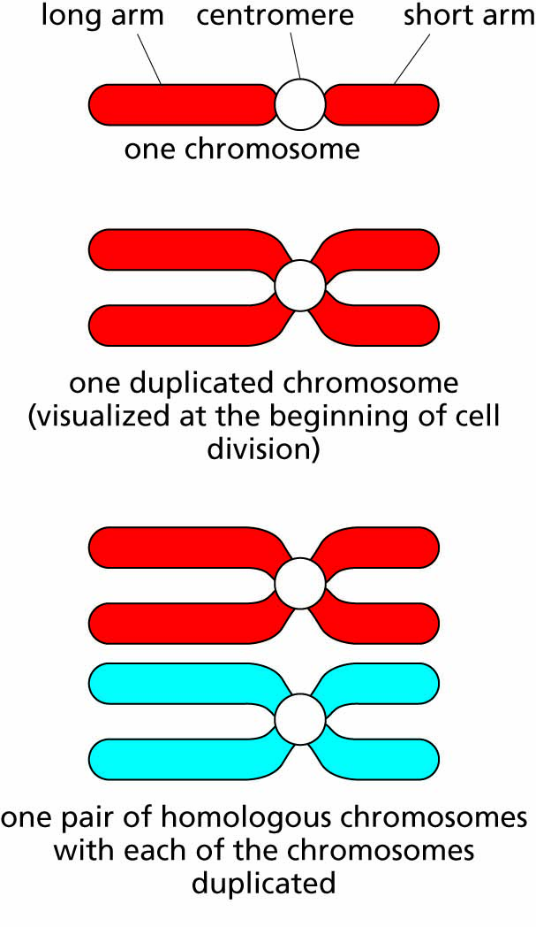
Figure 2.6 Comparison of a single chromosome, a duplicated chromosome, and a homologous pair of duplicated chromosomes.

Slide 13
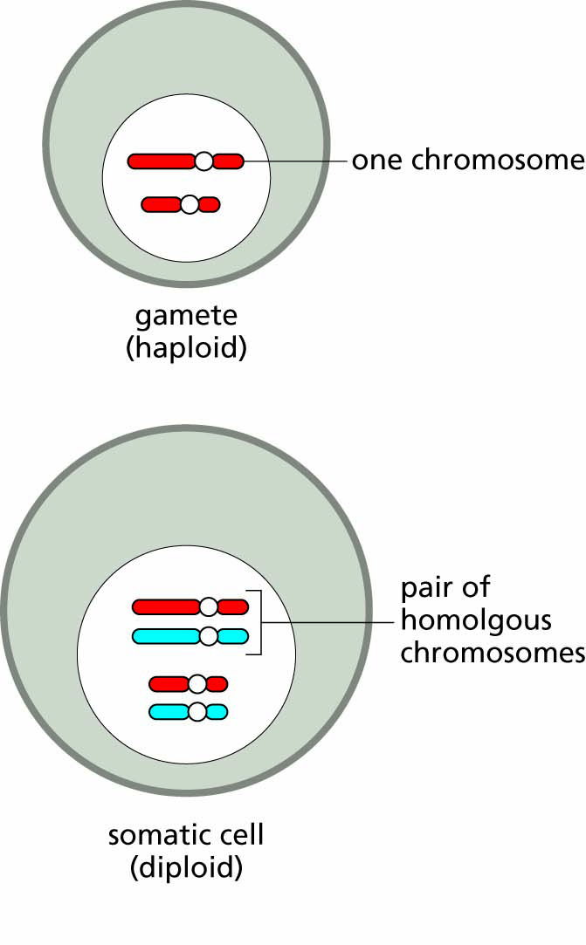
Figure 2.7 Comparison of chromosome numbers in a gamete (N=2) and a somatic cell (2N=4) from a diploid species that has its DNA divided between two distinct chromosomes.

Slide 14
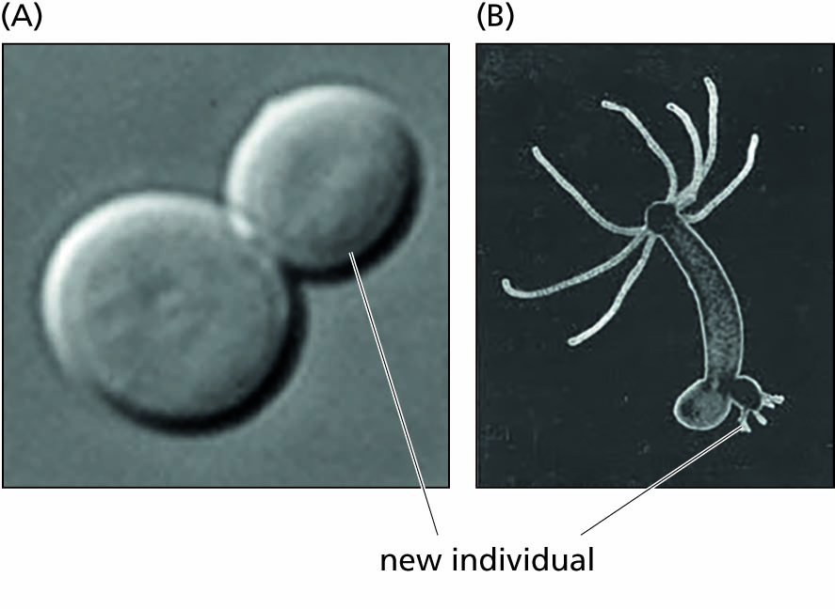
Figure 2.8 Asexual reproduction via mitosis. Many single-celled organisms, like the budding yeast Saccharomyces cerevisiae (A), and even some multicellular organisms, like hydra (B), reproduce asexually via mitotic cell division to produce a new, genetically identical individual (clone) that separates from the parent.

Slide 15
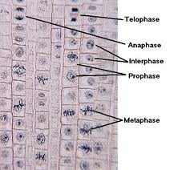
Mitosis in onion root tip cells

Slide 16
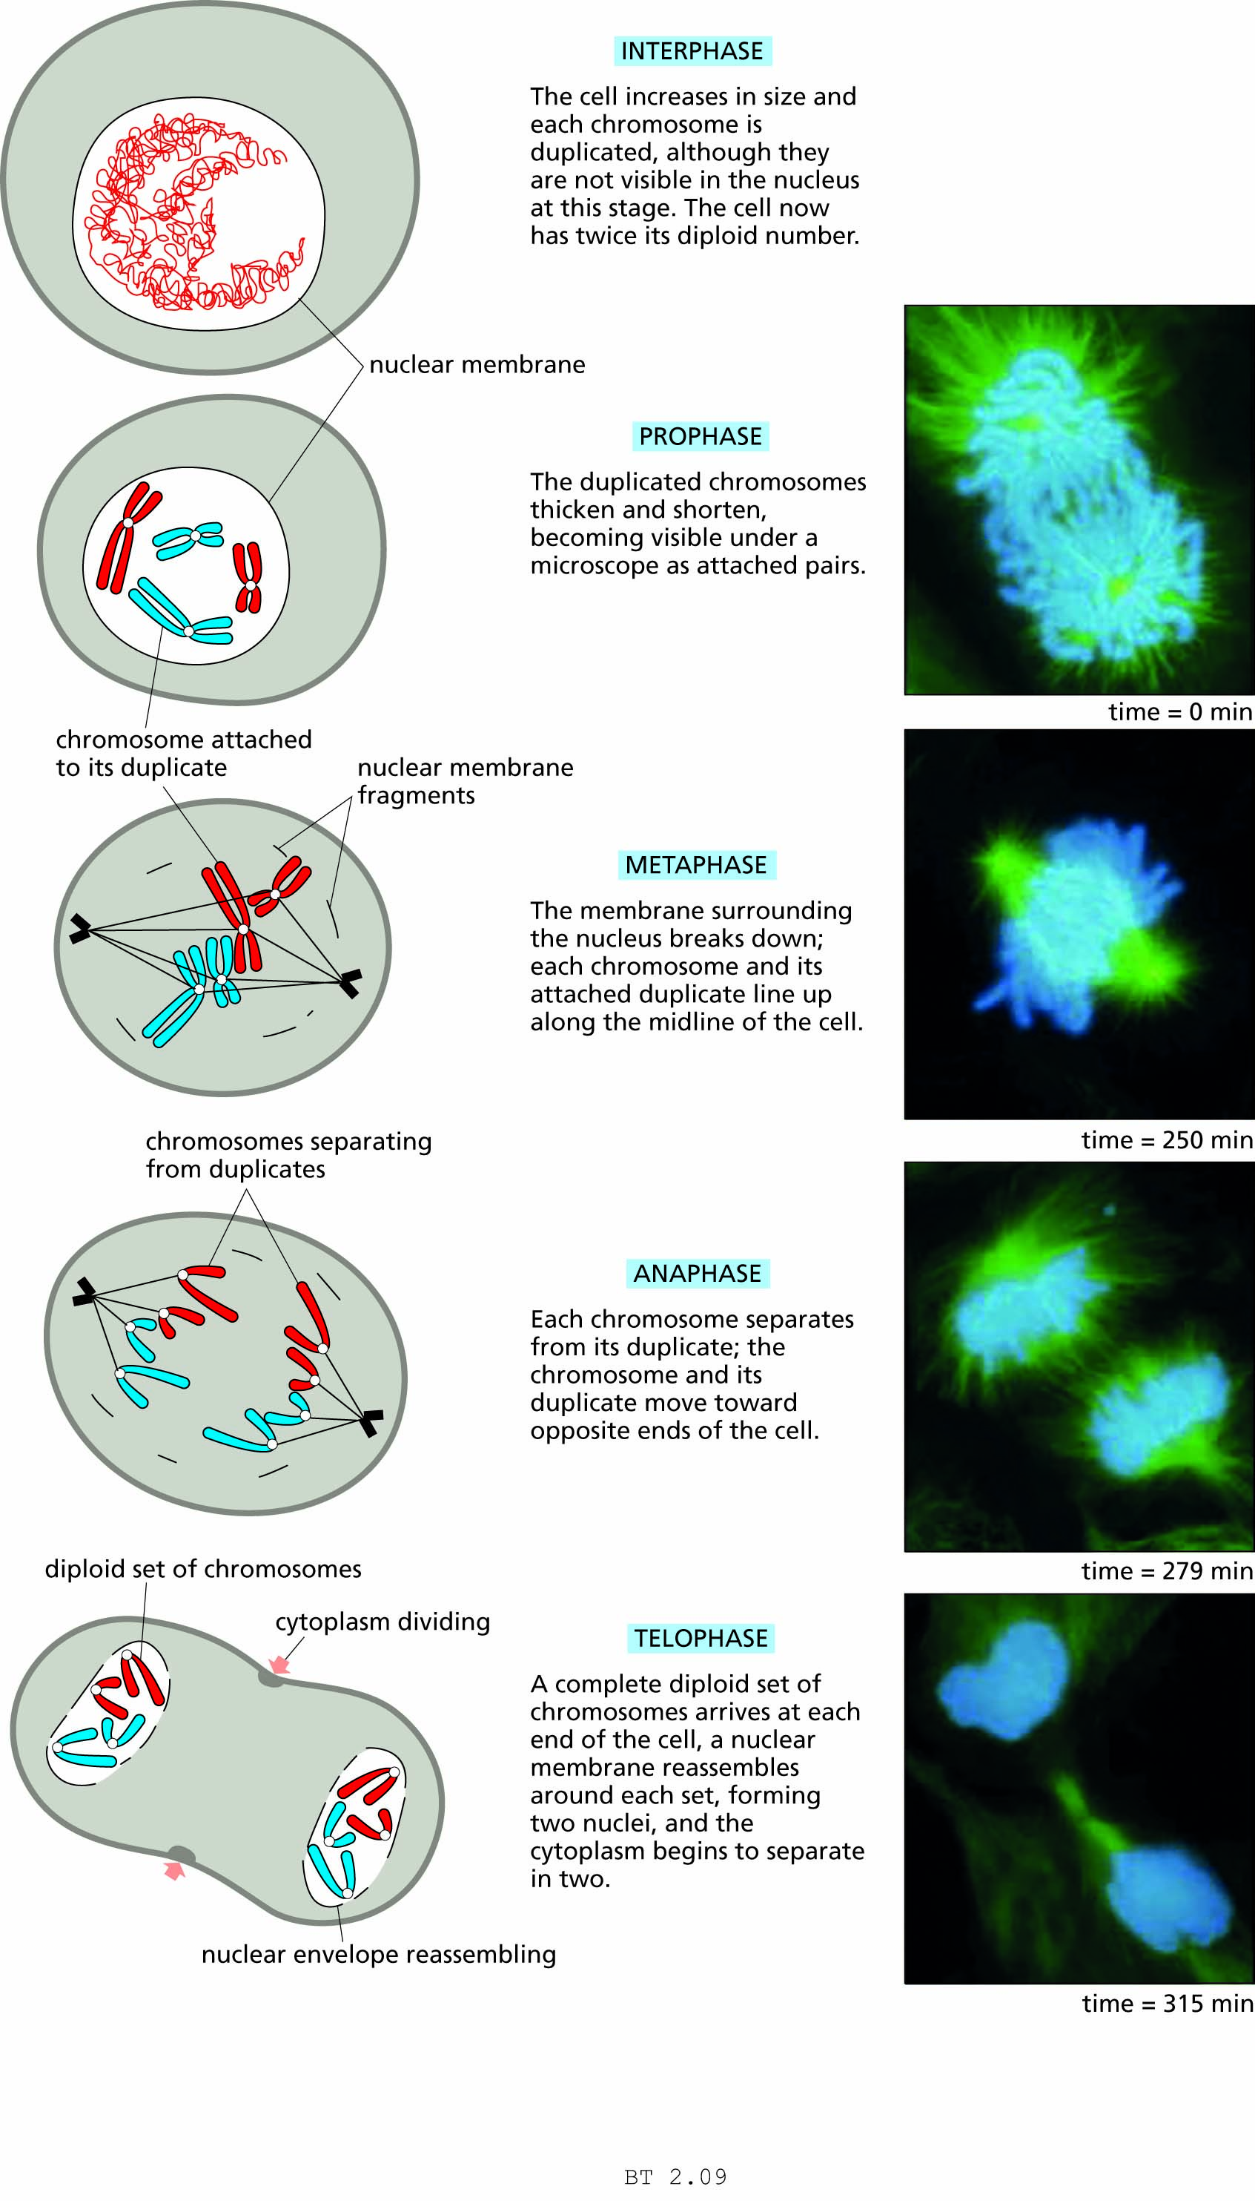
Figure 2.9 Mitosis.
The cell divides in such a way that each of the two offspring cells contains the same number of paired chromosomes as the parent cell did.
The drawings show a cell like that in Figure 2.6, with a diploid number of 2N=4 chromosomes (2 pairs).
The photographs are fluorescent images that show both chromosomes and spindle fibers.

Slide 18
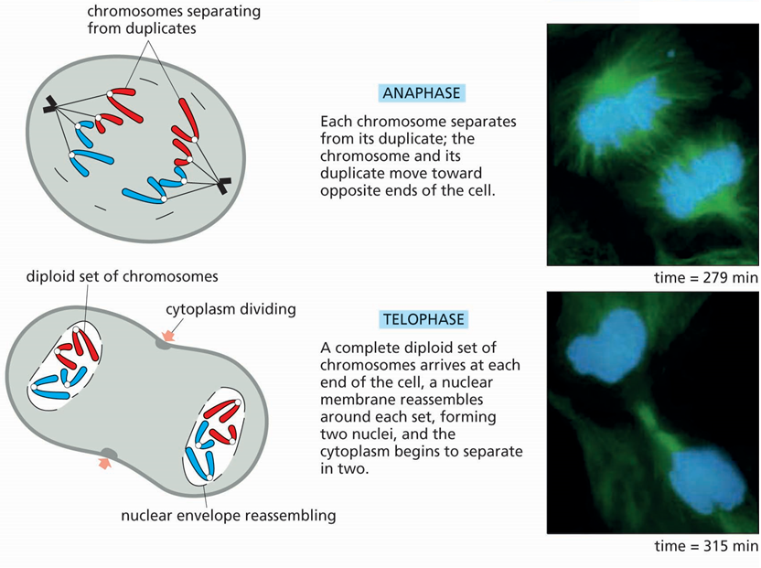

Slide 19
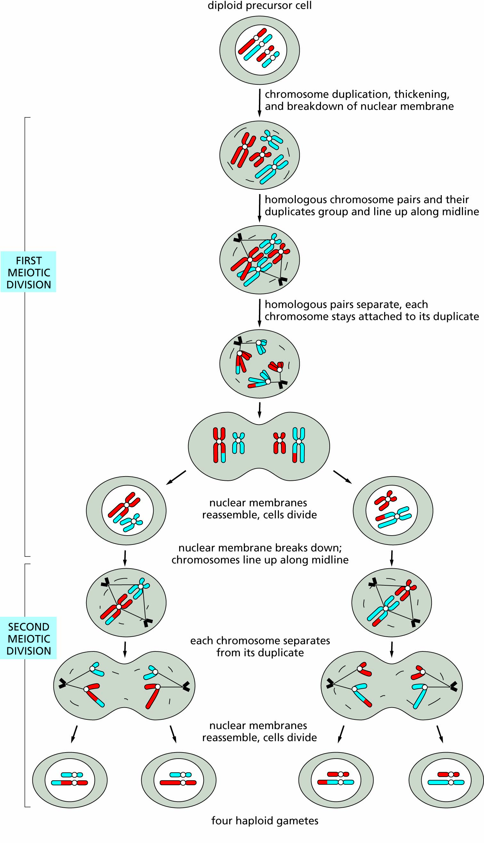
Figure 2.10 Meiosis.
A cell with a diploid number of chromosomes (2N=4 in this example) divides twice to produce four haploid gametes (here with 2 chromosomes each).

Slide 20
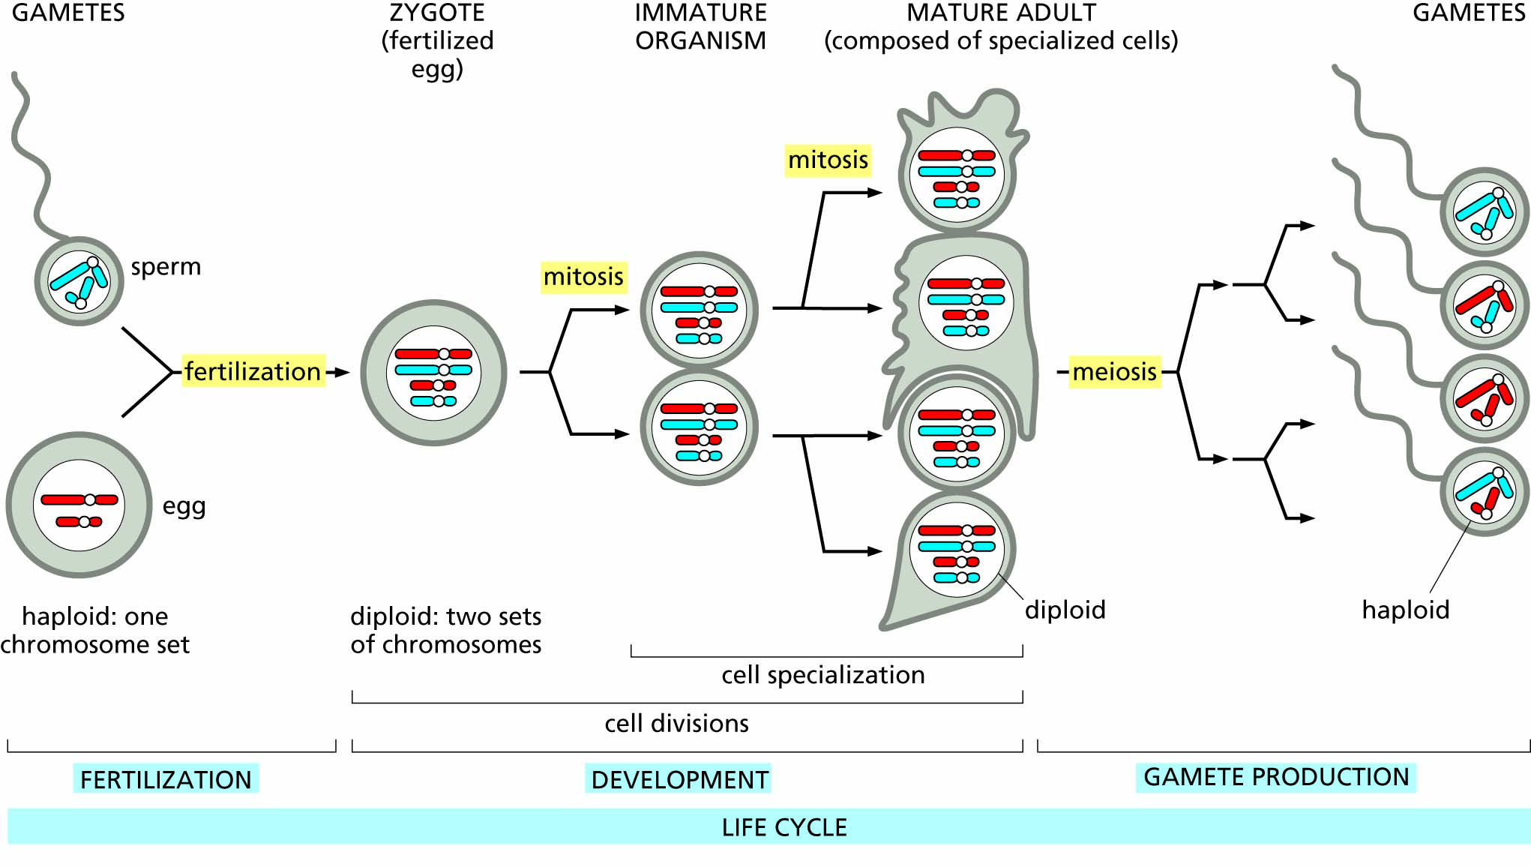
Figure 2.11 Sexual life cycles. In sexual reproduction, haploid gametes join by fertilization to form a new diploid individual with one of each pair of homologous chromosomes coming from each parent. In multicelled organisms the diploid zygote divides by mitosis to form the adult organism. Each of the somatic (body) cells contains a set of chromosomes the same as that in the zygote. In a male organism, meiosis produces sperm, as shown. In a female organism, meiosis produces eggs.

Slide 21
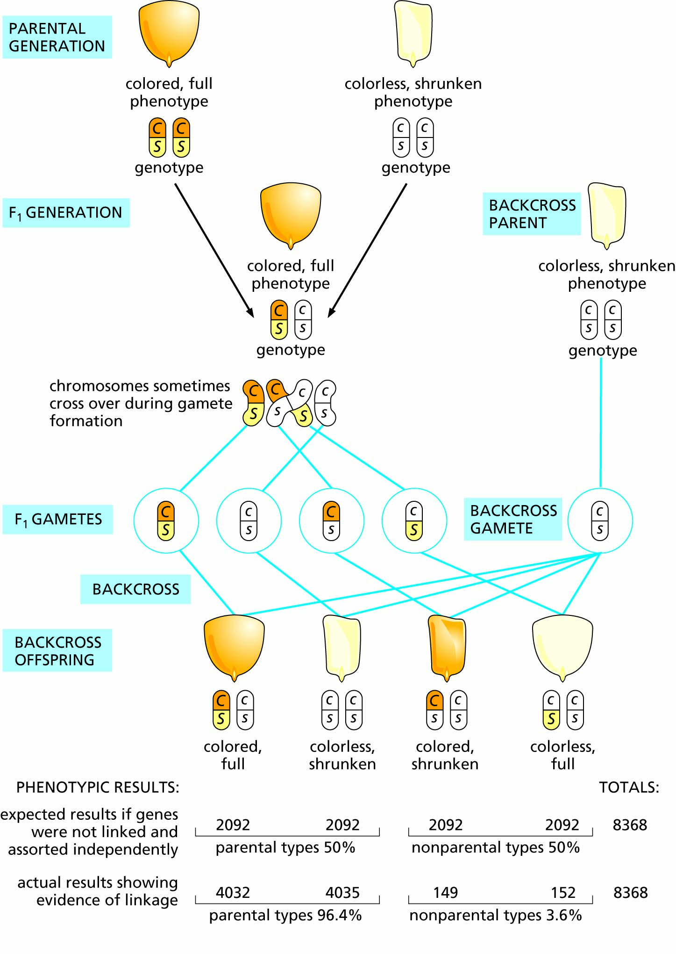
Figure 2.12 A cross between pure-line corn plants having different alleles for two linked genes located on the same chromosome.

Slide 22
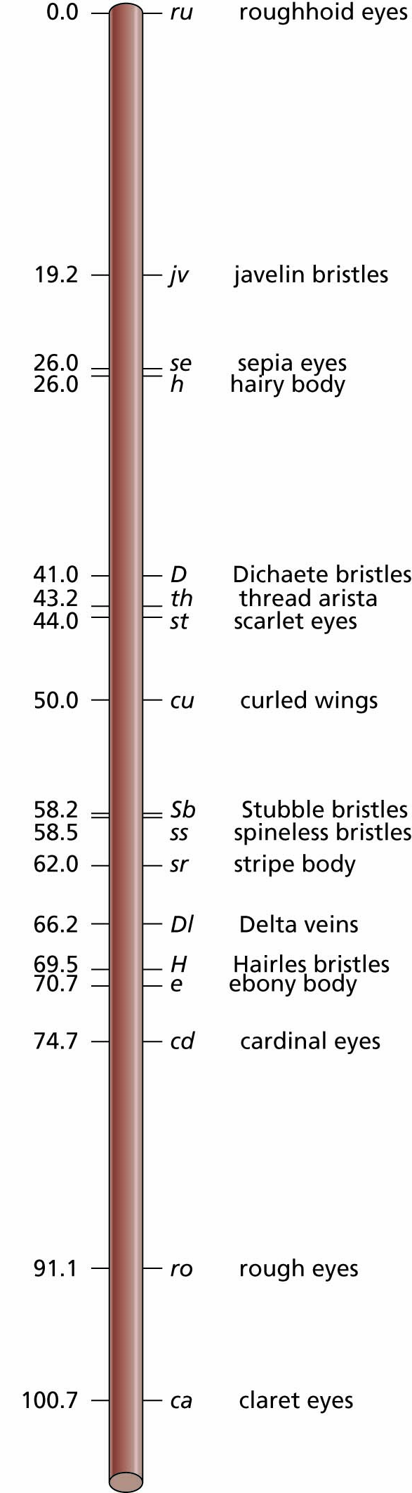
Figure 2.13 Linkage map of chromosome III in the fruit fly Drosophila melanogaster, showing just a few of the many genes known.
Genes for recessive traits are in lowercase; genes for dominant traits are capitalized.
Distances along the chromosome are in units called 'centimorgans'; a distance of 1 centimorgan corresponds to a 1% probability of a crossover between closely linked genes.

Slide 23
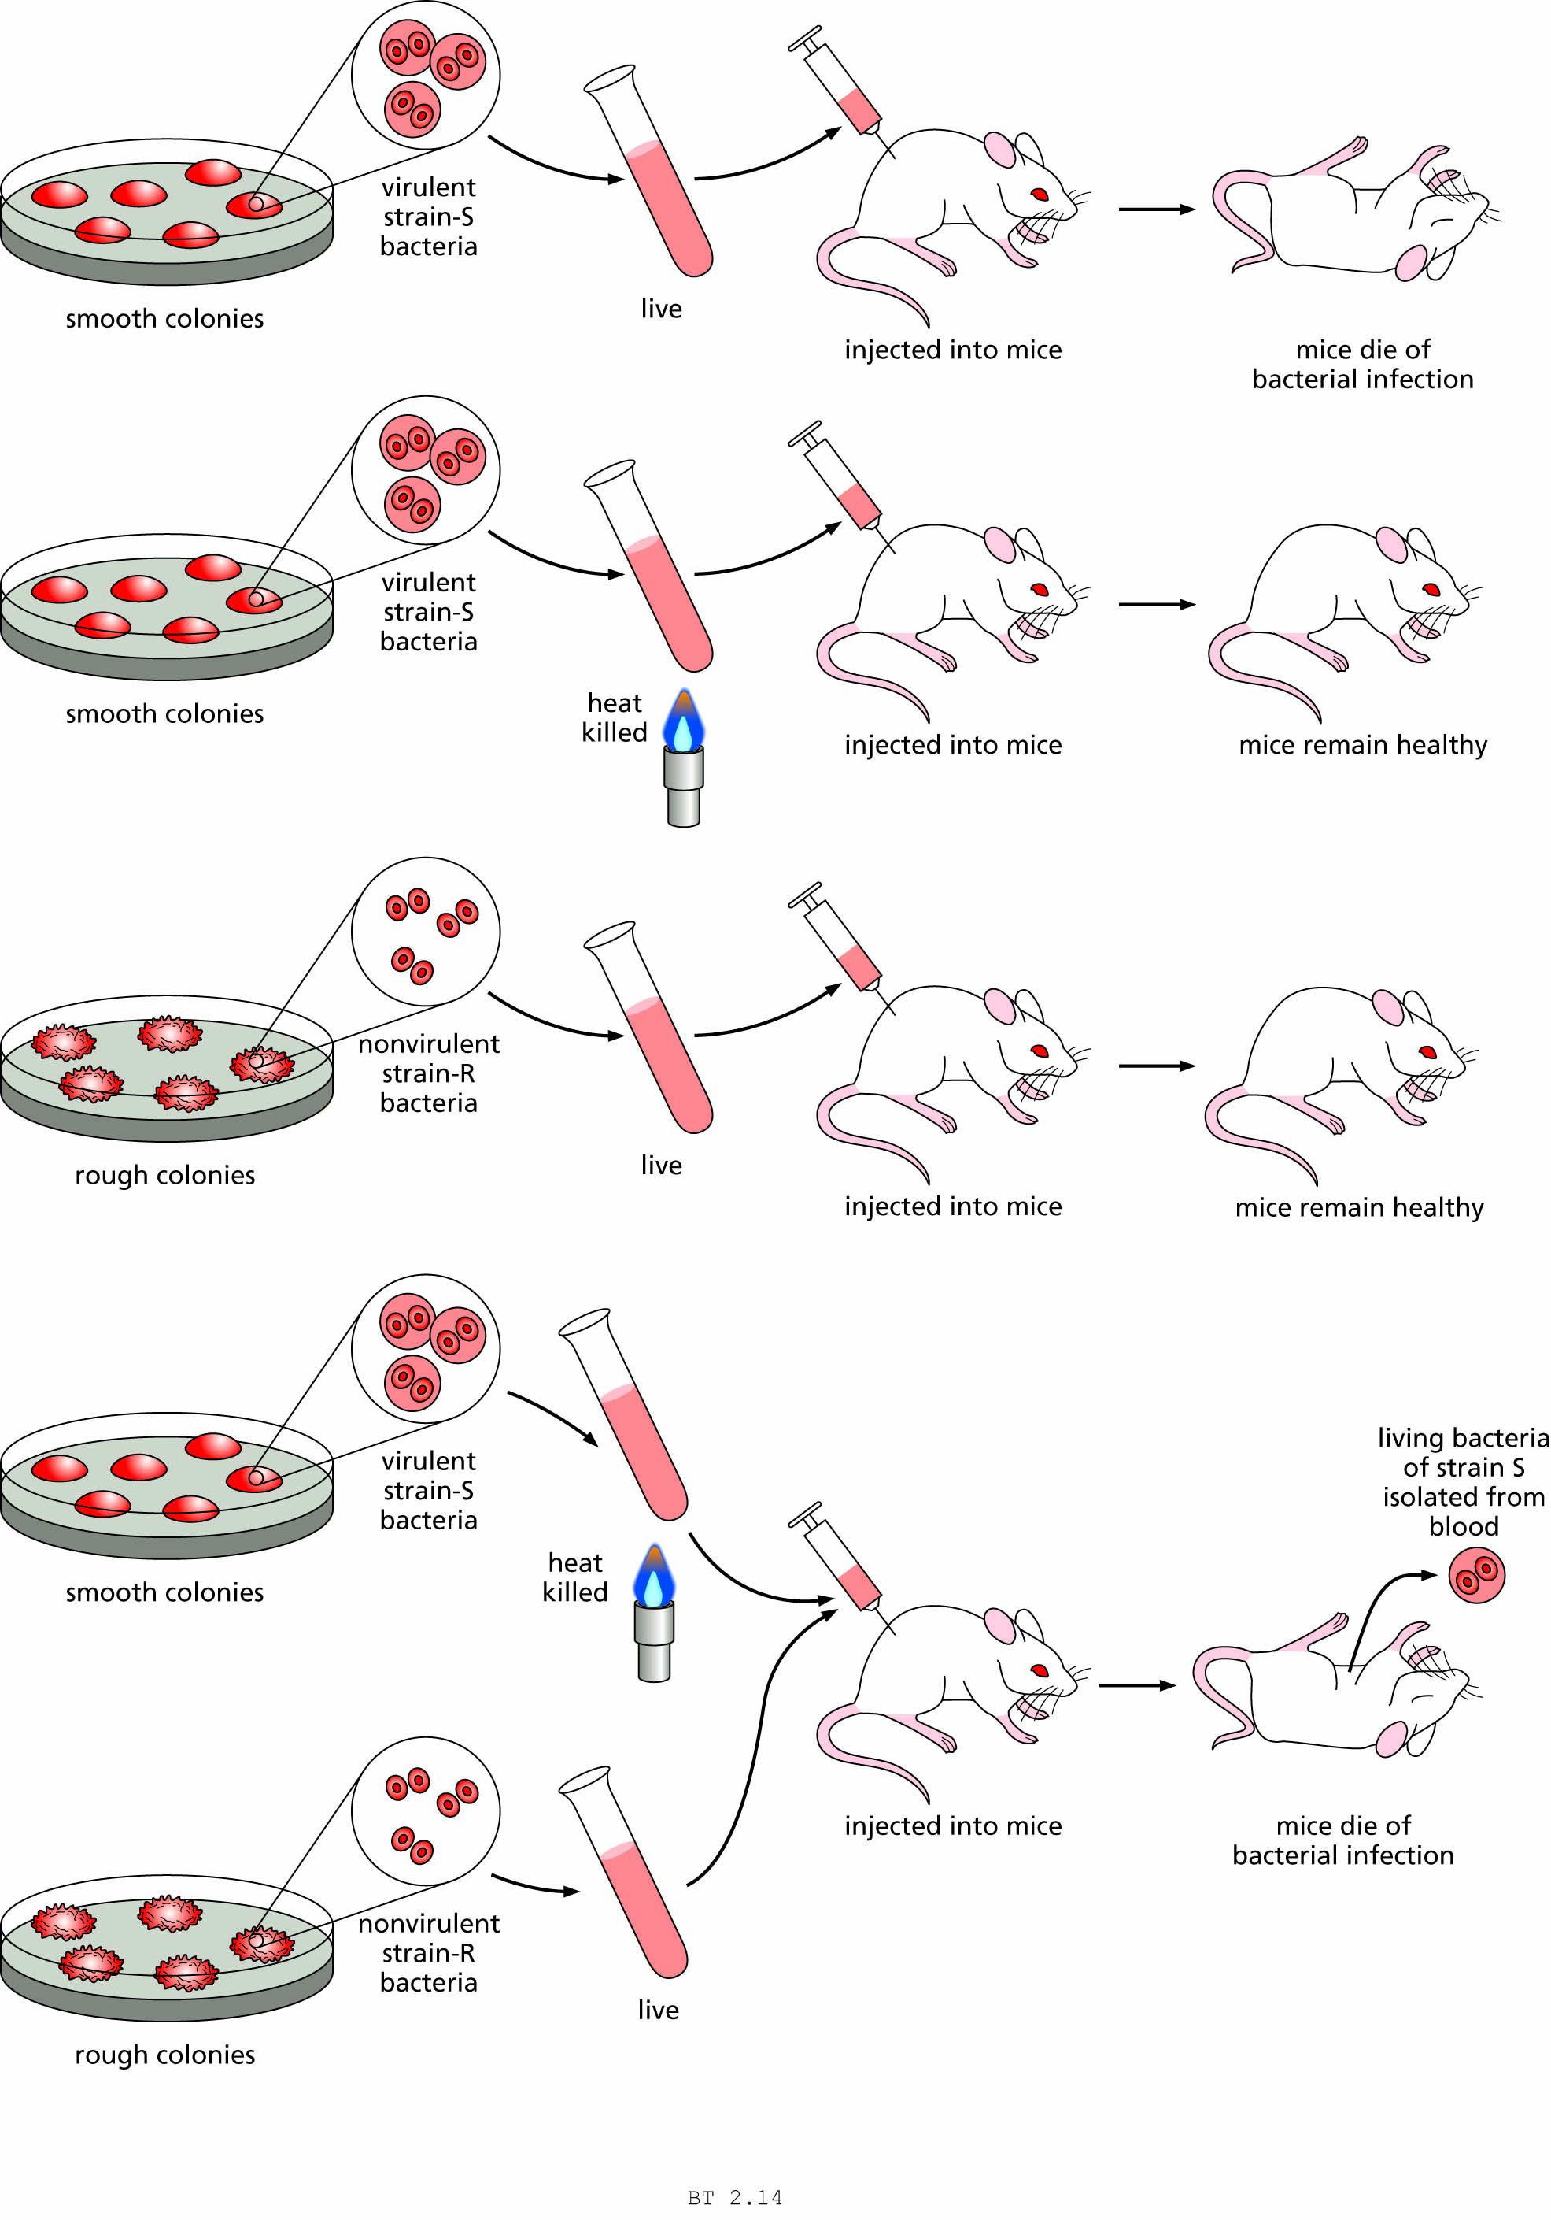
Figure 2.14 Griffith’s experiment demonstrating hereditary transformation in bacteria.

Slide 24
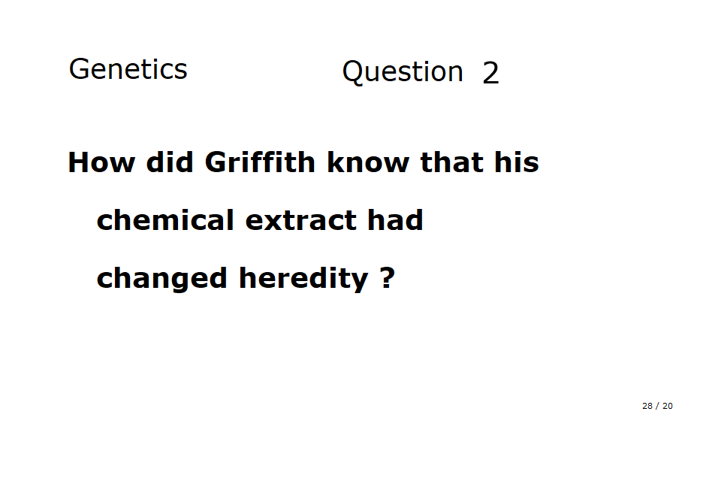

Slide 25
Avery, MacLeod, & McCarthy (1944)
tested chemical extracts of the bacteria
used by Griffith.
They showed that lipid or carbohydrate extracts
were inactive; even protein extracts were inactive.
Only the nucleic acid extracts contained the
“transforming principle”.
Ribonuclease (RNAse) enzymes had no effect.
Only DeoxyriboNuclease (DNAse) abolished
transformation.
Thus, the “transforming principle” was DNA !

Slide 26
The structure of DEOXYRIBONUCLEIC ACID (DNA) and how genes work:
NUCLEIC ACIDS were poorly understood until the 1950s
Two types exist: Ribonucleic acid (RNA) and Deoxyribonucleic acid (DNA).
Both contain:
1. Phosphate groups;
2. Five-carbon sugars (ribose or deoxyribose); &
3. Nitrogen-containing (nitrogenous) bases, usually abbreviated (A, G, C, T in DNA; A, G, C, U in RNA)

Slide 27
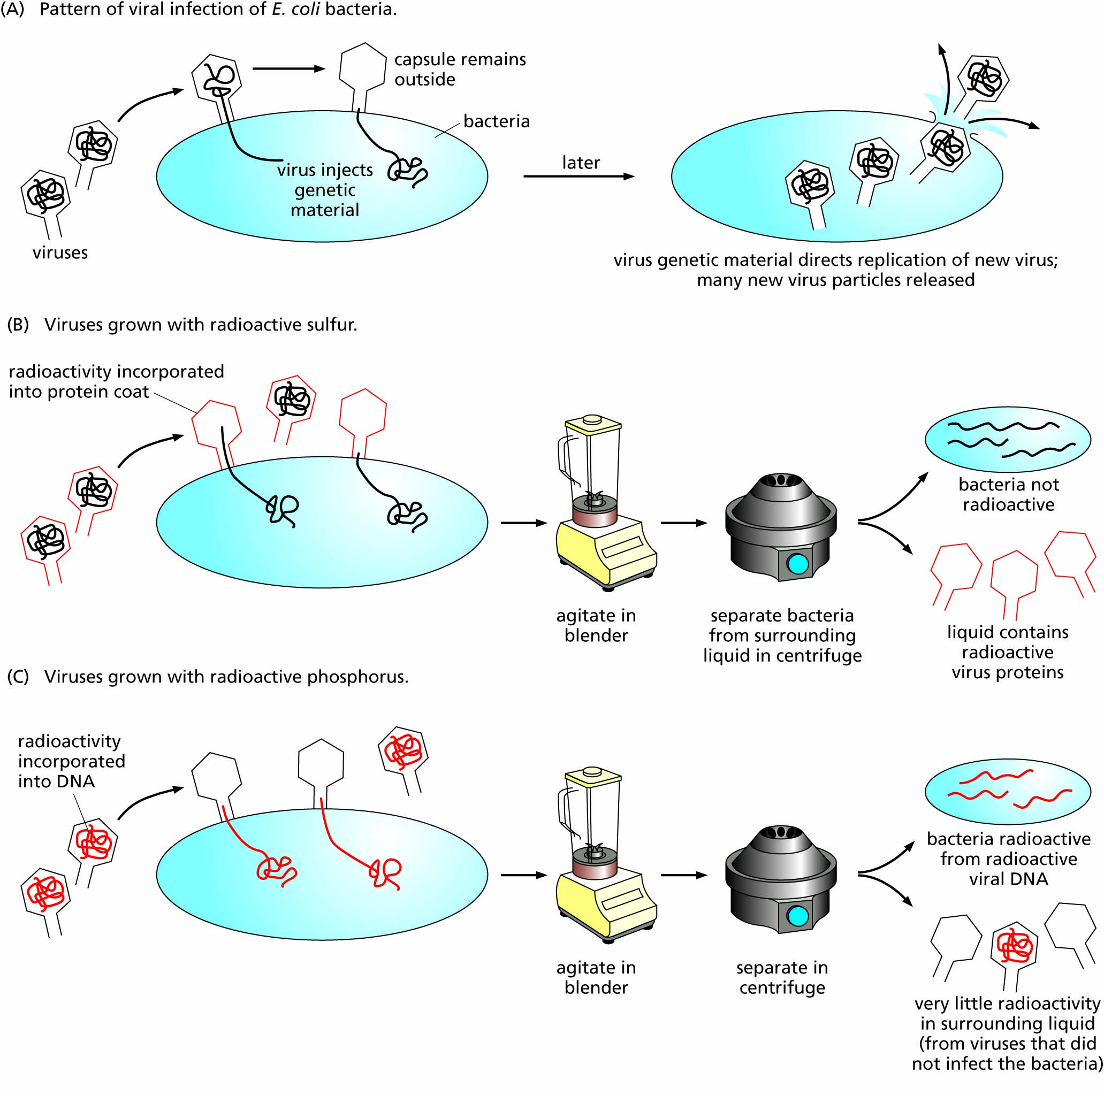
Figure 2.15 The Hershey–Chase experiment. This experiment confirmed DNA as the genetic material.

Slide 28
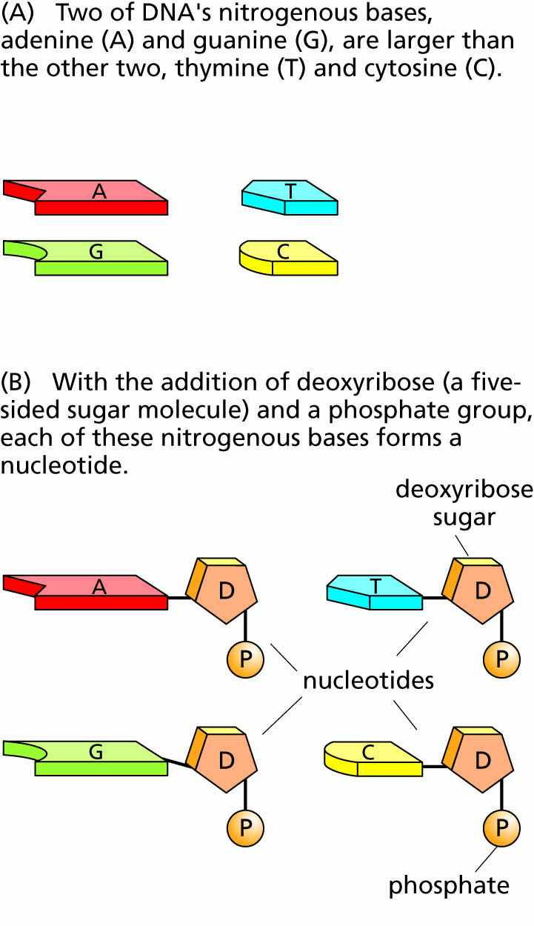
Figure 2.16 The nucleotides of DNA.

Slide 29
Chargaff (1952) and his rules:
Percentages of A, G, C, T varied among species.
Within a species, all DNA samples had the same percentages of A, G, C, T, even from different tissues
Percentages of A & T were always equal, and percentages of C & G were always equal

Slide 30
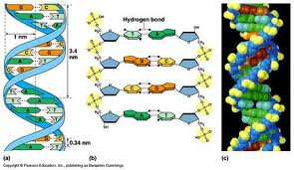

Slide 31
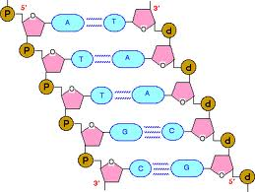

Slide 32
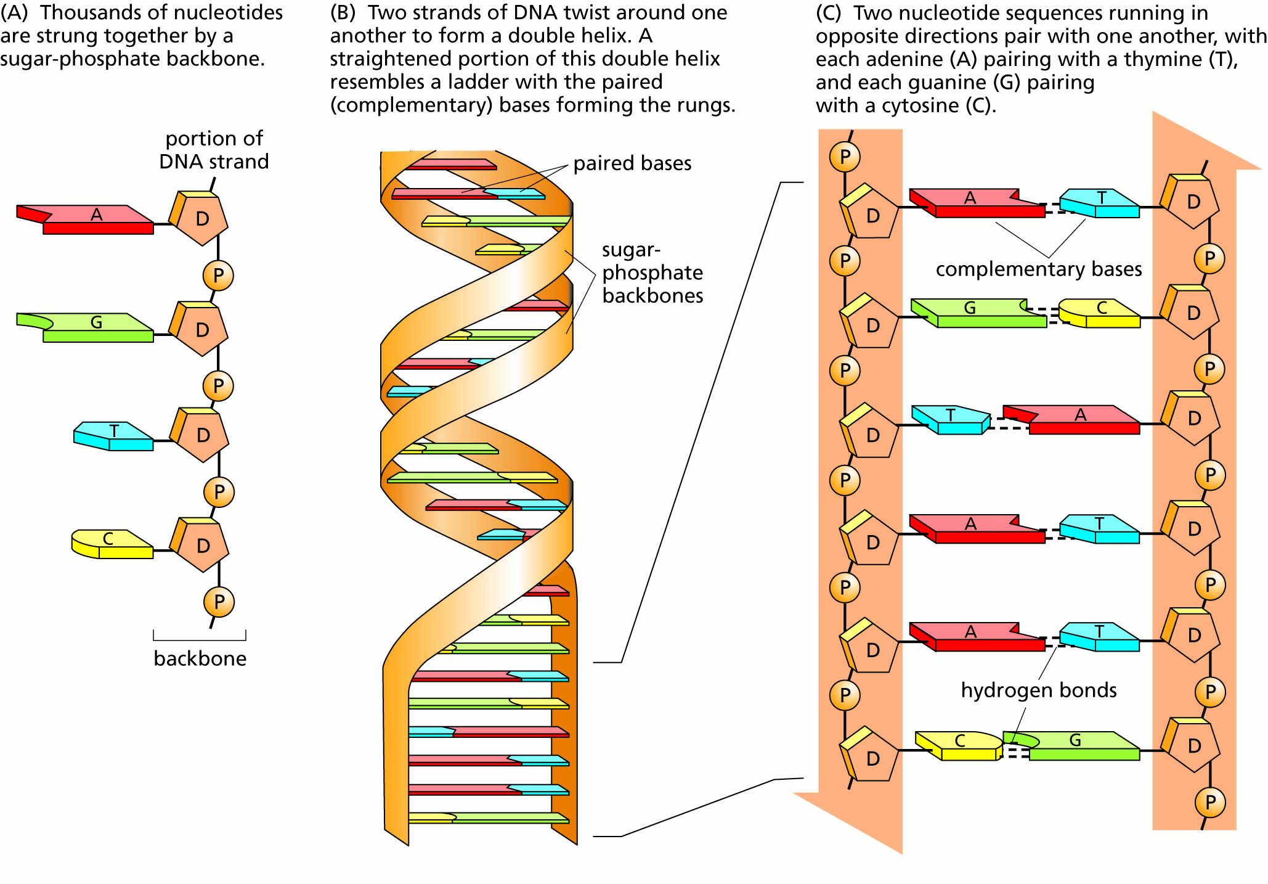
Figure 2.17 The three-dimensional structure of DNA as determined by the technique of X-ray crystallography.

Slide 33
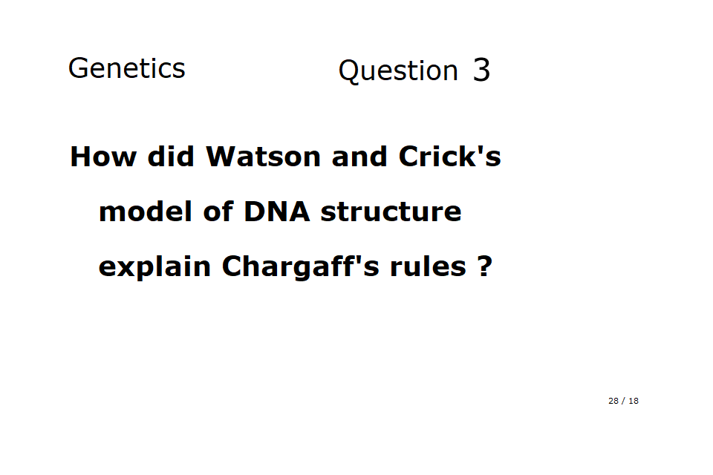

Slide 34
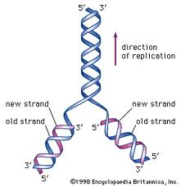

Slide 35
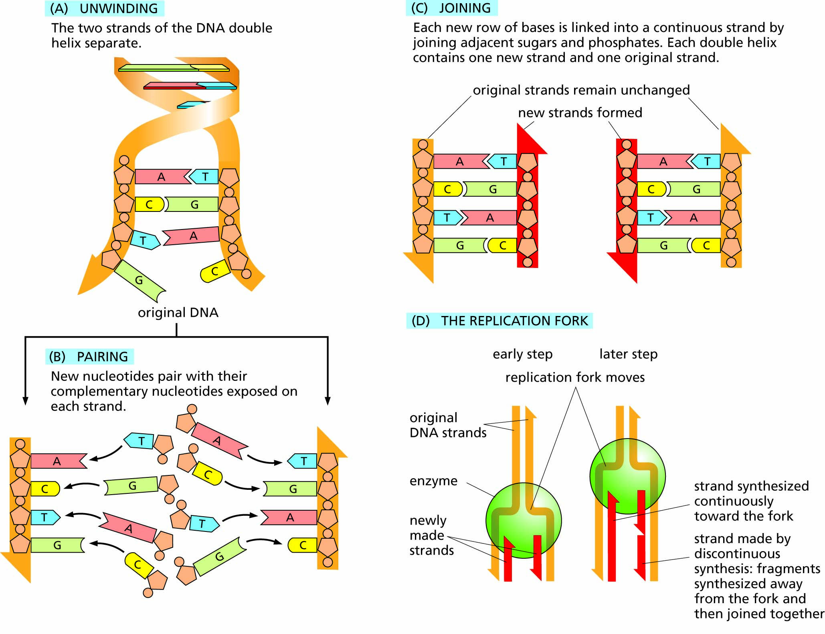
Figure 2.18 DNA replication. The two strands run in opposite directions, as denoted by the arrowheads on the orange (old) backbones. The direction of synthesis is indicated by the arrowheads on the red (new) backbones. Note that either strand contains all the information needed to synthesize the other (complementary) strand.

