Slide 1
Chapter 17: Plants to Feed the World
Biology Trending, 4e
Eli Minkoff and Jennifer Hood-DeGrenier

Slide 2
Plants capture the sun’s energy and make many useful products
The importance of plants
Photosynthesis
Agriculture and other plant uses

Slide 3
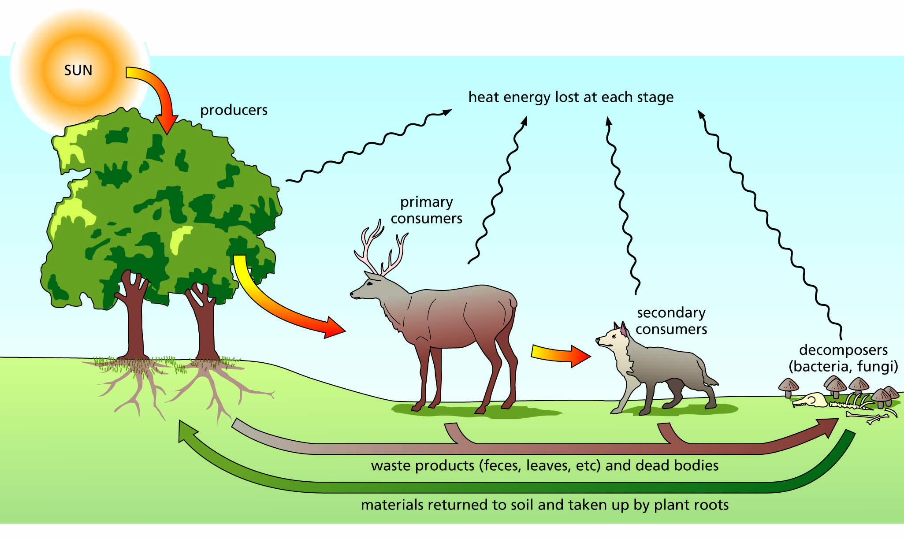
Figure 17.1 Energy flow through a biological system. Energy enters as sunlight. Producers convert the sunlight to chemical bond energy usable by other organisms, the consumers. Energy locked in the chemical bonds of dead producers and consumers is released by decomposer organisms. Energy is also lost as heat at each step, so more energy must continuously enter the system for the process to continue.

Slide 4
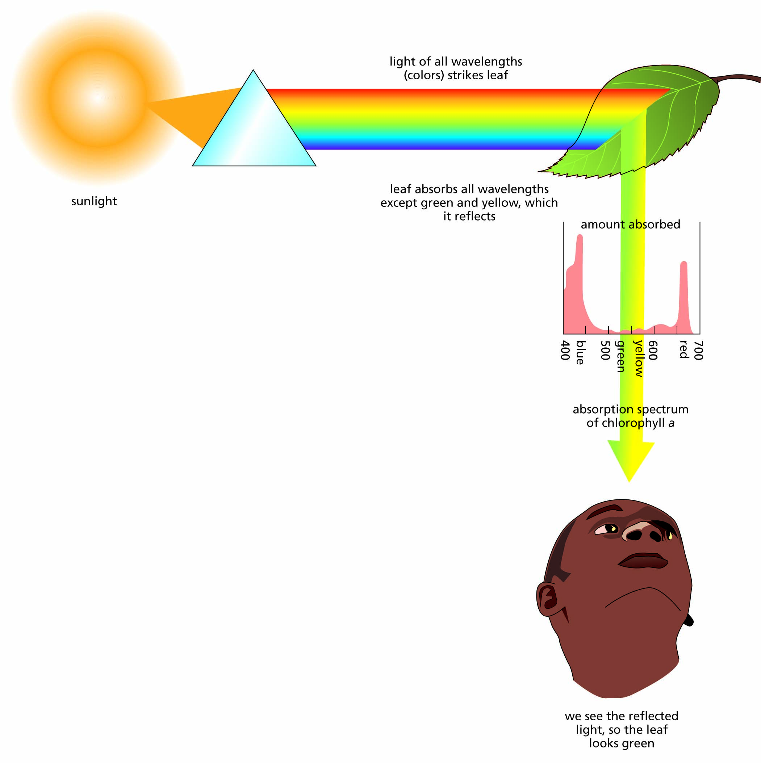
Figure 17.2 Perception of color.

Slide 5
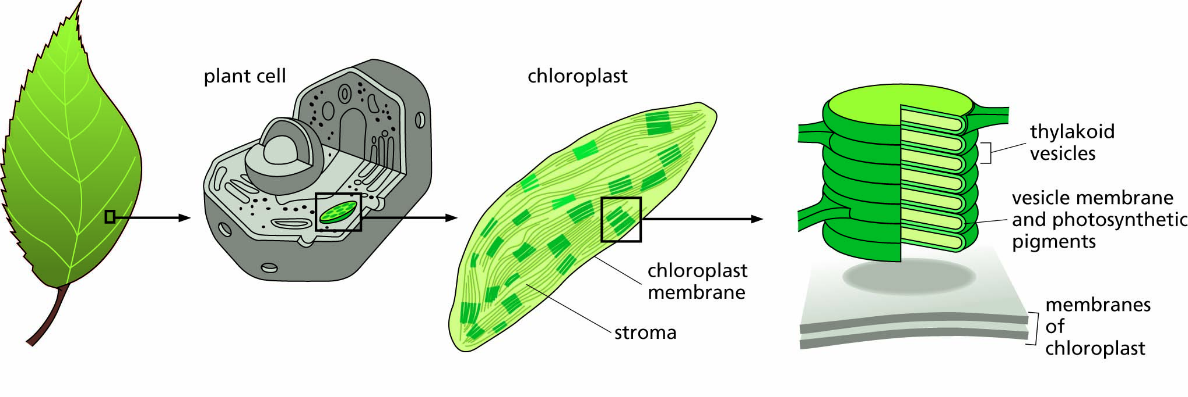
Figure 17.3 Location of photosynthesis in plant cells. Within plant cells there are chloroplasts. Each chloroplast contains stacks of thylakoids.

Slide 6
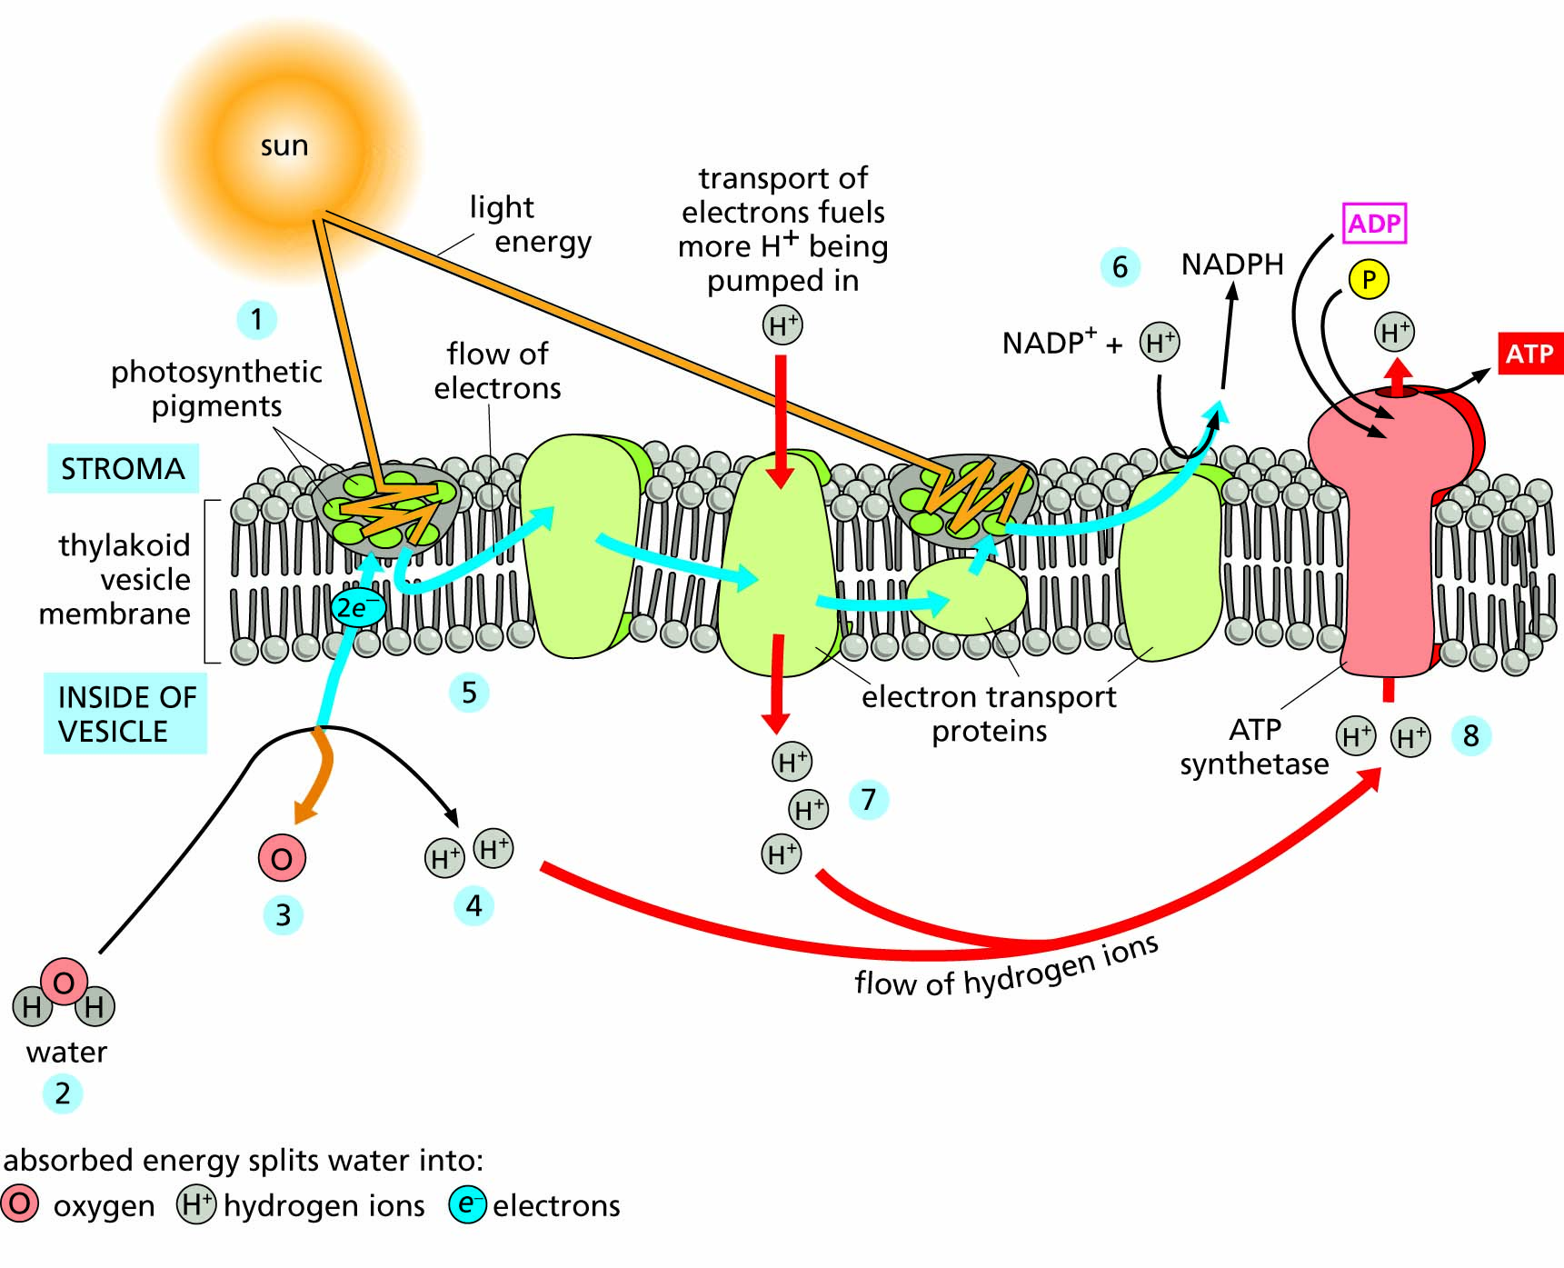
Figure 17.4 The light reactions of photosynthesis. The flows of energy, electrons, and hydrogen ions are shown, as are the syntheses of ATP and NADPH, both of which contain high-energy chemical bonds.

Slide 7
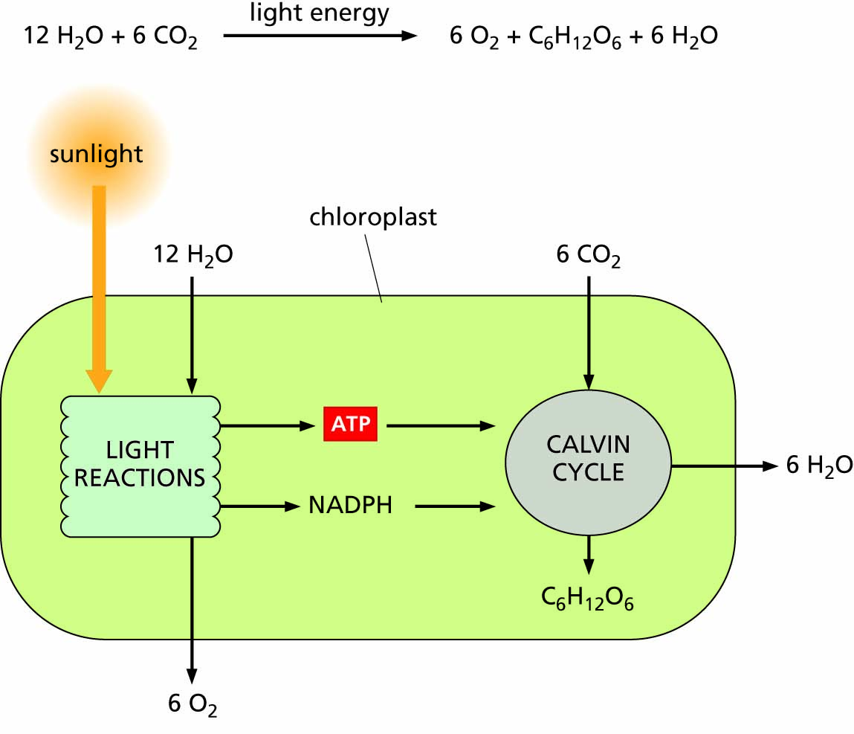
Figure 17.5 Summary of the reactions of photosynthesis.

Slide 8
Plants use specialized tissues and transport mechanisms
Tissue specialization in plants
Water transport in plants

Slide 9
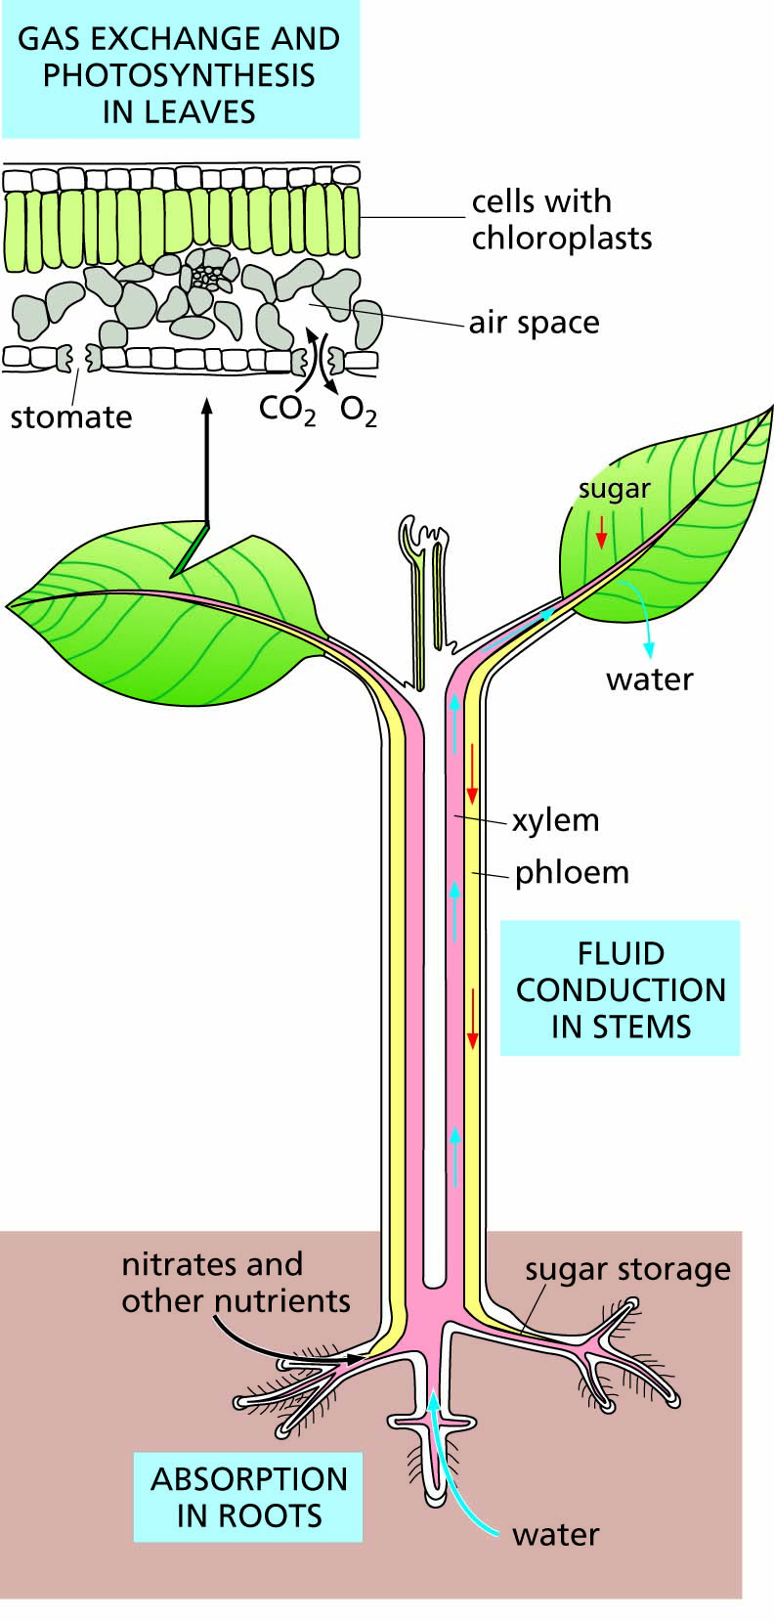
Figure 17.6 Different functions carried out by specialized parts of vascular plants. Detail at the top shows a cross-section through a leaf.

Slide 10
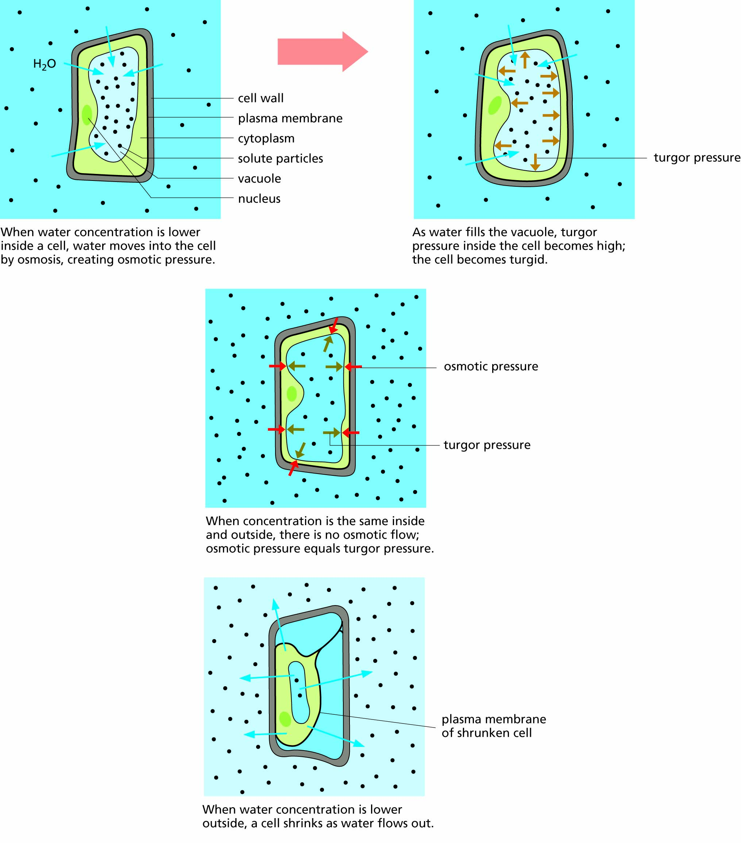
Figure 17.7 Osmosis in plant cells. Water moves across cell membranes toward the side with the lower water concentration and higher ion concentration.

Slide 11
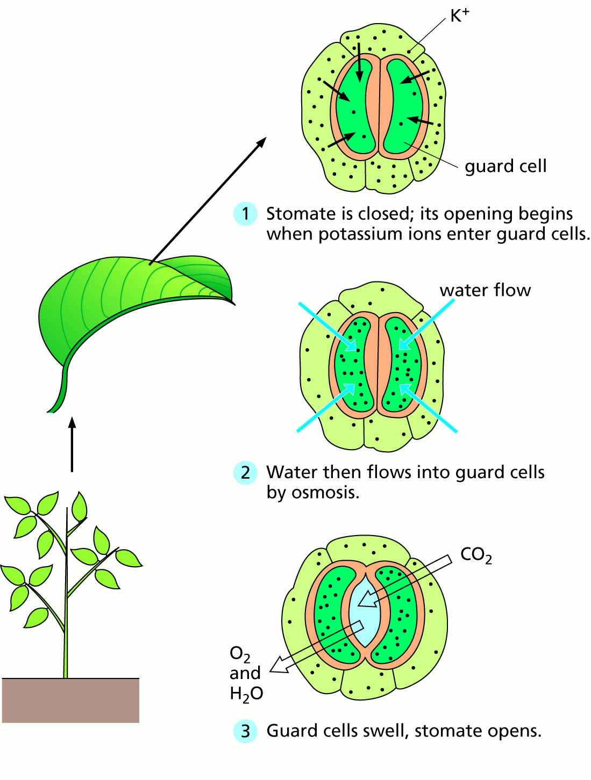
Figure 17.8 Opening of a stomate.
For an animated view of this process, please go to https://biologytrending.Routledge.com

Slide 12
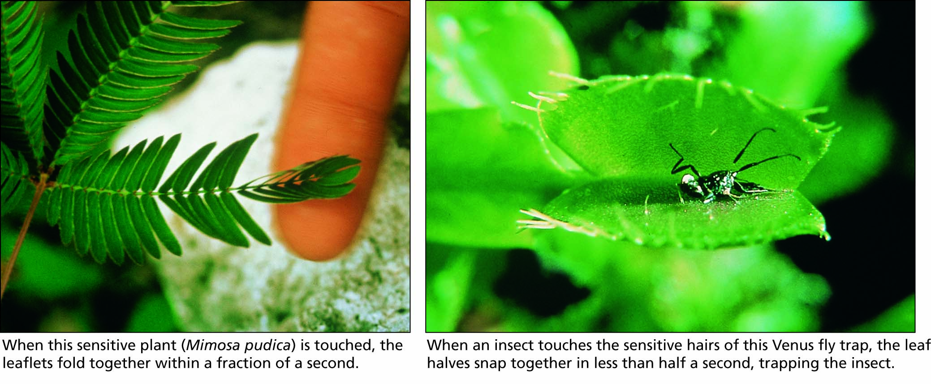
Figure 17.9 Rapid and selective movement in plants.

Slide 13
Nutrient materials circulate through the world’s ecosystems
Nitrogen for plant products
Mutualistic relationships
Plants living in nitrogen-poor soils

Slide 14
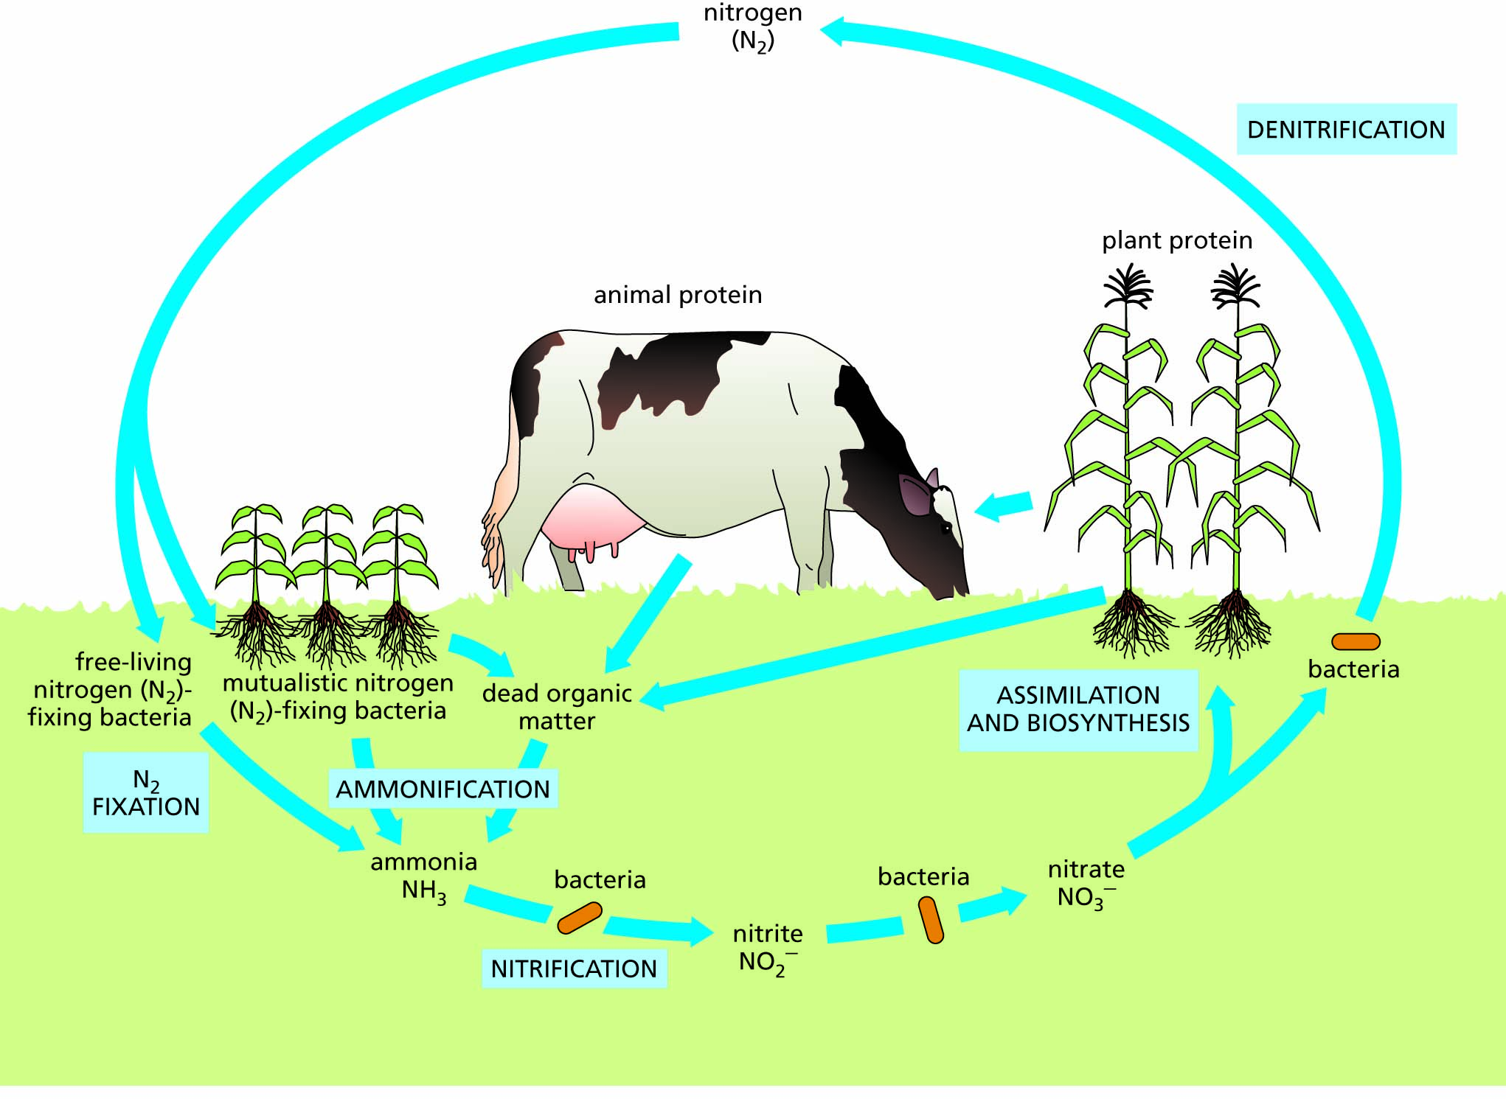
Figure 17.10 The nitrogen cycle.

Slide 15
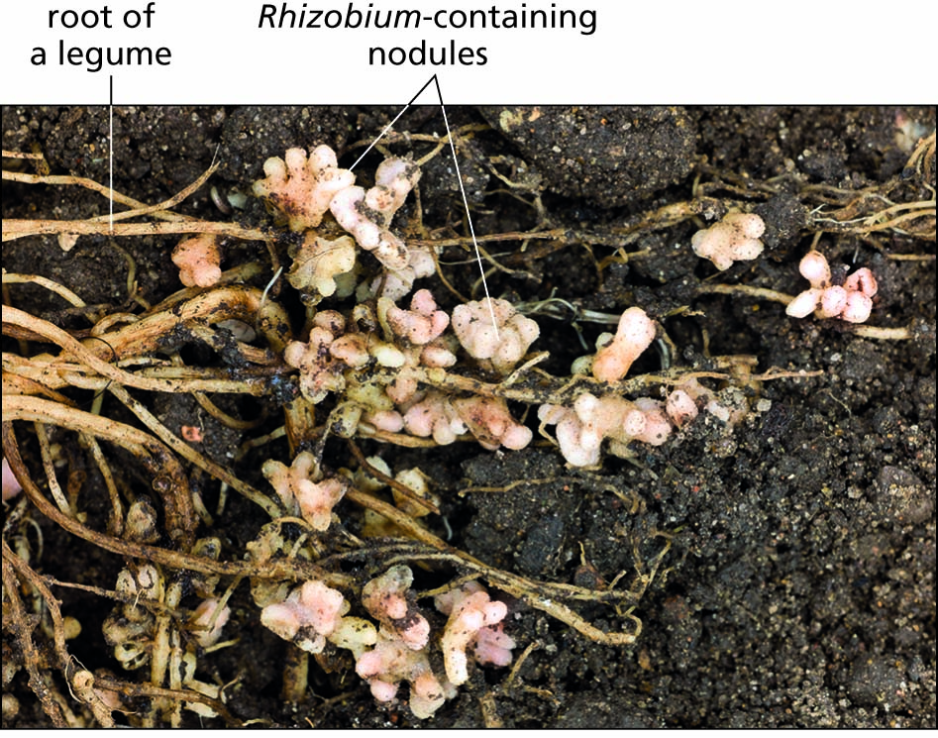
Figure 17.11 Underground nitrogen fixation in root nodules.

Slide 16
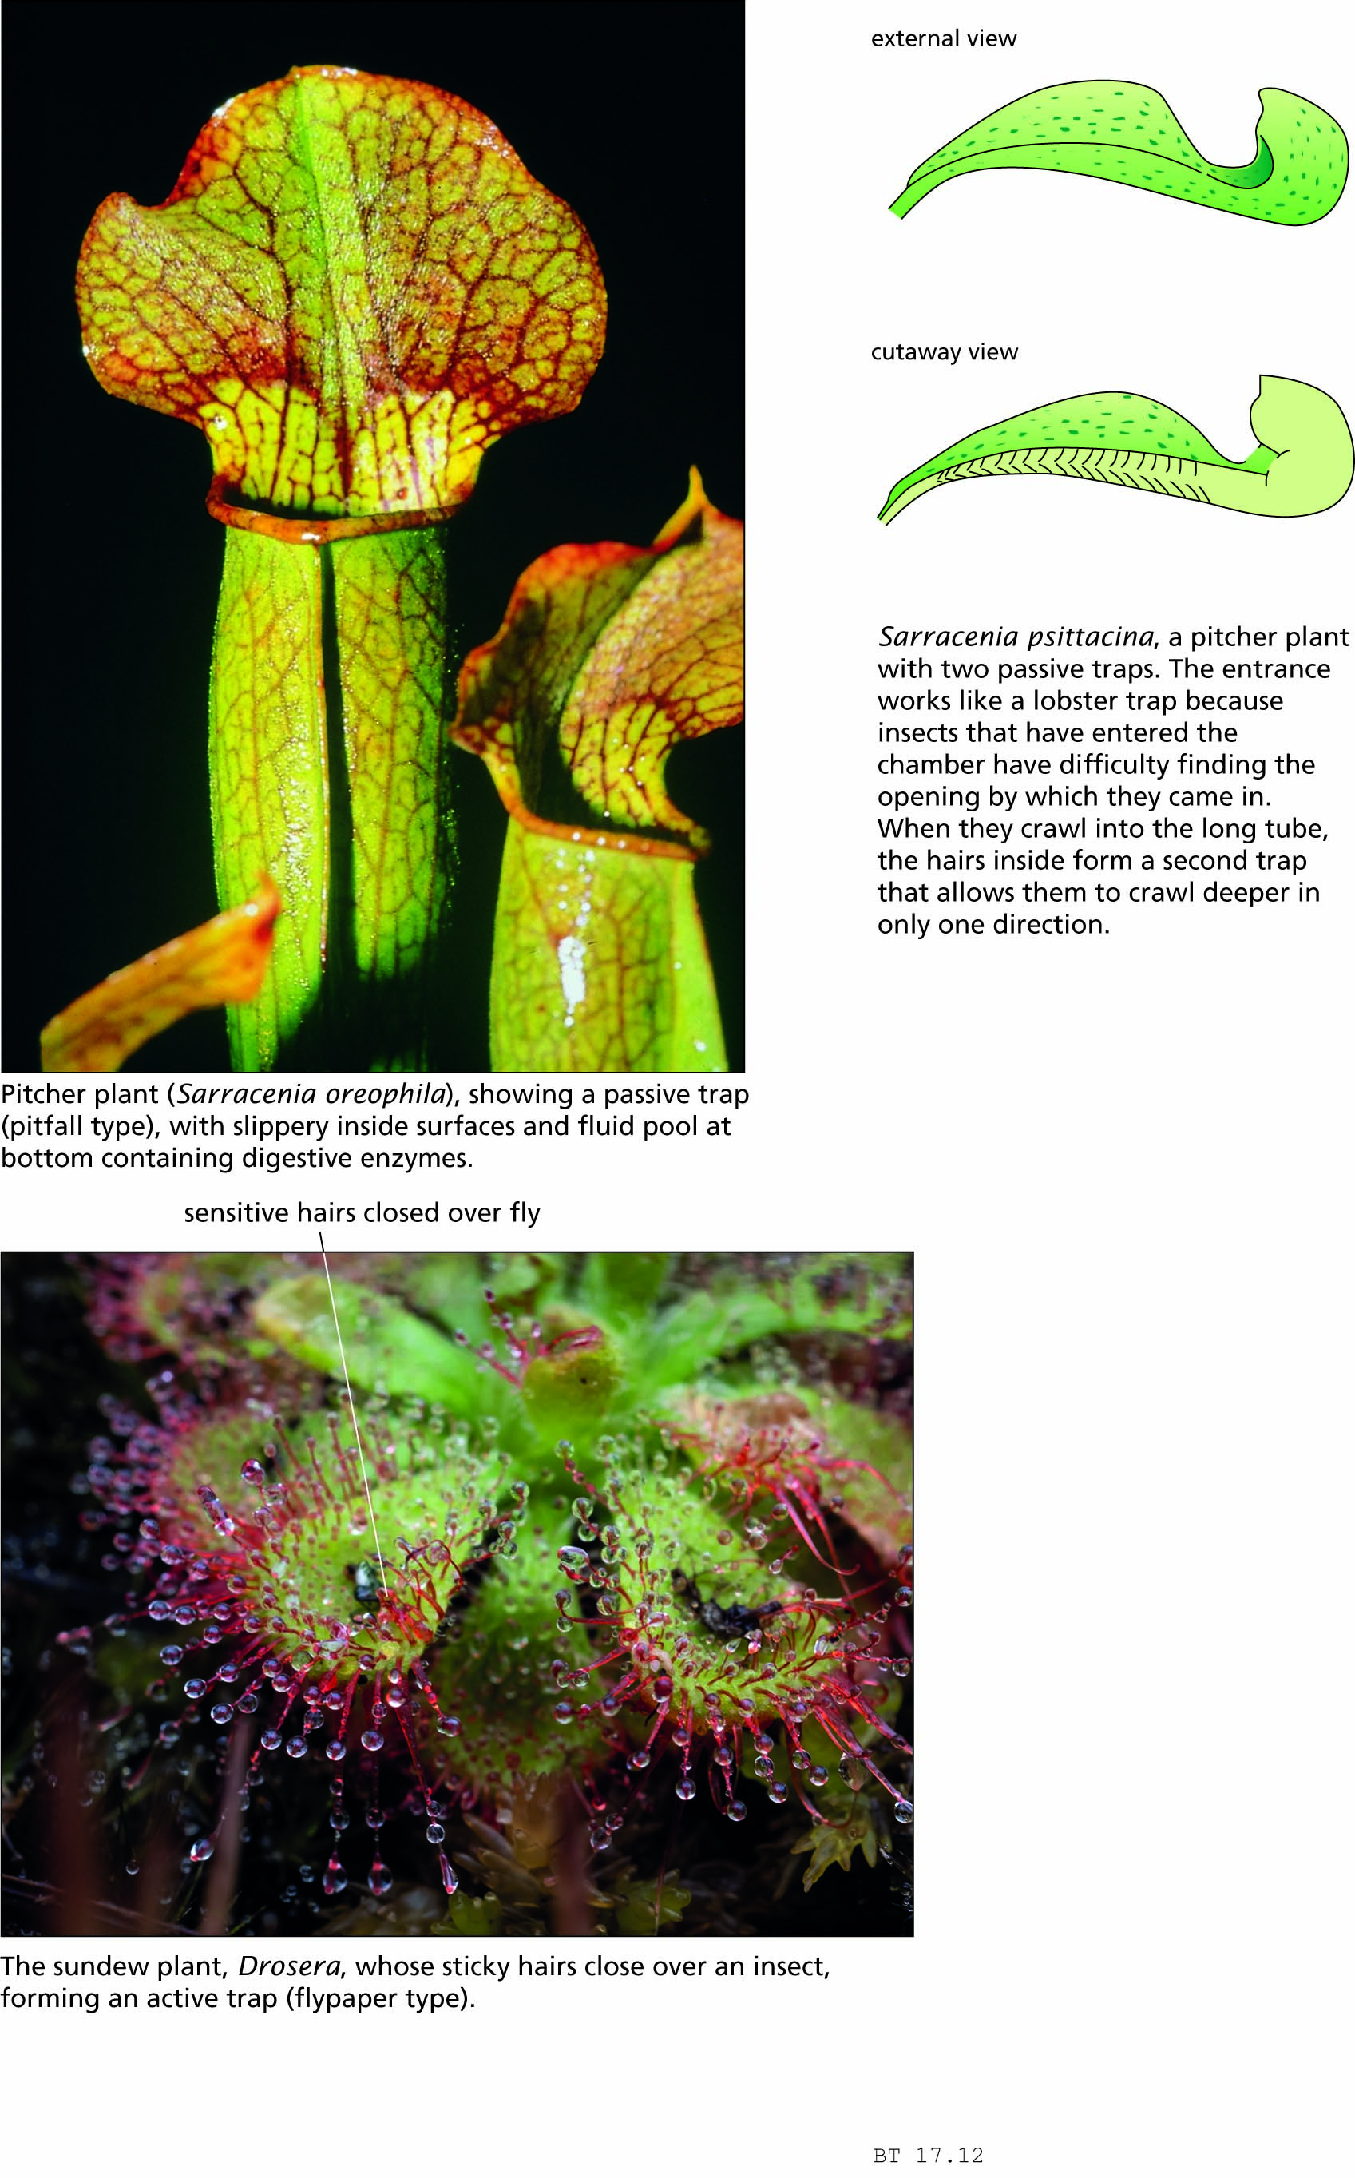
Figure 17.12 Plants that obtain nitrogen from animals.

Slide 17
Crop yields can be increased by overcoming various limiting factors
Fertilizers
Soil improvement and conservation
Irrigation
Hydroponics
Chemical pest control
Integrated pest management

Slide 18
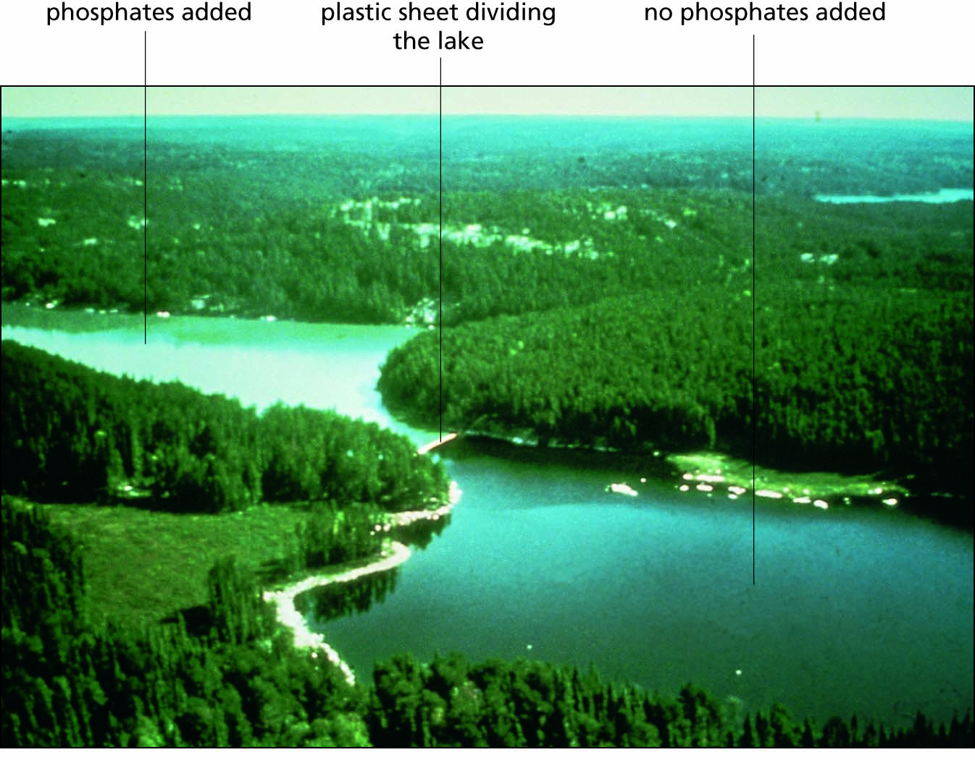
Figure 17.13 Eutrophication: algal blooms accelerated by fertilizer runoff. The two portions of this lake in Ontario were separated by a plastic curtain, and phosphates were added to one side of the curtain only. An algal bloom occurred only on the far side, to which the phosphates had been added, making the water look more cloudy.

Slide 19
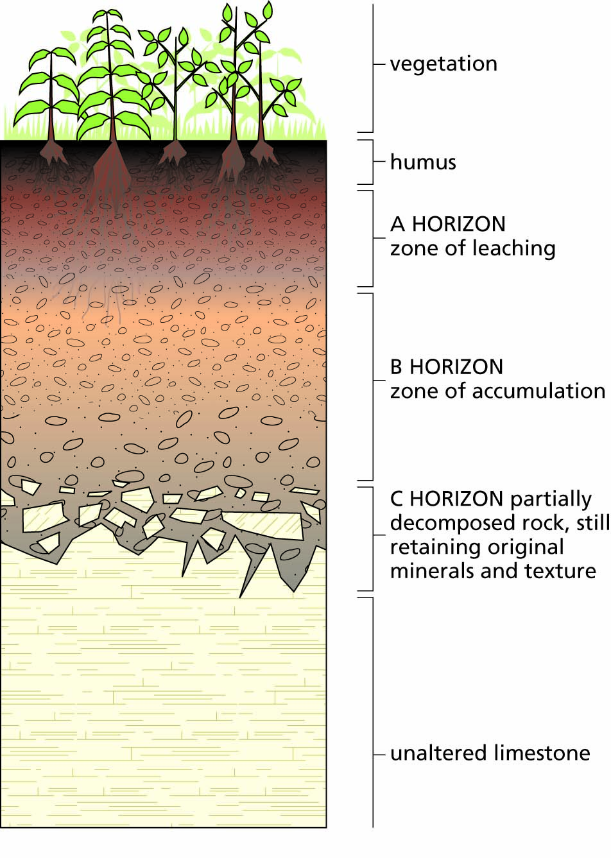
Figure 17.14 Soil formation from the weathering of rock (in this case, limestone) and from biological processes.

Slide 20
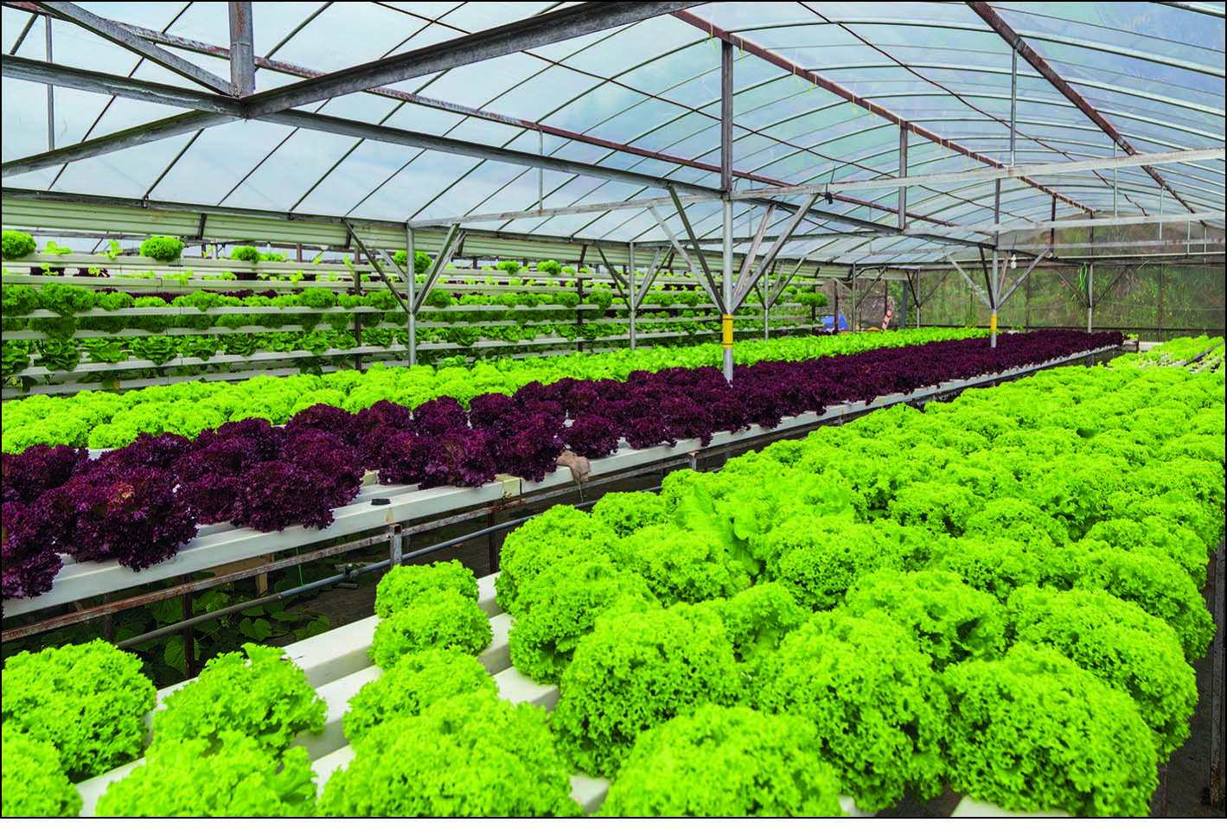
Figure 17.15 Hydroponics: growing plants in water tanks, without soil. The water supply is often covered over, as here, to retard evaporation.

Slide 21
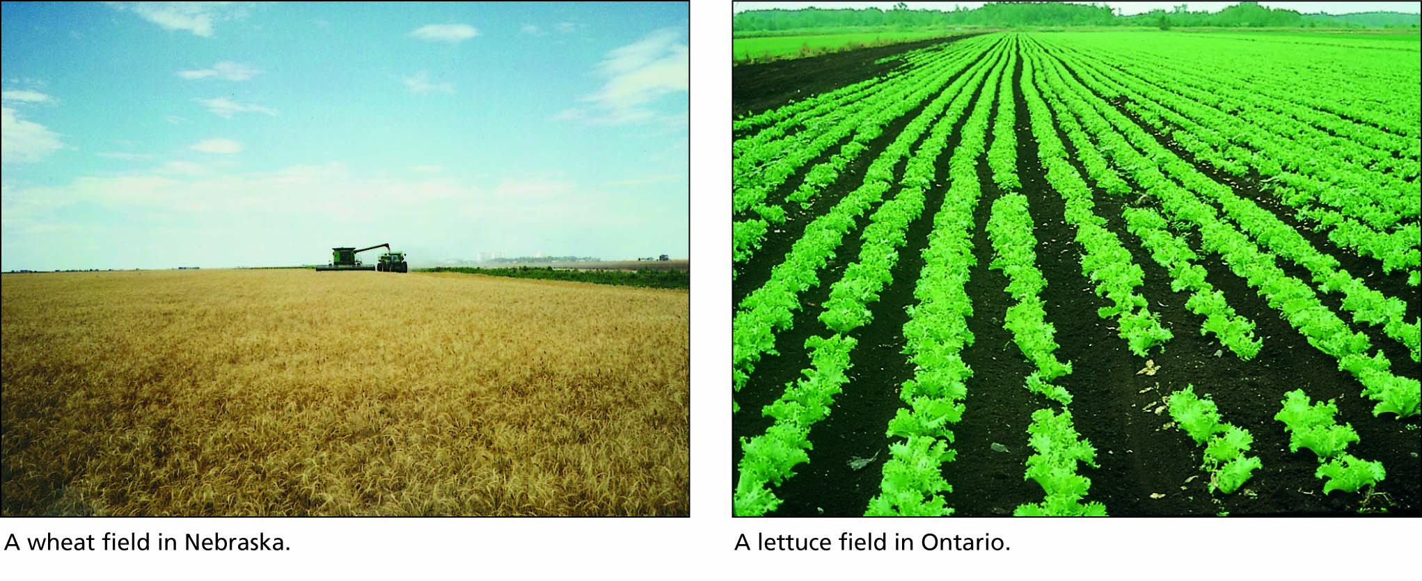
Figure 17.16 Monoculture: the planting of a single species only.

Slide 22
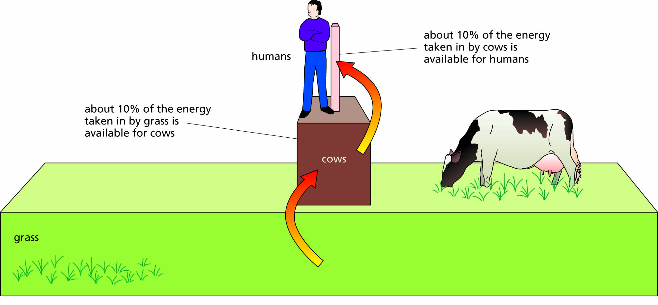
Figure 17.17 A simple food pyramid. The width of each column is proportional to the amount of energy available as food for the next higher step up the pyramid. At each energy conversion, 90% or more of the energy is lost, leaving only 10% available as food, as expressed by the widths of each step.

Slide 23
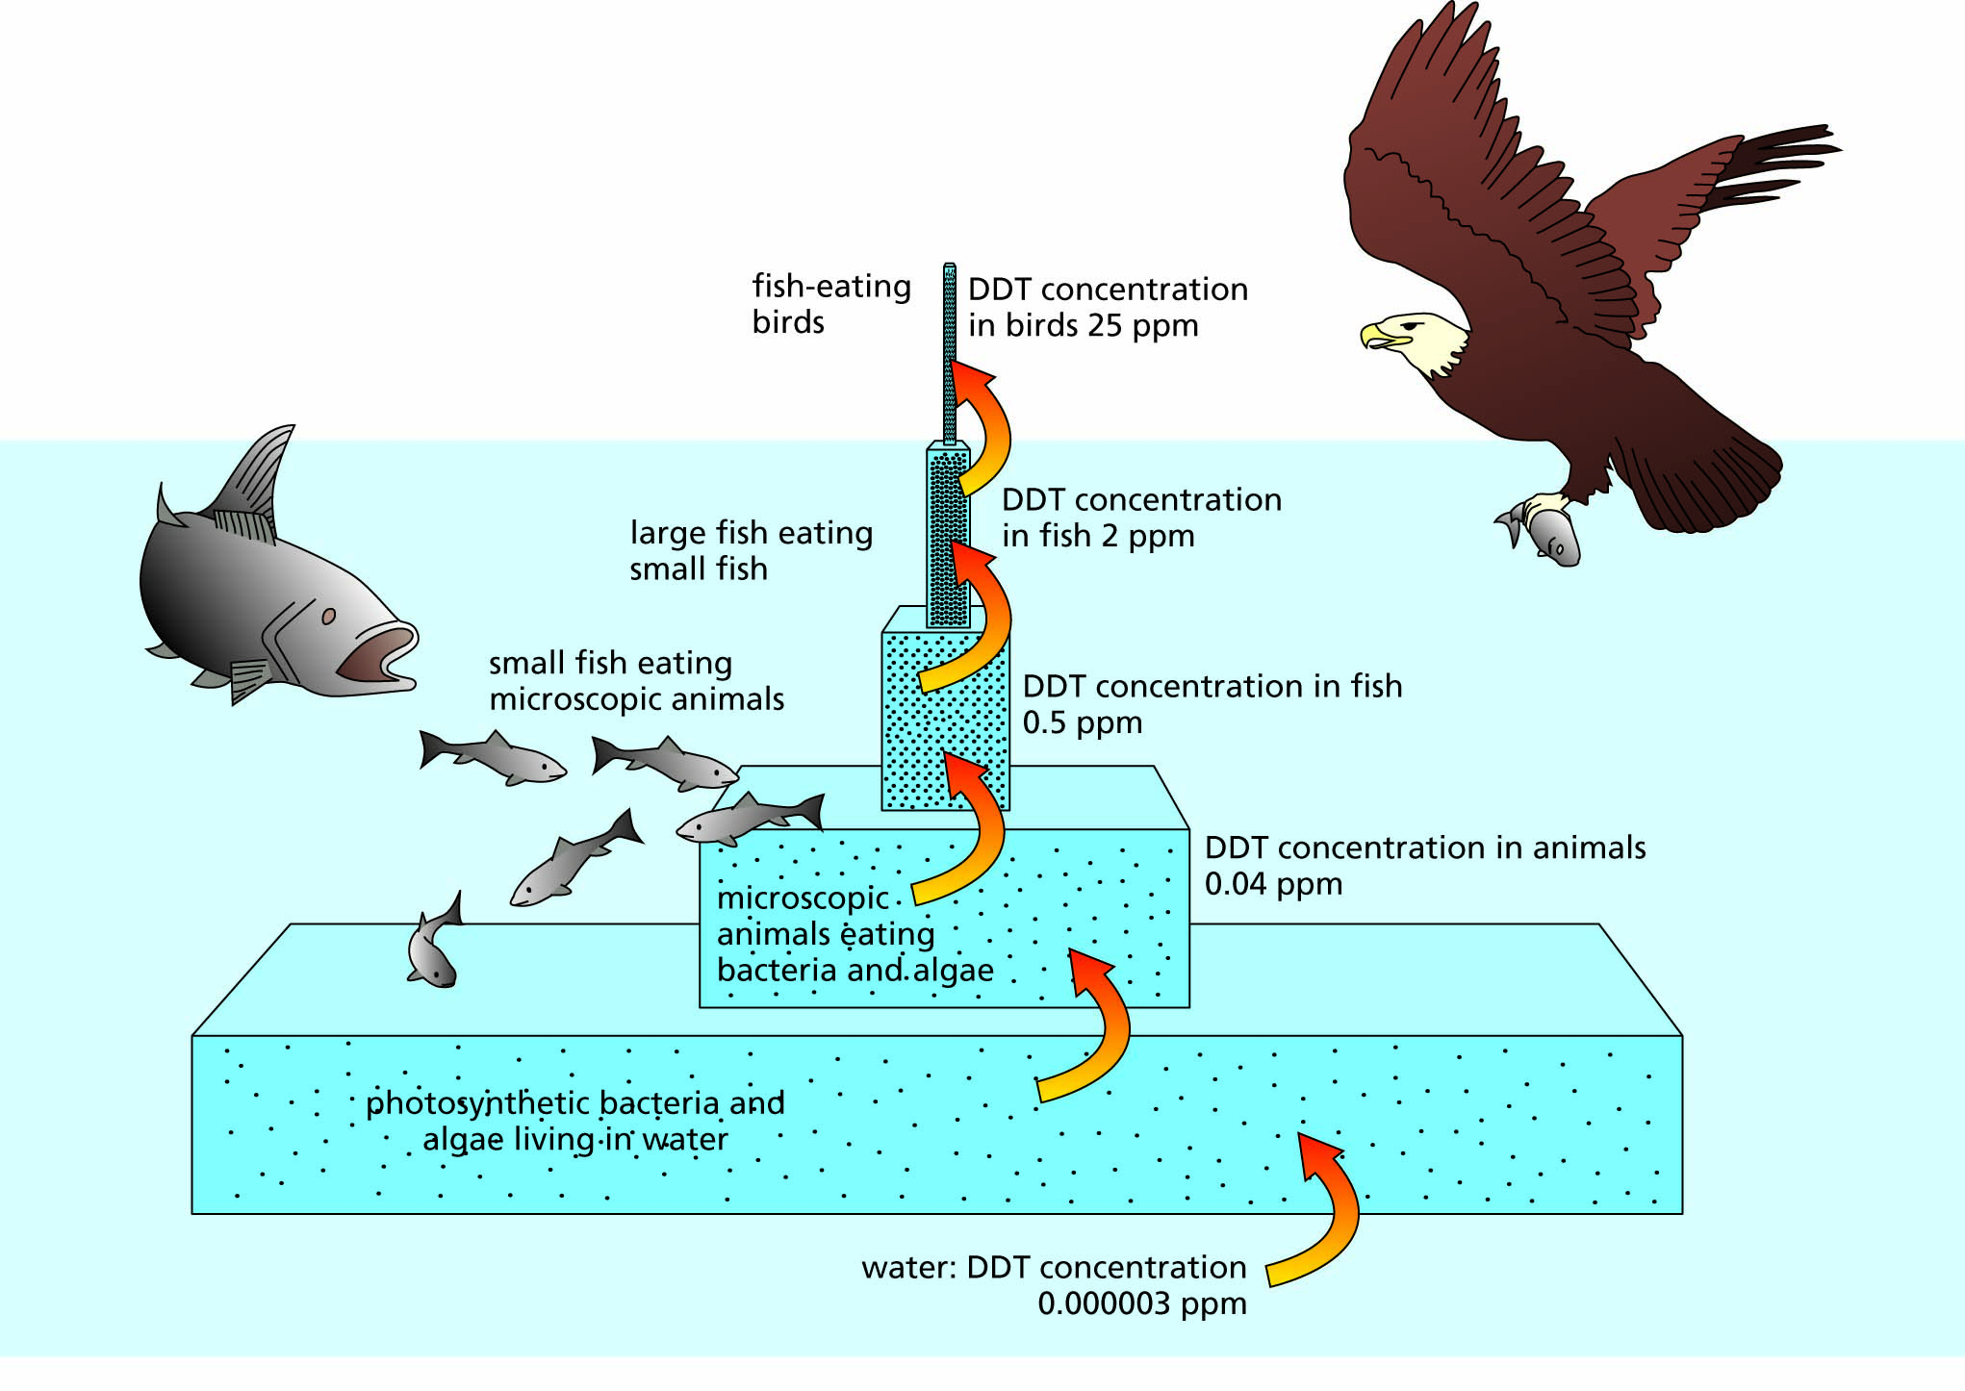
Figure 17.18 Biomagnification of DDT in Long Island Sound, New York, around 1970. The width of each column is proportional to the biomass.

Slide 24
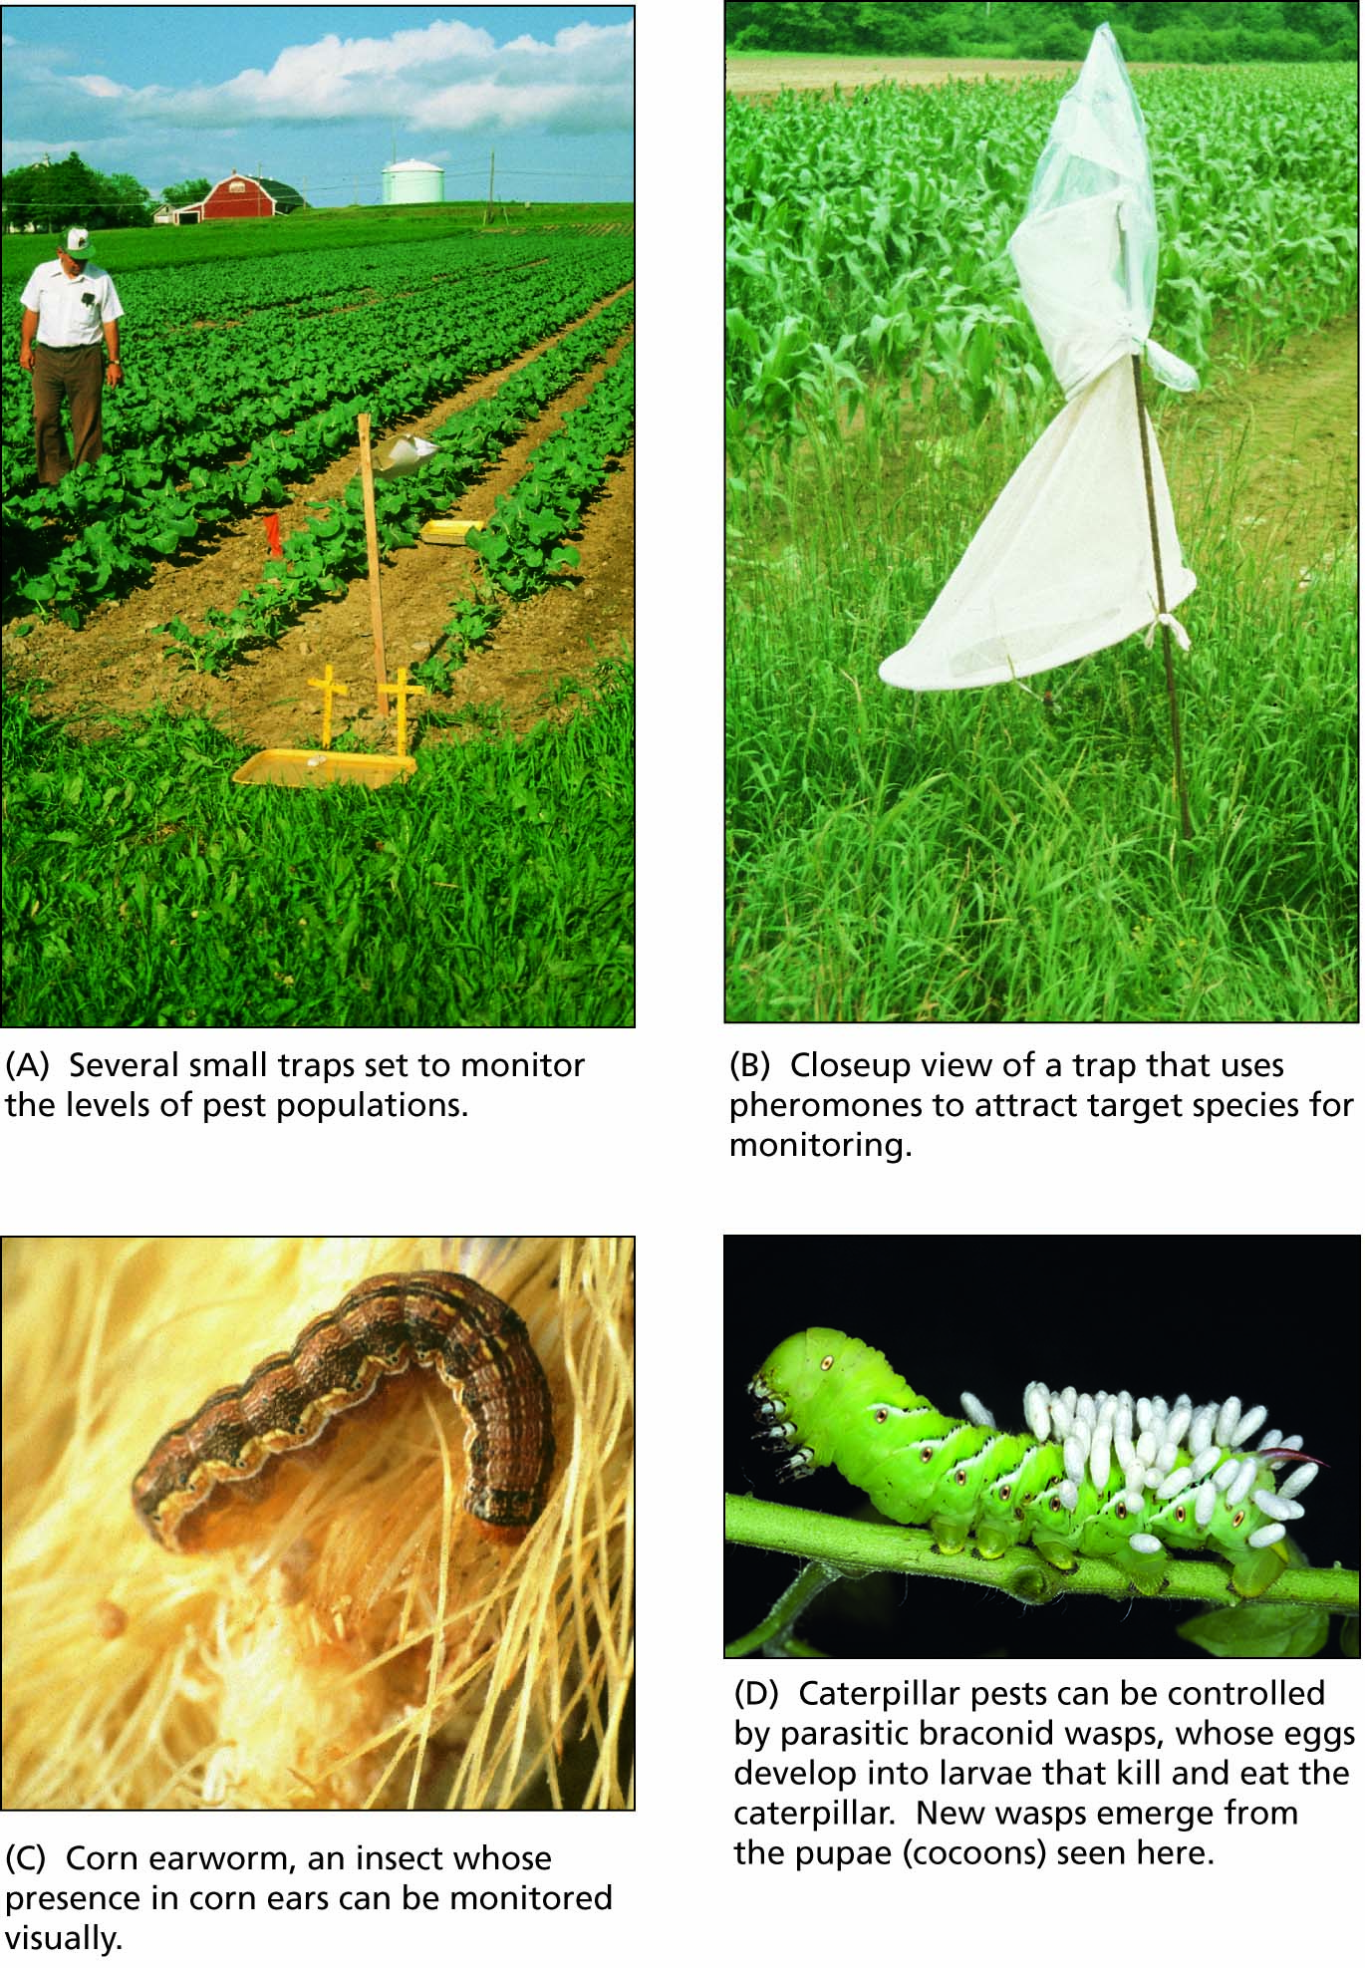
Figure 17.19 Various techniques of integrated pest management.

Slide 25
Crop yields can be increased further by altering plant genomes
Altering plant genomes is not new
Altering plant strains through genetic engineering
Uses of transgenic plants
Risks and concerns

Slide 26
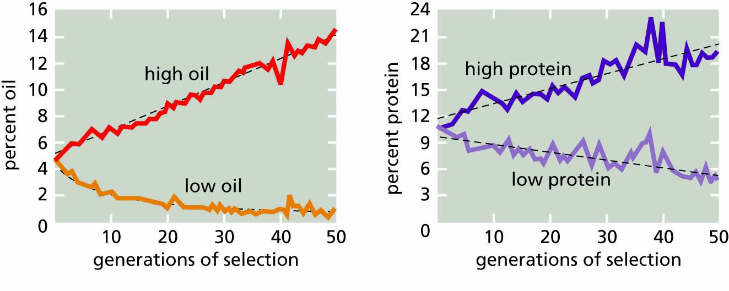
Figure 17.20 The results of 50 years of selection on the oil content and protein content of corn (Zea mays). By selectively breeding only those plants that had the highest or lowest protein or oil content in each generation, plant scientists have changed the inherited characteristics of each strain. (Redrawn from Woodworth et al., 1952). See Dudley and Lambert (2004) for a 100-year follow-up.

Slide 27
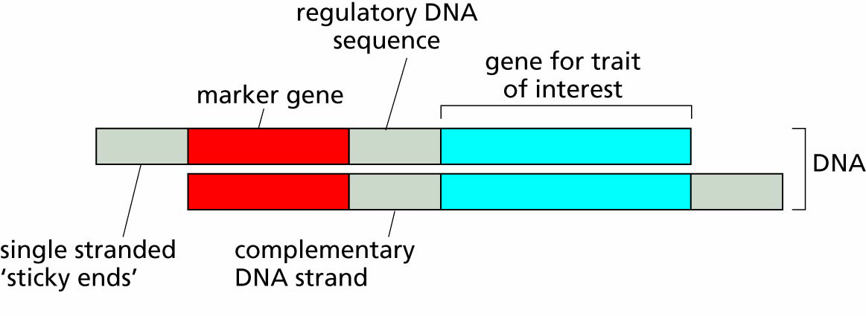
Figure 17.21 Structure of a DNA assembly for use in genetic engineering.

Slide 28
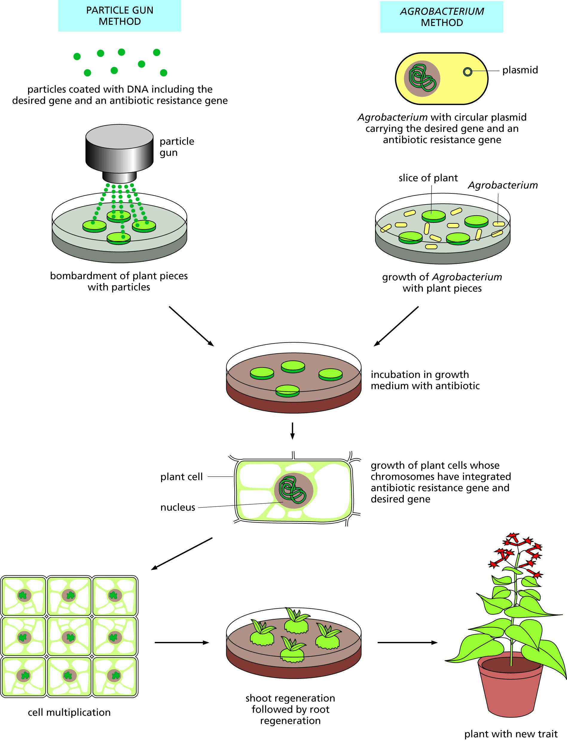
Figure 17.22 Methods for inserting new genes into plant cells.

