Slide 1
Chapter 16: New Infectious Threats
Biology Trending, 4e
Eli Minkoff and Jennifer Hood-DeGrenier

Slide 2
Pathogens are infectious agents that cause disease
Characteristics of pathogens
Evolution of virulence
Factors governing the spread of pathogens
Intentional transmission turns diseases into bioterrorism

Slide 3
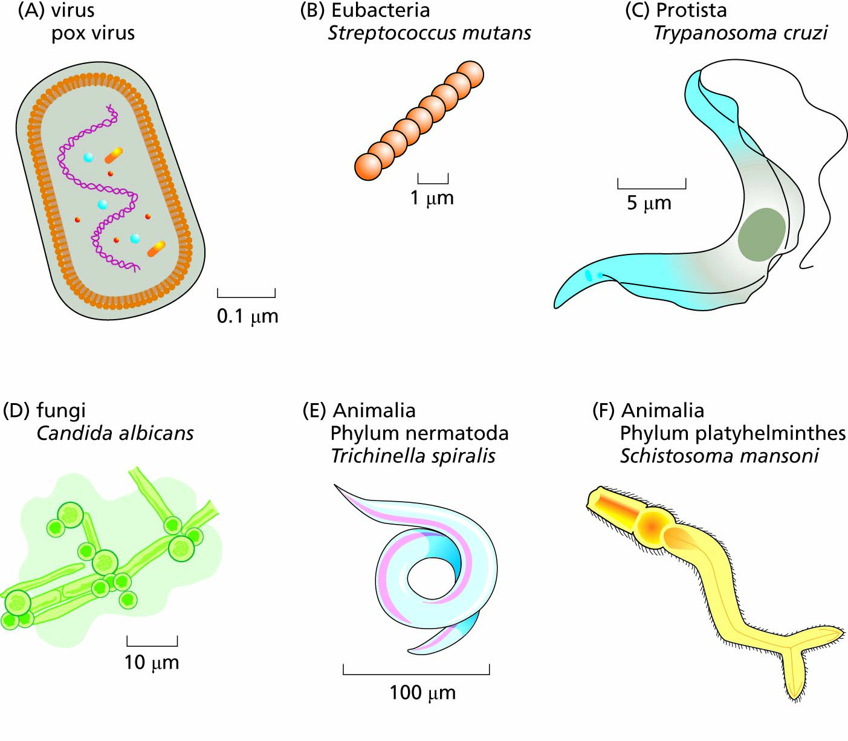
Figure 16.1 Pathogens are found in many kingdoms and phyla of living things.

Slide 4
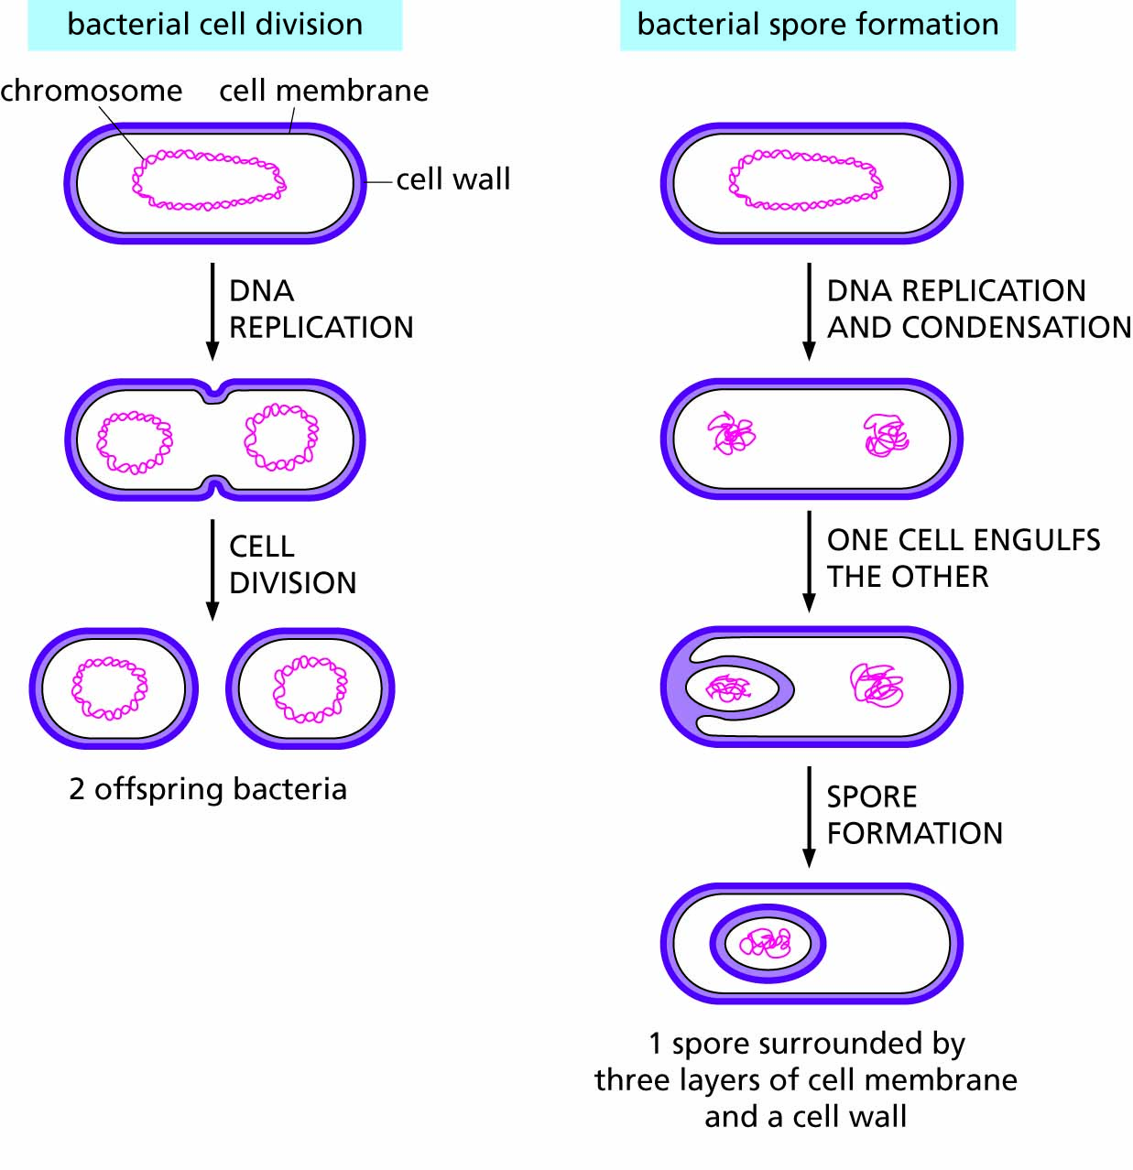
Figure 16.2 Spore formation compared with normal bacterial cell division.

Slide 5
Some diseases that spread by direct contact are increasing in prevalence
The major sexually transmitted diseases
Factors increasing prevalence
Tuburculosis
Other diseases spread by contact

Slide 6
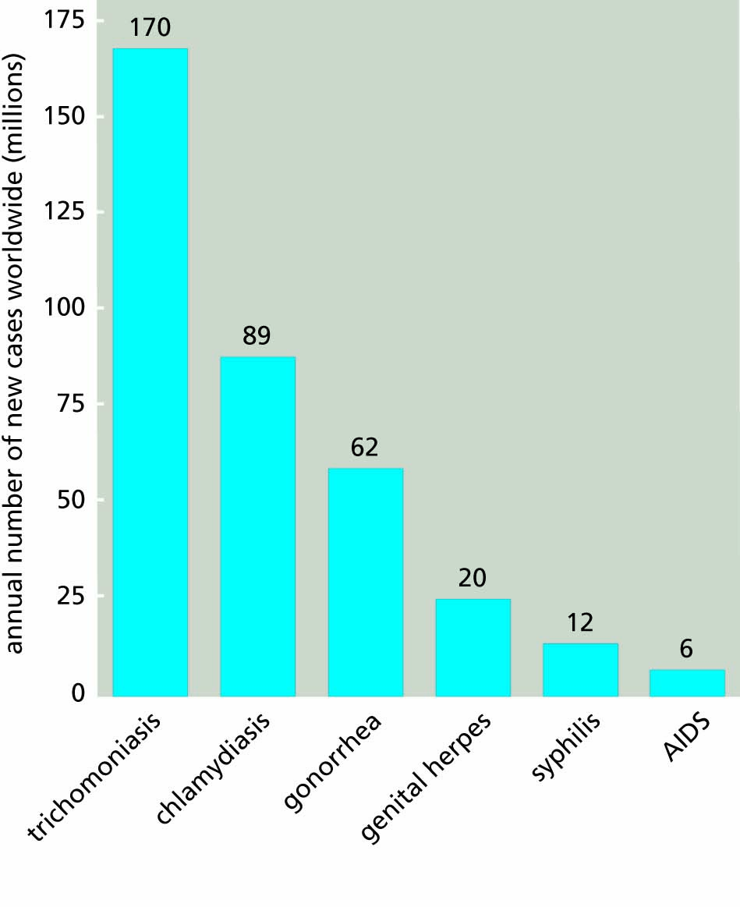
Figure 16.3 Worldwide incidence (new cases per year) of some sexually transmitted diseases (STDs). Data are from the World Health Organization Report from 1996, with the exception of HIV/AIDS which are data from 1998.

Slide 7
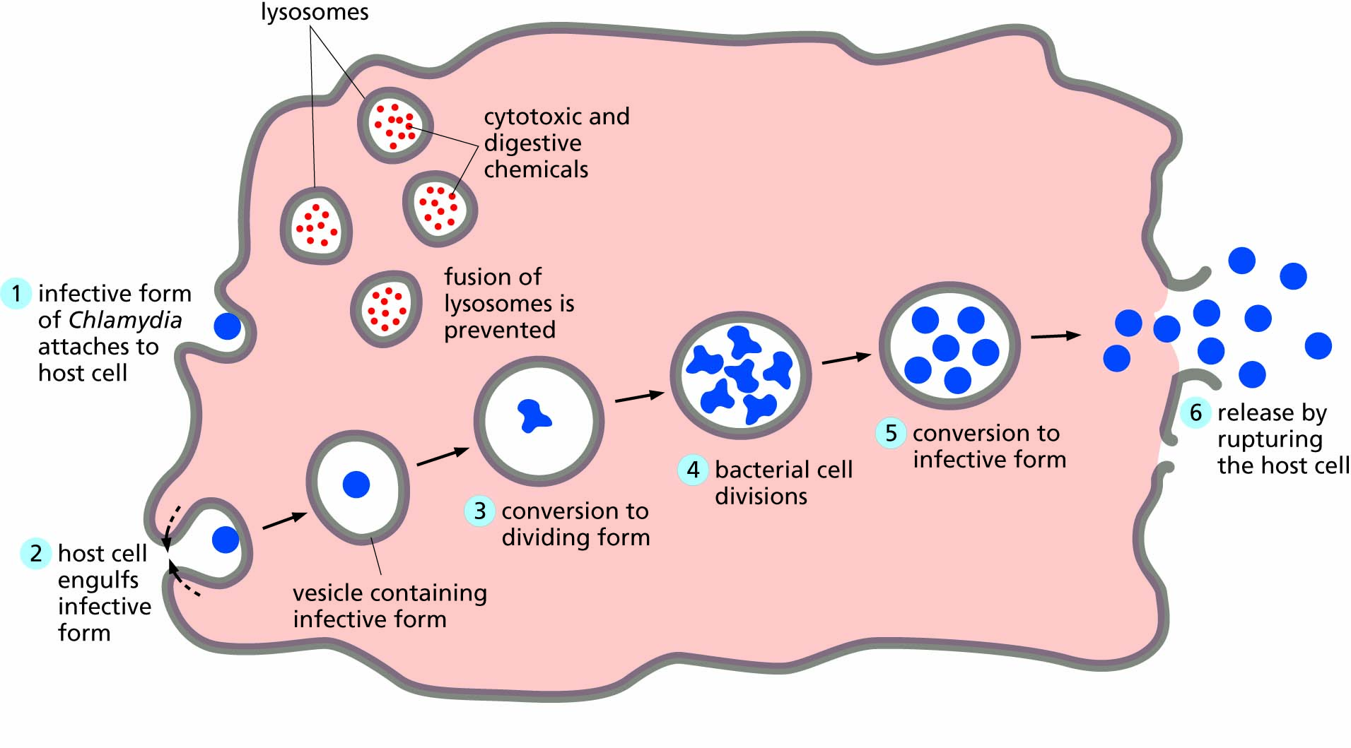
Figure 16.4 Life cycle of the bacterium Chlamydia trachomatis.

Slide 8
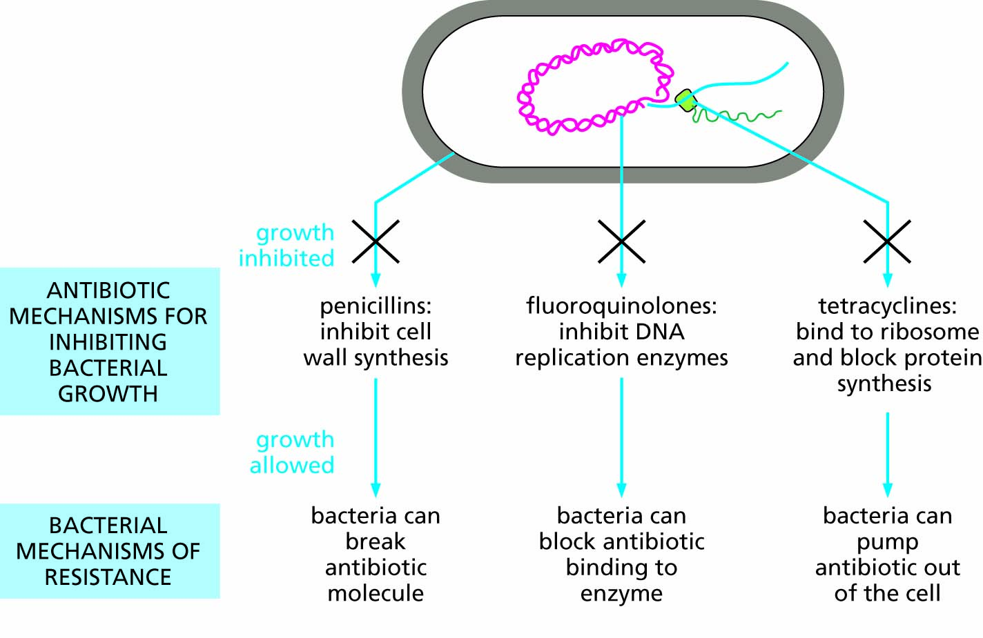
Figure 16.5 Sites and mechanisms of action of antibiotics and pathways to bacterial resistance to antibiotics.

Slide 9
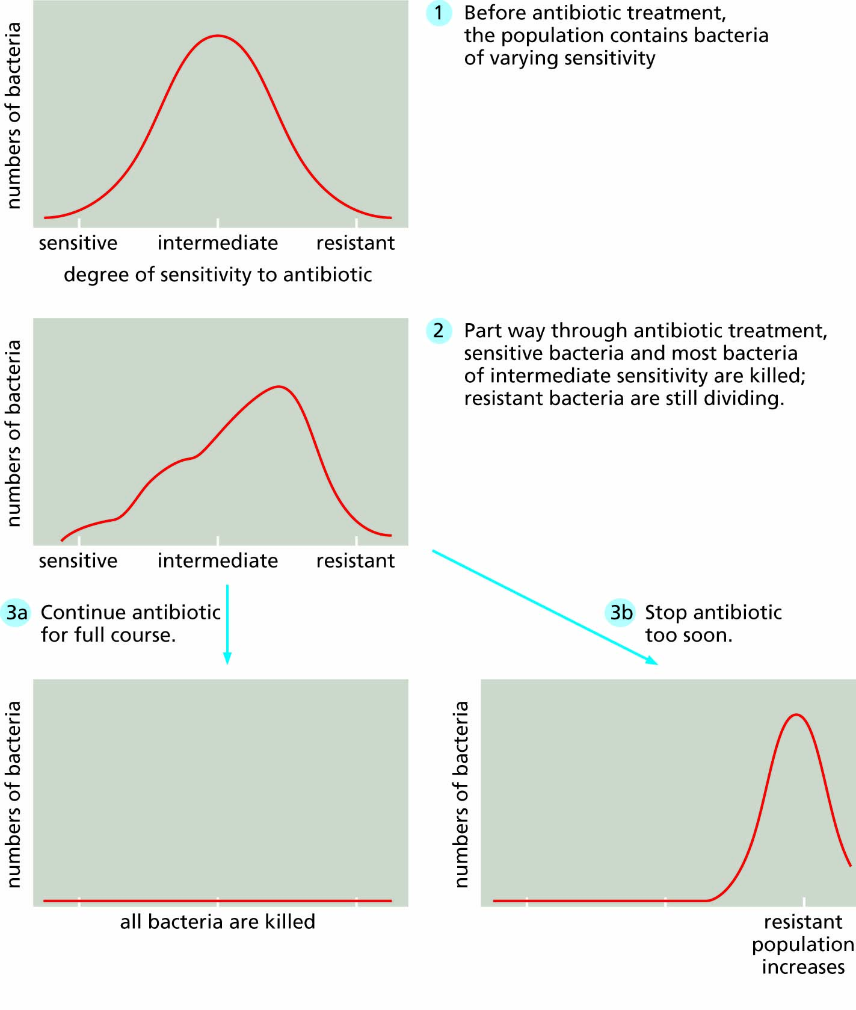
Figure 16.6 Evolution of resistance during antibiotic treatment.

Slide 10
Foodborne disease patterns reflect changes in food distribution
One example: variant Creutzfeld-Jakob disease
Social and economic factors contributing to disease outbreaks
Improvements needed

Slide 11
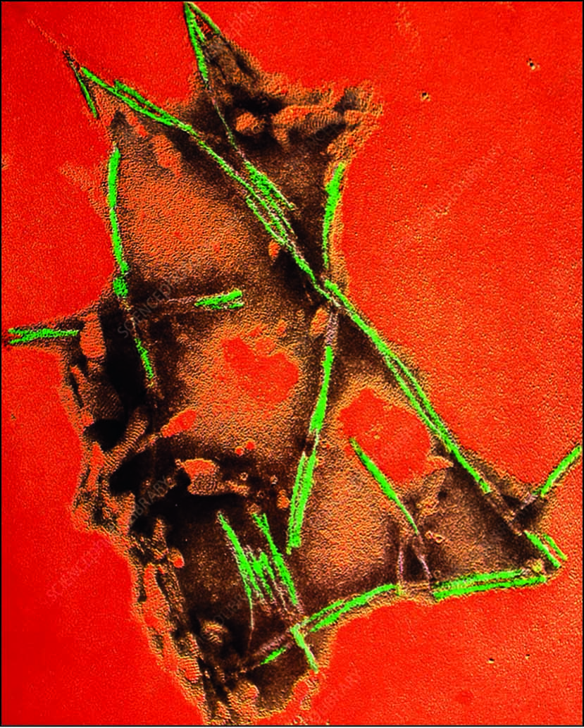
Figure 16.7 Prions are altered forms of proteins that self replicate in huge numbers, forming crystalline protein rods.

Slide 12
Waterborne diseases reflect changes in lifestyle and climate
Cholera
Legionnaire’s disease
The emerging waterborne parasites: Giardia, Schistosoma, and Cryptosporidium
Aerosol-dispersed viral diseases, including Covid-19

Slide 13
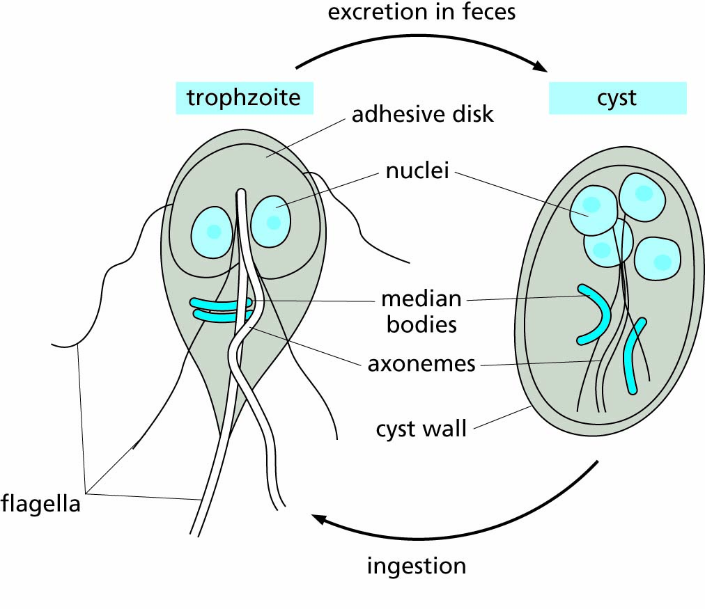
Figure 16.8 Giardia intestinalis, a single-celled parasite with two nuclei and a cytoskeleton, but with no other subcellular organelles.

Slide 14
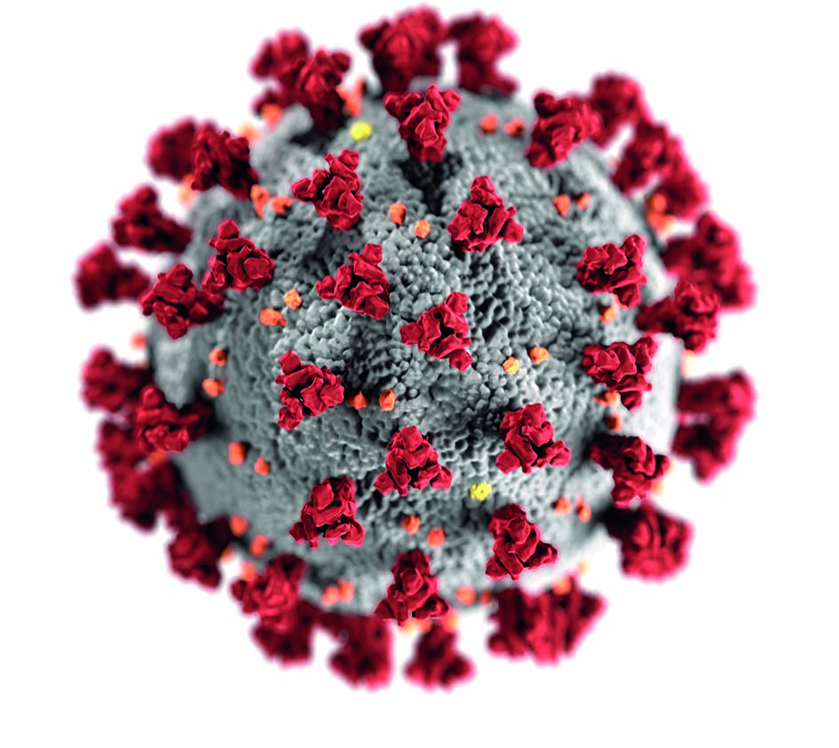
Figure 16.9 Structure of SARS-Cov2, the coronavirus responsible for the COVID-19 pandemic of 2019-2021 (source: Centers for Disease Control and Prevention).

Slide 15
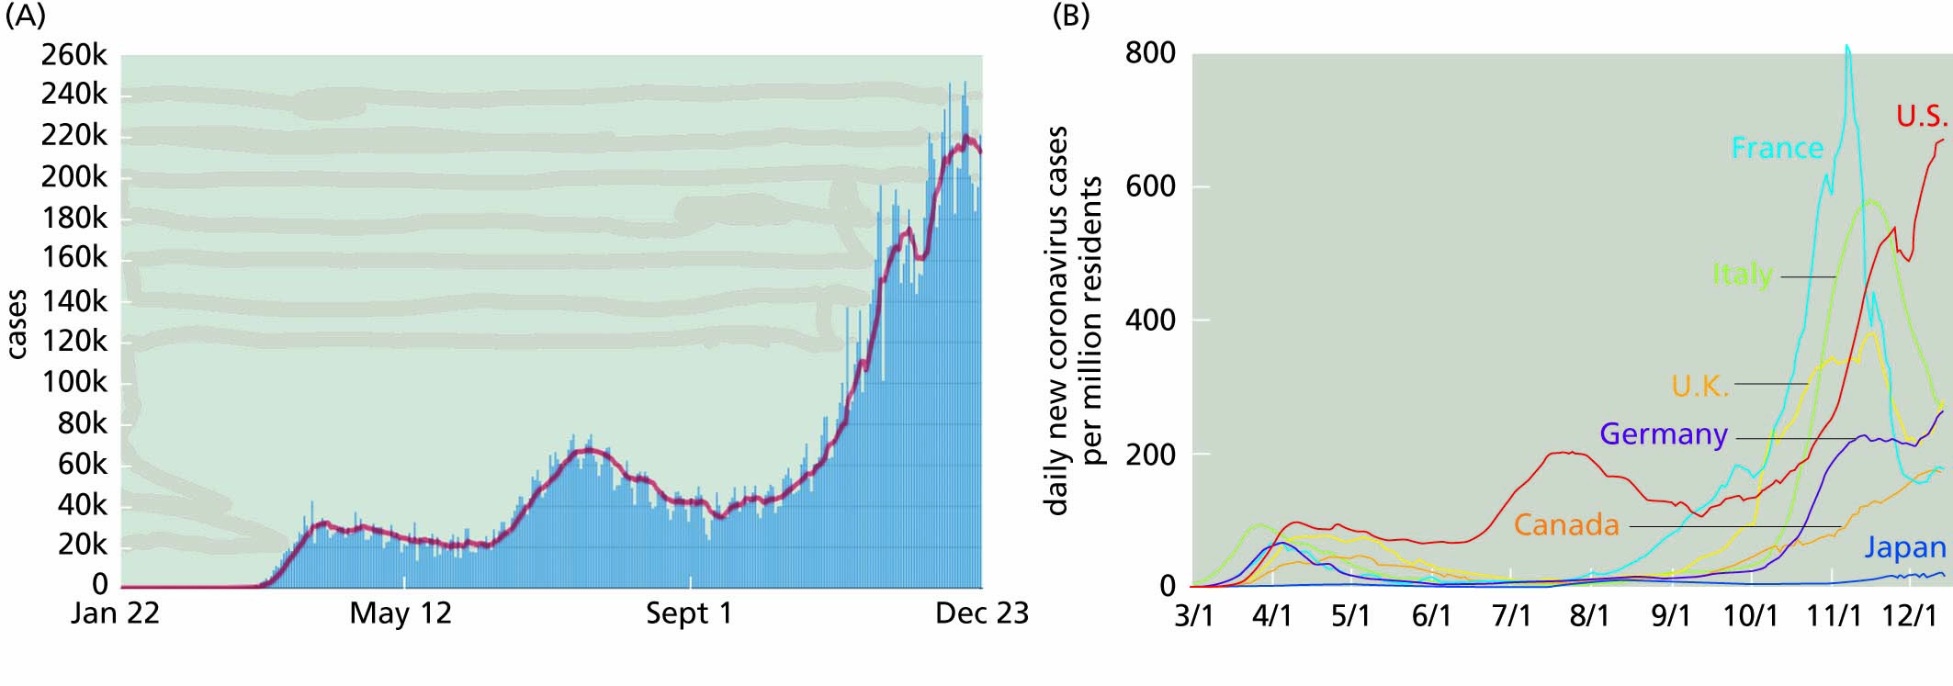
Figure 16.10 Timeline of COVID-19 infections during 2020.
In the United States (source: CDC).
In seven selected countries (source: Johns Hopkins University).

Slide 16
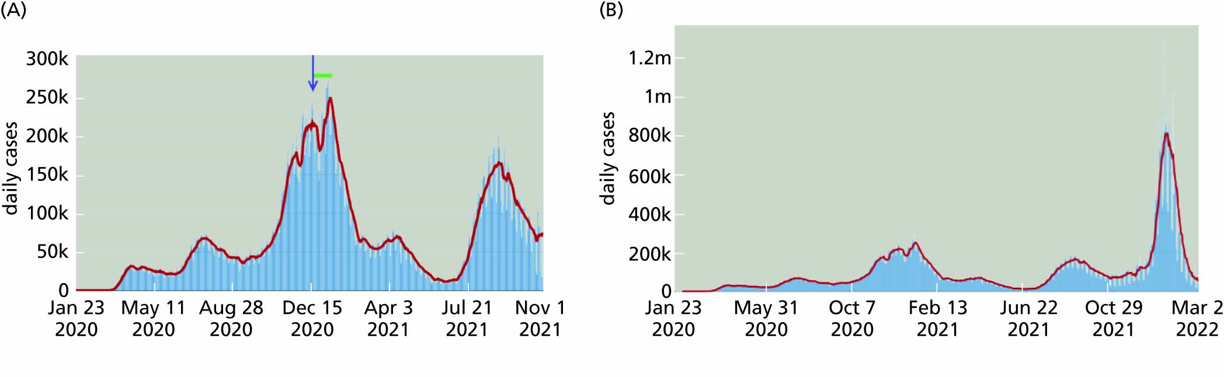
Figure 16.11 Time line of COVID-19 infections in the United States (source: CDC).
January 2020 through November 1, 2021. The red line represents a rolling 7-day average. The arrow represents the time when the first vaccines were approved (Dec. 15, 2020), but it took a few weeks for their distribution, as shown by the green bar.
January 2020 through March 2, 2022. The large spike in cases early in 2022 was largely due to the omicron variant.

Slide 17
Ecological factors especially affect patterns of vector-borne diseases
Plague
West Nile Virus and Eastern Equine Encephalitis
Leishmaniasis
Tick-borne diseases
Other vector-borne diseases

Slide 18
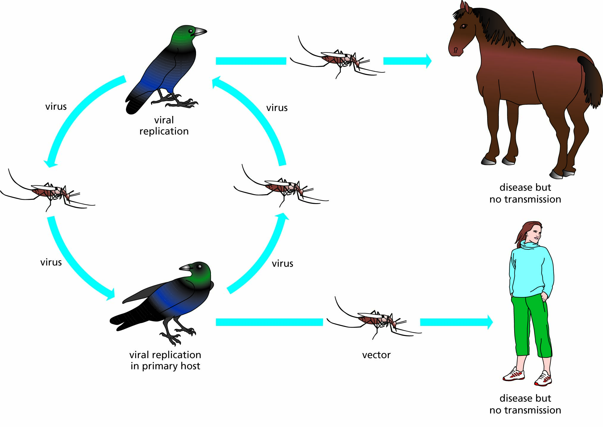
Figure 16.12 Life cycle of West Nile virus.

