Slide 1
Chapter 11: The Nervous System and Senses
Biology Trending, 4e
Eli Minkoff and Jennifer Hood-DeGrenier

Slide 2
The nervous system carries messages throughout the body
The nervous system and neurons
Nerve impulses: how messages travel along neurons
Neurotransmitters: how messages travel between neurons
Dopamine pathways in the brain: Parkinsonism and Huntington’s disease

Slide 3
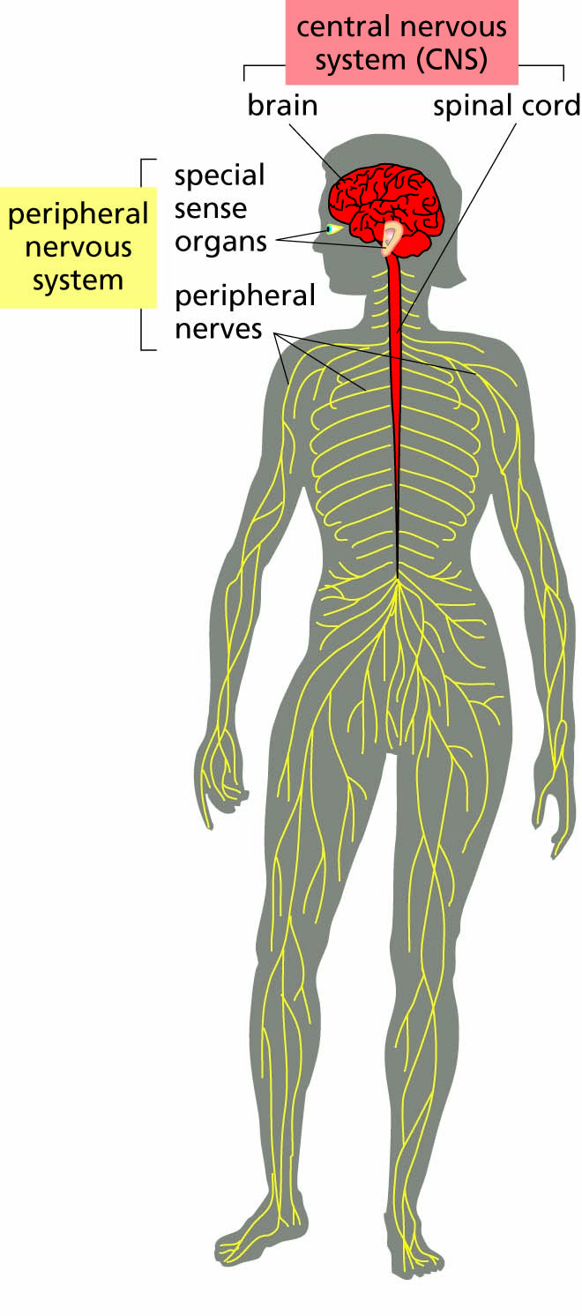
Figure 11.1 Major divisions of the nervous system.

Slide 4
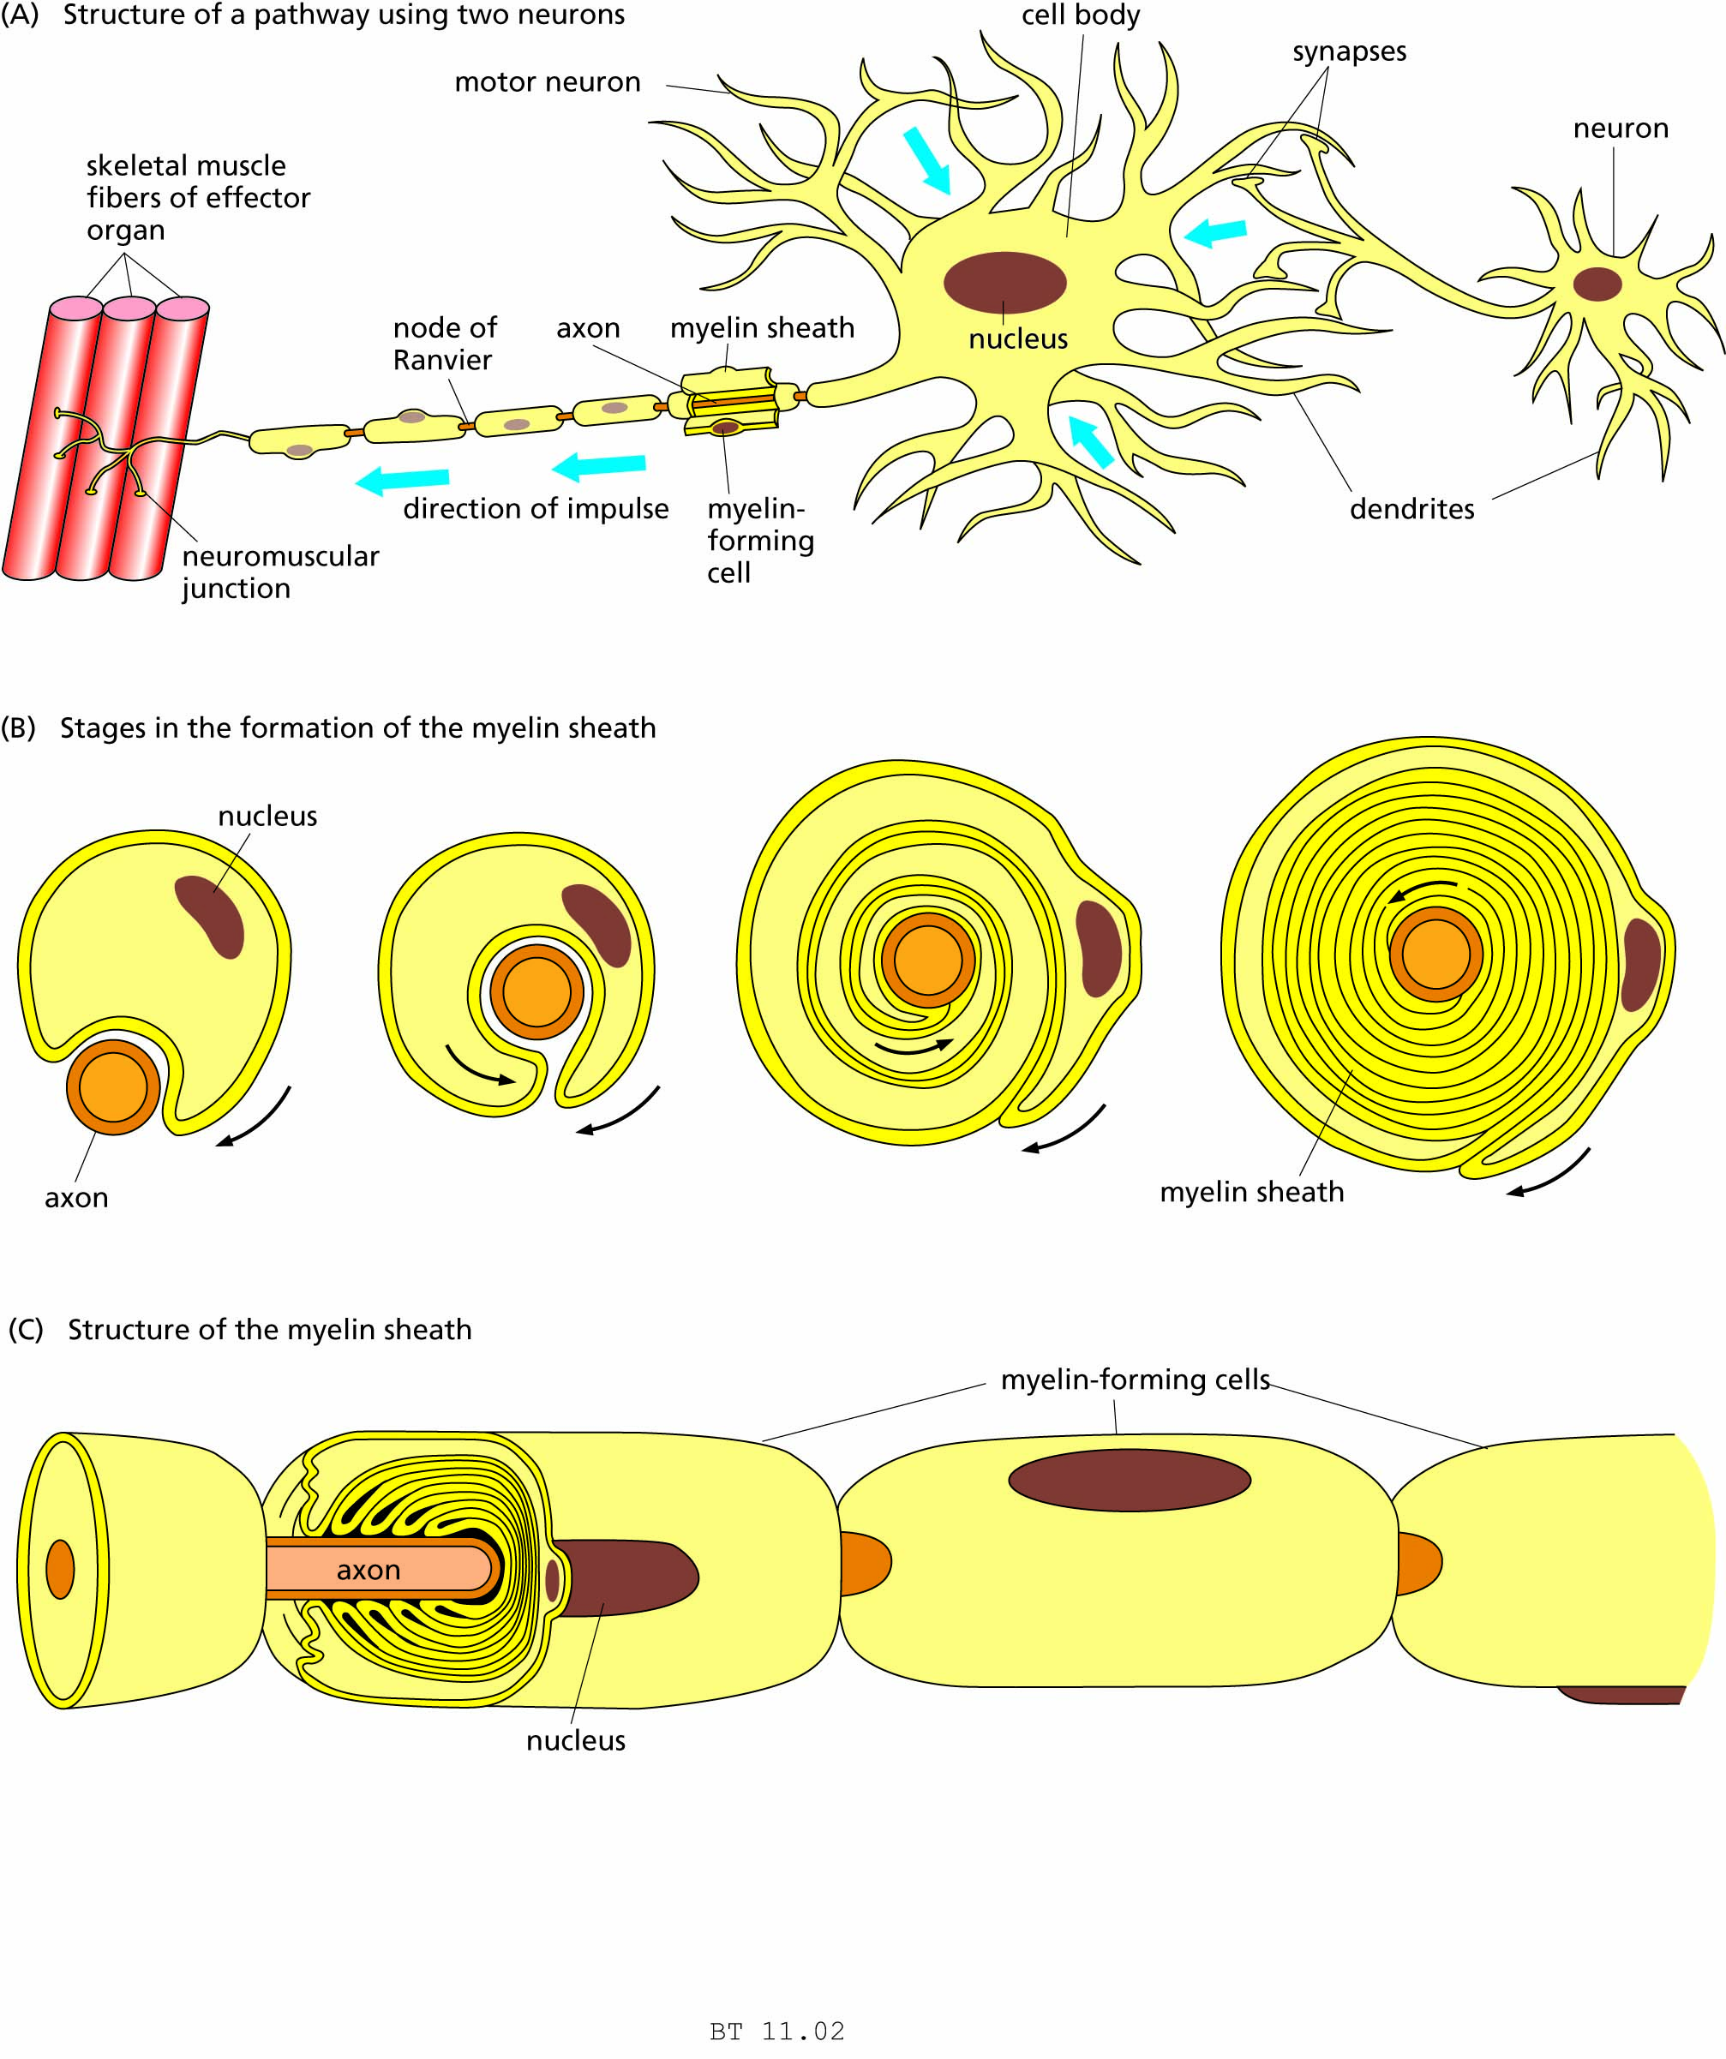
Figure 11.2 The neuron and its myelin sheath.

Slide 6
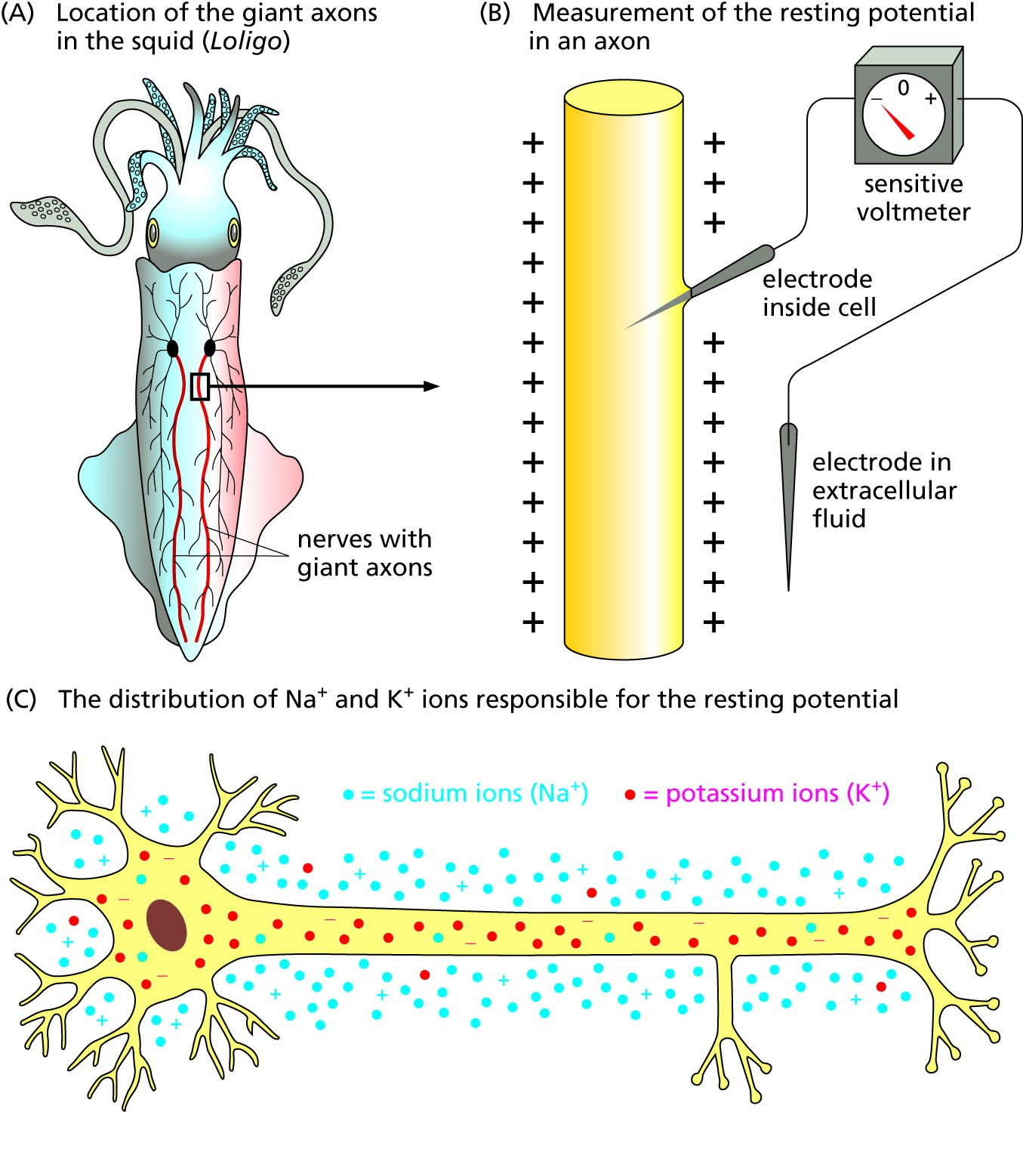
Figure 11.3 Resting potentials in the giant axons of the squid.

Slide 7
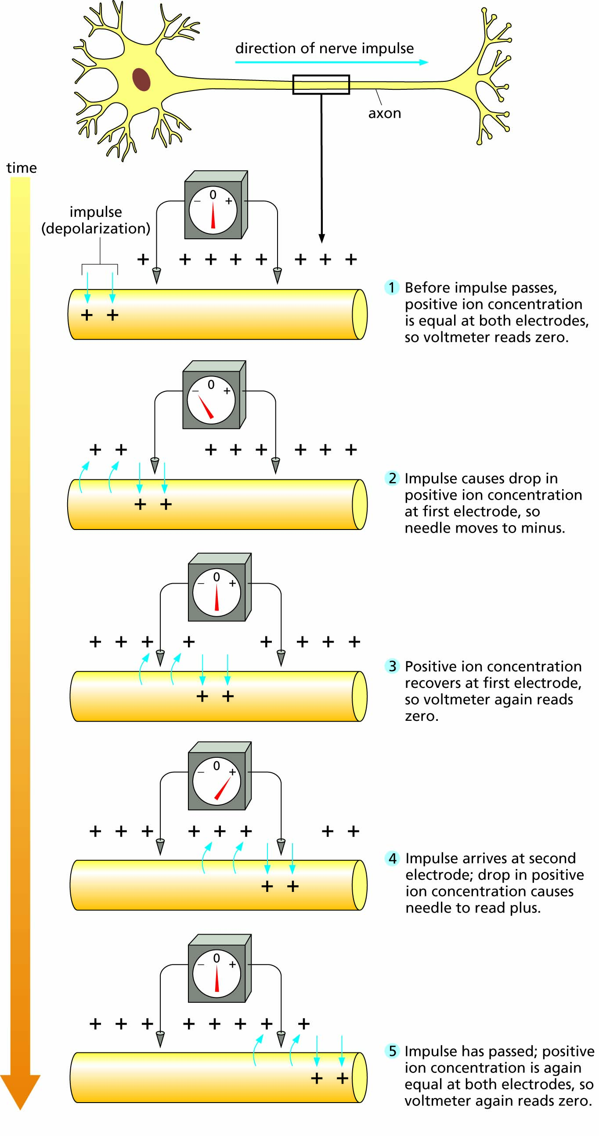
Figure 11.4 Detection of a nerve impulse by using a sensitive voltmeter.
For an animated version of this figure, please go to https://biologytrending.Routledge.com.

Slide 8
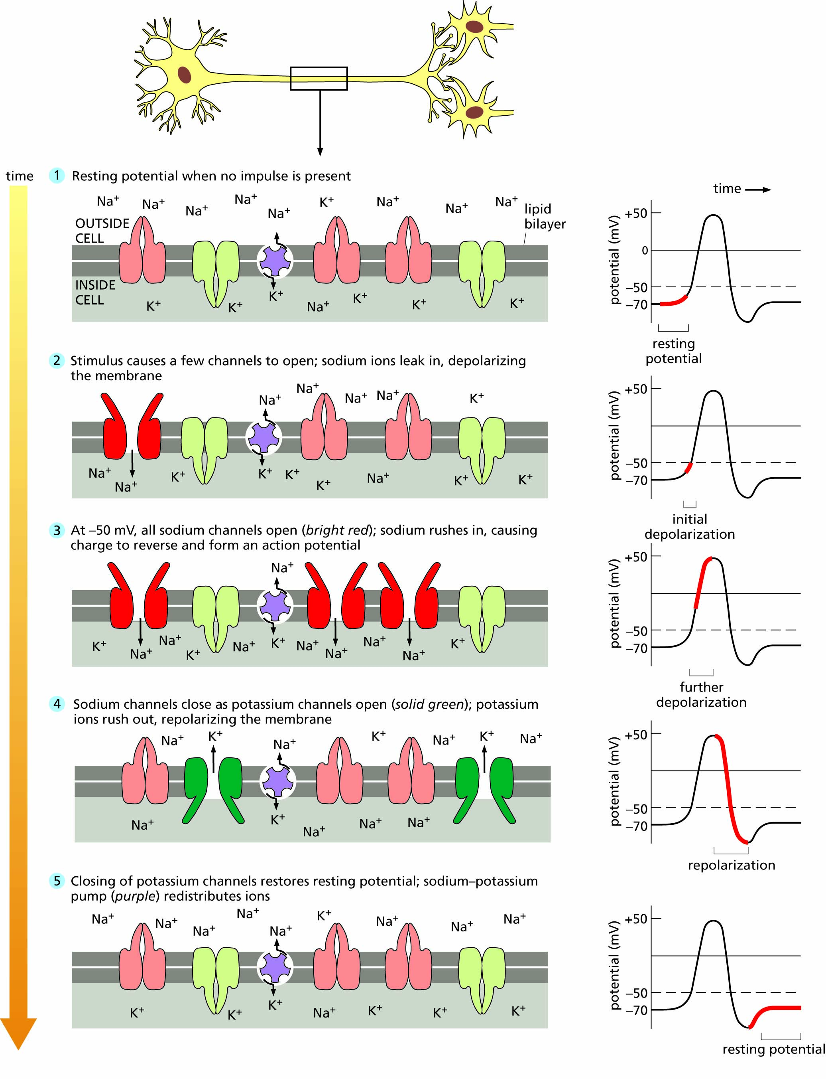
Figure 11.5 Generation of an action potential in a nerve cell. The action potential corresponds to steps 2 through 4 and extends from one resting potential to the next.
For an animated version of this figure, please go to https://biologytrending.Routledge.com

Slide 9
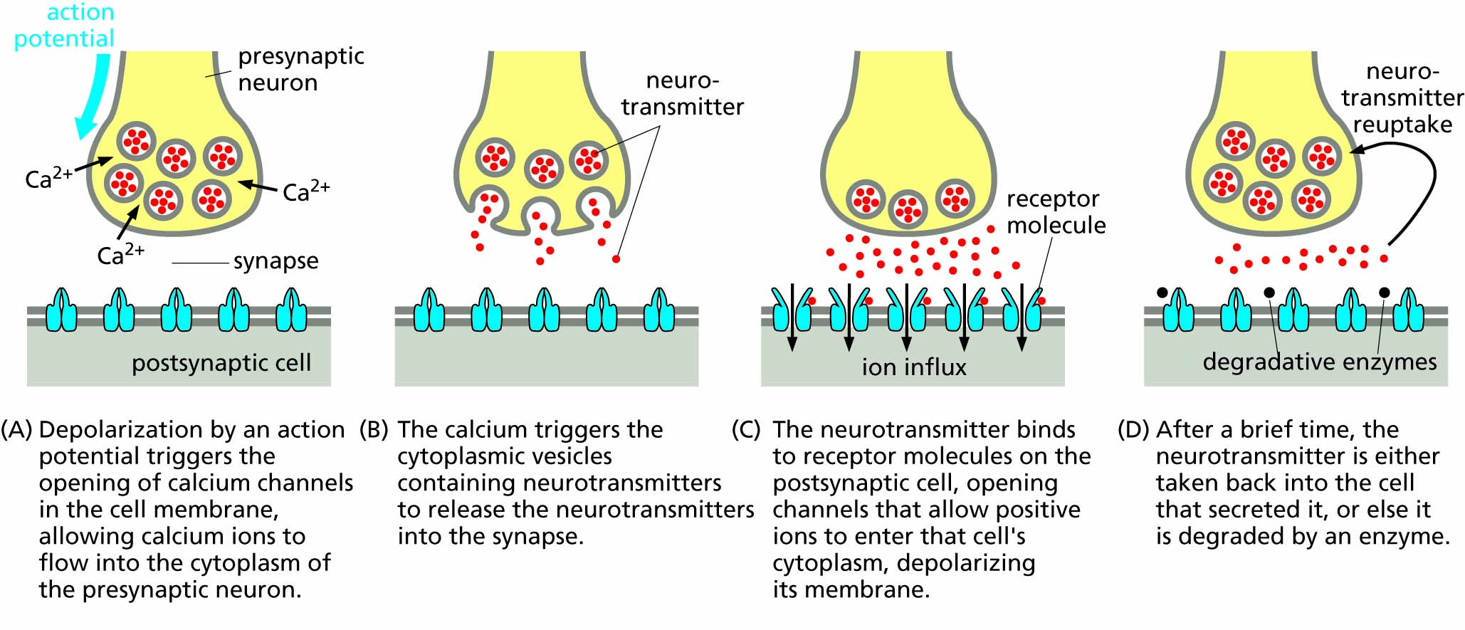
Figure 11.6 How a chemical synapse works.
For an animated version of this figure, please go to https://biologytrending.Routledge.com.

Slide 10
Table 11.1 Neurotransmitters
Amine Neurotransmitters | Protein or Peptide Neurotransmitters (Neuropeptides)
Epinephrine | Somatostatin
Norepinephrine | α-endorphin
Dopamine | β-endorphin
Serotonin | Leu-enkephalin
Histamine | Met-enkephalin
Anandamide | Substance P
Amino Acid Neurotransmitters | Gas Neurotransmitter
Aspartic acid (aspartate) | Nitric oxide (NO)
Glutamic acid (glutamate) | Ester Neurotransmitter
Gamma-aminobutyric acid (GABA) | Acetylcholine
Glycine

Slide 11
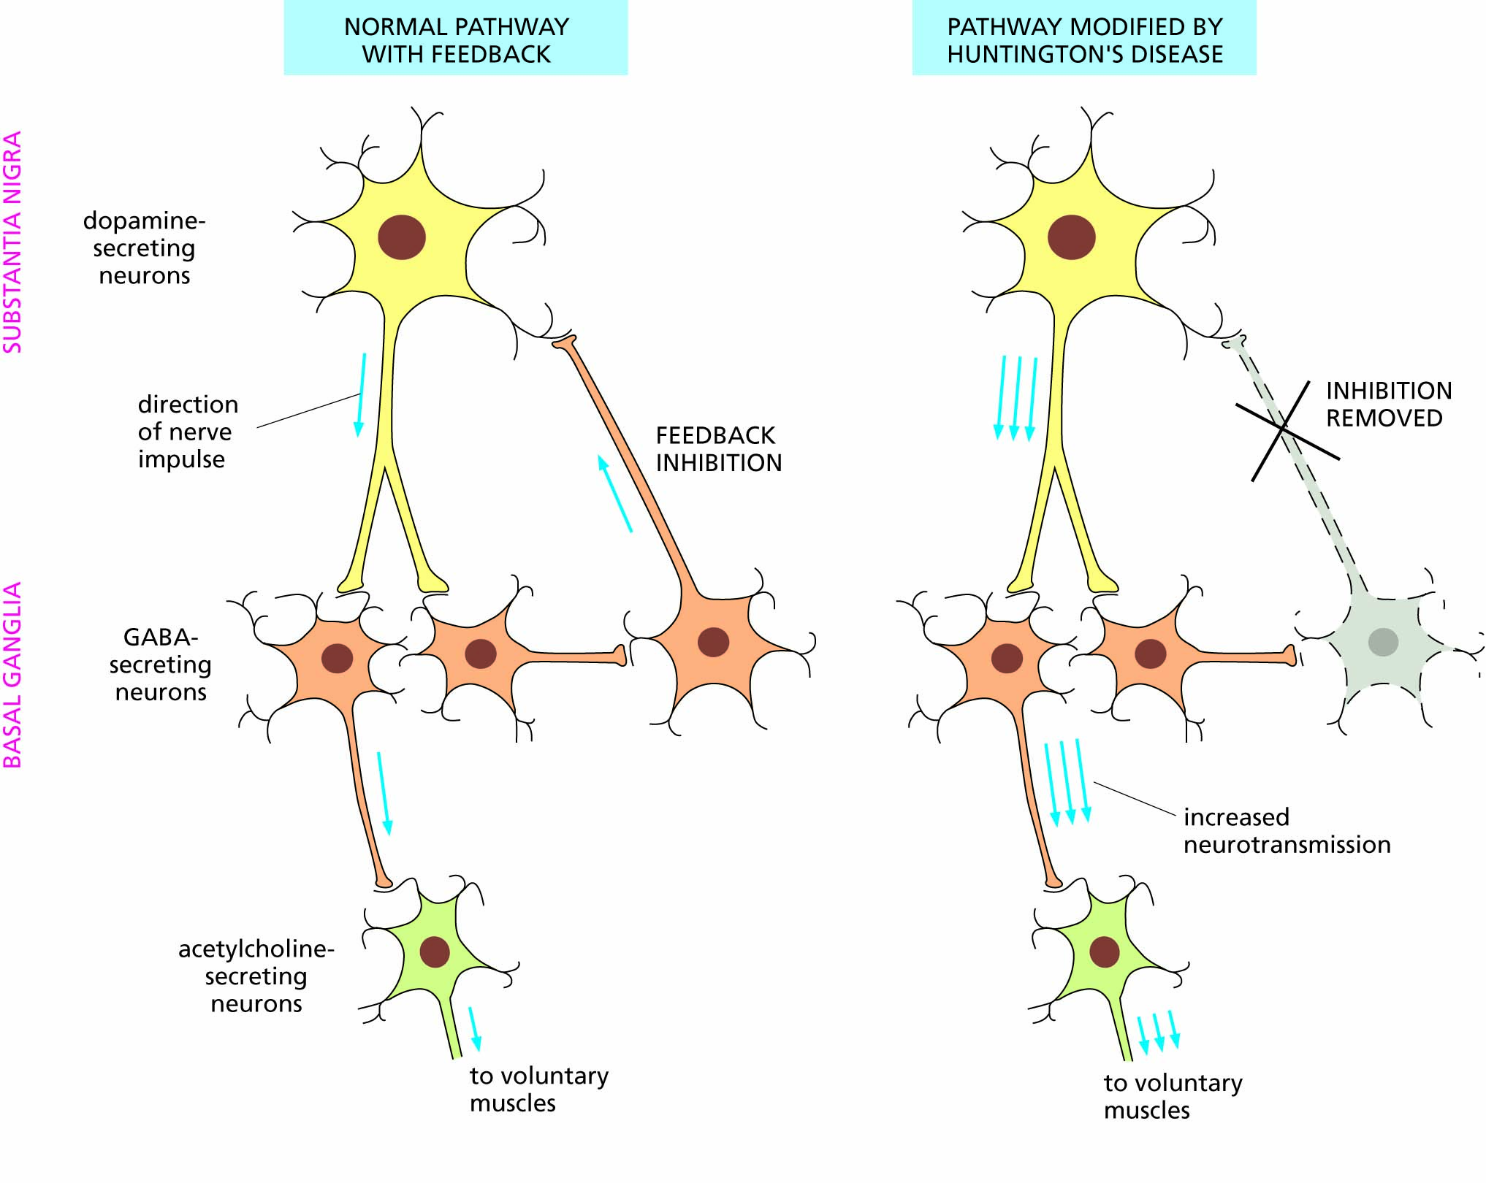
Figure 11.7 Feedback inhibition usually prevents dopamine overproduction, but impairment of the feedback pathway in Huntington’s disease allows dopamine overproduction.

Slide 12
Messages are routed to and from the brain
Message input: sense organs
Message processing in the brain
Message output: muscle contraction

Slide 13
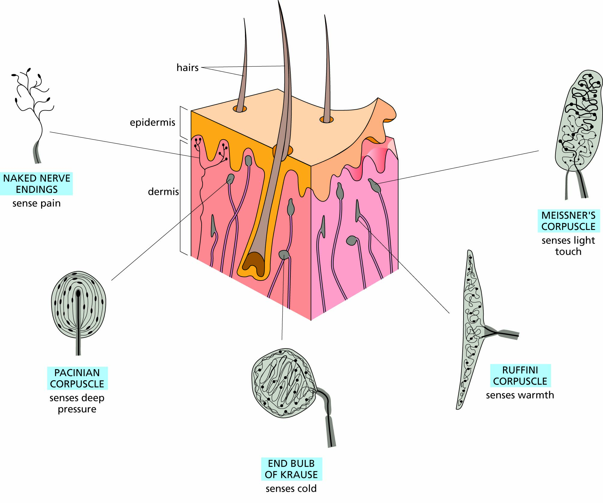
Figure 11.8 Nerve endings in the skin.

Slide 14
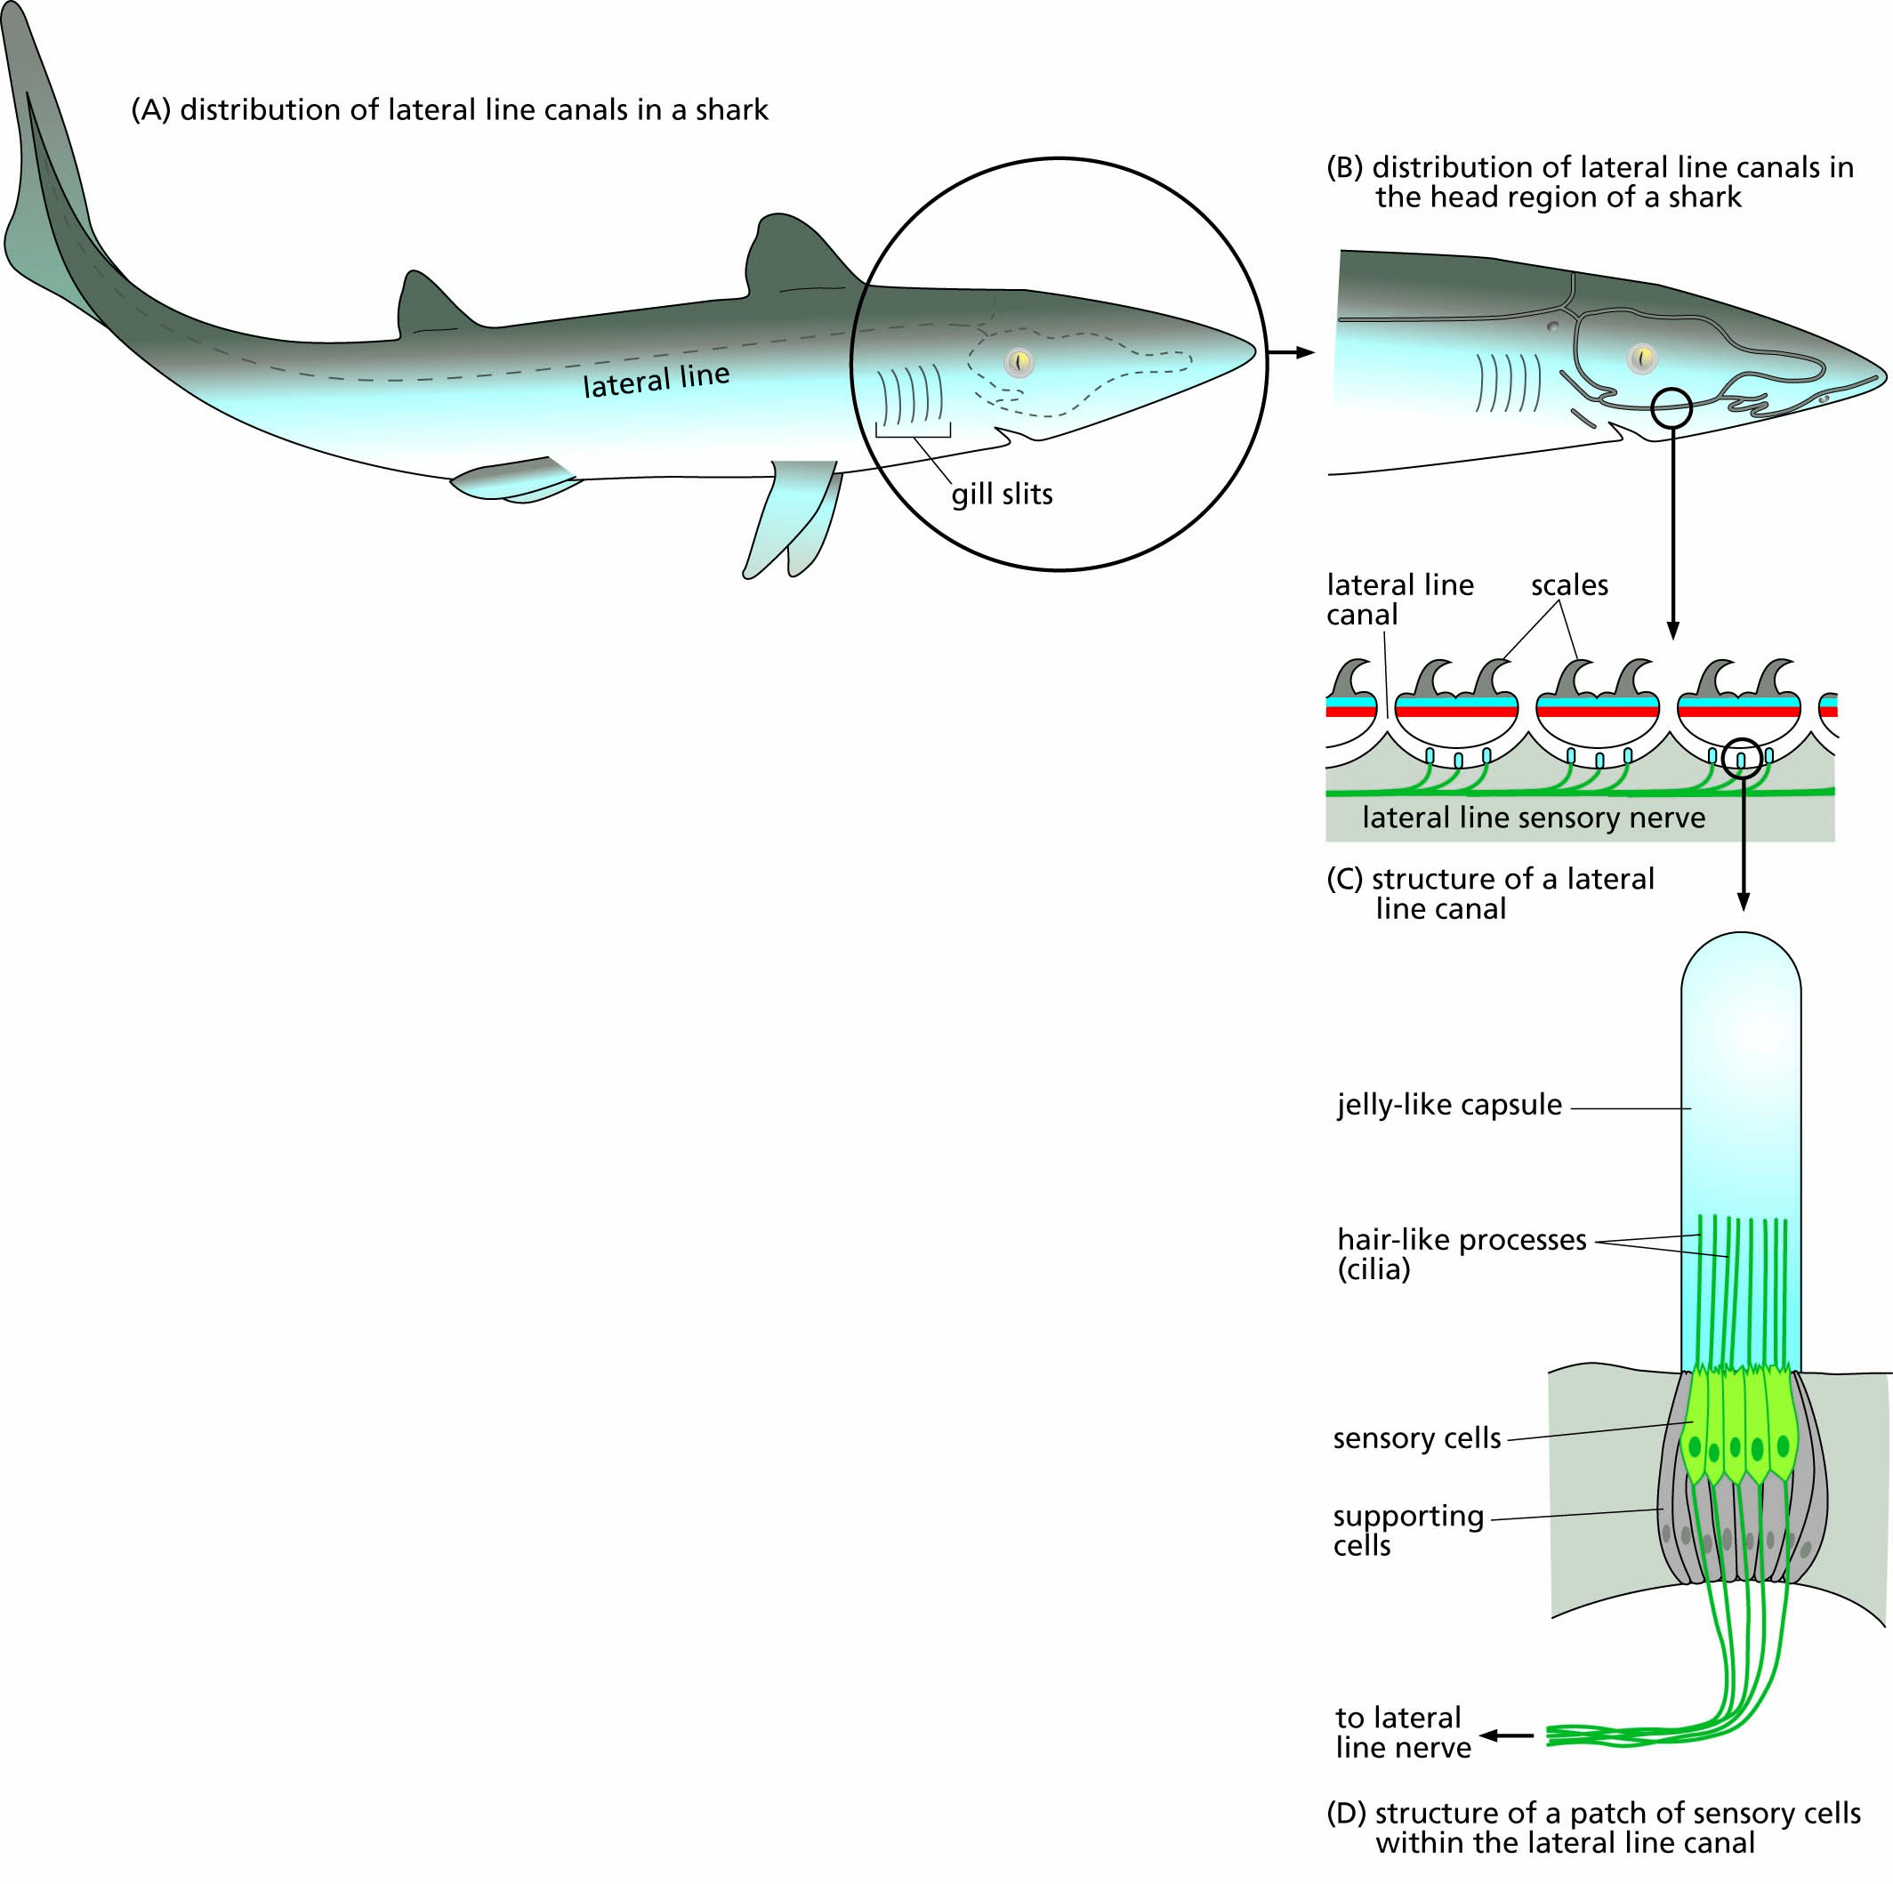
Figure 11.9 The lateral line system of fishes.

Slide 15
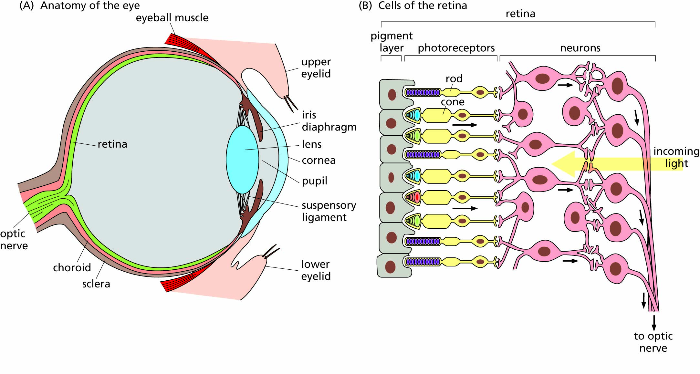
Figure 11.10 The human eye.

Slide 16
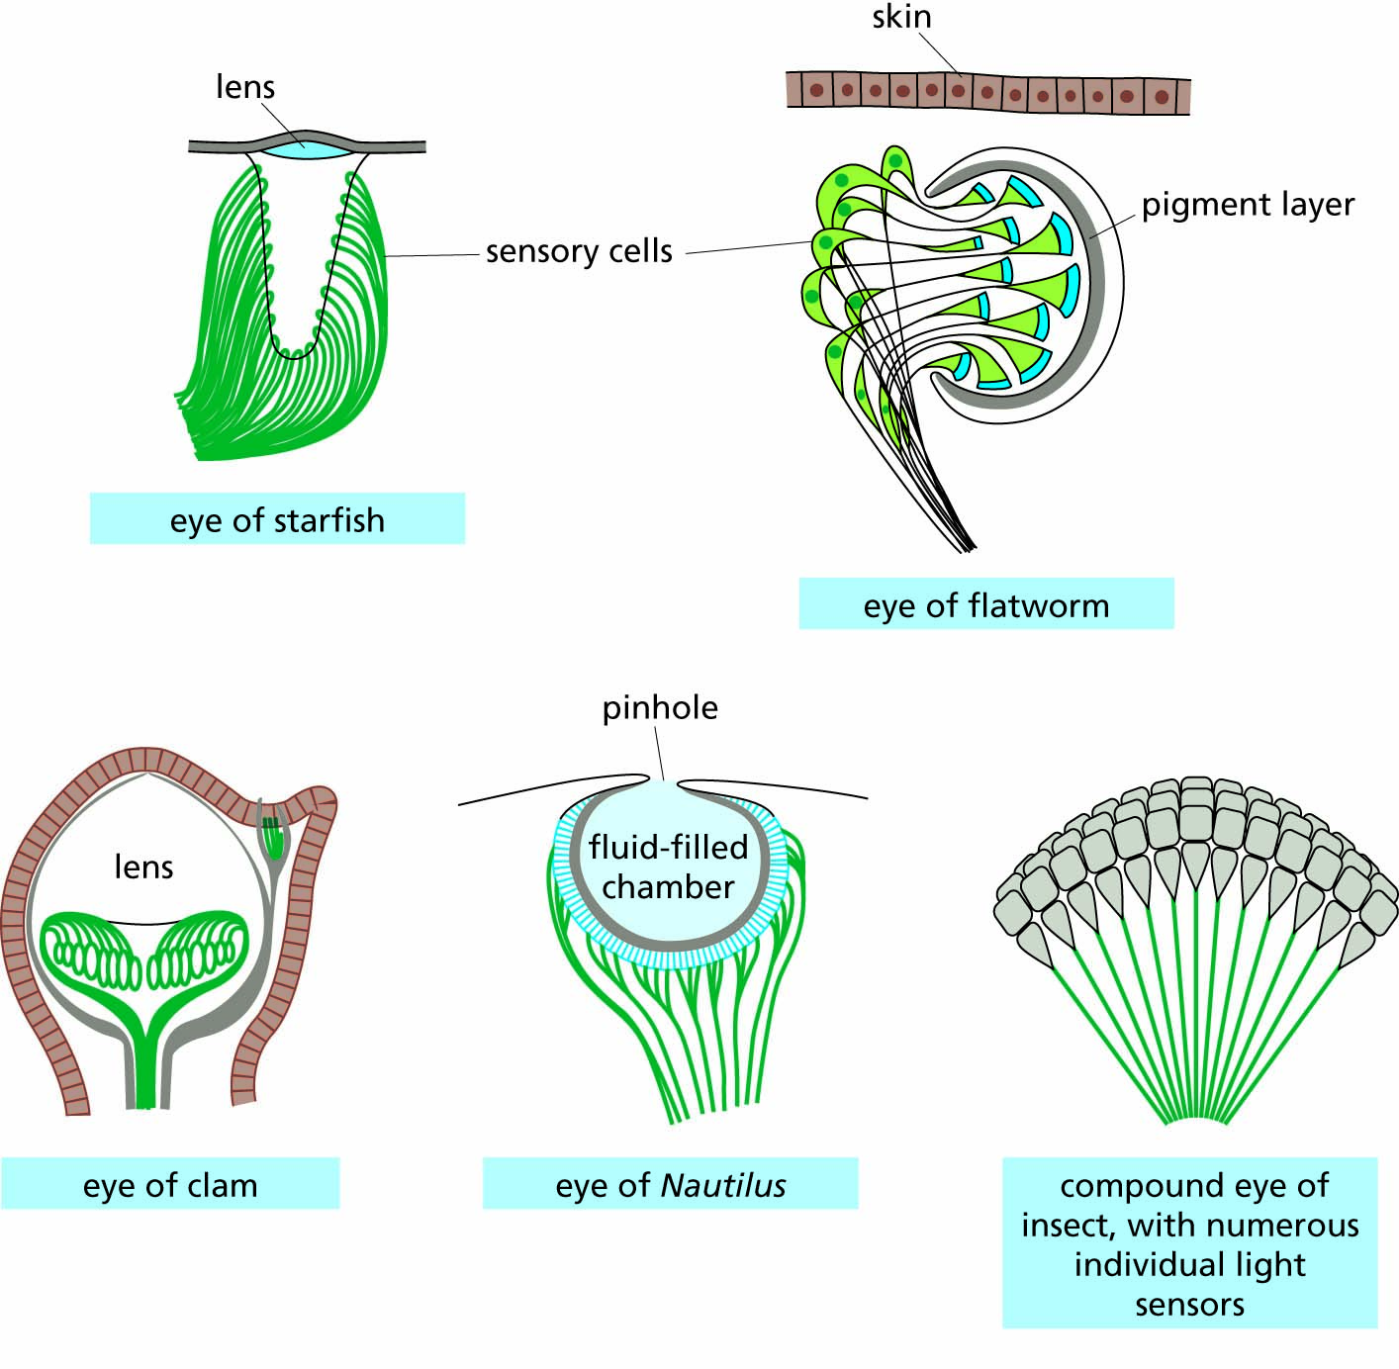
Figure 11.11 Differences in the structure of eyes in different groups of animals.

Slide 17
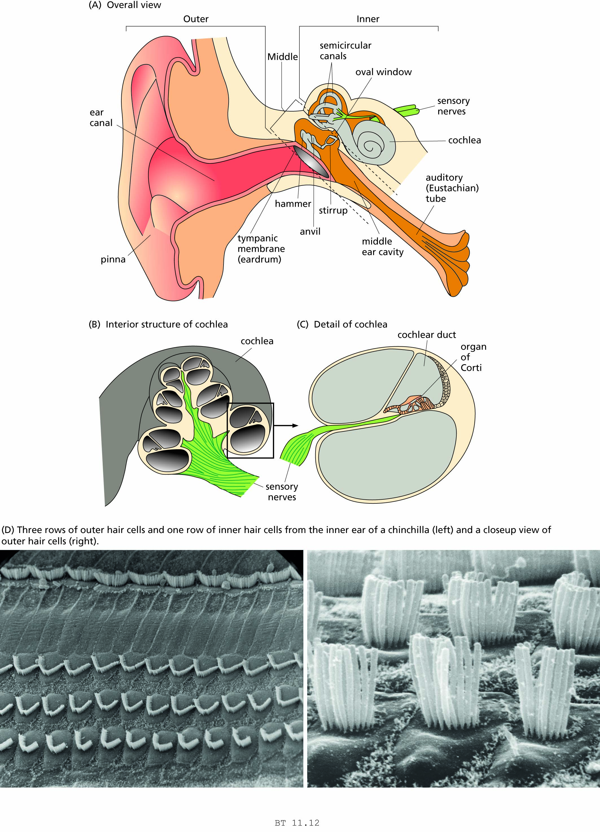
Figure 11.12 The human ear.

Slide 19
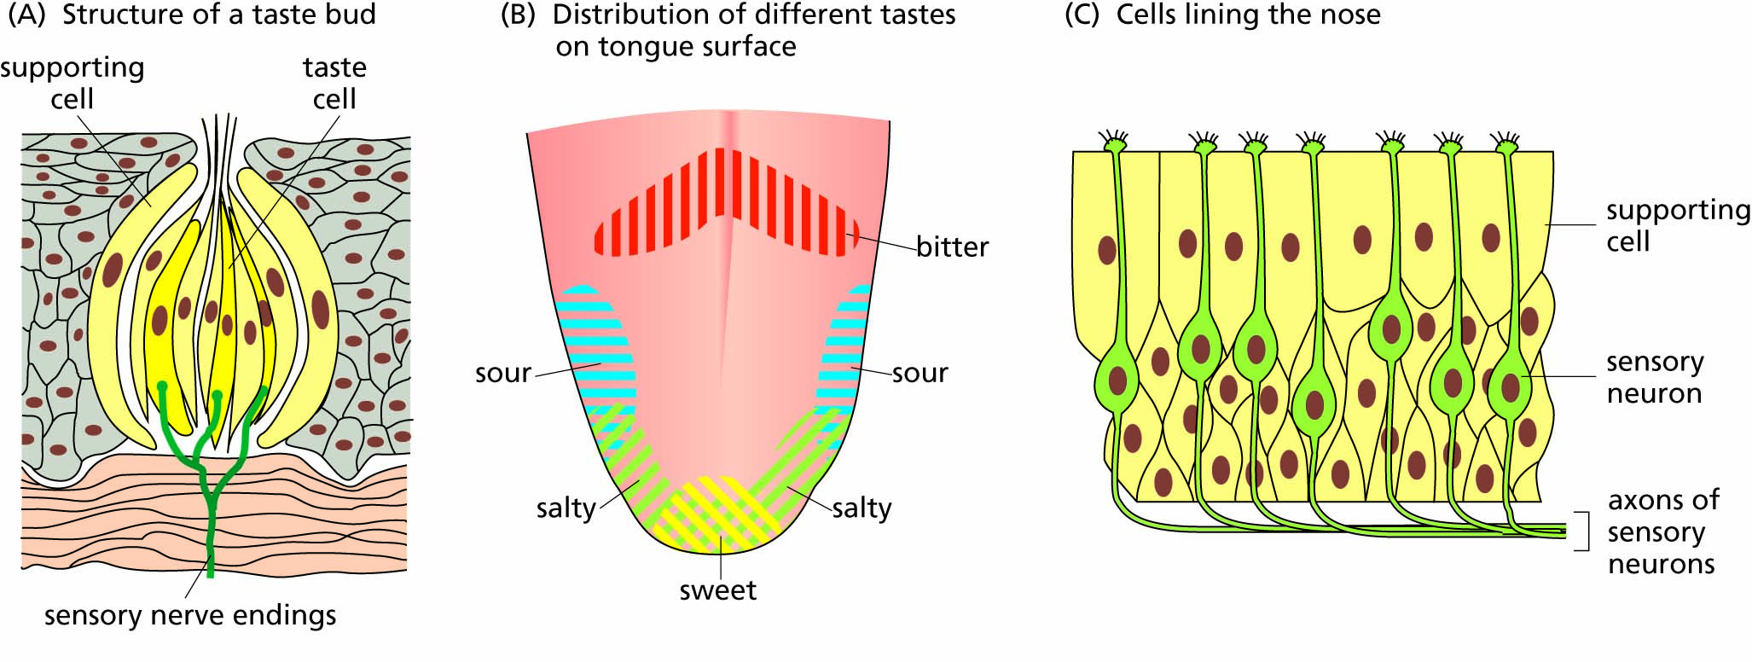
Figure 11.13 Organs of taste and smell.

Slide 20
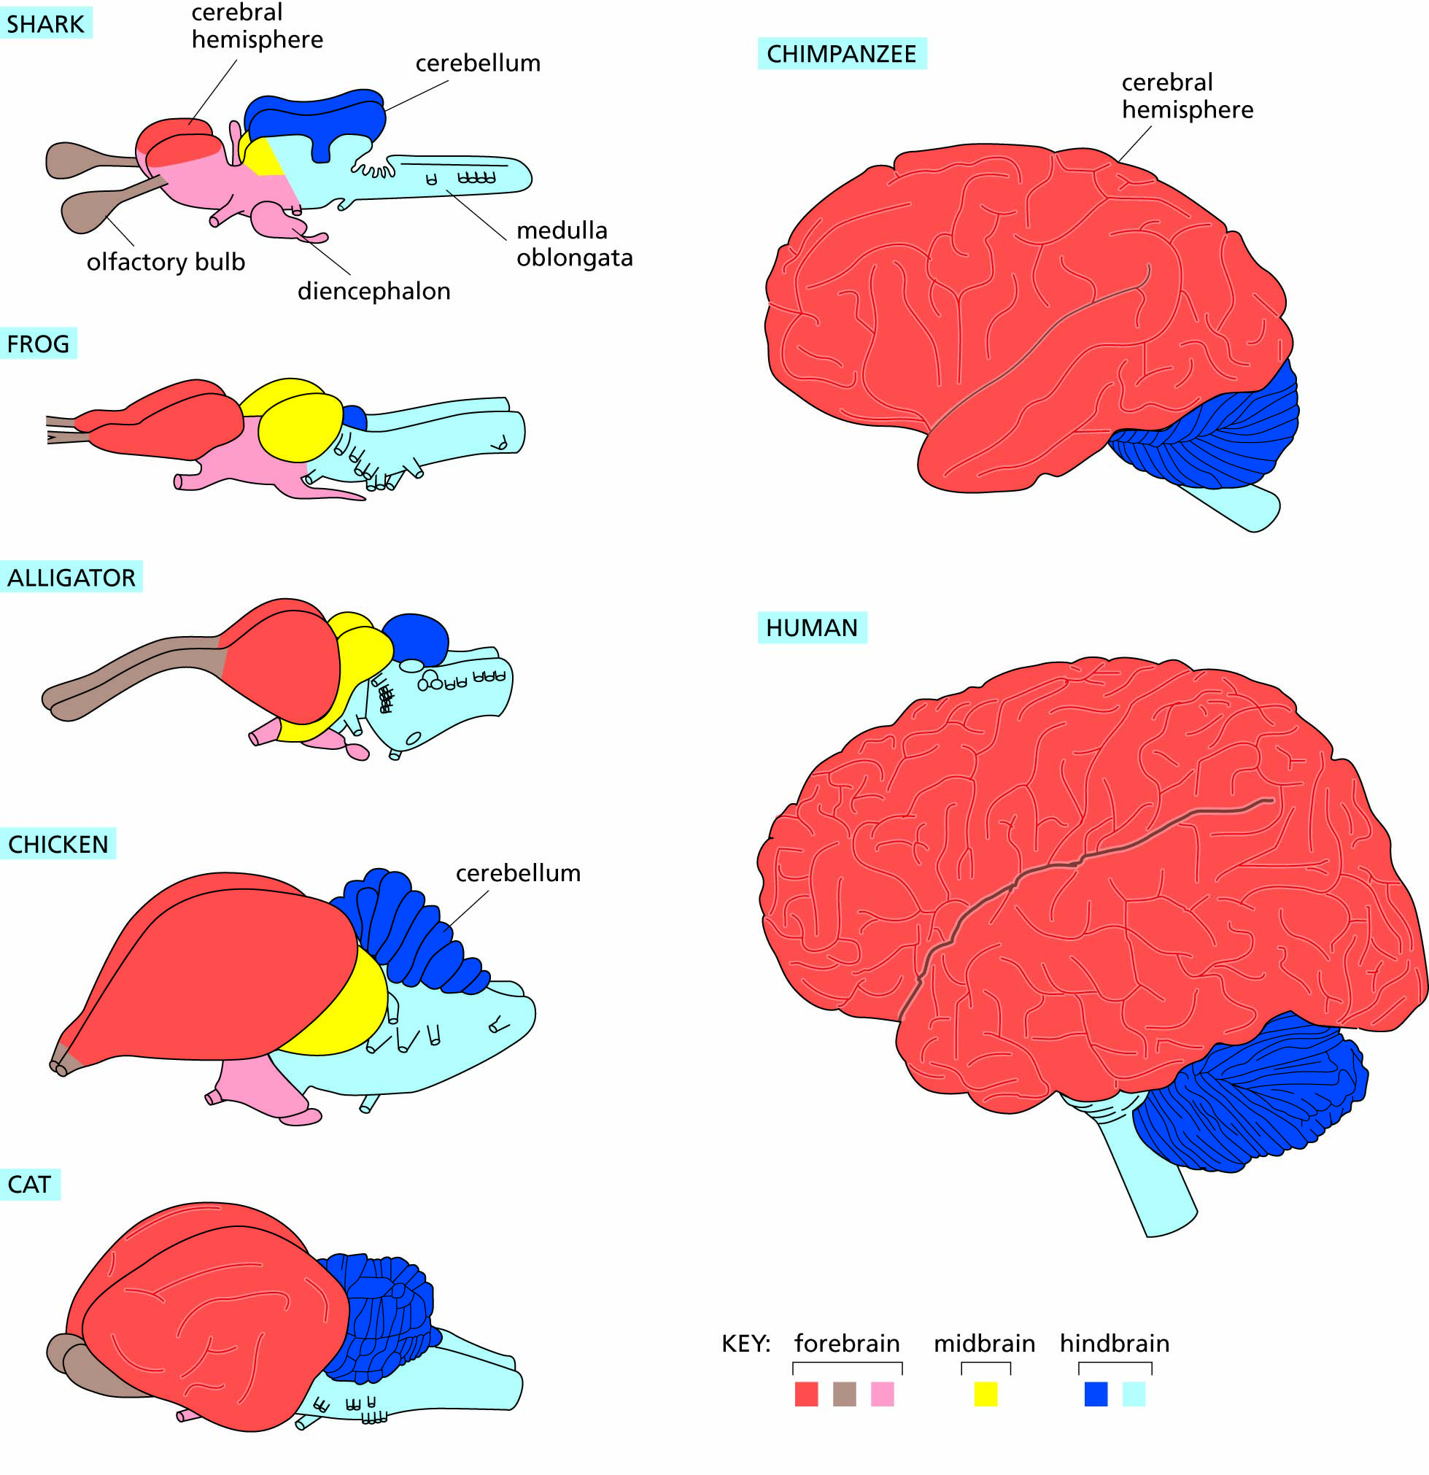
Figure 11.14 Correspondences among the brains of several vertebrate species (not to scale). In the chimpanzee and human brains, the olfactory bulbs and midbrain are concealed beneath the expanded cerebrum.

Slide 21
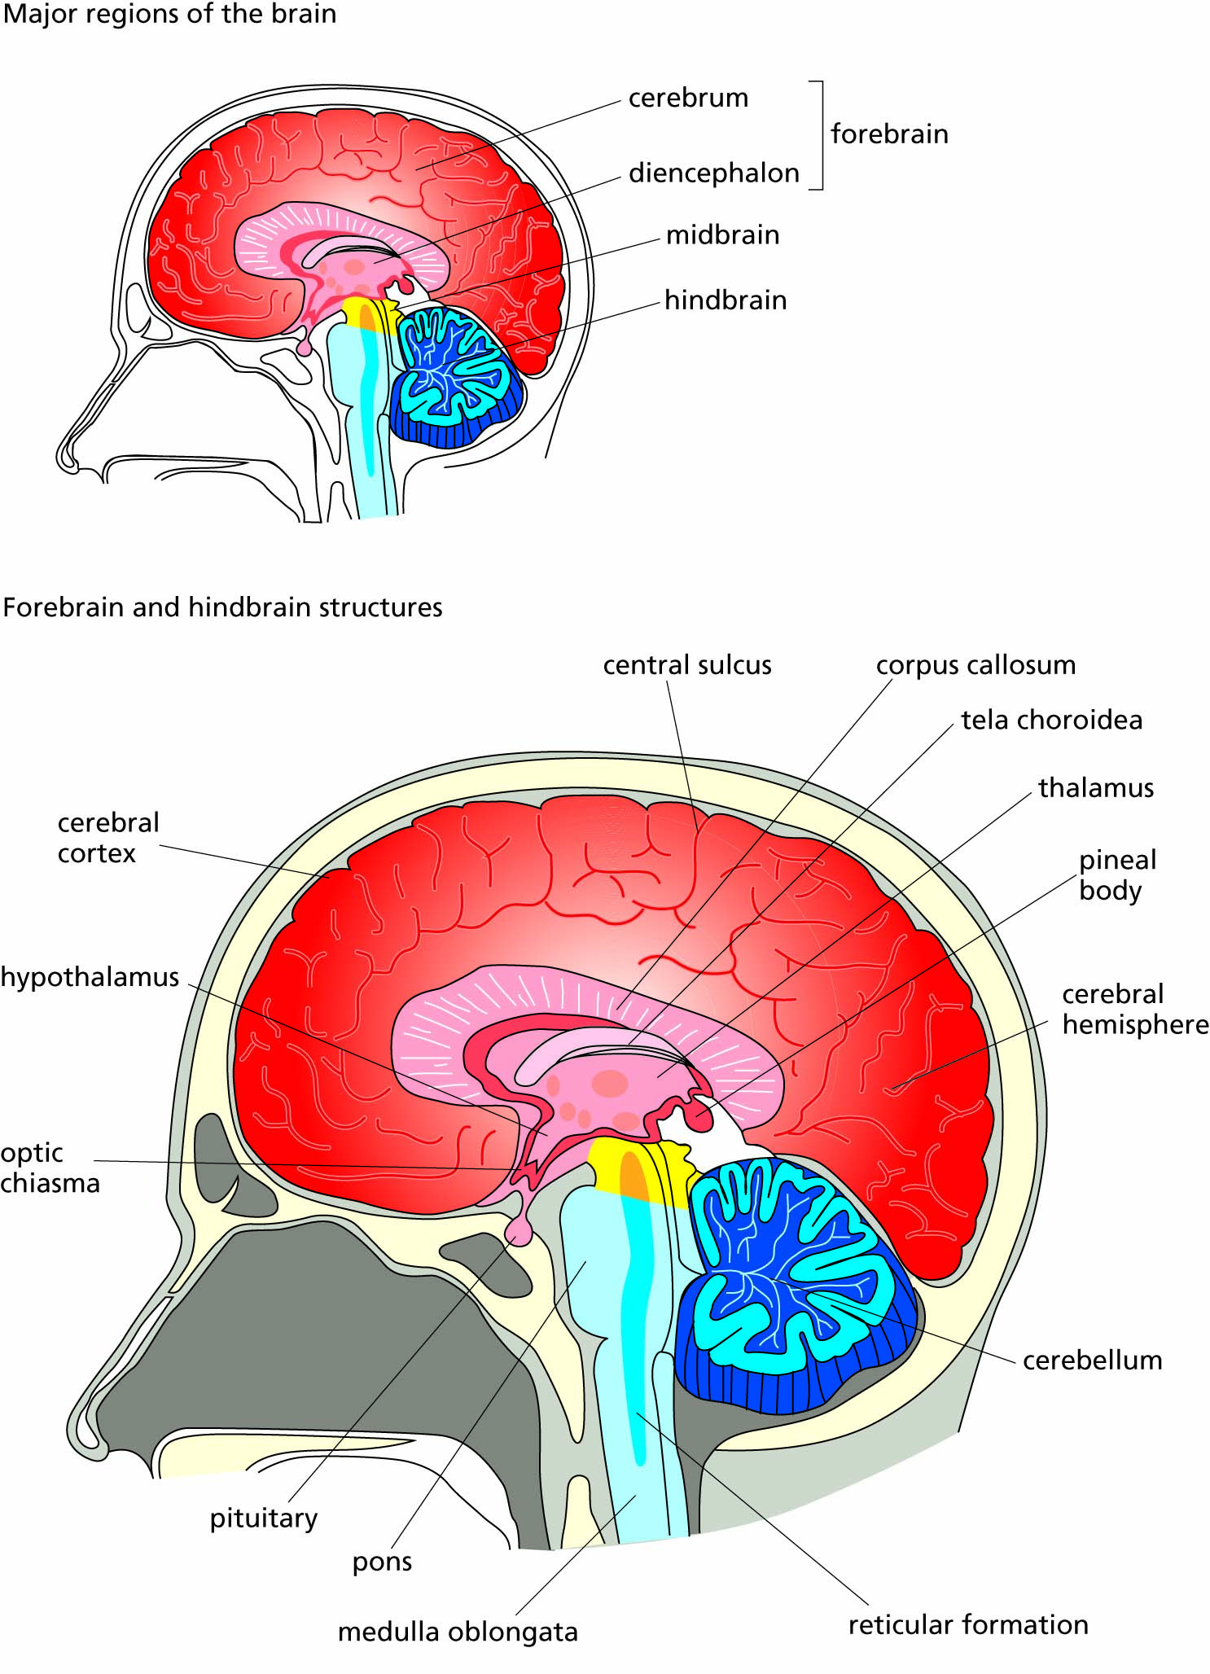
Figure 11.15 Section through the human brain. Only structures located in the midline plane are visible in this view; off-center structures (such as the olfactory bulbs) cannot be seen.

Slide 22
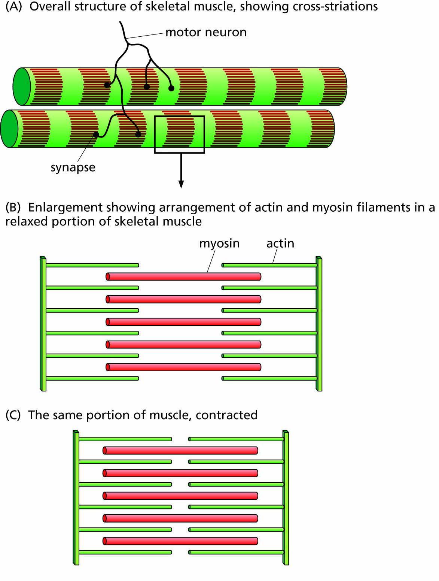
Figure 11.16 Structure of a portion of skeletal muscle.

Slide 23
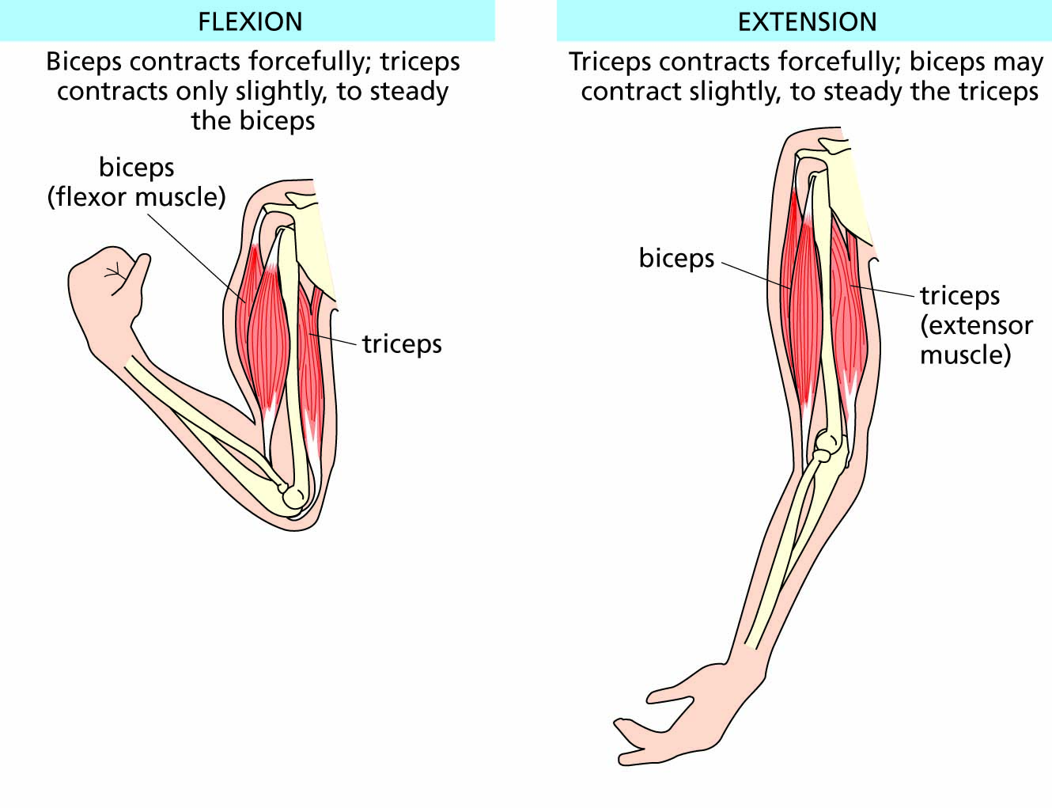
Figure 11.17 The major muscles that flex and extend the arm. Most muscles act together with other muscles that steady their action by pulling in the opposite direction.

Slide 24
The brain stores and rehearses messages
Learning: storing brain activity
Memory formation and consolidation
Biological rhythms: time-of-day messages
Dreams: practice in sending messages

Slide 25
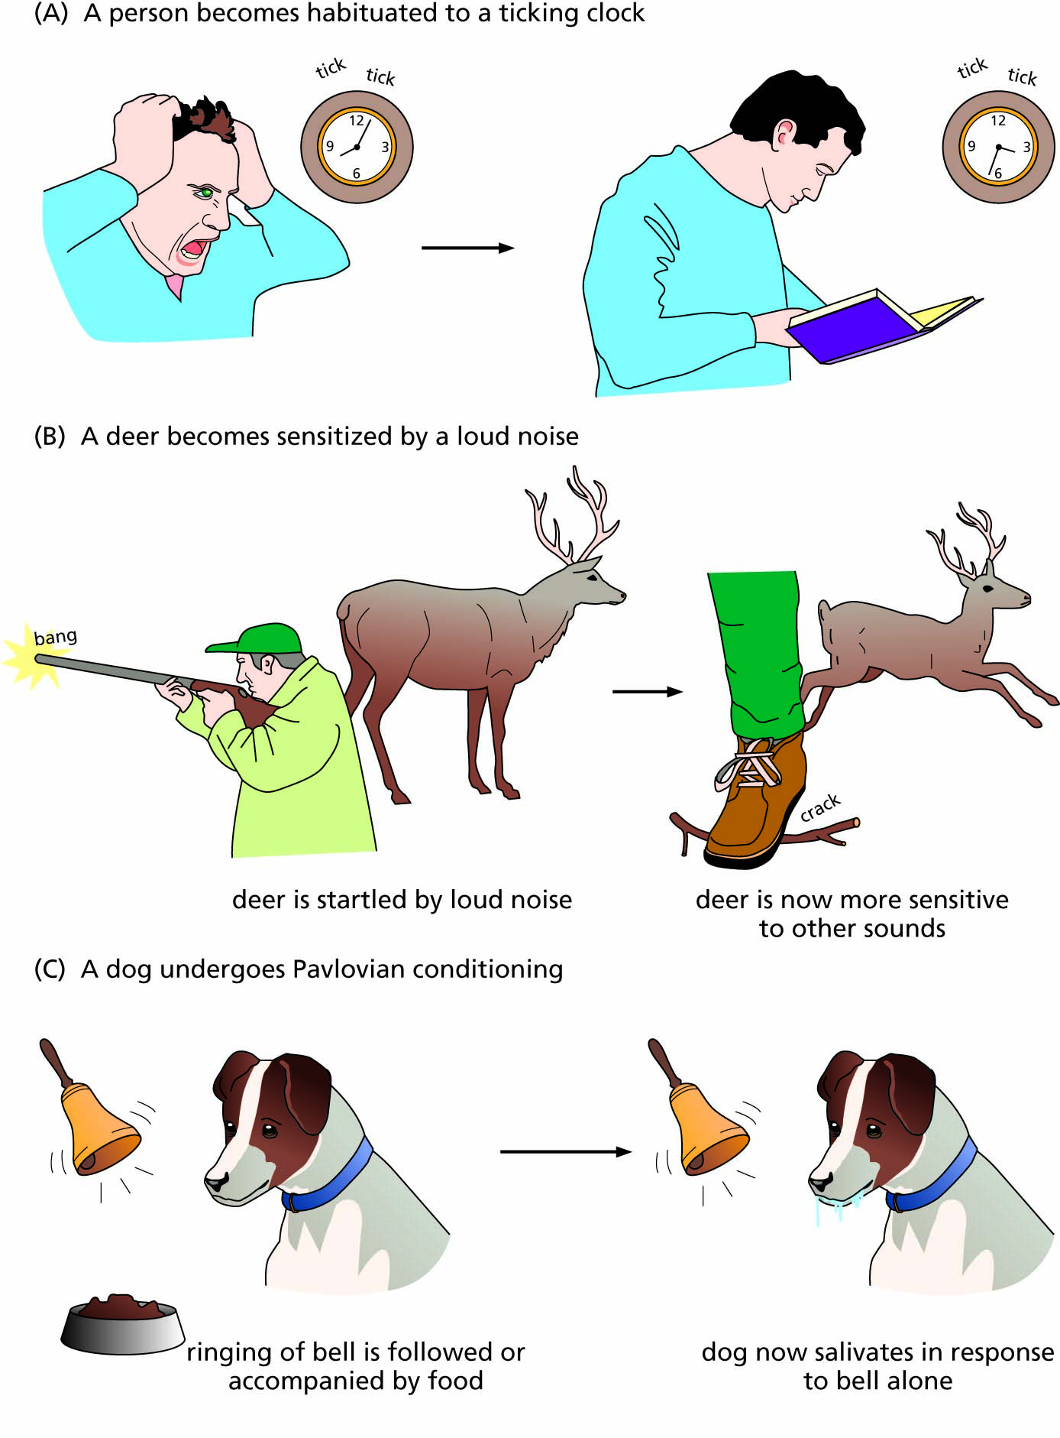
Figure 11.18 Three kinds of procedural learning.

Slide 26
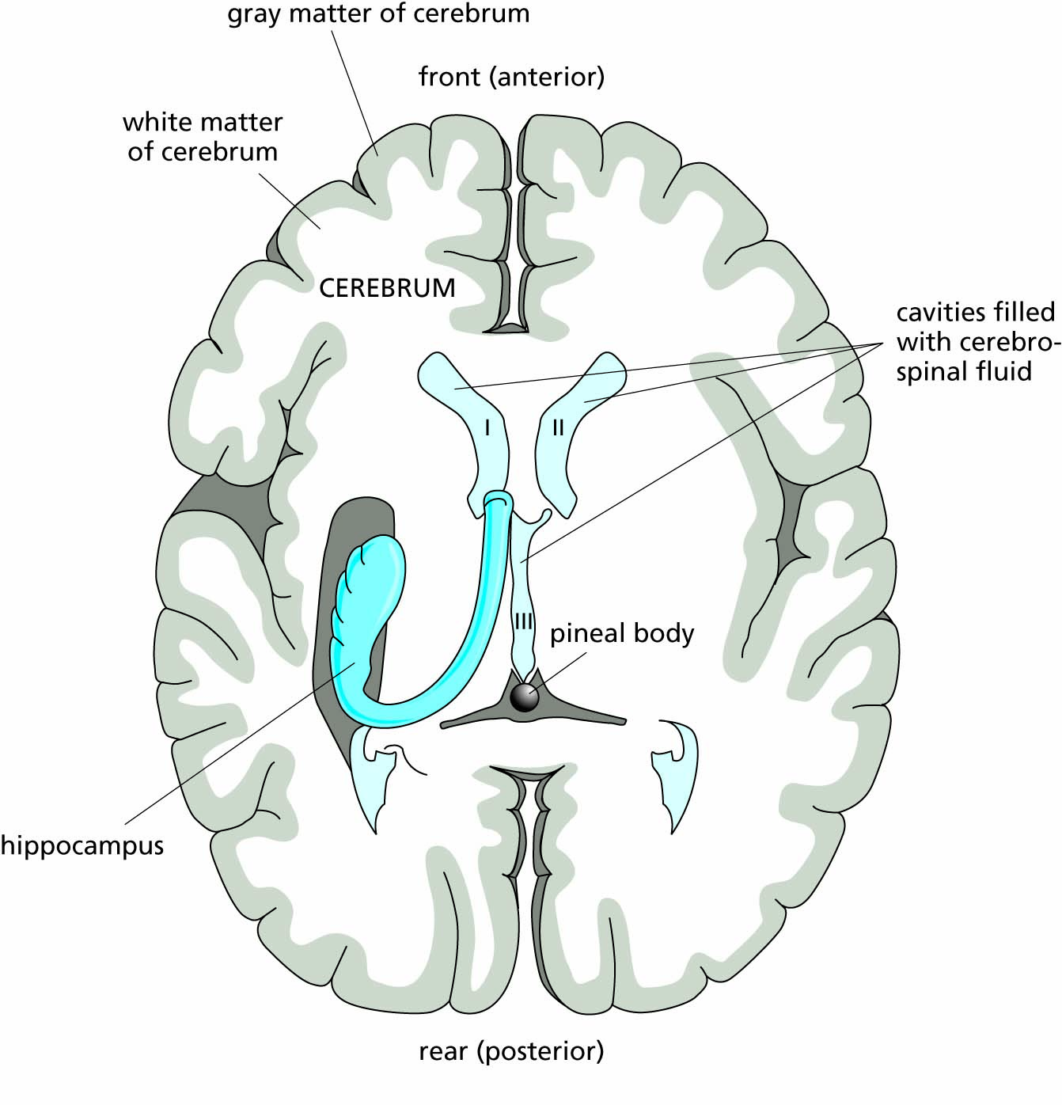
Figure 11.19 Horizontal section through the brain, showing the hippocampus, an important structure in the formation of certain types of memory. (Only one hippocampus is shown; the other is symmetrically located).

Slide 27
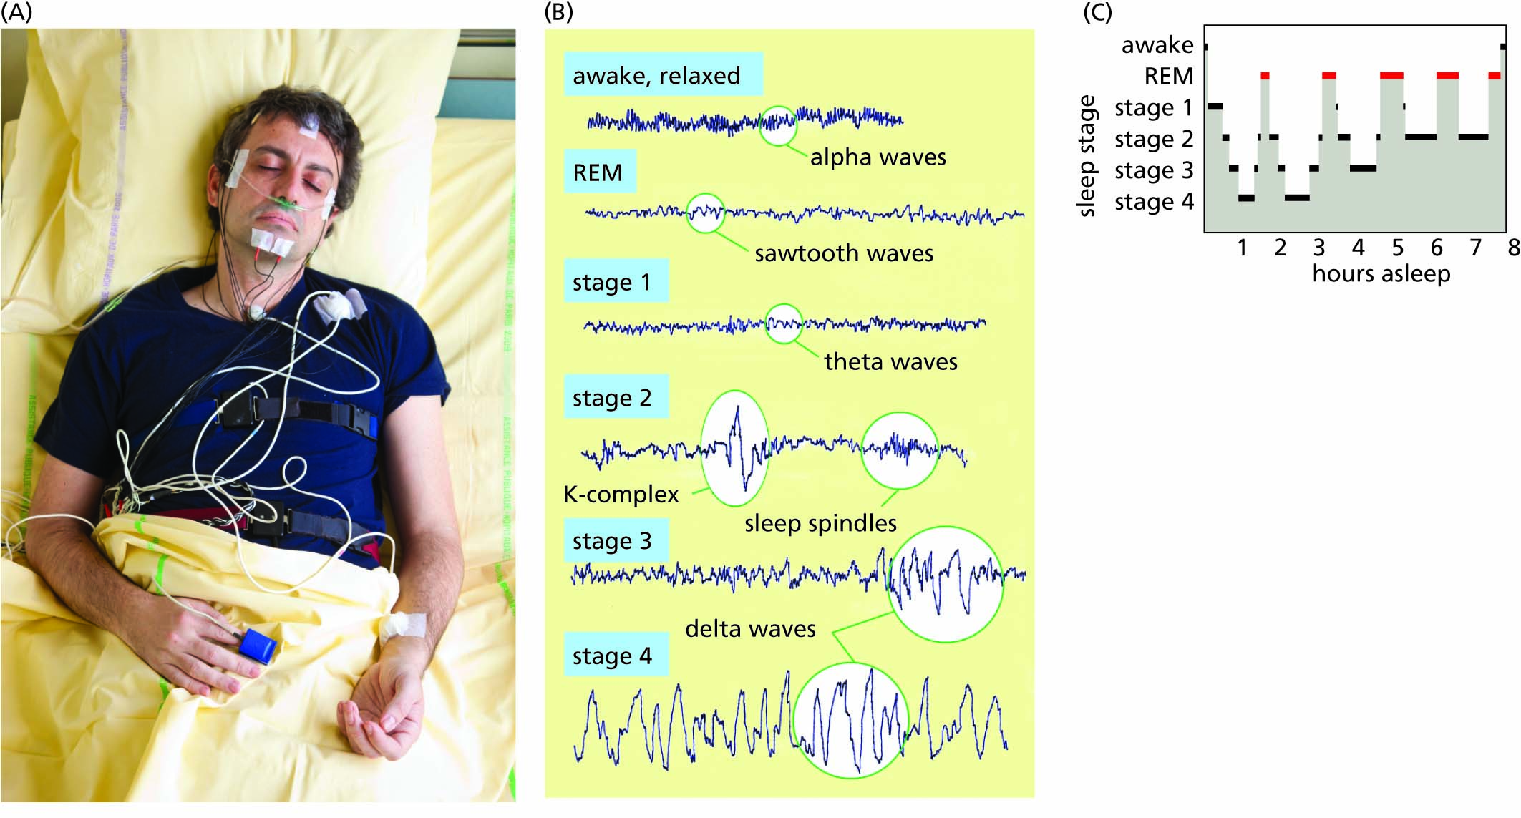
Figure 11.20 Electrical activity in the brain during different stages of sleep.

Slide 28
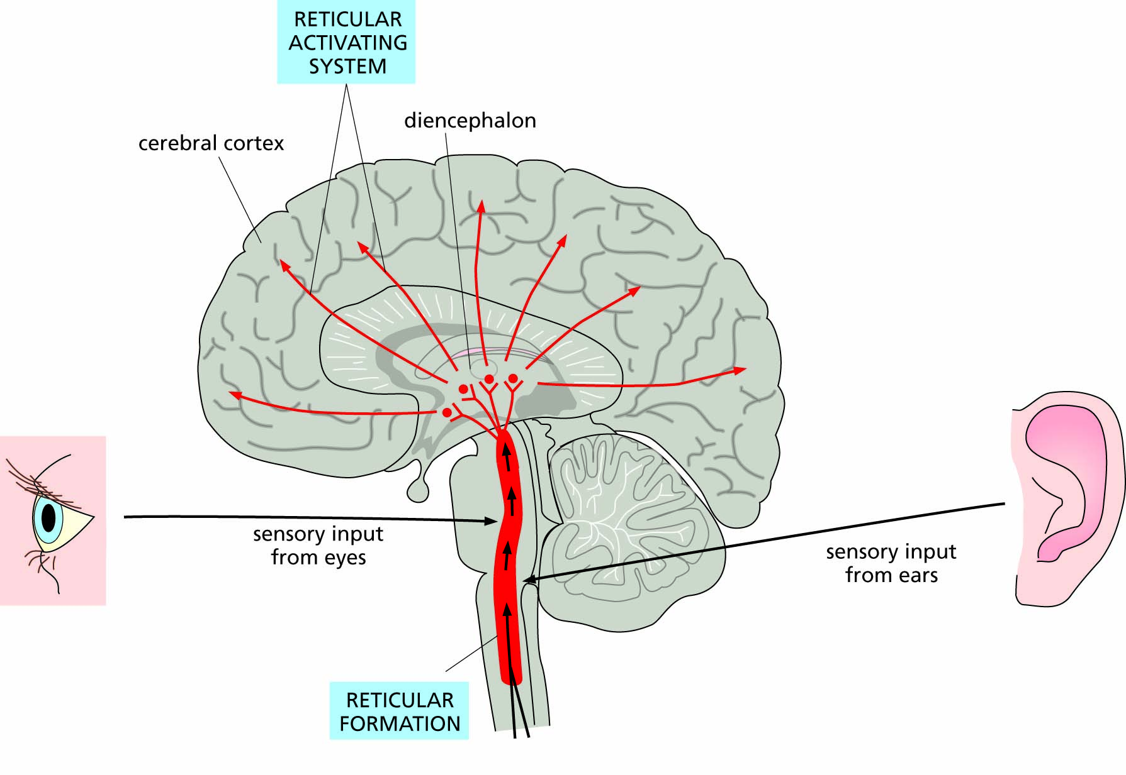
Figure 11.21 The reticular activating system.

Slide 29
Mental illness and neurotransmitters in the brain
Depression and serotonin
Schizophrenia and dopamine

