Slide 1
Chapter 7: Human Variation
Biology Trending, 4e
Eli Minkoff and Jennifer Hood-DeGrenier

Slide 2
There is biological variation both within and between human populations
Continuous and discontinuous variation within populations
Variation between populations
Concepts of race
based on culture
based on morphology
based on population genetics
“all one race”
The study of human variation

Slide 3
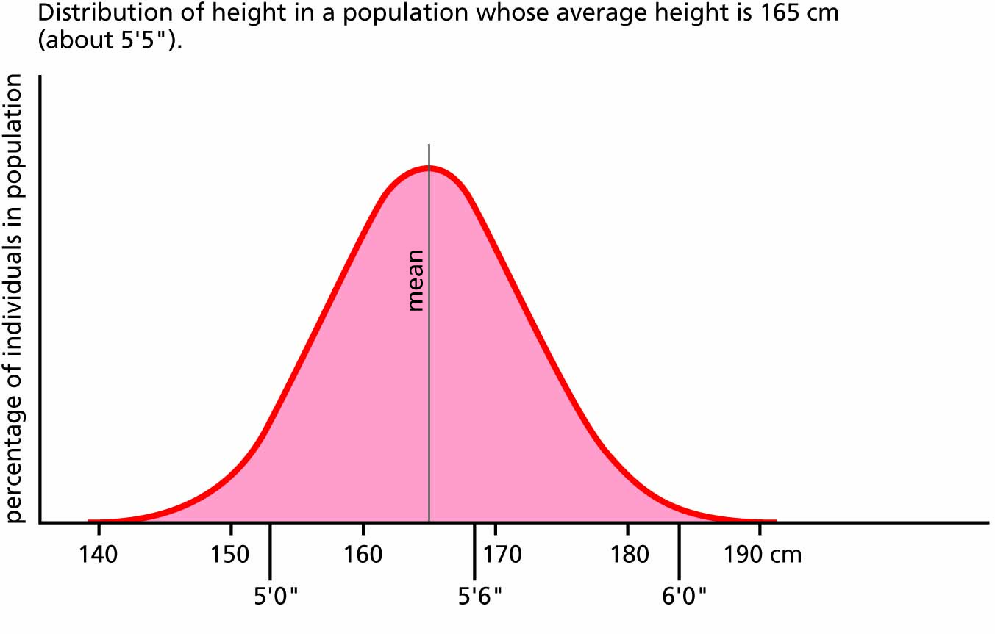
Figure 7.1 Continuous variation in a single population: all intermediate values are possible.

Slide 4
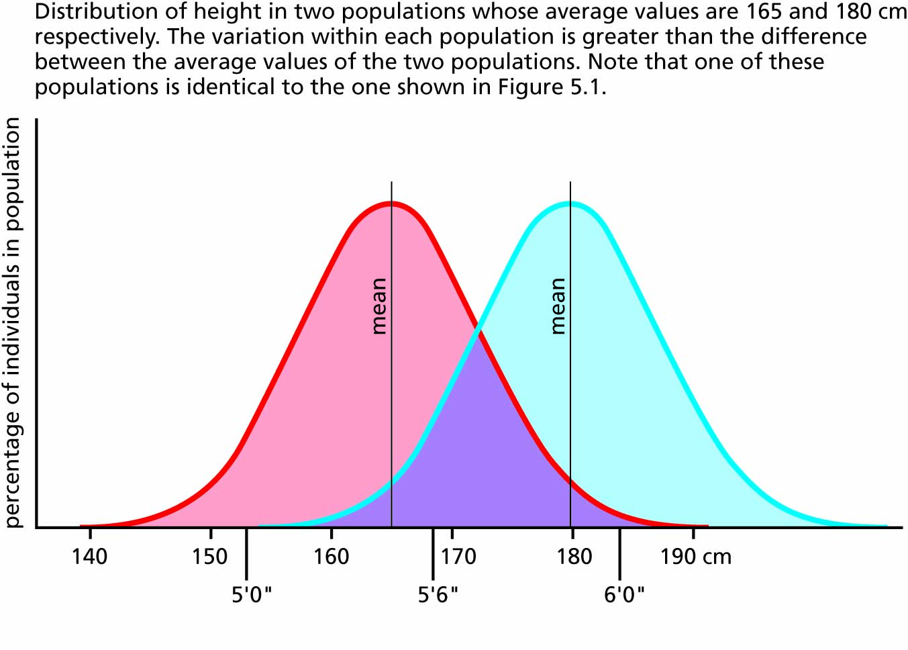
Figure 7.2 Continuous variation in two populations with different mean values.

Slide 5
Population genetics can help us to understand human variation
Human blood groups and geography
Isolated populations and genetic drift
Reconstructing the history of human populations

Slide 6
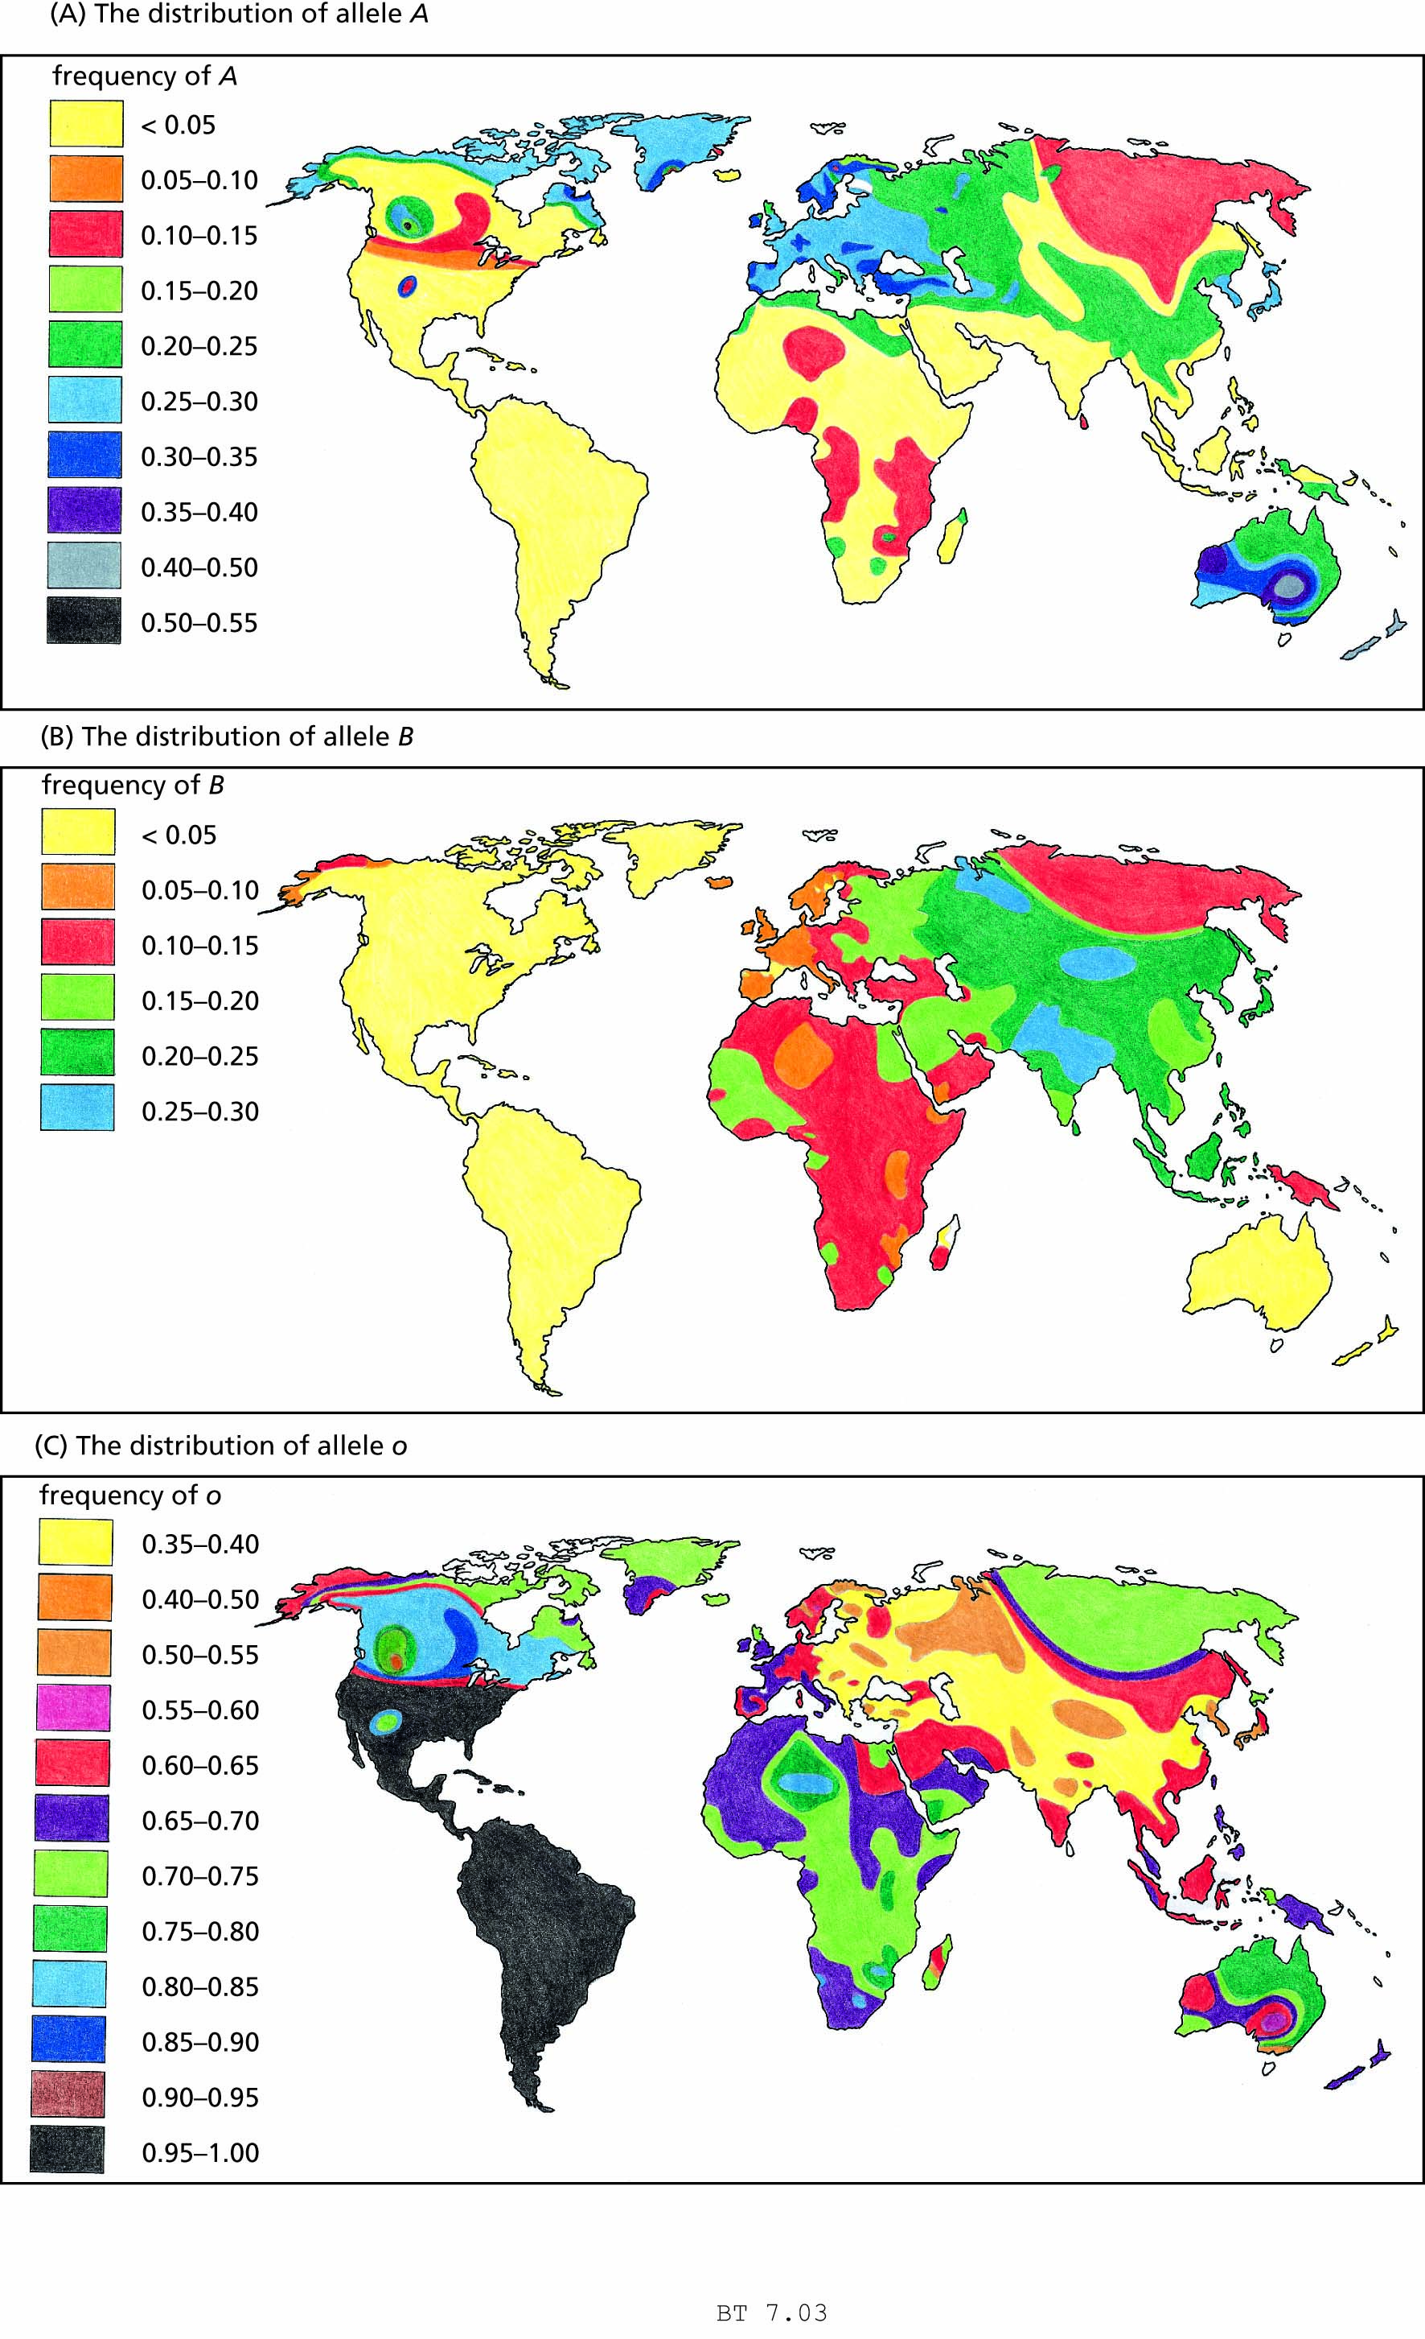
Figure 7.3(A) The clinal distribution of alleles for the ABO blood groups in indigenous populations of the world. Indigenous populations are those that have lived for hundreds or thousands of years in approximately the same region, to which they have had time to evolve adaptations. This includes Native Americans in the Western Hemisphere, Bantu and Xhoisan peoples in southern Africa, and Aborigines in Australia, but not the European colonists who came to these places after the year 1500.

Slide 9
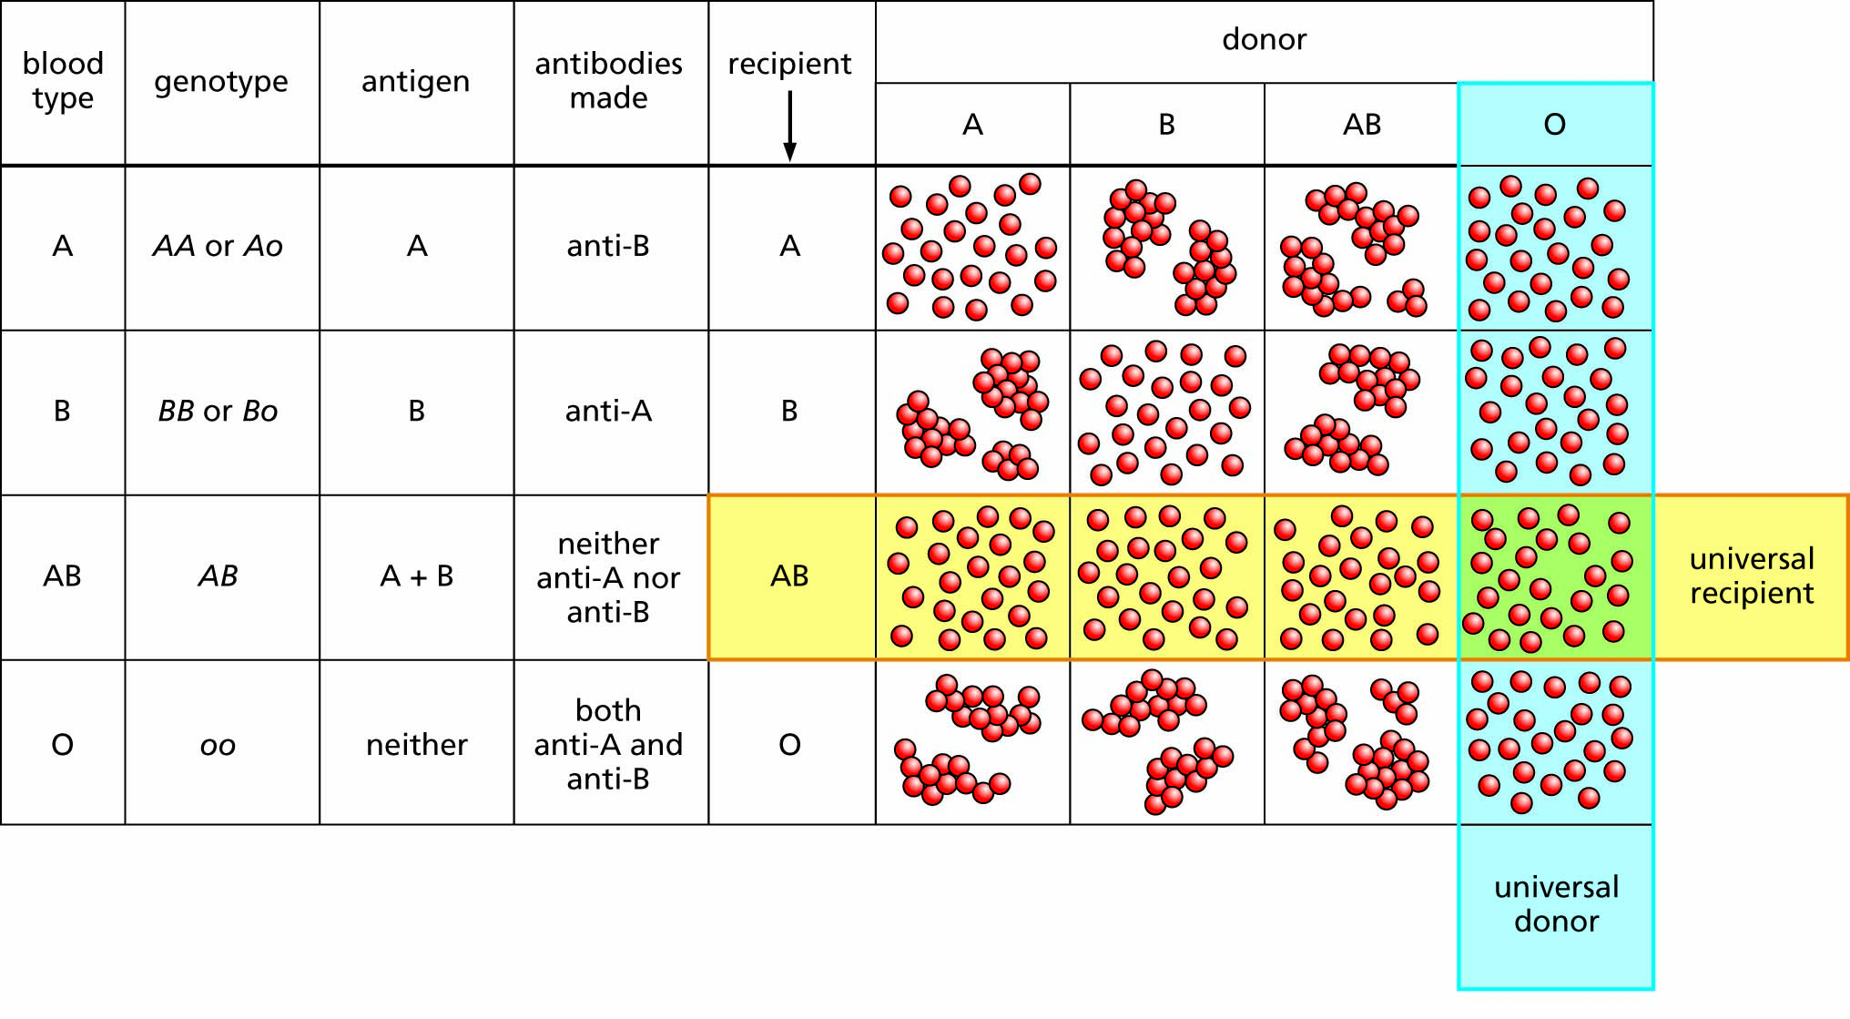
Figure 7.4 The human ABO blood groups. If a person of blood type A, who makes antibodies against blood type B, receives a transfusion of type B or AB blood, those antibodies cause the donated blood cells to clump together. Transfusion with matched blood or with blood type O (no A or B antigens) does not cause clumping.

Slide 10
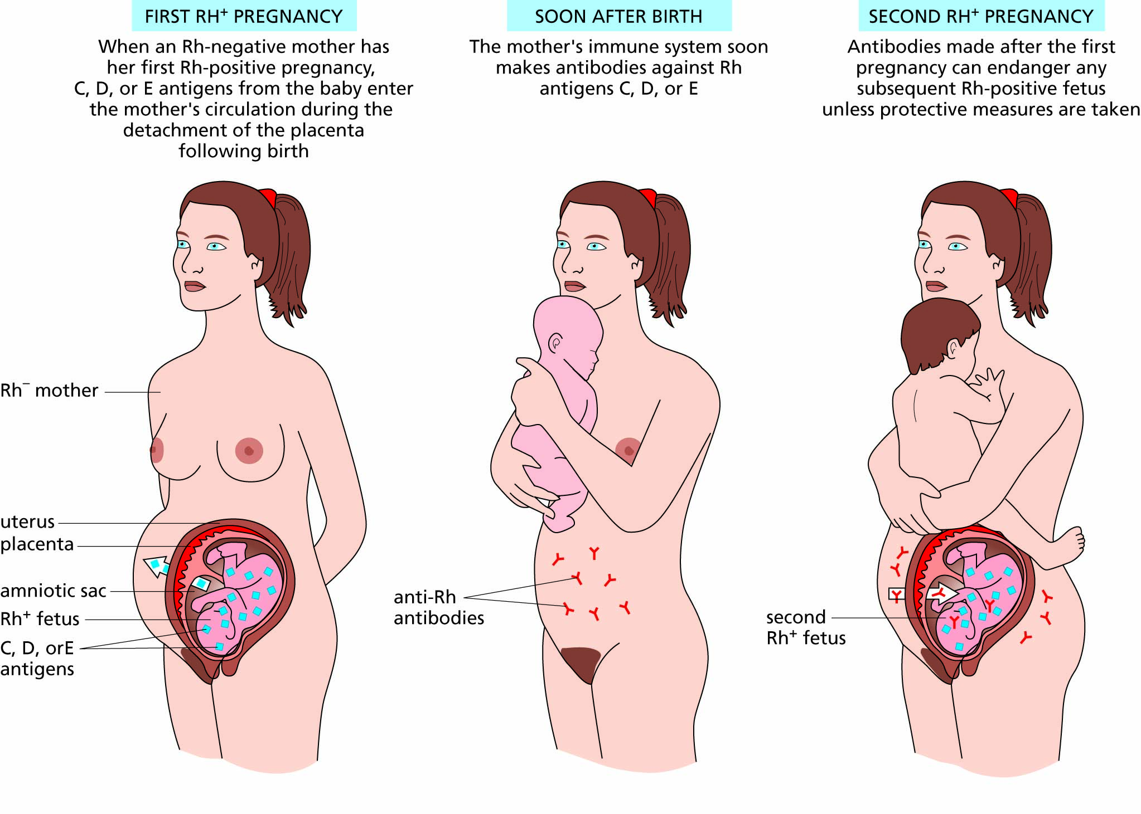
Figure 7.5 Rh incompatibility arising in an Rh-negative mother pregnant with an Rh-positive child.

Slide 11
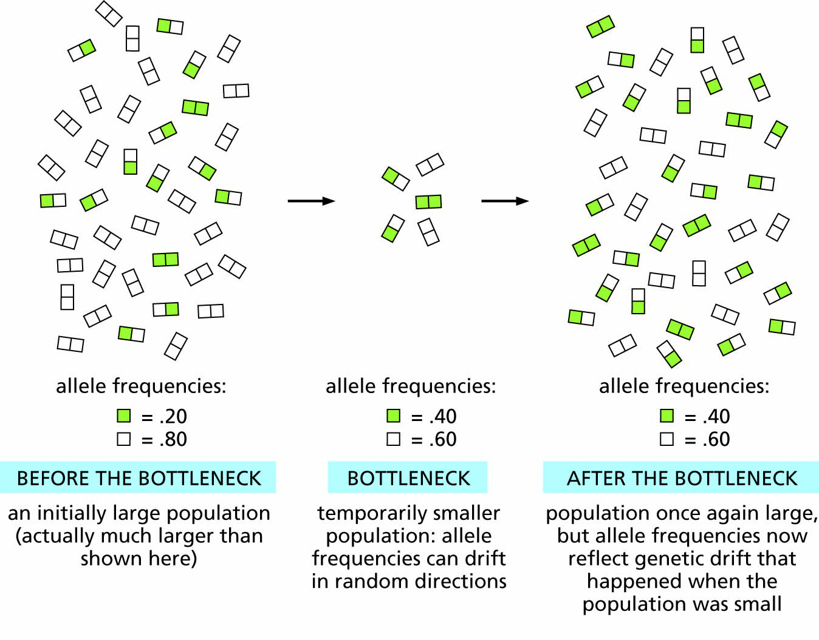
Figure 7.6 The bottleneck effect, a form of genetic drift that originates when populations are temporarily small.

Slide 12
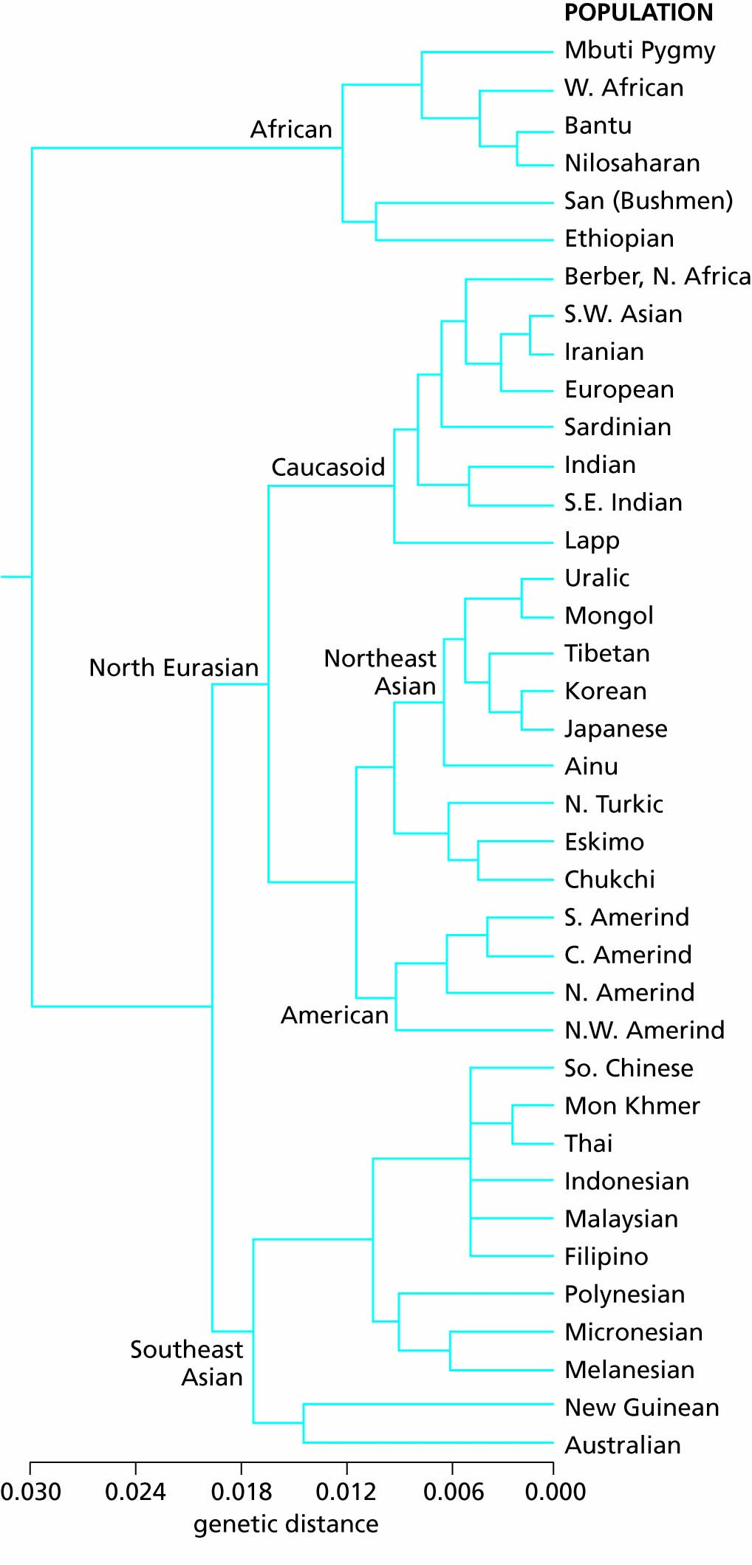
Figure 7.7 A family tree of human populations constructed on the basis of mitochondrial DNA sequences. ‘Genetic distance’ refers to the fraction of mitochondrial DNA sequence not shared by two populations, so that a fork at a genetic distance of 0.006 means that the populations share 99.4% of their mitochondrial DNA sequences.

Slide 13
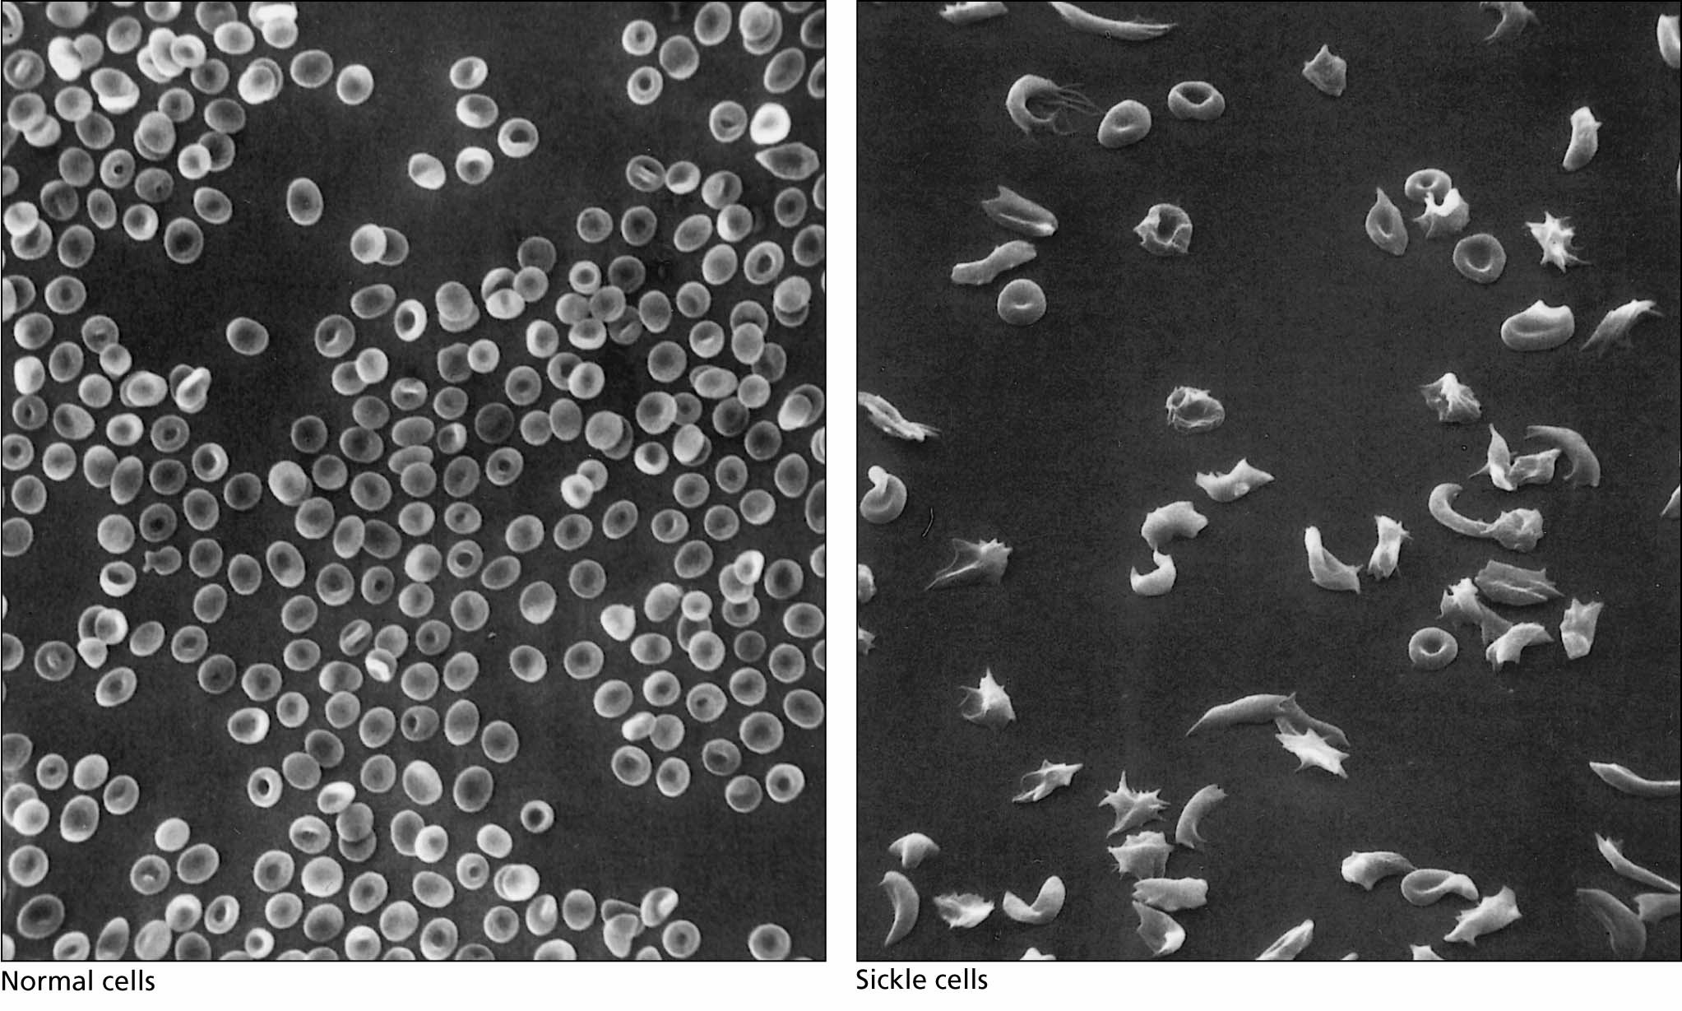
Figure 7.8 Normal red blood cells and red blood cells from a patient with sickle-cell anemia.

Slide 14
Malaria and other diseases are agents of natural selection
Malaria
Sickle-cell anemia and resistance to malaria
Other genetic traits that protect against malaria
Population genetics of malaria resistance
Other diseases as selective factors

Slide 15
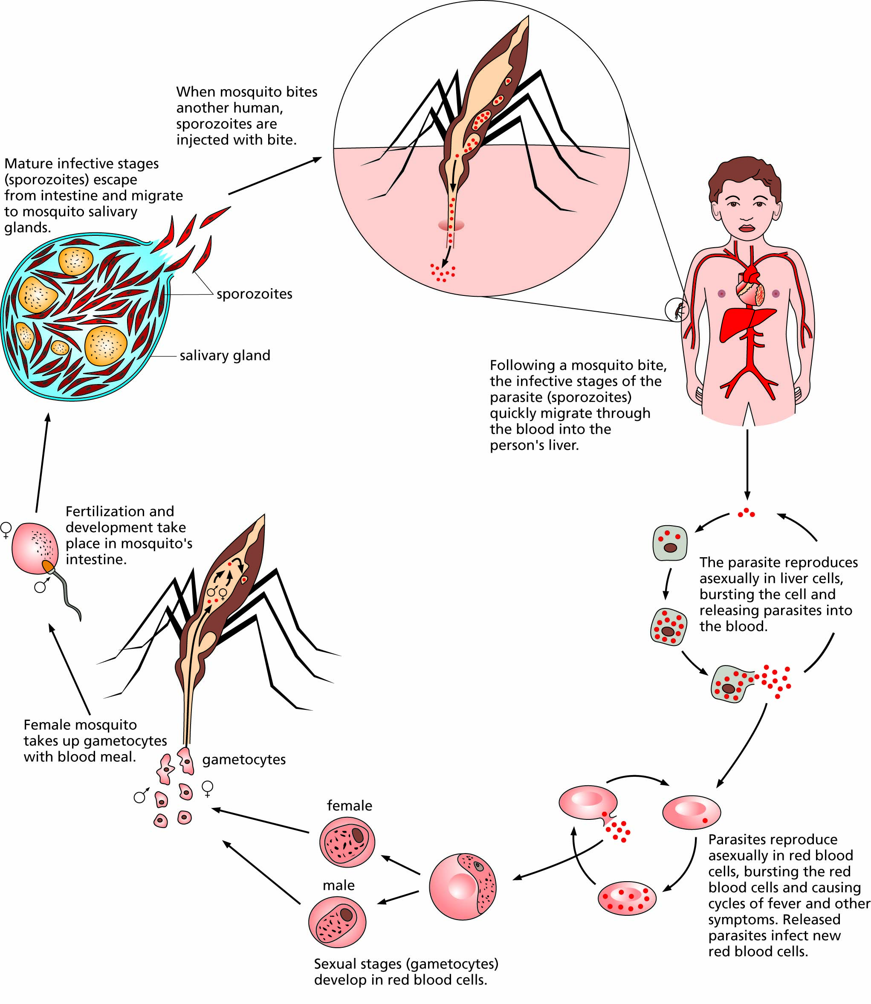
Life cycle of the malaria parasite Plasmodium

Slide 16
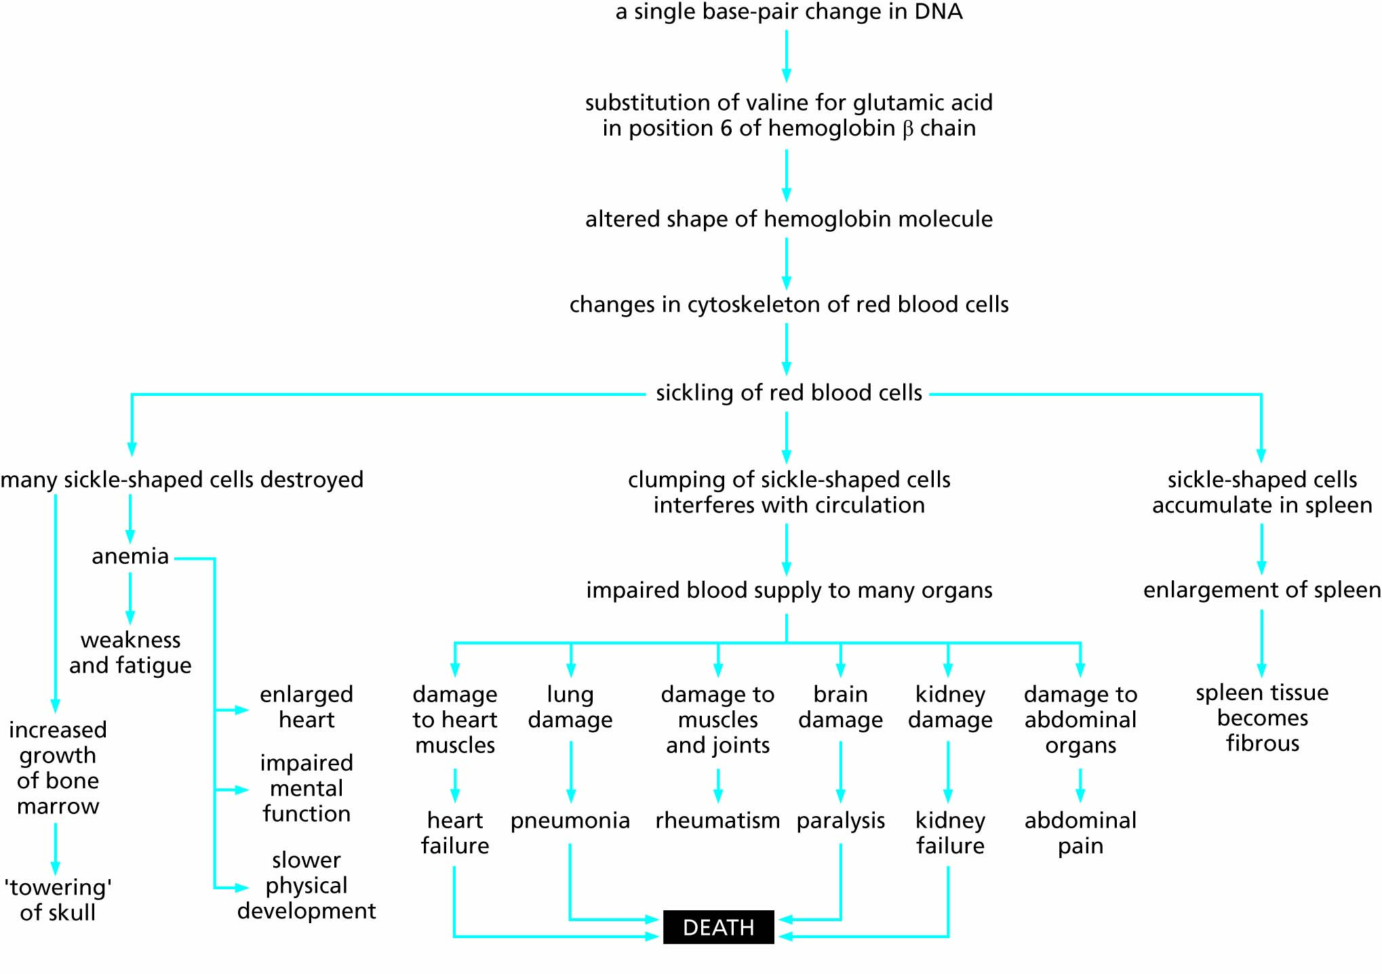
Figure 7.9 Development of the consequences of the Hb^{S} mutation in the hemoglobin gene. A small change in a gene can have many phenotypic consequences.

Slide 17
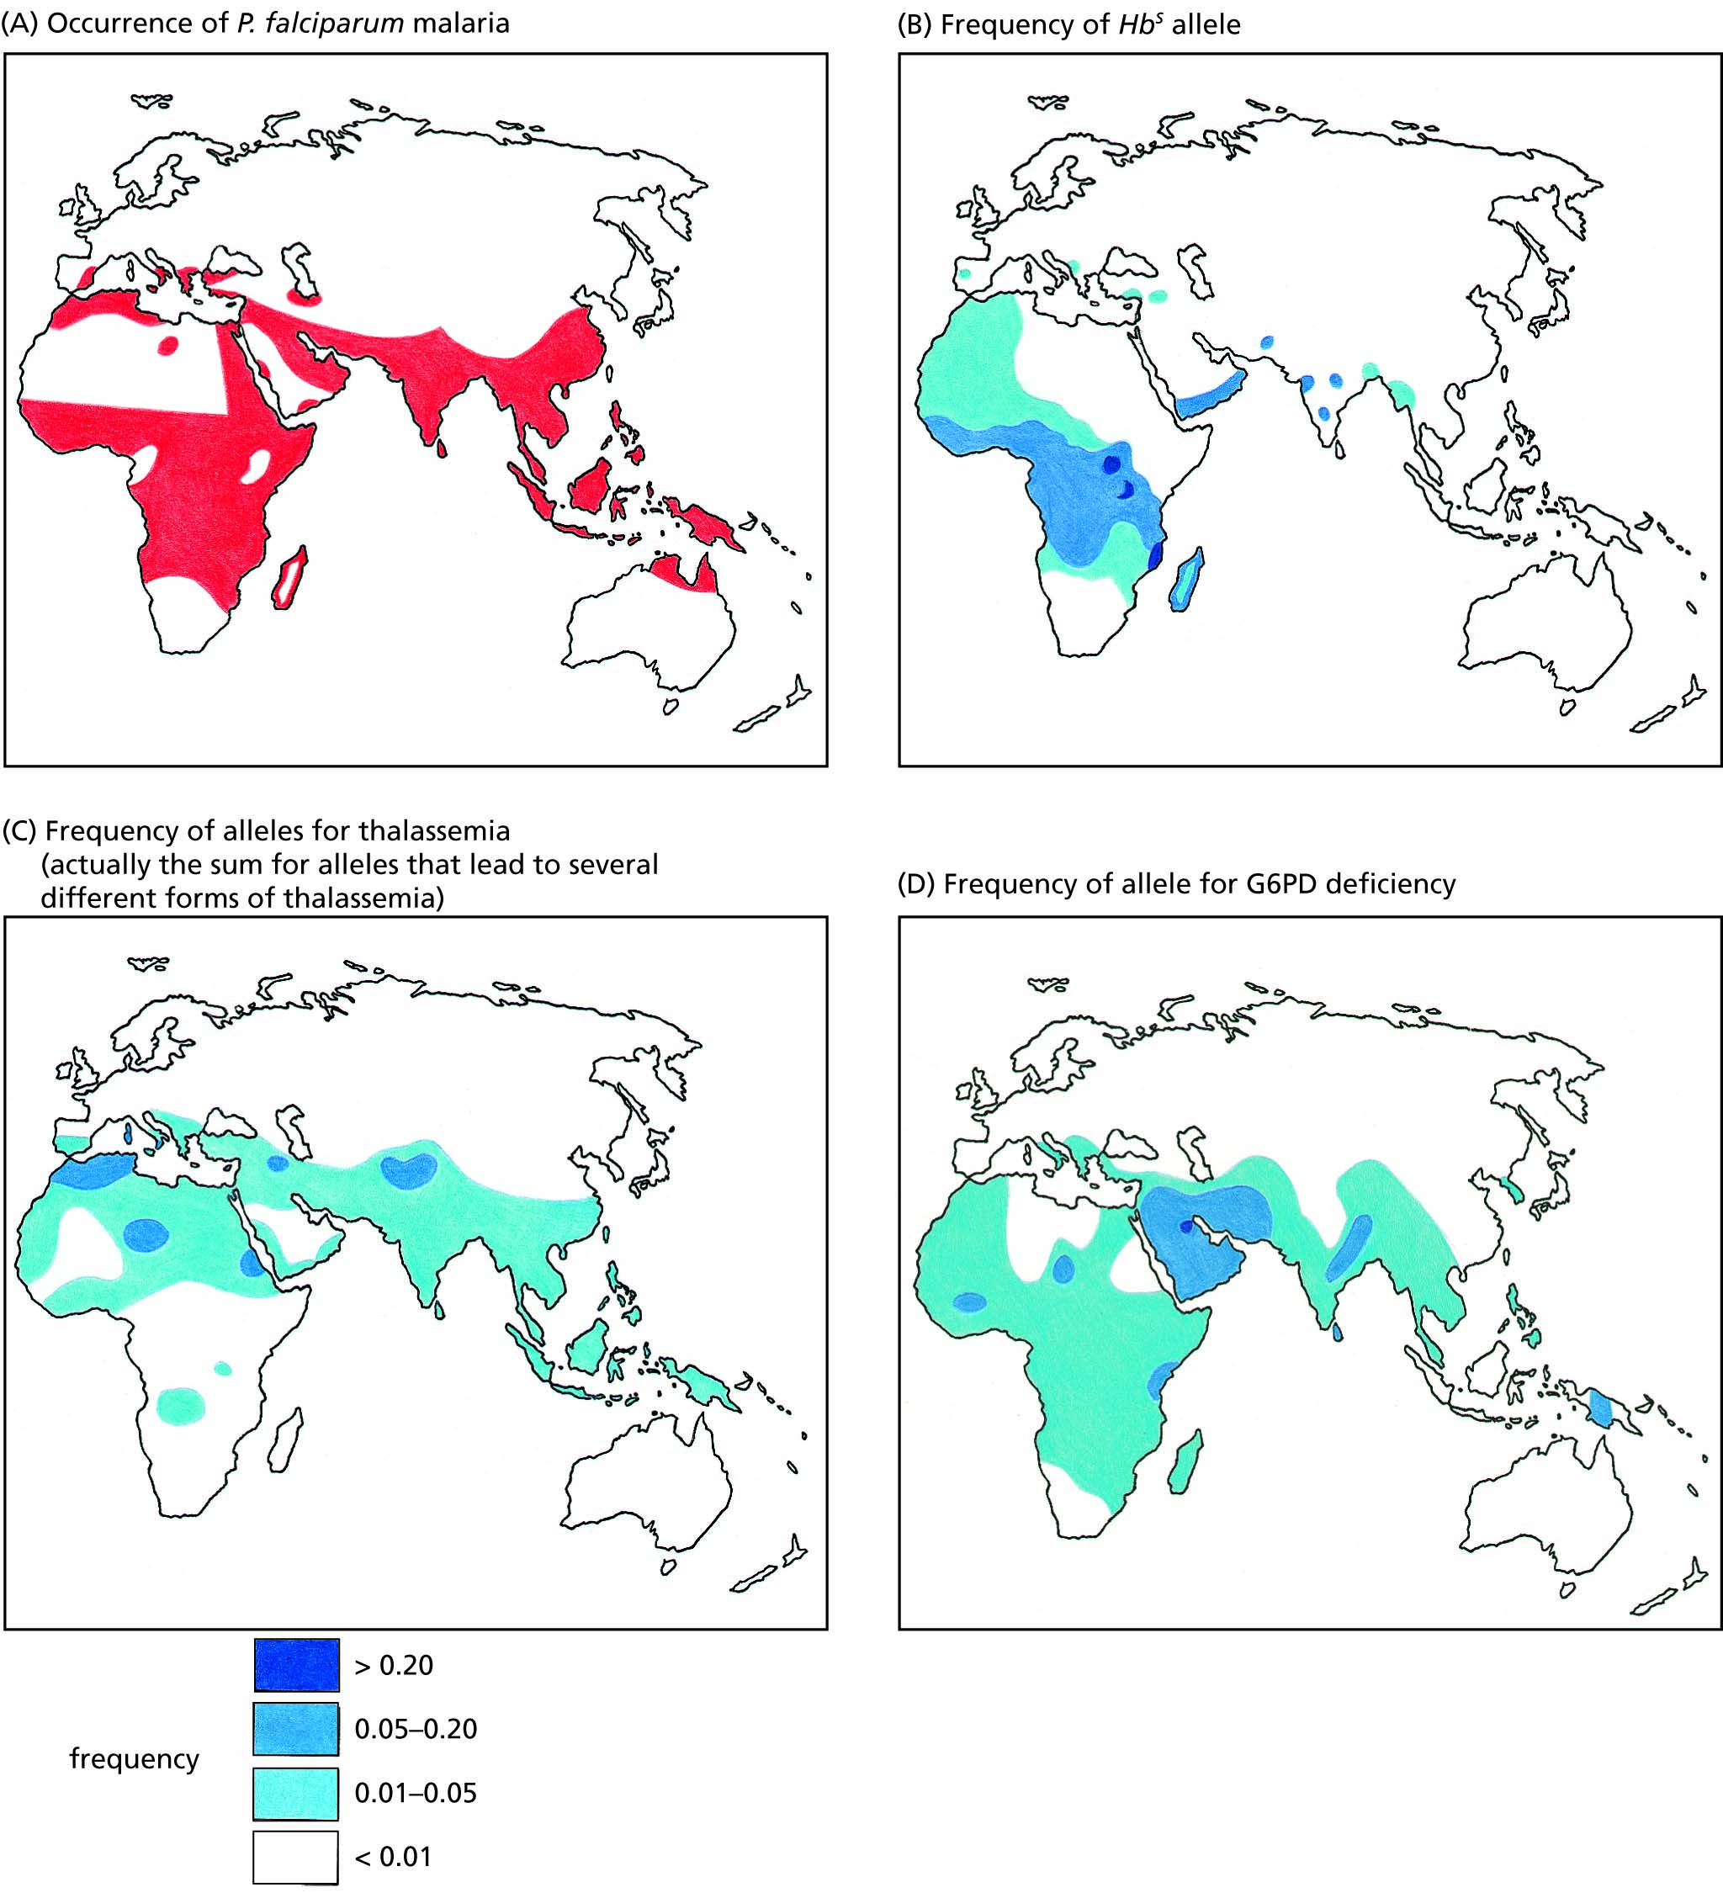
Figure 7.10 Distributions in the Eastern Hemisphere of Plasmodium falciparum malaria and several genetic conditions that protect against it.

Slide 18
Natural selection by physical factors causes more population variation
Human variation in physiology and physique
Natural selection, skin colour and disease resistance

Slide 19
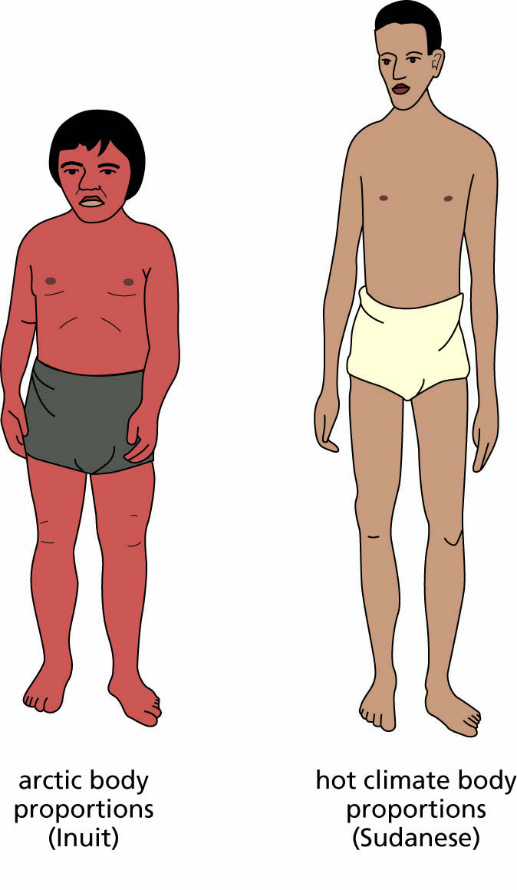
Figure 7.11 Bergmann’s and Allen’s rules illustrated by comparisons between arctic and tropical body forms.

Slide 20
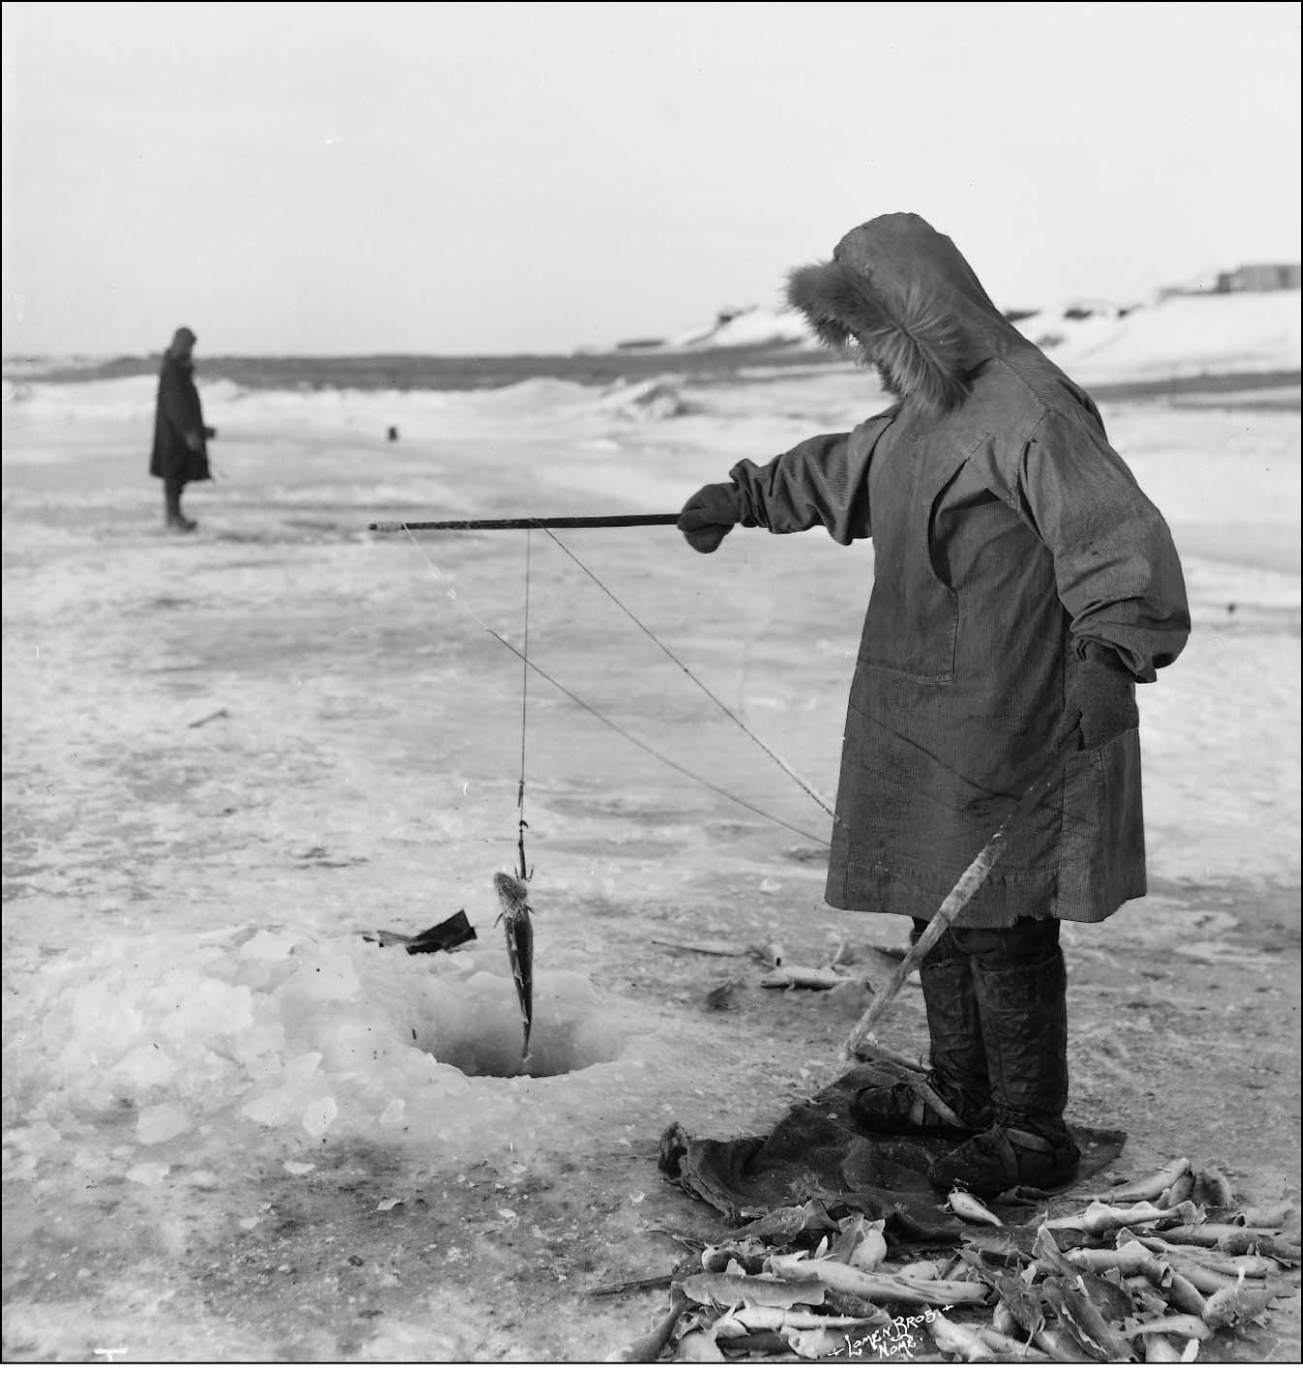
Figure 7.12 Traditional Inuit fishing. The Inuit get most of their vitamin D from eating whole fish, including the liver.

