Slide 1
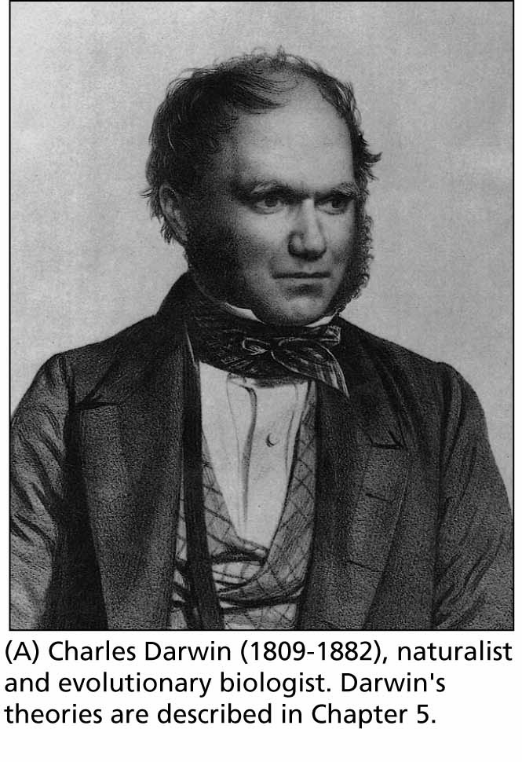
Chapter 5: Evolution
Biology Trending, 4e
Eli Minkoff and Jennifer Hood-DeGrenier

Slide 2
The Darwinian paradigm reorganized biological thought
Pre-Darwinian thought
The “Chain of Being”
Paley and “Natural Theology”
Lamarck: single-file evolution; strong environmental influence
The development of Darwin’s ideas
Family background and education
The voyage of H.M.S. Beagle
Big new idea #1: Branching descent, with modification
Malthus, animal breeders, etc.
Big new idea #2: Natural selection
Wallace and Darwin’s publication
Linnaean Society papers (1858)
On the Origin of Species (1859)
Quick acceptance of Branching Descent with Modification
Slower acceptance of Natural Selection

Slide 3
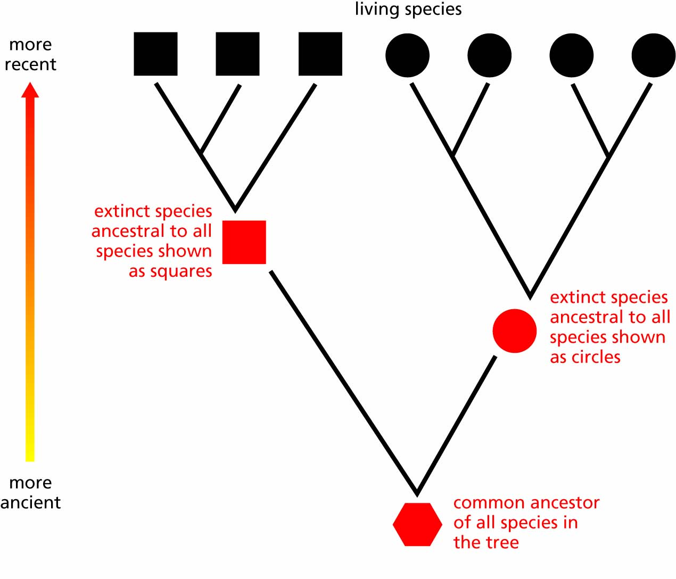
Figure 5.1 The pattern of branching descent. Living species in the top row are descended from the ancestors below them. The red circle represents the common ancestor to all other circles, and the red square is likewise ancestral to all the squares. The red hexagonal shape at the bottom is ancestral to all species shown in this family tree. In a classification, all the squares would be placed in one group and all the circles in another.

Slide 4
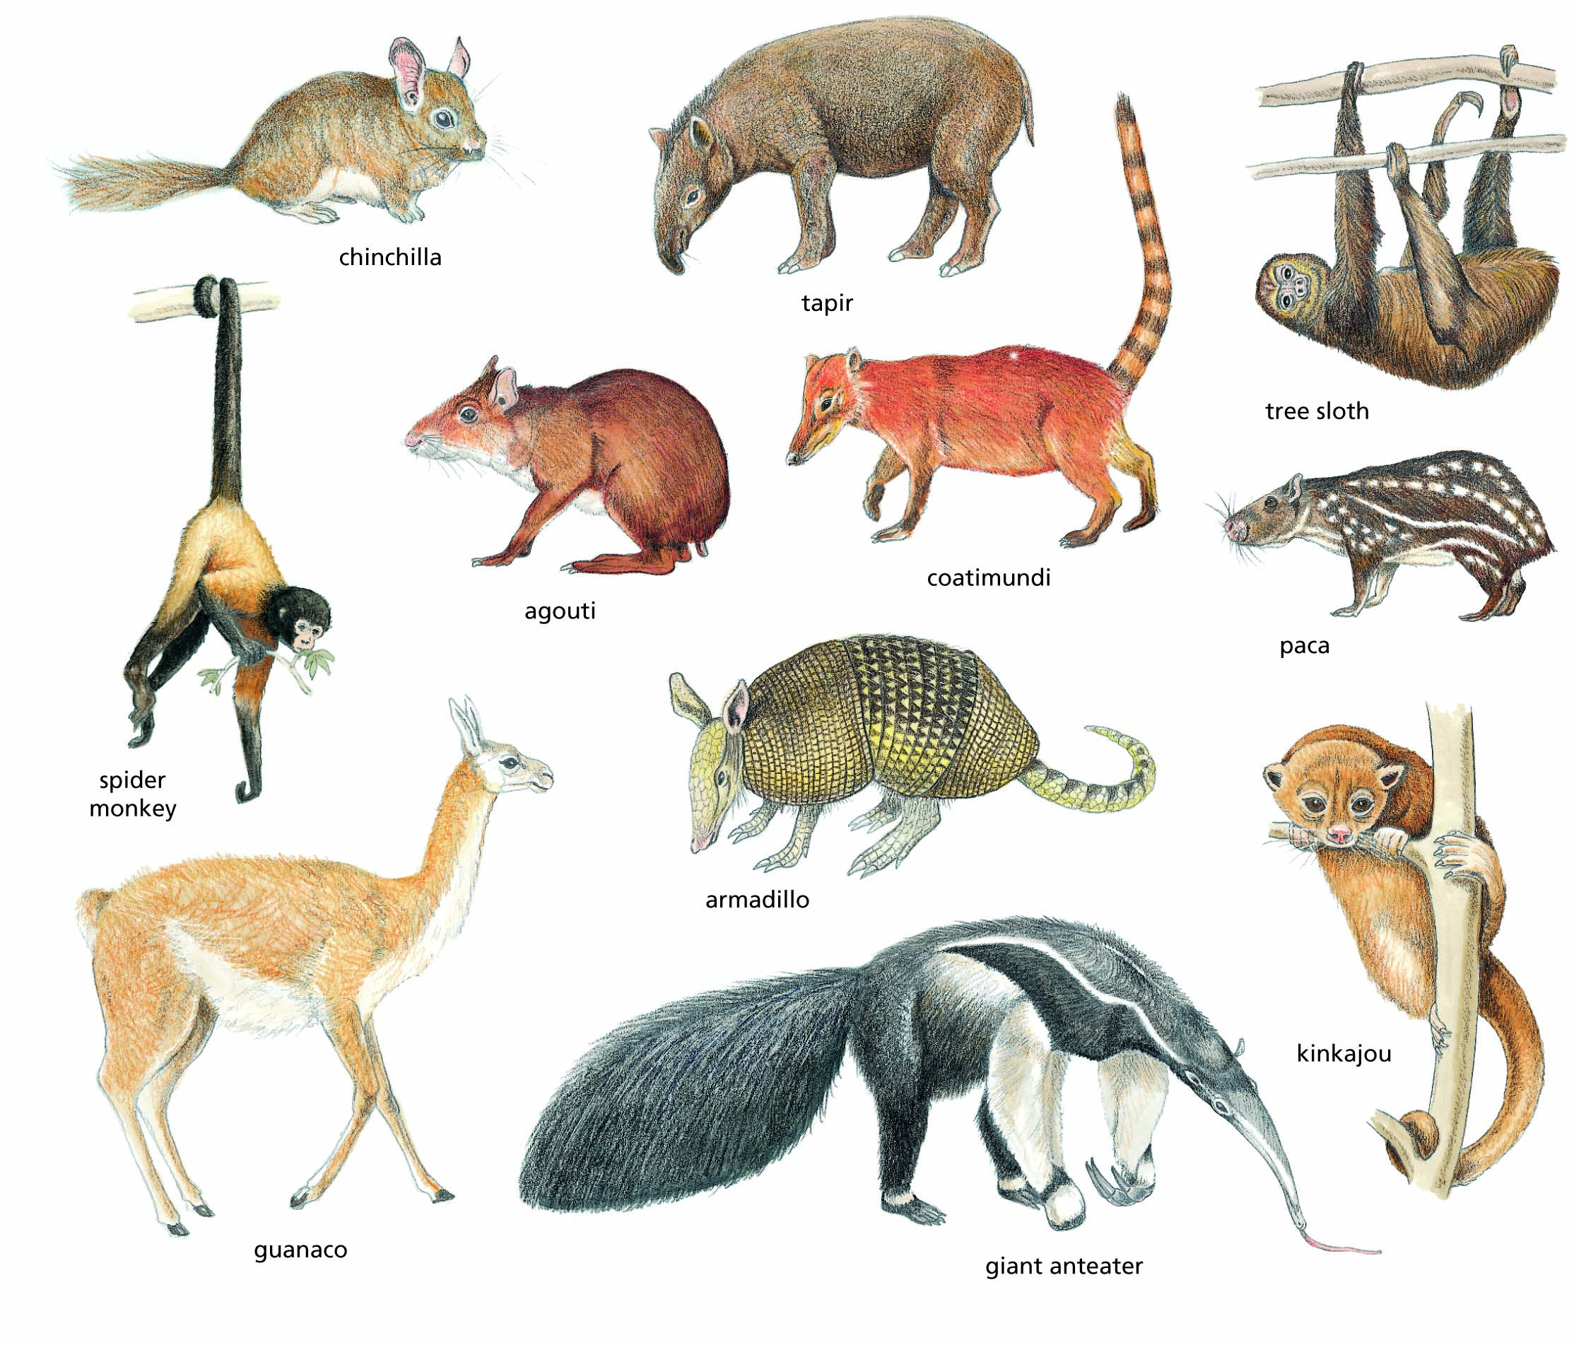
Figure 5.2 An assortment of South American mammals. These species are very different from the mammals found on other continents, even where climates are similar.

Slide 5
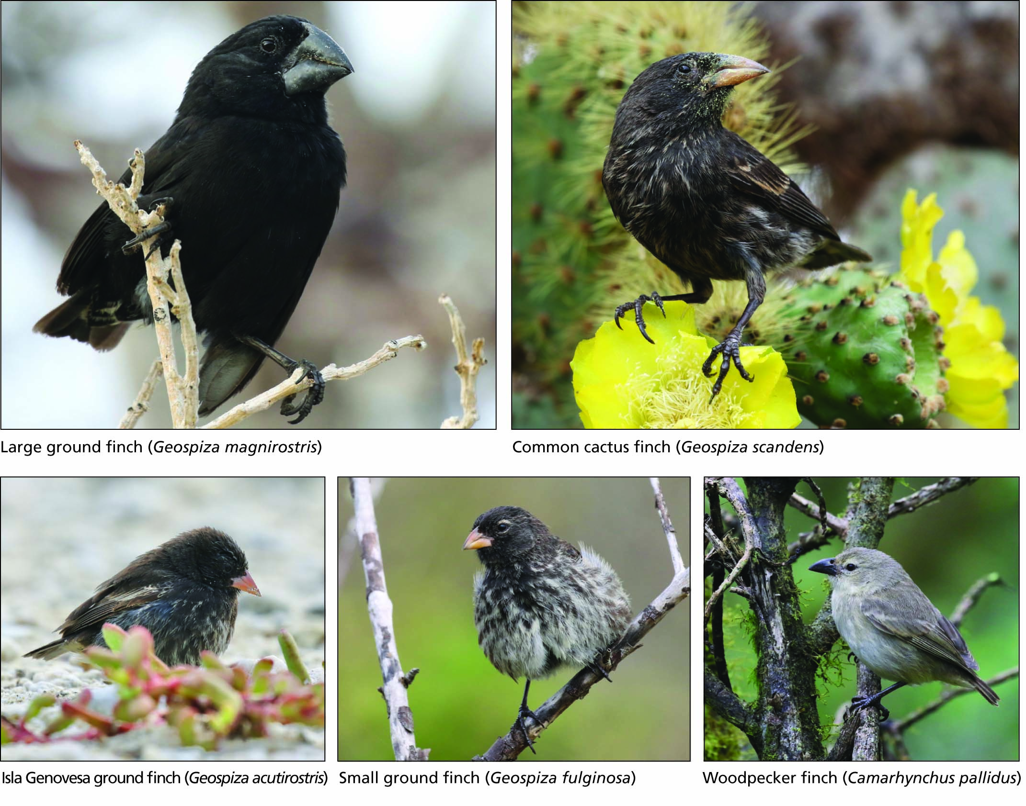
Figure 5.3 Five species of Darwin’s finches from the Galapagos Islands. All photos by Jonah Benningfield.

Slide 6
“I am almost convinced
(quite contrary to the opinion I started with)
that species are not
(it is like confessing to a murder)
Immutable.”
--Charles Darwin, letter to Joseph Hooker, 1844

Slide 7
Darwin argues against Paley’s ideas:
"As man can produce … a great result by his methodical and unconscious means of selection, what may not nature effect?
Man can act only on external and visible characters:
nature ... can act on every internal organ, on every shade of
constitutional difference, on the whole machinery of life.
Man selects only for his own good; Nature only for the being which she tends....

Slide 8
How fleeting are the wishes and efforts of man! how short his time! and consequently how poor will his products be, compared with those accumulated by nature during whole geological periods.
Can we wonder, then, that nature's productions should be far 'truer' in character; that they should be infinitely better adapted to the most complex conditions of life,
and should plainly bear the stamp of far higher workmanship?"
--Darwin, On the Origin of Species, p. 83-84

Slide 9
Darwin argues against both Lamarck’s ideas and Paley’s:
"With respect to the absence of whole orders on oceanic islands, Bory St. Vincent long ago remarked that ... frogs, toads, [and] newts have never been found on any of the many islands with which the great oceans are studded…
This general absence of frogs, toads, and newts on so many oceanic islands cannot be accounted for by their physical conditions [as environmentalist theories such as Lamarck's would claim]; indeed, it seems that islands are particularly well fitted for these animals; for frogs have been introduced into Madeira, the Azores, and Mauritius, and have multiplied so as to become a nuisance.

Slide 10
But as these animals and their spawn are known to be immediately killed by sea-water, on my view we can see that there would be great difficulty in their transportal across the sea, and therefore why they do not exist on any oceanic island.
But why, on the theory of creation, they should not have been created there, it would be very difficult to explain."
--Darwin, On the Origin of Species, p. 392-393

Slide 11
Darwin again argues against both Lamarck’s ideas and Paley’s:
"The most striking and important fact for us in regard to the inhabitants of islands, is their affinity to those of the nearest mainland, without being actually the same species.
Numerous instances could be given.... I will give only one, that of the Galapagos Archipelago.... Here, almost every product of the land and water bears the unmistakeable stamp of the American continent…
The naturalist, looking at the inhabitants of these volcanic islands in the Pacific, distant several hundred miles from the continent, yet feels that he is standing on American land. Why should this be so? Why should the species which are supposed to be created in the Galapagos Archipelago, and nowhere else, bear so plain a stamp of affinity to those created in America?

Slide 12
There is nothing in the conditions of life, in the geologic nature of the islands, in their height or climate..., which resembles closely the conditions of the South American coast: in fact, there is a considerable dissimilarity in all of these respects. On the other hand, there is a considerable degree of resemblance in the volcanic nature of the soil, in climate, height, and size of the islands, between the Galapagos and Cape de Verde archipelagoes: but what an entire and absolute difference in their inhabitants!
The inhabitants of the Cape de Verde Islands are related to those of Africa,
like those of the Galapagos to America. I believe this grand fact can receive
no sort of explanation on the ordinary view of independent creation;
whereas on the view here maintained, it is obvious that the Galapagos Islands
would be likely to receive colonists... from America, and the Cape de Verde Islands
from Africa, and that such colonists would be liable to modification;
the principle of inheritance still betraying their original birthplace."
--Darwin, On the Origin of Species, p. 397-399

Slide 13
Darwin explains natural selection:
"Can it, then, be thought improbable ... that other variations
useful in some way to each being in the great and complex battle of life, should sometimes occur in the course of thousands of generations?
If such do occur, can we doubt (remembering that many more individuals are born than can possibly survive) that individuals having any advantage, however slight, over others, would have the best chance of surviving and of procreating their kind?
On the other hand, we may feel sure that any variation that is in the least degree injurious would be rigidly destroyed.
This preservation of favoured variations, and the rejection of
injurious variations, I call natural selection."
--Darwin, On the Origin of Species, p. 80-81

Slide 14
Darwin comparing natural and artificial selection:
"We have seen that man by selection can certainly produce great results, and can adapt organic beings to his own uses, through the accumulation of slight but useful variations, given to him by the hand of Nature.
But Natural Selection ... is a power incessantly ready for action,
and is as immeasurably superior to man's feeble efforts as the works of Nature are to those of Art.“
--Darwin, On the Origin of Species, p. 61.

Slide 15
Great deal of evidence supports Darwin’s ideas
Mimicry as evidence for natural selection
Industrial melanism as further evidence for natural selection
Evidence for branching descent
Further evidence from the fossil record
Post-Darwinian thought

Slide 16
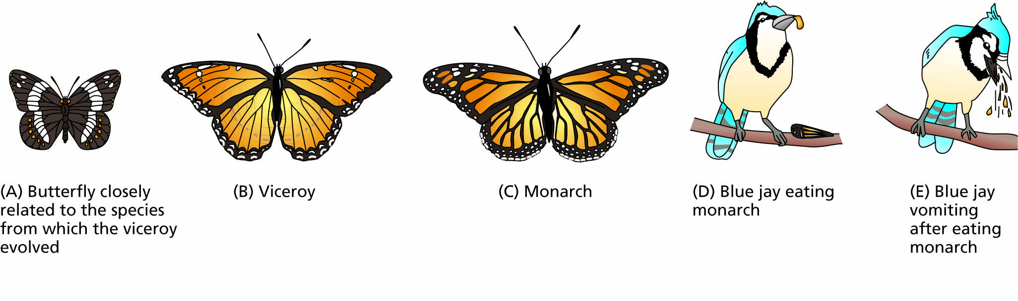
Figure 5.4 An example of mimicry. (A) Limenitis arthemis, a nonmimic relative of (B) Limenitis archippus, the viceroy. The viceroy resembles the unrelated monarch butterfly (C, Danaus plexippus), the model. The monarch is avoided by predators after just a single unpleasant experience (D, E). The warning color pattern of the monarch helps predators learn to avoid it; the viceroy is protected because its color pattern mimics that of the monarch.

Slide 17
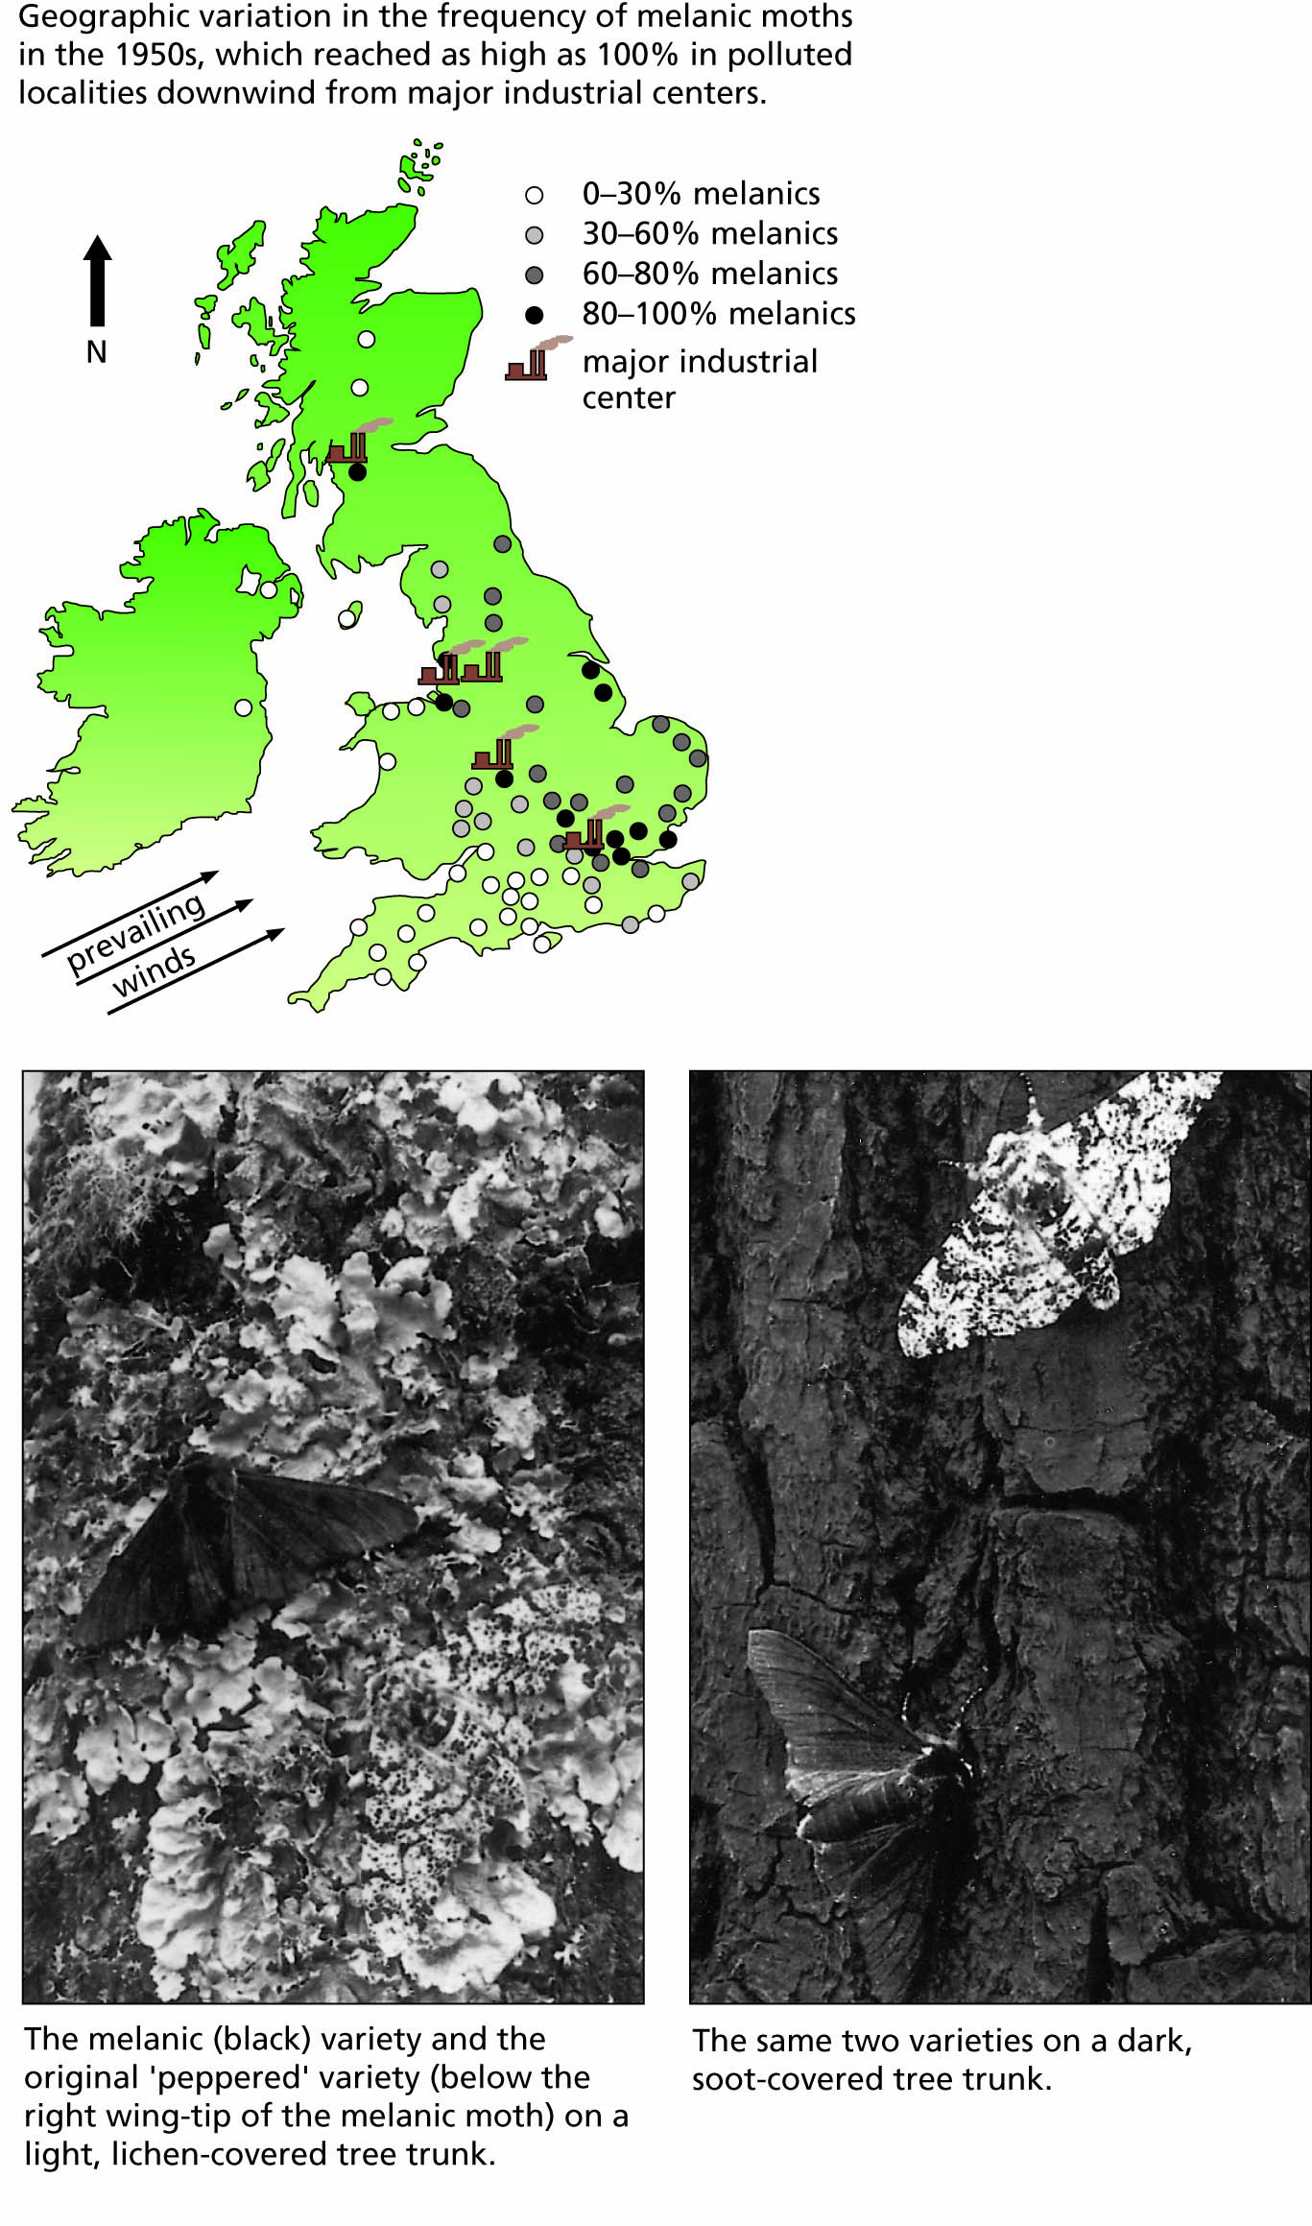
Figure 5.5 Industrial melanism in peppered moths in the British Isles.

Slide 18
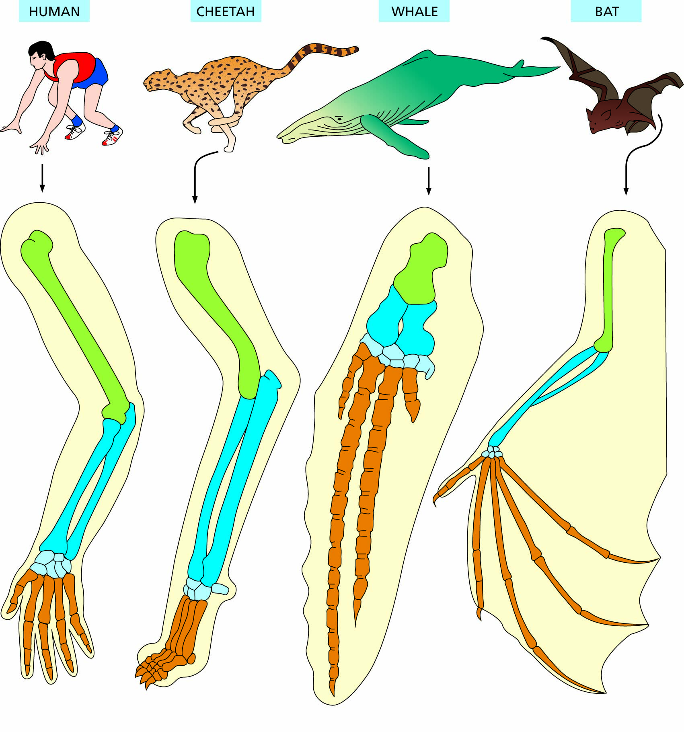
Figure 5.6 Homologies among mammalian forelimbs adapted to different functions.

Slide 19
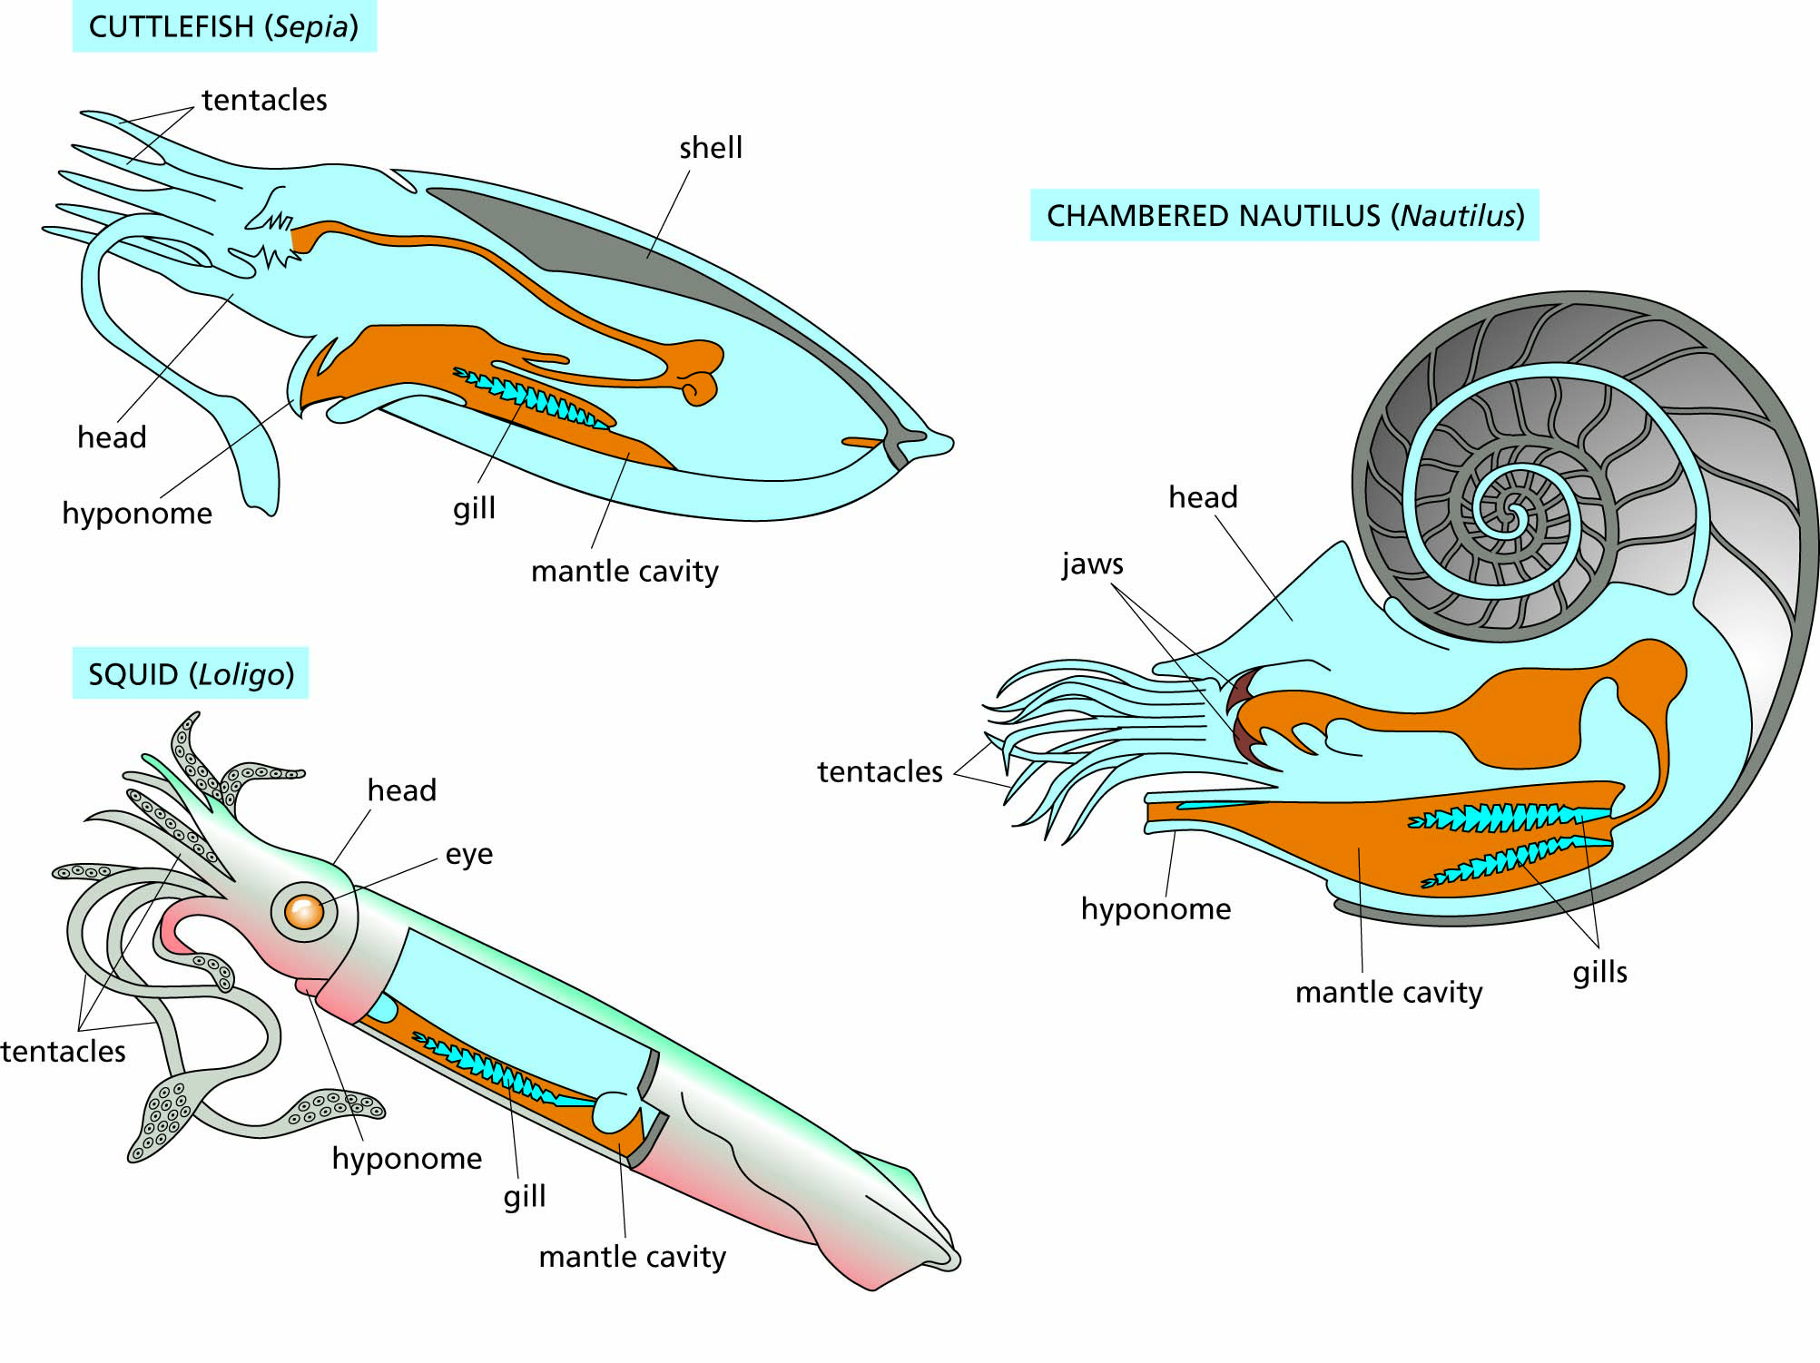
Figure 5.7 Three living types of cephalopod mollusks (kingdom Animalia, phylum Mollusca, class Cephalopoda): the cuttlefish, the squid, and the chambered nautilus.

Slide 20
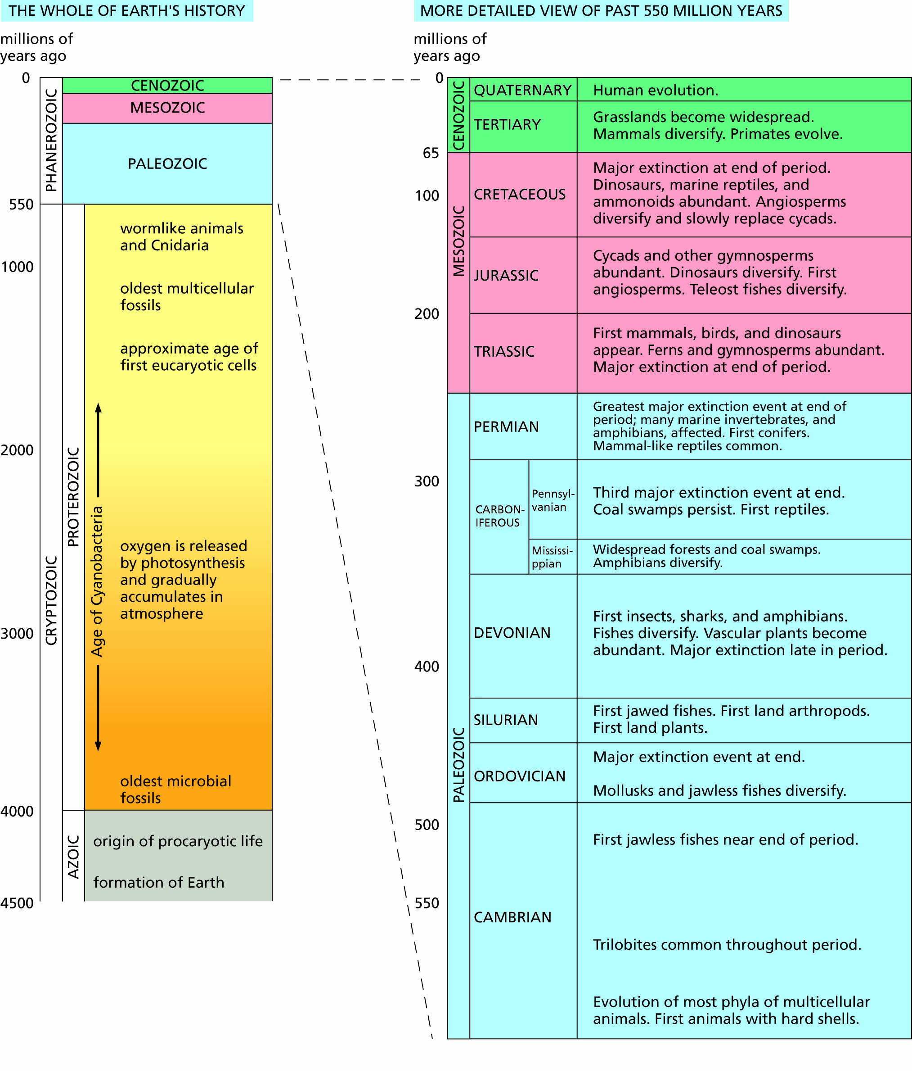
Figure 5.8 The geological time scale.

Slide 21
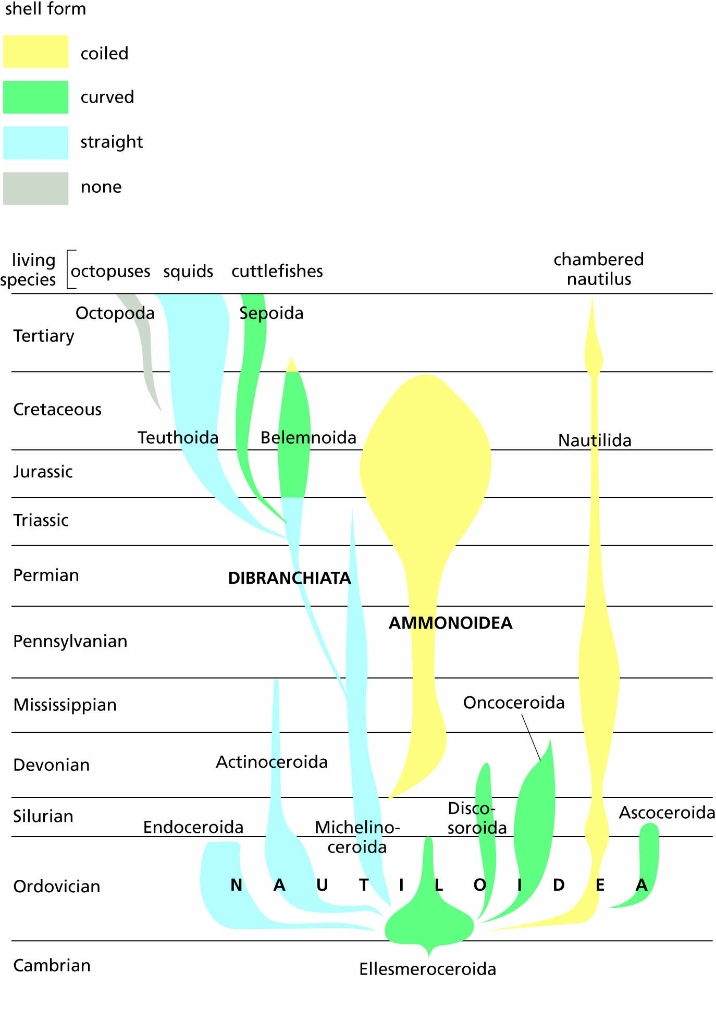
Figure 5.9 Family tree of the class Cephalopoda (phylum Mollusca), showing branching descent over time. Horizontal width represents number of species in each group; vertical distance represents time.

Slide 22
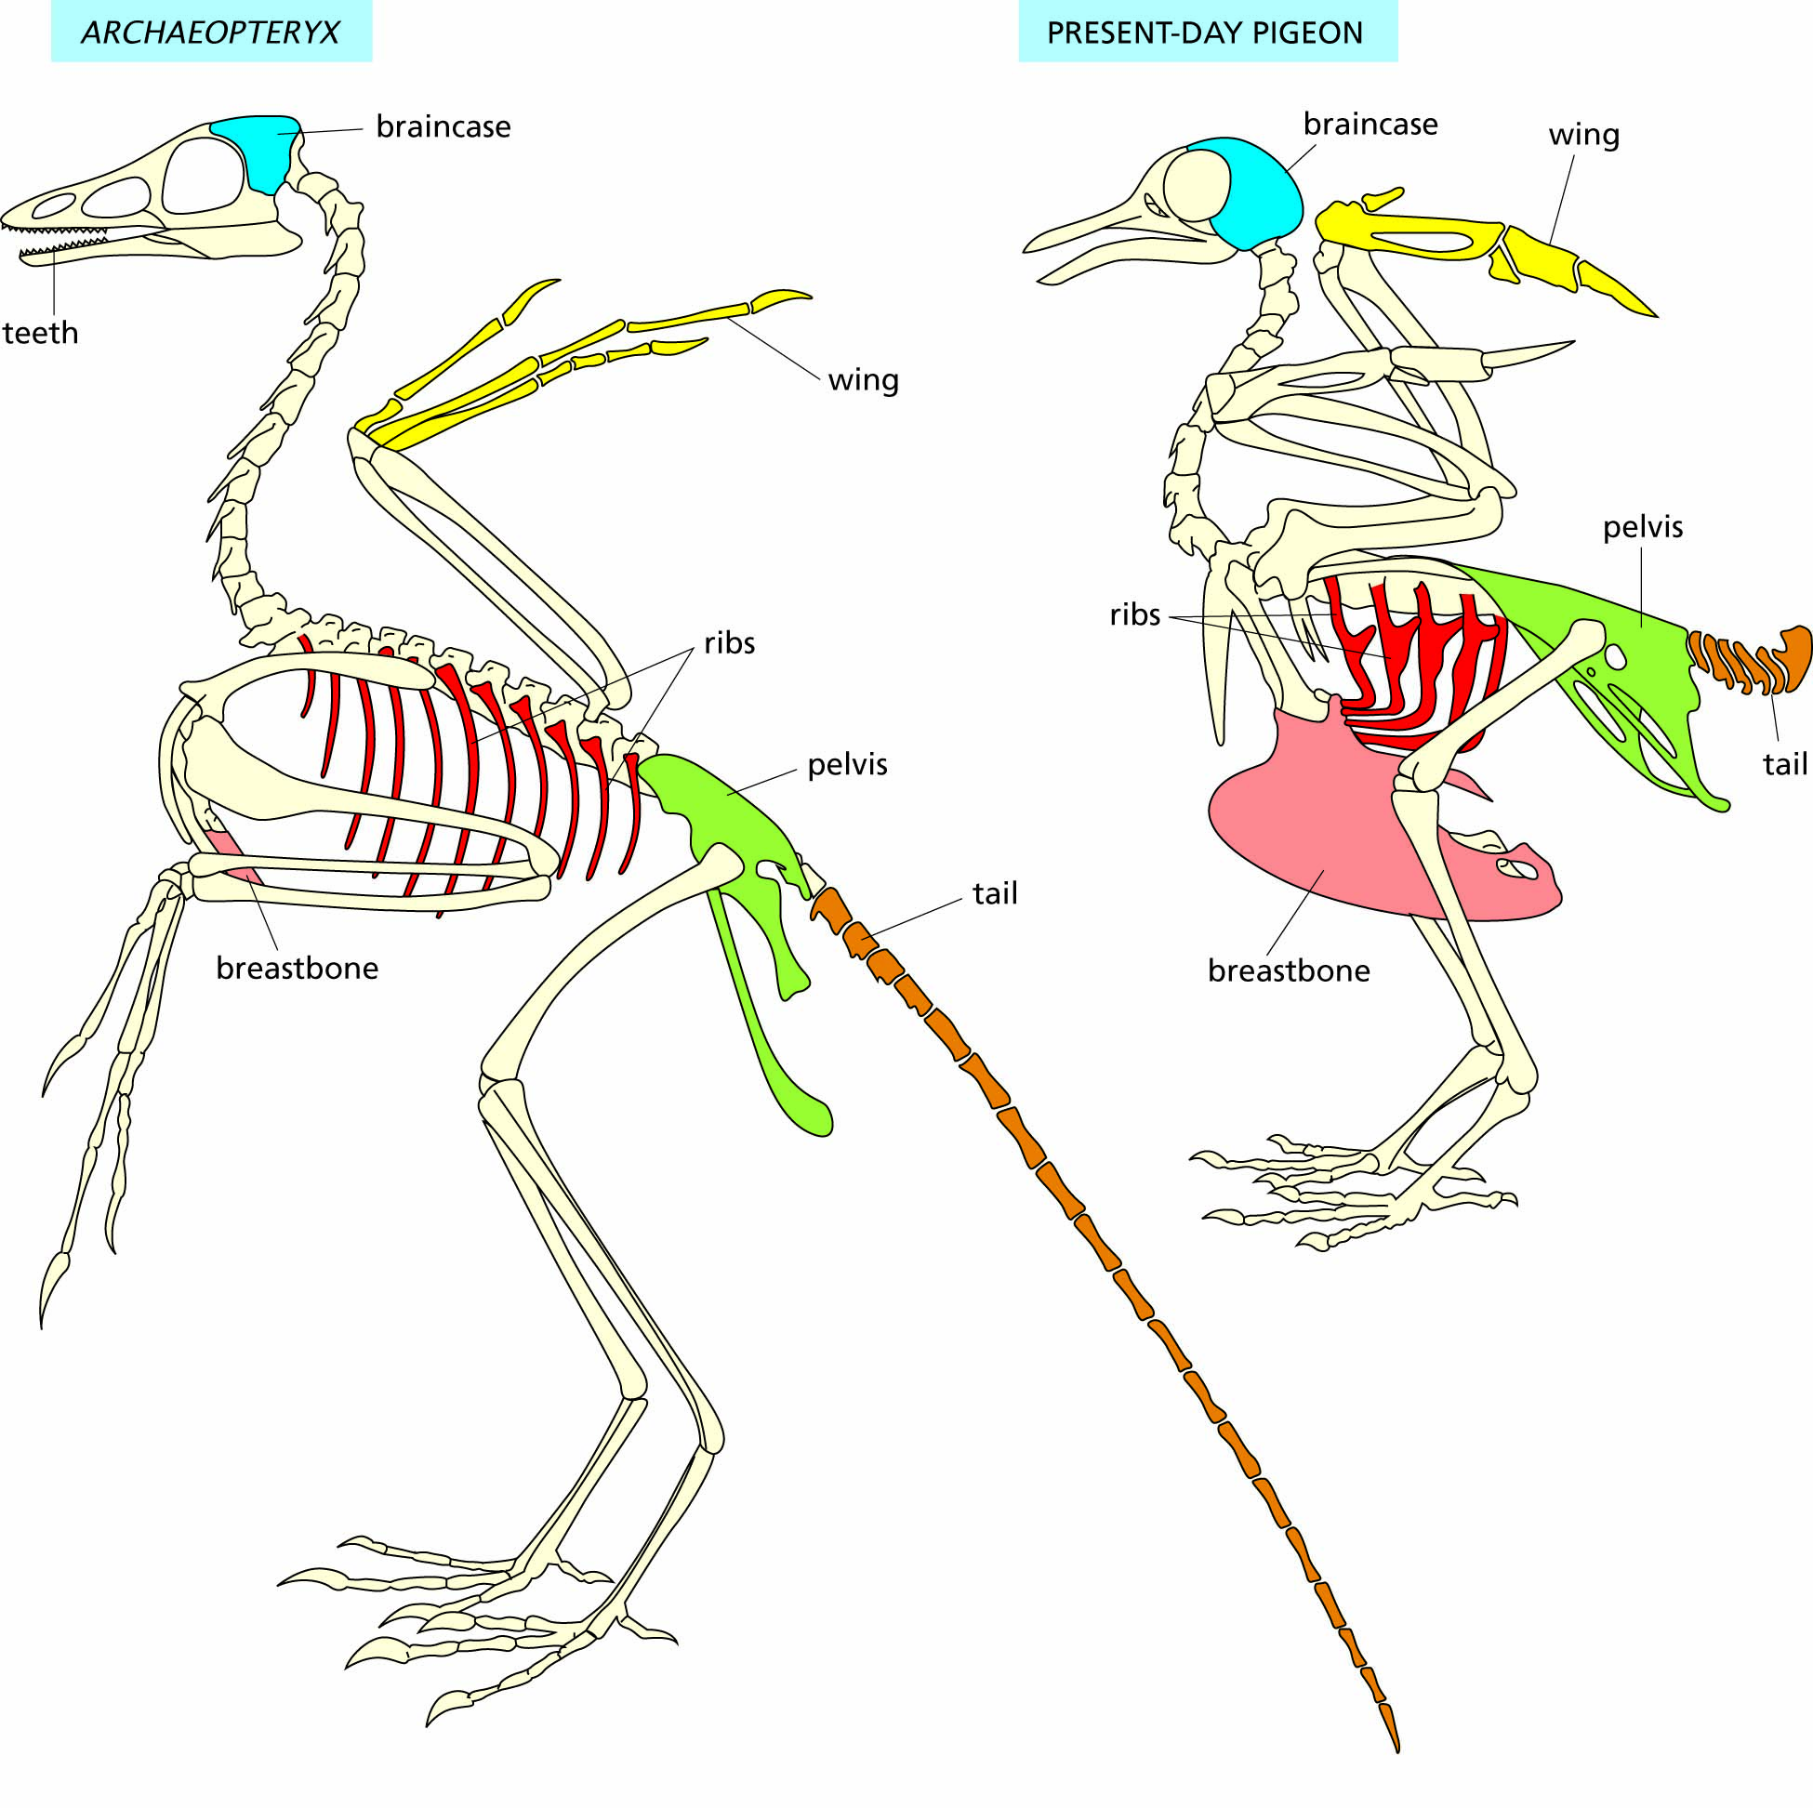
Figure 5.10 The early bird Archaeopteryx, compared with a modern-day pigeon. Modern birds lack teeth, and evolution has enlarged the braincase and strengthened other parts (wing, ribs, breastbone, pelvis, tail) highlighted here.

Slide 23
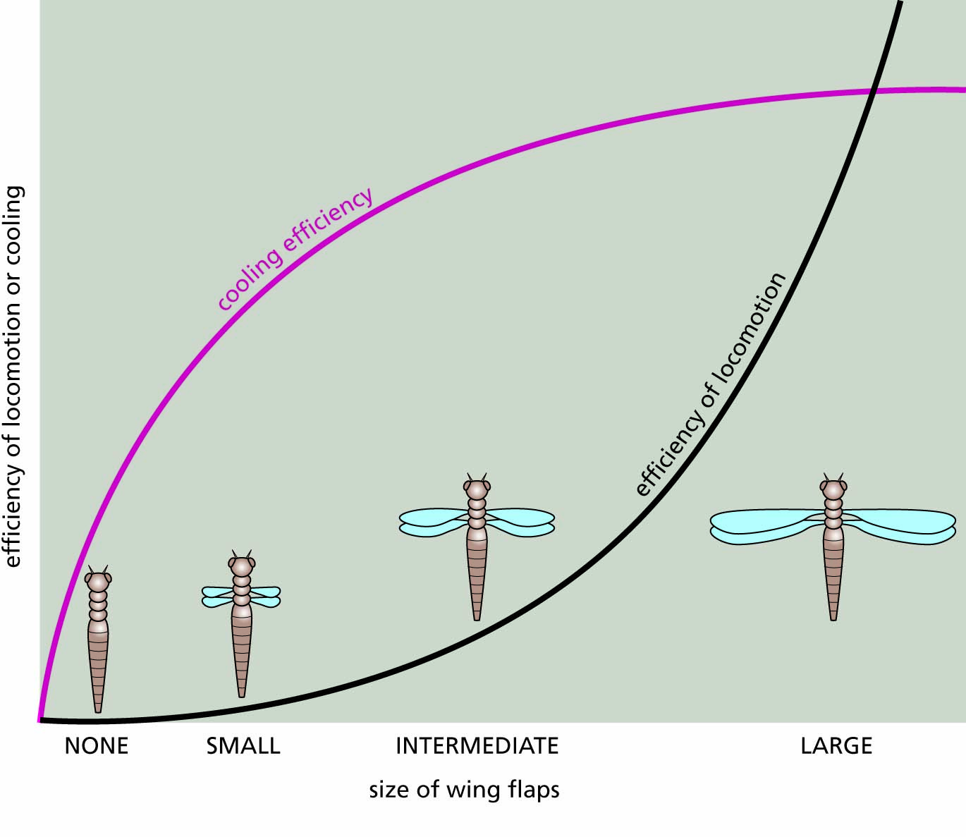
Figure 5.11 The evolution of insect wings. The efficiency of thoracic folds in primitive insect-like arthropods was measured according to two criteria: efficiency in cooling the body down by dissipating heat, and efficiency in airborne locomotion by adding to downward air resistance and to lift. Up to a certain size, increments in the size of the folds improved cooling ability but had little effect on locomotion. Thus, early increases in fitness among small to moderate wing sizes depended on improved cooling; however, later increases in fitness depended more on improvements in flying ability.

Slide 24
Creationists challenge evolutionary thought
Bible-based creationism
Intelligent design
Reconciling science and religion

Slide 25
Species are central to the modern evolutionary paradigm
Populations and species
How new species originate

Slide 26
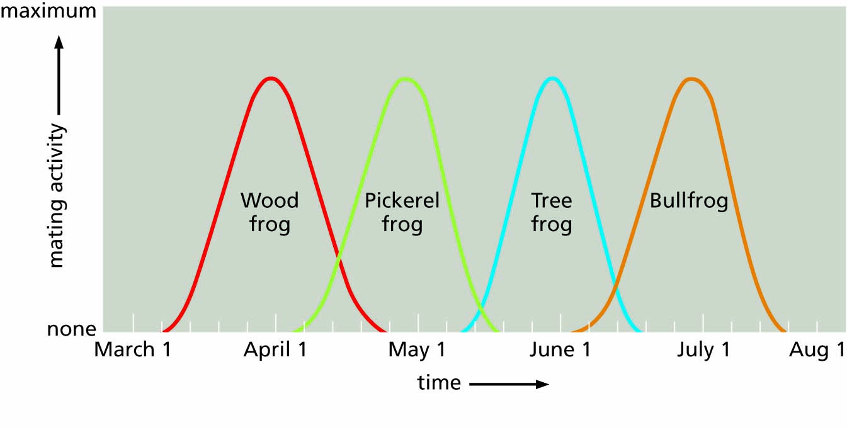
Figure 5.12 Reproductive isolation of several frog species by season of mating, an ecological means of preventing mating between species.

Slide 27
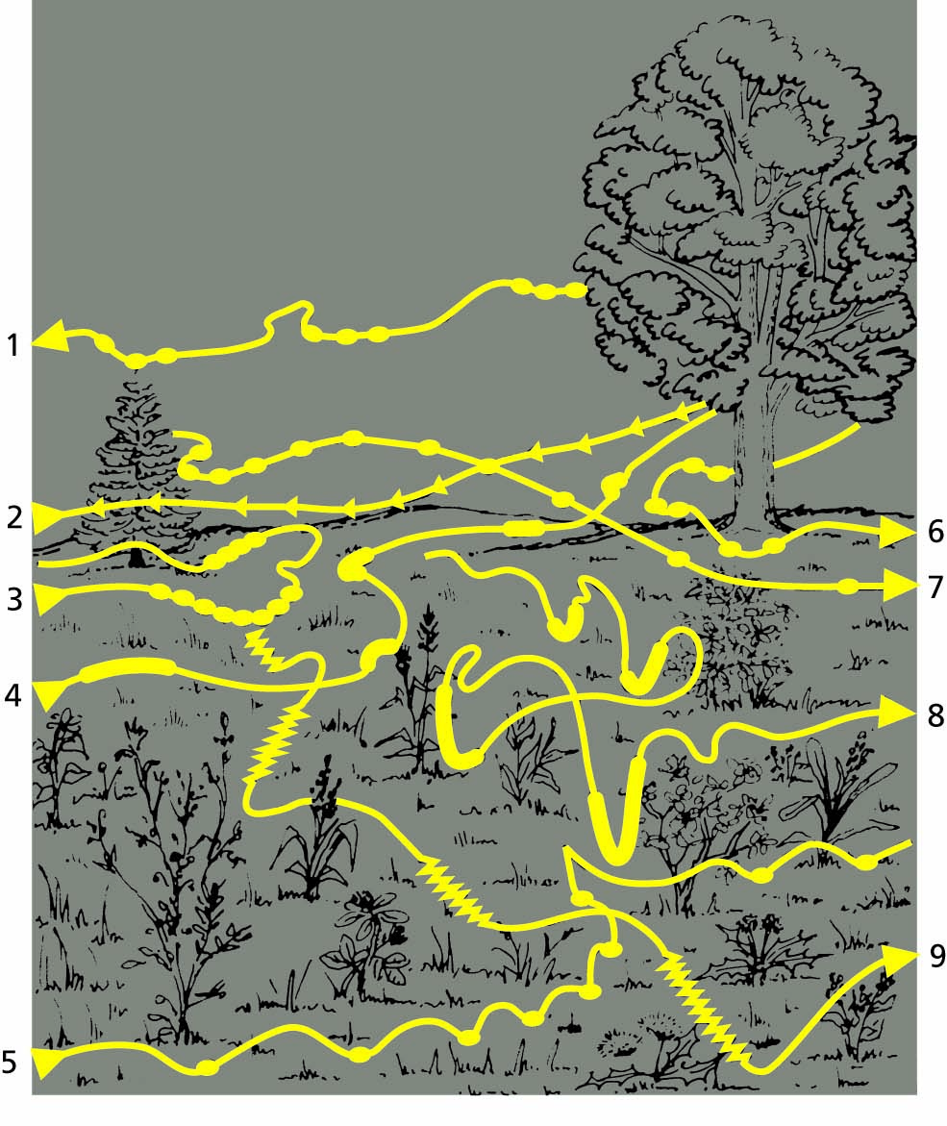
Figure 5.13 Flashing patterns used as mating signals by different species of fireflies. The species 1 to 9 are reproductively isolated from one another by the behavioral differences shown in these patterns. Details in this form of behavioral isolation include the duration of each flash, the number of repetitions, and the location of the insect when it flashes. A firefly will respond only to the flashing pattern of its own species.

Slide 28
"Species are groups of actually or potentially interbreeding natural populations which are reproductively isolated from other such groups."
--Ernst Mayr (1942)

Slide 29
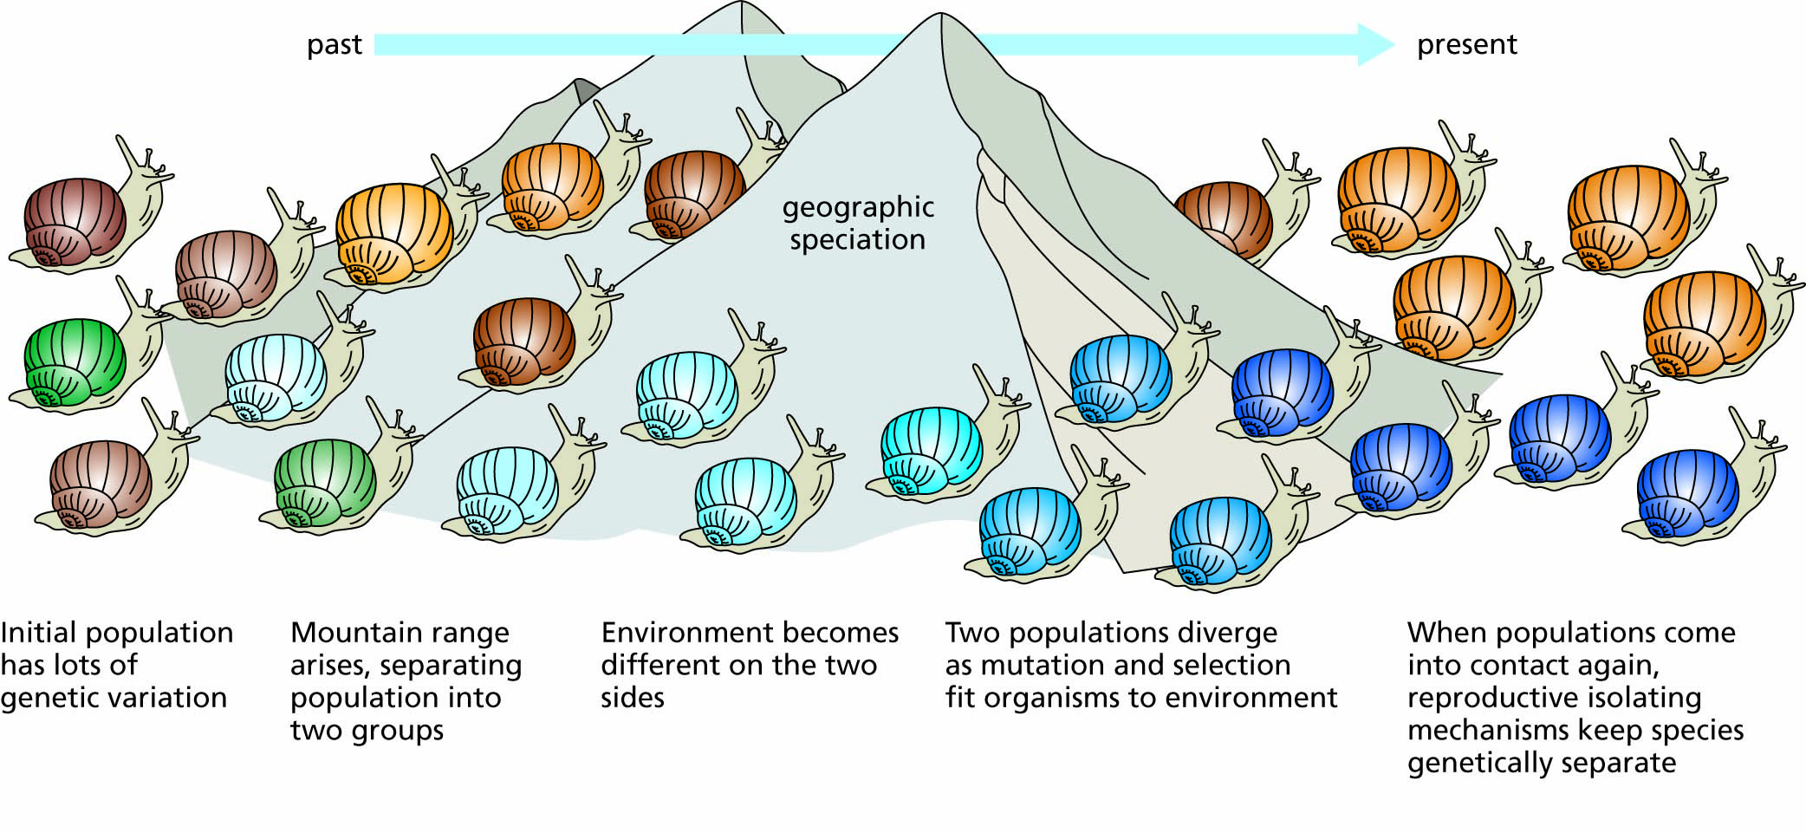
Figure 5.14 Geographic speciation: the evolution of reproductive isolation during geographic isolation. Genetically variable populations that spread geographically can develop locally different populations that are capable of interbreeding with one another initially. If the populations are separated for a long enough time by a barrier such as a mountain range or a deep canyon, they may develop differences that prevent interbreeding even after contact is resumed.

Slide 30
Life on Earth originated by natural processes and continues to evolve
Oparin, Miller and the Origin of Life
Evidence of early life on Earth
Evolution as an ongoing process

Slide 31
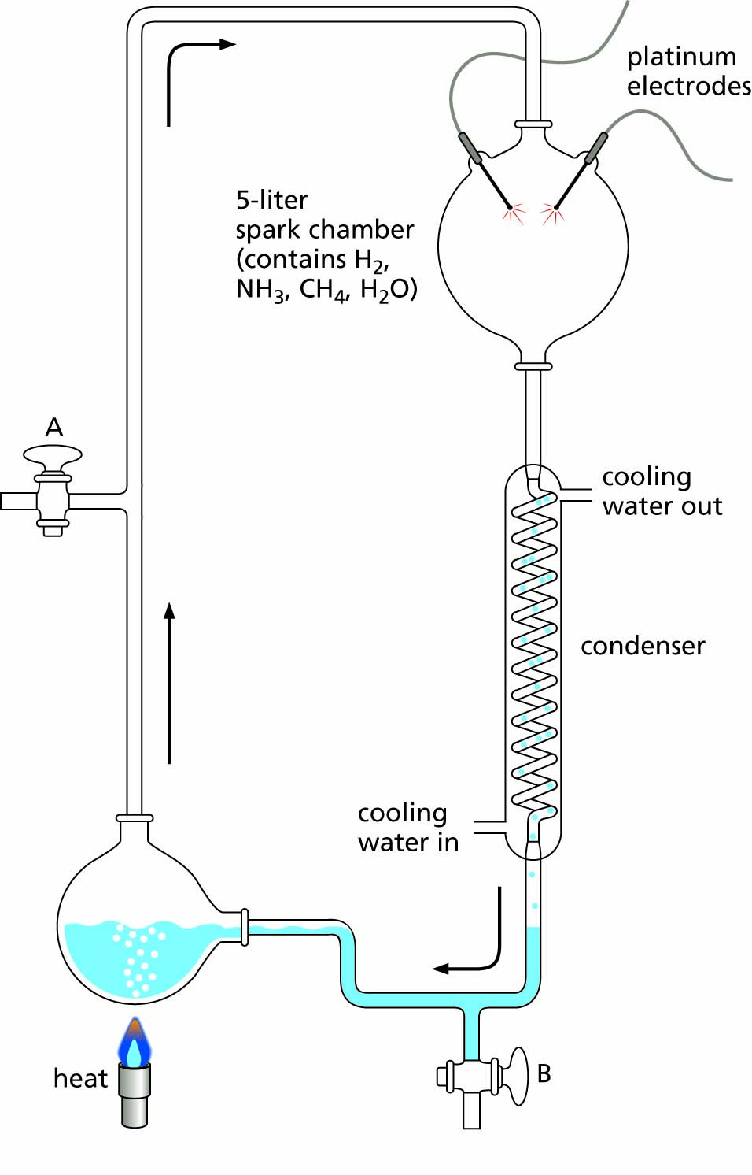
Figure 5.15 Stanley Miller’s experiment, in which amino acids and other molecules used by living organisms were produced. Heating the flask at the lower left boils the water and keeps the mixture circulating in the direction shown by the arrows. Reactions take place in the spark chamber and reaction products are condensed and recirculated. Valve A is used to sterilize the apparatus and to introduce the starting materials; valve B is used to withdraw samples of the reaction products.

Slide 32
… and evolution is an unfinished process
that keeps on going as species continue to adapt
and changes continue to occur

