Slide 1
Chapter 4: Genetic Engineering and Genomics
Biology Trending, 4e
Eli Minkoff and Jennifer Hood-DeGrenier

Slide 2
Genetic engineering makes targeted changes to genetic information
Methods of genetic engineering
Genetic engineering in medicine
New frontiers: CRISPR gene editing and direct base editing

Slide 3
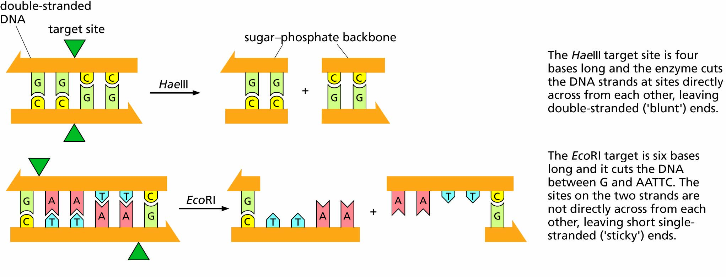
Figure 4.1 Restriction enzymes. The nucleotide sequences recognized and cut by the restriction enzymes HaeIII and EcoRI are shown.

Slide 4
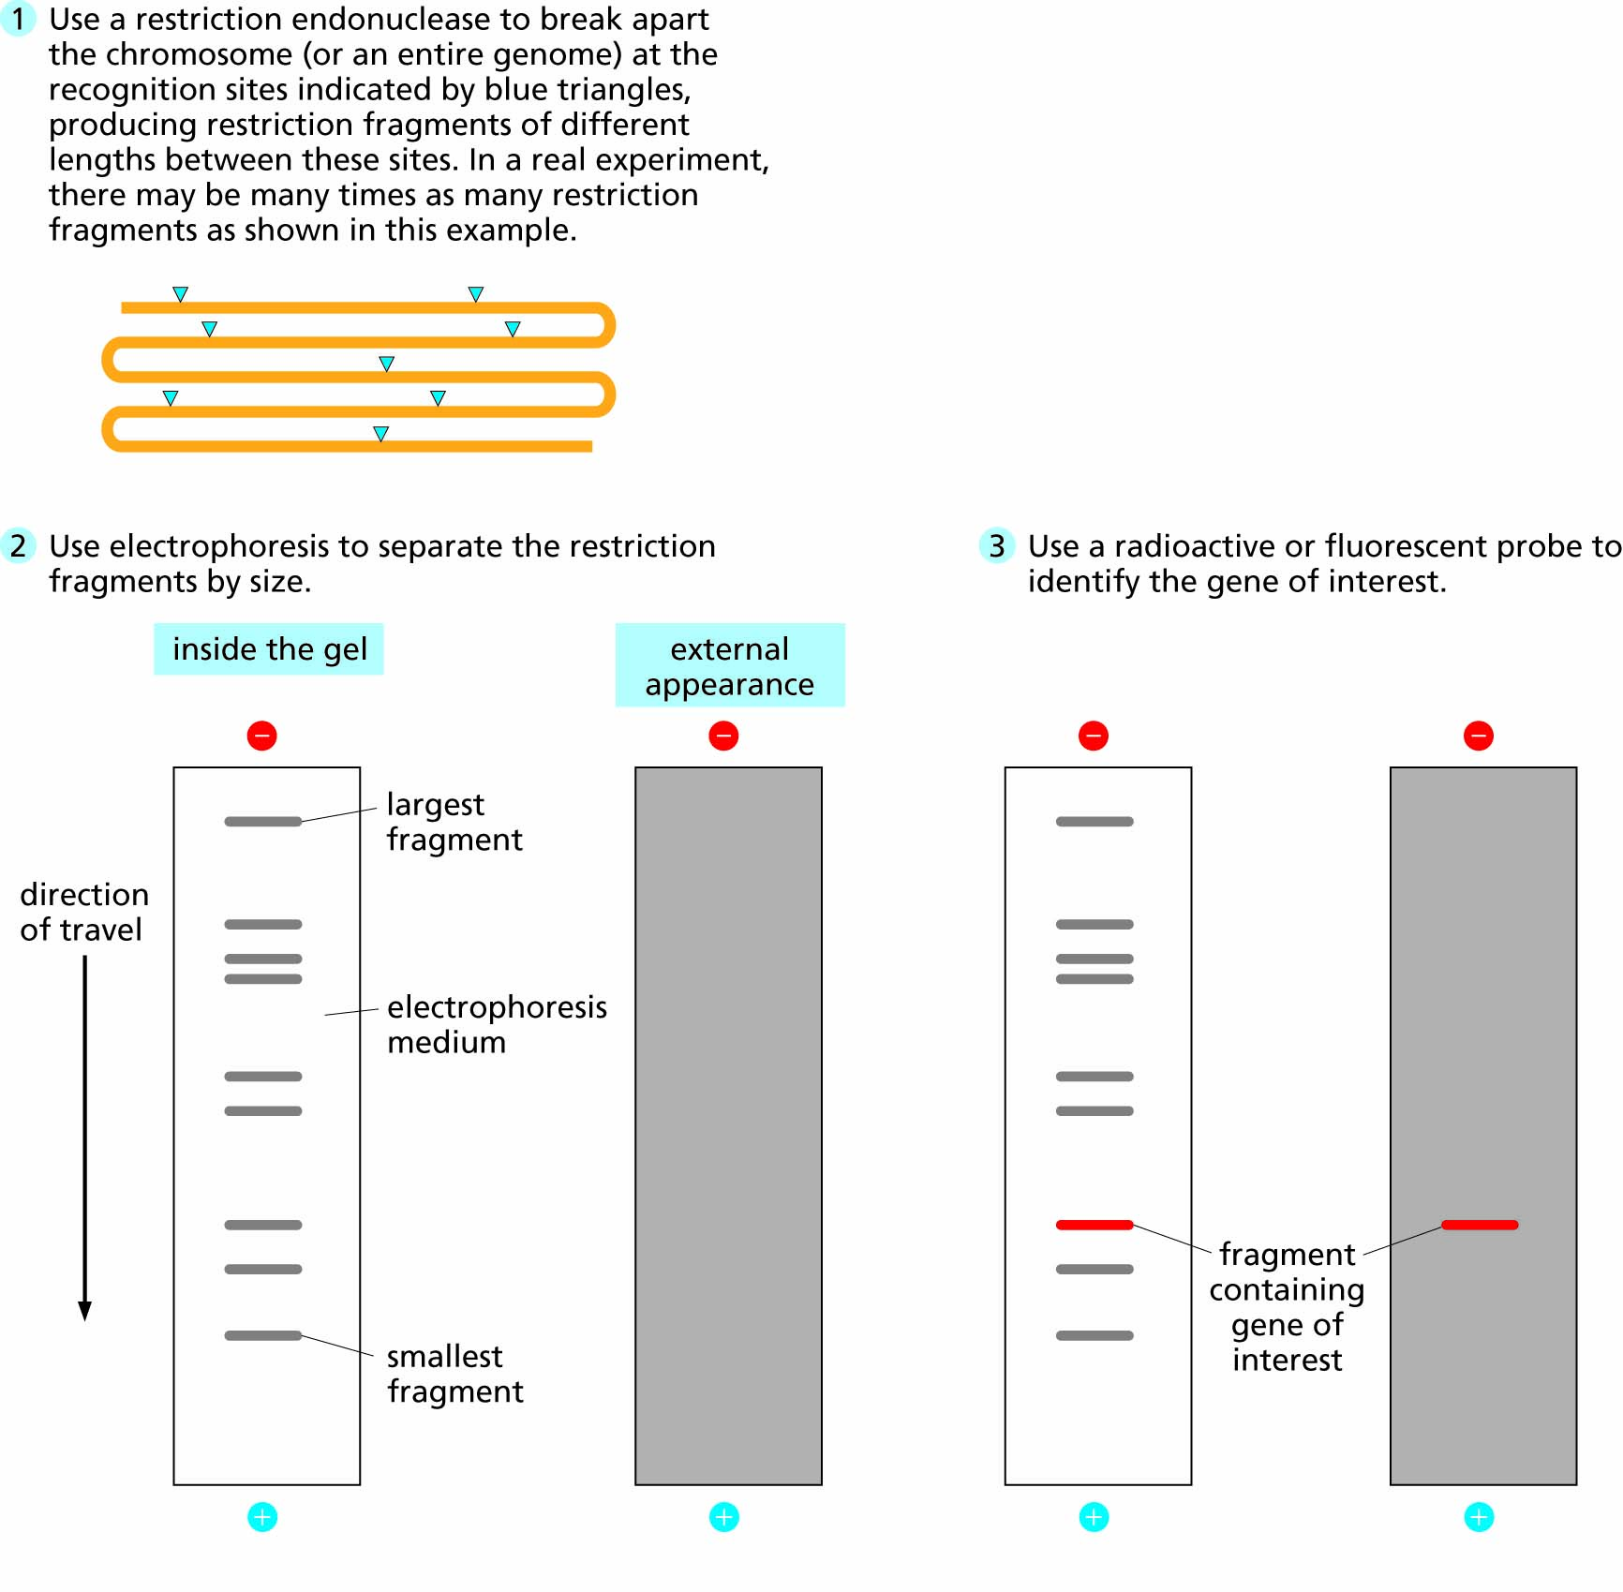
Figure 4.2 Cutting DNA with restriction enzymes and separating the fragments by gel electrophoresis.

Slide 5
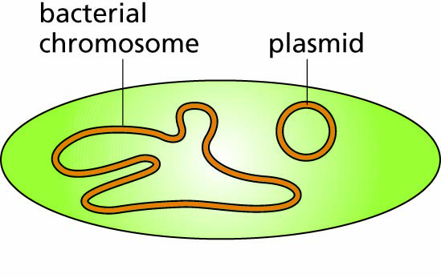
Figure 4.3 A bacterial cell showing its single, large, circular chromosome and one small, circular plasmid.

Slide 6
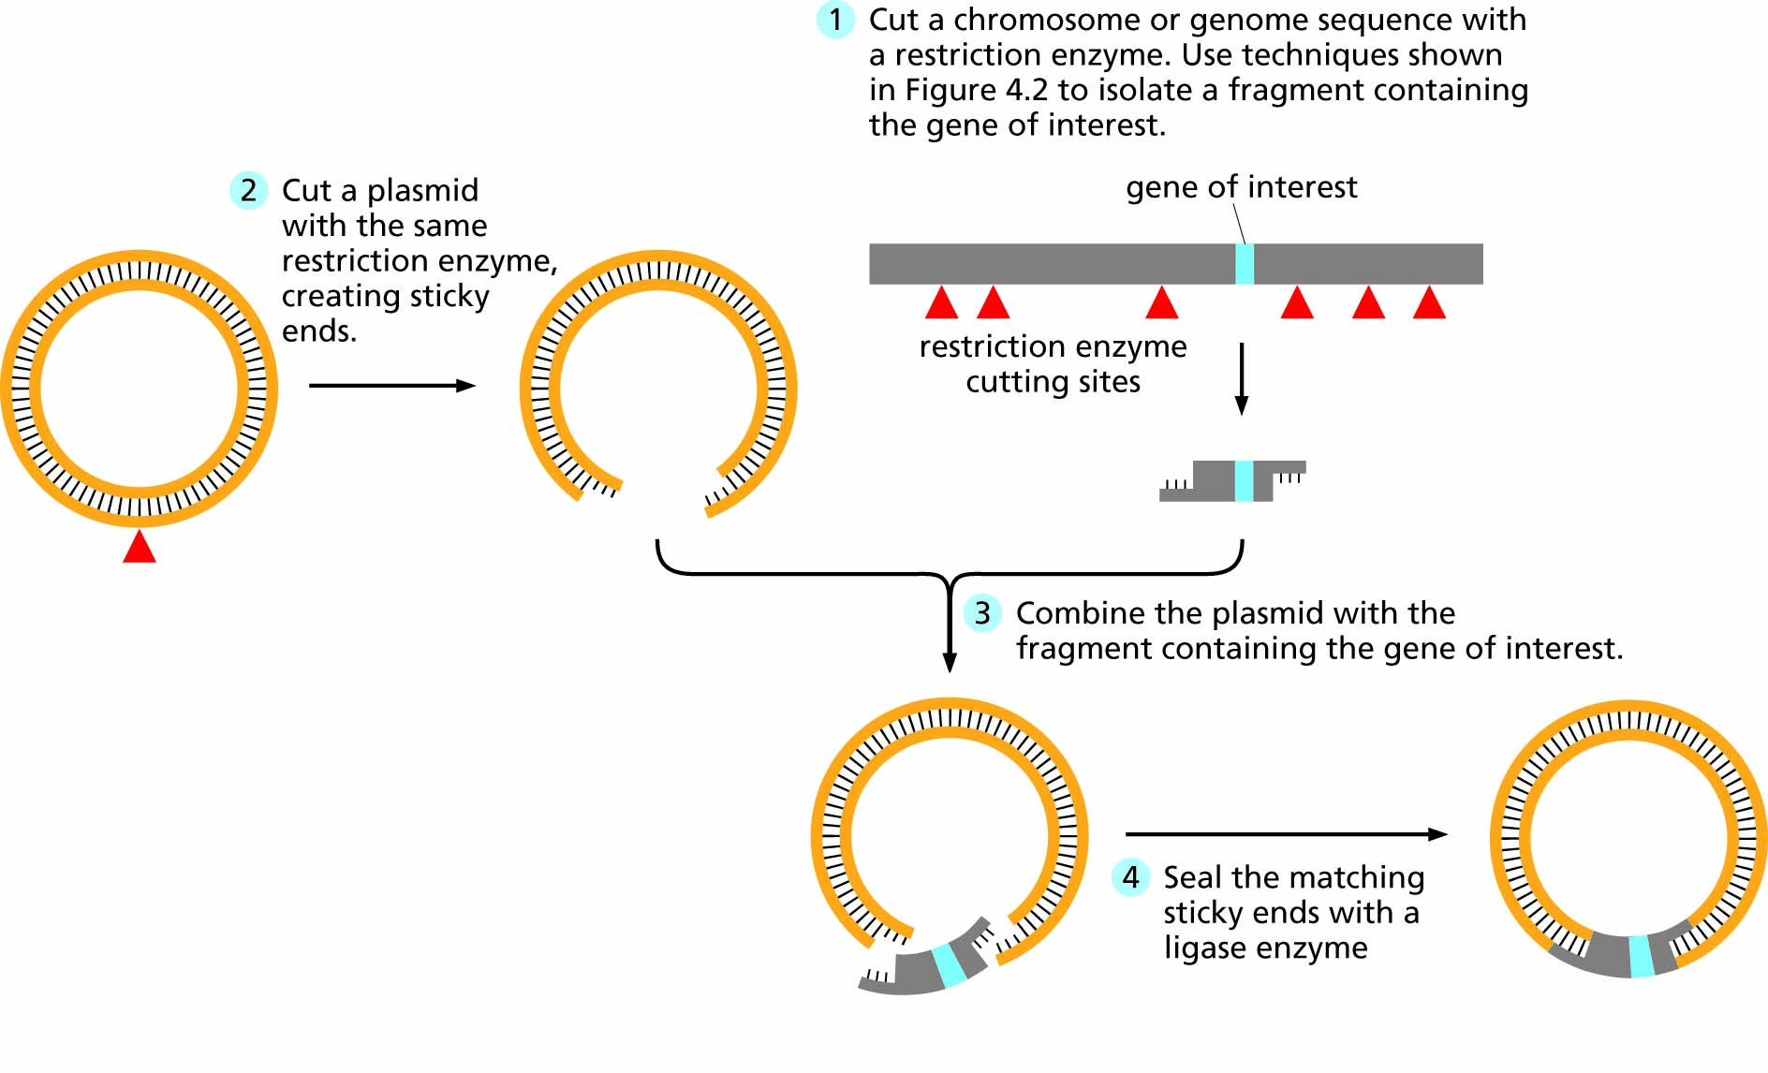
Figure 4.4 Inserting a gene into a plasmid by joining complementary sticky ends. The “insert” fragment may be generated by restriction enzyme digestion or by the polymerase chain reaction (PCR).

Slide 7
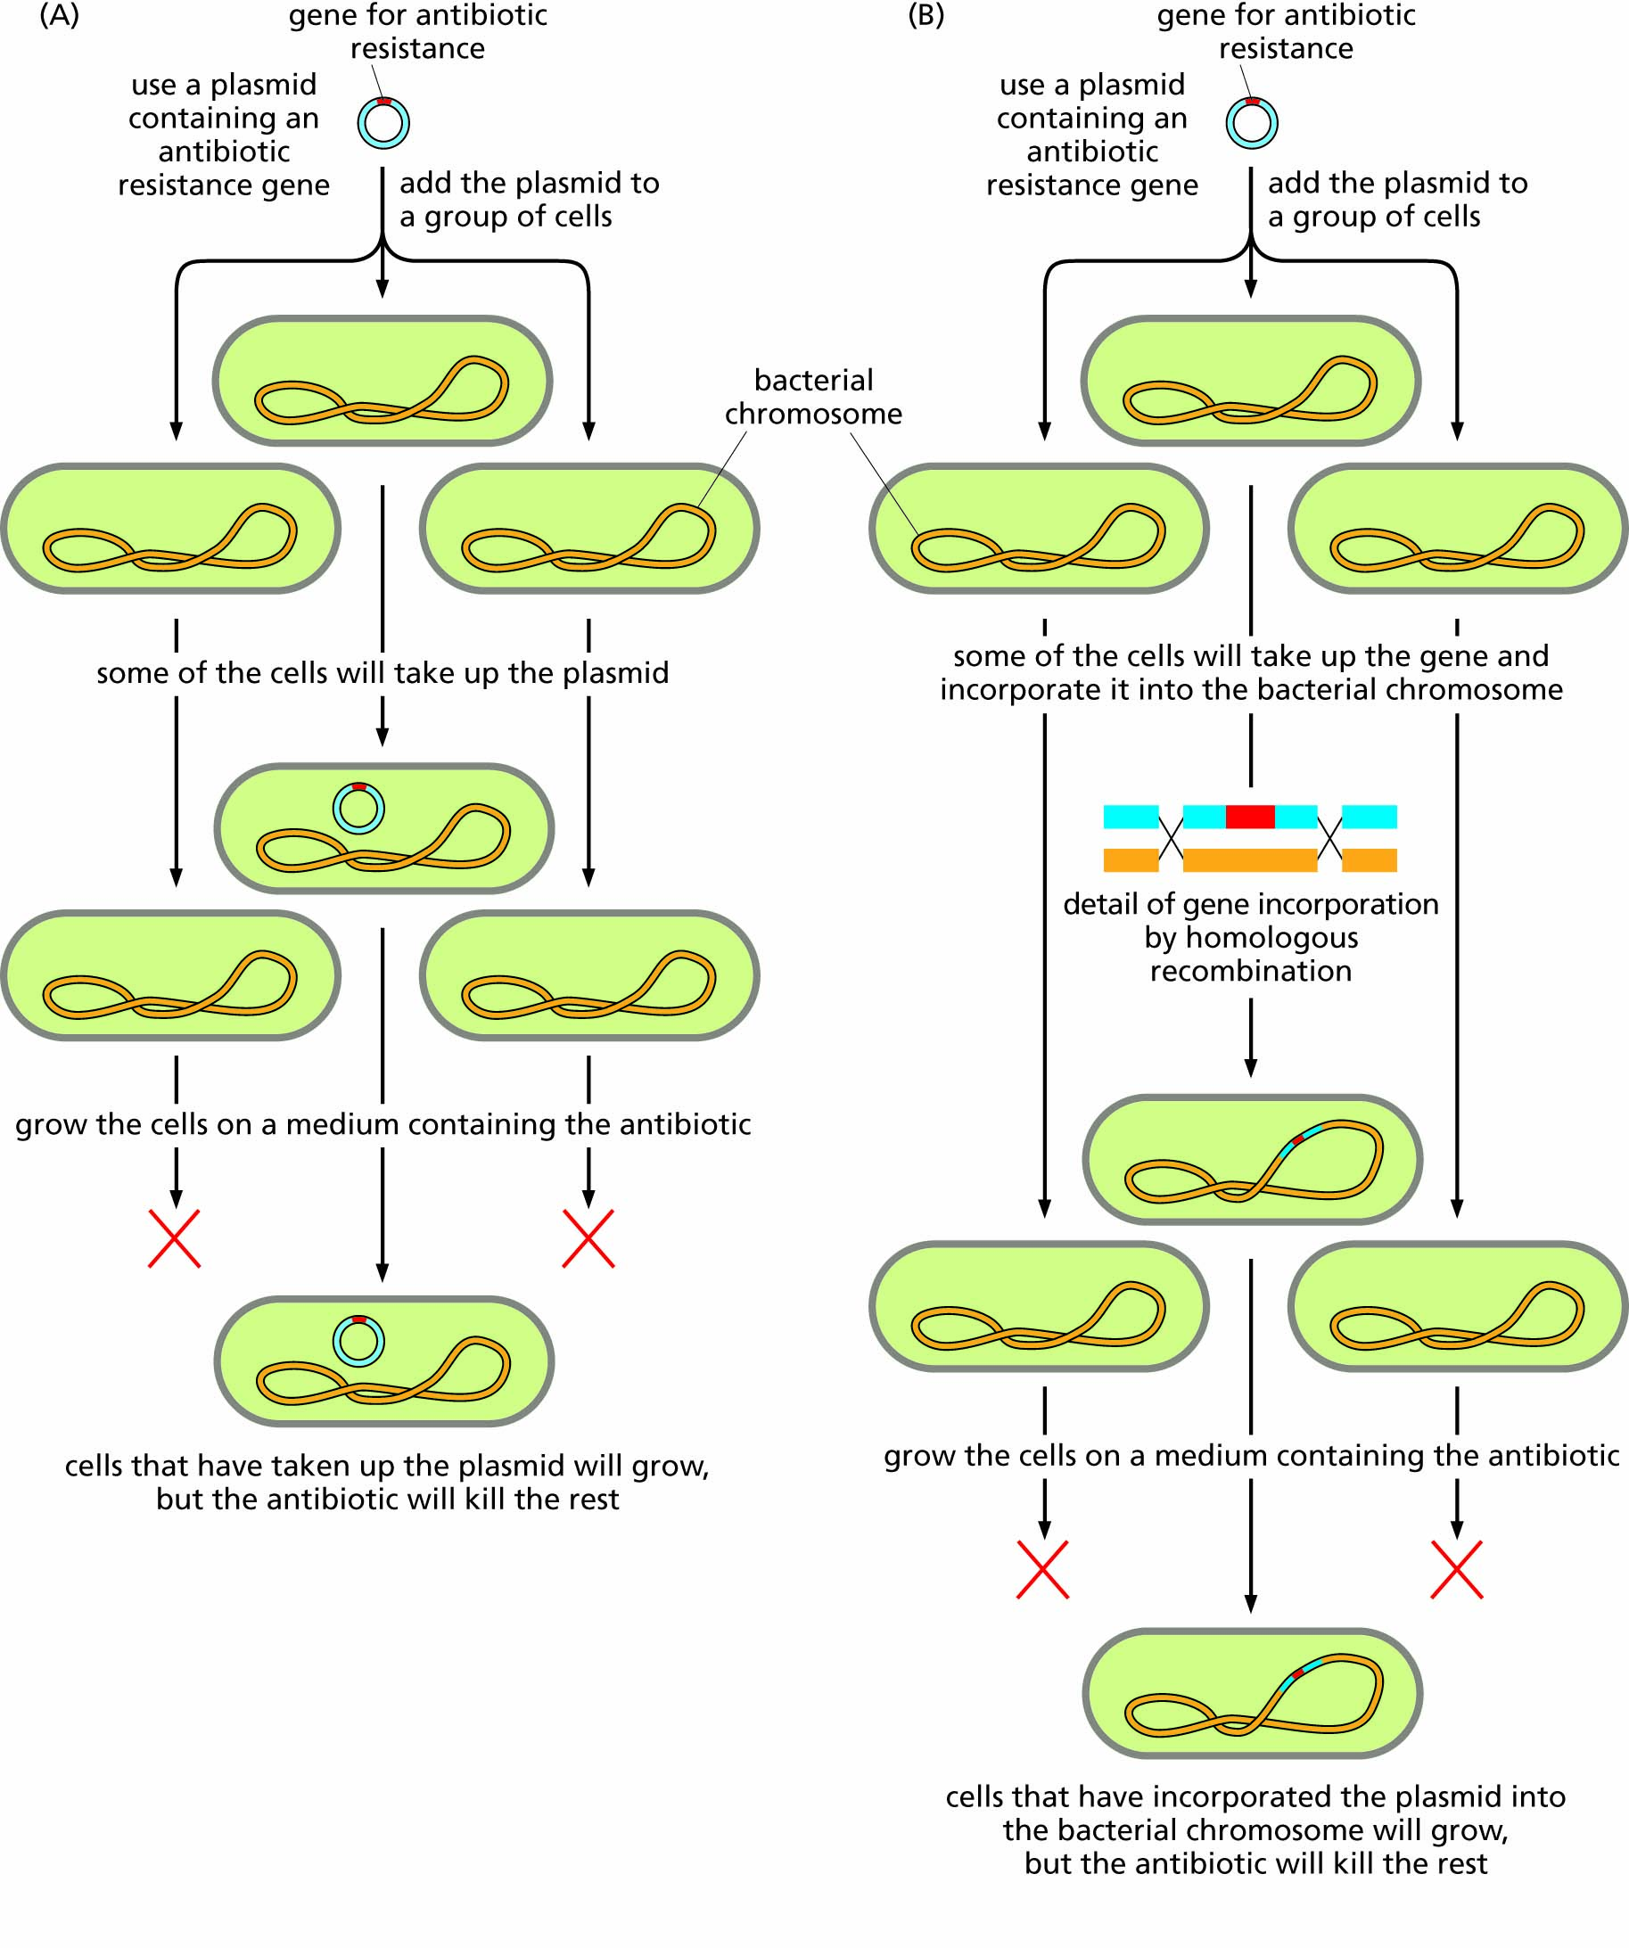
Figure 4.5 Two strategies for introducing and maintaining foreign DNA in host cells.

Slide 8
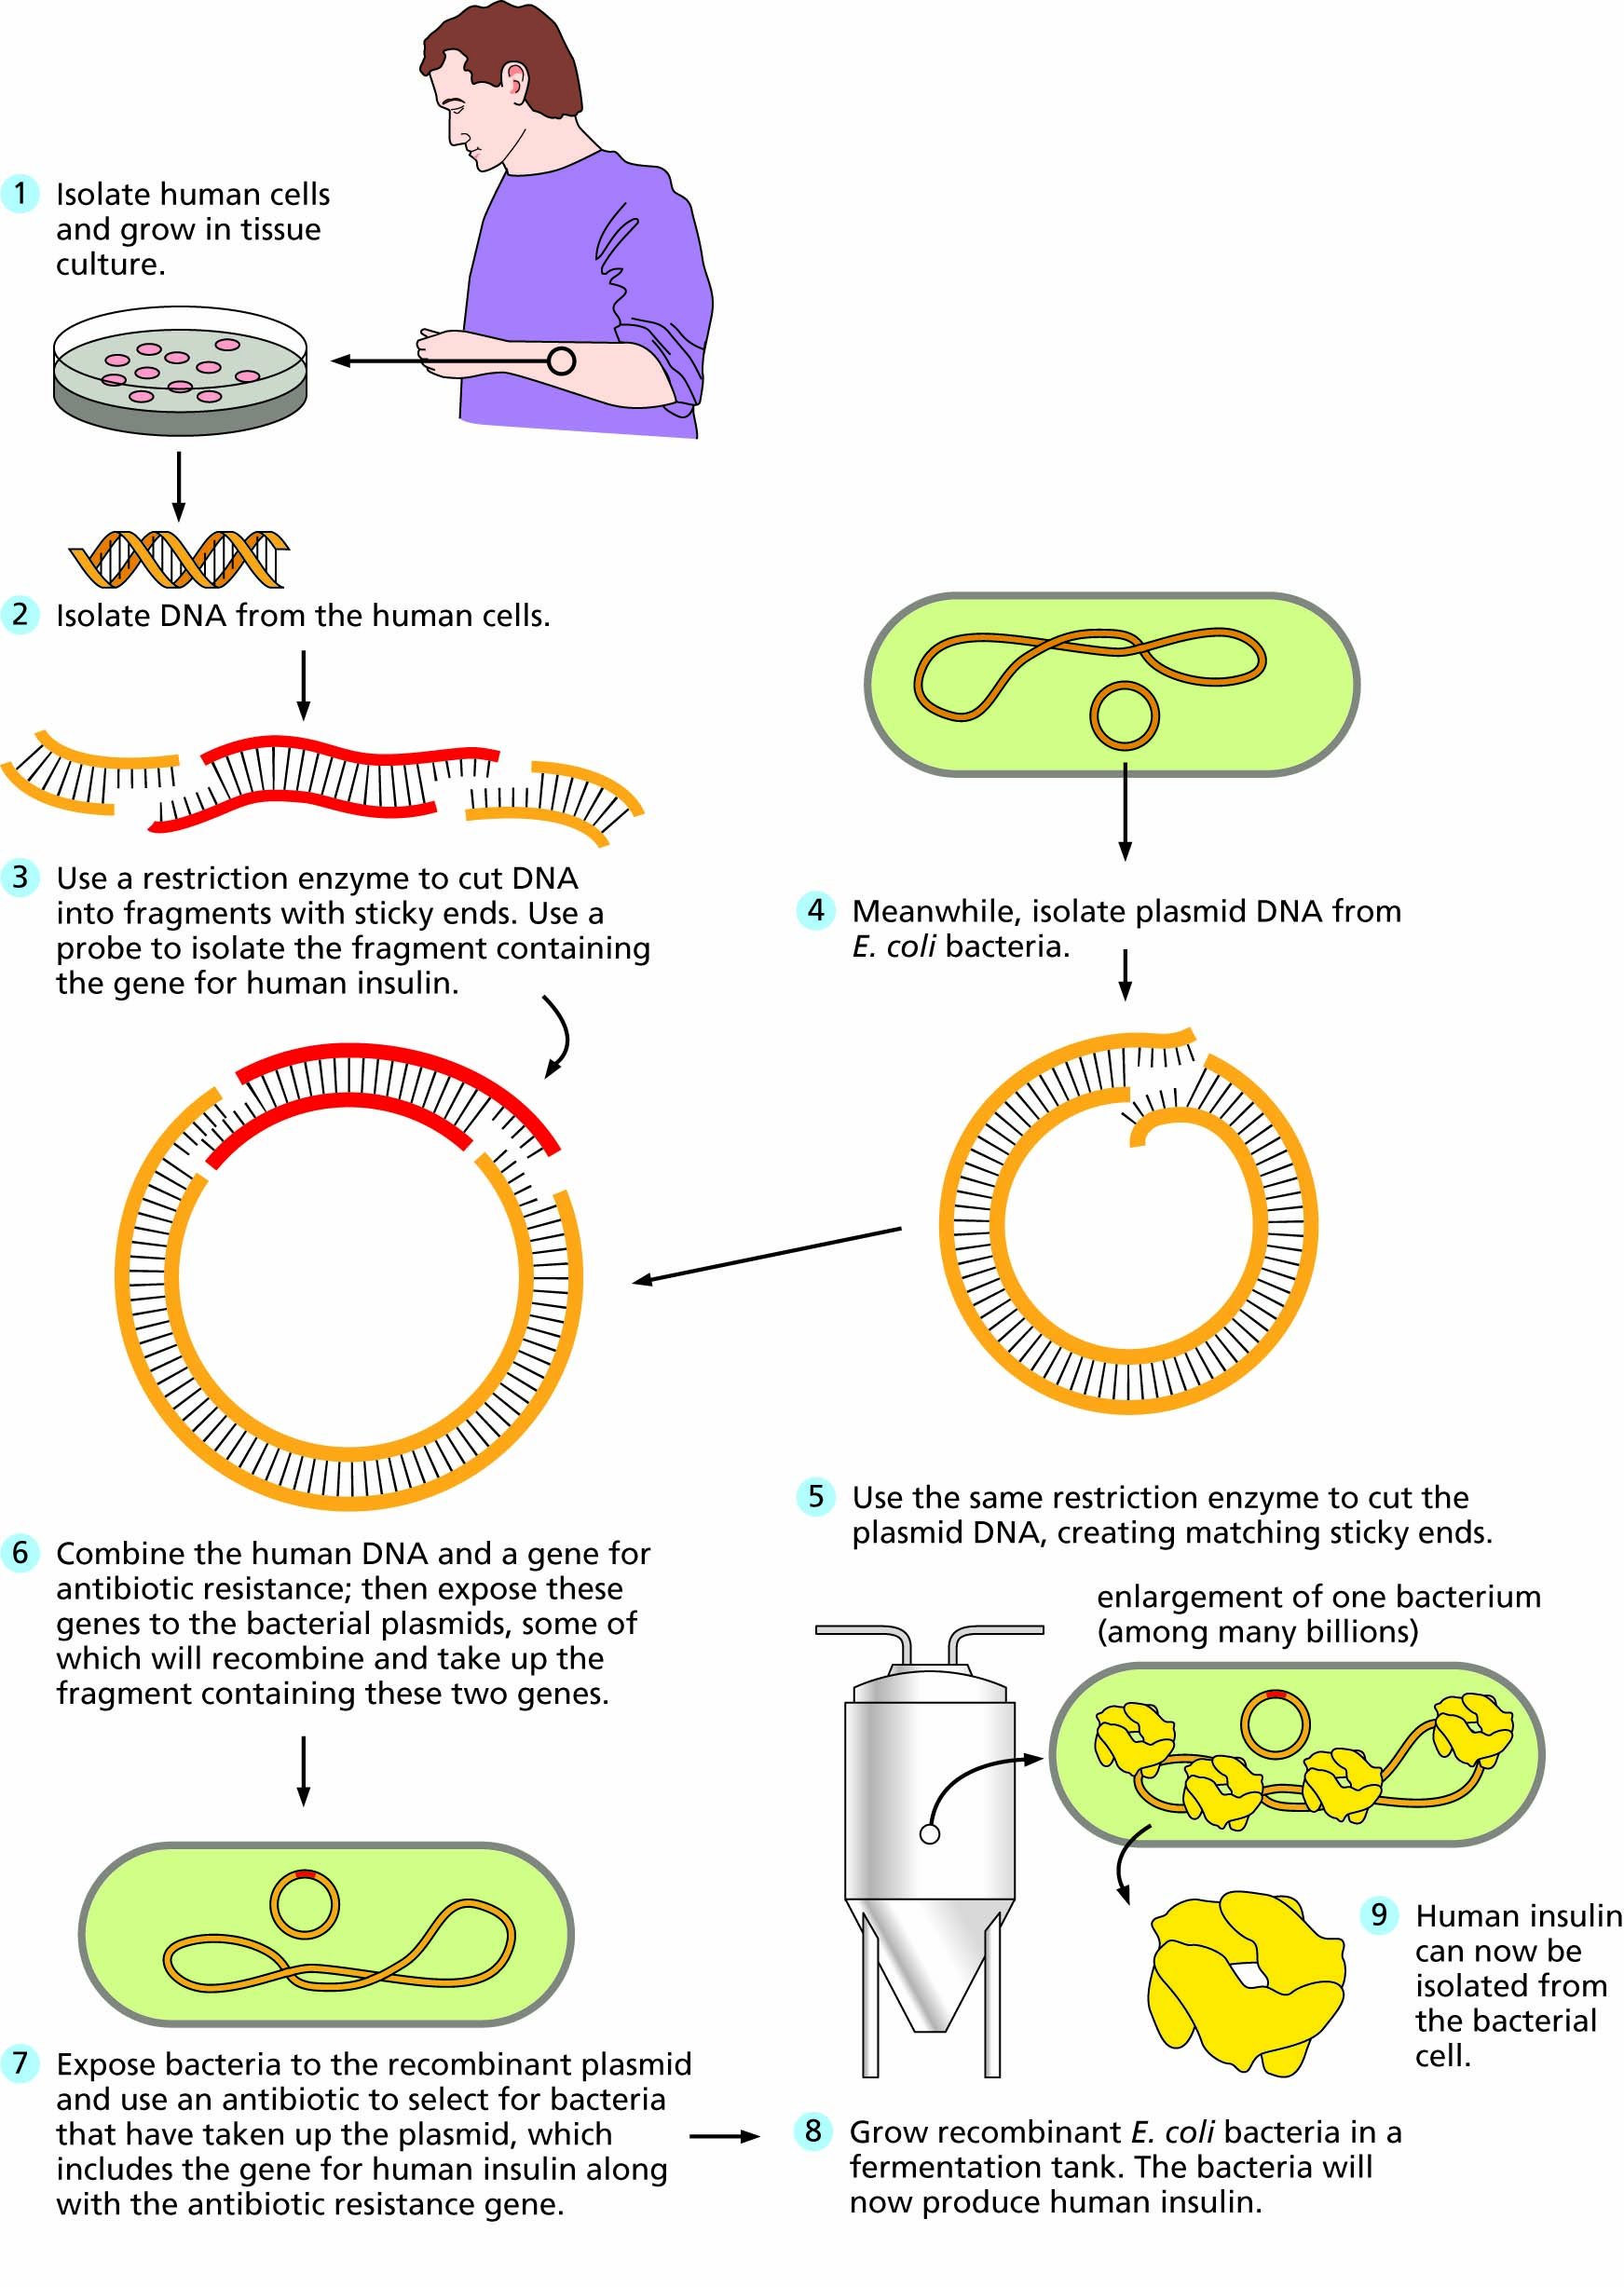
Figure 4.6 Production of human insulin by recombinant bacteria.

Slide 9
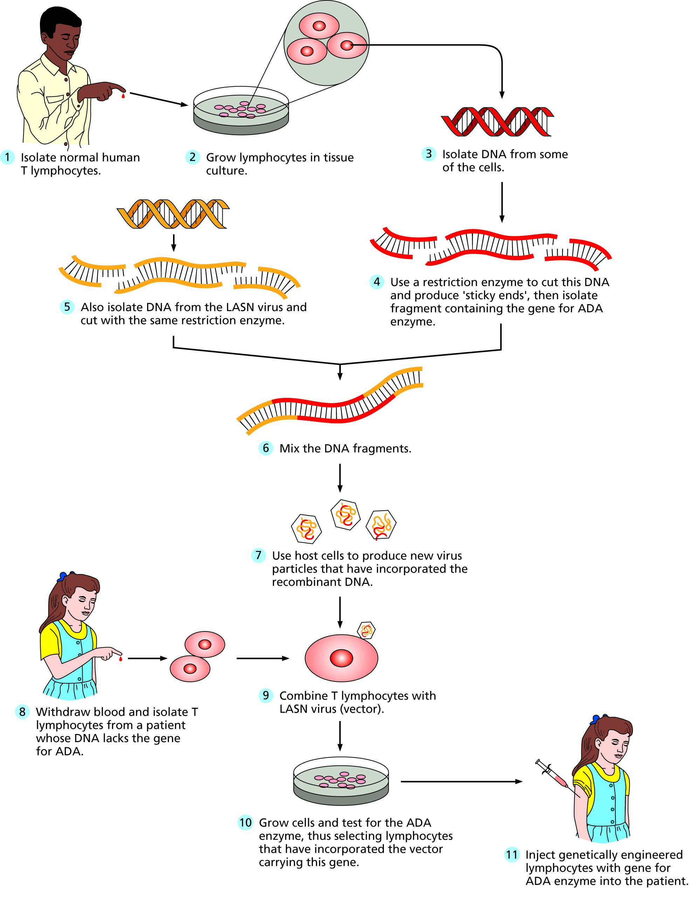
Figure 4.7 An example of gene therapy showing the transfer of the human gene responsible for adenosine deaminase (ADA).

Slide 10
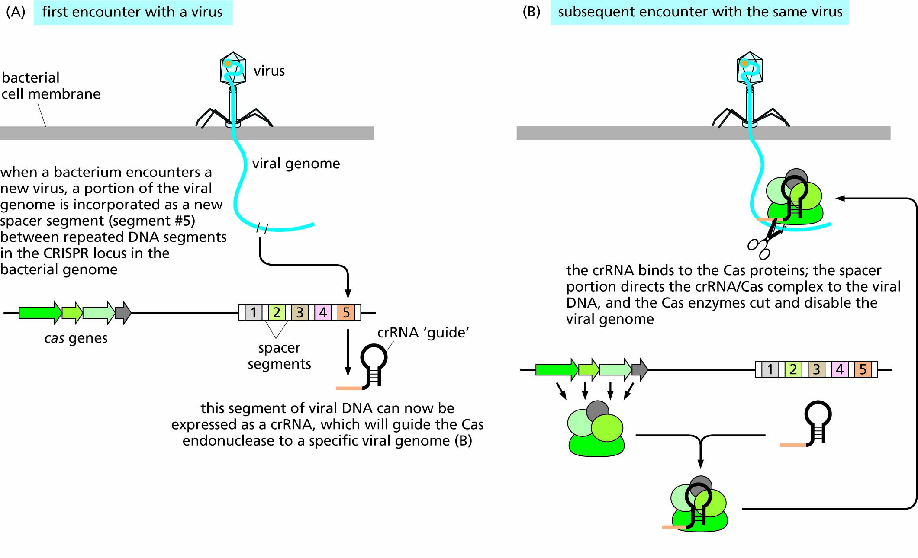
Figure 4.8 CRISPR RNAs function as a viral defense mechanism in bacteria.

Slide 11
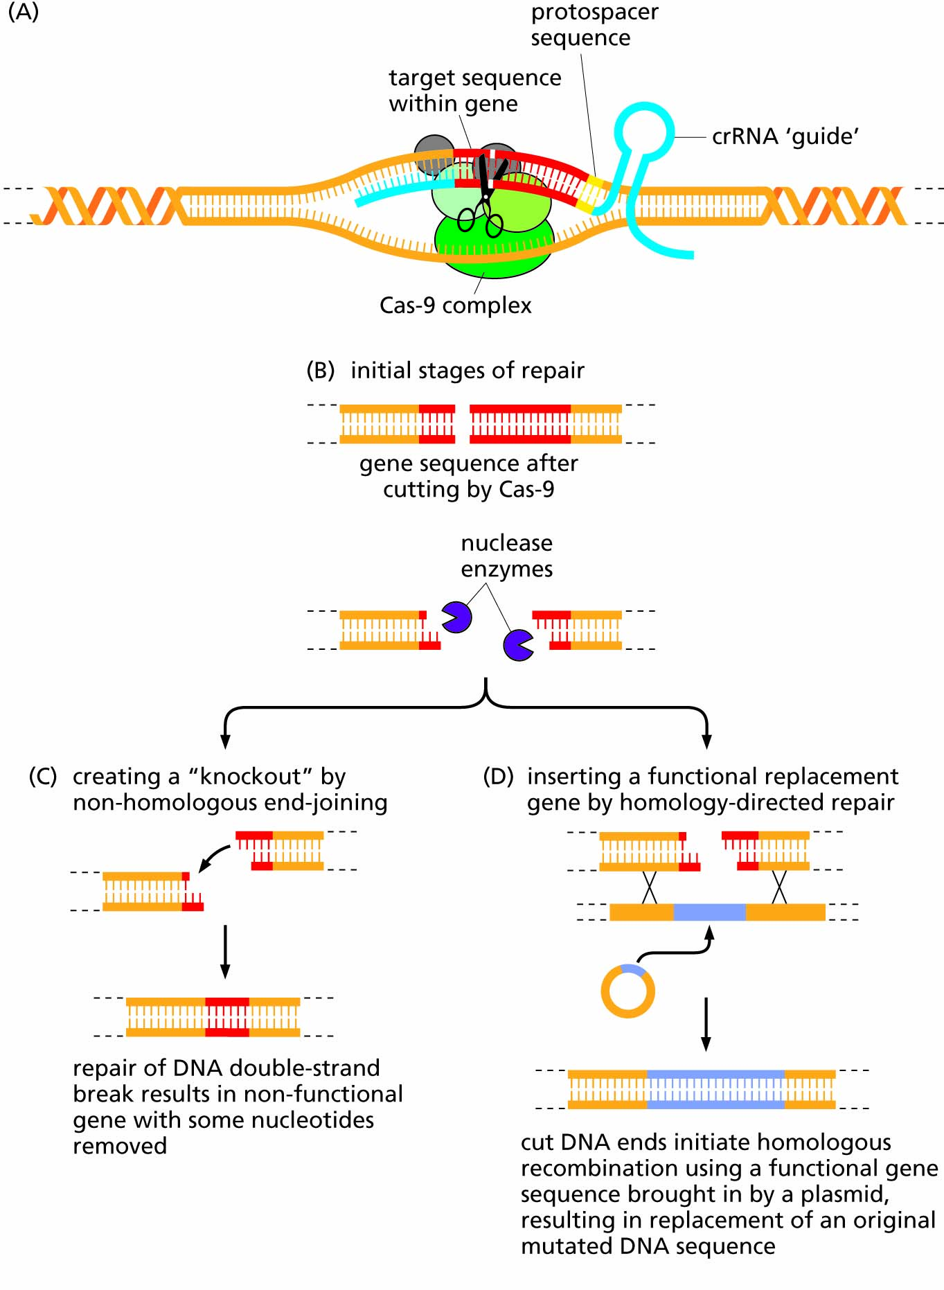
Figure 4.9 Application of CRISPR-Cas system to genetic engineering.

Slide 12
Molecular techniques have led to new uses for genetic information
The first DNA marker – restriction-fragment length polymorphisms (RFLPs)
Using DNA markers to identify individuals
Additional DNA markers
Using DNA testing in historical controversies

Slide 13
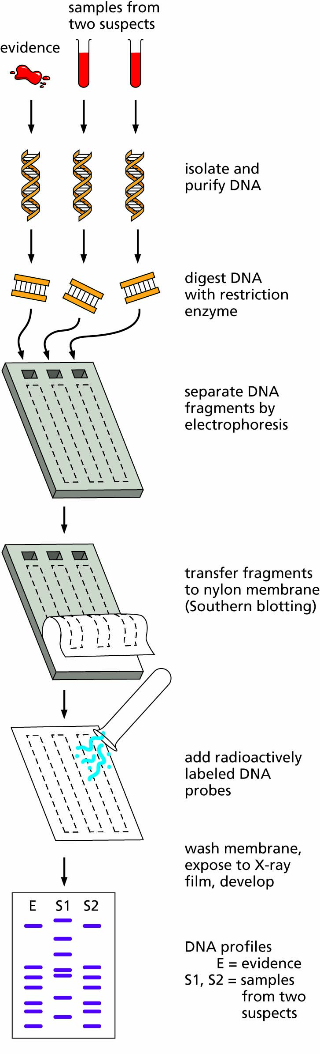
FIGURE 4.10. Forensic DNA analysis using RFLPs and DNA probes (Southern blotting). In this example, the evidence sample shows the same pattern of bands as DNA from suspect 2. There is therefore a high probability that the DNA in the evidence is from that suspect. The person from whom sample 1 was taken can be eliminated as a suspect.

Slide 14
The Human Genome Project has changed biology
Classical DNA sequencing methods were used to sequence the first human genome
The race to finish the human genome draft sequence
Lessons from the Human Genome Project
Some ethical and legal issues

Slide 15
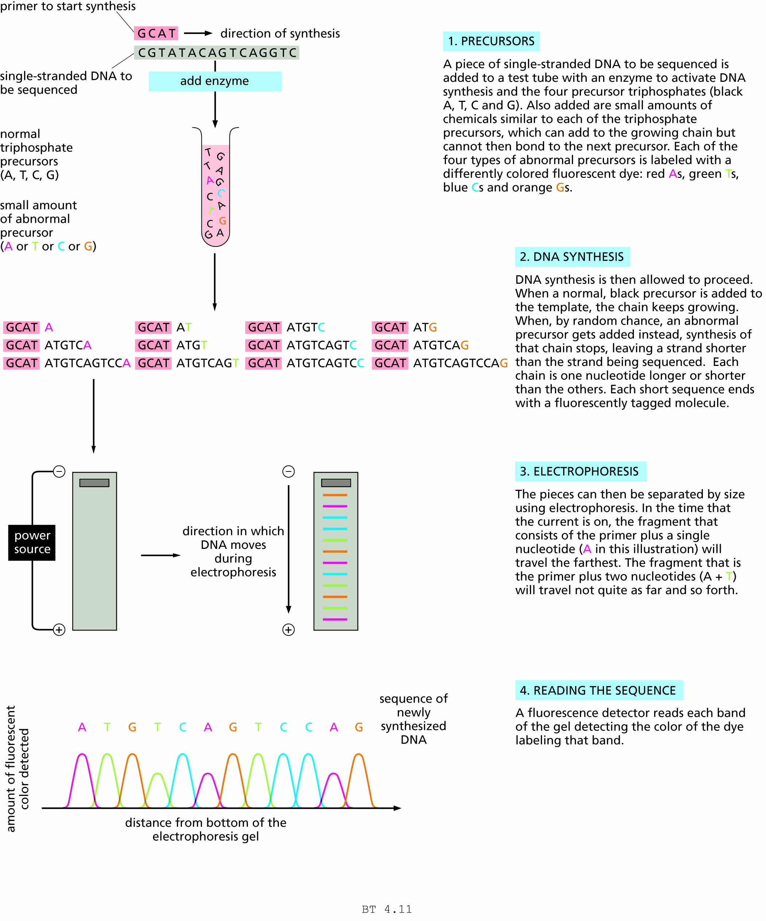
Figure 4.11 The Sanger (di-deoxy) method for determining the sequence of DNA. Steps 1-2.

Slide 16
Figure 4.11 The Sanger (di-deoxy) method for determining the sequence of DNA. Steps 2-4.

Slide 17
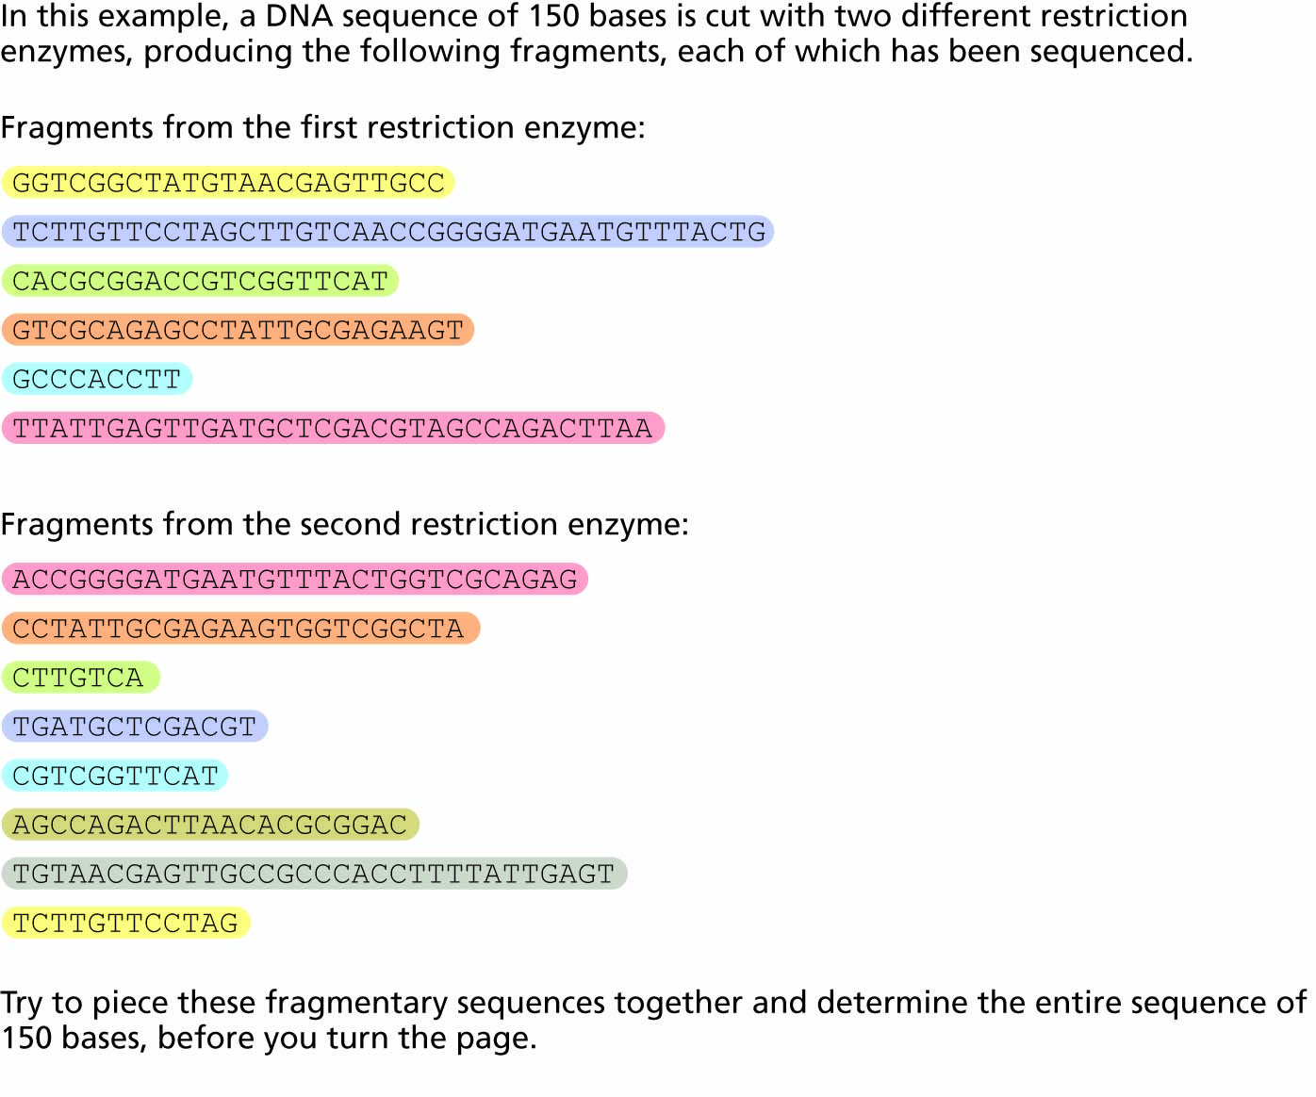
FIGURE 4.12 Model of the whole-genome shotgun method of genome assembly. Here are the fragments of a sequence cut with two different enzymes. Can you piece them together to reconstruct the complete sequence? Don’t turn the page until you’ve tried it!

Slide 18
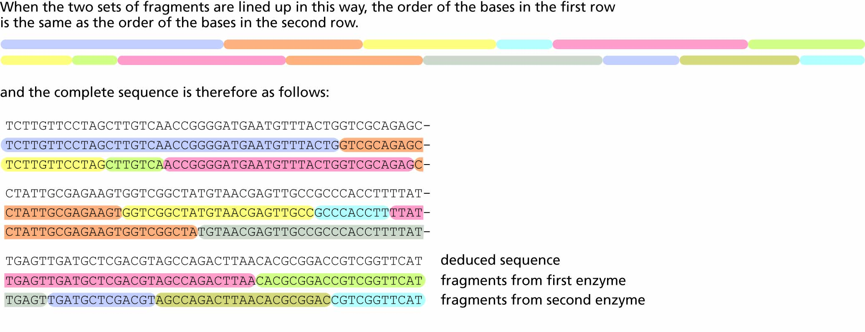

Slide 19
Lessons from the Human Genome Project:
Much of our DNA (≈98%) is non-coding
The number of human genes is less than 25,000
Most gene products are proteins of undetermined function
Most human genes are also found in other species; only ≈1% are unique
About 200 human genes have homologs in bacteria but not in most animals
Mutation rates vary throughout the genome
Many individual variations exist in single nucleotides (SNPs)

Slide 20
Genomics is a new field of biology developed as a result of the Human Genome Project
Bioinformatics
Next-generation DNA sequencing
Comparative genomics
Functional genomics
Proteomics
Transcriptomics

Slide 21
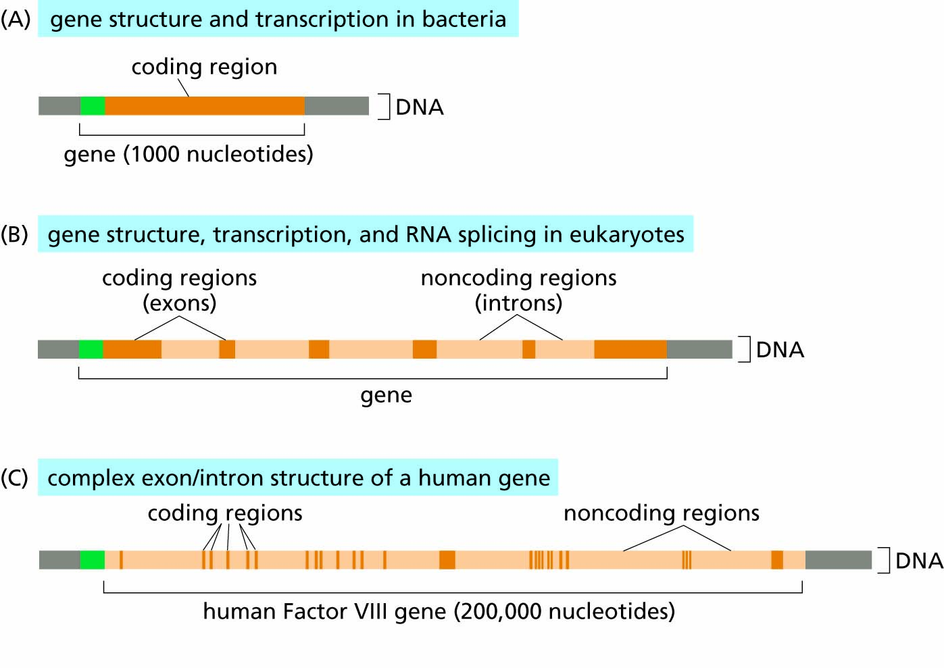
FIGURE 4.13 Differences in gene structures in bacteria compared to eucaryotic cells. (A) Bacterial protein-coding genes contain only coding regions, meaning that all of the RNA transcribed from the DNA is then translated to protein. (B) In eucaryotic cells, noncoding regions (introns) are interspersed between coding segments (exons) of genes. Both exons and introns are transcribed into RNA, but the introns are removed by a process called RNA splicing to generate the mature mRNA that is then translated to protein. (C) In humans (a eucaryotic species), the amount of noncoding DNA (introns) is much greater than the amount of coding DNA (exons), and some genes have a large number of exons and introns.

Slide 22
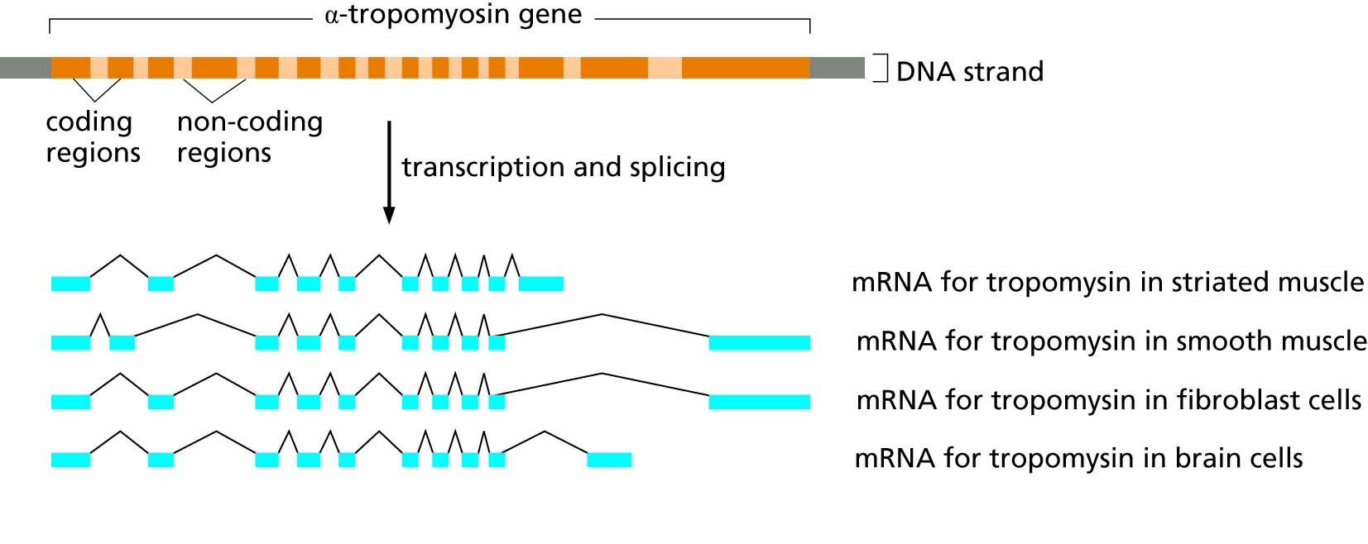
FIGURE 4.14 A single human gene can give rise to multiple proteins depending on which exons are included in the final mRNA that is translated. Different protein isoforms are expressed in different tissues and have specialized functions.

Slide 23
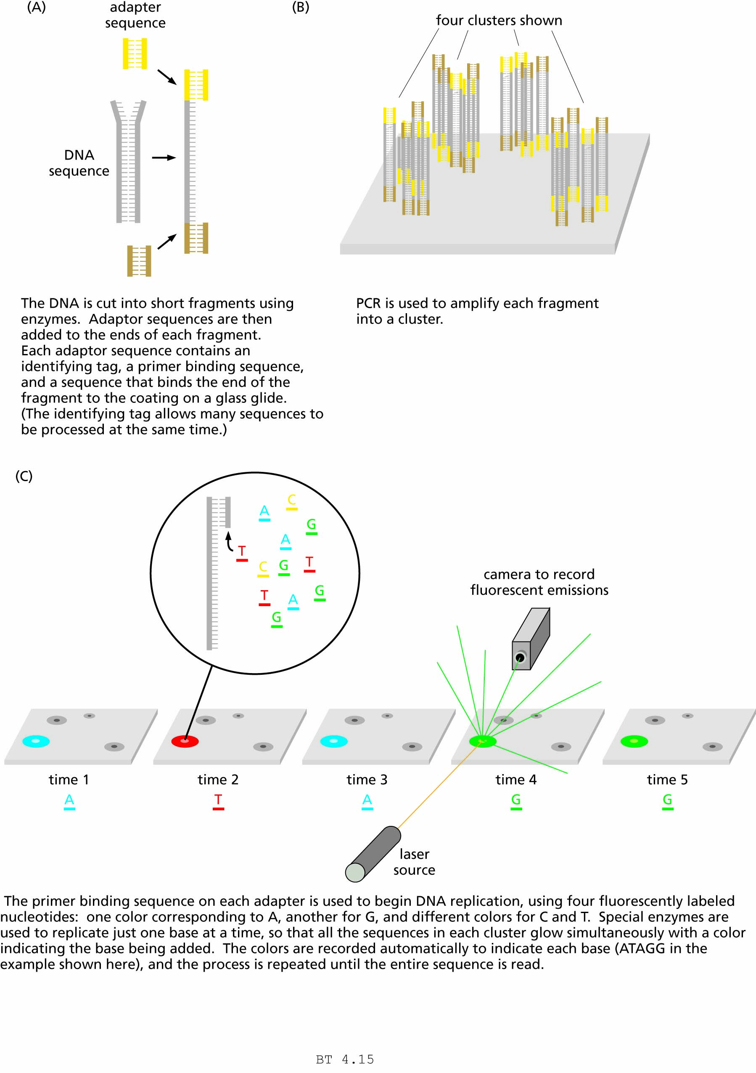
FIGURE 4.15 The Illumina method of next-generation DNA sequencing.

Slide 24
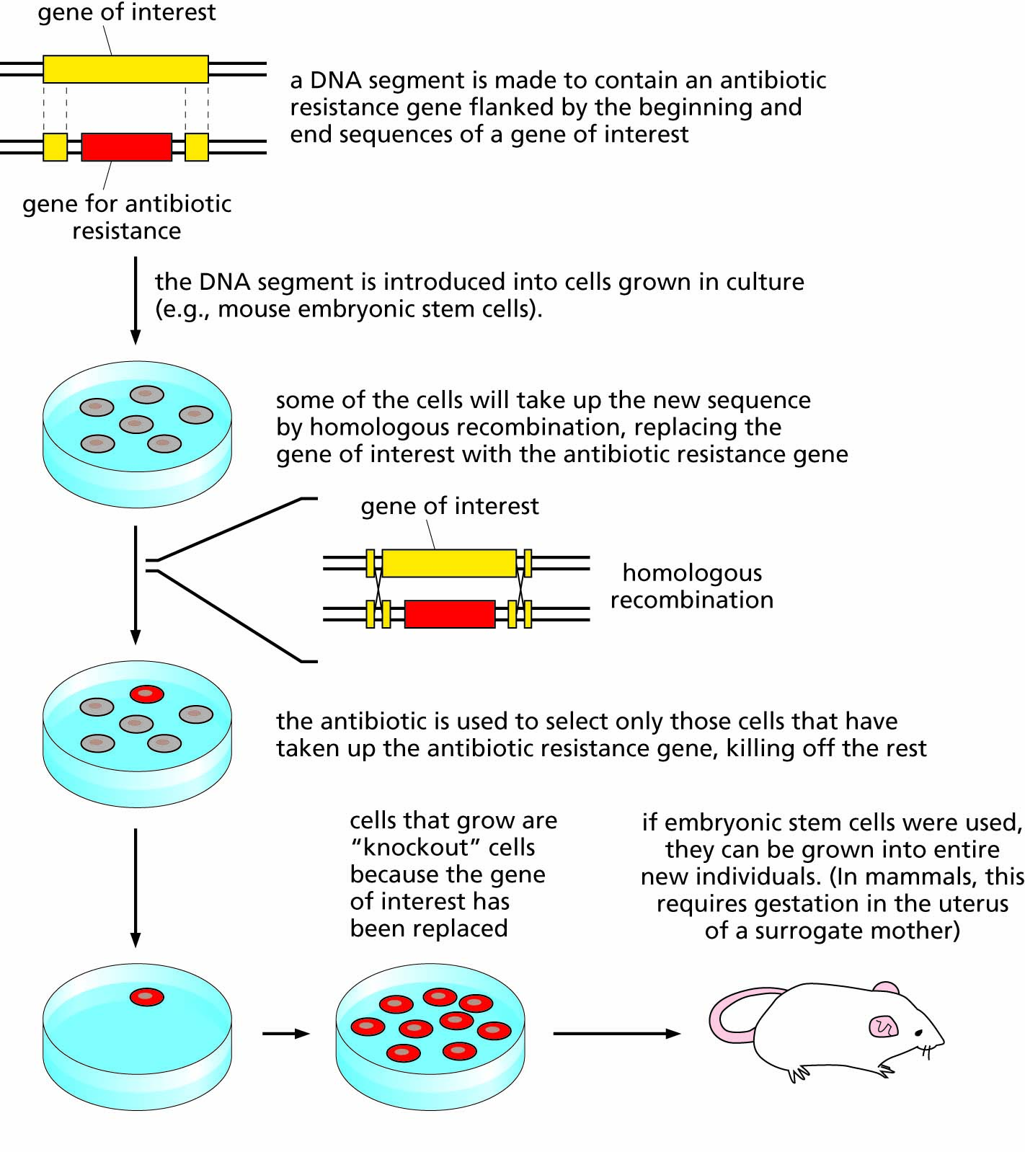
FIGURE 4.16 Creation of a gene disruption (‘knockout’) by homologous recombination of a selectable marker.

Slide 25
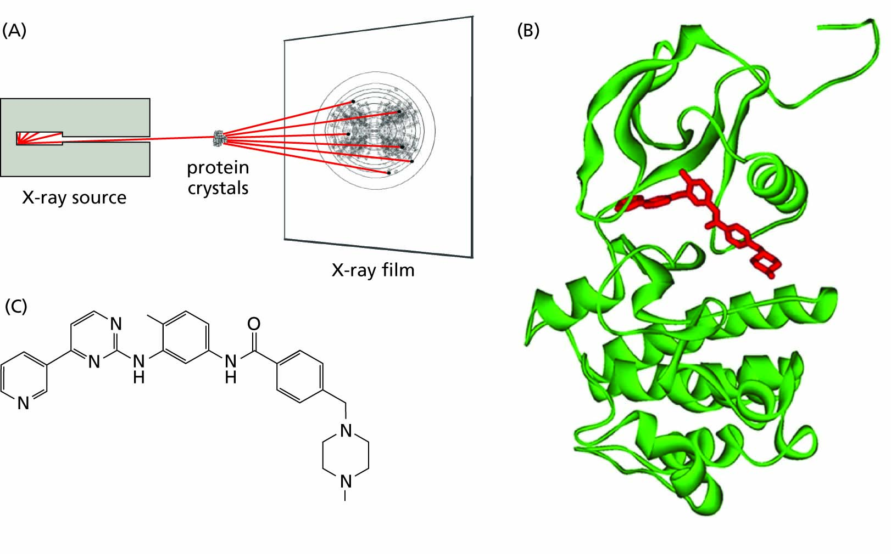
FIGURE 4.17 Protein structures determined by X-ray crystallography can be used to design drug molecules that inhibit proteins responsible for disease. A. Protein crystals can be bombarded with X-rays, and the scattering patterns can be interpreted by computer programs to determine the 3-dimensional protein structure. B. An example, showing the hybrid Bcr-Abl protein (in green) responsible for a type of leukemia (see Sec. 10.5.2), and a drug molecule (Gleevec®, in red) designed to fit into this protein and render it harmless. C. The molecular structure of Gleevec®.

