Slide 1
Chapter 1: Biology, Science and Society
Biology Trending, 4e
Eli Minkoff and Jennifer Hood-DeGrenier

Slide 2
Biology
Biology is the scientific study of living things.
… so
What is SCIENCE?
What is LIFE?

Slide 3
Science
Science is a method of investigation based on the formulation and testing of HYPOTHESES.
HYPOTHESES: a tentative explanation, capable of being tested.
FALSIFIABLE: capable of being falsified by observations or data.
EXPERIMENTAL versus NATURALISTIC testing.
THEORY: a cluster of well-tested hypotheses (usually with “theoretical” vocabulary.

Slide 4
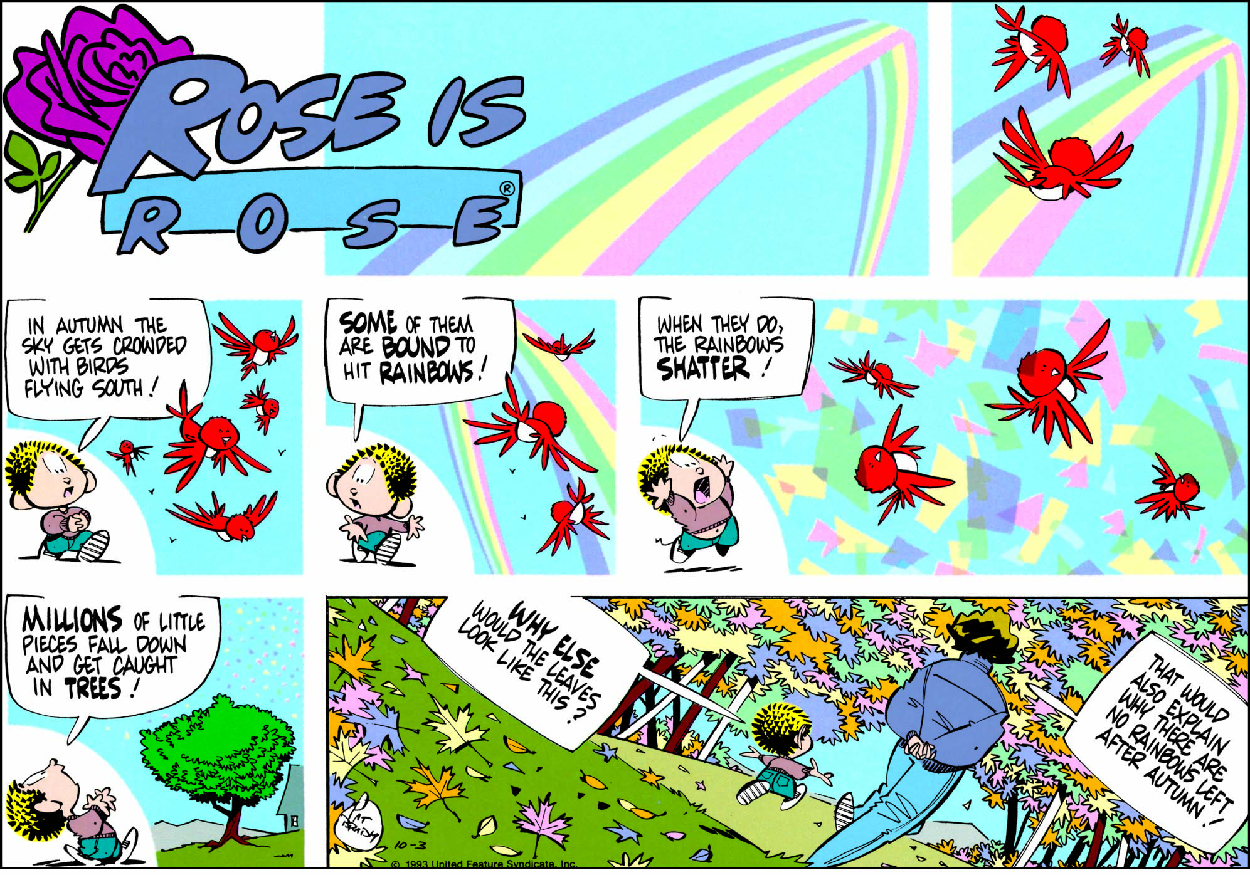
Figure 1.1 Imaginative hypotheses may originate from various logical or extralogical processes, especially from young scientists. Does the idea shown here qualify as a scientific hypothesis? Why, or why not? Is it testable?

Slide 5
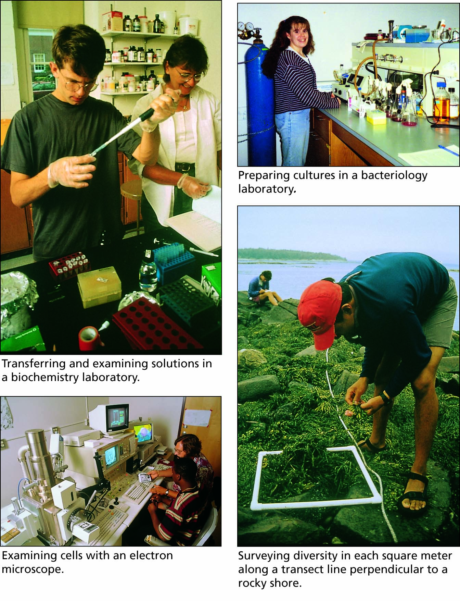
Figure 1.2 Scientists at work.

Slide 6
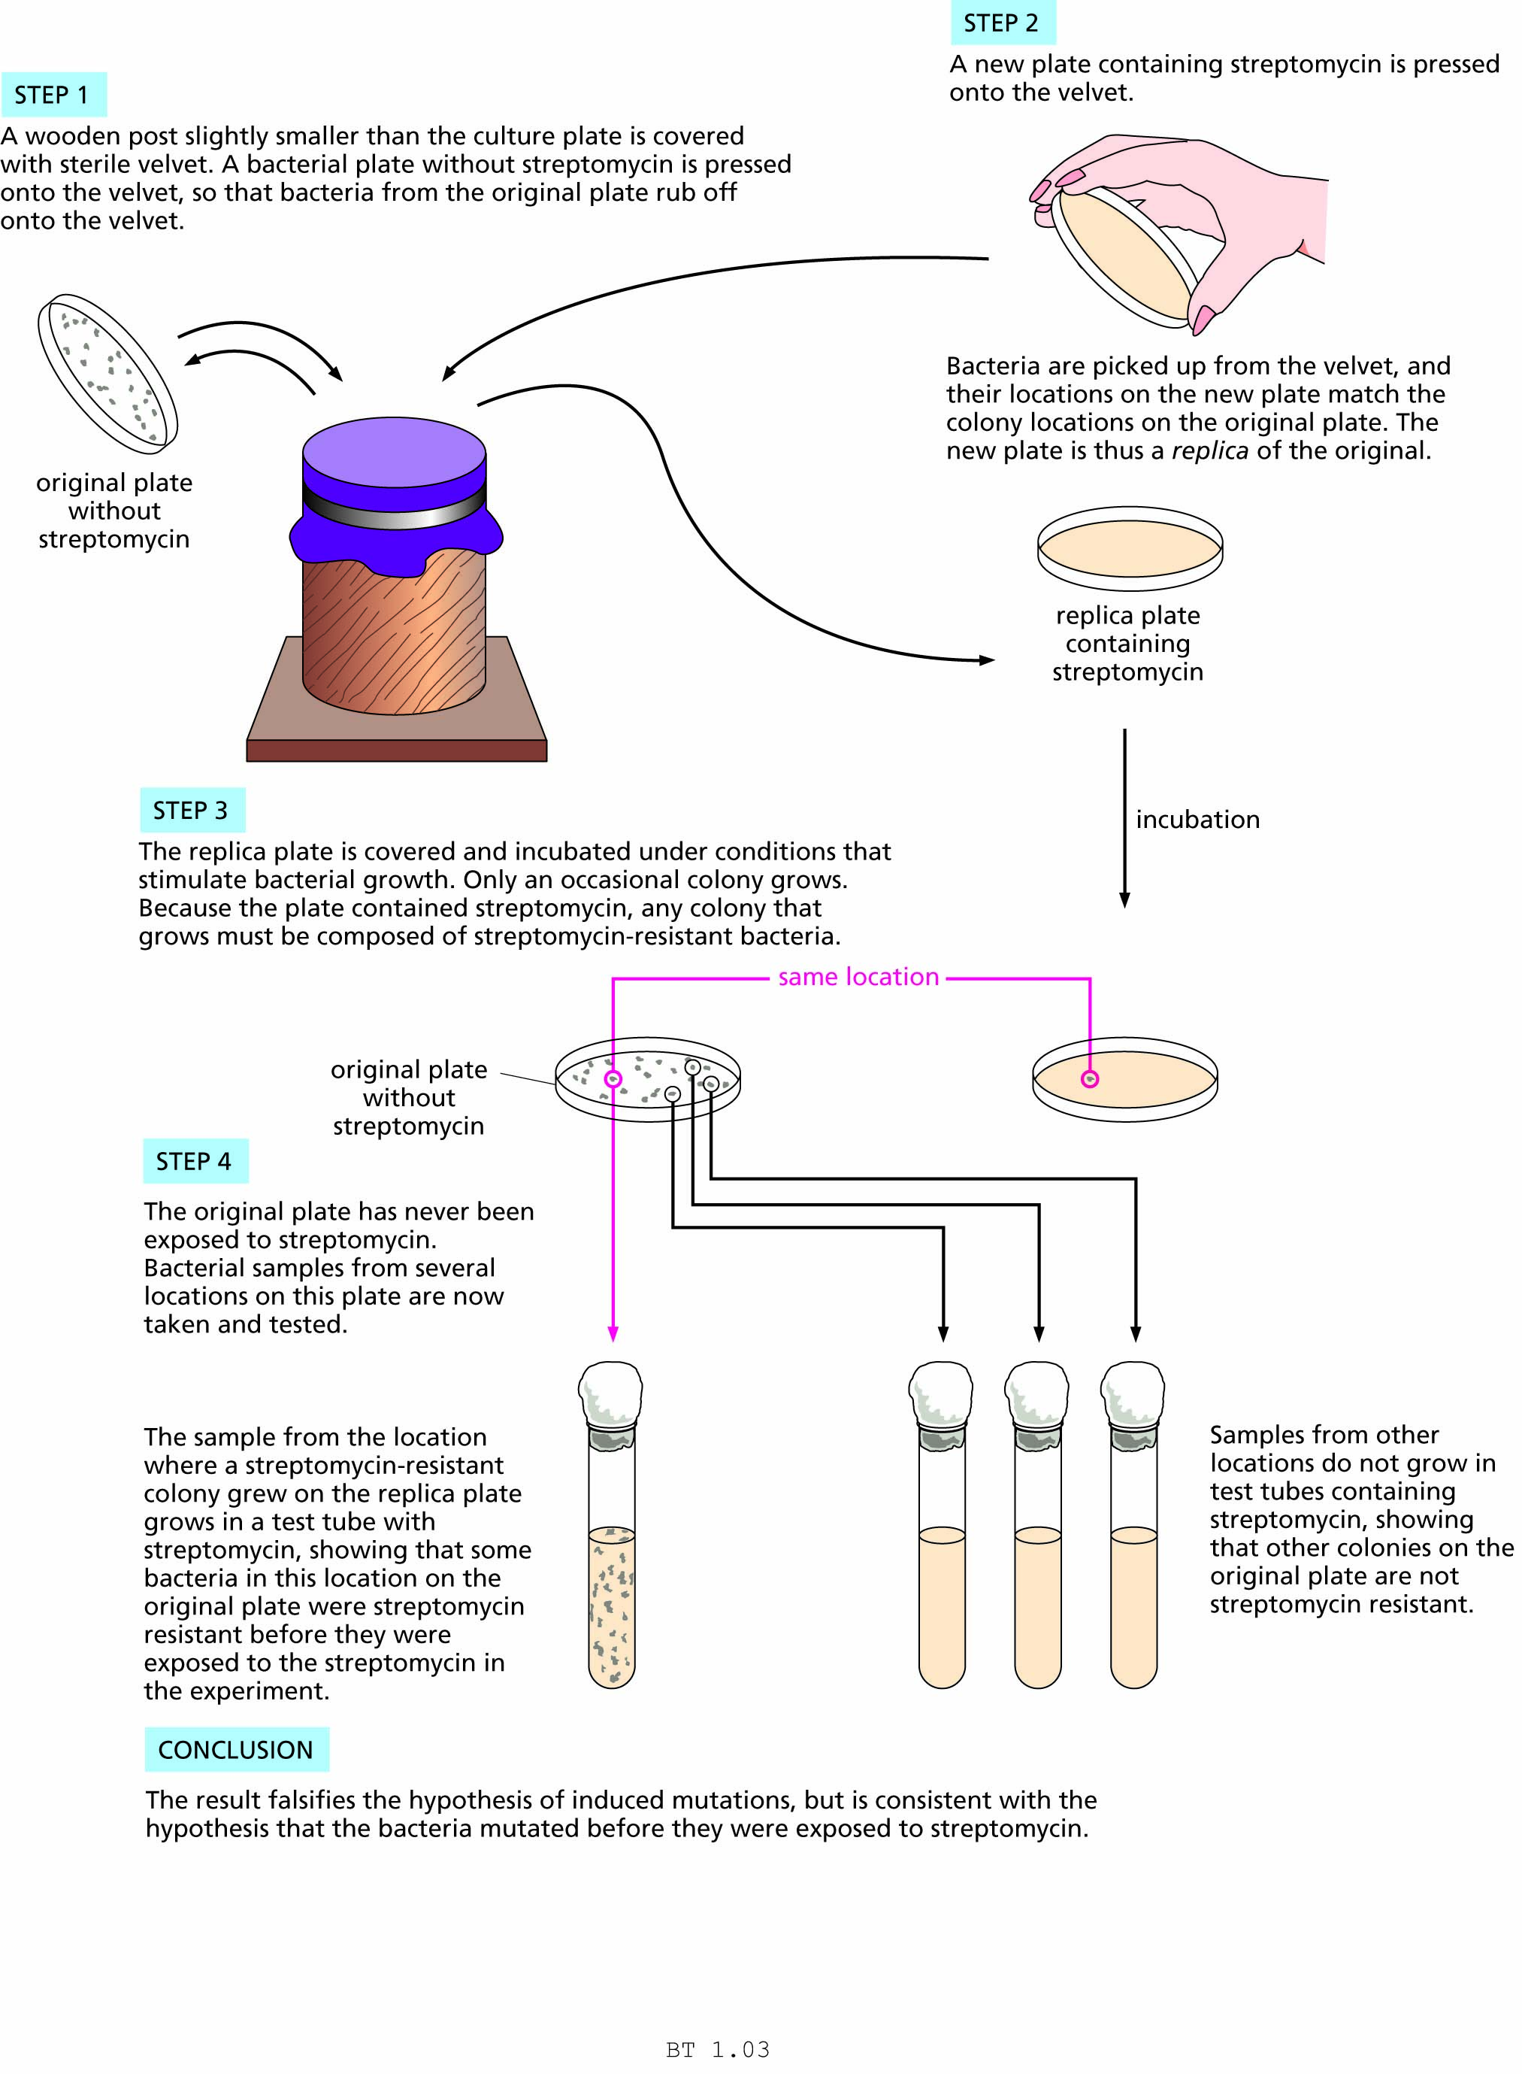
Figure 1.3 The replica-plating experiment of Lederberg and Lederberg.

Slide 7
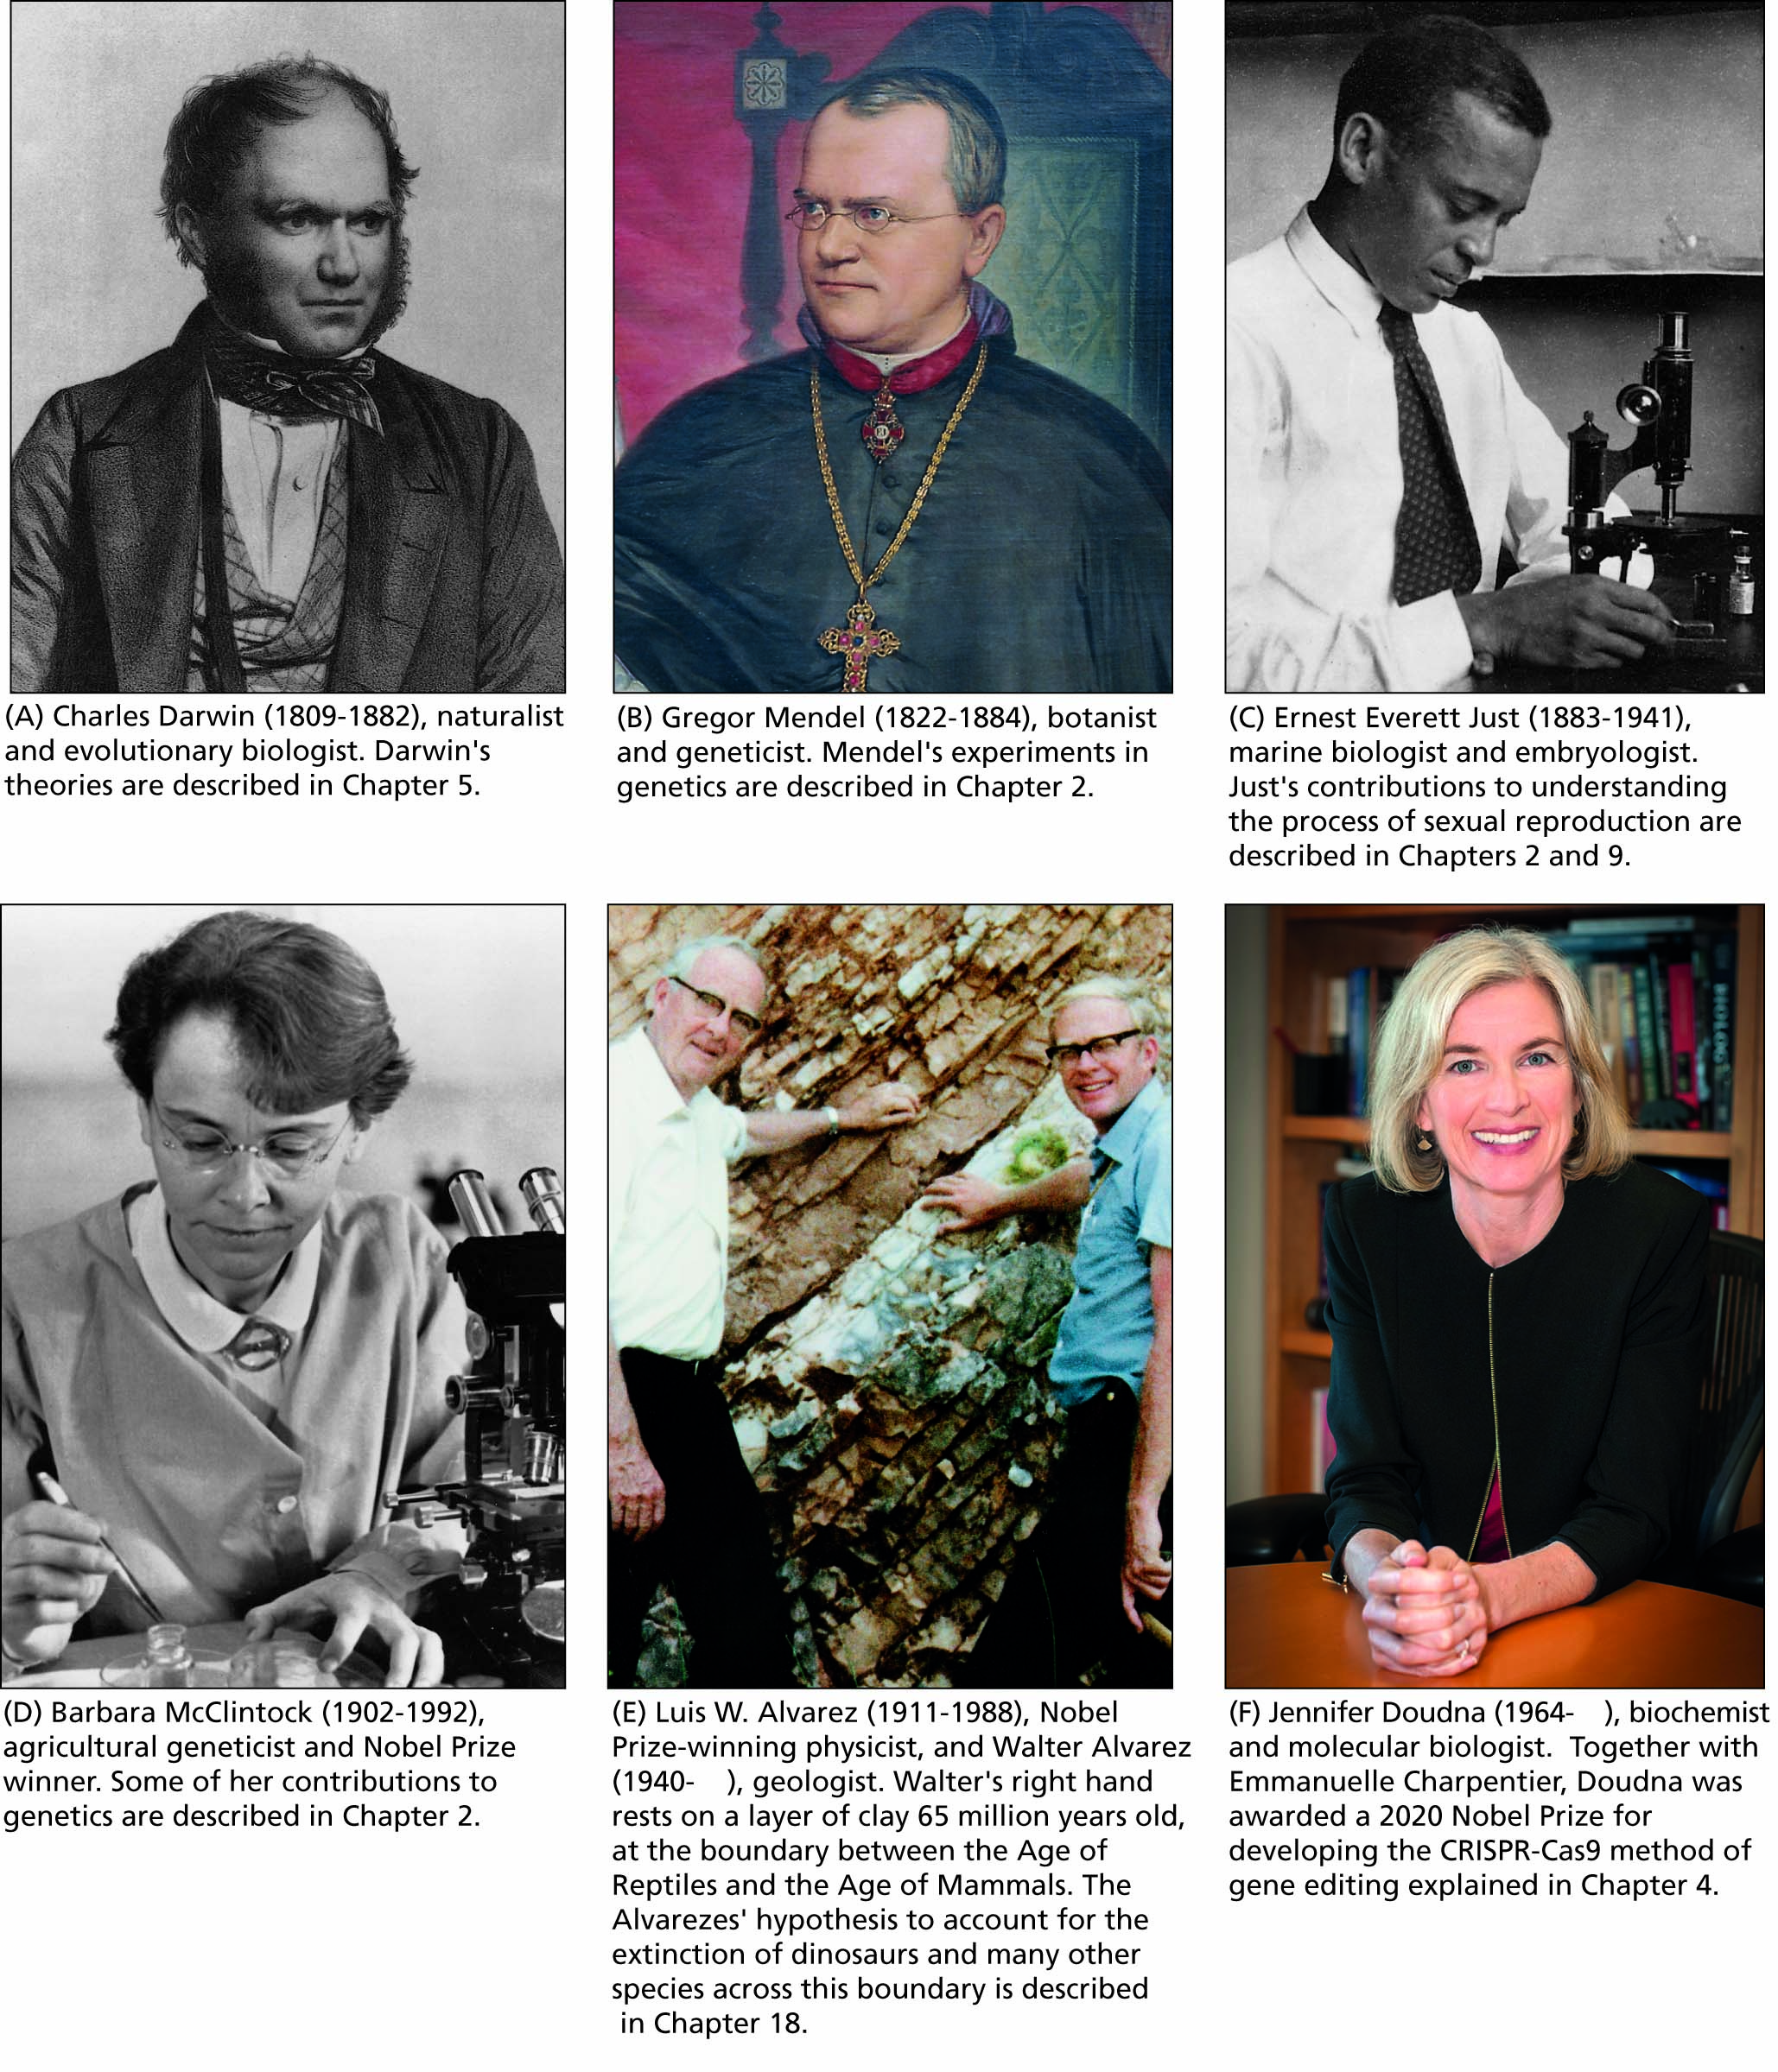
Figure 1.4 A few notable scientists.

Slide 8
Table 1.1 Properties of living systems
Cellular organization
Metabolism
Selective Response
Homeostasis
Growth and biosynthesis
Genetic material
Reproduction
Population structure

Slide 9
Scientists work in PARADIGMS
Scientific revolutions only occur when paradigms are replaced
Example: molecular genetics
Scientific communities
Scientific literacy
Scientists often face social issues
Deontological ethics
Utilitarian issues

Slide 10
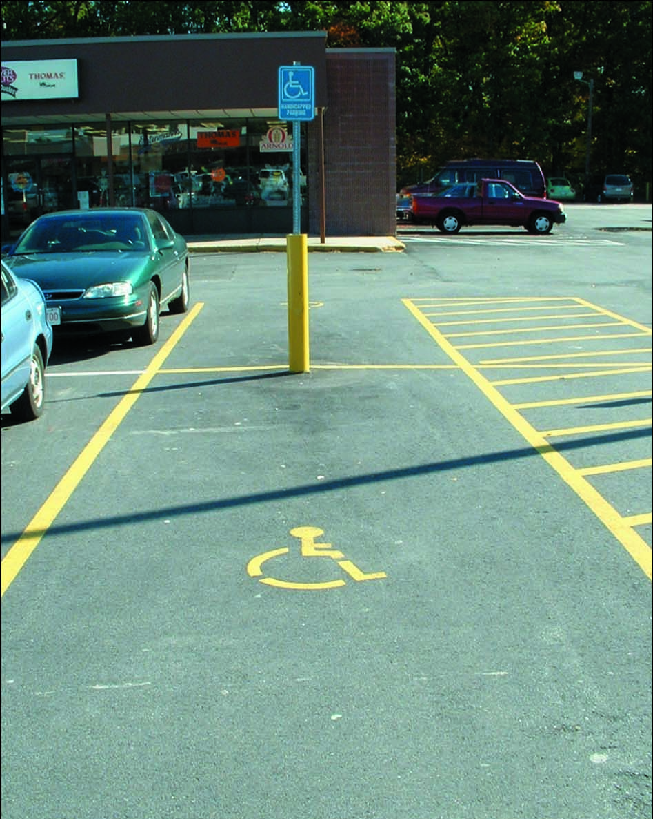
Figure 1.5 Would you park in this space? Give reasons to support your decision.

Slide 11
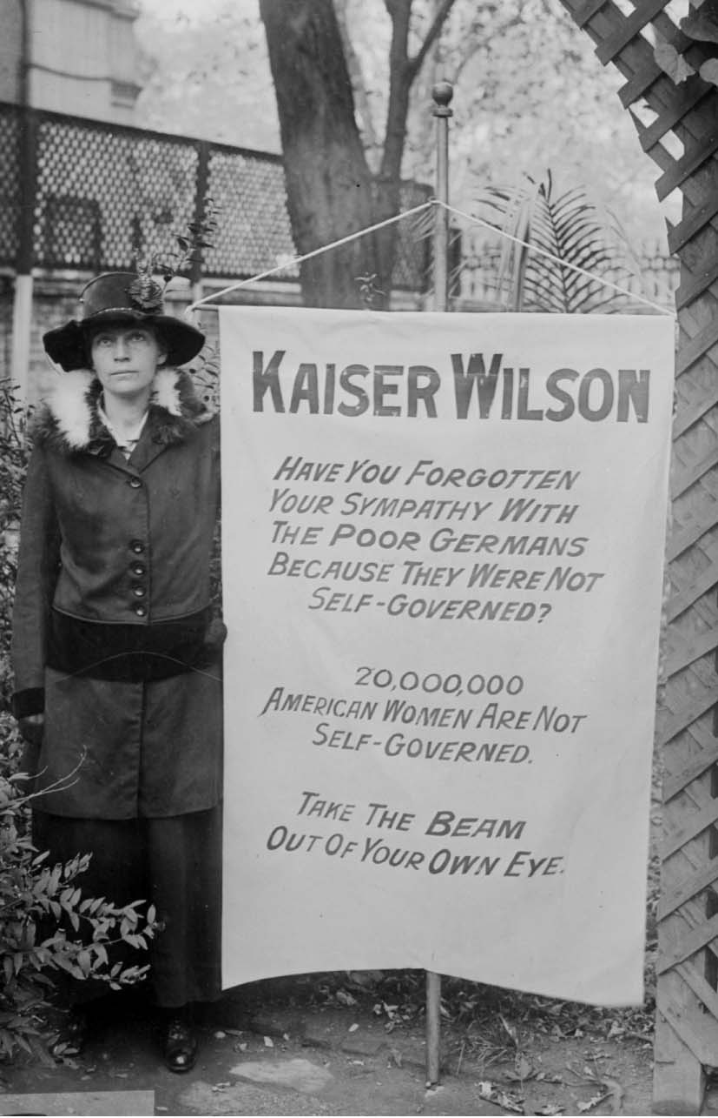
FIGURE 1.6 Do you have a deontological reason for agreeing or disagreeing with the premise that all persons share the same basic rights?
This woman was protesting the fact that U.S. President Woodrow Wilson supported the rights of poor Germans in World War I, while women in the United States were denied the right to vote.

Slide 12
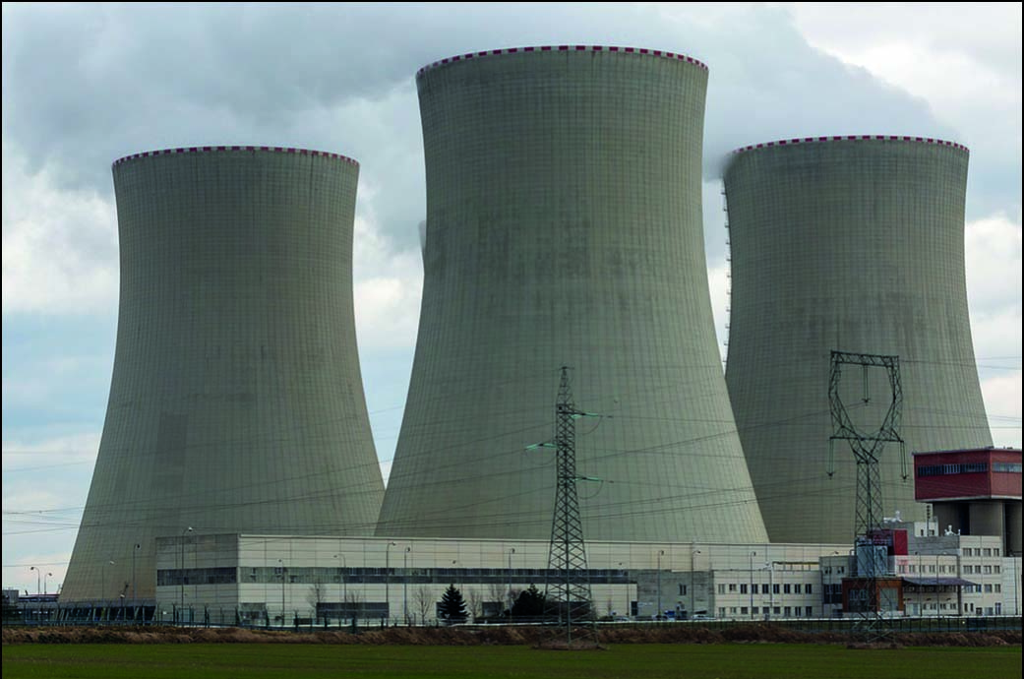
FIGURE 1.7 What benefits could come to society from this nuclear power plant? What costs or risks are present? How would a utilitarian argue in favor of this power plant? How might another utilitarian argue against it?

Slide 13
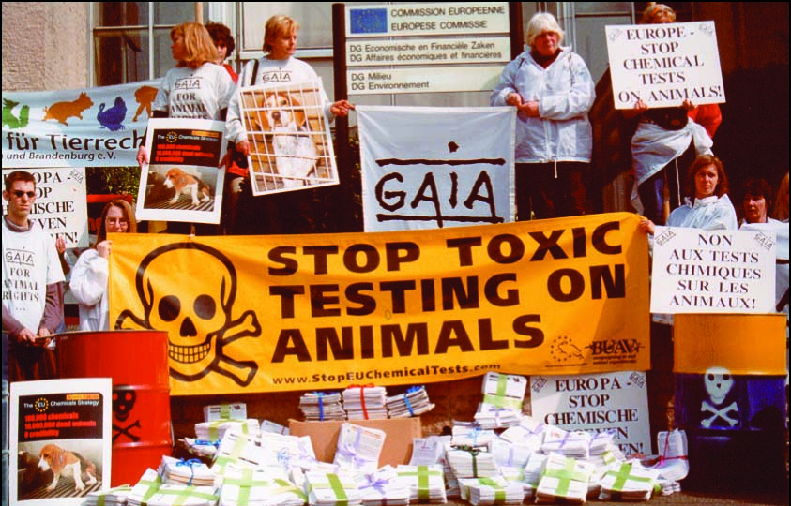
FIGURE 1.8 Why do people have a right to express their opinions through public demonstrations like this one? What role do such public demonstrations have in shaping social policy?

